Slide 1
Pairs Trading
A Statistical Arbitrage Strategy
Emmanuel Fua
Christopher Melgaard
James (Yi-Wei) Li
Notes:
Chris

Slide 2
Background
Developed in the 1980’s by a group of Quants at Morgan Stanley, who reportedly made over $50 million profit for the firm in 1987
A contrarian strategy that tries to profit from the principles of mean-reversion processes
In theory, one could expand the strategy to include a basket of more than a pair of related stocks
Notes:
Chris

Slide 3
Main Idea
Choose a pair of stocks that move together very closely, based on a certain criteria (i.e. Coke & Pepsi)
Wait until the prices diverge beyond a certain threshold, then short the “winner” and buy the “loser”
Reverse your positions when the two prices converge --> Profit from the reversal in trend
Notes:
Emmanuel

Slide 4
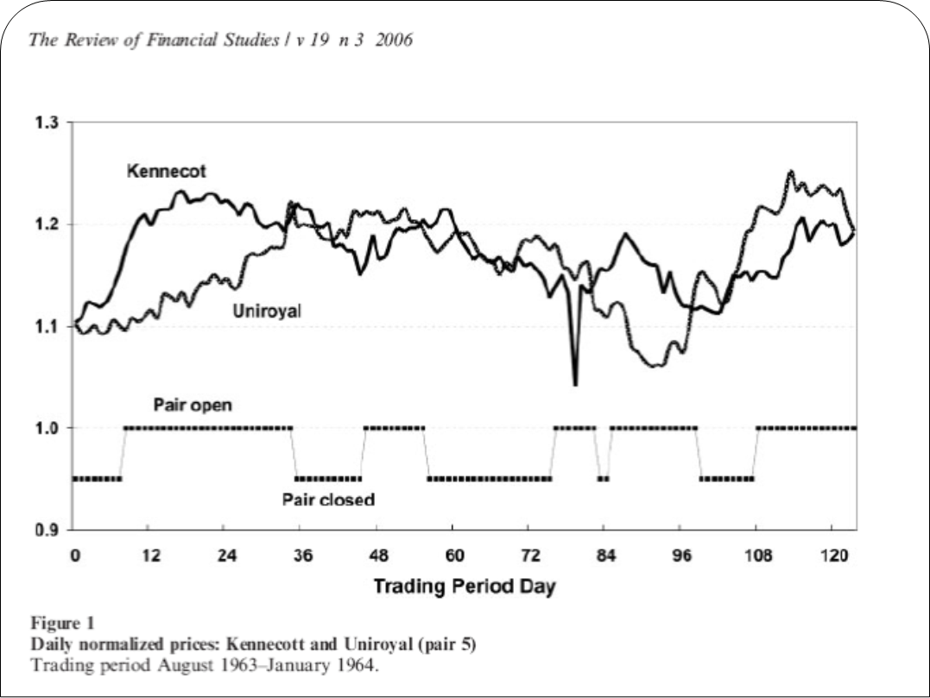
Example of a Pairs Trade
Notes:
Emmanuel

Slide 5
Investor Decisions
Pair Selection Criteria
  Correlation (Parametric & Non-Parametric Spearman’s Rho)
  Dickey-Fuller Test Statistic (Cointegration)
Trading Threshold (areas of consideration)
  Volatility of the Market
  Historical returns
  Cost of each transaction
Notes:
James

Slide 6
Normalization of Stock Data
METHOD:
  Find pair that has maximal correlation
  Normalize price series, plot spread over 1 year “formation period”
  Generate optimal threshold non-parametrically: choose a threshold T_{i}=c*sd(spread), calculate profit for each T_{i}, choose T_{i} generating max profit
    Calculate profit by going $1 short on winner, $1 long on loser; close position when prices converge, i.e. spread=0
  Normalize price series in 6 month “trading period” using mean and sd from formation period
  Plot spread using optimal threshold found from formation period, calculate profit
  Lower thresholds→ More transactions→ Higher transaction costs → Lower Returns
  Higher transaction costs→ Smaller Returns
Notes:
E

Slide 7
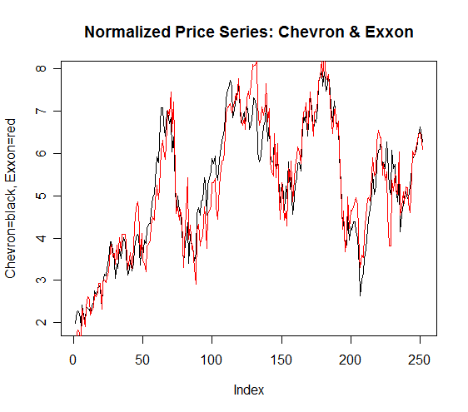
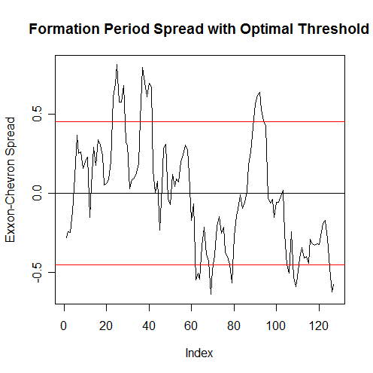
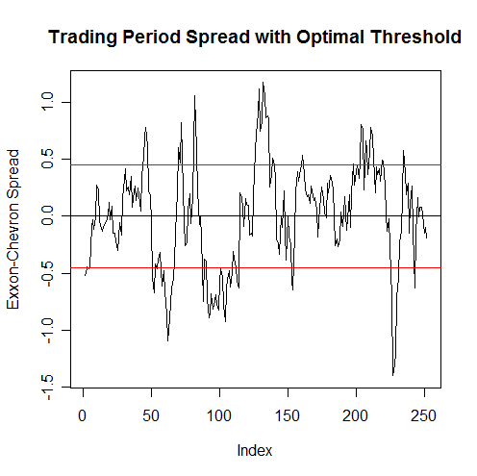
Chevron & Exxon
Formation Period Corr=0.93
Trading Period Corr=0.96
Optimal Threshold=1.25*sd’s
# Transactions=10
Returns=15%
Win.
Notes:
E

Slide 8
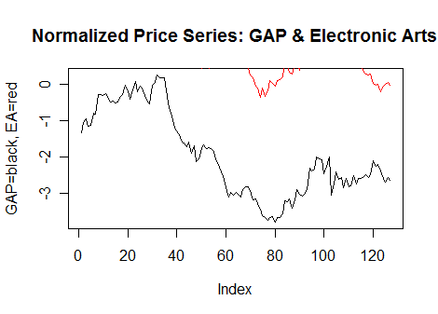
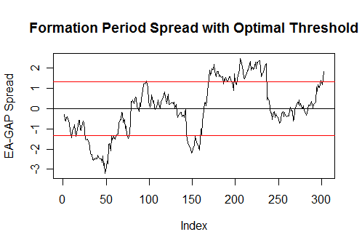
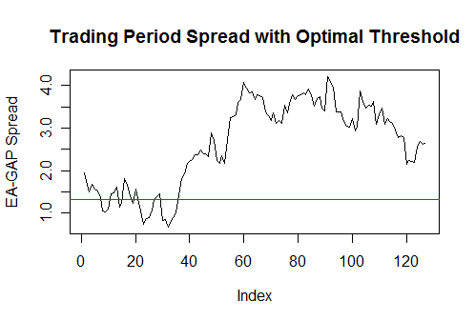
Electronic Arts & GAP
Formation Corr=0.12
Trading Corr=0.56
Optimal Threshold=1 sd
# Transactions=0 (Open a position, but spread never returns to 0)
Return= -0.04
Lose.
Notes:
E

Slide 9
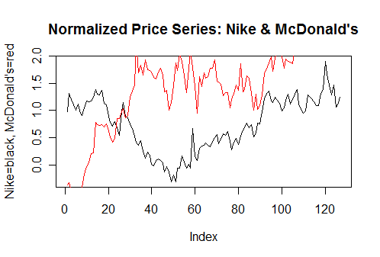
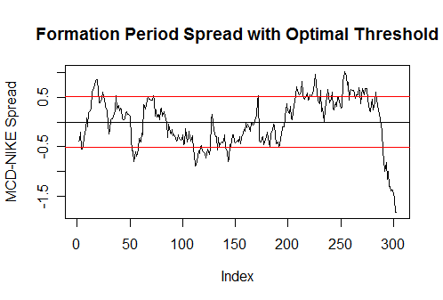
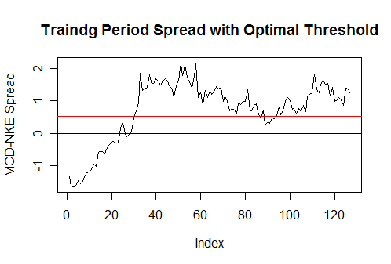
Nike & McDonald’s
Formation Corr=0.87
Trading Corr=0.02
#Transactions=1
Return= -0.05
Lose.
Correlation is imperfect criteria for selecting pairs.
Notes:
E

Slide 10
Interesting result involving market volatility
 |  | Formation Period |  | Trading Period
Pair | Dates | Corr. | Optimal Threshold* | #Trans | Returns | Corr.
Exxon, Chevron | Period 1 | 0.93 | 1 | 6 | 0.11 | 0.85
 | Period 2 | 0.85 | 1.75 | 6 | 0.05 | 0.69
 | Period 3 | 0.93 | 1.25 | 10 | 0.15 | 0.96
Nike, McDonald’s | Period 1 | 0.87 | 1.5 | 2 | -0.05 | 0.02
 | Period 2 | 0.10 | 1 | 6 | -0.02 | 0.29
 | Period 3 | 0.87 | 2 | 4 | 0.04 | 0.87
Electronic Arts, GAP | Period 1 | 0.12 | 1 | 0 | -0.04 | 0.56
 | Period 2 | 0.19 | 2 | 4 | -0.03 | -0.09
 | Period 3 | 0.31 | 1.75 | 4 | 0.06 | 0.10
Positive profits for all measured pairs in period 3.
Period 3 includes January 2008, a very volatile month for the stock market.
It seems that high market volatility allows the possibility for positive profits for uncorrelated pairs which would not generate such profits in low volatility periods, although this can surely work either way.
Notes:
E

Slide 11
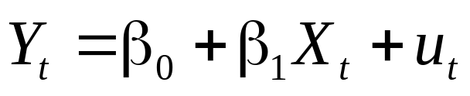
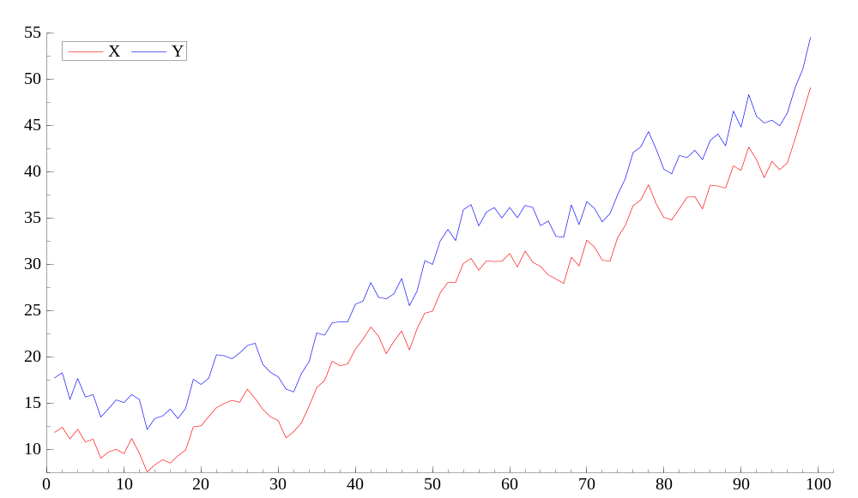
Cointegration
If there exists a relationship between two non-stationary I(1) series, Y and X , such that the residuals of the regression
are stationary, then the variables in question are said to be cointegrated
Note: X and Y here are clearly not stationary, but they seem to move together. In fact, they are cointegrated -->
(Y- β₁X-β₀ )should be stationary
Notes:
J

Slide 12
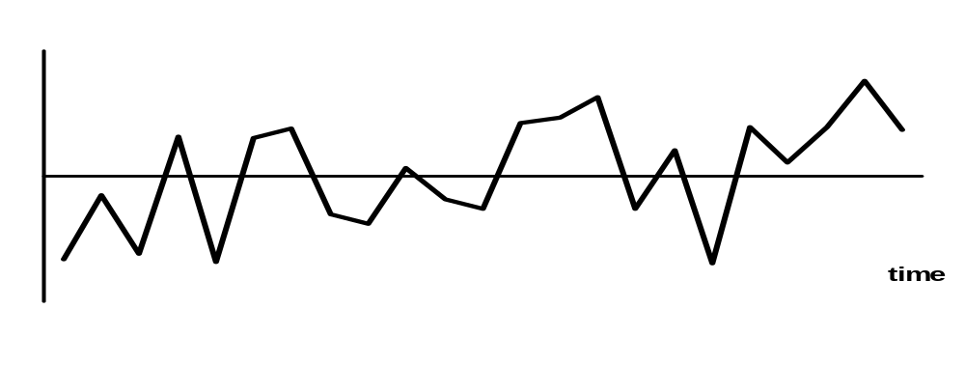
Application to Pairs Trading
If we have two stocks, X & Y, that are cointegrated in their price movements, then any divergence in the spread from 0 should be temporary and mean-reverting.
The important issues here are: 1) how to test for cointegration between prices and 2) estimating the constant
Spread
0
Notes:
J

Slide 13

Testing For Cointegration
Many Methods – most of them focus on testing whether the residuals of are stationary processes
We use the Cointegrating Regression Dickey-Fuller Test, which essentially operates the following regression:
Δu_{t} = φ u_{t-1} + e_{t}
H₀: φ = 0 => no cointegration*
H_{a}: φ < 0 => cointegration*
To obtain the cointegration factor estimates, we must regress the de-trended Y_{t} on the de-trended X_{t}
* We must use critical values different from Gaussian ones due to non-symmetric properties of the Dickey-Fuller distribution
Notes:
J

Slide 14
Results of Test
NO PAIR OF PRICES ARE COINTEGRATED!
No surprise there
Alternative: take the “most cointegrated” pair & optimize thresholds as we did with normalized data
Compare the results against normalized thresholds in the same time period
Notes:
J

Slide 15
Normalization Vs Cointegration
Figure 5: Normalized strategy VS Cointegrated strategy
LUV(Southwest Airlines) & PLL (Pall Corporation) | Normalization | Cointegration
Correlation coef. /CRDF stat. over Formation Period | 0.24 | -0.52*
Cointegration Factor | N/A | 0.43
Optimal SD Threshold over Formation Period | 1.25 SDs | 1.75 SDs
Optimal Returns over Formation Period | ~0% | ~2%
Number of Transactions over Trading Period | 4 | 4
Returns over Trading Period | ~5% | ~13%
*CRDF statistic insignificant against the H₀: The Time Series is not cointegrated (5% critical value = -3.39)
**Fixed transaction costs implicit in both models
Notes:
J

Slide 16
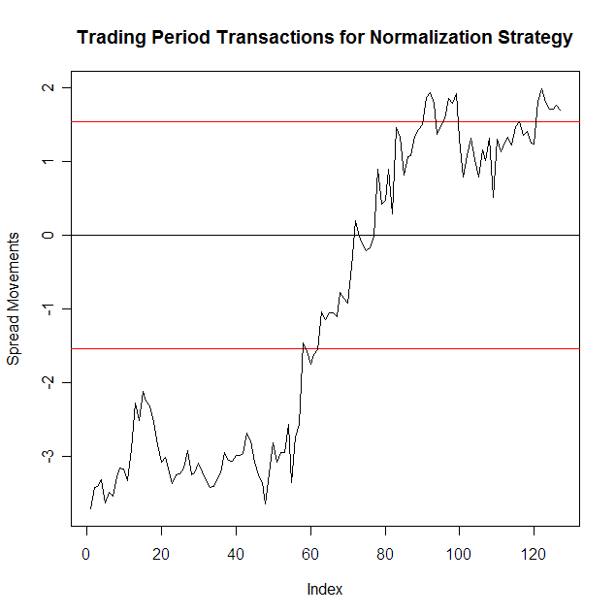
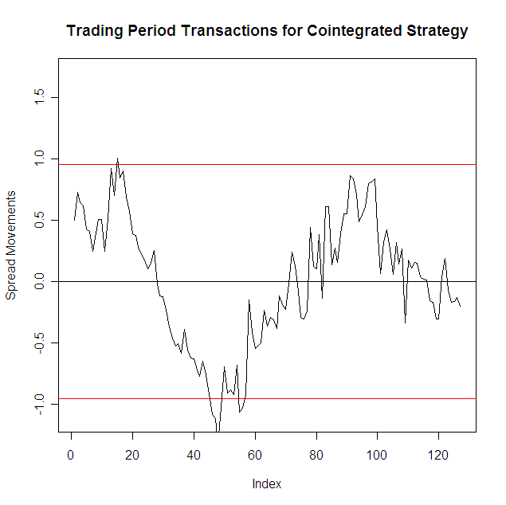
Trading Period Comparison
Figure 6: Normalized LUV & PLL spread VS Cointegrated LUV & PLL spread
Notes:
J

Slide 17
Auto-Regressive Time Series
Cointegration is an ideal construct for pairs trading
But Dickey-Fuller Hypothesis Test is inconclusive
Instead we can fit a time series to the spread data
    AR(1): Y_{t} = β Y_{t-1} + ε_{t}
Looking for a spread that produces an AR(1) with |β| < 1, so that will be stationary.
Notes:
C

Slide 18
Choosing thresholds with AR(1)
For the interest of time, we are only going to focus our most cointegrated pair: LUV and PLL.
We will fit an AR(1) to the data by estimating β and the standard deviation of each iid white noise ε_{t.}
Then we will run one thousand simulations of this AR(1) model and estimate each of their optimal benchmarks
The average of the optimal benchmarks from each simulation will serve as our estimate for the optimal benchmark in the formation period.

Slide 19
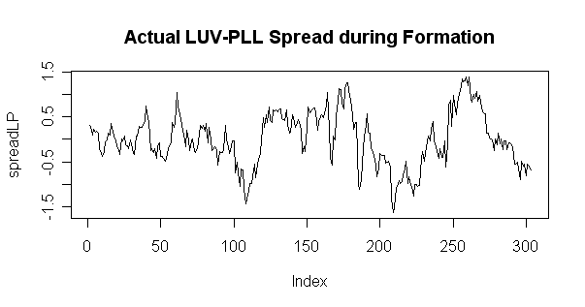
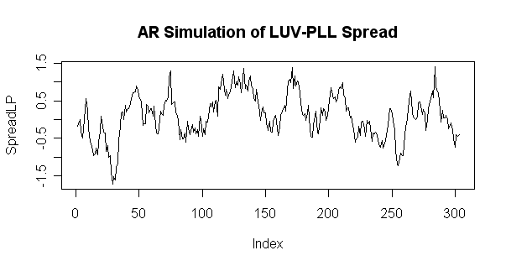
Results of AR(1) Thresholds
AR(1) Coefficient estimate (μ-hat) | 0.8605
Optimal Threshold estimate | 1.046
SD of Optimal Threshold | 0.2597
Number of Transactions | 12
Returns over Trading Period | 17.7%

Slide 20
Alternative Strategies
Conditional correlation or some other measure of “relatedness”, such as Copulas
Modeling the spread as GARCH processes
Optimize profits w.r.t. certain global indicators (i.e. market volatility, industry growth, etc.)
Factor Analysis on the spread
Notes:
J

Slide 21
Bibliography
Gatev, Evan, William N. Goetzmann, and K. Geert Rouwenhorst, “Pairs Trading:
Performance of a Relative-Value Arbitrage Rule,” Review of Financial Studies (2006): 797-827.
Vidyamurthy, Ganapathy, Pairs Trading: Quantitative Methods and Analysis (New
Jersey: John Wiley & Sons, Inc., 2004).
Wooldridge, Jefferey M., Introductory Econometrics, A Modern Approach, Third Edition (Ohio: Thomson South-Western, 2006).

