Slide 1
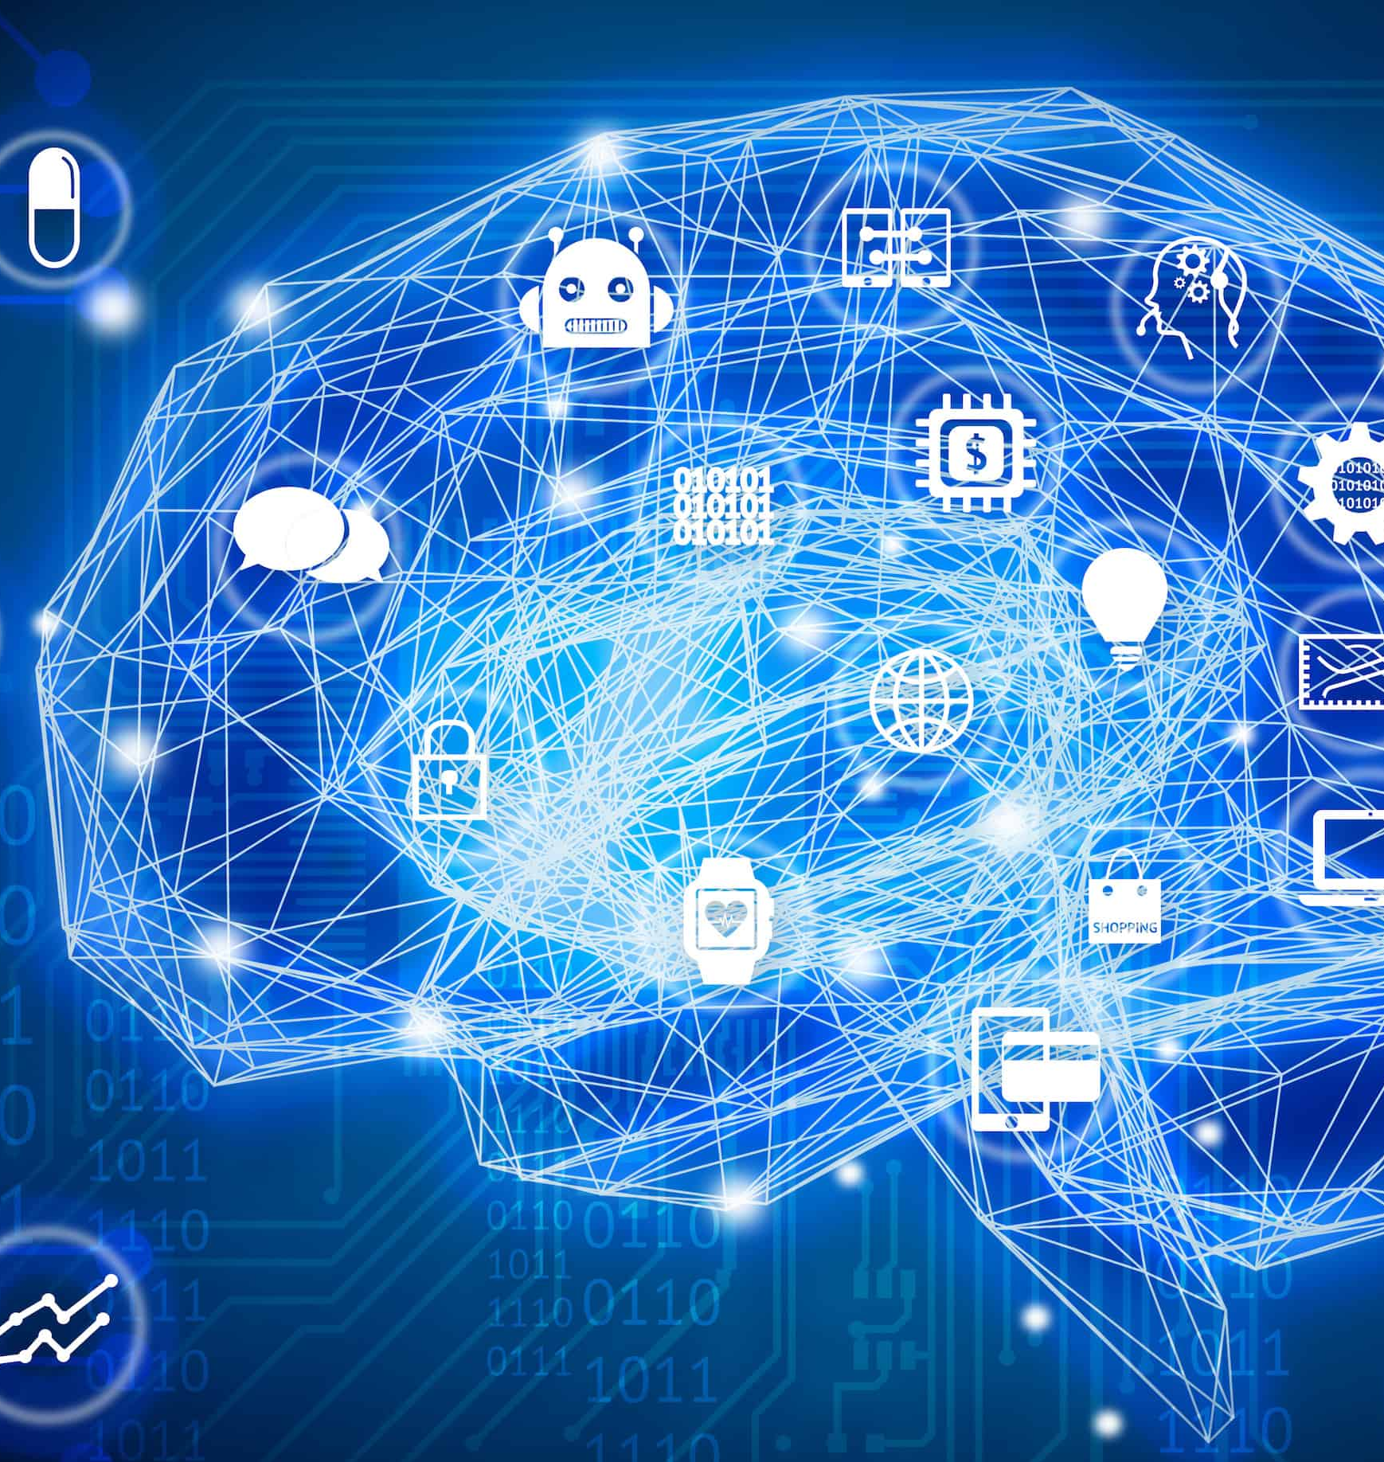
CS 5/7320 Artificial Intelligence More Important AI Topics
Slides by Michael Hahsler
This work is licensed under a Creative Commons Attribution-ShareAlike 4.0 International License.

Slide 2
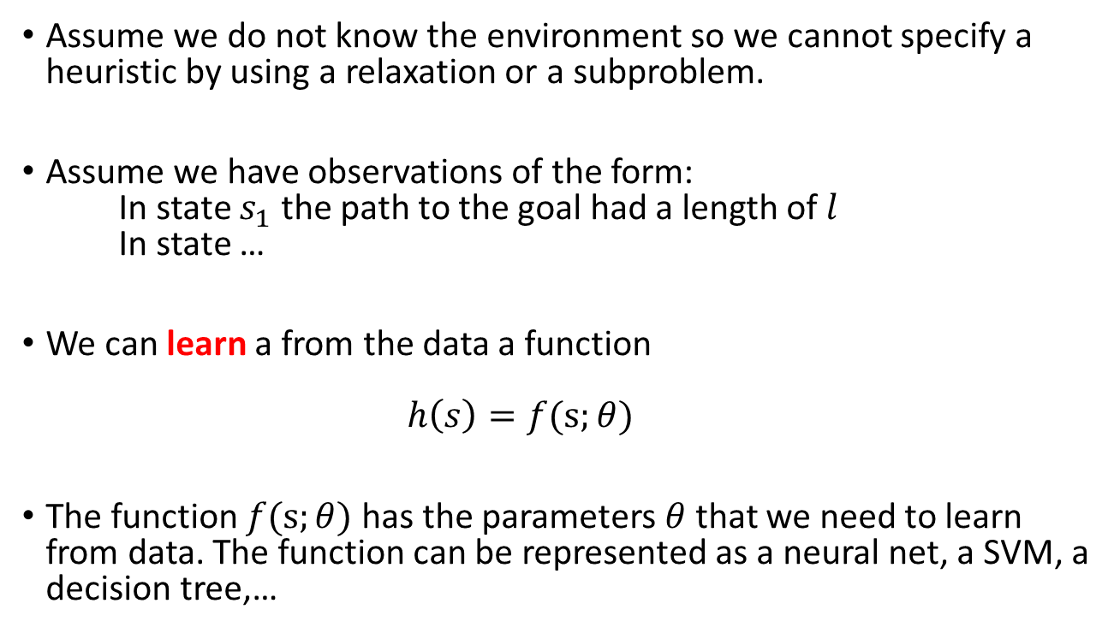
Learn Heuristics from Data
Assume we do not know the environment so we cannot specify a heuristic by using a relaxation or a subproblem.
Assume we have observations of the form: In state $s_{1}$ the path to the goal had a length of $l$ In state …
We can learn a from the data a function $h\left(s\right)=f(s;θ)$
The function $f(s;θ)$ has the parameters $θ$ that we need to learn from data. The function can be represented as a neural net, a SVM, a decision tree,…

Slide 3
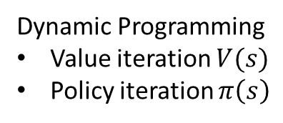
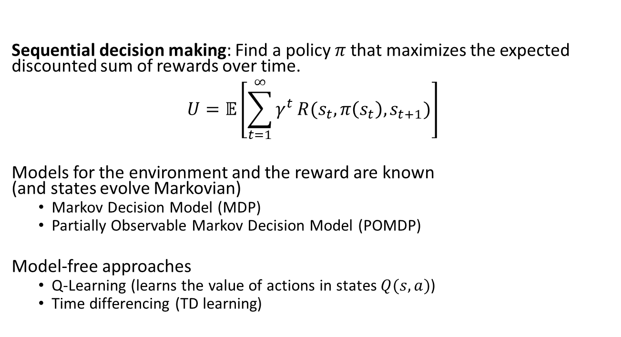
Reinforcement Learning
action
observation + reward
action
observation + reward
…
Max. reward over time
Sequential decision making: Find a policy $π$ that maximizes the expected discounted sum of rewards over time. $$U=𝔼\left[\sum_{t=1}^{∞}{γ^{t}}R(s_{t}, π\left(s_{t}\right), s_{t+1})\right]$$
Models for the environment and the reward are known (and states evolve Markovian)
Markov Decision Model (MDP)
Partially Observable Markov Decision Model (POMDP)
Model-free approaches
Q-Learning (learns the value of actions in states $Q(s,a)$)
Time differencing (TD learning)
Dynamic Programming
Value iteration $V(s)$
Policy iteration $π\left(s\right)$
Learn iteratively

Slide 4
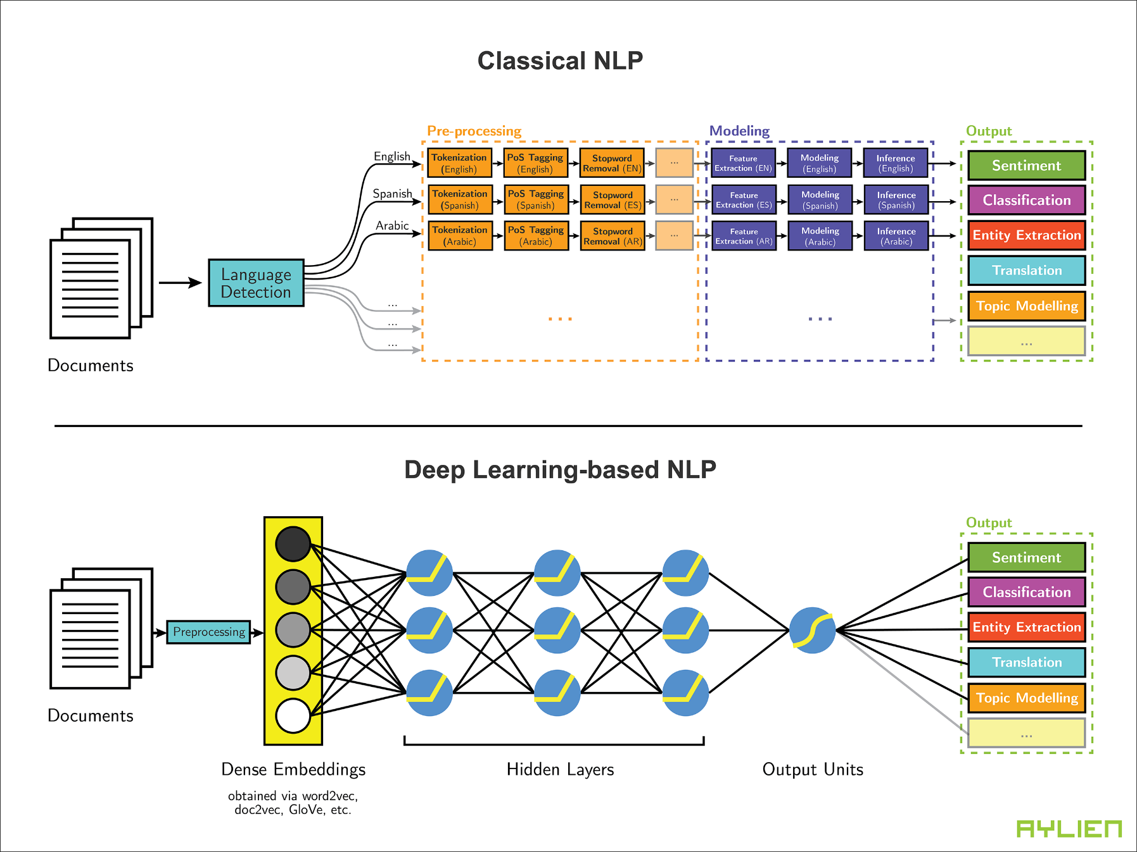
Natural Language Processing
Speech recognition
Language Models
Information Retrieval
Source: Leveraging Deep Learning for Multilingual Sentiment Analysis - AYLIEN News API

Slide 5
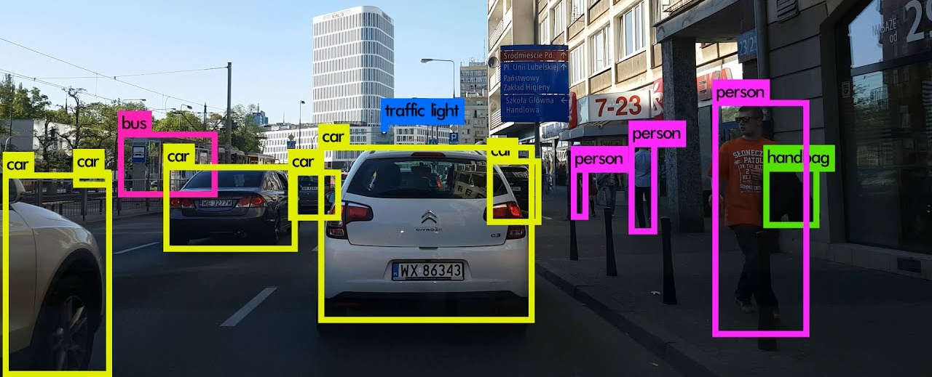
Image Processing & Object Recognition Uses Deep Convolutional Neural Networks

Slide 6
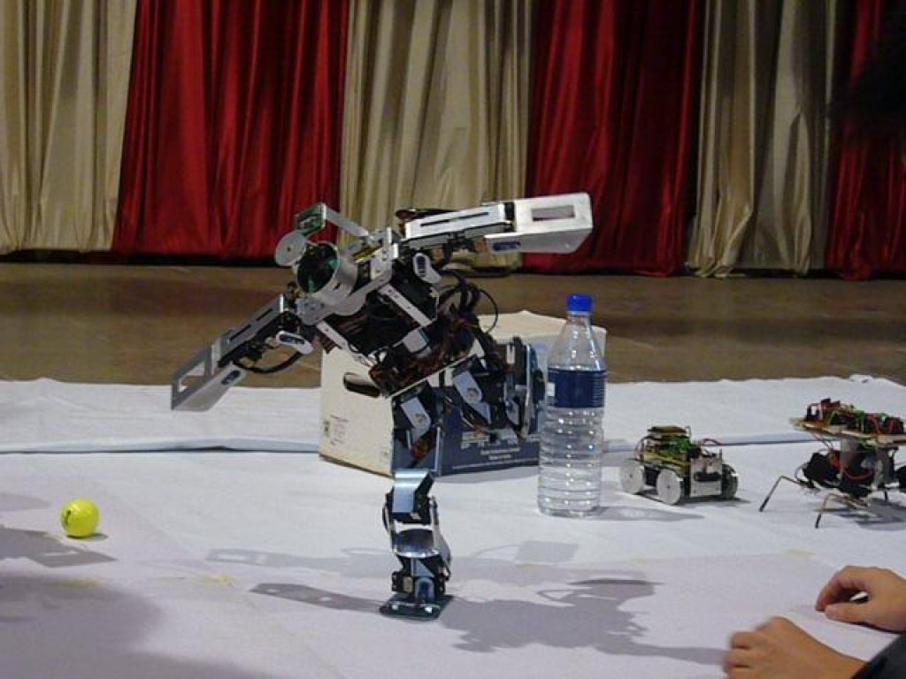
Robotics
Hardware, sensors, control theory (feedback-based controllers)

