Slide 1
Approval Tests/ AutoFixture/ AutoMoq Oh MY! Wyatt Webb, Red Arrow Labs

Slide 2

Wyatt Webb
Introduction
Vermont => Milwaukee
15 years of professional development
Red Arrow Labs develops technology solutions for companies who are transforming health.
Notes:
Grew up in Vermont
Traveled in a UWP
Landed in WI at Carroll University
Red Arrow is a Business to Business/ Business to Consumer Custom Software Shop
History of the last 6 years
Purchase by Dohmen January 2014
Where we go from here, Creating an efficient, effective, and easy to use health experience.

Slide 3


Approval Test / AutoFixture/ AutoMoq
Unit testing validation
Manual Assert vs. Approval Tests
Testing multiple inputs in one test
.NET Web API Testing
Testing with Approval Tests
Unit testing Razor views
Razor Generator
Testing coverage improvement
Approval Utilities Logger
Introduction to AutoMoq
Questions
Contact Info
@wyattwebb
https://github.com/wyattwebb/ApprovalTestsTalk
http://wyattwebb.com
Introduction
Persistence / View Model Mapping
Unit testing auto projection (mapping)
Manual Asserts vs. Approval Test
What are Approval Tests
How are they used? Why they are useful?
How to install them
Introduction to AutoFixture
Reporters
JSON Reporter
HTML Reporter

Slide 4
Participation
Notes:
How many people write c# unit tests
How many people hate writing tests that end up being more code then what you are testing?
How many people have had to write unit tests for a legacy code base?
How many people most often develop using TDD?
Who has heard of Approval Tests .net or the concept?
Who has used them?
Who has heard of AutoFixture/ AutoMoq?
Who has used them?

Slide 5
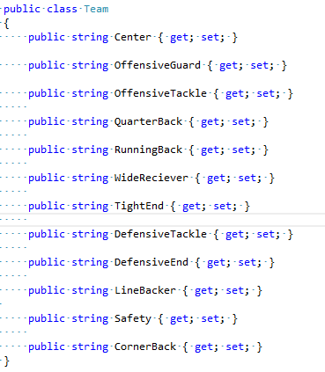
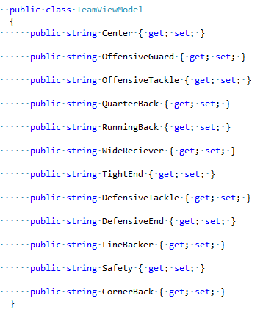
Persistence / View Model Mapping
Unit Testing
Model Separation
Woes of Mapping
To Auto Map or Not
Notes:
ORM’s and data mapping
Why not to expose the persistence models
Mapping code is really gross
Auto maps are not refactor friendly without unit tests.
Using automapper in some cases it will silently fail when you refactor, forcing you to author unit tests that defeat the purpose.
Junior developers don’t pay attention

Slide 6
Code
Notes:
Bring in Persistence Models
Bring in View Models
Create DataService - Get data service

Slide 7
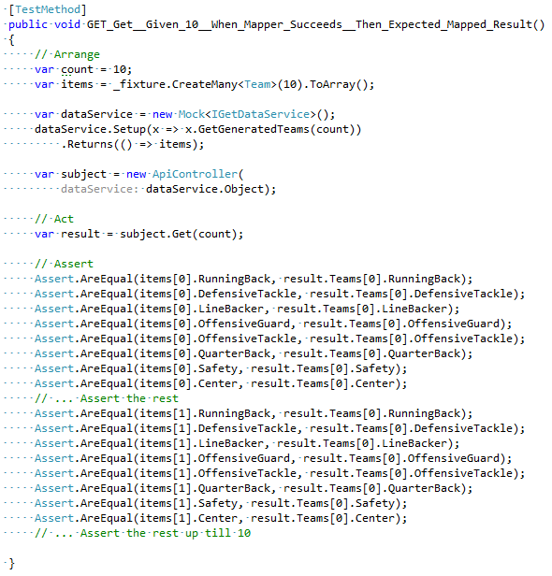
Persistence / View Model Mapping
Unit Testing
Unit Testing Maps
Traditional Asserts
Approval Test

Slide 8
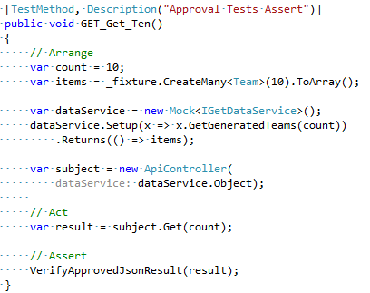
Persistence / View Model Mapping
Unit Testing
Unit Testing Maps
Traditional Asserts
Approval Test

Slide 9


What Are Approval Tests?
Approval Tests
Approval tests simplify unit testing by taking a snapshot of the results, and confirming that they have not changed.
Human knowledge
How are they used
Why are they useful
Notes:
Human knowledge
They required human intelligence for them to work as code is created/refactored
They can replace MANY MANY lines of manual unit test assertions.
They could be used for automated tests to visually inspect results of inputs and outputs.
Makes development faster and more efficient.

Slide 10
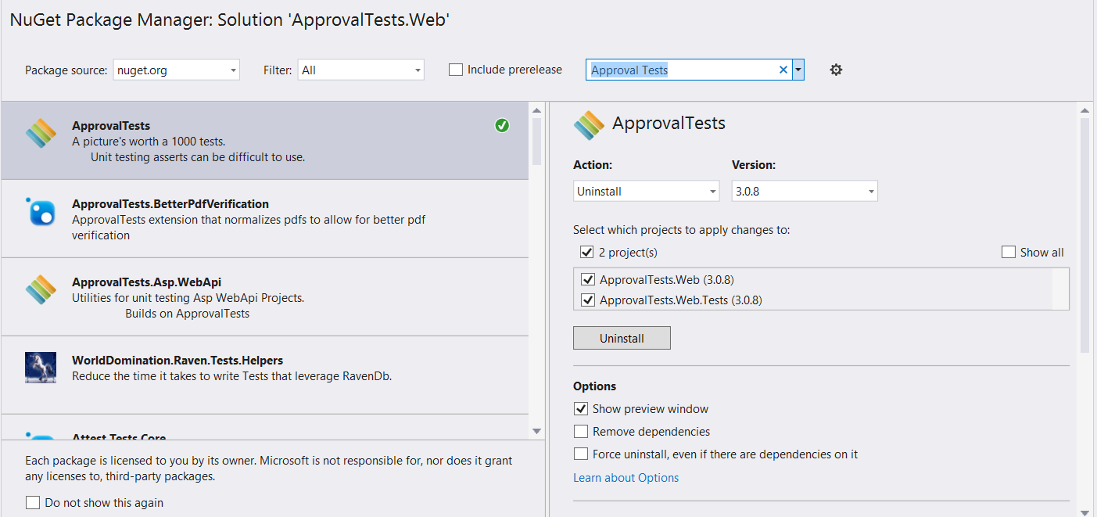
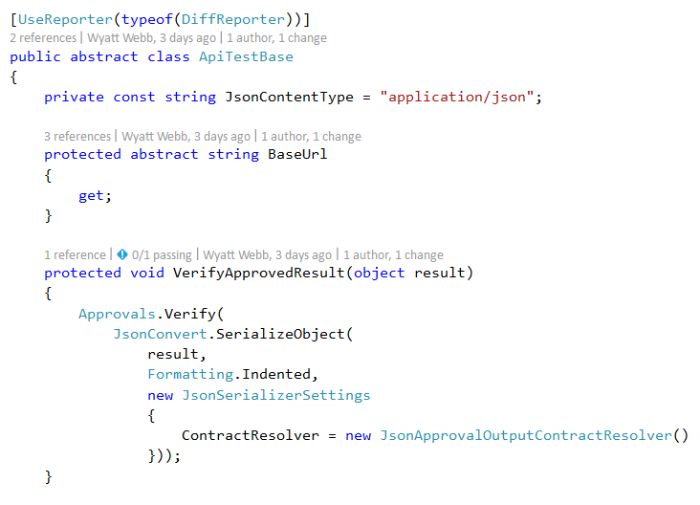
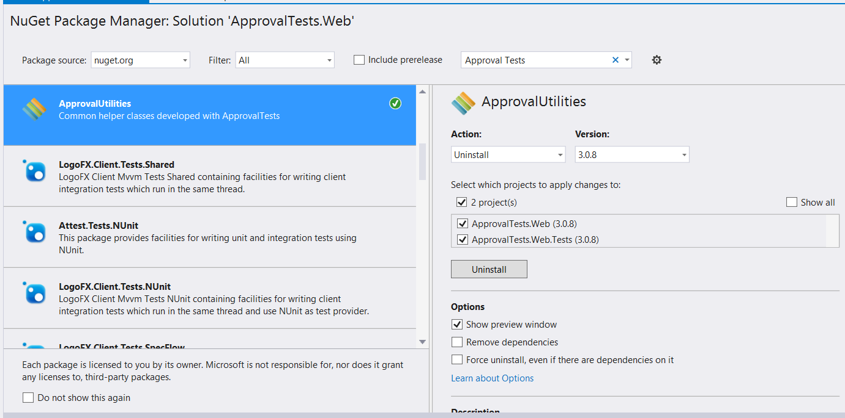
Installation
Approval Tests
via nuGet
NUnit
xUnit.net
MSTest
MBunit

Slide 11
Code
Notes:
Show installation or nugget packages
Show base API Test file and walk through it. Explain that we are serializing to JSON
Run
GET_Get__Given_10__When_Mapper_Succeeds__Then_Expected_Mapped_Result
Run
GET_Get_Ten

Slide 12

Introduction
AutoFixture
AutoFixture is an open source library for .NET designed to minimize the 'Arrange' phase of your unit tests in order to maximize maintainability.
Arrange/Act/Assert
Traditional Arrange
AutoFixture Arrange
Customize
Gotchas

Slide 13
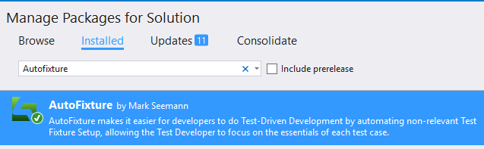
Introduction
AutoFixture
AutoFixture is an open source library for .NET designed to minimize the 'Arrange' phase of your unit tests in order to maximize maintainability.
Arrange/Act/Assert
Traditional Arrange
AutoFixture Arrange
Customize
Gotchas
Notes:
Support in all unit test frameworks. We’ll be using mstest

Slide 14
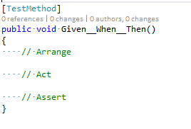
Introduction
AutoFixture
AutoFixture is an open source library for .NET designed to minimize the 'Arrange' phase of your unit tests in order to maximize maintainability.
Arrange/Act/Assert
Traditional Arrange
AutoFixture Arrange
Customize
Gotchas

Slide 15
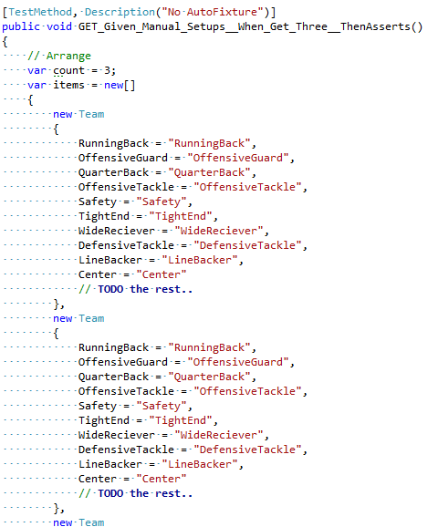
Introduction
AutoFixture
AutoFixture is an open source library for .NET designed to minimize the 'Arrange' phase of your unit tests in order to maximize maintainability.
Arrange/Act/Assert
Traditional Arrange
AutoFixture Arrange
Customize
Gotchas

Slide 16
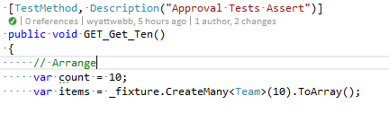
Introduction
AutoFixture
AutoFixture is an open source library for .NET designed to minimize the 'Arrange' phase of your unit tests in order to maximize maintainability.
Arrange/Act/Assert
Traditional Arrange
AutoFixture Arrange
Customize
Gotchas

Slide 17
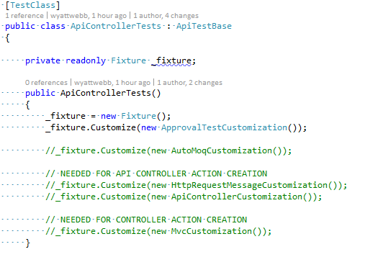
Introduction
AutoFixture
AutoFixture is an open source library for .NET designed to minimize the 'Arrange' phase of your unit tests in order to maximize maintainability.
Arrange/Act/Assert
Traditional Arrange
AutoFixture Arrange
Customize
Gotchas
Notes:
Guids vs Strings
Enumerations
Build vs Create

Slide 18
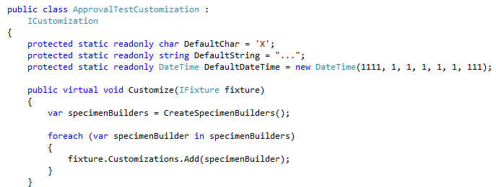
Introduction
AutoFixture
AutoFixture is an open source library for .NET designed to minimize the 'Arrange' phase of your unit tests in order to maximize maintainability.
Arrange/Act/Assert
Traditional Arrange
AutoFixture Arrange
Customize
Gotchas
Notes:
Guids vs Strings
Enumerations
Build vs Create
Pipe line explanation – Request comes in, Customizations (blank), runs defaults, and residue collectors, and out anonymous data

Slide 19

Introduction
AutoFixture
AutoFixture is an open source library for .NET designed to minimize the 'Arrange' phase of your unit tests in order to maximize maintainability.
Traditional Arrange
AutoFixture Arrange
Customize
Gotchas
Notes:
SQL Column Lengths
Registering dependencies
Shiny new hammer

Slide 20
Code
Notes:
Show – Custom :
_fixture.Customize(new ApprovalTestCustomization()); at top of controller tests.
Walk through ApprovalTestCustomization including all of it.
Point out ISpecimenBuilder
Show QuarterBackSpecimenBuilder
Run
GET_Given_Manual_Setups__When_Get_Three__ThenAsserts
Run
GET_Get_Ten_UsingAutoFixture

Slide 21
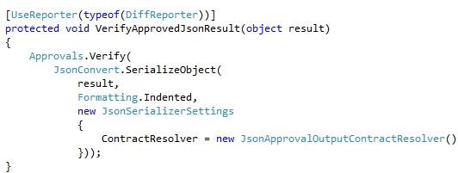
Reporters/Approvers
Approval Tests
DiffReporter
Using JSON Serialization
FileLauncherReporter
Html verification

Slide 22

Reporters/Approvers
Approval Tests
DiffReporter
Using JSON Serialization
FileLauncherReporter
Html verification

Slide 23
Code
Notes:
Show base class again with diff reporters
Show JsonApprovalOutputContractResolver
Mention image diffs
Audio Diffs
Also configuration at the method/class/config/ machine config override
Mention use of config for build server.
Run
GET_Get_Given_Parameter__When_Executed__Then_Return_Validation_Errors_Html

Slide 24
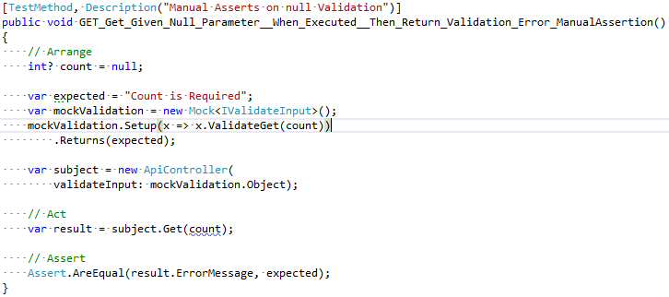
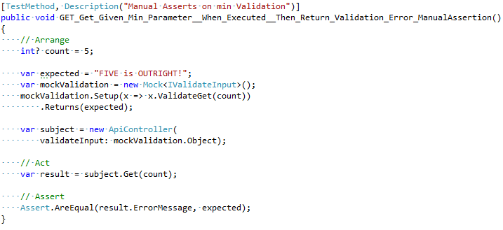
Validation
Unit Testing
Manual Assert
Approval Tests
Multiple Input Scenarios

Slide 25
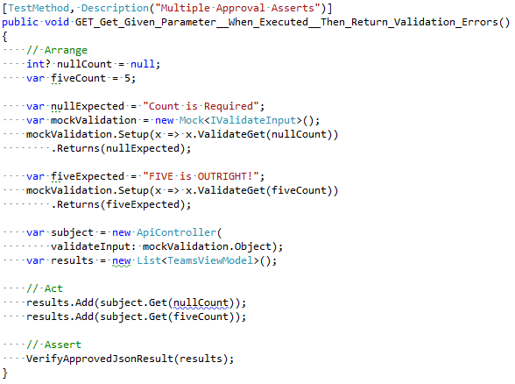
Validation
Unit Testing
Manual Assert
Approval Tests
Multiple Input Scenarios

Slide 26
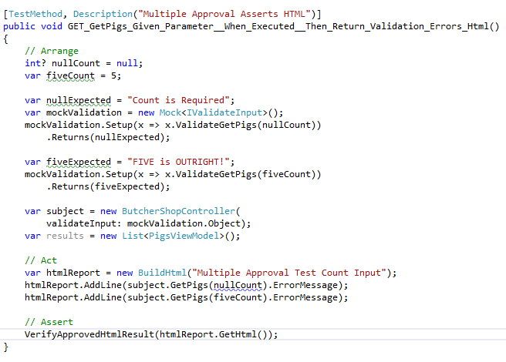
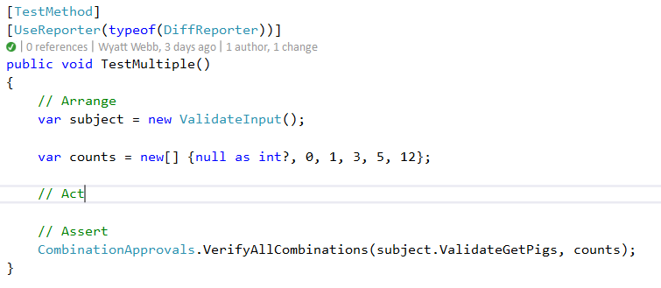
Validation
Unit Testing
Manual Assert
Approval Tests
Multiple Input Scenarios

Slide 27
Code
Notes:
API Controller Tests:
GET_Get_Given_Null_Parameter__When_Executed__Then_Return_Validation_Error_ManualAssertion
GET_Get_Given_Min_Parameter__When_Executed__Then_Return_Validation_Error_ManualAssertion
GET_Get_Given_Parameter__When_Executed__Then_Return_Validation_Errors
Go over
ApprovalUtilities.SimpleLogger;
CombinationApprovals
TestMultiple() test

Slide 28
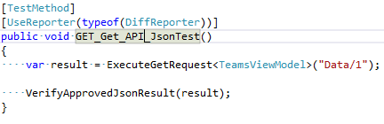
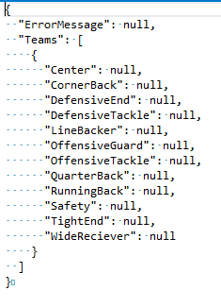
.NET Web API
Unit Testing
Approval Tests

Slide 29
Code
Notes:
GET_Get_API_JsonTest
Show WebApiConfig and CamelCasePropertyNamesContractResolver

Slide 30
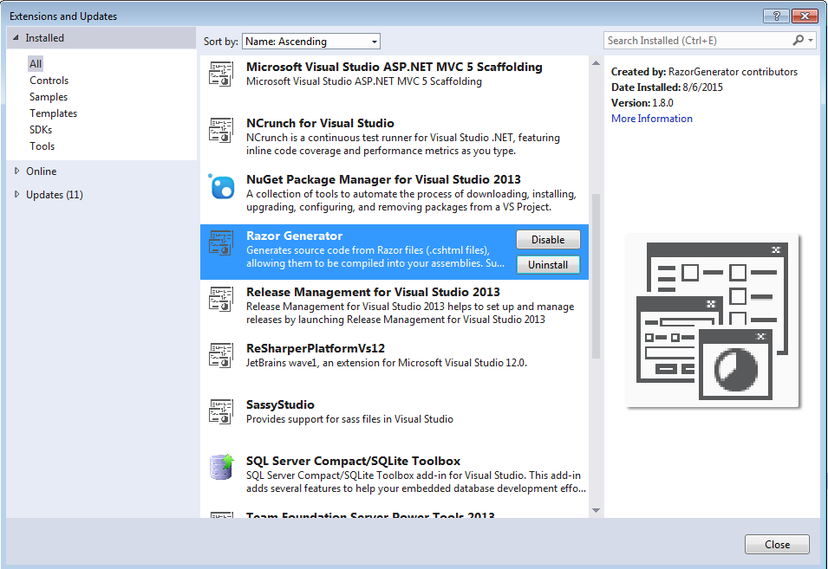
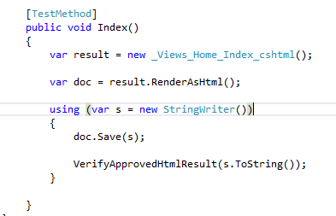
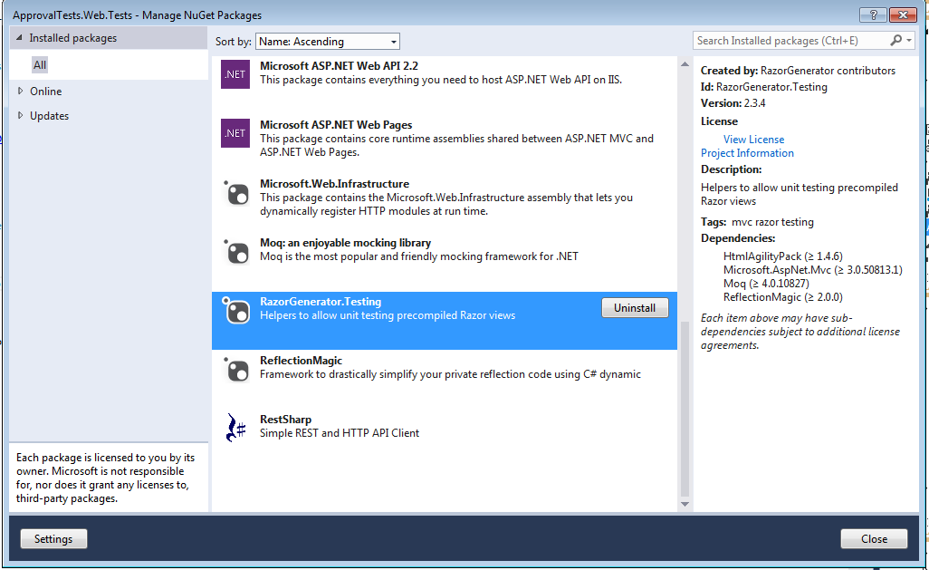
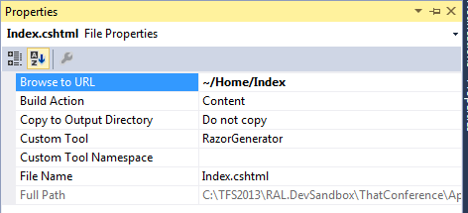

Testing Razor Views
Unit Tests
Razor Generator

Slide 31
Code
Notes:
HomeControllerTests
Show razor generator extension and file properties of a view.

Slide 32
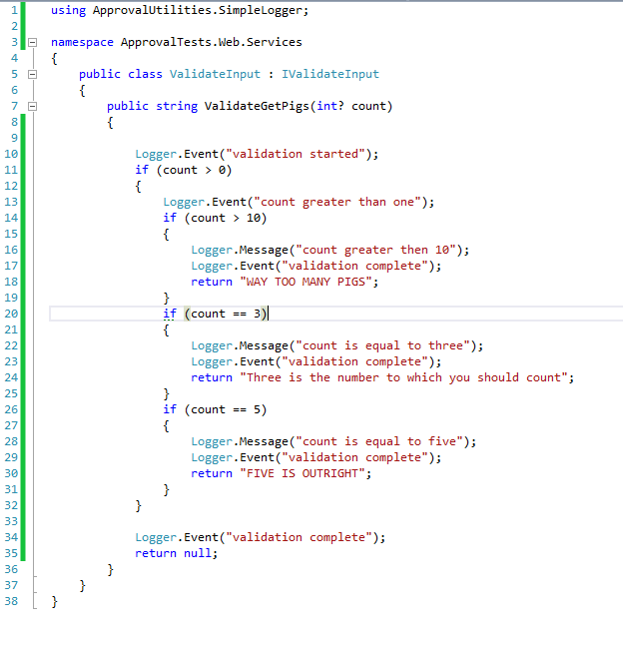
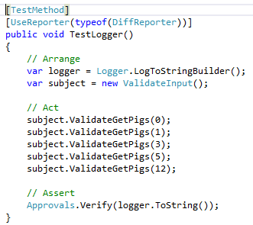
Testing coverage improvement
Unit Tests
Logger

Slide 33
Code
Notes:
TestLogger test and validation Logger code

Slide 34
Introduction
Moq and AutoMoq
Moq is a mocking library for .net
AutoMoq is AutoFixture using Moq to automatically resolve dependencies.
Traditional Moq Constructor Tests
AutoMoq Test

Slide 35
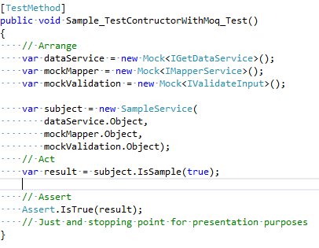
Introduction
Moq and AutoMoq
Moq is a mocking library for .net
AutoMoq is AutoFixture using Moq to automatically resolve dependencies.
Traditional Moq Constructor Tests
AutoMoq Test

Slide 36
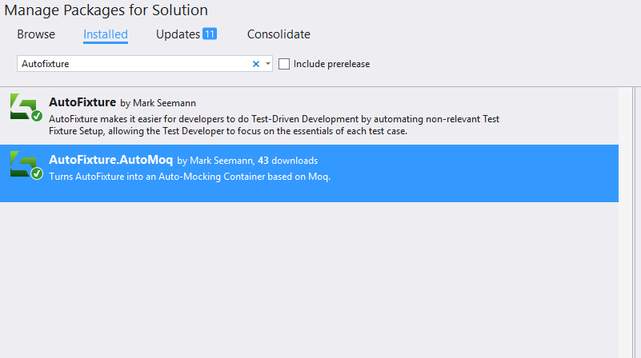
Introduction
Moq and AutoMoq
Moq is a mocking library for .net
AutoMoq is AutoFixture using Moq to automatically resolve dependencies.
Traditional Moq Constructor Tests
AutoMoq Test
Notes:
Nuget package

Slide 37
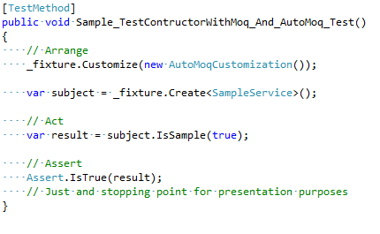
Introduction
Moq and AutoMoq
Moq is a mocking library for .net
AutoMoq is AutoFixture using Moq to automatically resolve dependencies.
Traditional Moq Constructor Tests
AutoMoq Test

Slide 38
Code
Notes:
Show refactoring of constructor of SampleService Nuget package for Autofixture.Automoq
Show Tests
Sample_TestContructorWithMoq_Test
Sample_TestContructorWithMoq_And_AutoMoq_Test
Show customizations with APIController
TestContructorWithMoq_Test
TestContructorWithMoq_And_AutoMoq_Test

Slide 39
References
References
Approval Tests.Net
Pluralsight
Approval Tests.com
Razor Generator
https://github.com/approvals/ApprovalTests.Net
http://www.pluralsight.com/
http://approvaltests.com
http://razorgenerator.codeplex.com/

Slide 40
Approval Test / AutoFixture/ AutoMoq
Unit testing validation
Manual Assert vs. Approval Tests
Testing multiple inputs in one test
.NET Web API Testing
Testing with Approval Tests
Unit testing Razor views
Razor Generator
Testing coverage improvement
Approval Utilities Logger
Introduction to AutoMoq
Questions
Contact Info
@wyattwebb
https://github.com/wyattwebb/ApprovalTestsTalk
http://wyattwebb.com
Introduction
Persistence / View Model Mapping
Unit testing auto projection (mapping)
Manual Asserts vs. Approval Test
What are Approval Tests
How are they used? Why they are useful?
How to install them
Introduction to AutoFixture
Reporters
JSON Reporter
HTML Reporter

Slide 41
QUESTIONS

