Slide 1
Zero Person Team (ZPTeam)
AI-powered sales operations.
zpteam.ai | request@zpteam.ai

Slide 2
The problem. The solution.
The reality for most sales teams
What ZPT does
Manual enrichment — copy-pasting between tabs for hours
Scattered data across spreadsheets, CRMs, and inboxes
Inconsistent prospect profiles — everyone does it differently
Hours spent per prospect on research that goes stale
No time left for actual selling
You share your sales context and data. ZPT sources, enriches, qualifies, and delivers results back through your CRM.
This isn't a tool you learn. It's a service you receive.

Slide 3
Enhancing the full sales funnel
LinkedIn
Google Maps
Web
Job boards
Conferences
Many More...
1
Find Prospects
Source leads from LinkedIn, directories, GMaps, conferences, and competitor intel.
2
Enrich & Qualify
Build full profiles with decision-maker data, company intel, and ICP scoring
2
3
Personalized Outreach
Draft emails using the company's voice, positioning, and prospect research.
4
Manage Pipeline
Track activity, follow-ups, and sync with the existing CRM.
ZPT handles every stage. You approve the output.

Slide 4
What the output looks like
Simple Template
Advanced Template
Company | Contact | Role | Email | Status
Acme Corp | Jane Smith | CRO | jane@acme.com | Verified
Beta Inc | Tom Brown | VP Sales | tom@beta.io | Enriched
Gamma SA | Lisa Muller | CEO | lisa@gamma.de | Verified
Delta Ltd | Mark Roberts | Head of Sales | mark@delta.co.uk | Pending
Echo GmbH | Anna Weber | CMO | anna@echo.de | Verified
Acme Corp
SaaS, 50-200 employees, Munich, Germany
ICP-Fit
5 / 5
Decision maker
Jane Smith, CRO
Pain signals
Hiring SDR, manual CRM updates, low outreach volume
Personalized hook
"Saw your SDR job post on LinkedIn. ZPT could cover that function at a fraction of the cost..."
Recommended channel
LinkedIn + email sequence
Templates are fully customizable. Each client defines their own fields, scoring criteria, and output format.

Slide 5
How it works
One system. Reads your context, searches the web, updates your CRM, delivers structured output.
AI Agent
Your Company Folder
HubSpot
↔
↔
Web Search
company-context/ ICP, positioning
skills/ outreach templates
workflows/ enrichment steps
memory/ lessons learned
CLAUDE.md operating instructions
Salesforce
↔
↔
Google Maps
Google Drive
↔
↔
LinkedIn
All-in-one. No tab-switching. No copy-pasting. The agent reads your context, executes across all connected tools, and delivers structured output.

Slide 6
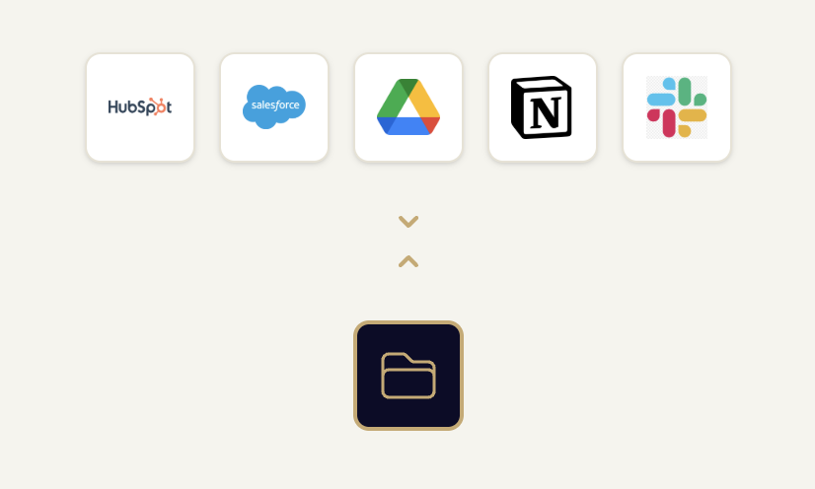
Connects to your stack
No migration. No new software. ZPT plugs into what you already use.

Slide 7
How we get started
1
→
2
→
3
Collect company context
Connect to your CRM
Start delivering results
We learn your ICP, positioning, current process, and examples of good-fit accounts.
We hook into HubSpot, Salesforce, or whatever your team already uses.
ZPT begins sourcing, enriching, and qualifying prospects. Output flows back through your CRM.
You get the output. We run the system.
Start with 100 contacts enriched for free.

Slide 8
Who this is for
Inconsistent enrichment
Spreadsheet chaos
Companies with sales data but no reliable, repeatable way to enrich and verify it.
Teams working from spreadsheets or a CRM that needs serious cleanup before it's useful.
More pipeline, no new hires
Lean teams, big goals
Firms that want to grow their pipeline without the cost and time of hiring more people.
Small sales teams that need enterprise-level output from their existing process.

Slide 9
Ready to see what ZPT can do for your sales?
request@zpteam.ai
Start with 100 contacts enriched for free.

