Slide 1

WSI Toolkit

Slide 2

Preface
Cross-platform (iOS, Mac, Android, Unix,WP and Windows) library with development tools.
Framework.
RAD software architect.

Slide 3
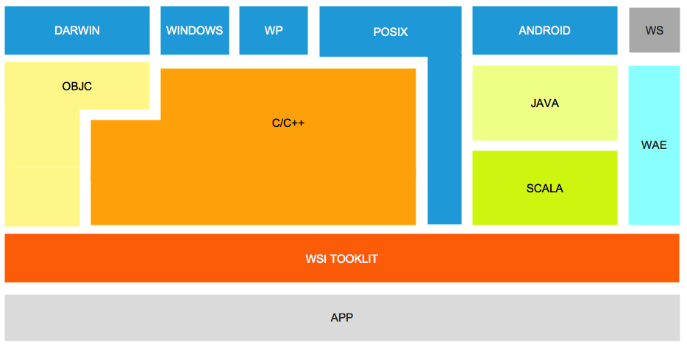
Architect

Slide 4
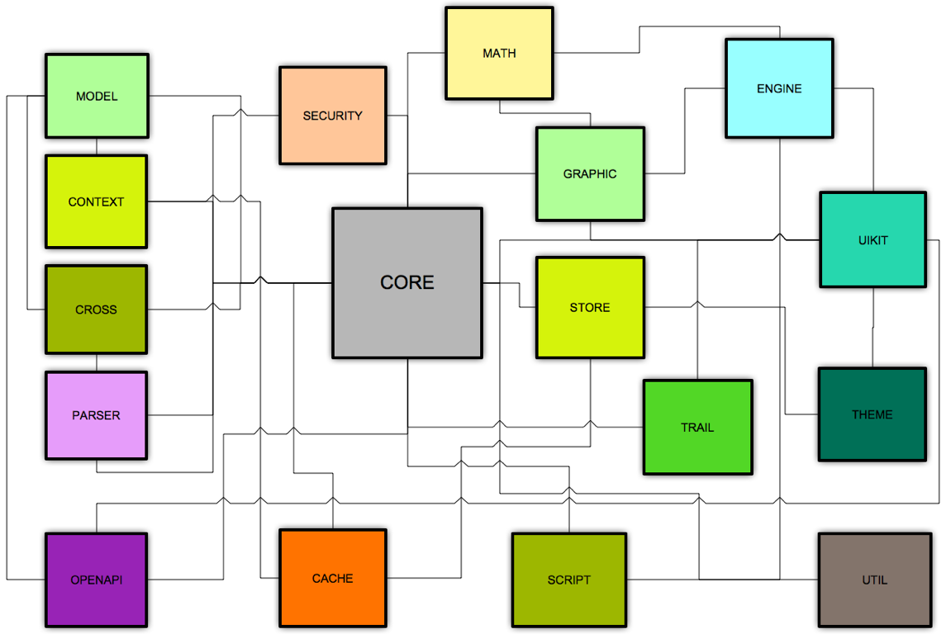
Modules

Slide 5
Core
Implement Signals/Slots, Store/Attach patterns language independence.
Implement Application class for create new APP easily.
Provide System Cache for cache every datas.
Extend STL algorithm.

Slide 6
Uikit
New Excellent Controls.
  cover, qrcode, spreadsheet, ...
Add Signals/Slots to every control.
Merge the difference between SDKs or Versions.
Layout System for everywhere or every-orientation.

Slide 7
MVC
MODEL class to hide the implementation of data-process, cache-system, and error-process.
CROSS class to hide the implementation of data-access. (xmlrpc, jsonrpc, webservice.)
SERVER class to process model asynchronously and synchronically.

Slide 8
Security
USE Open-SSL for MD5, Base64, RSA, SHA, AES ....

Slide 9
Theme
Provide a Theme-Maker application (Mac).
App instances resource from theme by key.
Themes manager.
Refresh UI quickly.

Slide 10
Graphic
Cocoa++ for flexible program.
Juice-Engine for 2D/3D program.
Collision System.
Physical Engine from Box2d.

Slide 11
Store
SQL databases’s drivers. (MySQL, SQLite, MSSQL Server, PostgreSQL, Oracle)
NoSQL databases’s drivers. (BDB, LevelDB)
DB Model.
Configuration System.
Spatialite integration for GIS.

Slide 12
Parser
Plain-Text Parser. (Html, XML, JSON,CSS)
Search html in C++ like JQuery.
Template Parser. (Mustache)
File Parser. (CHM)
SOAP.
Graphic Format.(GIF,SVG)

Slide 13
Network
SOCK Server/Client.
XMPP Client.
SOAP Server.
WEB Server in-app.
RPC implementation.

Slide 14
Script
Python Integration.
Lua Integration.
Tiny Scheme Integration.

Slide 15
OPENAPI
One interface to 新浪微博、网易微博、腾讯微博、腾讯动态、豆瓣、人人网、开心网.
Share login with 新浪、网易、腾讯网、人人网、开心网、豆瓣、淘宝网.

Slide 16
PAY
支付宝手机快捷支付
银联手机支付

Slide 17
App Engine
Base on Openstack Infrastructure.
Unify Interface to Web-Services.
Minimum cost for App-Maintain.

Slide 18















Contribution

Slide 19
END
THANKS

