Slide 1
The pytorch ecosystem
Machine Learning Operations
Nicki Skafte Detlefsen,
Postdoc
DTU Compute

Slide 2
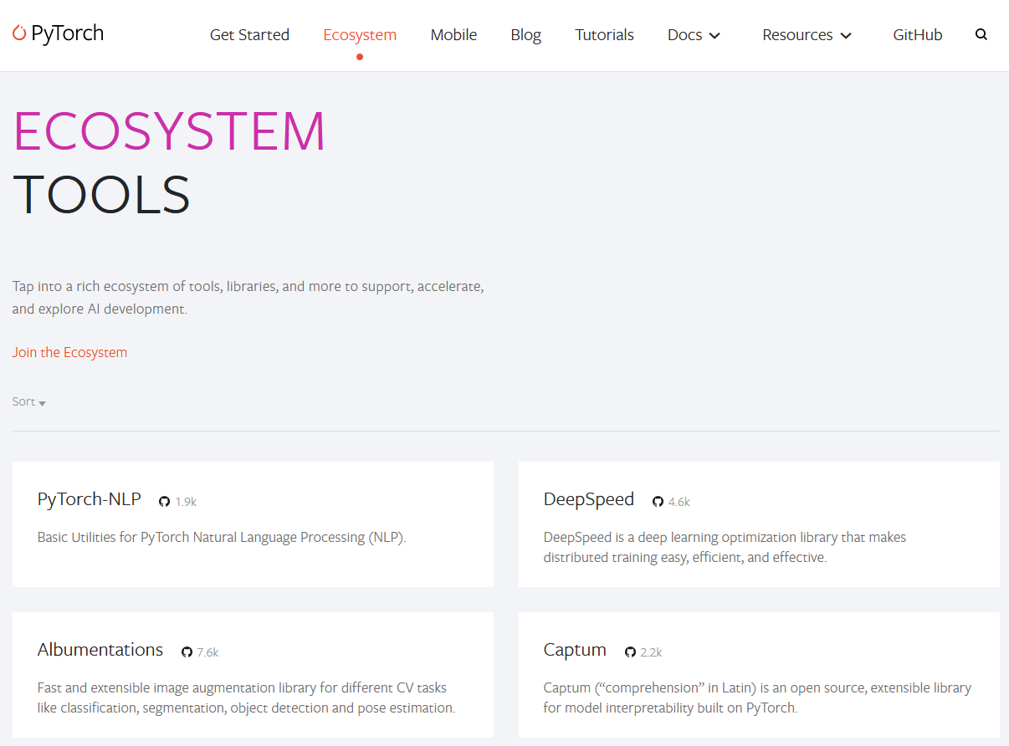
The ecosystem
Collection of frameworks build to be used in combination with Pytorch

Slide 3

Fremwork categorising
Data specific frameworks | Training frameworks | Utility fremeworks
Transformers | fastai | Albumentations
Detectron2 | Ray | PySyft
Pytorch geometric | Pytorch Lightning | Pyro
Flair | Horovod | Optuna
AllenNLP | DeepSpeed | Hydra
ParlAI | ONNX Runtime | Pytorch Metric Learning
DGL | skorch | Einops
PyTorch3D | Ignite
MMF | Polyaxon
Kornia

Slide 4
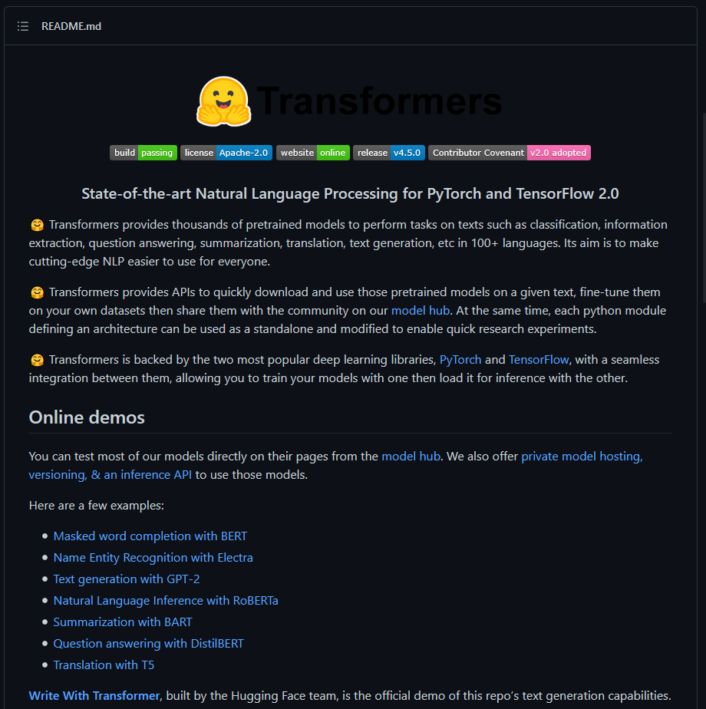
Project 1: NLP
Framework: Transformers (Huggingface)
https://github.com/huggingface/transformers
State-of-the-art NLP models
Most starred framework in the ecosystem

Slide 5
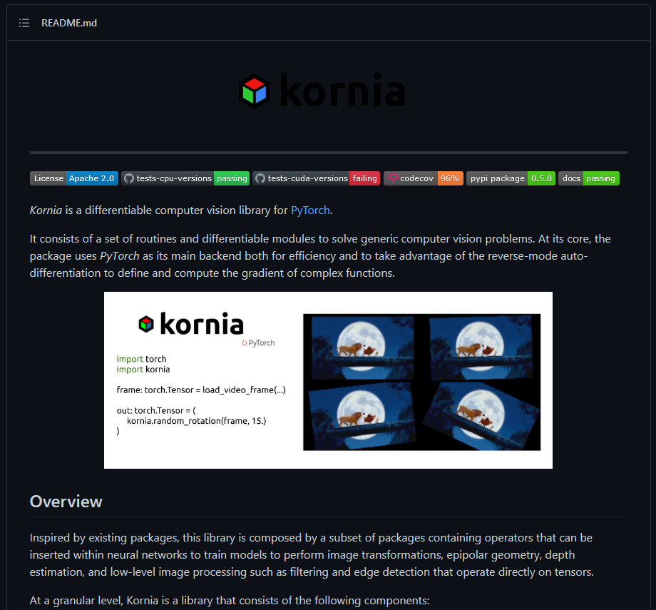
Project 2: CV
Framework: Kornia
https://github.com/kornia/kornia
Differentiable computer vision algorithms

Slide 6
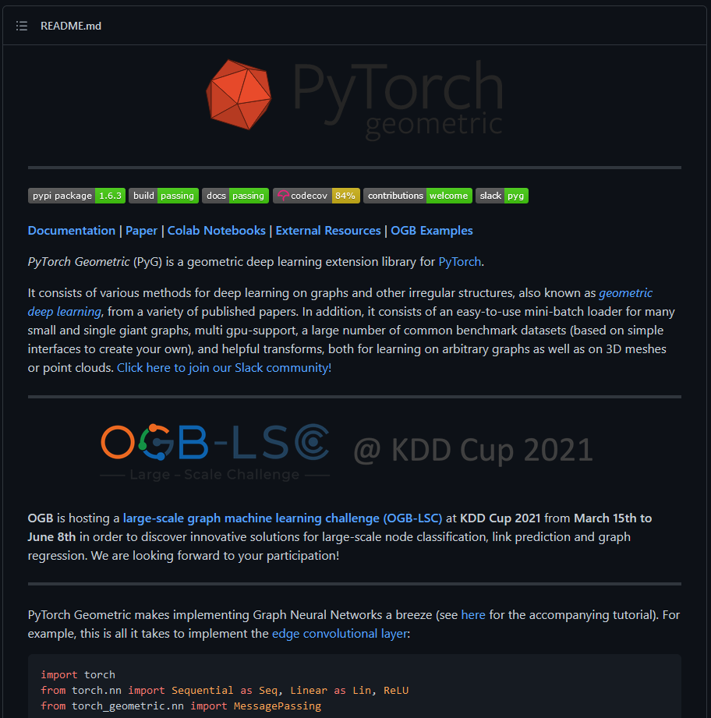
Project 3: Graphs and points
Framework: Pytorch Geometric
https://github.com/rusty1s/pytorch_geometric
Neural networks on graphs and point clouds

Slide 7
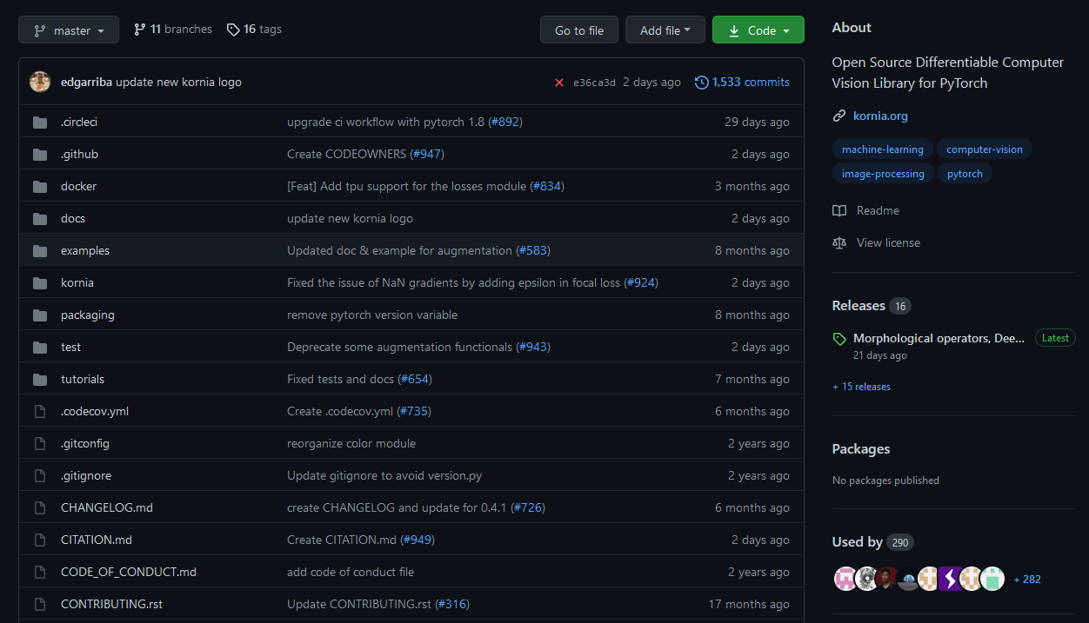
Getting a good idea

Slide 8
Summary
Pick a framework (try running their notebooks/examples!):
Project 1: NLP
Project 2: CV
Project 3: Graphs and points
Brainstorm a project. It does not have to be particular big as you only have 4 full days for working on it
Write a small (max 1 page) project description including:
What model do intent to implement
What data are you going to use
How you think the chosen framework can be incorporated

Slide 9
Checklist (also in todays readme)
Create a git repository
Make sure that all team members have write access to the github repository
Create a dedicated environment for you project to keep track of your packages
Create the initial file structure using cookiecutter
Fill out the `make_dataset.py` file such that it downloads whatever data you need and
Add a model file and a training script and get that running
When you have something that works somewhat, remember at some point to to some profiling and see if you can optimize your code
Remember to fill out the `requirement.py` file with whatever dependencies that you are using
Write unit tests for some part of the codebase and calculate the
Get some continues integration running on the github repository
Use either tensorboard or wandb to log training progress and other important metrics/artifacts in your code
Remember to comply with good coding practices while doing the project

Slide 10
Hand-in
By 17:00 today ONE group member should send an email to me (nsde@dtu.dk) with the following info
Link to github reposatory
Study number of all group members
Your project description

Slide 11
Exam format
Thursday 24/6 – internal evaluation by Nicki and Søren
Group presentation
7-10 minutes of powerpoint/reposatory showcase
7-10 minutes of discussion
What you will be evaluated on:
How well you have included what is though in the course
What you will NOT be evaluated on
How epic your deep learning model is

Slide 12
Some good advice
Document everything
Take screenshots of your work
Parallize work
Many of the checkpoints are independent of each other

Slide 13
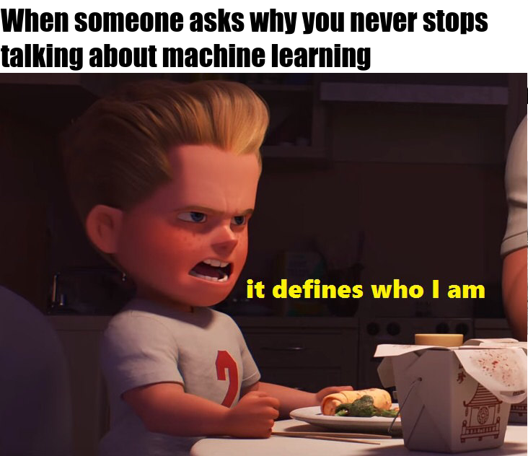
Meme of the day

