Slide 1
Continues Integration (CI)
Machine Learning Operations
Nicki Skafte Detlefsen,
Postdoc
DTU Compute

Slide 2
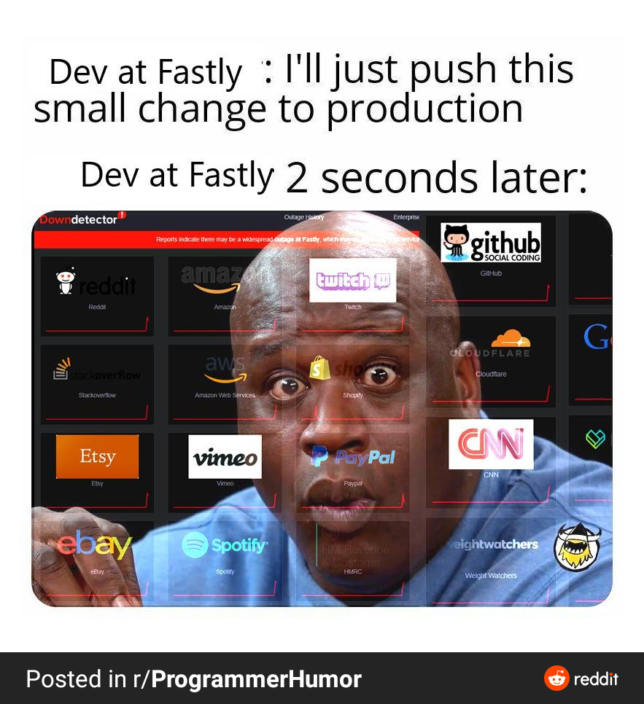
Why you should care about todays exercises

Slide 3
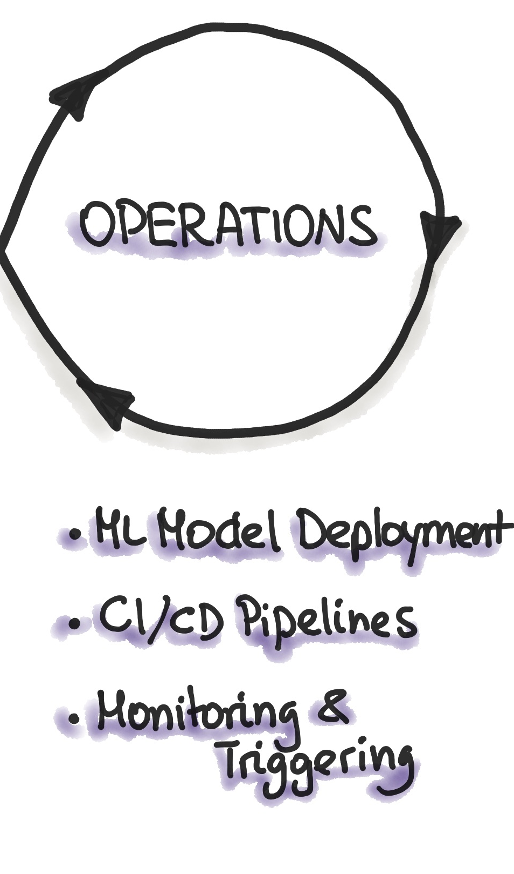
What is continues integration?
Software practise
Frequently commit code to shared repository
By commit sooner than later, errors are captured early
Make merging easier
Automate build + test
App independent

Slide 4
What is continues deployment?
How to get your code to the user
3 phases: Testing, staging and deploying
App dependent
Note: Not covered in this course

Slide 5
What should you know about CI?
CI is one of those topics that are best though as learning-by-doing
If you understand how to use git, the rest is basically googling stuff
Let's look at a practical example

Slide 6
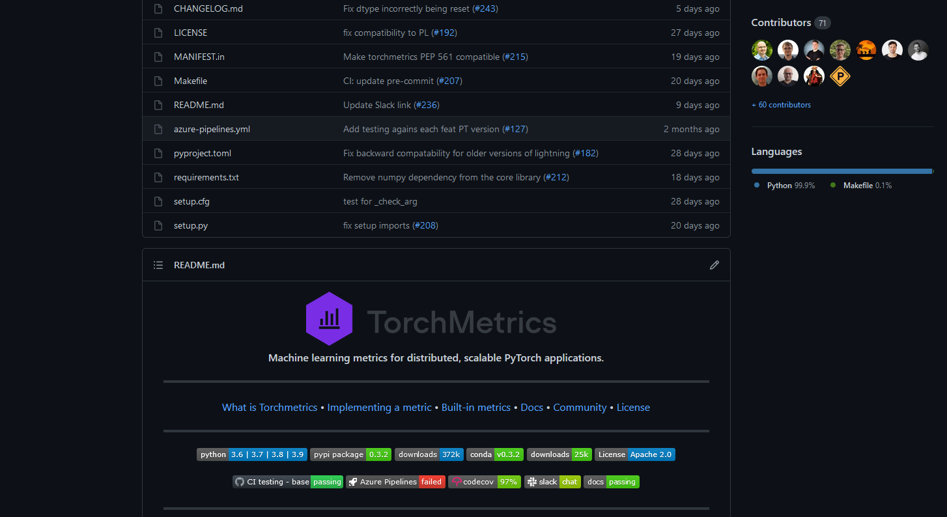
A small case study
All the metric in the world – now in pytorch
Have I seen that guy before?

Slide 7
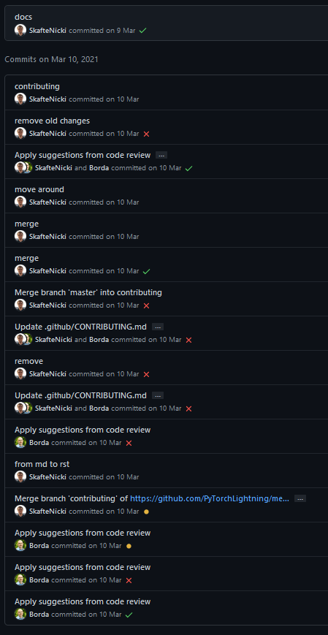
CI step 1: Commiting code
Commit frequently
Catch errors sooner than later
Merging can be done automatically
Create someting
Break it
Fix it

Slide 8
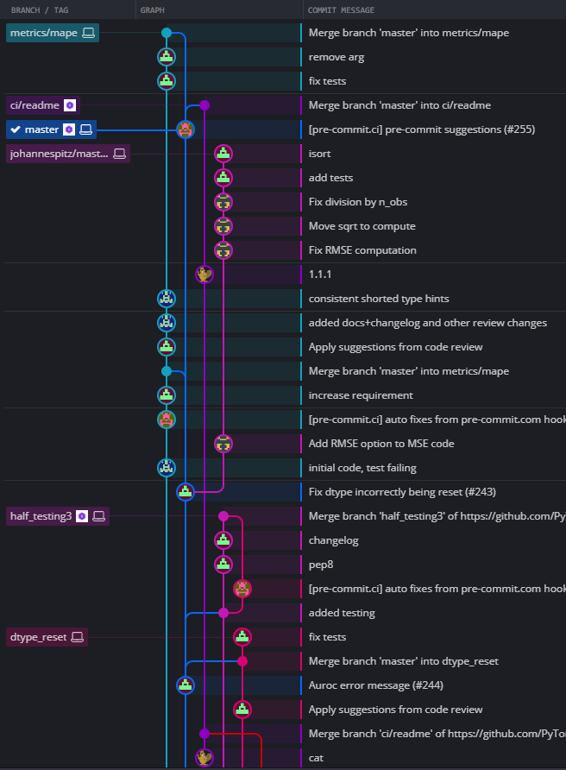
CI step 1: Commiting code
Use branches
Enables parallel workflow
Experimental features/changes are keept away from ”stable” master

Slide 9
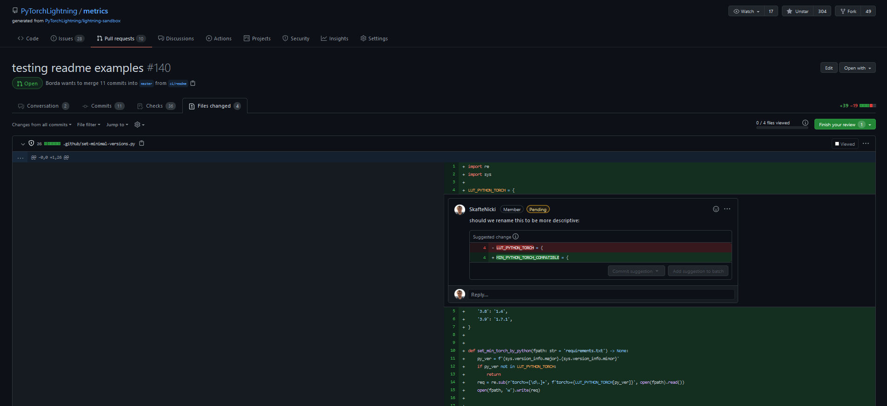
CI step 1: Commiting code
Use PRs, other can review your code
1. Find PR
2. Check changed files
4. Send review
3. Make one or more comments

Slide 10
CI step 2: Automating stuff
What can be automated: EVERYTHING
Functional tests
Documentation creation
Linters (which check style formatting)
Security checks
Code coverage
Custom checks…

Slide 11
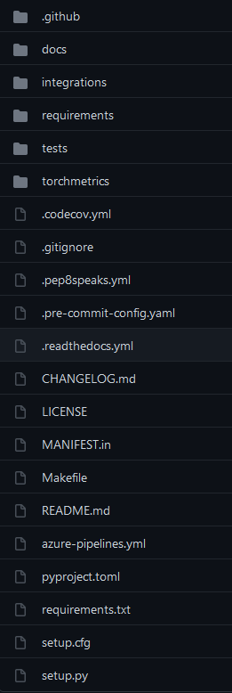
A small casestudy
Ranked by importance (biased)
Source code
Tests
Setup
CI workflows
Documentation

Slide 12
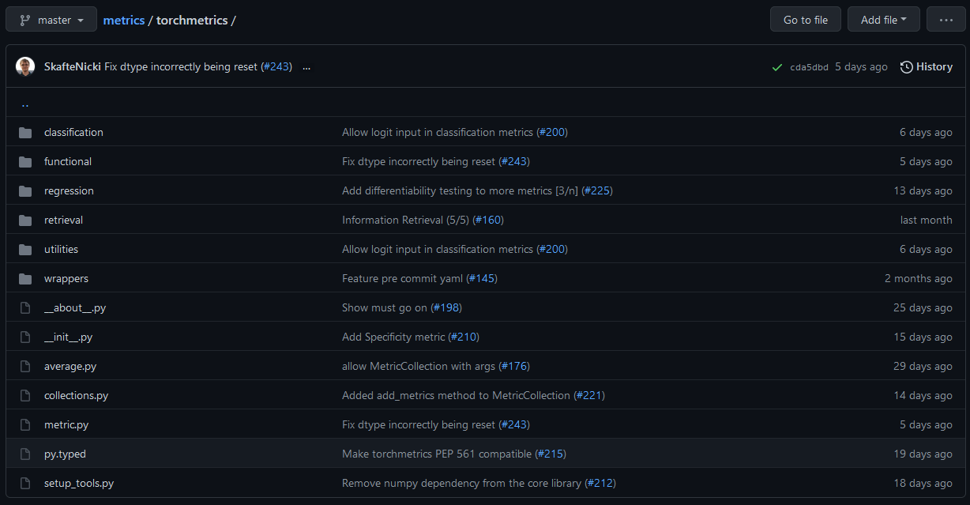
Source code

Slide 13
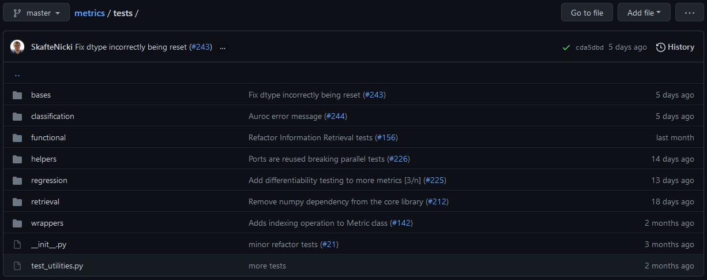
Test code
In total we have 6365 tests

Slide 14
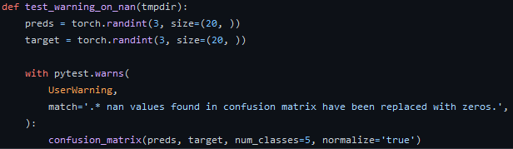
Test example 1
Can be simple

Slide 15
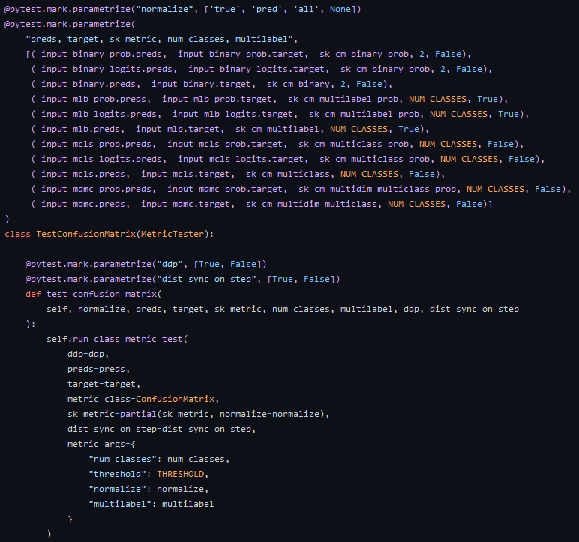
Test example 2
Can be very complex

Slide 16
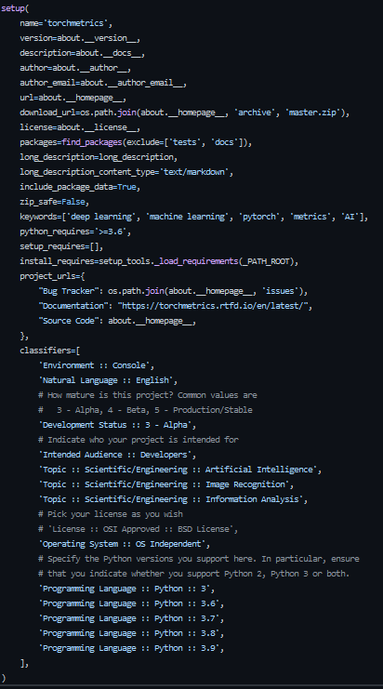
Setup files
Contains all information regarding the project
Allow people to do:
python setup.py install
or if uploaded to pip
pip install my_package

Slide 17

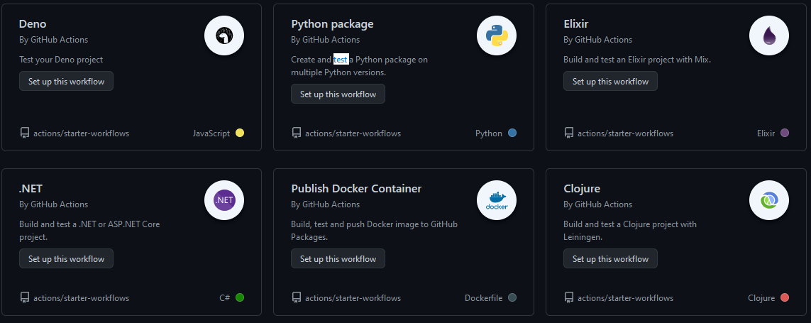
Github actions
Build-in CI for github
Free 2,000 automation minutes/month (public repository)
Many ready to go workflows

Slide 18
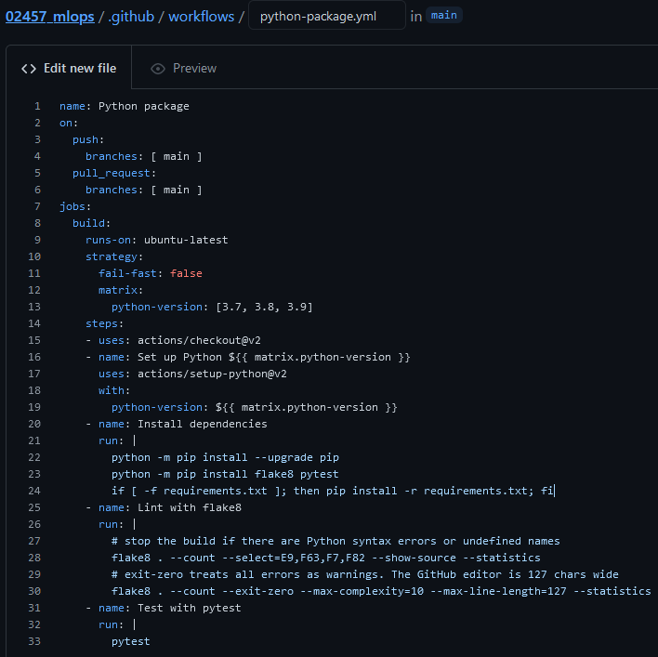
The anatomy of a workflow file
When tests should be triggered
Define Operating system + python version
Setup python
Install dependencies
Check linting (stop if errors)
Run tests

Slide 19
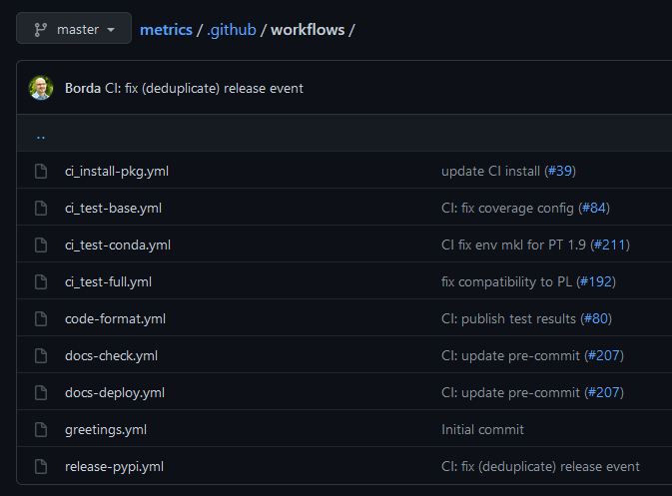
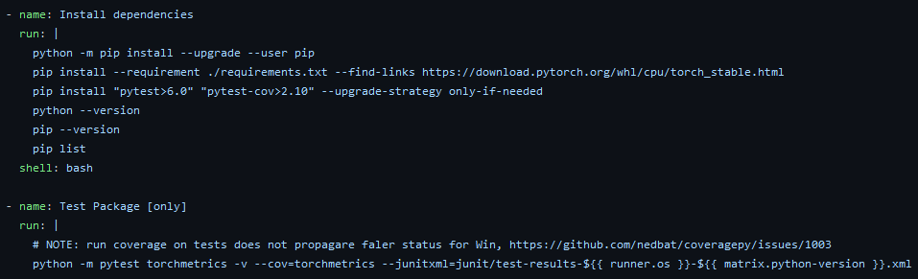
A small case study

Slide 20
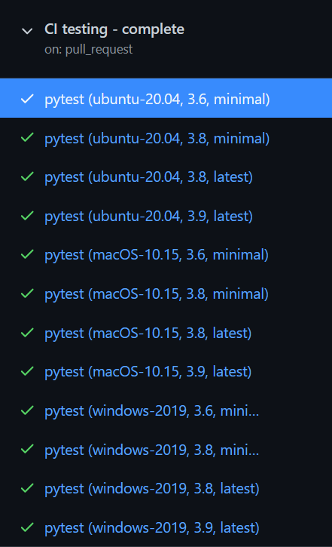
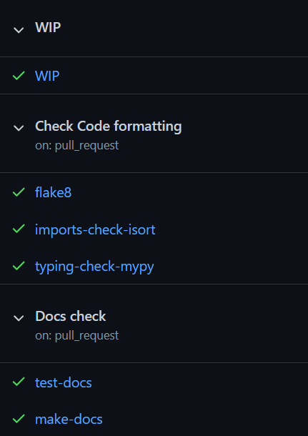
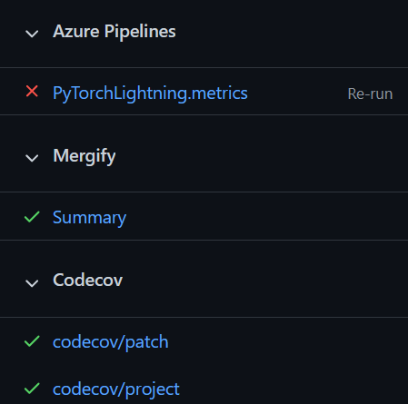
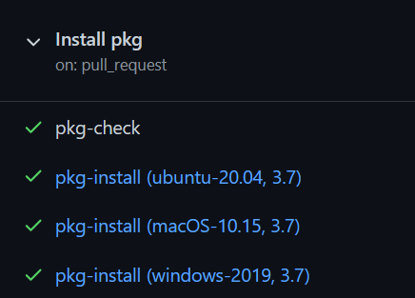
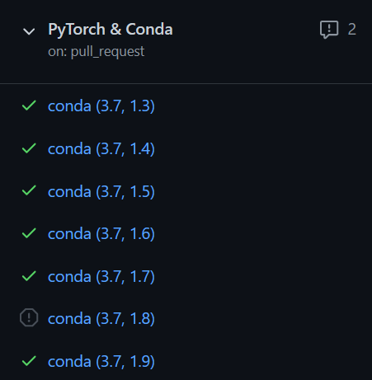
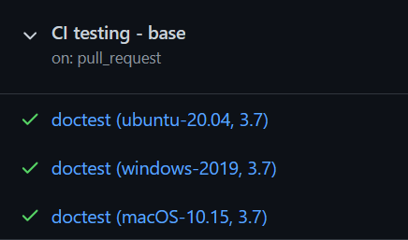
All of our workflows – 36 in total
Not github actions
Test combination of
Hardware setup
Operating system
Python version
Dependencies
Runs tests, docs, coverage, lintint, package install ect

Slide 21
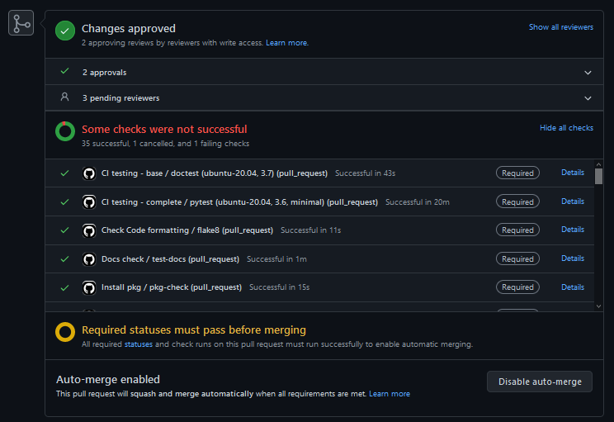
Each PR triggers all tests

Slide 22
Other files to consider
reguirements.txt
LICENSE
README.md
.gitignore

Slide 23
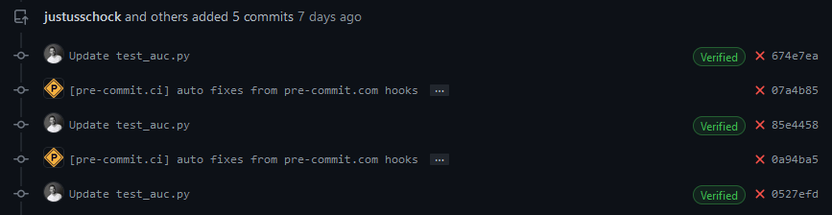
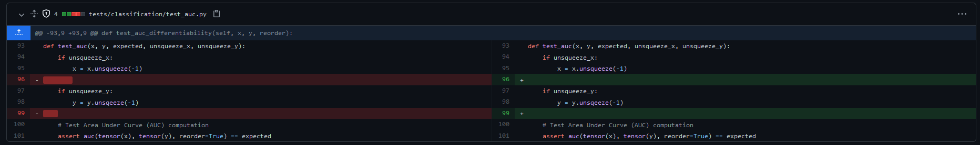
Advanced: Use bots
Bots can take care of tidious task for you (like linting)

Slide 24
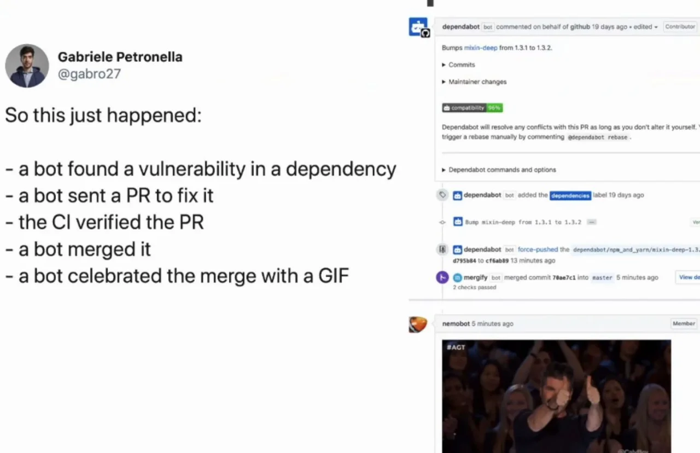
The future is here

