Slide 1

AI TAROT PROJECTION
For people who don't believe in tarot,
but believe in thinking out loud.
The cards never predict. They get you talking.
wyc79.github.io/ai-tarot-projection
Runs on your own API key · open source · stores nothing, anywhere
Notes:
Opening: this is a tarot app for skeptics. The pitch in one line: tarot cards as a projective surface, something specific and strange to point at, so the thing you actually wanted to say has an easier route out. The AI reader never predicts; it hands your own words back to you in an order you hadn't tried.

Slide 2
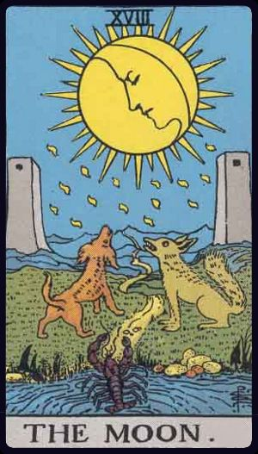



THE IDEA
A projective surface, not a fortune
Three cards go face down before anything is said. You're asked what you see in the one in front of you. Not what it means: what you see.
Projection, not prediction
A flip shows the card's name, never a caption.
You always speak first
What you see in the picture becomes the conversation.
The card is the third object in the room
Pointing at a picture beats “I've been a bit off lately.”
Smith-Waite 1909 · public-domain scans
AI Tarot Projection · 2
Notes:
The core reframe: for the target user, tarot's value is not divination. A strange, specific image is easier to talk through than a blank 'how are you feeling?'. Three design consequences: (1) the app never describes the picture, because a printed description is something to agree with, and agreeing is not projecting; (2) the user's projection is the disclosure, and the reader builds only on their words; (3) talking through a layout keeps the card as a mediating third object, which is what lowers resistance. The deck is a pretext for the conversation the person was already trying to have.

Slide 3

GROUNDINGS
A studied counseling technique
Clinton (2024)
Semetsky (2005, 2006)
13/15
Tarot as a projective technique in counseling: secular, client-led, no expertise required.
The layout as a mediating container; talking through it reduces resistance.
participants found a single-session reading personally meaningful
White (2007)
Ramey, Young & Tarulli (2010)
Maps of Narrative Practice: the scaffolding map our question engine runs on.
Vygotsky's zone of proximal development as the mechanism under White's map.
Semetsky, 2005
Both tarot papers ship in the repo. Full citations and links in the notes.
AI Tarot Projection · 3
Notes:
Fact-checked citations, with links: 1) Clinton, E. (2024). Divining the self: Applying tarot as a projective technique in counseling. Educational Specialist project, James Madison University. https://commons.lib.jmu.edu/edspec202029/97/ . The academic twin of this product: secular projective use, the client's interpretation over card tradition, no tarot expertise required. Its projection prompts seed our reader's few-shots. 2) Semetsky, I. (2006). Tarot as a projective technique. Spirituality and Health International, 7(4). https://onlinelibrary.wiley.com/doi/10.1002/shi.252 . Source of the mediated-communication argument, and of our anti-pattern: her case study treats client disagreement as confirmation; our correction-wins rule exists to prevent exactly that. 3) Semetsky, I. (2005). Integrating Tarot readings into counselling and psychotherapy. Spirituality and Health International, 6(2). https://onlinelibrary.wiley.com/doi/10.1002/shi.52 . The 13-of-15 figure is this study's participant outcome, as cited in the repo's research chain via Clinton (2024). 4) White, M. (2007). Maps of Narrative Practice. New York: W. W. Norton. The scaffolding-conversations map: questions climb ordered levels of distance from the known. 5) Ramey, H. L., Young, K., & Tarulli, D. (2010). Scaffolding and concept formation in narrative therapy: A qualitative research report. Journal of Systemic Therapies, 29(4), 74-91. https://guilfordjournals.com/doi/10.1521/jsyt.2010.29.4.74 . Note: the repo plan cites this as Journal of Marital and Family Therapy; the actual venue is Journal of Systemic Therapies. Lineage: projective techniques in counseling run back through Clark (1995) and Pepinsky (1947), per Clinton's review.

Slide 4
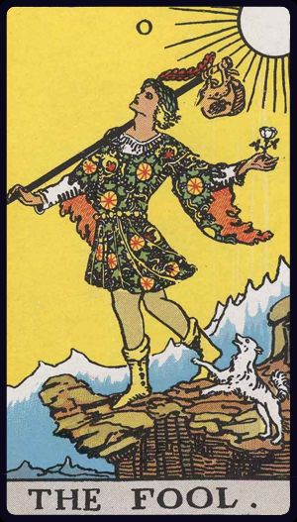
HOW A READING WORKS
Cards are earned, not dealt
1
2
3
4
Everything face down
→
You read the card first
→
The reader follows
→
Sharing turns the next card
The whole spread hits the table before a word is said.
“What does this feel like it's pointing at, for you?”
One observation, one question per turn.
Cards turn when you say something real, not on a timer.
The earned fourth card: an epilogue that only exists when the reading earned it. Otherwise, “one card stays with the deck today; it'll be there when you come back.”
AI Tarot Projection · 4
Notes:
Flip-gating is the signature mechanic: face-down cards ahead are the incentive made physical. Rhythm per card: flip, your projection, follow-up, next flip. Depth decides, not turn count: a rich answer can flip early, a thin answer gets a softer follow-up instead of a stall, and a fresh disclosure gets dwelled in for one exchange rather than skipped past, because flipping on a disclosure would teach that opening up ends the subject. The fourth card is earned by something of your own, unhedged, on the advice card. Not earned, the closing names it once as an invitation, never as a grade. That line is the return hook.

Slide 5

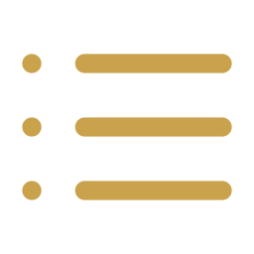
INTERNAL DESIGN · NARRATIVE MAPS
The reading knows where it's going
SITUATION
setup
OBSTACLE
tension
ADVICE
resolution
It keeps the thread
Your topic and your own words, kept word for word.
→
→
↓
EPILOGUE
only if earned
It keeps its story straight
Every card and reading is on record. No contradictions.
The spread and a story arc are the same shape, so the session steers toward a landing.
AI Tarot Projection · 5
Notes:
Coherence is designed in, not patched on. The anchor is committed after card one, built from the user's own projection: theme, their phrases verbatim, and where the session should land. It is re-stated to the model every turn and declared to outrank the conversation history: constraint, not suggestion. The ledger records every card drawn and every read given; new draws elaborate and never contradict, so spamming a re-draw gets 'the deck answers the same question the same way.' Together they make the deck feel like one narrator with a memory rather than a slot machine.

Slide 6




INTERNAL DESIGN · NARRATIVE MAPS
Questions climb a ladder, one rung at a time
One rung above you, never two
Two steps out is an answer you'd have to invent.
plans
what you'll do
Two tracks: the picture, and your life
Moving between them is a step of its own.
intentions
why it matters
evaluate
what it's like for you
A dodge is respected
It backs off and asks something smaller, more concrete.
consequences
what happens next
name
what it is
Card flips ride a separate track
Turning a card is earned by depth of sharing, not by ladder height.
The scaffolding map from narrative therapy (White, 2007). The person never hears the levels named.
AI Tarot Projection · 6
Notes:
Important separation: the ladder decides how high the next QUESTION aims; card FLIPS are a different mechanism. A judge scores each answer's disclosure depth, and depth is what earns the flip (depth-gated, not turn-count-gated). So someone can climb the ladder without flipping a card, and a rich answer can flip early. A fresh disclosure even delays the flip by one exchange (the dwell rule), so opening up never ends its own card. The question engine: five distancing levels from narrative therapy, with a +1 movement rule. The target is one rung above the user's last answer, capped per card position (situation caps at evaluate, obstacle at intentions, advice opens plans). People who jump levels unprompted get met there: followed, never marched. A rail-crossing question targets the current level, because crossing is already the step. A deflection drops the target and the next question comes back smaller. Every rule exists because a transcript showed the failure, and a protocol scanner now flags each violation (level_jump, rail_switch_climb, rail_switch_unsettled). The level trace of a session is a primary A/B metric.

Slide 7
INTERNAL DESIGN · PROMPT ASSEMBLY
What the AI reads before each reply
THE RULEBOOK
who the reader is · example readings · the rules · the spread · your topic
never changes during a session,
so it can be cached: faster, cheaper
RECENT CONVERSATION
only the last 10 exchanges
keeps the voice natural;
the facts live in the box below
THE SESSION SO FAR
your topic, in your words · each card's reading · what this turn should do
rebuilt fresh every turn; when this and
the chat disagree, this wins
All of this lives in plain text files. Changing how the reader behaves means editing a file, not shipping new code.
AI Tarot Projection · 7
Notes:
The prompt is assembled in two halves, and the split is load-bearing. readerSystem is the stable prefix: persona, few-shots, standing rules, spread, topic. About 22 KB, identical every turn, which is exactly what a provider can cache (cache_control on Anthropic, automatic prefix caching elsewhere). The turn block is what changes: the session record assembled from state (anchor with the user's verbatim phrases, one line per card, arc position, depth, safety state), the resolved card, the ladder target, and the turn instruction. About 3 KB, sent in the last user message after the transcript. The transcript itself is only the last 10 exchanges, affordable because everything a later turn must stay consistent with lives in the recap block, which is declared to outrank the history: the old turns are texture, not record. Two more properties worth saying out loud: the turn is decided before it is written (turnPlan() returns the turn's decisions as data, and the prose renders from that plan, so rules are testable against data rather than English); and prompts are data, not code: persona, few-shots and packs are static files, so editing a prompt is a file save, with no redeploy and no relay change.

Slide 8






DESIGN · SAFETY AND PRIVACY
Safe by design, private by construction
Guardrails that scale with what's at stake
Your key, your choice of path
Everyday topics
A normal, reflective reading. No predictions, ever.
Direct
Your browser talks straight to the AI provider.
Serious topics
Medical, legal, money: it says this needs a professional.
Your own relay
~300 lines of Python you can read in one sitting.
Crisis: the tarot voice stops
It answers plainly and points to real help, from turn one.
Hosted
Under 140 lines, with no code that could log you.
“That's not it” always wins
Push back and it updates. Disagreement is never “resistance.”
Tested, not promised
Tests plant a fake key; it must show up nowhere.
AI Tarot Projection · 8
Notes:
Safety: the flip gate classifies stakes on every answer, before a single card turns. Low: the normal reading, with one quiet onboarding line saying this is reflection, not therapy or crisis support. High (medical, legal, financial): the tarot frame stays but agency is handed back explicitly: 'the cards can help you think; this needs a professional and real information.' Crisis (grief, self-harm): the reader exits the tarot voice entirely, answers plainly, and points at real resources. Correction wins: dispute an observation and the anchor updates with your words; the cold-reading move of treating disagreement as resistance is ruled out by design, and a protocol scanner machine-checks every transcript. Privacy: no account, no server that remembers you. Three key paths: direct (works where provider CORS allows), your own relay, or the hosted Cloudflare Worker. The key arrives per request in the Authorization header, is used inside that request, and is gone: never stored, never logged, never echoed back, redacted by header name and by value. The Worker has no logging code path at all, not a disabled one, so hosted conversations are unloggable by construction. One 20-assertion contract suite runs against both relays, including a canary key checked against every error branch, and the frontend cannot tell which relay answered. Session state lives client-side only.

Slide 9


POSITIONING
What the competition doesn't have
vs. Aluma, TAROGO, Inner Arcana. Validated against their own user reviews.
Cards you earn
One consistent reading
Opening up is what turns cards over. Nobody else has this.
It remembers what it said and never contradicts itself.
Provably private
Swappable decks
You can read the code and run the tests. Not a promise.
A deck is a data file. Drop in your own; the app doesn't change.
AI Tarot Projection · 9
Notes:
Four defensible differences against Aluma, TAROGO and Inner Arcana, whose spreads are static pages with chat underneath. Flip-gating is the moat: it changes the incentive structure of the session, since opening up is what turns cards over, and it took the whole narrative-map machinery to make that feel like pacing rather than a paywall. Coherence: competitors patch contradictions with cooldowns; here the anchor and ledger prevent them structurally. Privacy: competitors ask for trust; this hands you three hundred readable lines and a contract test suite. Packs: the whole symbol system (cards, meanings, persona, few-shots) is a data pack, which makes the engine reusable beyond tarot.

Slide 10




FUTURE DIRECTIONS
Where this goes next
Custom-designed decks
Zodiac integration
A new deck is art and text, not code: Marseille, Chinese, original art.
The audiences overlap. A birth-chart layer, plus a daily card ritual.
Memory that's earned
Beyond tarot
It remembers you more with each visit. Stored only on your device.
The same engine can power journaling or any talk-through-a-picture tool.
Already shipped: use your own physical deck. Only the card's name is ever sent.
AI Tarot Projection · 10
Notes:
Ordered by leverage. Custom decks: packs are pure data, so a Marseille pack proves swappability, a zh-CN variant opens a market, a secular 'reflection cards' pack serves people the tarot frame puts off, and commissioned original art becomes a premium deck. Zodiac: most people who believe in tarot also follow astrology, so a birth-chart layer is a second symbol system on the same engine, and a date-seeded daily card is the ritual hook that brings people back. Memory: familiarity stages, where the reader earns the right to remember across sessions, with an explicit memory screen and export/import, still nothing server-side. Beyond tarot: the engine is deliberately generic; the same core can back a journaling companion or an embeddable reflection chat. Physical-deck mode already shipped: lay your real cards face down, turn them by hand, tell the app what you drew.

Slide 11
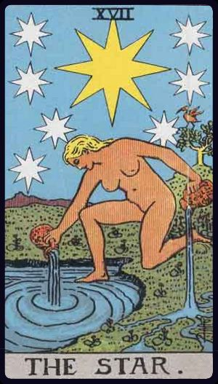
“One card stays with the deck today;
it'll be there when you come back.”
AI Tarot Projection
Open source. Runs on your own key. Stores nothing, anywhere.
The deck never tells you anything. It gets you to say it.
Try it: wyc79.github.io/ai-tarot-projection
Thank you
Notes:
Close on the product's own line: the un-earned fourth card is the retention mechanic and the emotional thesis in one sentence. Invite the audience to try a reading with their own key, or with their own physical deck.

