Slide 1
Reverse Nearest Neighbor Search On Sliding Window

Slide 2
Outline
Part 1: Motivation
Part 2: Definition
Part 3: Methods
Part 4: Experiment

Slide 3
Part 1: Motivation
Determine the “influence” of a data point on the database

Slide 4
Part 2: Definition
❶KNN(K Nearest Neighbor)
❷RNN(Reverse Nearest Neighbor)
Notes:
In this part, I will introduce 2 definitions, the KNN definition can make us understand the RNN better, so I will introduce the KNN first

Slide 5
Part 2: Definition ❶K Nearest Neighbor(KNN) Search
Step1:
Sort using the distance to
c
e
b
e
b
f
e
a
d
g
c
h
i
a
e
Nearest farest
f
d
e
g
h
Step2:
Get the nearest k tuples to
i
e
Example : k=2
e
b
f
e
a
d
g
c
h
i
Nearest farest
Notes:
For example, we want to find the tuple e’s nearest neighbor, and the parameter k is equal to 2, in the first step we compute the distance to e, and rank the tuples with the distance frome the smallest to the largest, Then we get a rank order.
In the second step, we choose the first two tuples as the nearest neighbor.

Slide 6
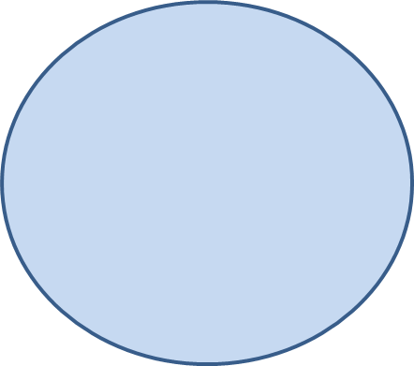
Part 2: Definition ❷Reverse Nearest Neighbor(RNN)
If point P is one of the k nearest neighbors of point Q,
then Q is the reverse nearest neighbor of P.
(It’s an inverse relation)
reverse nearest neighbor
kth
Q
K
P
K- nearest neighbor
Notes:
Definition of rnn need revise

Slide 7
Part 3
Brute force method
Minimal probing
Minimal probing +lifespan
Optimized Minimal probing +lifespan
DISP+ Minimal probing
Experiment

Slide 8
Part 3: Basic Approach Reverse Nearest Neighbor(RNN) search
Using the definition of RNN
K nearest neighbor search
Get the KNN set of Q
If P is in KNN set of Q
P is Q’s RNN
Else
P is not Q’s RNN
reverse nearest neighbor
kth
Q
K
P
K- nearest neighbor

Slide 9
Part 3: Basic Approach Properties of RNN
Tuple Q is the RNN of Tuple P
------D( , )< D( , )
Tuple Q is not the RNN of Tuple T
------D( , )> D( , )
Q
P
Q
K
Q
T
Q
K
T
reverse nearest neighbor
Q
K
kth
P
K- nearest neighbor

Slide 10


Part 3: Basic Approach (another version)
Using the distance relationship:
------when we get the KNN set, we can easily get the kth-nearest neighbor
By comparing the distance with D( , )
Tuple Q is the RNN of Tuple P
------D( , )< D( , )
Tuple Q is not the RNN of Tuple T
------D( , )> D( , )
Q
P
Q
K
T
Q
T
Q
K
reverse nearest neighbor
Q
K
kth
P
K- nearest neighbor

Slide 11
First Probing Method
Using the properties mentioned before:
Get D( , )
If D( , ) <= D( , ): is RNN of
Else is not RNN of
Q
K
Q
X
Q
K
Q
X
Q
X
T
reverse nearest neighbor
Q
K
kth
P
K- nearest neighbor

Slide 12
First Method in Sliding Window
To query tuple
Determine each tuple in the window is RNN or not:
Get the Kth-nearest neighbor of that tuple in window
Compare D( , ) and Da
If D( , ) < Da → is RNN of
If D( , ) > Da → is not RNN of
X
a
b
c
d
e
f
g
h
i
j
slide1 slide 2 slide 3 slide 4 slide 5
a
b
c
d
e
f
g
h
i
j
slide1 slide 2 slide 3 slide 4 slide 5
Da
Distance to kth-nearest neighbor
a
X
X
a
a
X
X
a
a
X
Notes:
Using the evidence
or using the knn search

Slide 13
First Method in Sliding Window
When window slides:
(old ones expire and new ones come in)
The knn of each tuple change, we need to do the same operation again in the next whole window

Slide 14


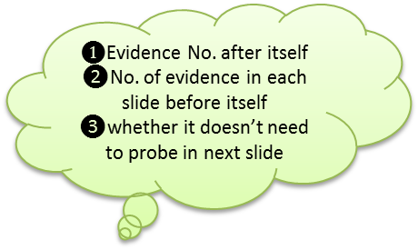
Minimal probing +lifespan Workflow :
Step1 :
What we keep:
$❶$Evidence No. after itself
❷No. of evidence in each slide before itself
❸whether it doesn’t need to probe in next slide
query
Probing order
(Lifespan optimization)
Evidence enough
Then stop
(Minimal probing)

Slide 15
Minimal probing +lifespan Workflow :
Step 2(when slide happens):
There are two different situations:
Tuples have old evidence
new
The same probing method as in step 1
If( safe) →next
Else:
Update the evidence by probing the new slide,
It may change to safe one

Slide 16
Conclusion
When we get enough evidence, we stop probing
We keep the evidence that have longer lifespan, so we avoid to update the evidence

Slide 17
Outline
Brute force method
Minimal probing
Minimal probing +lifespan
Optimized Minimal probing +lifespan
DISP+ Minimal probing
Experiment

Slide 18
Optimize Minimal probing +lifespan Workflow :
❶for the new tuples:
We keep:
The Evidence No. after itself
No. of evidence in each slide before itself

Slide 19
Optimize Minimal probing +lifespan Workflow :
❷convenience for the next window:
We keep the tuples we need to probe as:
No. of slide in window:4
This tuple get enough evidence when probing this slide
This tuple get enough evidence when probing this slide
This tuple get enough evidence when probing this slide
Or, The evidence is not enough.
(is RNN)
Continue→

Slide 20
Optimize Minimal probing +lifespan Workflow :
When slide happens:
No. of slide in window:4
This tuple get enough evidence when probing this slide
This tuple get enough evidence when probing this slide
This tuple get enough evidence when probing this slide
discard
Or, The evidence is not enough.
(is RNN)
Add tuples in new slides
No. of safe evidence<k
Probing all
No. of safe evidence>=k

Slide 21
Outline
Brute force method
Minimal probing
Minimal probing +lifespan
Optimized Minimal probing +lifespan
DISP+ Minimal probing
Experiment

Slide 22
DISP and Minimal Probing Workflow :
Window size
Step 1:
Sort the tuples in window, by computing the distance to the reference point
Reference point
nearest
farest

Slide 23
DISP and Minimal Probing Workflow (continue):
Step 2: suppose we want to get the reverse nearest neighbor of the query tuple
Reference point
No need to probe
nearest
We need to probe each point in the window, by the new order we just sorted
Stopping rule
Probing order
query
There is a stopping rule :
If the stopping rule is satisfied, we stop probing
They are not RNN of the query point
farest

Slide 24
DISP and Minimal Probing Workflow (continue):
Step 3:
suppose we are determining whether a certain point is the RNN of that query point
We need to collect the evidence, by a new order, we stop until we collect enough evidence
Minimal probing
9
8
7
Using this order, we can find the evidence faster , then determined earlier
5
query
3
1
2
determining
4
6

Slide 25
DISP and Minimal Probing Conclusion
There are two early terminations:
→One is using the stopping rule of the DISP
→The other is the minimal probing optimization

Slide 26
Outline
Brute force method
Minimal probing
Minimal probing +lifespan
Optimized Minimal probing +lifespan
DISP+ Minimal probing
Experiment

Slide 27
Experiment
time
Minimal probing + lifepan
Brute force
Minimal probing
Minimal probing + lifespan (updated)
Disp + Minimal probing
Window number

Slide 28
Without Brute Force
time
Minimal probing + lifepan
Minimal probing
Minimal probing + lifespan (updated)
Disp + Minimal probing
Window number

