Slide 1









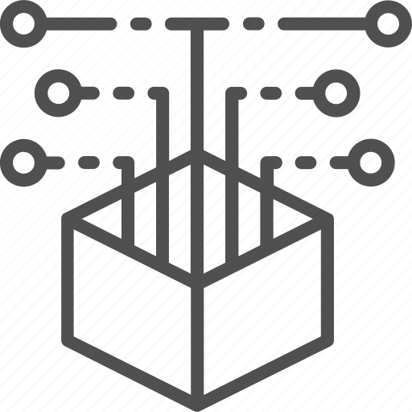
















Step 1: Prompt Synthesis and Optimization
Step 3: Summary Encoder Pretraining
Prompt Optimization
Initial Prompt Synthesis
Synthesized Prompts
As a helpful AI assistant training for prompt optimization, you are asked to optimize the following prompt:
<PROMPT>
+
Alice, a binary reverse engineering professional, was given the following prompts: <PROMPT>
Here are Alice’s responses:
# Decompiled Code Example 1
>> Input:
<Code 1>
>> Output:
<Ground Truth Summary 1>
…
# Decompiled Code Example N
>> Input:
<Code N>
>> Output:
<Ground Truth Summary N>
What’s the best fit for <PROMPT>？
Reverse engineer the code and provide a high-level explanation of its functionality.
….
$$w_{1}$$
$$e_{1}$$
$$w_{3}$$
+
$$e_{3}$$
$$w_{1}$$
$$w_{2}$$
$$w_{3}$$
$$w_{4}$$
Human Generated Prompts
❹
+
$$e_{2}$$
As a helpful AI assistant for binary code understanding, you are given a <BINARY-FORMAT> code, Can you summarize it in human language?
….
Binary Code Summarization
$$w_{1}$$
$$w_{2}$$
$$w_{3}$$
$$w_{4}$$
+
$$e_{4}$$
❶
$$w_{2}$$
+
$$e_{2}$$
Code Samples
LLMs
Summaries
$$w_{4}$$
+
$$e_{4}$$
❷
❺
Prompt Variant Generation
Prompt Evaluation
Summary Encoder
Produce a different version of the subsequent instruction while retaining its semantic significance:
<PROMPT>
❸
Step 4: Testing and Semantic Evaluation
Summaries and Ground Truth
Evaluator
Selected Prompts
Add Selected Prompt
Test Code Sample
LLM
Step 2: Binary Dataset Construction
Ground Truth Comment
LLM-generated
Summary
❻
Compilation
Stripping
Code Format | Source code Decompiled code IR code Assembly code Machine Code
Architecture | X86, x64, ARM, MIPS
Optimization | O0, O1, O2, O3
Decompiler | Ghidra, Hex-rays, Angr
Summary Encoder
Summary Encoder
Open-sourced
Repositories
Binaries w/
Debugging Info
Stripped Binaries
❽
❾
[0.12, -1.11, …, 0.23]
[0.12, -1.11, …, 0.23]
❼
Extraction
❾
Semantic Embedding
Semantic Embedding
❽
❾
Code Dataset with
Diverse Representations
Similarity Function
Ground Truth Comment
Comment-Address Alignment
Binary Analyzer
Semantic Similarity Score

