Slide 1
CSC518 - OO Programming with Java
Dr. Yurong (Kevin) Xu
The PPT theme is created by Prof. Cornel Pokorny

Slide 2
Who am I
I am Kevin Xu
Got Ph.D in CS in USA. Got B.A. M.S. degree from China.
Can use almost all the traditional languages.
Can program code from server to embedded chips.

Slide 3
Lecture 1
1. Syllabus
2. Java Basic
3. OOP Basic
4. Home assignment

Slide 4
1. Syllabus of CSC518
a. Course Name: CSC518 - OO Programming with Java
b. Course description:
c. A Computer is required, (Mac, Linux, Windows/Cygwin)

Slide 5
1. Syllabus of CSC518
d. Textbooks:
  Official Java Specifications. (we will based on Java SE 5.0 and above)
  http://docs.oracle.com/javase/specs/
  https://docs.oracle.com/javase/specs/jls/se5.0/jls3.pdf
  Some other textbooks, could download from internet:
  Effective Java, by Joshua Bloch
  The Java Programming Language, By Ken Arnold, James Gosling, David Holmes
  Think Java, by Allen B. Downey
  Others

Slide 6
1. Syllabus of CSC518
e. Grading
  The MidTerm/final exam will count for 40%
  Assignment/Projects will count for 60%
f. Grade Calculation (*):
    90 – 100: A, which includes A+, A or A-
    80 - 89: B, which includes B+, B or B-
    70 – 79: C, which includes C+, C or C-
    60 - 69: D, which includes D+, D or D-
    59 or less: F
g. Course Schedule
Weekends: 6/4-6/6, 7/2 - 7/3, 7/30 - 7/31 (Final on last day)
* The final grading calculation will be generated by EMS automatically.

Slide 7
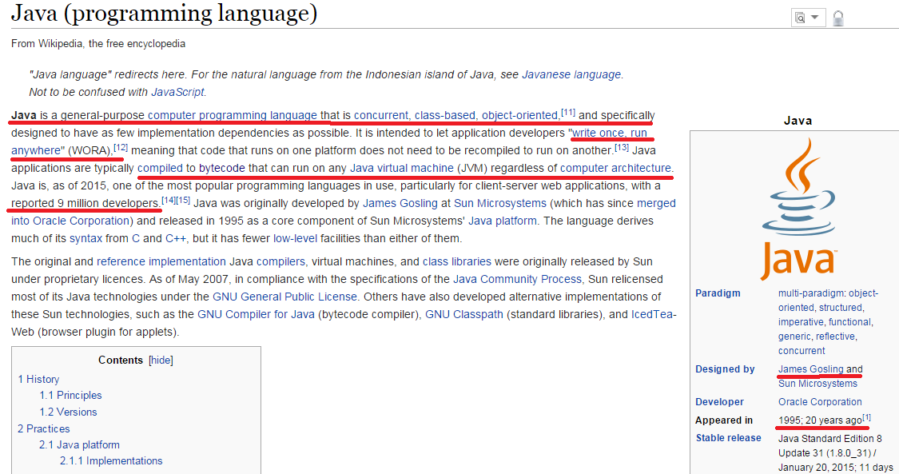
2. Java Basic
What is java?

Slide 8
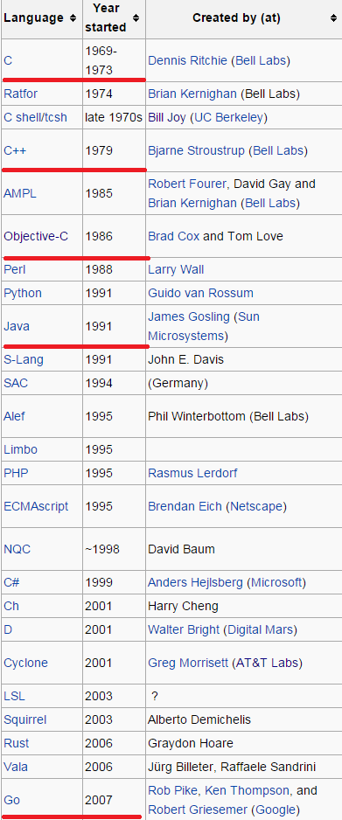
2. Java Basic
Where Java comes from?
Notes:
Developed by Sun Microsystems (James Gosling)
A general-purpose object-oriented language
Based on C/C++
Designed for easy Web/Internet applications
Widespread acceptance
Developed by Sun Microsystems (James Gosling)
A general-purpose object-oriented language
Based on C/C++
Designed for easy Web/Internet applications
Widespread acceptance

Slide 9
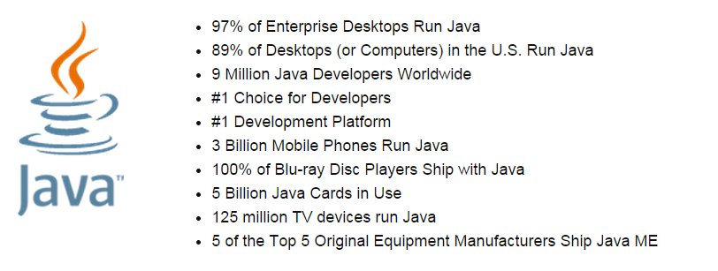
2. Java Basic
What Java can do?

Slide 10
2. Java Basic - Features
Simpler
  Less language constructs than C/C++ have
Different to C/C++
  No direct memory access (pointers)
  automatic garbage collection
  rich pre-defined class library
Object oriented
  OOPL
  Encapsulated functions with data
  almost all data types are objects (such as files, strings, etc.)
  potentially better code organization and be reusable

Slide 11
2. Java Basic - Features
Distributed
  Java is designed to support various levels of network connectivity. Java applications are network-supported, TCP/IP support is built into Java class libraries.
  Java can open and access remote objects over the Internet.
Interrupted
  Java is compiled to bytecodes, which are interpreted by a JVM.
  the compiled byte-codes are platform-independent
  java compiler generate bytecodes, not native machine code
  java byte codes are translated at the running time to machine readable instructions in a target machine.

Slide 12
2. Java Basic - Features
Reliable
  Java is strongly typed language, eliminates certain types of programming errors. which allows extensive compile-time error checking.
  It does not support memory pointers, which eliminates the possibility of overwriting memory and corrupting data.
  automatic memory management eliminates memory leaks.
Secure
  Java is designed to be secure in a networked environment.
  The JVM uses a bytecode verification process to ensure that code loaded over the network does not violate Java security constraints.
  Without JVM help, Java code can’t access hardware.

Slide 13
2. Java Basic - Features
Multithread
  multiple concurrent threads of executions can run simultaneously
  utilizes a sophisticated set of synchronization primitives to achieve this
Dynamic
  libraries can easily add new methods and instance variables without any effect on their clients
  interfaces promote flexibility and reusability in code by specifying a set of methods an object can perform, but leaves open how these methods should be implemented
  class types are checked at runtime

Slide 14
2. Java Basic – Disadvantages
Slow
No pointers
tree->leaf vs. tree.leaf
No enumeration types
No local constants.

Slide 15
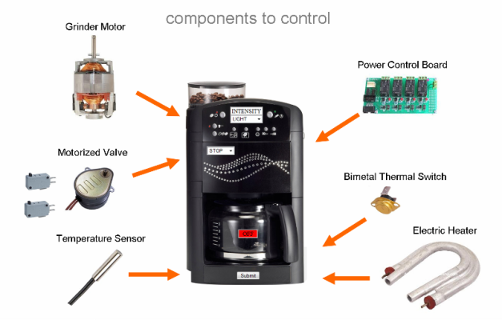
2. Java Basic – How to run Java

Slide 16
2. Java Basic – Install Java Environment
Could be installed in different platform
Mac, Linux, Windows,
Verify whether it is correctly installed?
Java –version
Javac –version
Java –help

Slide 17
2. Java Basic – HelloWorld
Open an editor, and save it as HelloWorld.java
  Example Code: HelloWorld.java
  /**
  * The HelloWorld class
  * prints "Hello World!" to the standard output
  */
  public class HelloWorld {
  public static void main(String[] args) {
  // Display "Hello World!"
  System.out.println("Hello World!");
  }
  }

Slide 18
2. Java Basic – Input
Open an editor, and save it as HelloInput.java
  import java.util.Scanner;
  /**
  * input class
  */
  public class HelloInput {
  public static void main(String[] args) {
  Scanner keyboard = new Scanner(System.in);
  System.out.println("enter an integer");
  int myint = keyboard.nextInt();
  }
  }

Slide 19
2. Java Basic – Variables
Primary
  built-in
  boolean either TRue or false
  char 16-bit Unicode UTF-16 character (unsigned)
  byte 8-bit integer (signed)
  short 16-bit integer (signed)
  int 32-bit integer (signed)
  long 64-bit integer (signed)
  float 32-bit floating-point (IEEE 754)
  double 64-bit floating-point (IEEE 754)
  variable names can be

