Slide 1
CSC518 - OO Programming with Java
Dr. Yurong (Kevin) Xu
The PPT theme is created by Prof. Cornel Pokorny

Slide 2
Schedule
1. Mid-term
2. Project

Slide 3
Mid-term
Mid-term: Sunday (9:30-11:30am July 3rd)
Open books
Include choice, concepts, coding/debugging and programming questions
Submission for coding question:
Submit the source & log files to EMS system,
If you have time you can show the result to me.

Slide 4
Mid-term
Mid-term: Sunday (9:30-11:30am July 3rd)
Open books
Include choice, concepts, coding/debugging and programming questions

Slide 5
Lecture 3: Abstraction, Encapsulation, Inheritance and Polymorphism (APIE)
Abstraction: refers to the act of representing essential features without including the background details or explanations.
Encapsulation: is a technique used for hiding the properties and behaviors of an object and allowing outside access only as appropriate.
Inheritance: is the technique by which objects of one class acquire the properties of objects of another class.
Polymorphism is: a characteristic of being able to assign a different meaning or usage to something in different contexts
Notes:
Last class, we talk about node class,
we talked about SuperClass vs. SubClass:

Slide 6
Example: a chain of derived classes
If we have a class of “person”, How can we define a class of “student”:
Person -> student-> graduate student -> ph.d student: (example Lec2-0.java, write a Lec3-0.java)
OOP usage:
1. Reuse the data,
2. reuse the possible print function (example)
Notes:
Last class, we talk about node class,
we talked about SuperClass vs. SubClass:

Slide 7
Interface
1. Interfaces:
An Interface is like a class with certain restrictions: It has only constant data members (if at all) and its methods are all non-implemented, i.e. they are declared but have no method body.
The class that derives from the Interface must implement all methods of the interface: it has to write them WITH method body.
Notes:
Last class, we talk about node class,
we talked about SuperClass vs. SubClass:

Slide 8
Interface
Interface is similar to Class:
1. contains data and methods,
2. source file in with a .java, bytecode in a .class.
B. Interface is different to Class:
1.cannot instantiate an interface.
2. An interface does not contain any constructors.
3. All of the methods in an interface are abstract.
Example: Source code Lec3-2.java, Interface could be extended Lec3-3.java
Notes:
Last class, we talk about node class,
we talked about SuperClass vs. SubClass:

Slide 9
Use a predefined Interface from Java.lang
Use the Interface Comparable<T>. This is a so called type template, for T you can insert any type. Add Interface Comparable<Person> to the definition of the Person class in the package people.
Example: Lec3-8.java

Slide 10
Vector Data structures in Java
Vector, (Lec3-4.java)

Slide 11
Interface usage - Enumeration
http://docs.oracle.com/javase/7/docs/api/java/util/Enumeration.html
public interface Enumeration<E>
Example: Lec3-3.java

Slide 12
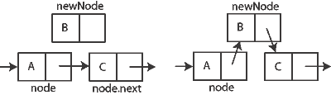

Data structure: single linked list
1. Arrays: most important data structure in programming. (and how to traverse it with loop) Lec3-5.java, Lec3-6.java Lec3-7.java
2. single linked list (write a Lec3-1.java)
Notes:
Last class, we talk about node class,
we talked about SuperClass vs. SubClass:

Slide 13
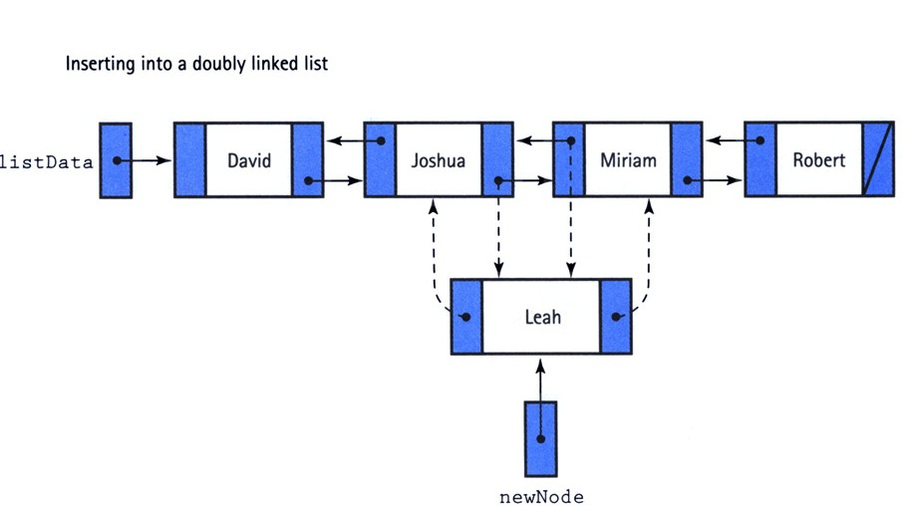
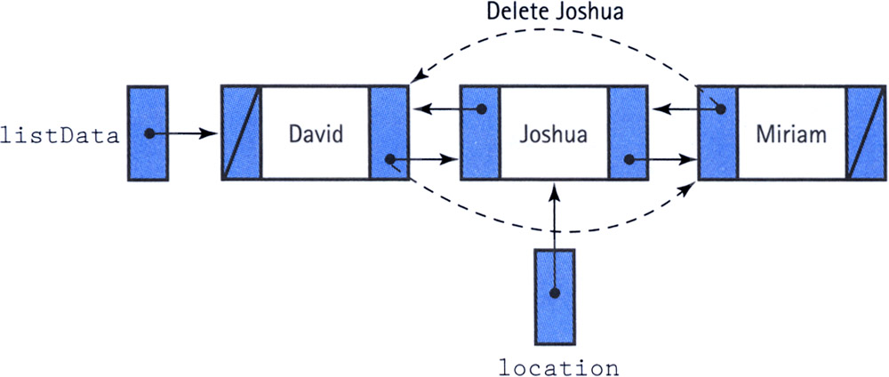
Data structure: single linked list
3. Double-linked list (write a Lec3-1.2.java)
Notes:
Last class, we talk about node class,
we talked about SuperClass vs. SubClass:

Slide 14
StringTokenizer
Reading mixed integers and strings from the keyboard. With the Scanner you have to know beforehand, what is coming on input. With a Stringtokenizer you can find tokens in a String. Tokens are usually separated by spaces in the String. Read the whole string, take its tokens, check them and if the first character is a number convert it as an integer, otherwise leave it as a String.
String v = scanner.nextLine();
StringTokenizer tok = new StringTokenizer(v);
Use the methods: hasMoreTokens() and nextToken(); to take the tokens off the
String. The tokens are all of type String.
Work with internet and predefined classes.
Let us look up the String class in the Java documentation (internet or book)
http://docs.oracle.com/javase/6/docs/api/java/lang/String.html

Slide 15
Checking characters
Get the first character of the token, check if the first character is a digit. Use the class Character
char c = token.charAt(0);

Slide 16
Project
I. Project for Java course:
II. Form teams of 1-2 students
III. Potential project:
1. Java with social networks:
Using Java library to access meetup API:
2. java with Internet of Things:
Design a smart home project for a house. should include family members as well as sensors, buzzers inside the house.
3. Other project
your named projects are welcomed.

Slide 17
Project
VI. Requirements:
4.1. need to be have simple design doc, (>= 1page)
4.2. Java-based,
4.3. need to have some important library be used, such threat, timer etc...
4.4. need to include >= 5 classes definitions.
Project abstract is due tomorrow, you can talk with me today/tomorrow.
have project name + project abstract and team ready.
More discussion for tomorrow.

Slide 18
Assignment 4

