Slide 1
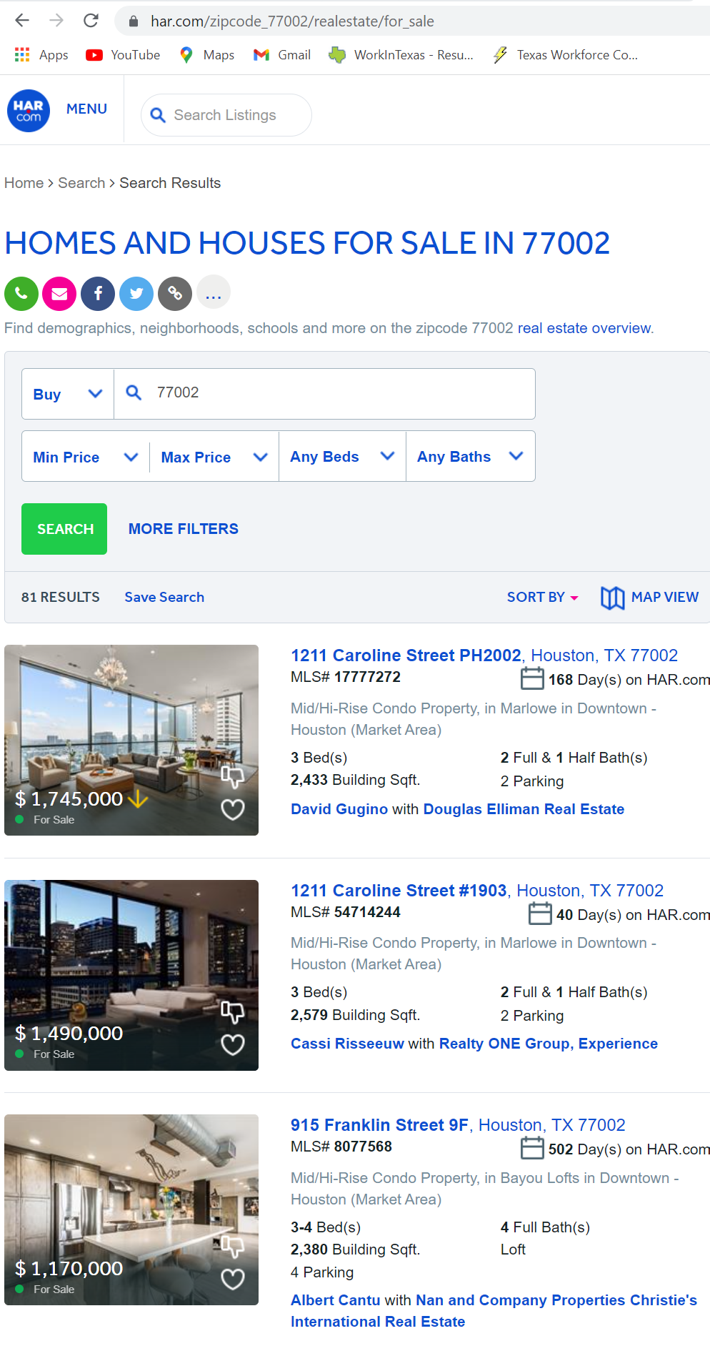
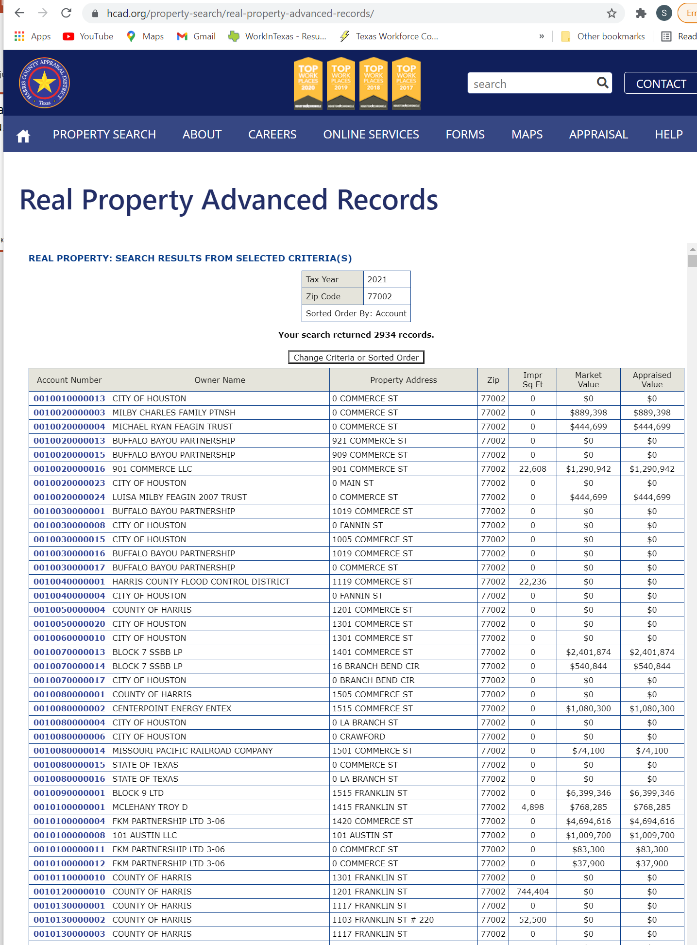
Houston Real Estate – Tax value Versus Sales Price
Stanislav Kuzmin, Henry Wycislo
?

Slide 2


Questions Asked and Plan
Questions:
When people sell the house, do they price it above or below the tax appraisal value?
Does it depend on the area ?
Plan:
Download reals estate tax appraisal database from Harris County Appraisal District www.hcad.org
Scrape listings from Houston Association of Realtors http://www.har.com for all Harris county zip codes
Match sales listings to the values extracted from real property tax database

Slide 3
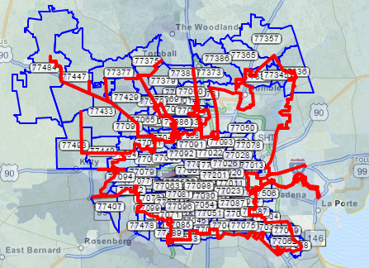

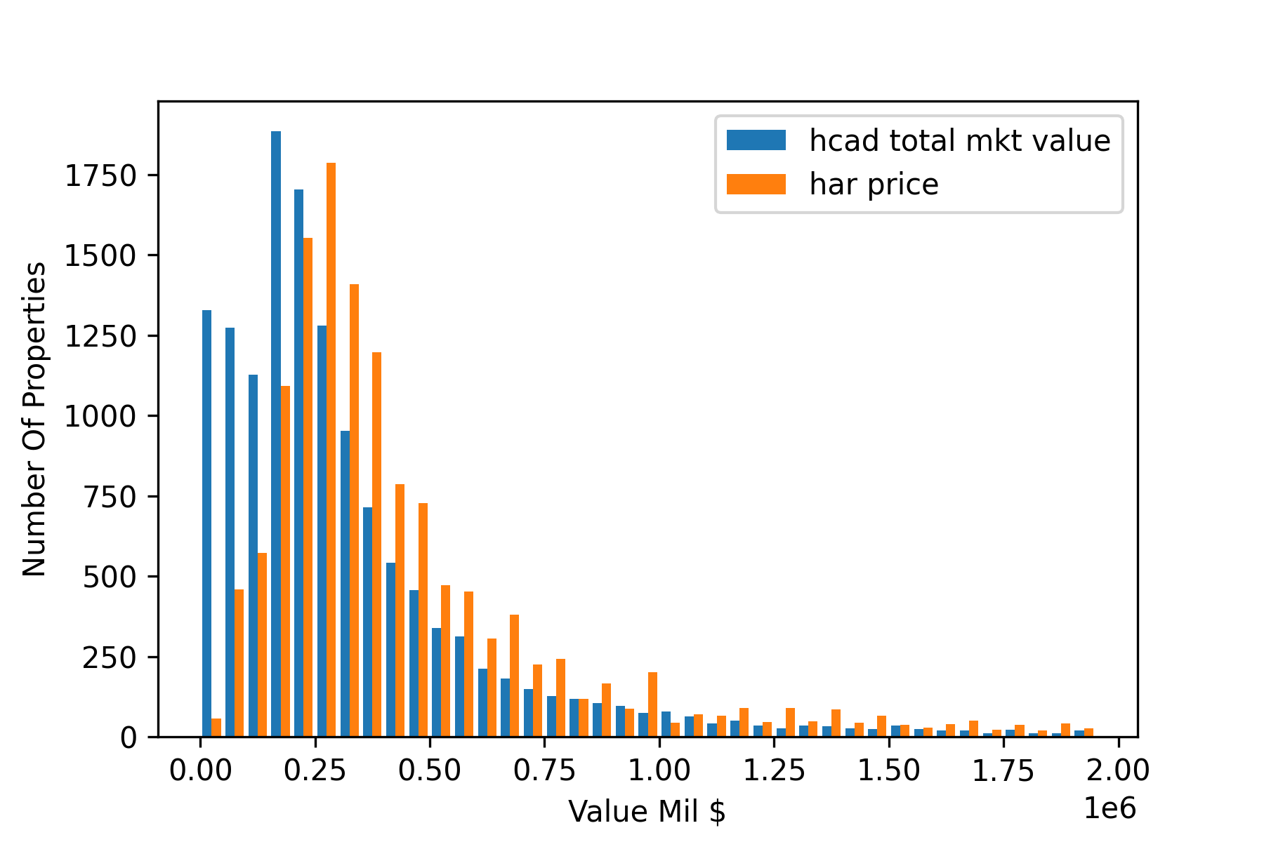




Workflow
List of Haris County ZIP Codes
Download data from HCAD as flat file (800+mb)
Search properties in a ZIP
Cycle through search pages for particular ZIP
Scrape to dataframe
Pull data into a Pandas dataframe:
Delete columns
Clean
Cross-match properties on the market with properties in the HCAD TAX database using SQL query
Plot comparison histograms and crossplots
Parse addresses house number, street name, apartment and zip
Load data into PostgreSQL database
Load data into PostgreSQL database

Slide 4
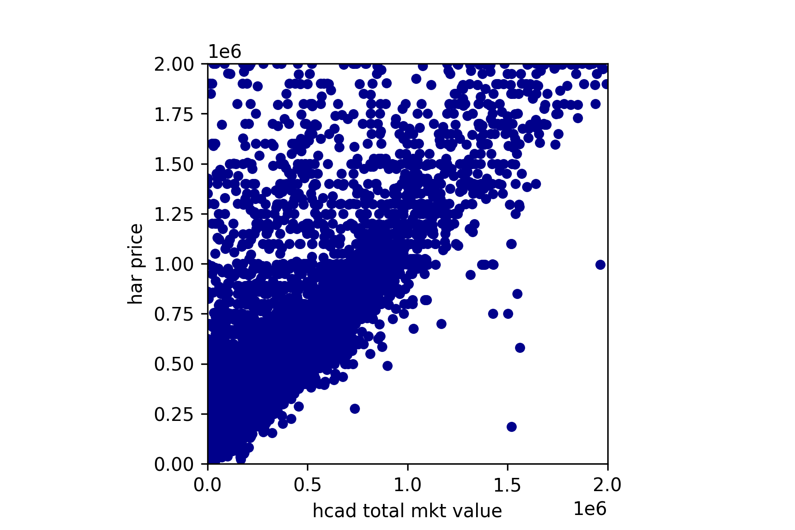
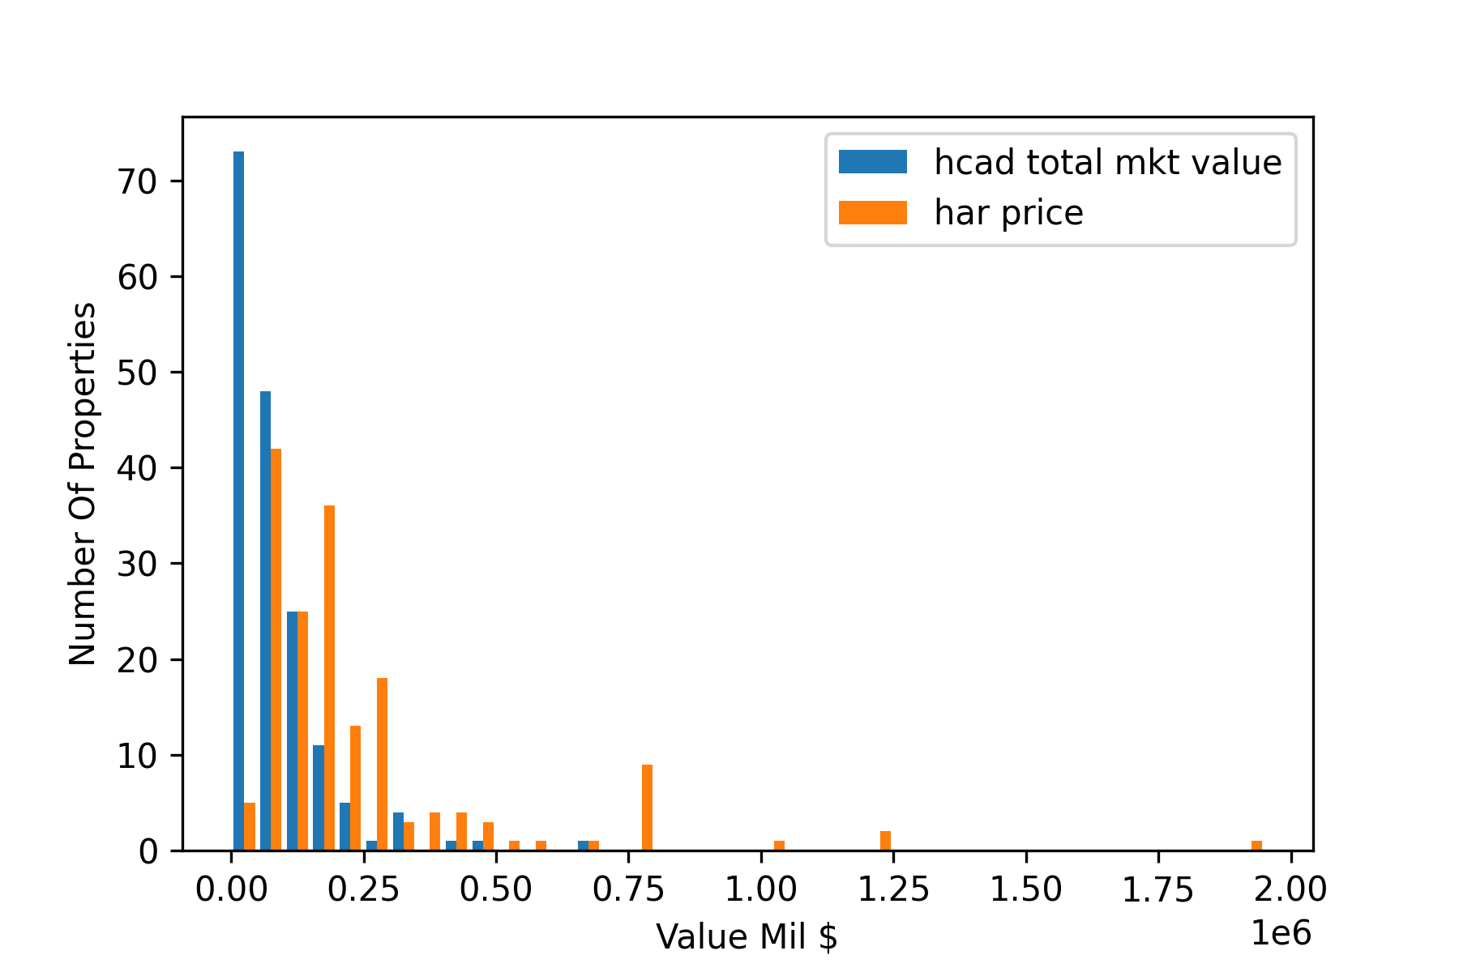
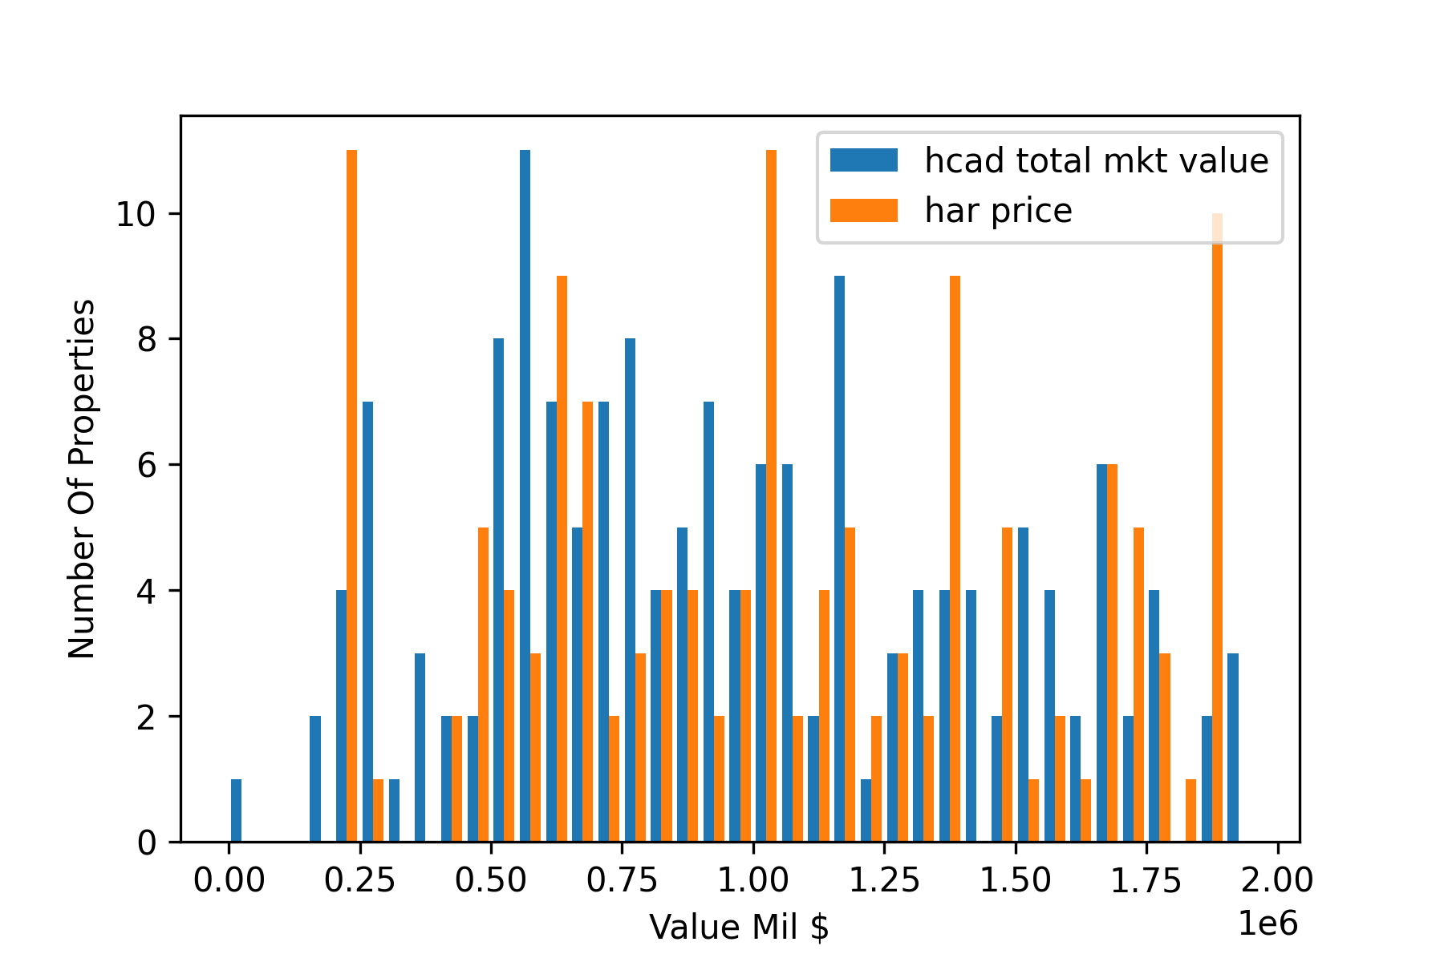
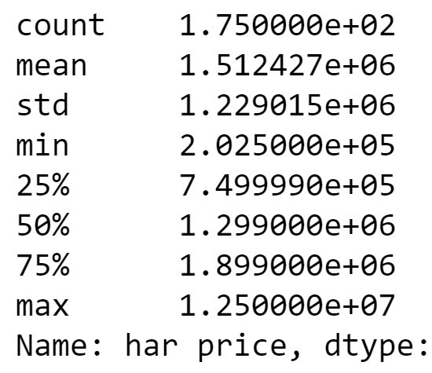
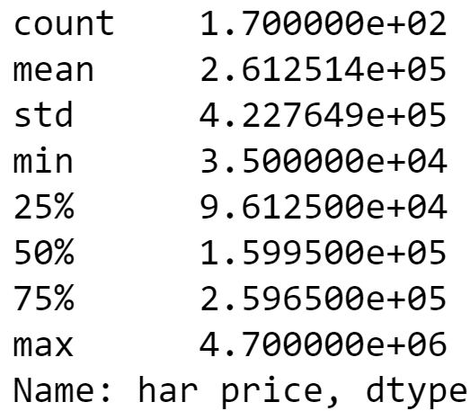
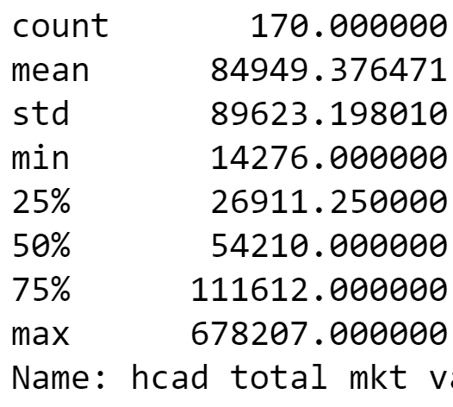
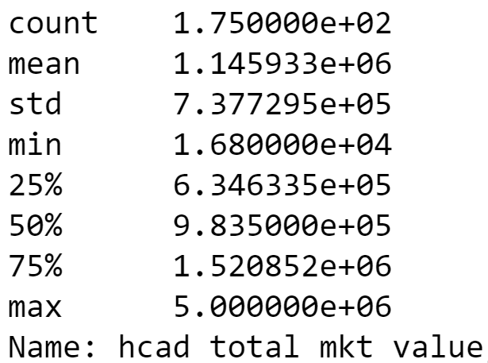
Results and conclusions
Overall sellers value their houses higher than the tax value
Both low and high price zip codes display the same trend
Overall advertising price is close to tax value, but there are more optimists than pessimists that skew the distribution towards higher prices
Optimists
Pessimists
Low price ZIP 77026
High price ZIP 77005

