Slide 1
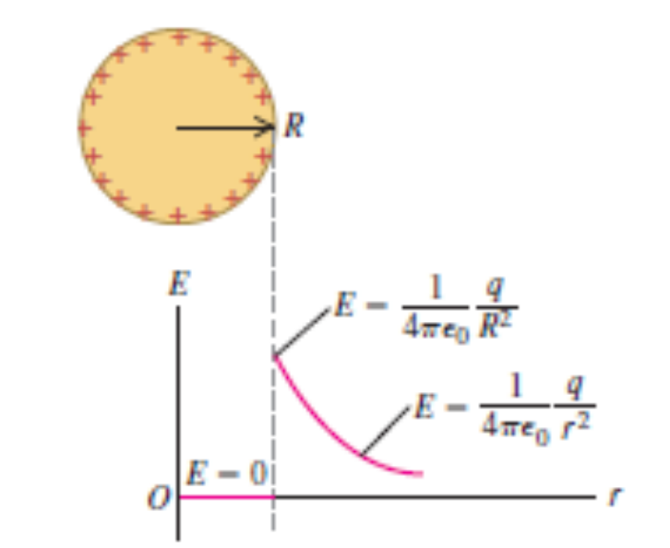
Chapter 22
Gauss’s Law

Slide 2
Goals for Chapter 22
  To use the electric field at a surface to determine the charge within the surface
  To learn the meaning of electric flux and how to calculate it
  To learn the relationship between the electric flux through a surface and the charge within the surface
  To use Gauss’s law to calculate electric fields
  To learn where the charge on a conductor is located

Slide 3
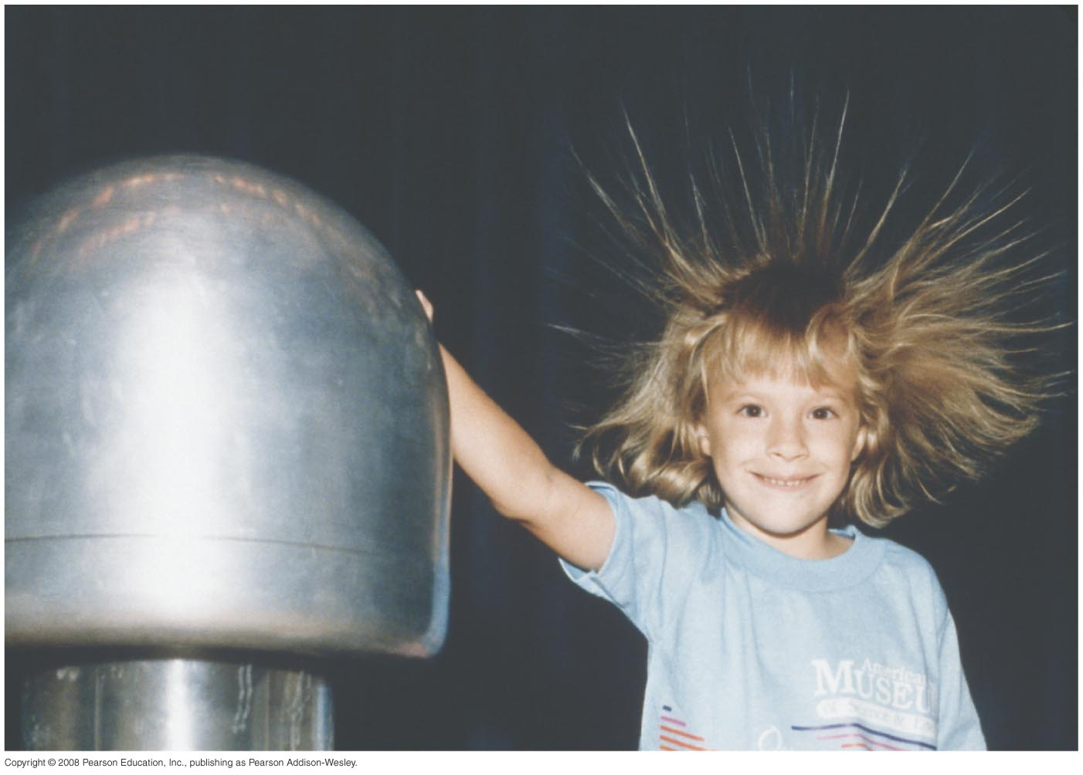
Introduction
  Would the girl’s hair stand on end if she were inside the metal sphere?
  Symmetry properties play an important role in physics.
  Gauss’s law will allow us to do electric-field calculations using symmetry principles.

Slide 4
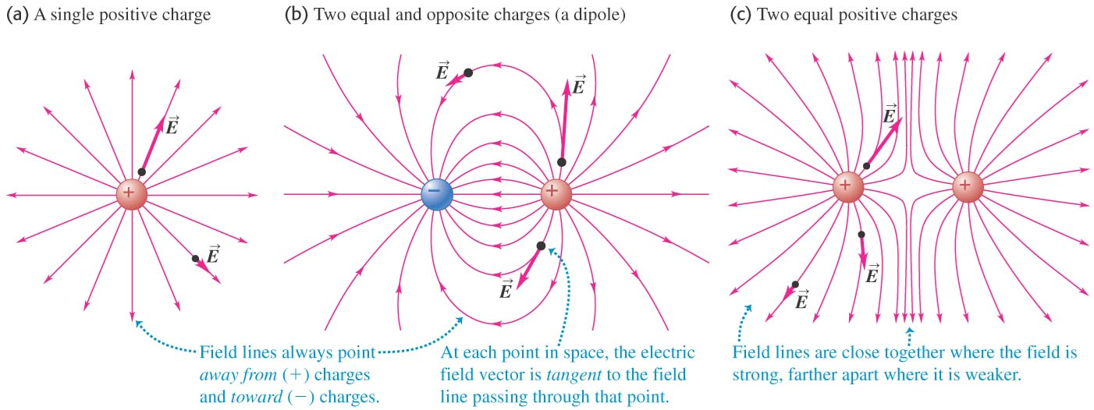
Charge and electric flux
  Positive charge within the box produces outward electric flux through the surface of the box, and negative charge produces inward flux. (See Figure 22.2 below.)

Slide 5
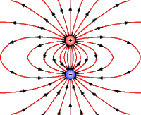

Slide 6
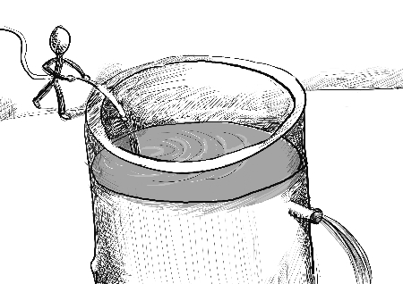

Slide 7


Slide 8
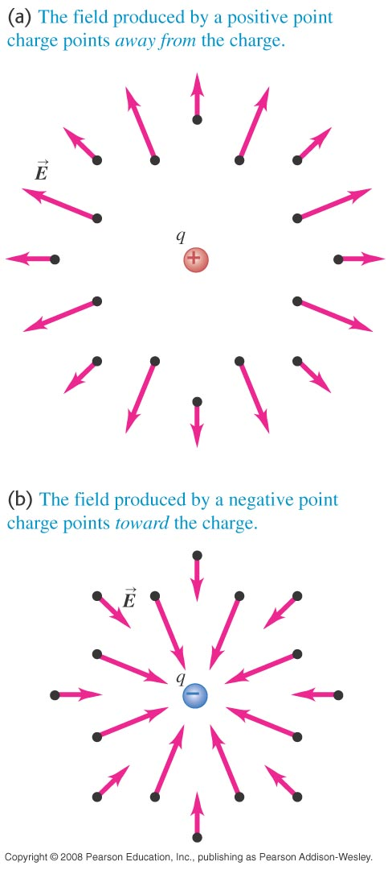



Slide 9


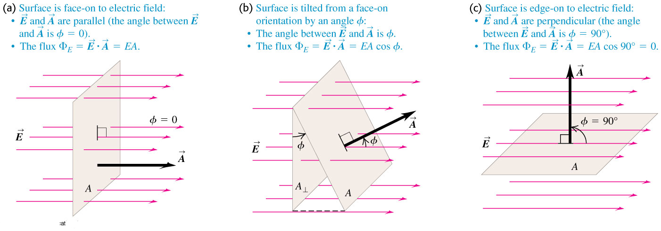
Calculating electric flux
  Follow the discussion in the text of flux calculation for uniform and nonuniform fields, using Figure 22.6 below.

Slide 10
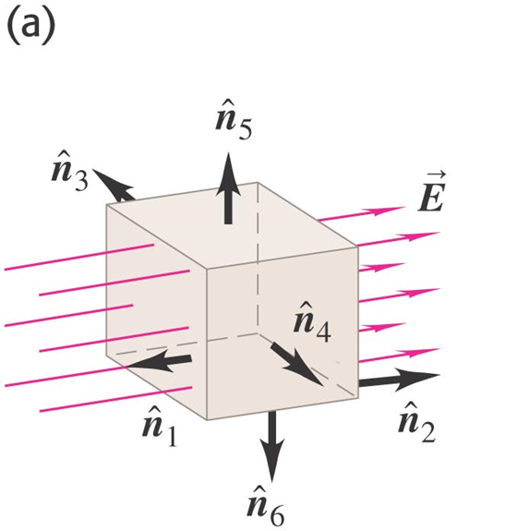

Electric flux through a box

Slide 11
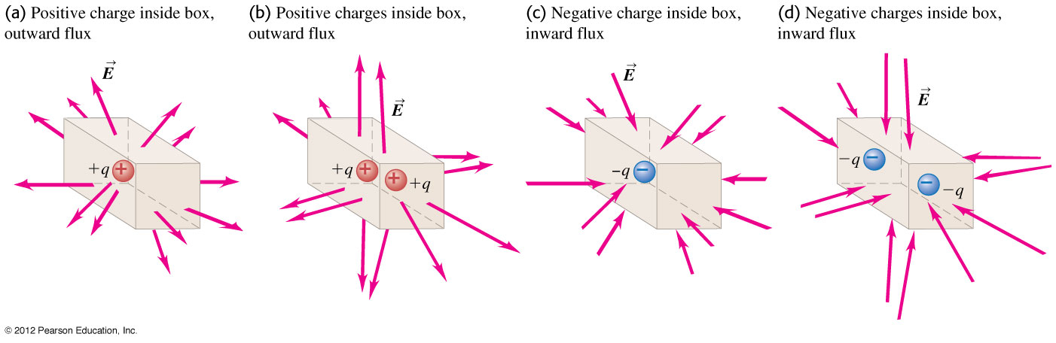

Charge and electric flux
  Positive charge within the box produces outward electric flux through the surface of the box, and negative charge produces inward flux. (See Figure 22.2 below.)

Slide 12
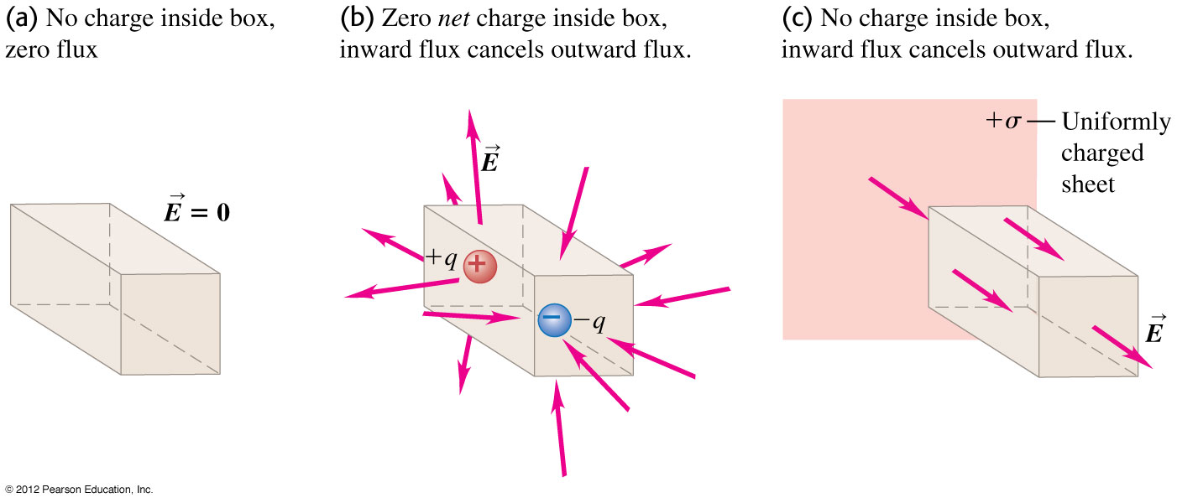
Zero net charge inside a box
  Figure 22.3 below shows three cases in which there is zero net charge inside a box and no net electric flux through the surface of the box.

Slide 13
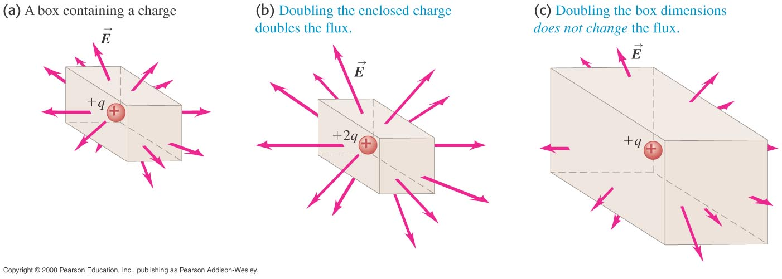
What affects the flux through a box?
  As Figure 22.4 below shows, doubling the charge within the box doubles the flux, but doubling the size of the box does not change the flux.
  Follow the discussion of charge and flux in the text.

Slide 14
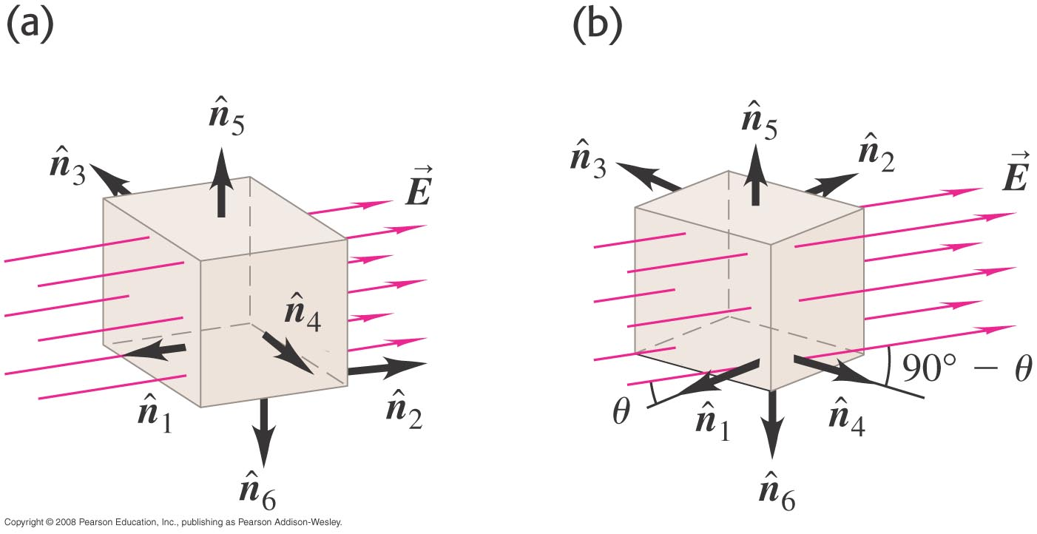

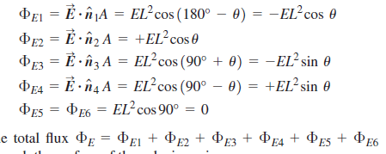

Electric flux through a cube

Slide 15
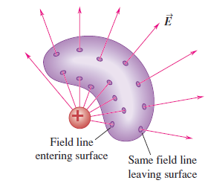
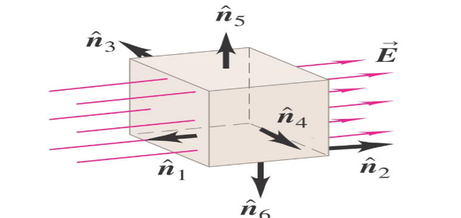
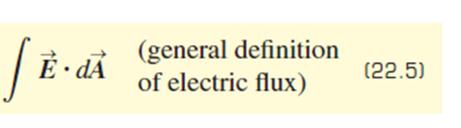

Electric flux through a cube

Slide 16
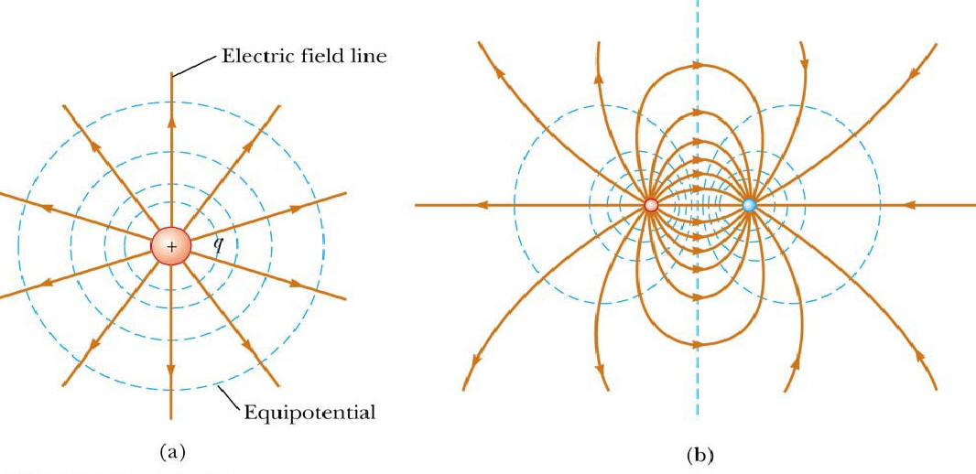
What affects the flux through a box?

Slide 17
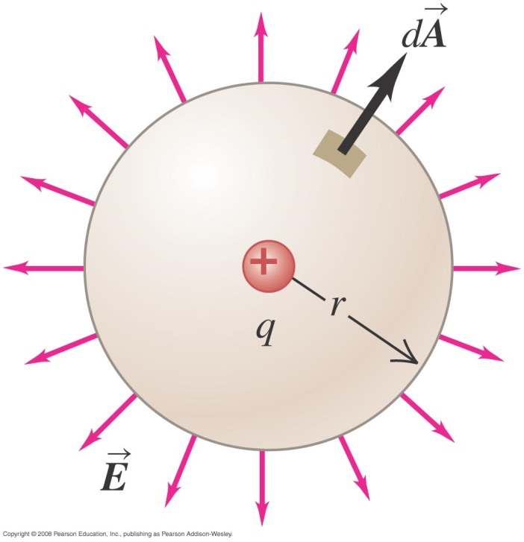
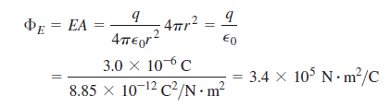
Electric flux through a sphere

Slide 18

Electric flux through a sphere
?

Slide 19
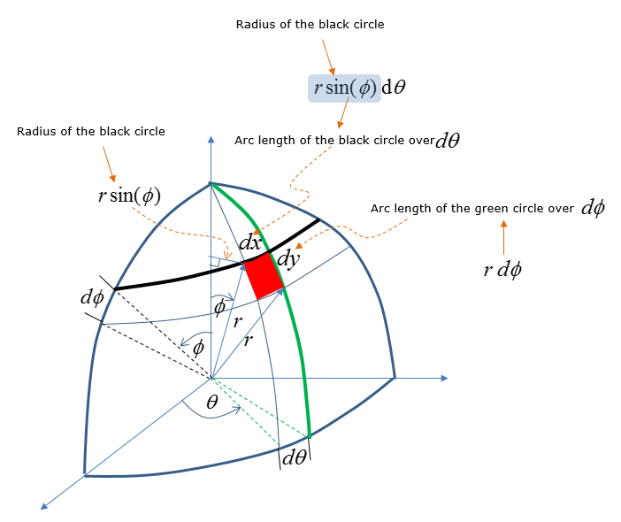

Electric flux through a sphere

Slide 20
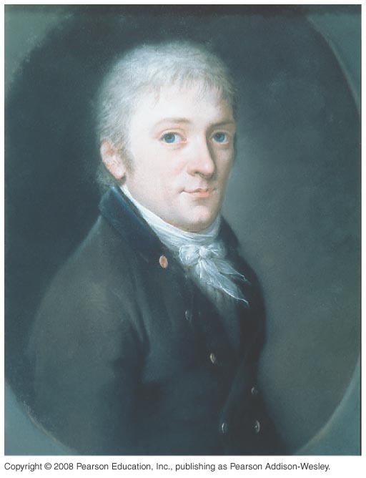
Gauss’s Law
  Gauss’s law is an alternative to Coulomb’s law and is completely equivalent to it.
  Carl Friedrich Gauss, shown below, formulated this law.

Slide 21
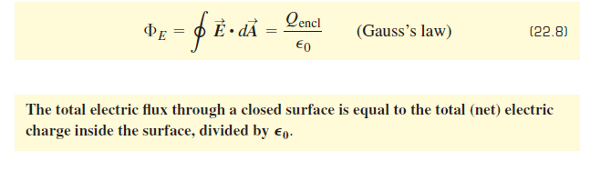
Gauss’s Law

Slide 22
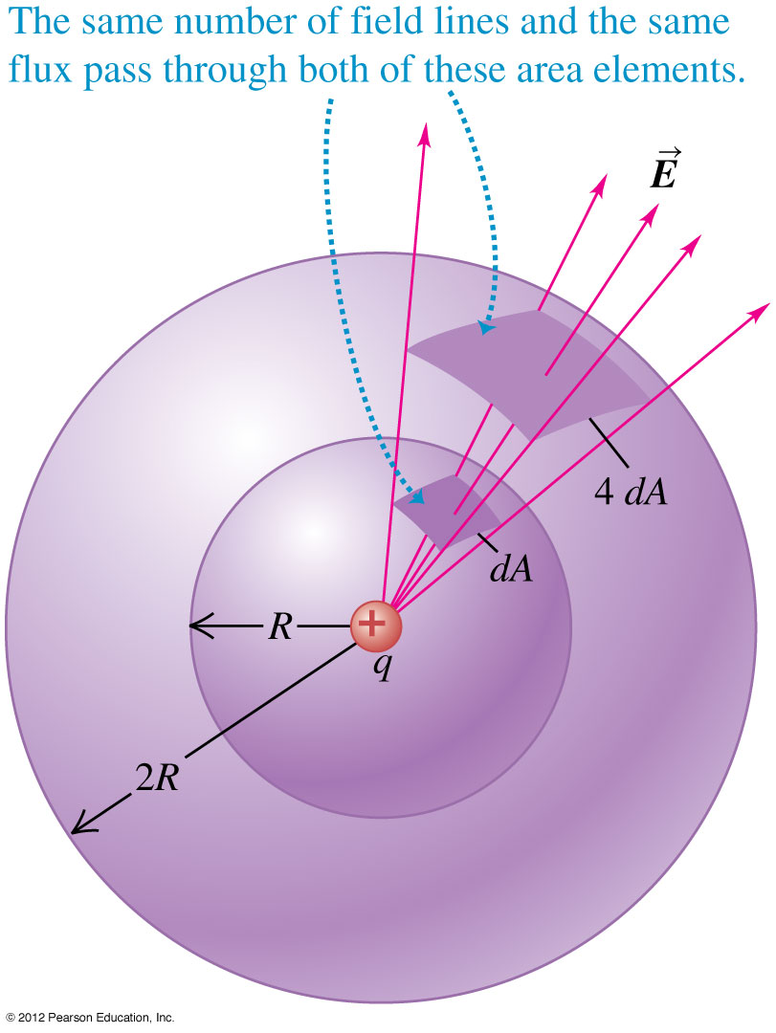

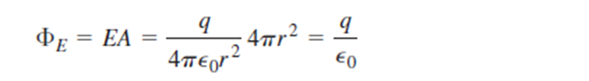
Point charge centered in a spherical surface
  The flux through the sphere is independent of the size of the sphere and depends only on the charge inside. Figure 22.11 at the right shows why this is so.
Radius

Slide 23
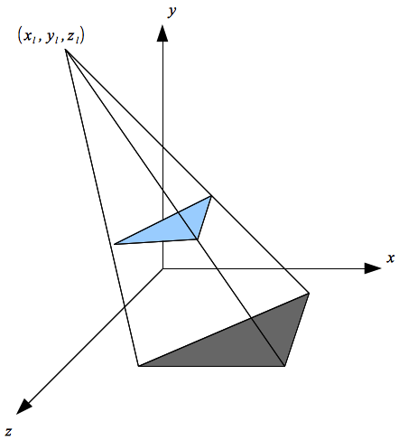
Point charge centered in a spherical surface
  The flux through the sphere is independent of the size of the sphere and depends only on the charge inside. Figure 22.11 at the right shows why this is so.
Radius
Projection area

Slide 24
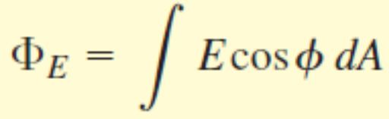
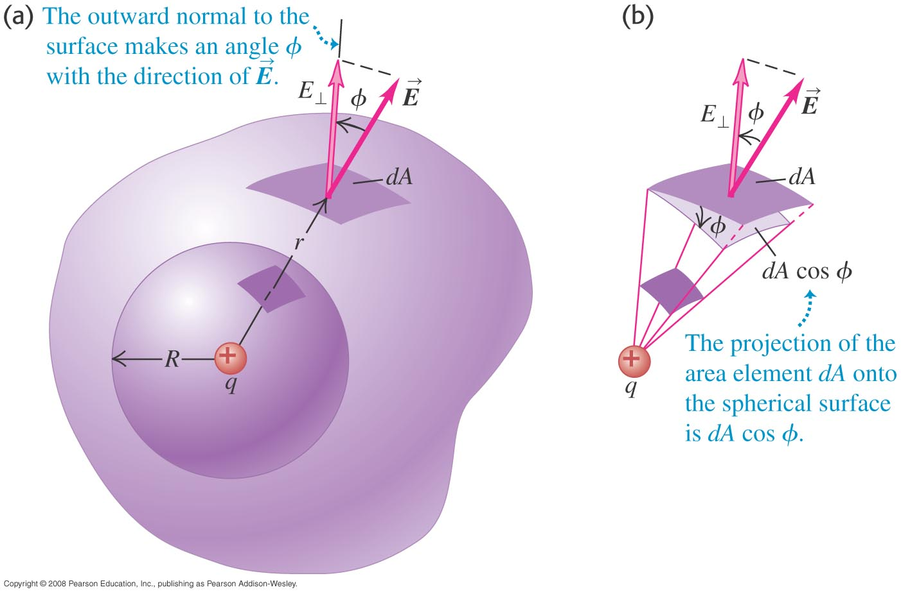
Point charge inside a nonspherical surface
  As before, the flux is independent of the surface and depends only on the charge inside. (See Figure 22.12 below.)

Slide 25
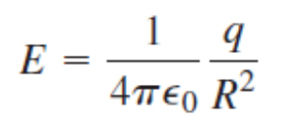
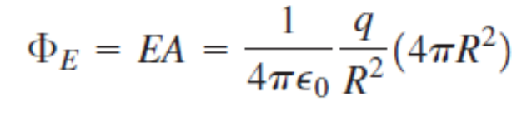
Point charge inside a nonspherical surface
  As before, the flux is independent of the surface and depends only on the charge inside. (See Figure 22.12 below.)

Slide 26
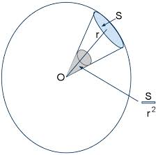
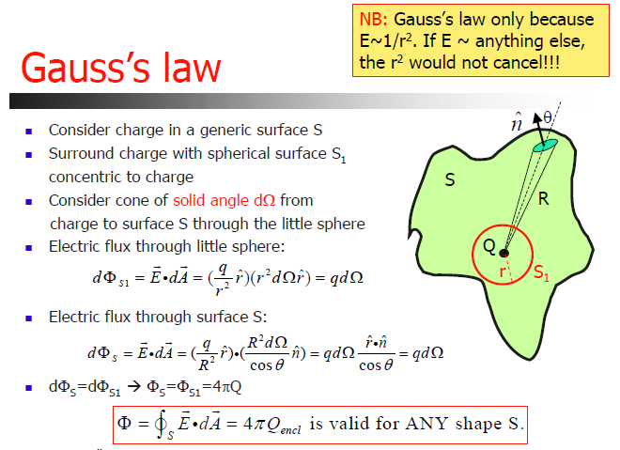

Slide 27
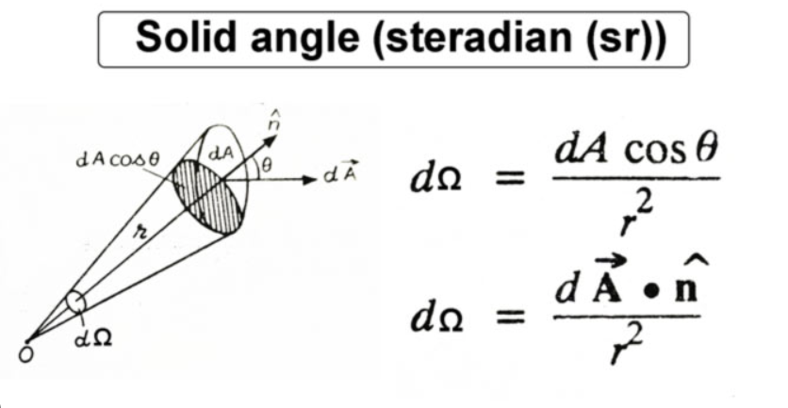

Slide 28
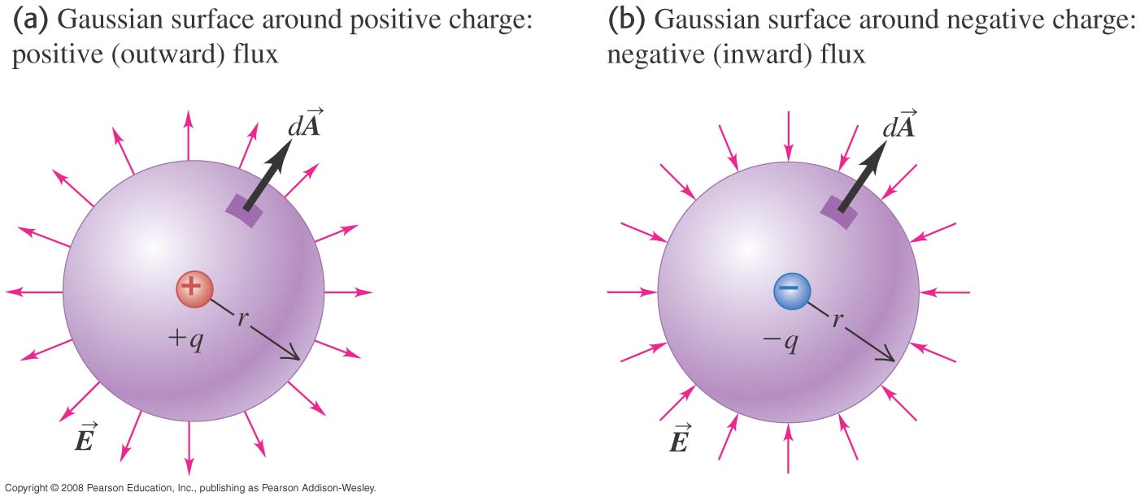

Positive and negative flux
  Figure 22.14 below shows that flux is positive if the enclosed charge is positive, and negative if the charge is negative.

Slide 29
Gauss’s Law
  Gauss’s law is an alternative to Coulomb’s law and is completely equivalent to it.
  Carl Friedrich Gauss, shown below, formulated this law.

Slide 30

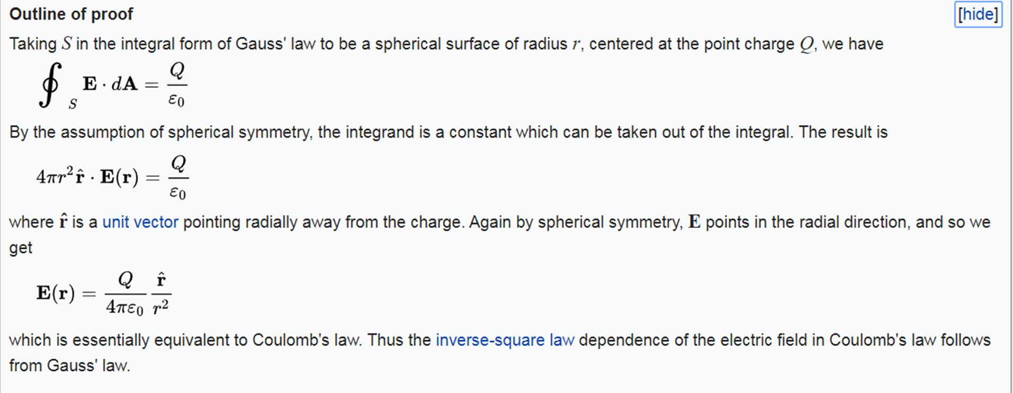

Slide 31



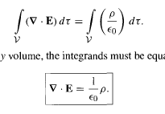

Slide 32
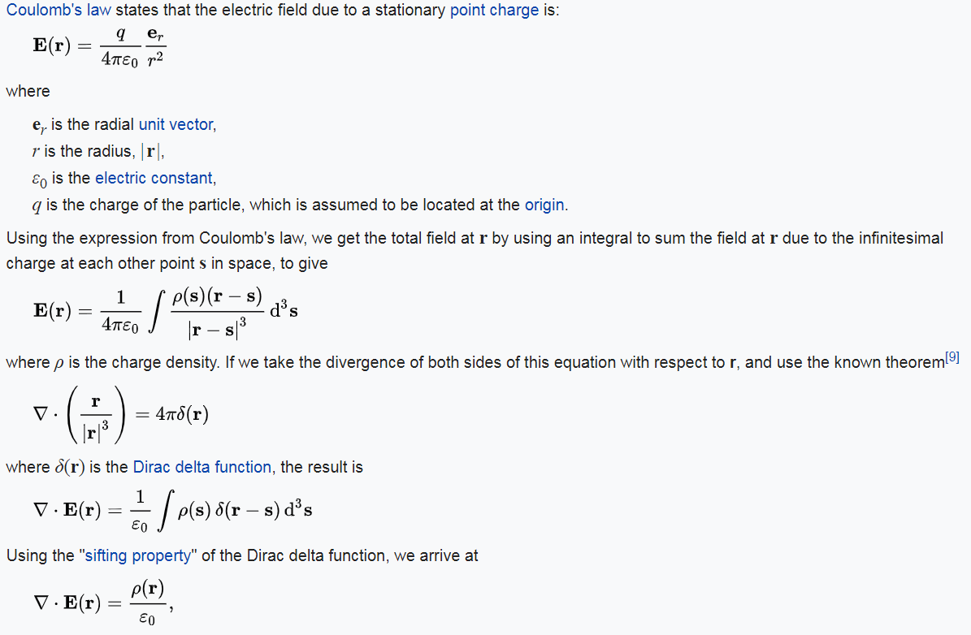

Slide 33
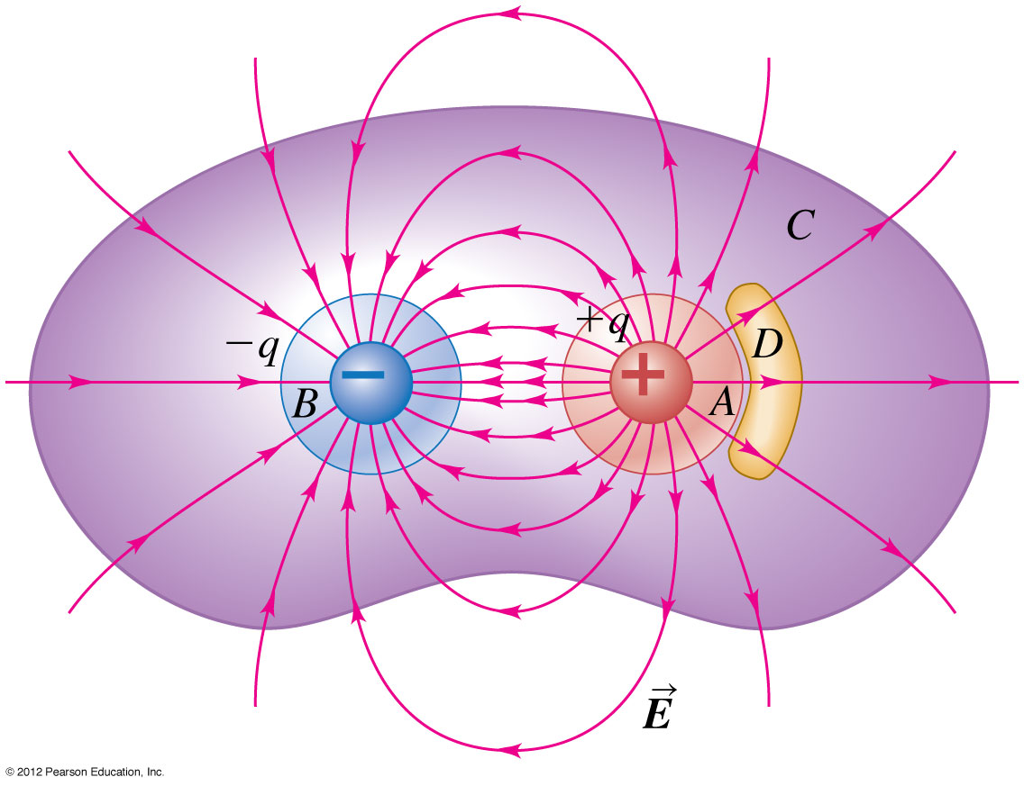
General form of Gauss’s law
  Follow the text discussion of the general form of Gauss’s law.

Slide 34
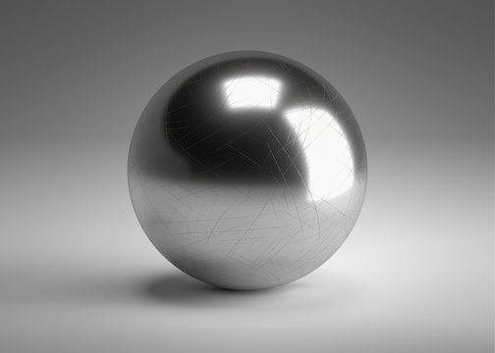
Applications of Gauss’s law: conductor - VIP
+

Slide 35
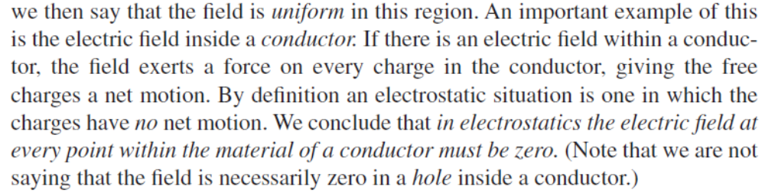
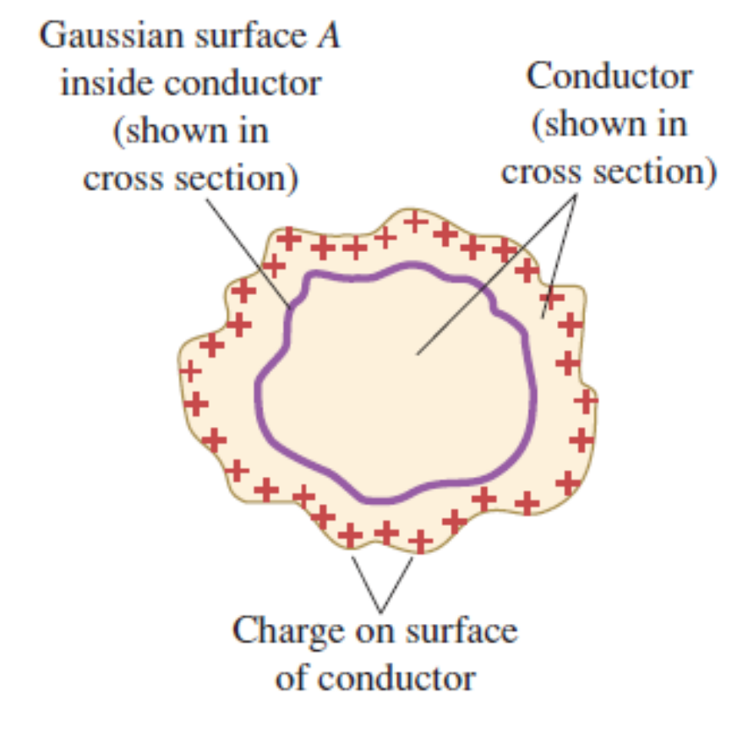
Applications of Gauss’s law: E=0 - VIP
  Under electrostatic conditions, any excess charge on a conductor resides entirely on its surface.

Slide 36
Applications of Gauss’s law: surface charge - VIP
  Under electrostatic conditions, any excess charge on a conductor resides entirely on its surface.

Slide 37
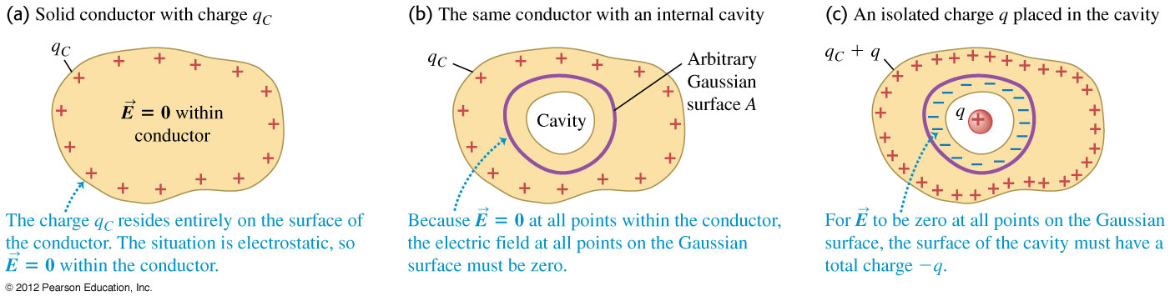

Charges on conductors
  In the text, follow the discussion on charges in a conductor having a cavity within it. Figure 22.23 below will help the explanation.

Slide 38
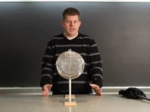

Slide 39
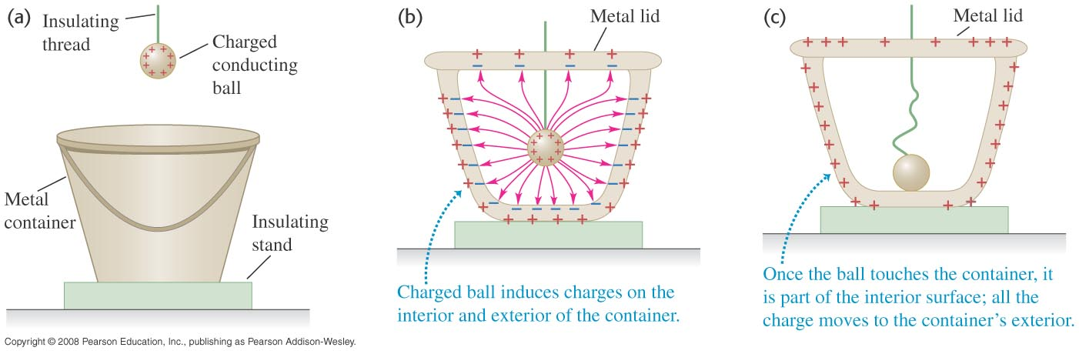
Testing Gauss’s law experimentally
  Follow the discussion of Faraday’s icepail experiment, which confirmed the validity of Gauss’s law. Use Figure 22.25 below.

Slide 40


Slide 41
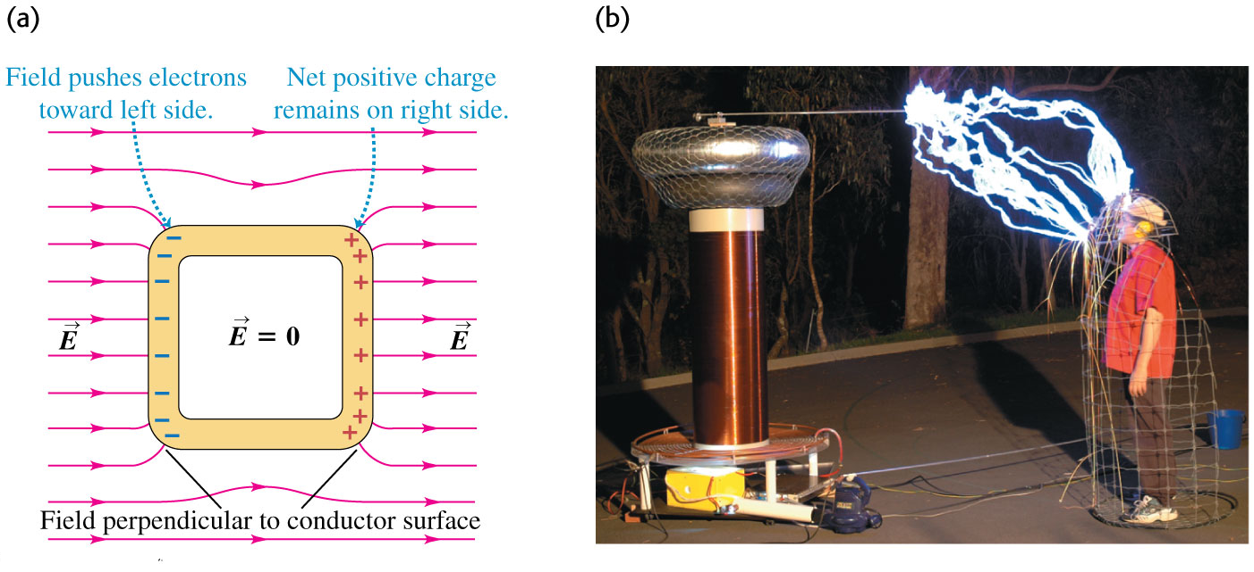
Electrostatic shielding
  A conducting box (a Faraday cage) in an electric field shields the interior from the field. (See Figure 22.27 below.)

Slide 42
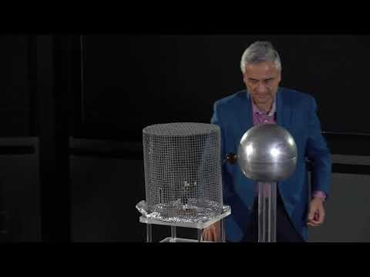

Slide 43
+

Slide 44
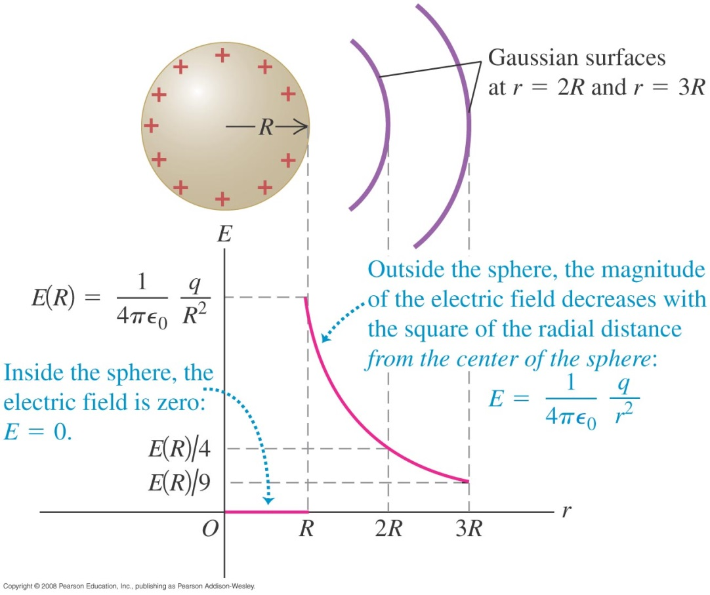
Applications of Gauss’s law: conductor

Slide 45
Applications of Gauss’s law: conductor

Slide 46

Applications of Gauss’s law: conductor
=

Slide 47
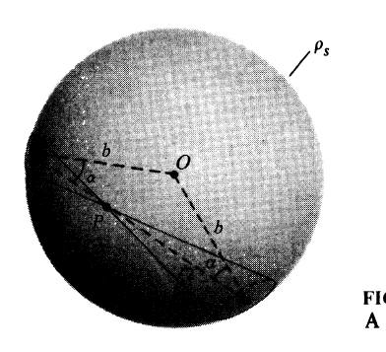
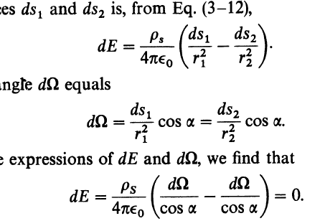

Slide 48
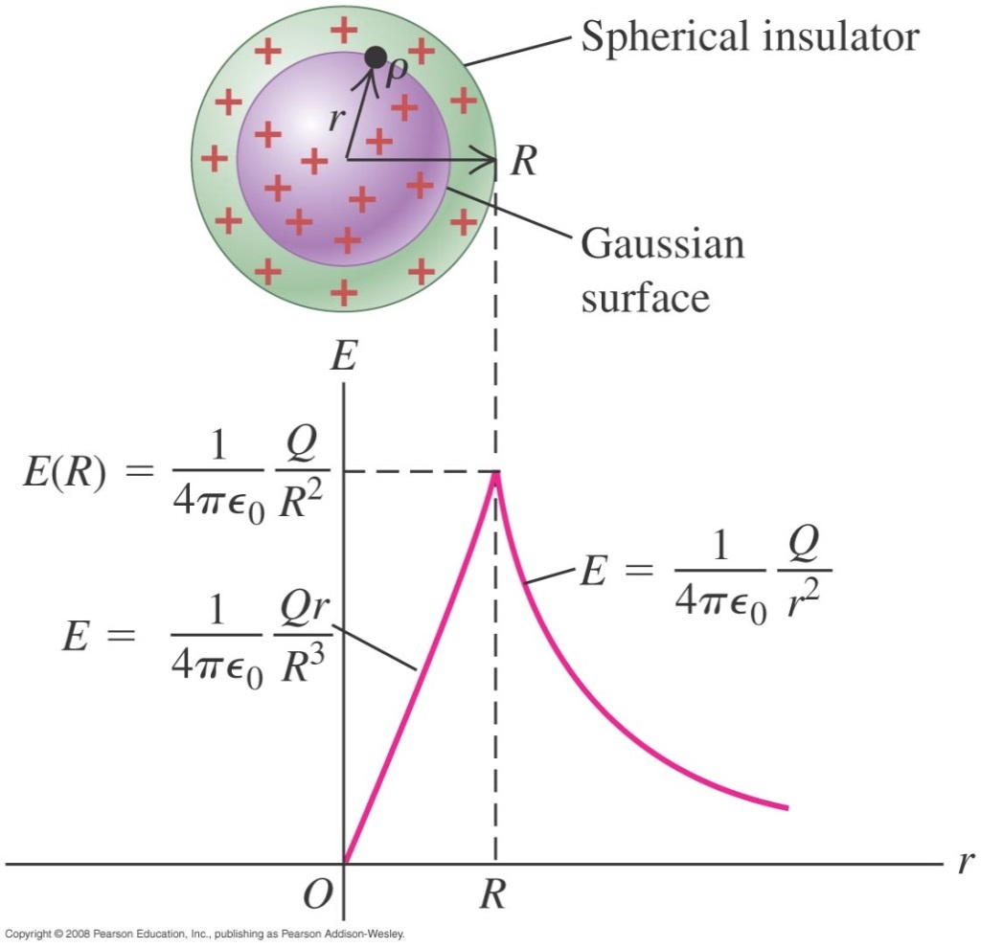
A uniformly charged sphere
  Follow Example 22.9 using Figure 22.22 below, for the field both inside and outside a sphere uniformly filled with charge.
  Follow Example 22.10 for the charge on a hollow sphere.

Slide 50
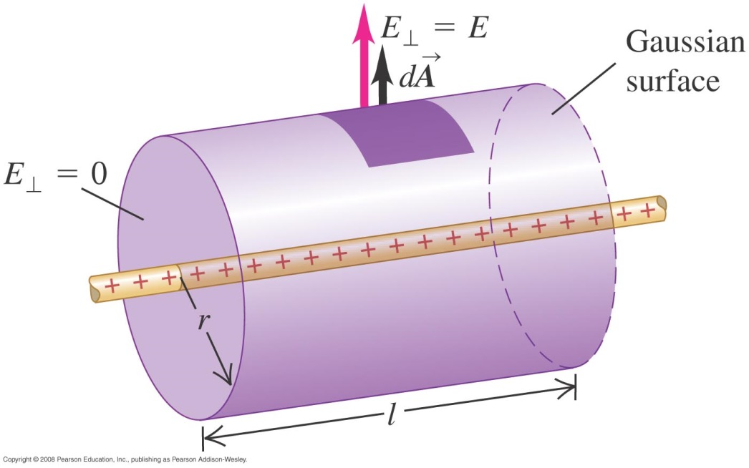

Field of a line charge
  Follow Example 22.6 using Figure 22.19 below, for a uniform line charge(infinite)

Slide 51



A cylindrical capacitor

Slide 52


Field of a sheet of charge
  Follow Example 22.7 using Figure 22.20 below, for an infinite plane sheet of charge.

Slide 53



Field of a sheet of charge
  Follow Example 22.7 using Figure 22.20 below, for an infinite plane sheet of charge.

Slide 54

Field at the surface of a conductor
  The electric field at the surface of any conductor is always perpendicular to the surface and has magnitude σ/ε₀.
  Follow the discussion in the text, using Figure 22.28 at the right.
  Follow Conceptual Example 22.12.
  Follow Example 22.13, which deals with the electric field of the earth.

Slide 55


Field between two parallel conducting plates
  Follow Example 22.8 using Figure 22.21 below for the field between oppositely charged parallel conducting plates.

Slide 56
Field between one conducting plates
  Follow Example 22.8 using Figure 22.21 below for the field between oppositely charged parallel conducting plates.
+

Slide 57

Field between two parallel conducting plates
  Follow Example 22.8 using Figure 22.21 below for the field between oppositely charged parallel conducting plates.

Slide 58

Field of two oppositely charged infinite sheets
  Follow Example 21.12 using Figure 21.26 below.

Slide 59
Field between two parallel conducting plates
  Follow Example 22.8 using Figure 22.21 below for the field between oppositely charged parallel conducting plates.

Slide 60
Field between two parallel conducting plates
  Follow Example 22.8 using Figure 22.21 below for the field between oppositely charged parallel conducting plates.
+
0

Slide 61


Slide 62


