Slide 1
Chapter 23
Electric Potential

Slide 2
Goals for Chapter 23
  To calculate the electric potential energy of a group of charges
  To know the significance of electric potential
  To calculate the electric potential due to a collection of charges
  To use equipotential surfaces to understand electric potential
  To calculate the electric field using the electric potential

Slide 3

Introduction
  How is electric potential related to welding?
  Electric potential energy is an integral part of our technological society.
  What is the difference between electric potential and electric potential energy?
  How is electric potential energy related to charge and the electric field?

Slide 4

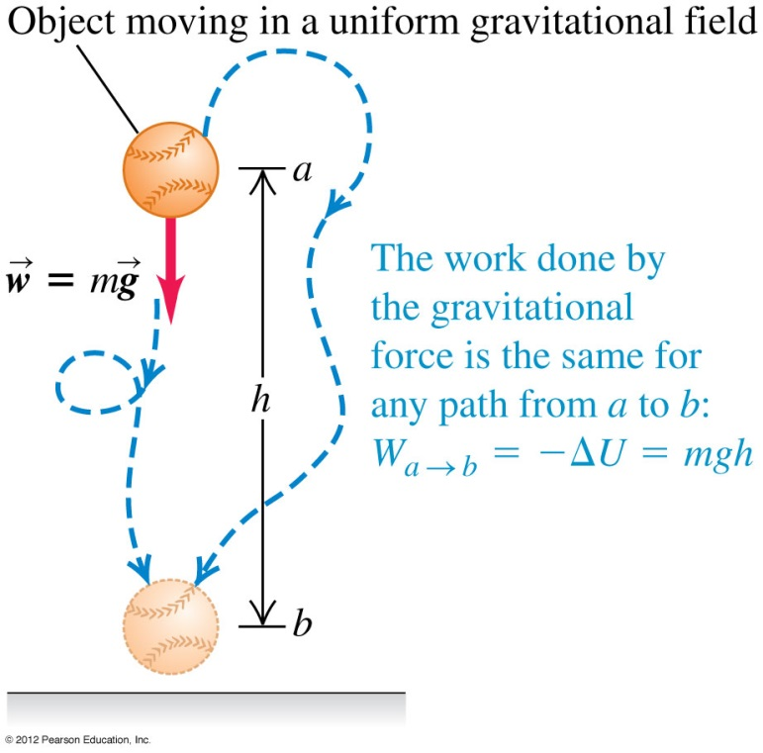
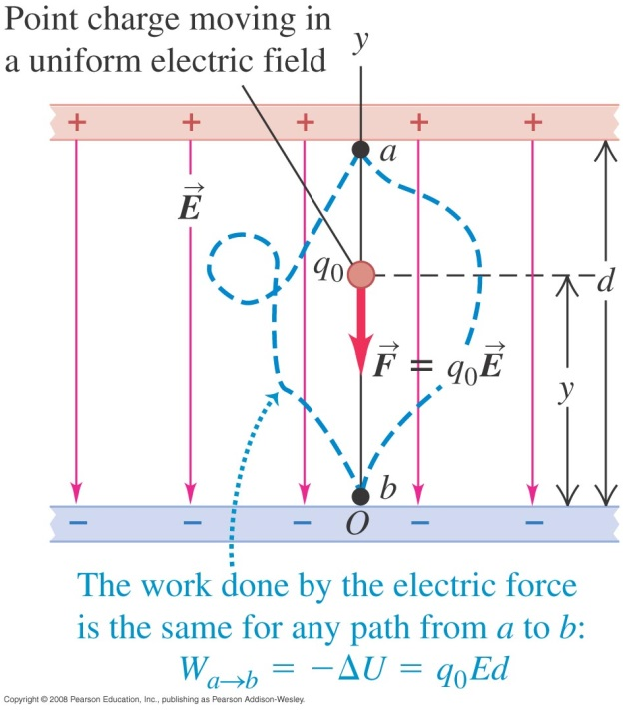
Electric potential energy in a uniform field

Slide 5
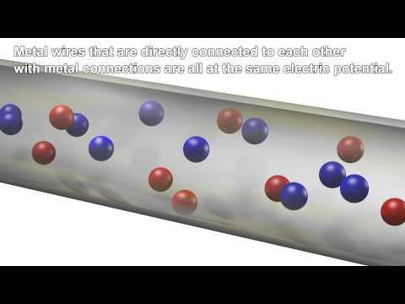

Slide 6
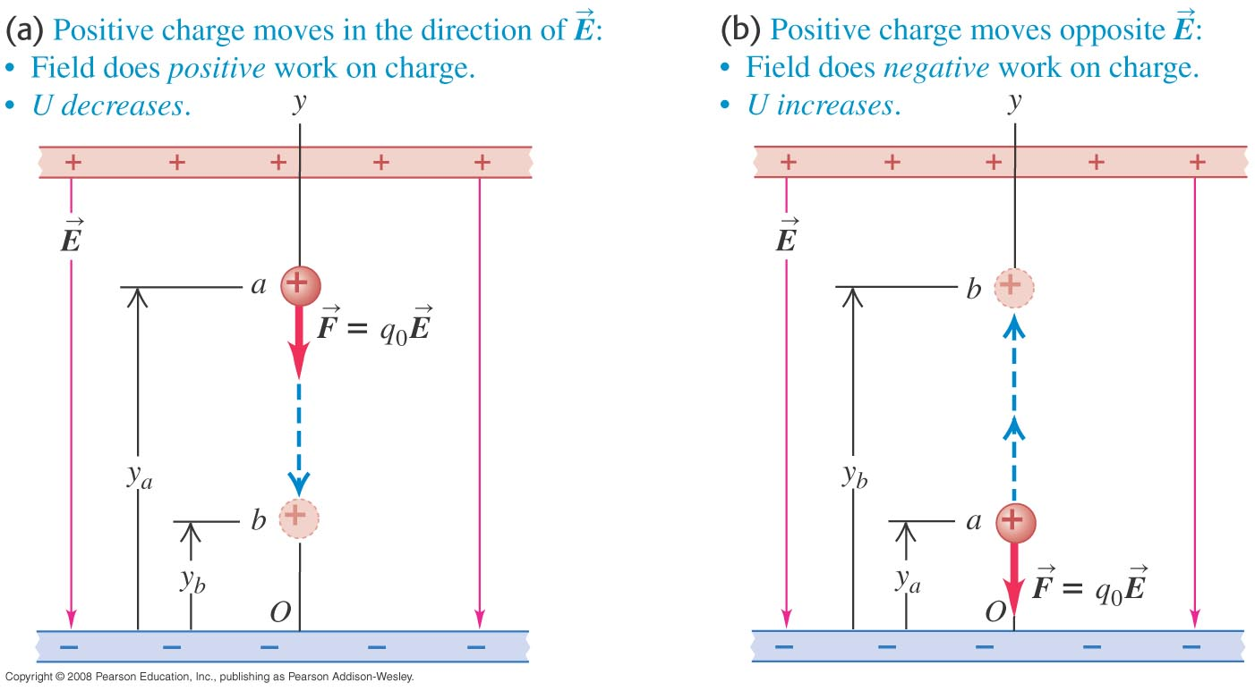
A positive charge moving in a uniform field
  If the positive charge moves in the direction of the field, the potential energy decreases, but if the charge moves opposite the field, the potential energy increases.

Slide 7
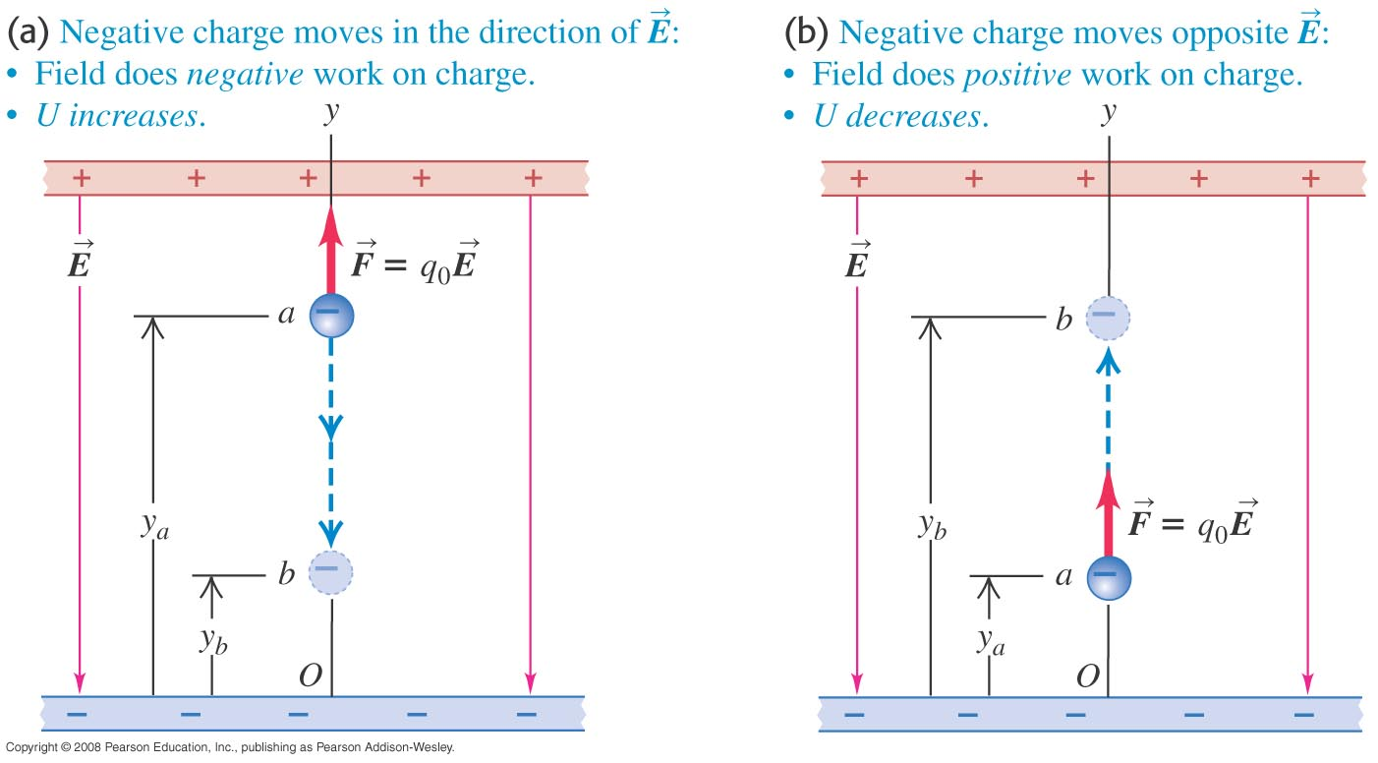
A negative charge moving in a uniform field
  If the negative charge moves in the direction of the field, the potential energy increases, but if the charge moves opposite the field, the potential energy decreases.
  Figure 23.4 below illustrates this point.

Slide 8

+
+
-
+
+
+

Slide 9
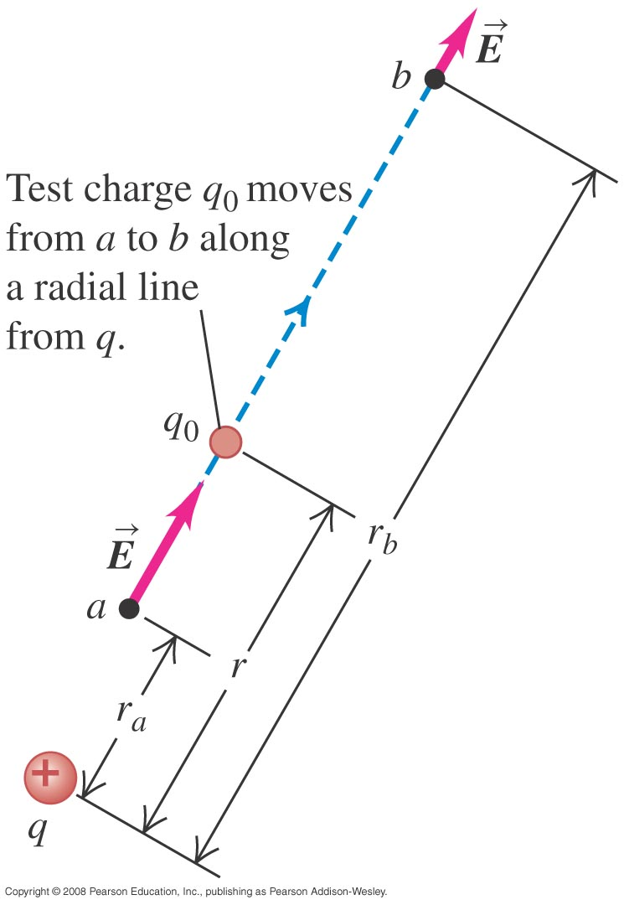


Electric potential energy of two point charges
  Follow the discussion of the motion of a test charge q₀ in the text.
  The electric potential is the same whether q₀ moves in a radial line (left figure) or along an arbitrary path (right figure).

Slide 10
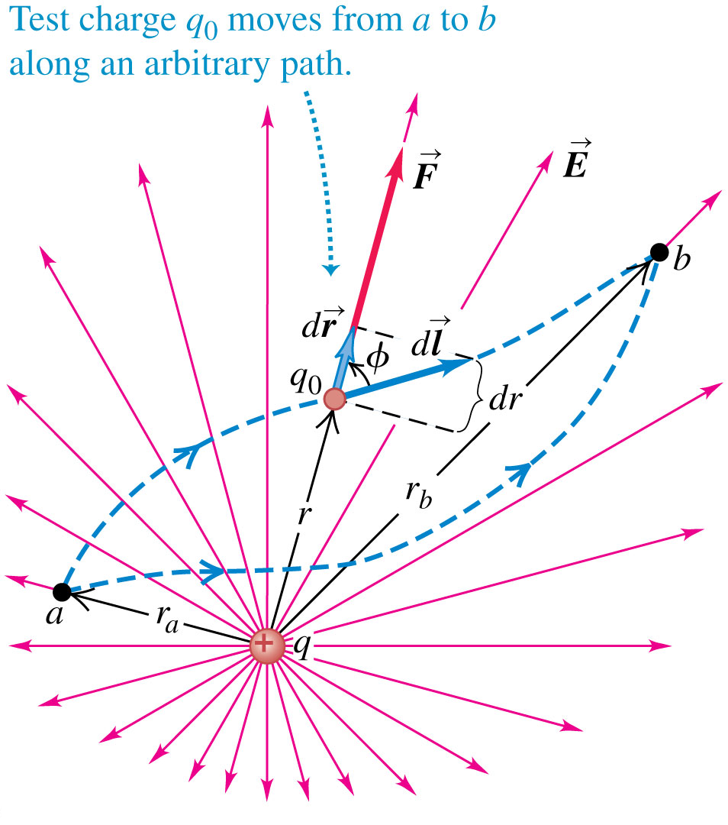


Electric potential energy of two point charges
  Follow the discussion of the motion of a test charge q₀ in the text.
  The electric potential is the same whether q₀ moves in a radial line (left figure) or along an arbitrary path (right figure).

Slide 11
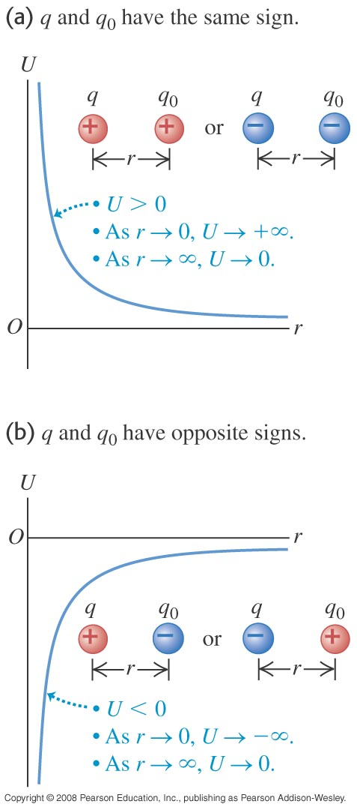

Graphs of the potential energy
  The sign of the potential energy depends on the signs of the two charges.
Zero at the infinity

Slide 12
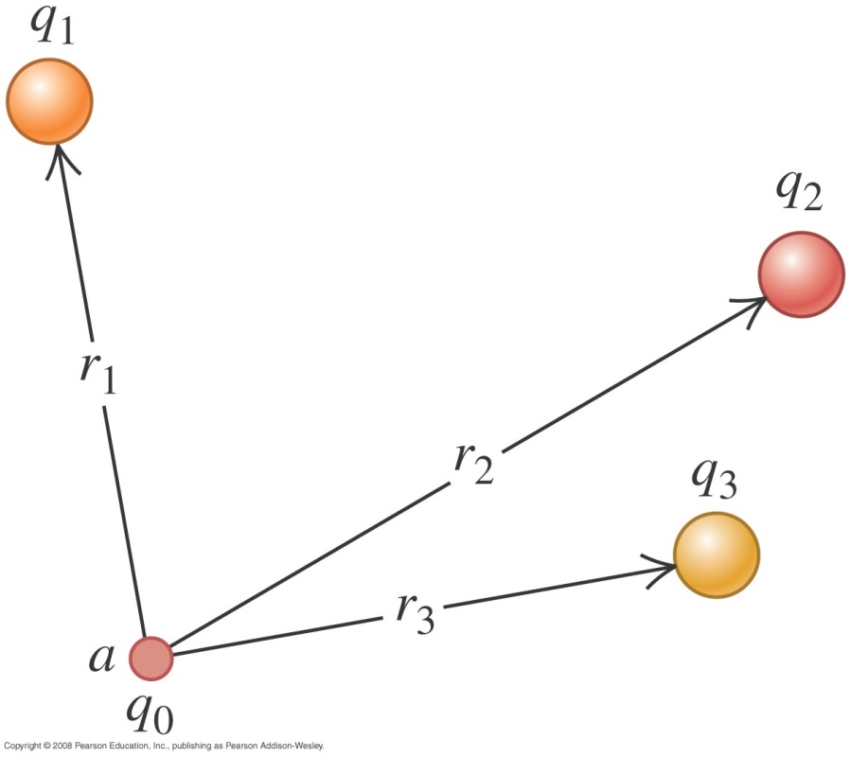

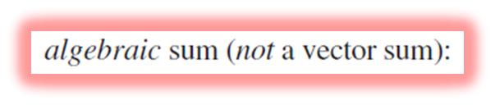
Electrical potential with several point charges
  The potential energy associated with q₀ depends on the other charges and their distances from q₀, as shown in Figure 23.8 at the right.
  Follow the derivation in the text of the formula for the total potential energy U.
  Follow Example 23.2.

Slide 13
Electric potential
  Potential is potential energy per unit charge.
  We can think of the potential difference between points a and b in either of two ways. The potential of a with respect to b (V_{ab} = V_{a} – V_{b}) equals:
    the work done by the electric force when a unit charge moves from a to b.
    the work that must be done to move a unit charge slowly from b to a against the electric force.
  Follow the discussion in the text of how to calculate electric potential.

Slide 14




Electric potential
  Potential is potential energy per unit charge.
  Potential zero at ∞.

Slide 15
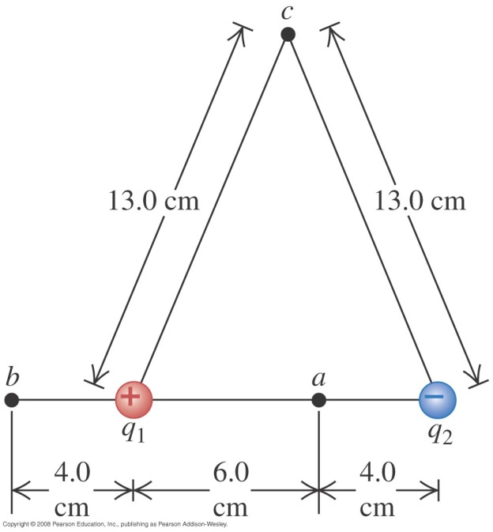

Potential due to two point charges
  Follow Example 23.4 using Figure 23.13 at the right.
  Follow Example 23.5.
http://www.falstad.com/emstatic/index.html

Slide 16
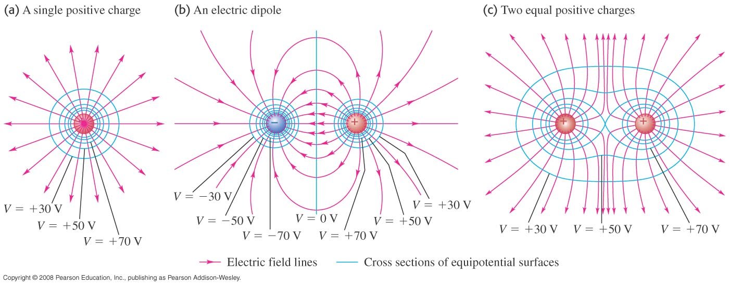
Equipotential surfaces and field lines
  An equipotential surface is a surface on which the electric potential is the same at every point.
  Figure 23.23 below shows the equipotential surfaces and electric field lines for assemblies of point charges.
  Field lines and equipotential surfaces are always mutually perpendicular.

Slide 17
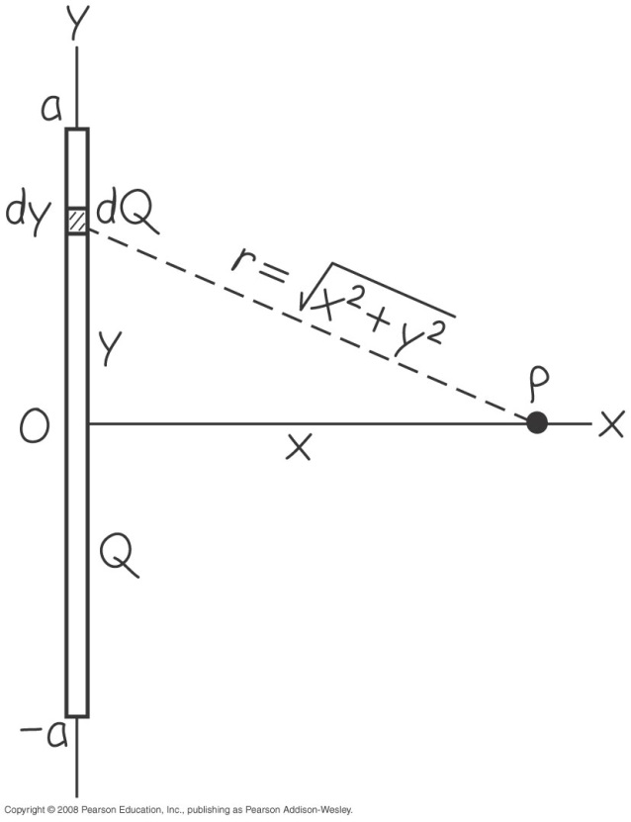
A finite line of charge
  Follow Example 23.12 using Figure 23.21 below.

Slide 18
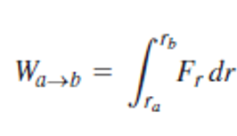
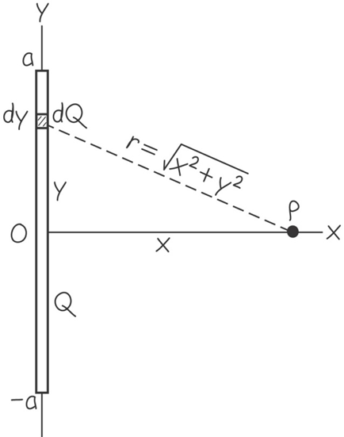
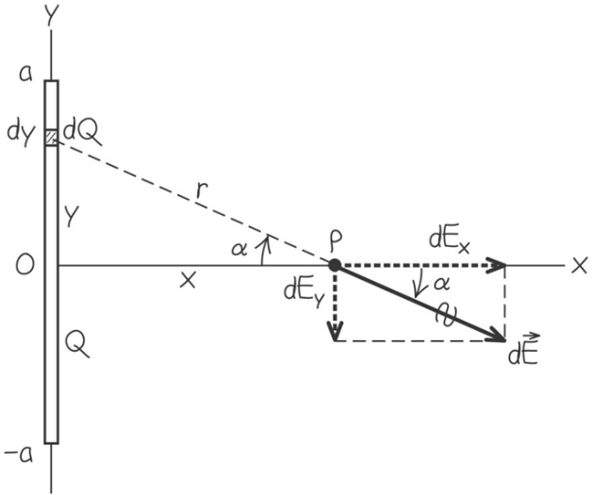
V vs. E

Slide 19
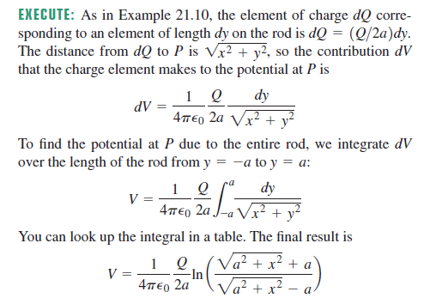
A finite line of charge
  Follow Example 23.12 using Figure 23.21 below.

Slide 20
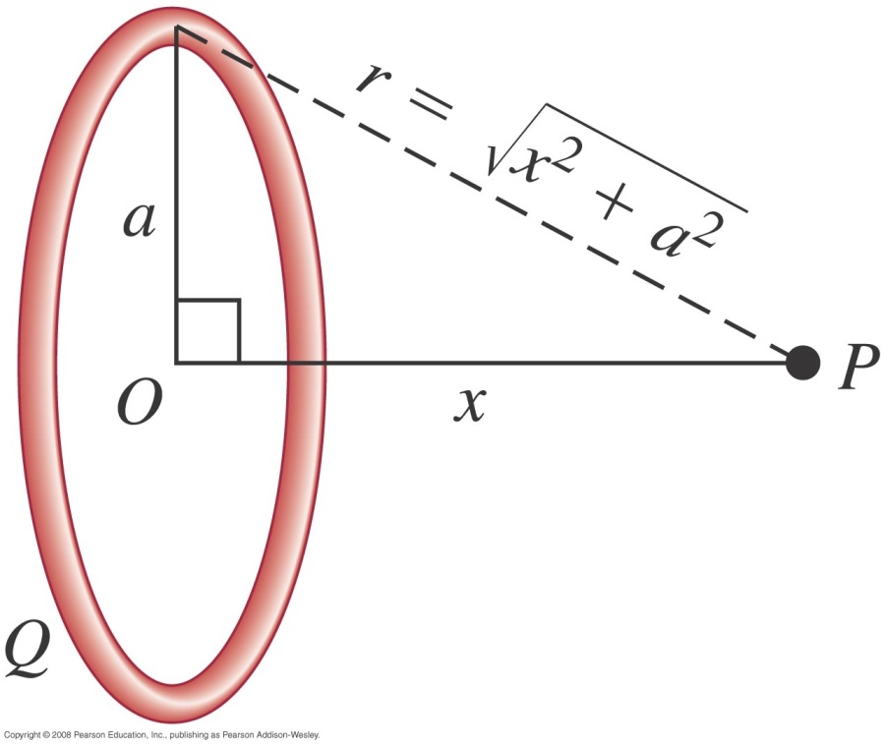
A ring of charge
  Follow Example 23.11 using Figure 23.20 below.

Slide 21

A ring of charge
  Follow Example 23.11 using Figure 23.20 below.

Slide 22
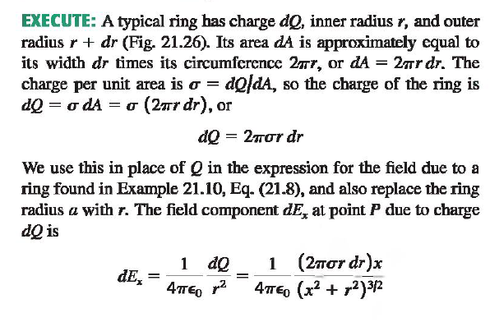
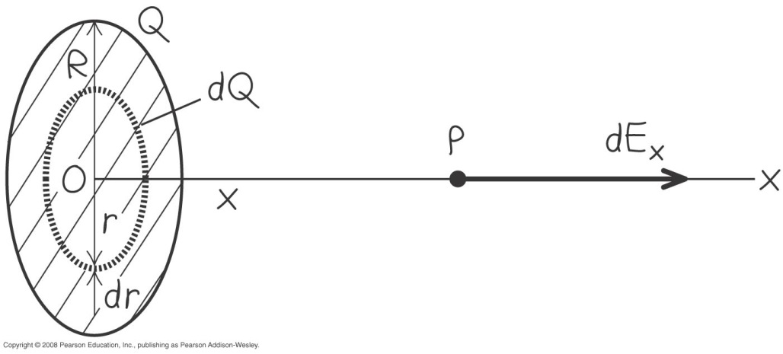
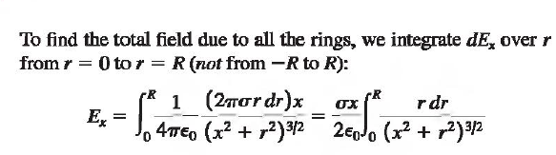
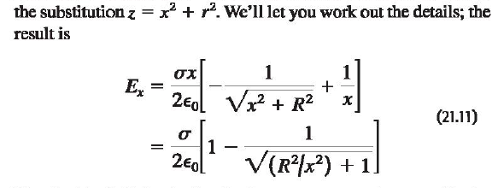
Field of a uniformly charged disk
  Follow Example 21.11 using Figure 21.25 below.

Slide 23
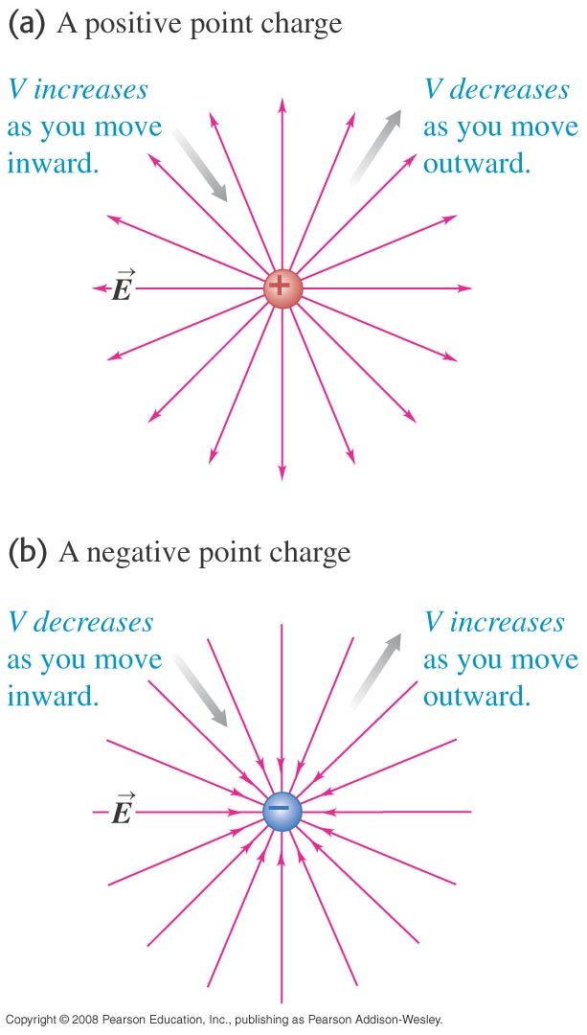



Finding electric potential from the electric field：VIP
  If you move in the direction of the electric field, the electric potential decreases, but if you move opposite the field, the potential increases. (See Figure 23.12 at the right.)

Slide 24
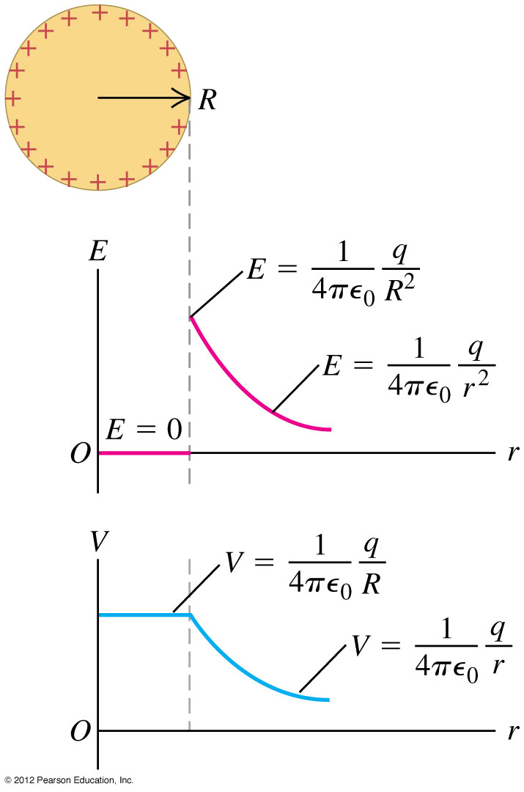
Calculating electric potential
  Read Problem-Solving Strategy 23.1.
  Follow Example 23.8 (a charged conducting sphere) using Figure 23.16 at the right.

Slide 25
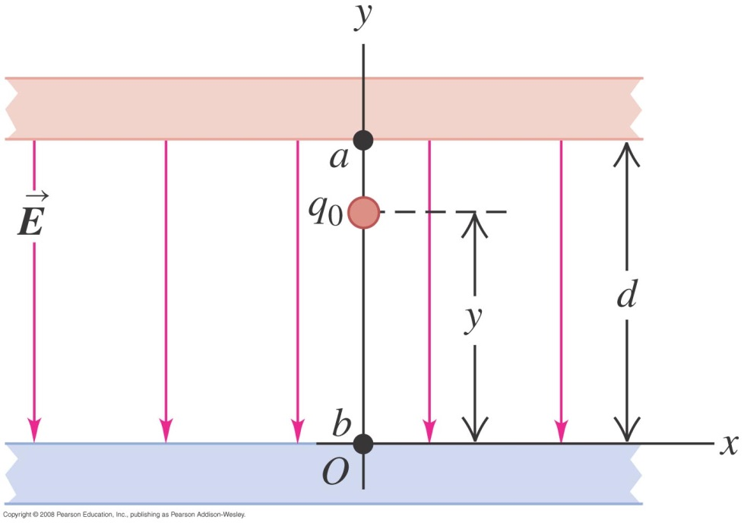
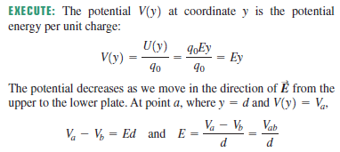
Oppositely charged parallel plates
  Follow Example 23.9 using Figure 23.18 below.

Slide 26
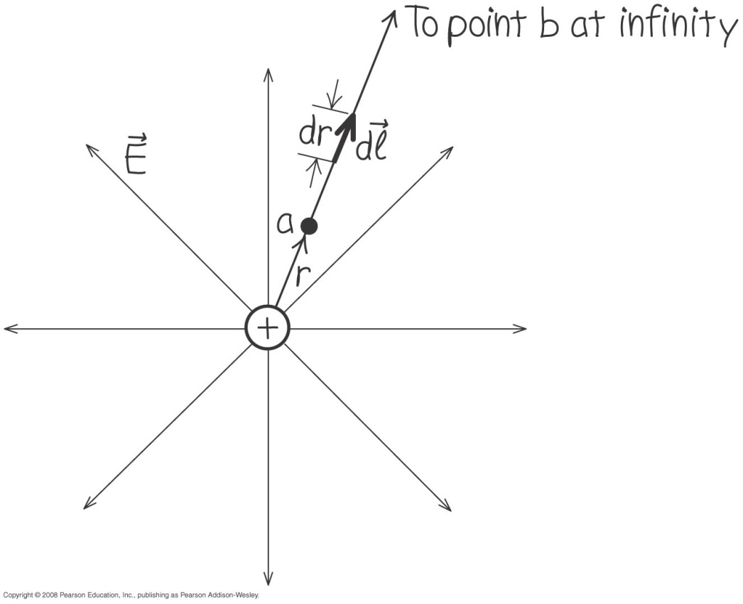
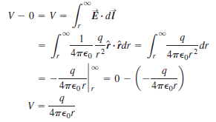
Point Charge
  Example 23.6 shows how to find the potential by integration. Follow this example using Figure 23.14 at the right.

Slide 27
Electric potential energy of two point charges
  Follow the discussion of the motion of a test charge q₀ in the text.
  The electric potential is the same whether q₀ moves in a radial line (left figure) or along an arbitrary path (right figure).

Slide 28
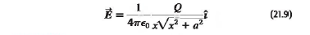
A finite line of charge： second approach （HW2）
  Follow Example 23.12 using Figure 23.21 below.

Slide 29
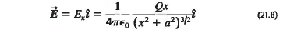
A ring of charge (HW2)
  Follow Example 23.11 using Figure 23.20 below.

Slide 30
Calculating electric potential：symmetry
3D

Slide 31
Calculating electric potential
  Read Problem-Solving Strategy 23.1.
  Follow Example 23.8 (a charged conducting sphere) using Figure 23.16 at the right.

Slide 32

Calculating electric potential
  Read Problem-Solving Strategy 23.1.
  Follow Example 23.8 (a charged conducting sphere) using Figure 23.16 at the right.
Outside:
Inside:

Slide 33
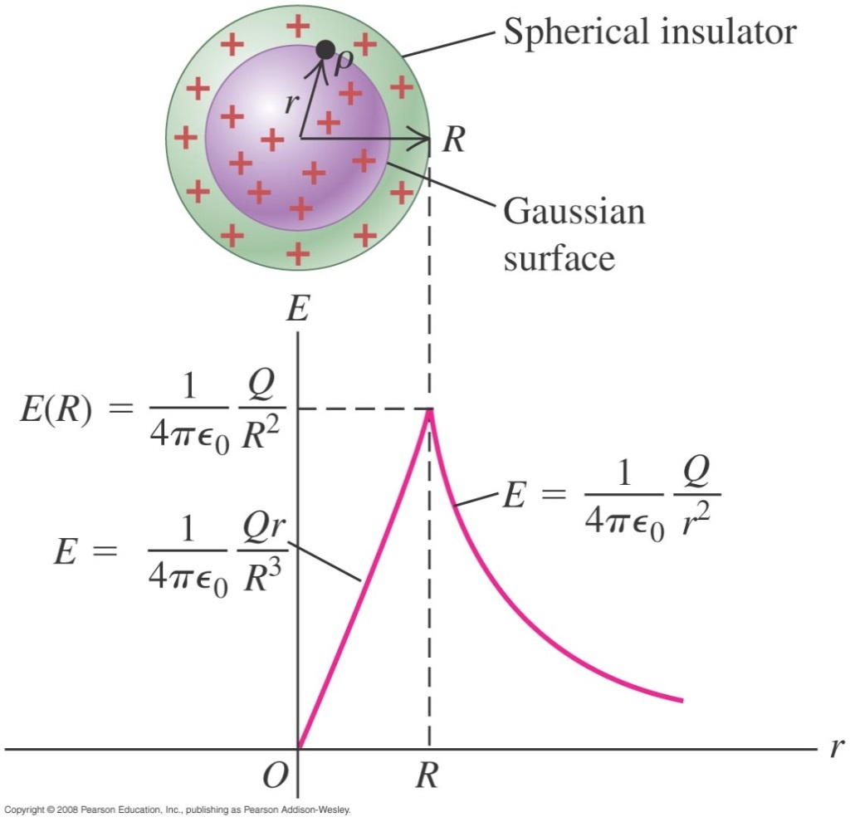
A uniformly charged sphere
  Follow Example 22.9 using Figure 22.22 below, for the field both inside and outside a sphere uniformly filled with charge.
  Follow Example 22.10 for the charge on a hollow sphere.

Slide 34
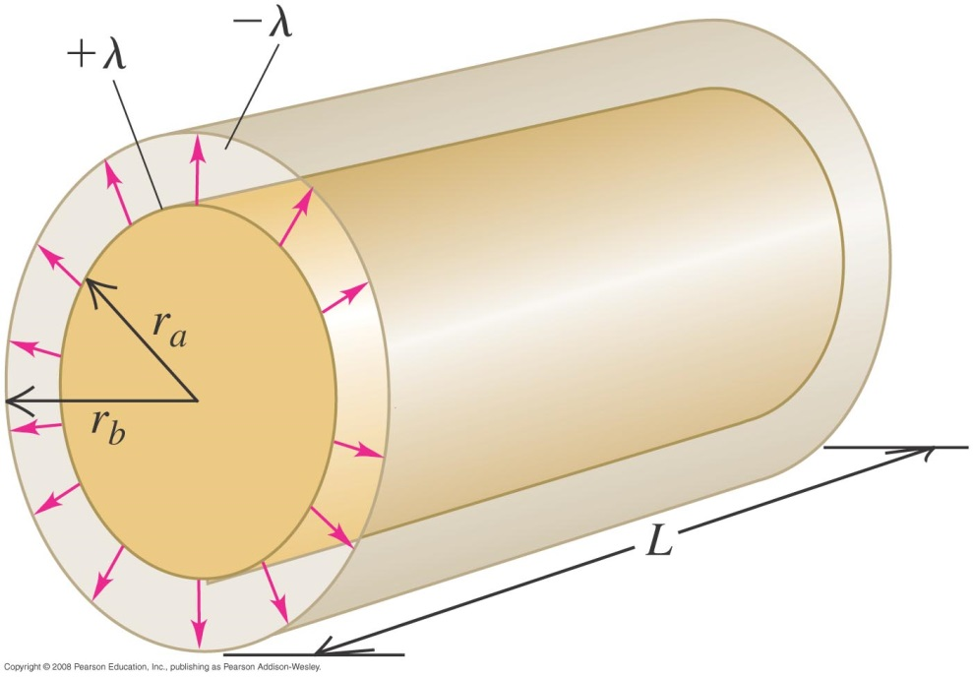
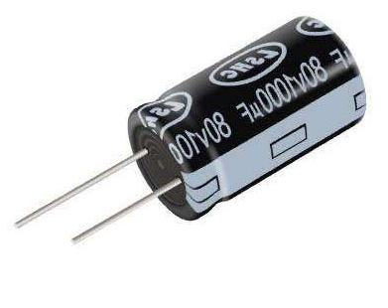
A cylindrical capacitor

Slide 35
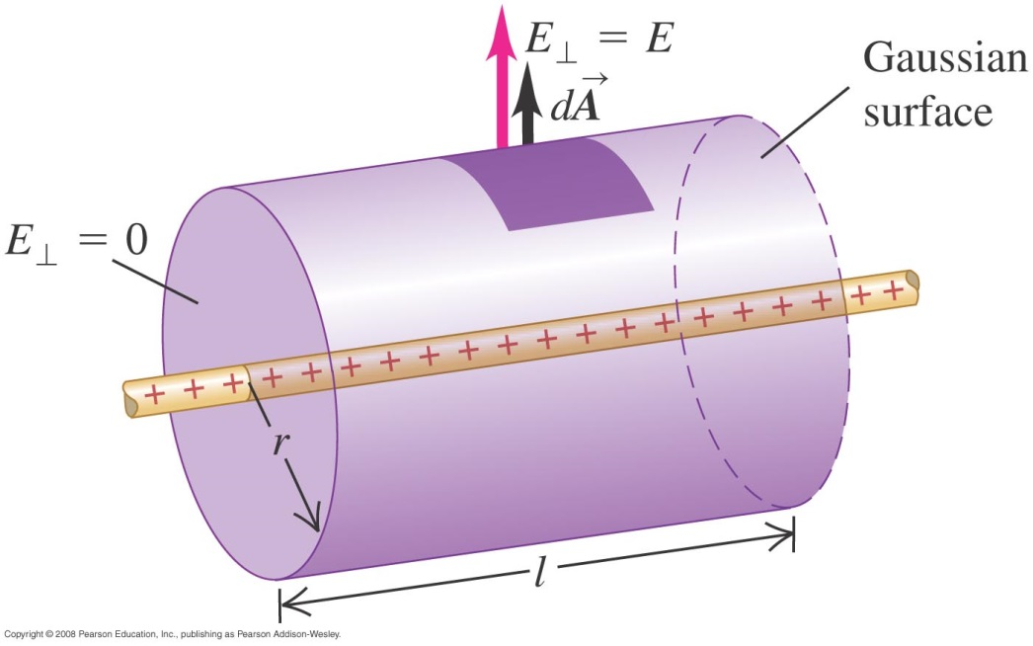
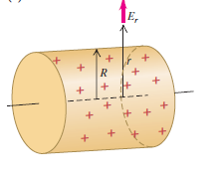
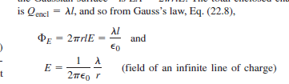

Slide 36

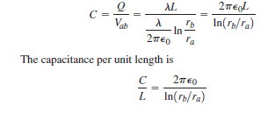

A cylindrical capacitor

Slide 37
Equipotential surfaces and field lines
  An equipotential surface is a surface on which the electric potential is the same at every point.
  Figure 23.23 below shows the equipotential surfaces and electric field lines for assemblies of point charges.
  Field lines and equipotential surfaces are always mutually perpendicular.

Slide 38
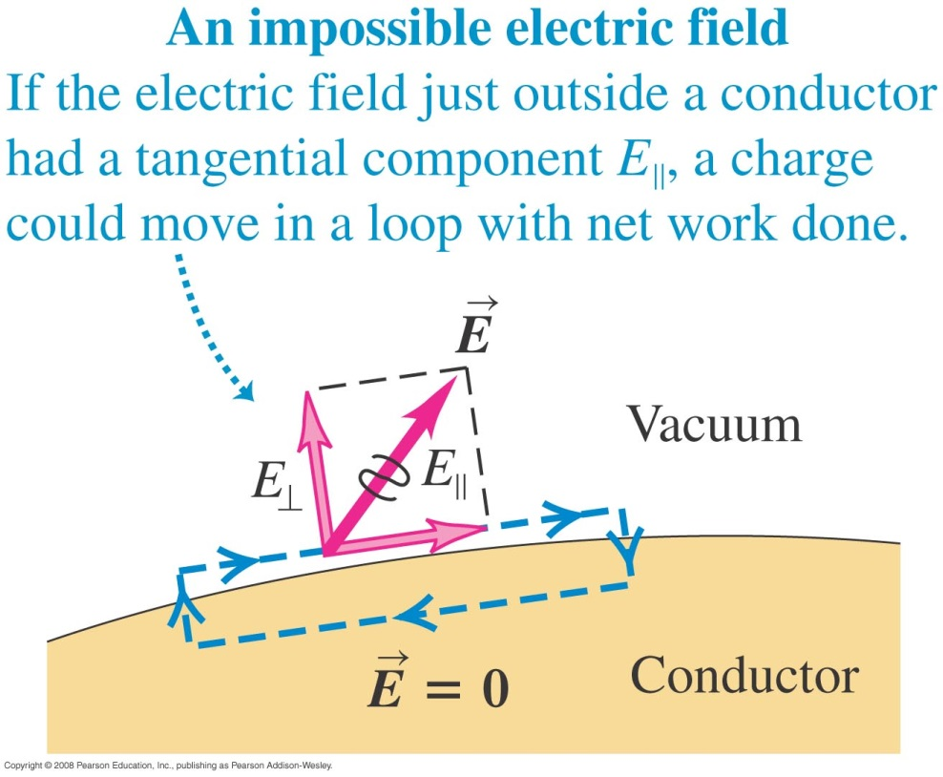
    the electric field just outside a conductor is always perpendicular to the surface (see figures below).
http://www.falstad.com/emstatic/index.html

Slide 39

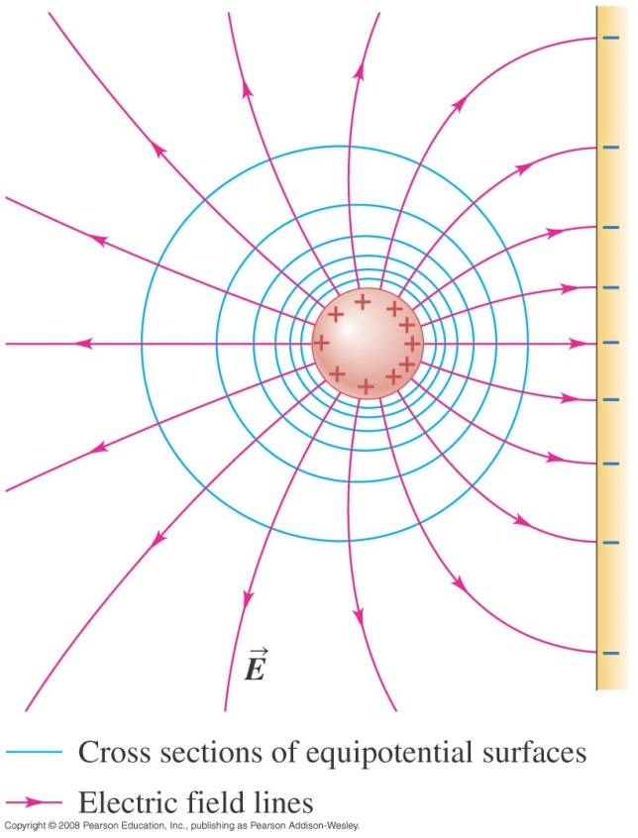
Equipotentials and conductors
  When all charges are at rest:
    the electric field just outside a conductor is always perpendicular to the surface (see figures below).
    the surface of a conductor is always an equipotential surface.
    the entire solid volume of a conductor is at the same potential.

Slide 40

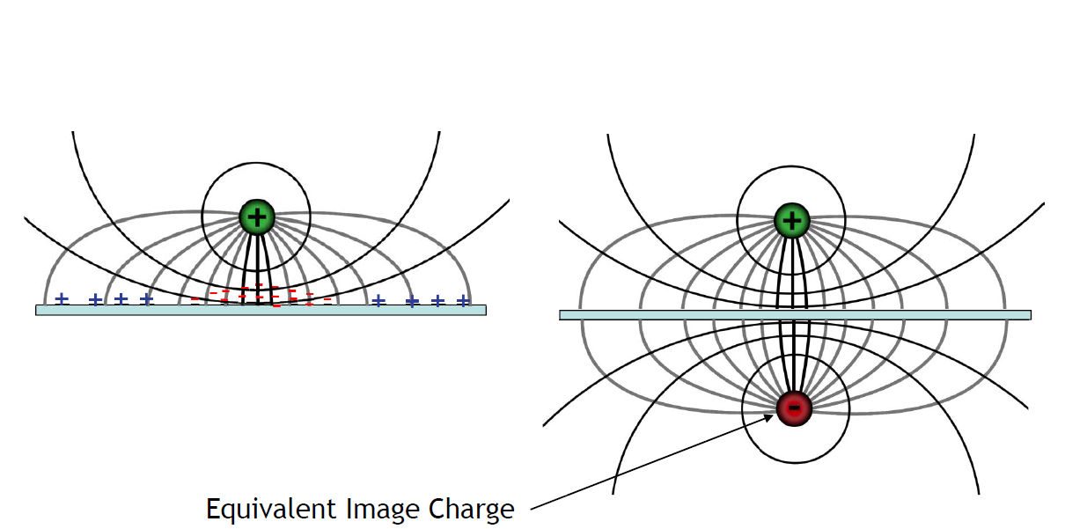
Equipotentials and conductors

Slide 41
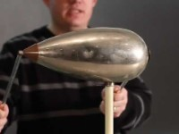

Slide 42
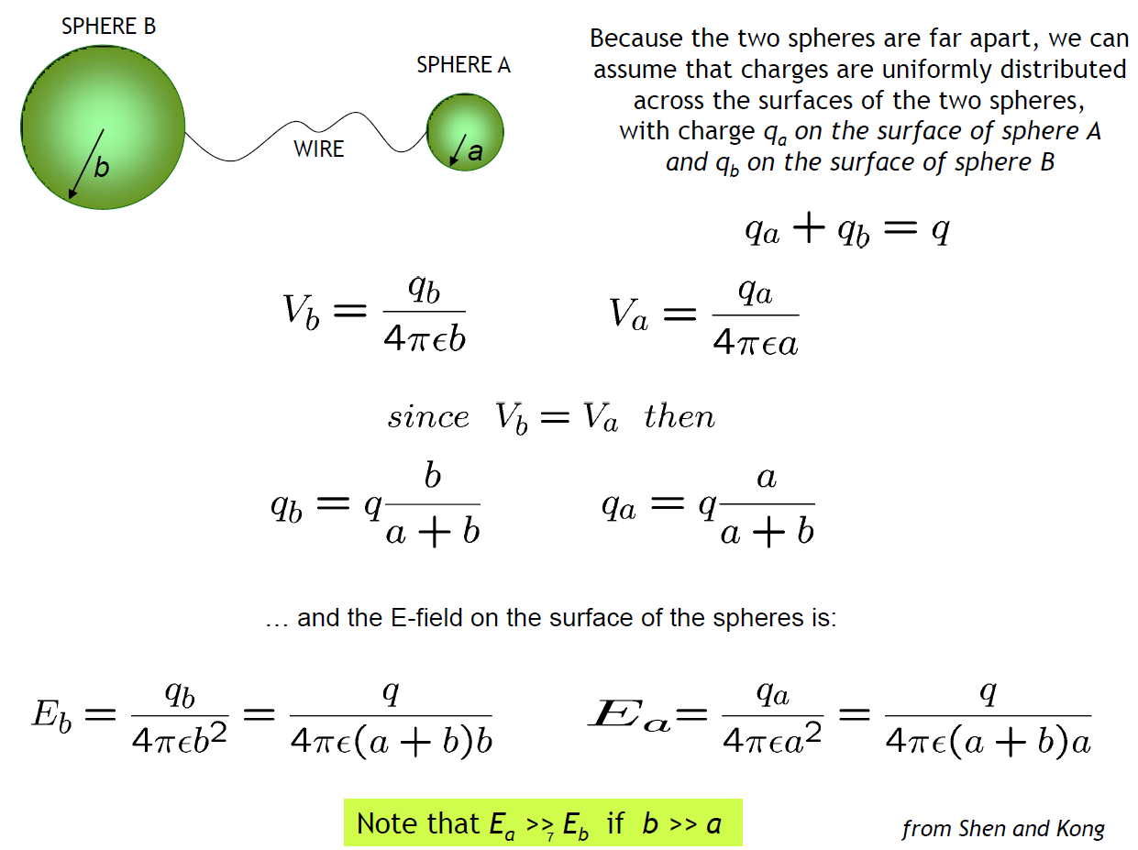
Equipotentials and conductors

Slide 43
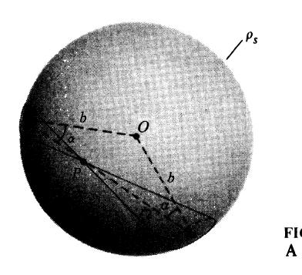
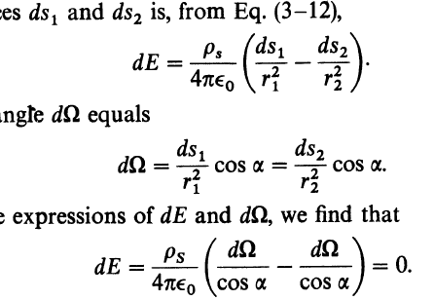
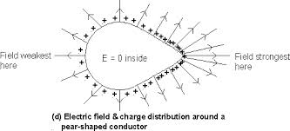

Slide 44
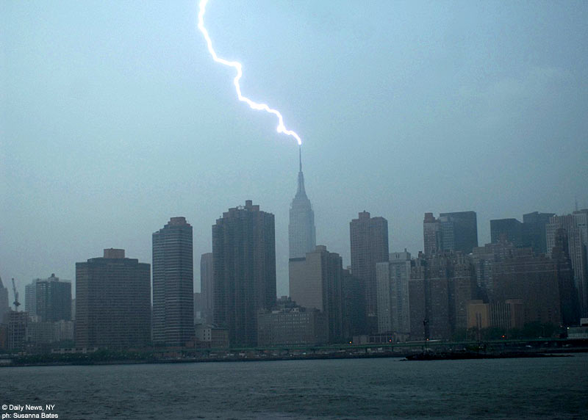
Equipotentials and conductors

Slide 45


Slide 46

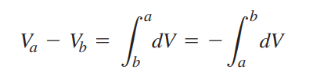



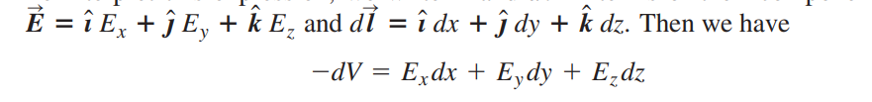
V → E

Slide 47
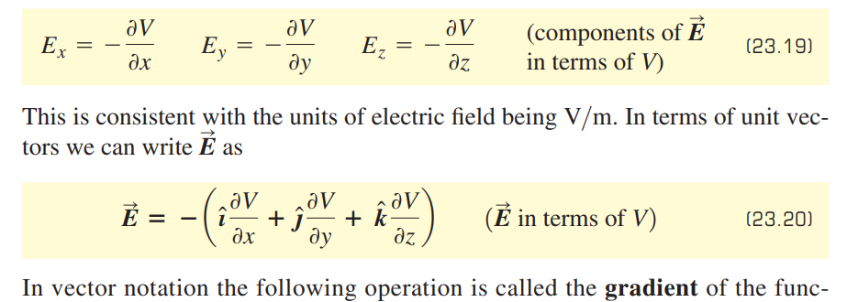


Slide 48

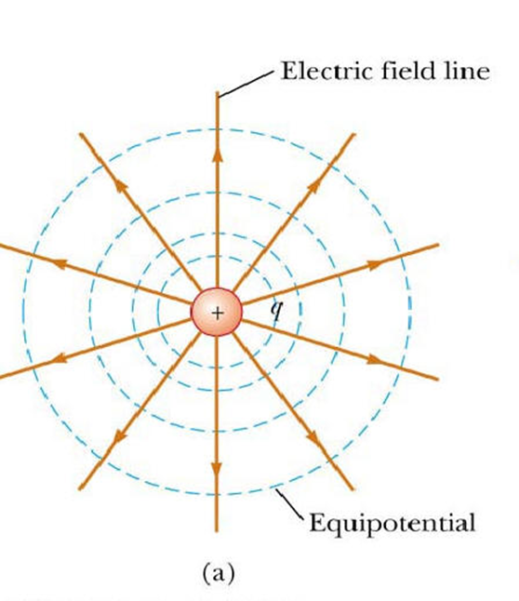



Slide 49

A ring of charge
  Follow Example 23.11 using Figure 23.20 below.

