Slide 1
Chapter 25
Current, Resistance, and Electromotive Force

Slide 2
Goals for Chapter 25
  To understand current and how charges move in a conductor
  To understand resistivity and conductivity
  To calculate the resistance of a conductor
  To learn how an emf causes current in a circuit
  To calculate energy and power in circuits

Slide 3

Introduction
  Electric currents flow through light bulbs.
  Electric circuits contain charges in motion.
  Circuits are at the heart of modern devices such as computers, televisions, and industrial power systems.

Slide 4

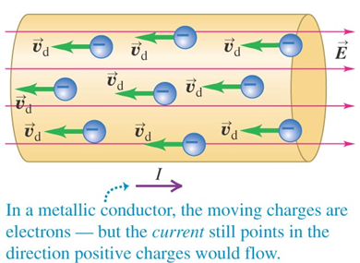
Current

Slide 5
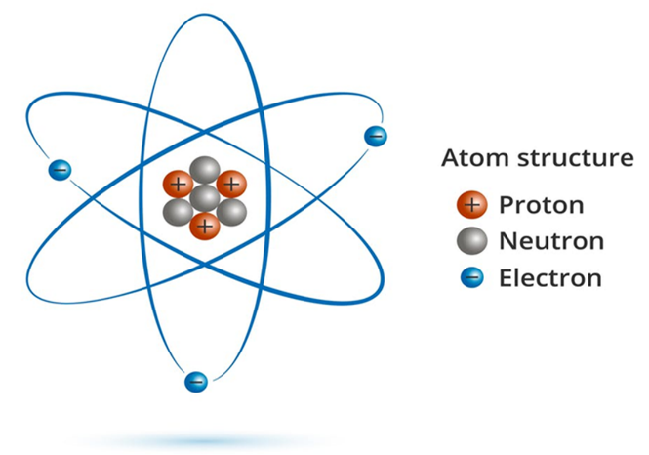
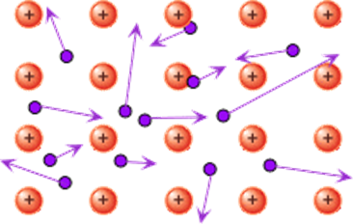
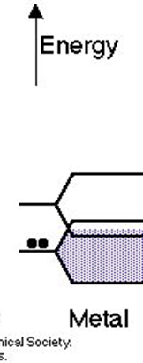
Electrons in Metal

Slide 6
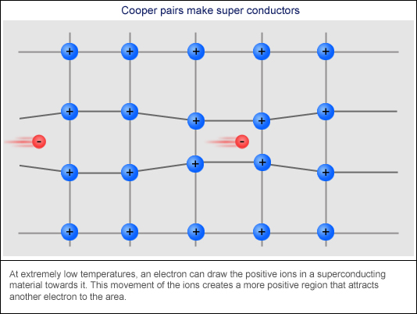
Superconducting Current

Slide 7
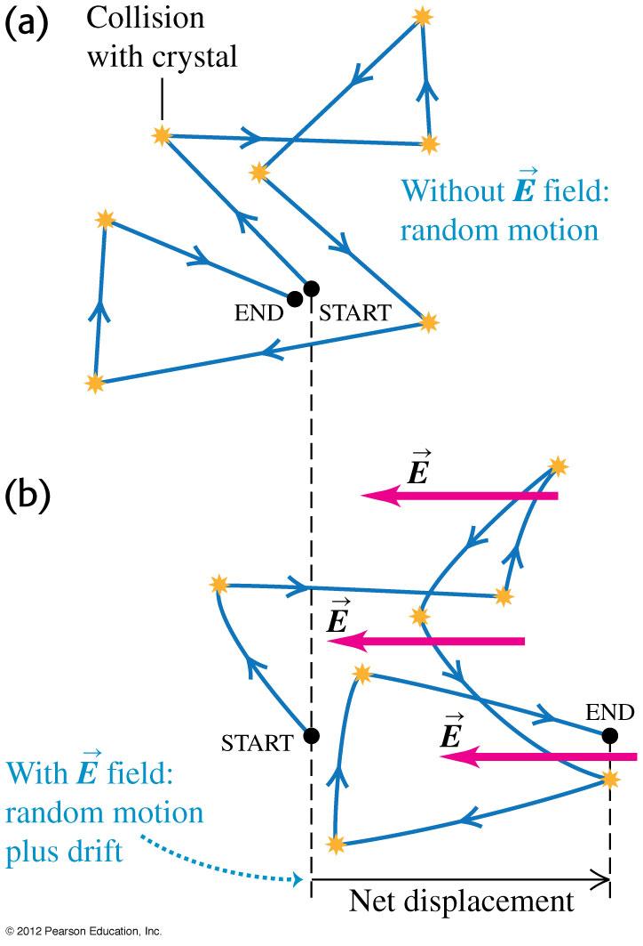
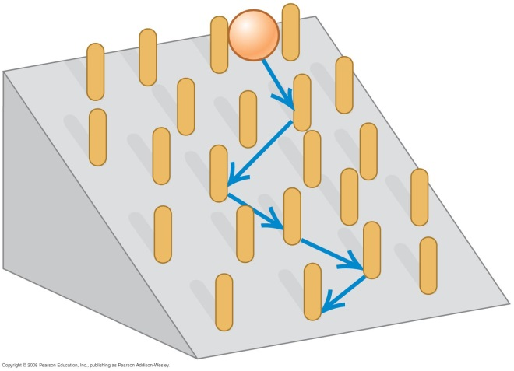
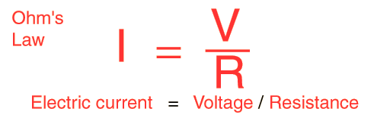
Theory of metallic conduction
  Follow the discussion in the text using Figures 25.26 (right) and 25.27 (below). Both illustrate the random motion of electrons in a conductor.
  Follow Example 25.11.
https://iwant2study.org/lookangejss/05electricitynmagnetism_17current/ejss_model_driftvelocity/driftvelocity_Simulation.xhtml

Slide 8
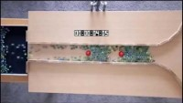

Slide 9

Theory of metallic conduction
V.S.

Slide 10
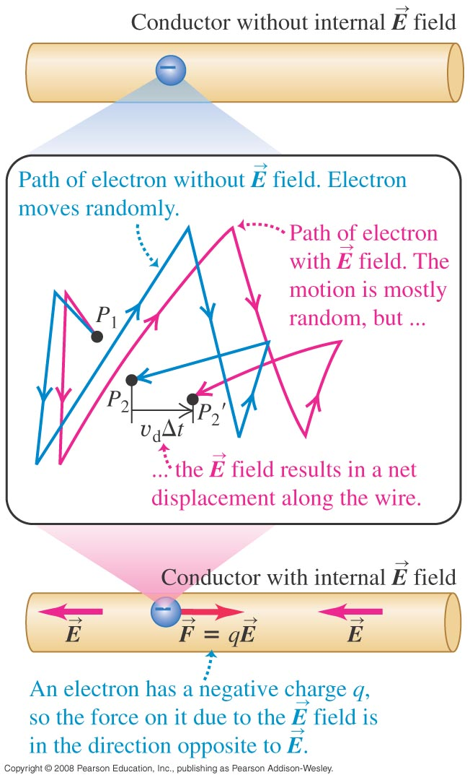
Current
  A current is any motion of charge from one region to another. Current is defined as I = dQ/dt.
  An electric field in a conductor causes charges to flow. (See Figure 25.1 at the right.)
  E≠ 0 anymore

Slide 11


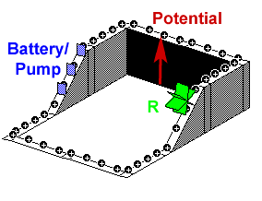
Electric charge : indirect way

Slide 12
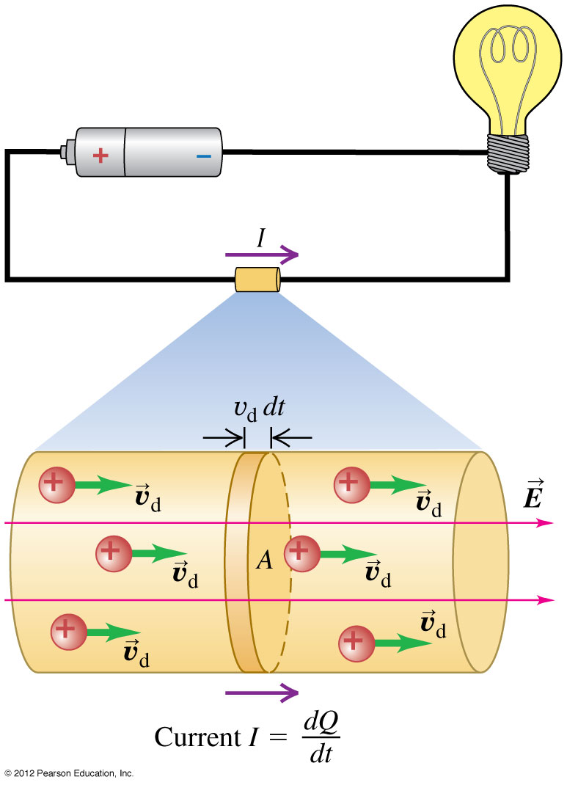
Current, drift velocity, and current density
  Follow the discussion of current, drift velocity, and current density.
  Figure 25.3 at the right shows the positive charges moving in the direction of the electric field.
  Follow Example 25.1.

Slide 13

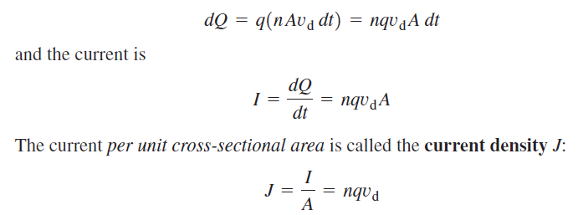
Current, drift velocity, and current density

Slide 14

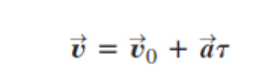






Resistivity
  The resistivity of a material is the ratio of the electric field in the material to the current density it causes:

Slide 15
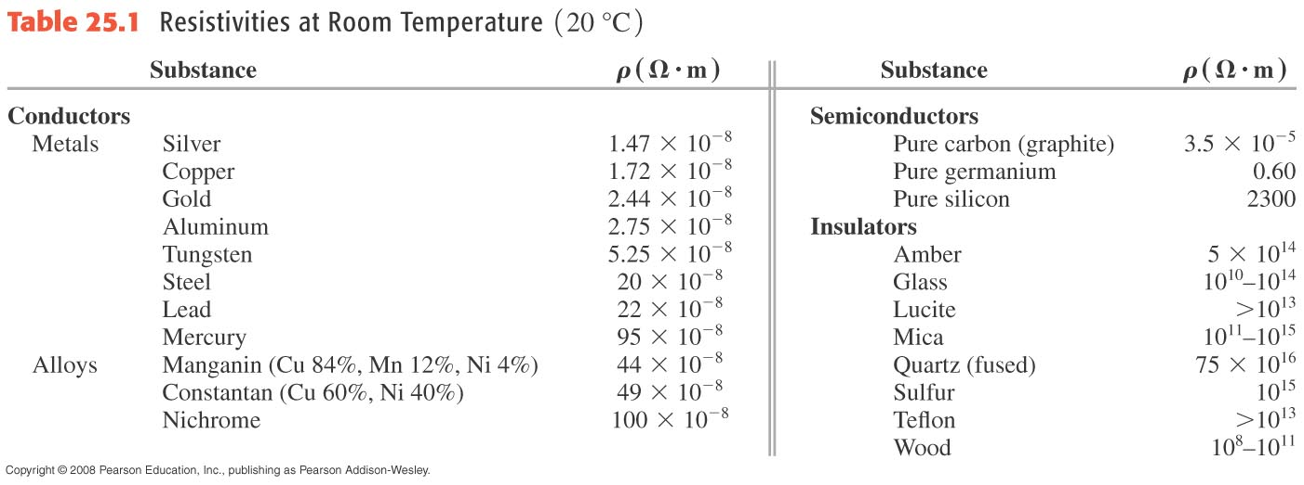
Resistivity
  The resistivity of a material is the ratio of the electric field in the material to the current density it causes:
  The conductivity is the reciprocal of the resistivity.

Slide 16

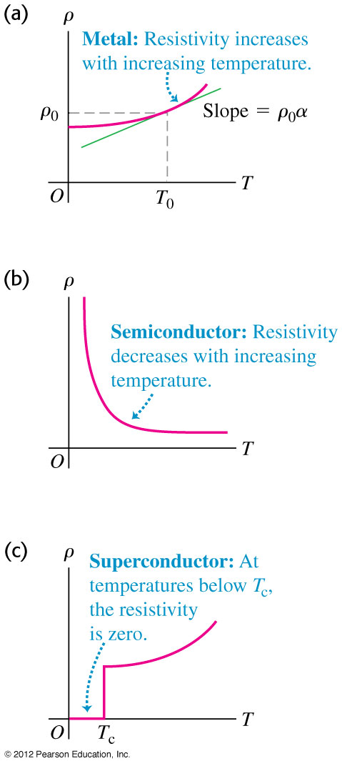
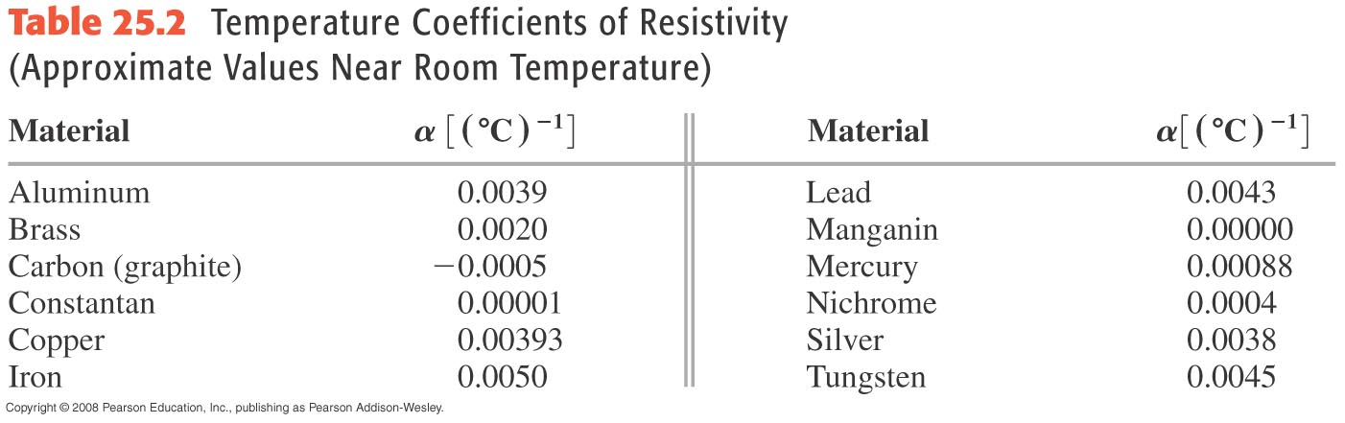
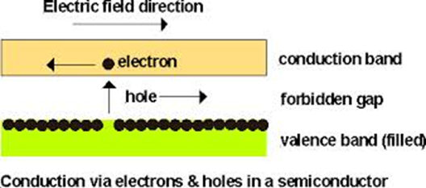
Resistivity and temperature

Slide 17
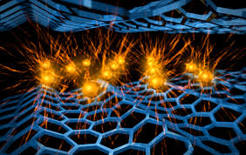
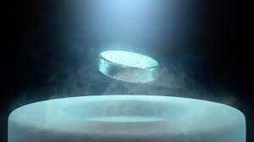
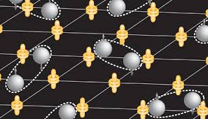
Theory of metallic conduction
Superconductor
scattering
Cooper pairs

Slide 18
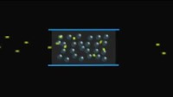
https://www.youtube.com/watch?v=xgC5zgr6Hdc

Slide 19
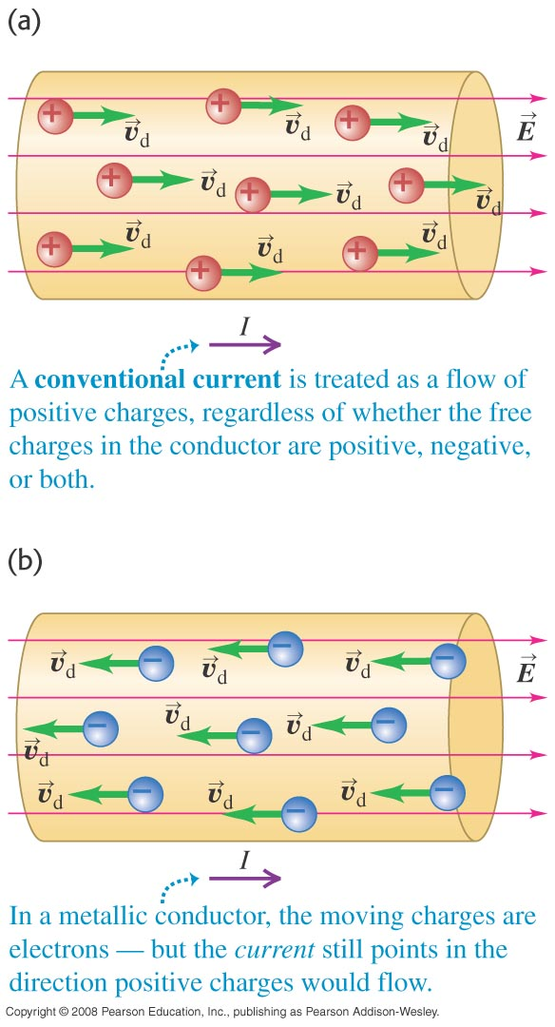
Direction of current flow
  A current can be produced by positive or negative charge flow.
  Conventional current is treated as a flow of positive charges.
  The moving charges in metals are electrons (see figure below).

Slide 20
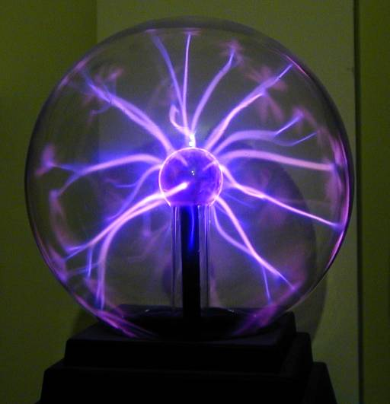


Direction of current flow
Plasma
Semiconductor

Slide 21
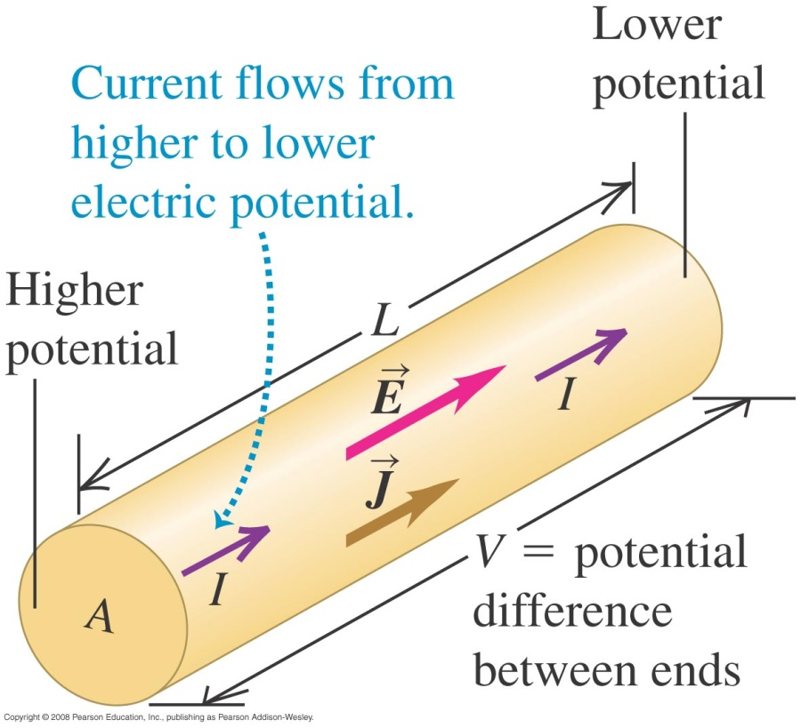
Resistance ( Material + Geo.)
  The resistance of a conductor is R = ρL/A (see Figure 25.7 below).
  The potential across a conductor is V = IR.
  If V is directly proportional to I (that is, if R is constant), the equation V = IR is called Ohm’s law.

Slide 22
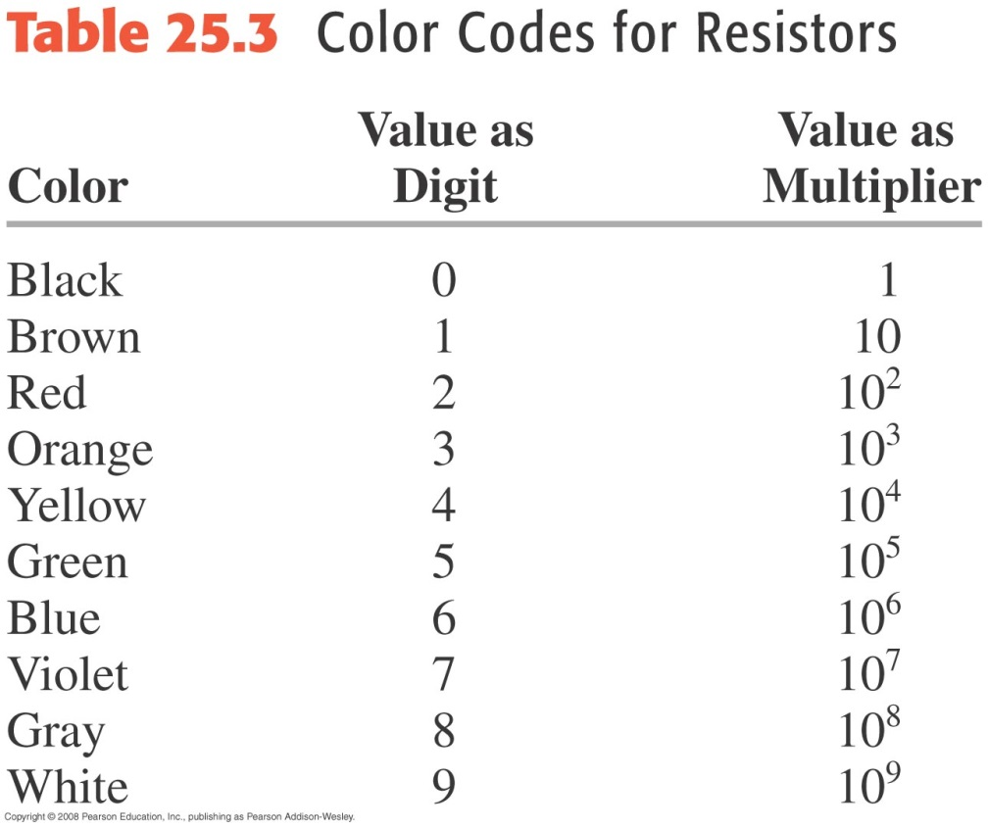
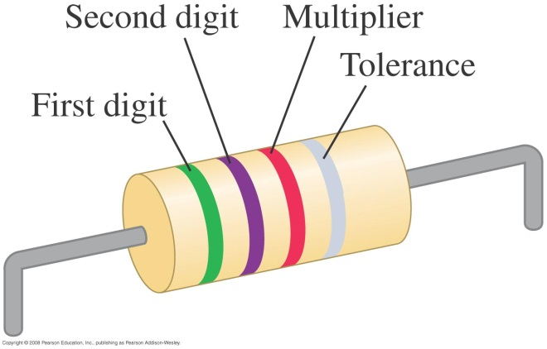
Resistors are color-coded for easy identification
This resistor has a resistance of 5.7 kΩ with a tolerance of ±10%.

Slide 23
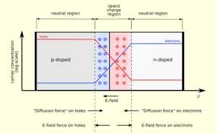
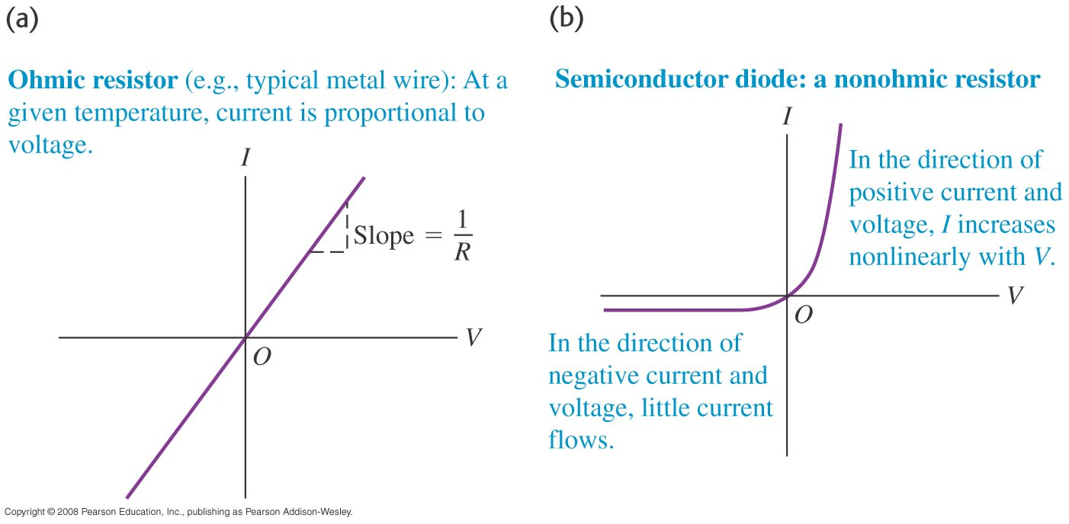
Ohmic and nonohmic resistors

Slide 24
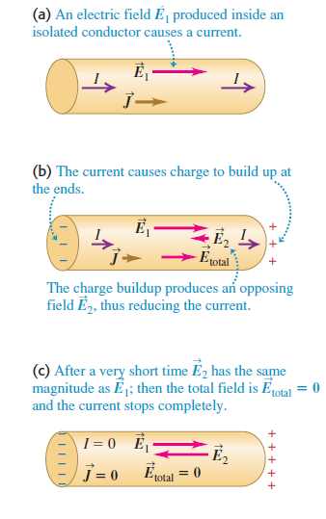
Circuits

Slide 25
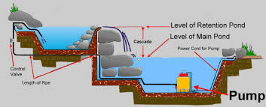
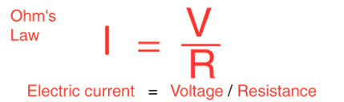
Electromotive force and circuits
V
emf
pumping
V

Slide 26
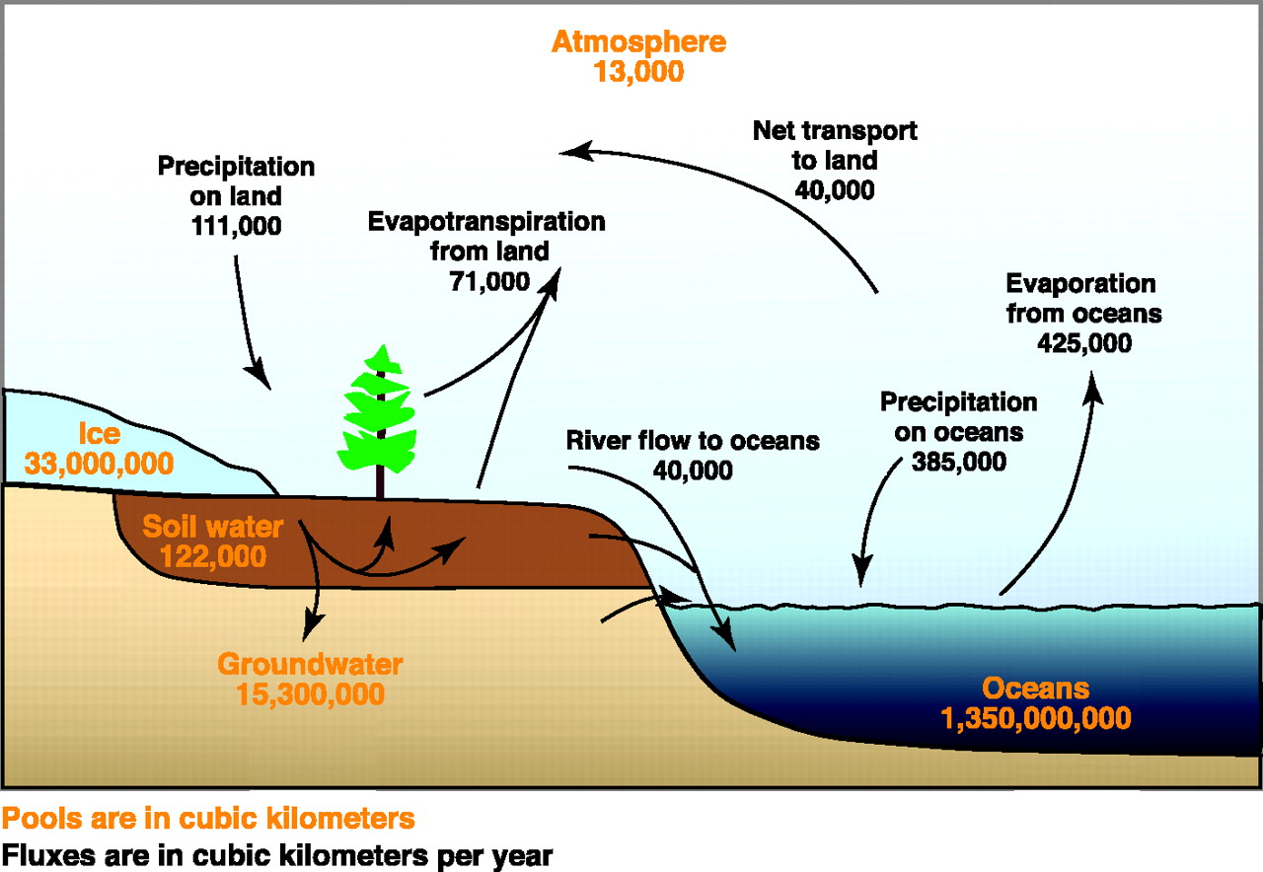

Slide 27
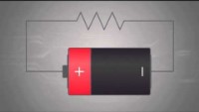
https://www.youtube.com/watch?v=cbSKkrzdXe4

Slide 28
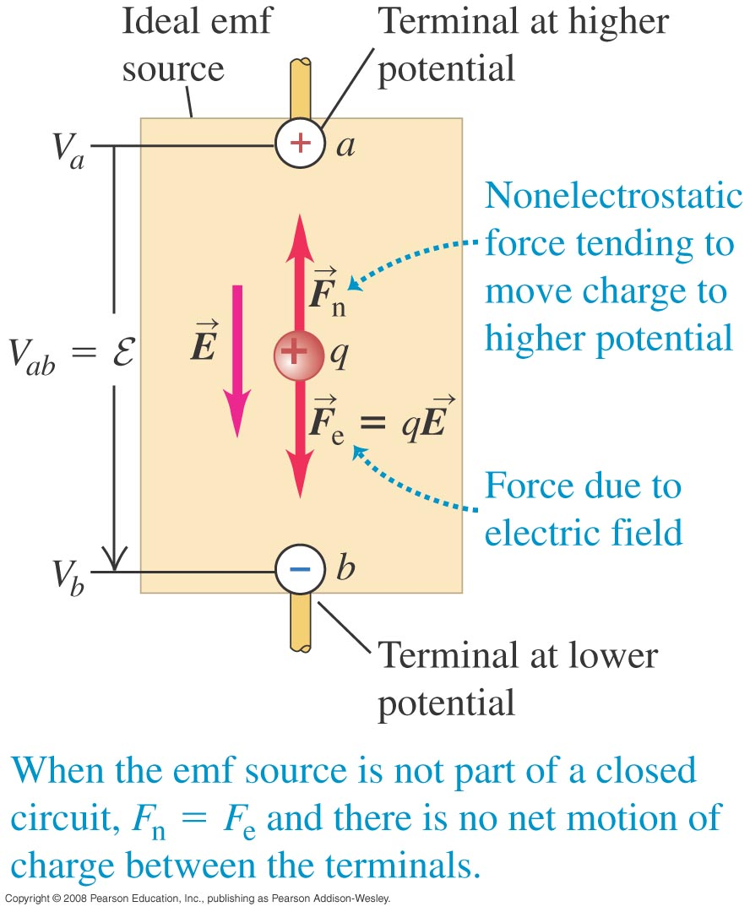




Electromotive force and circuits
  An electromotive force (emf) makes current flow. In spite of the name, an emf is not a force.
  The figures below show a source of emf in an open circuit (left) and in a complete circuit (right).

Slide 29
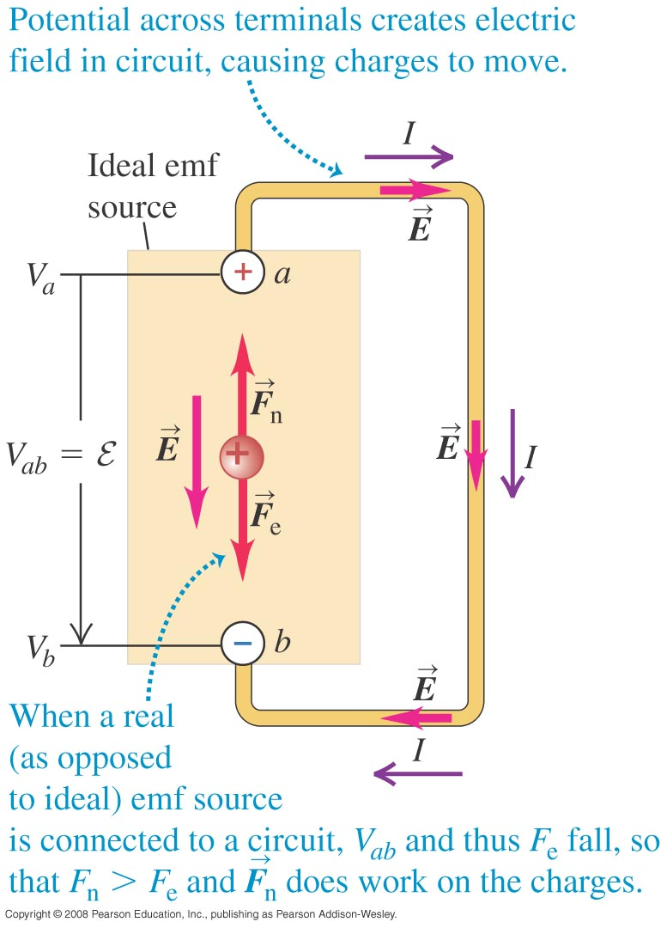

Electromotive force and circuits
  An electromotive force (emf) makes current flow. In spite of the name, an emf is not a force.
  The figures below show a source of emf in an open circuit (left) and in a complete circuit (right).

Slide 30
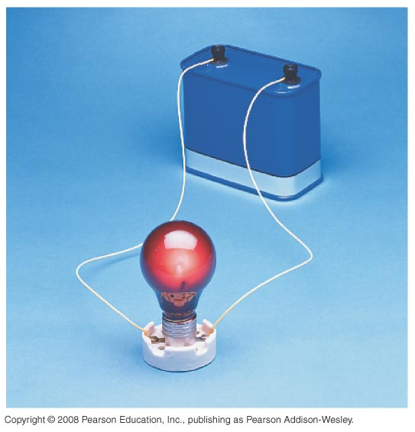
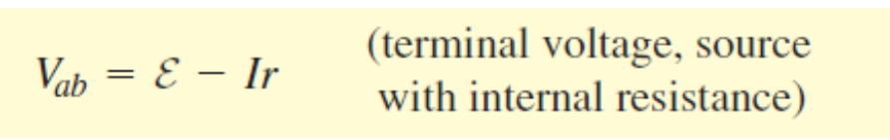
Internal resistance
  Real sources of emf actually contain some internal resistance r.
  The terminal voltage of an emf source is V_{ab} = ξ – Ir.
  The terminal voltage of the 12-V battery shown at the right is less than 12 V when it is connected to the light bulb.

Slide 31

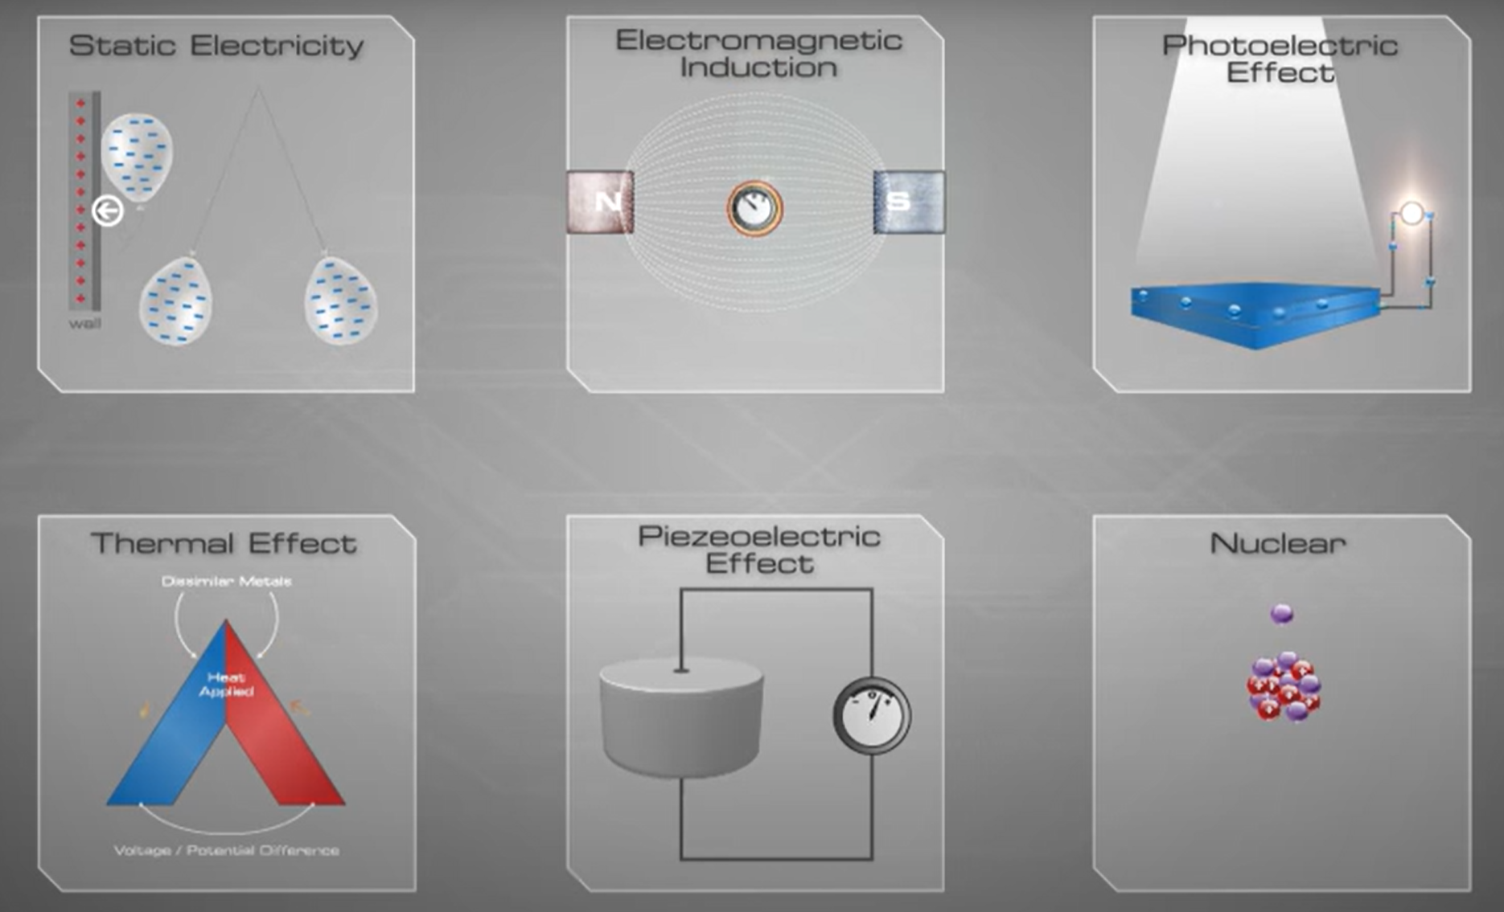

Slide 32
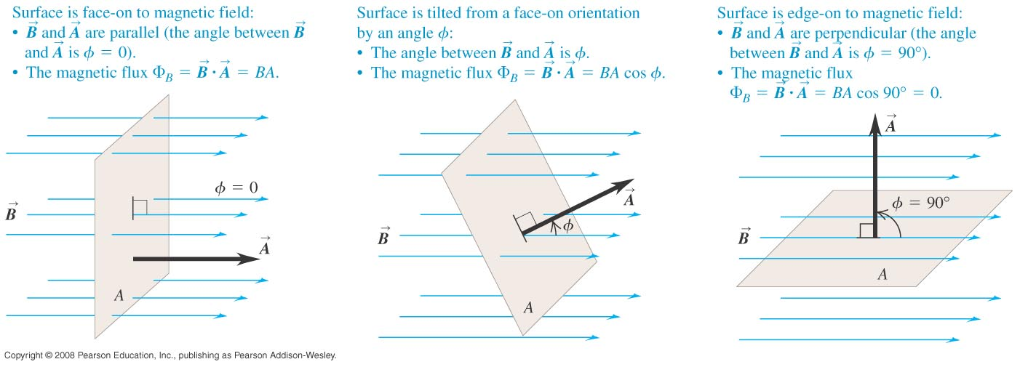
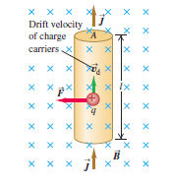
Faraday’s law
  The flux depends on the orientation of the surface with respect to the magnetic field. See Figure 29.4 below.

Slide 33
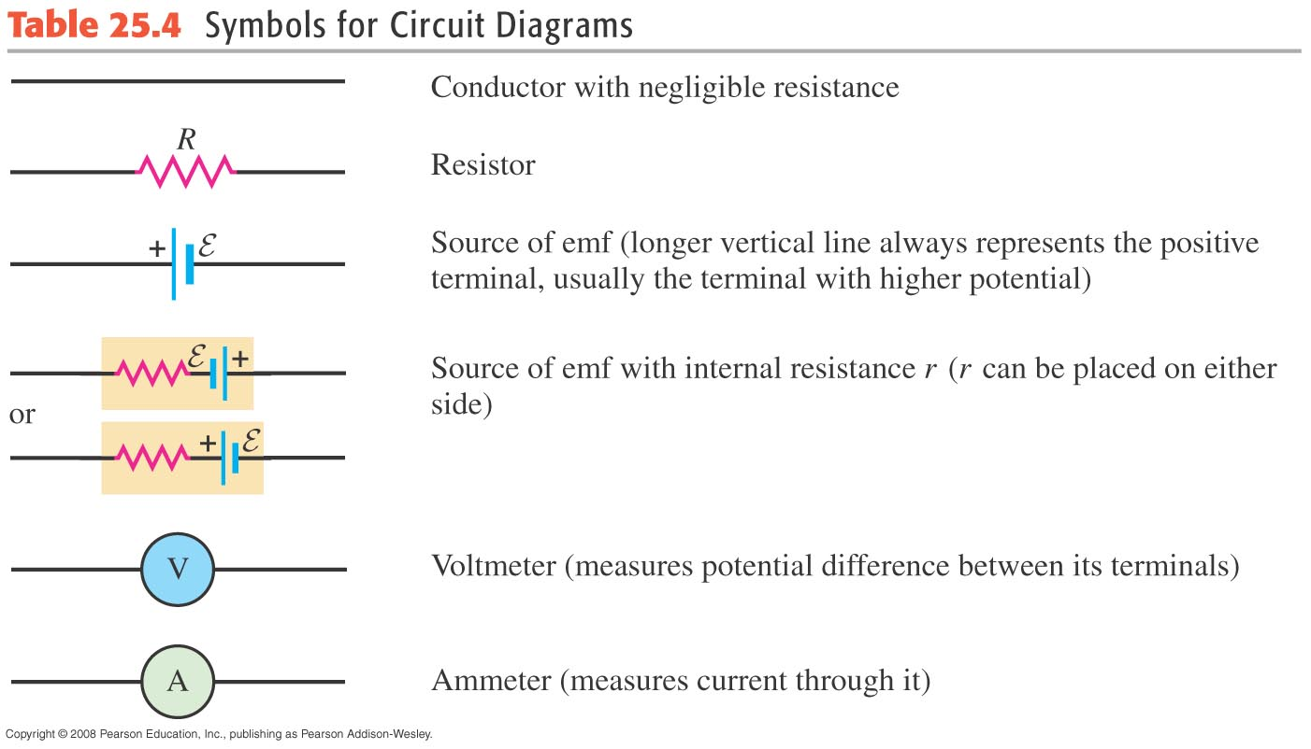
Symbols for circuit diagrams
  Table 25.4 shows the usual symbols used in circuit diagrams.

Slide 34
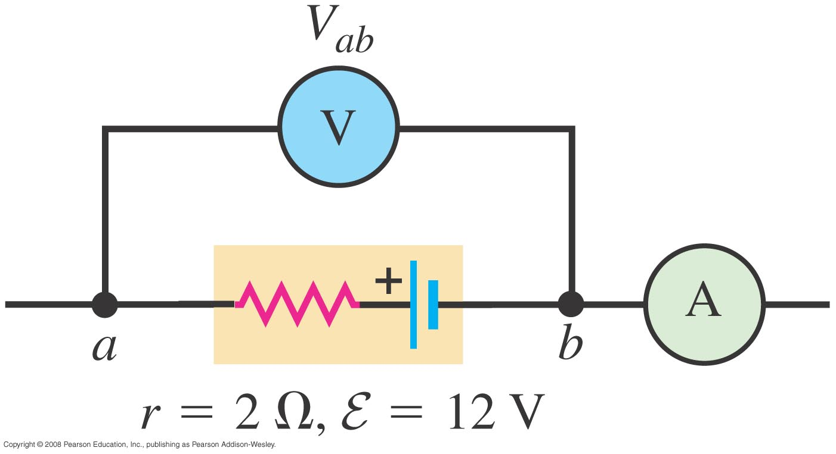
A source in an open circuit
  Follow Conceptual Example 25.4 using Figure 25.16 below.

Slide 35
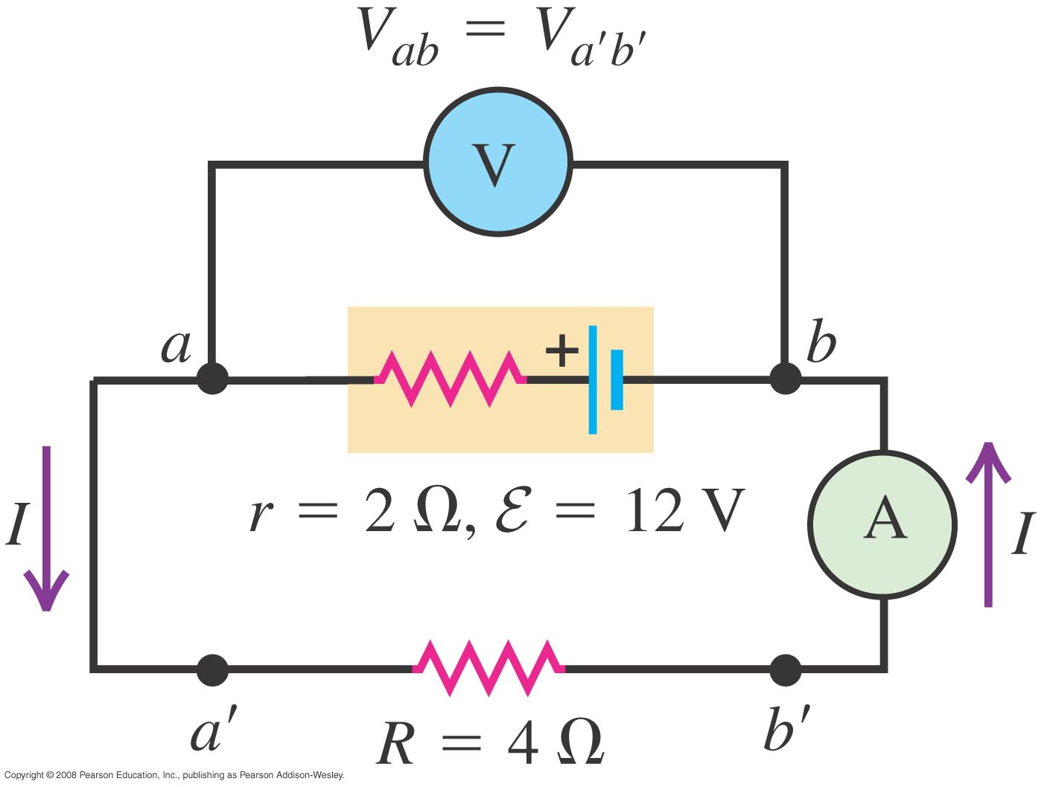
Source in a complete circuit
  Follow Example 25.5 using Figure 25.17 below.

Slide 36
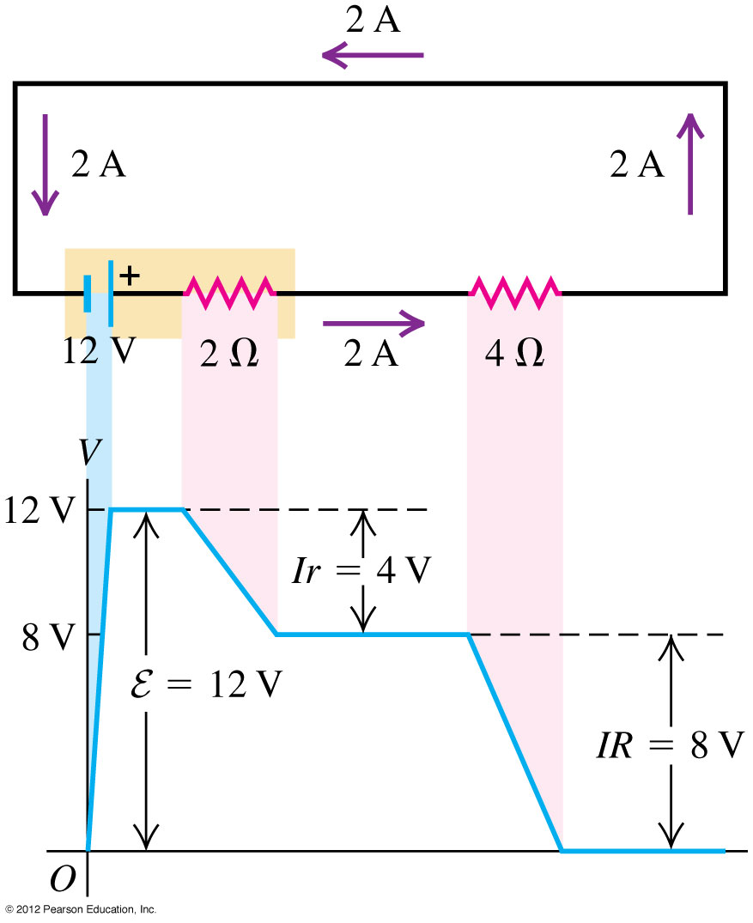
Potential changes around a circuit
  The net change in potential must be zero for a round trip in a circuit.
  Follow Figure 25.20 at the right.

Slide 37
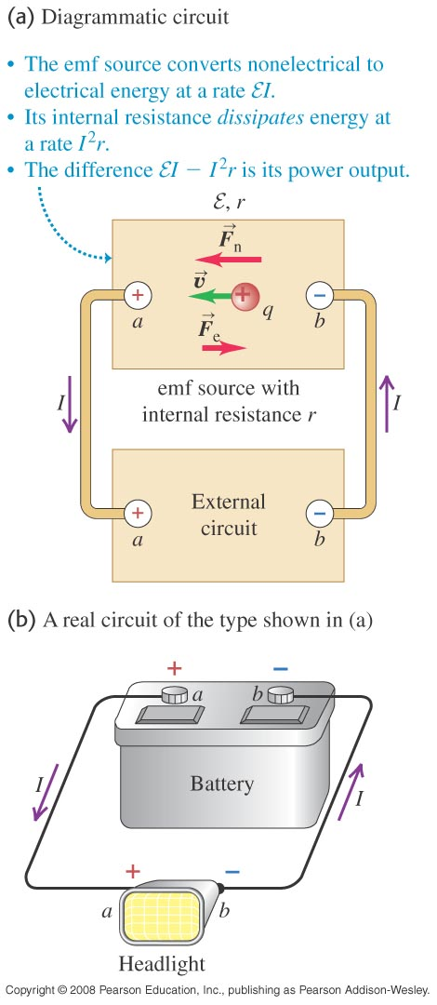
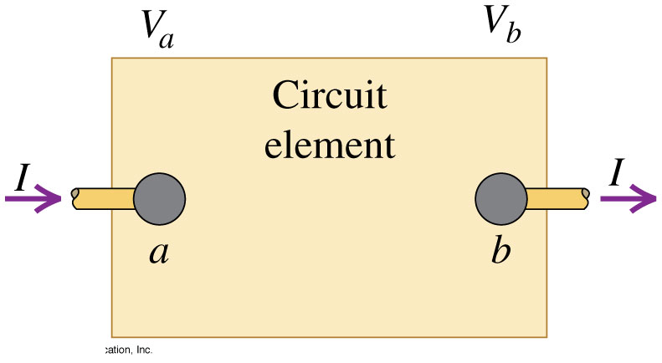
Energy and power in electric circuits
  The rate at which energy is delivered to (or extracted from) a circuit element is P = V_{ab}I. See Figures 25.21 (below) and 25.22 (at right).
  The power delivered to a pure resistor is P = I²R = V_{ab}²/R.

Slide 38
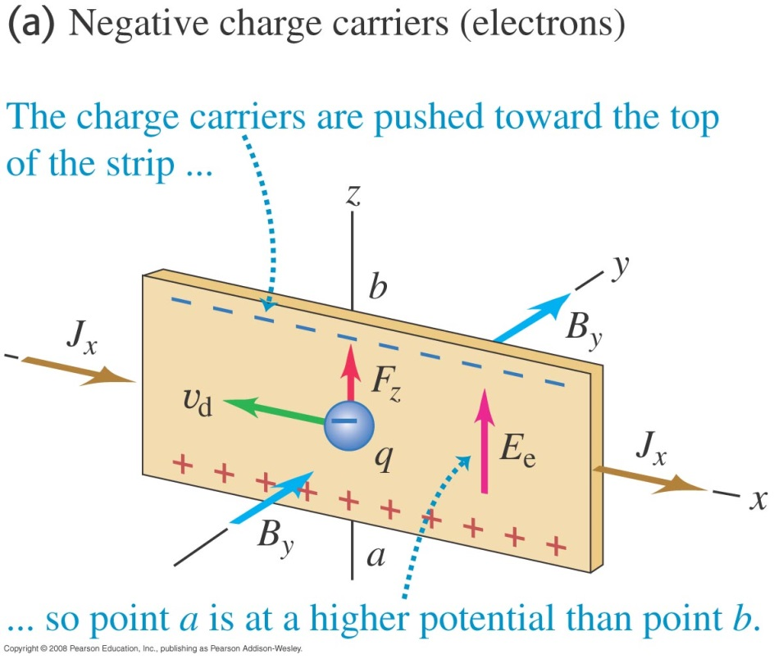
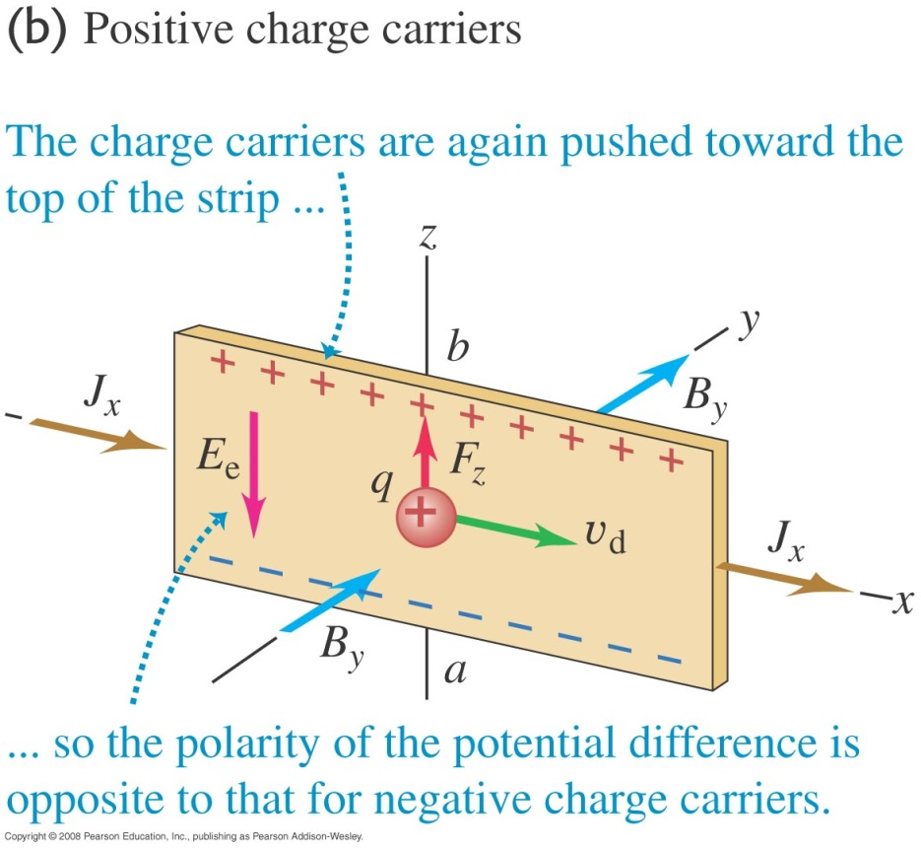

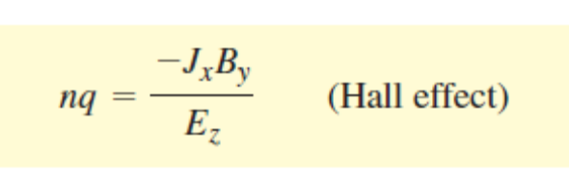

The Hall Effect
Follow the discussion of the Hall effect in the text using Figure 27.41 below.
Follow Example 27.12.

