Slide 1
Chapter 28
Sources of
Magnetic Field

Slide 2
Goals for Chapter 28
To determine the magnetic field produced by a moving charge
To study the magnetic field of an element of a current-carrying conductor
To calculate the magnetic field of a long, straight, current-carrying conductor
To study the magnetic force between current-carrying wires
To determine the magnetic field of a circular loop
To use Ampere’s Law to calculate magnetic fields

Slide 3
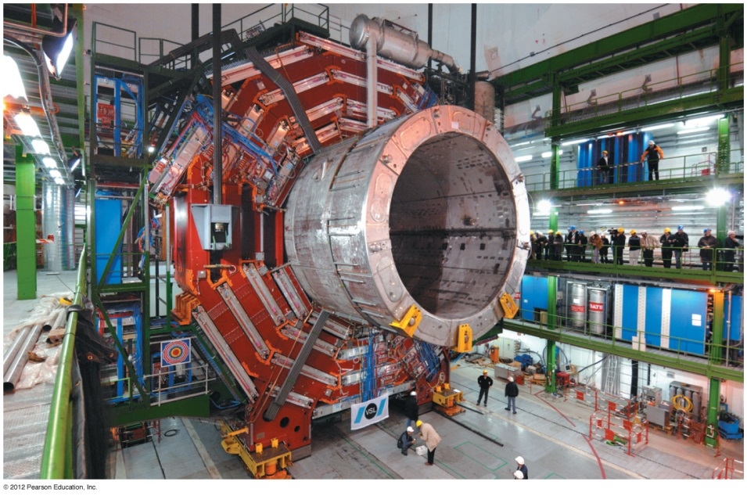
Introduction
What can we say about the magnetic field due to a solenoid?
What actually creates magnetic fields?
We will introduce Ampere’s law to calculate magnetic fields.

Slide 4


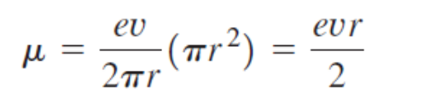

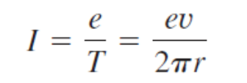


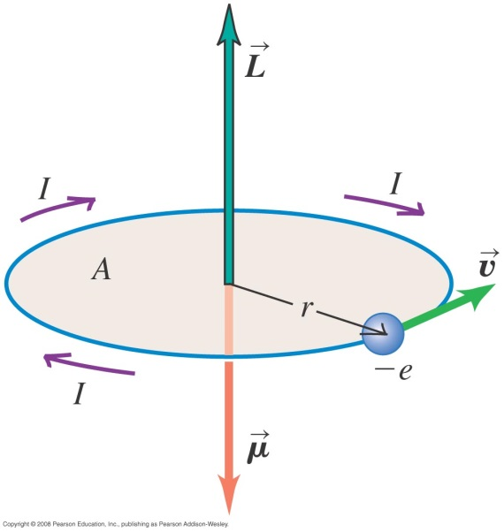


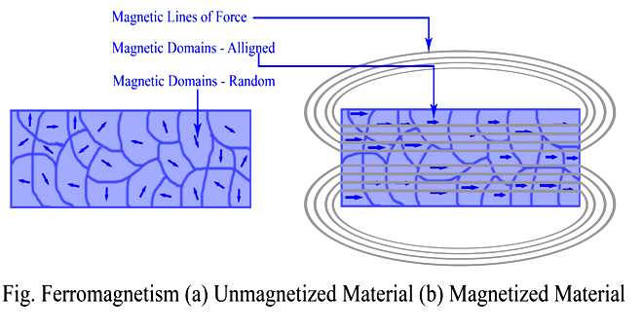
The Bohr magneton and paramagnetism
Follow the text discussions of the Bohr magneton

Slide 5
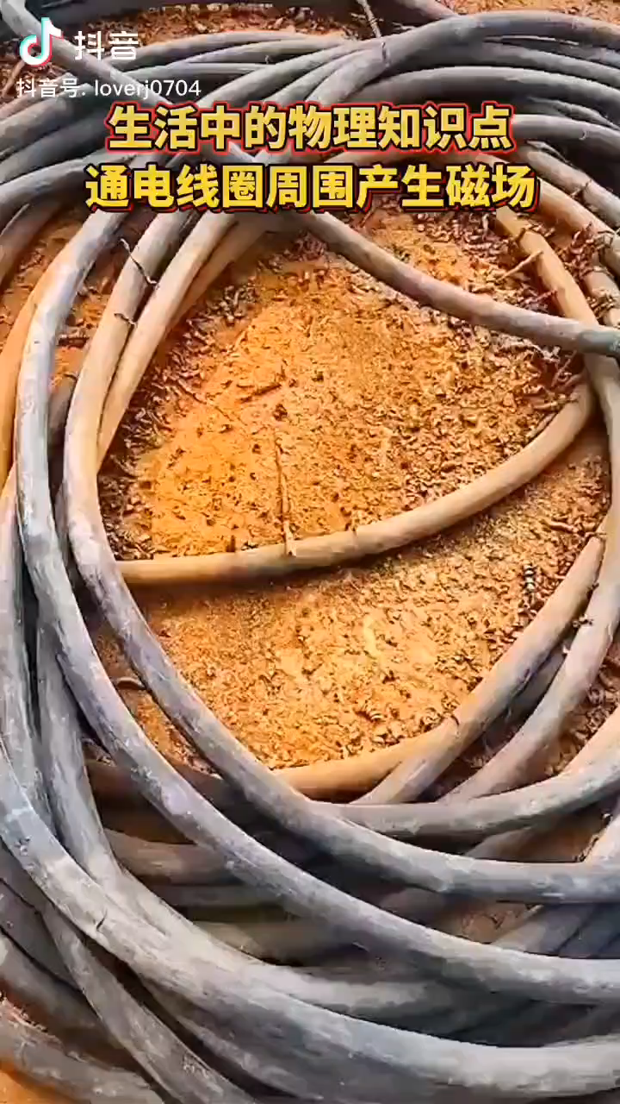

Slide 6
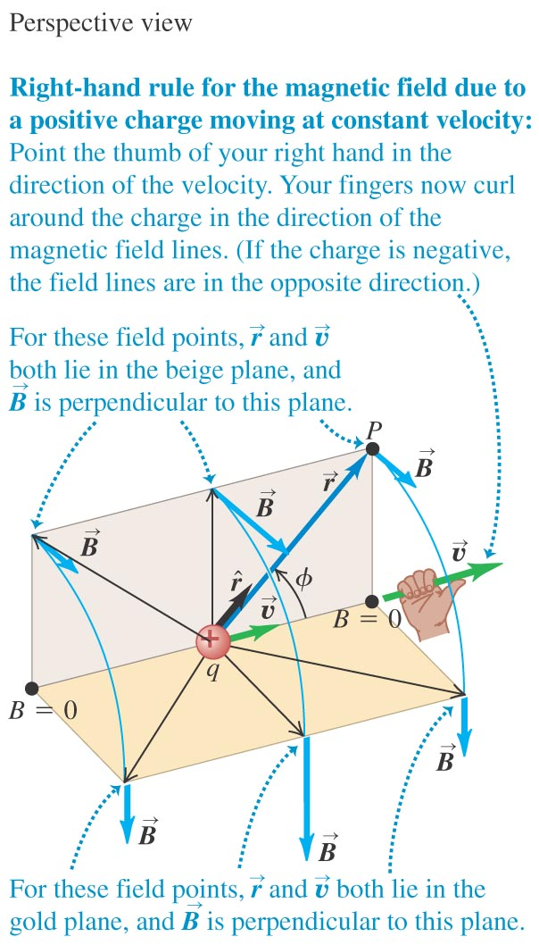
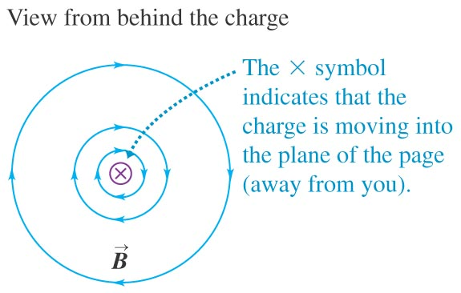
The magnetic field of a moving charge
A moving charge generates a magnetic field that depends on the velocity of the charge.
Figure 28.1 shows the direction of the field.

Slide 7


The magnetic field of a moving charge

Slide 8
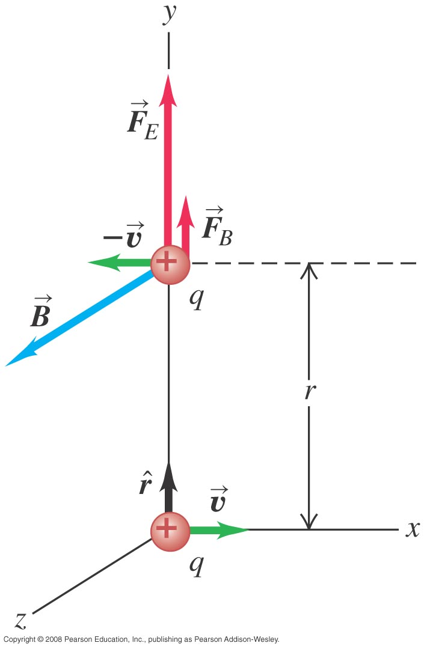






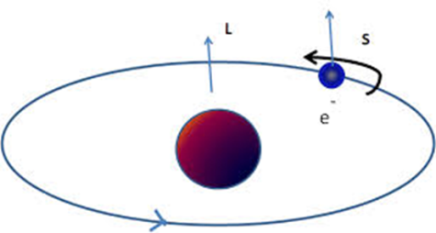
Magnetic force between moving protons
10⁶ m/s

Slide 9

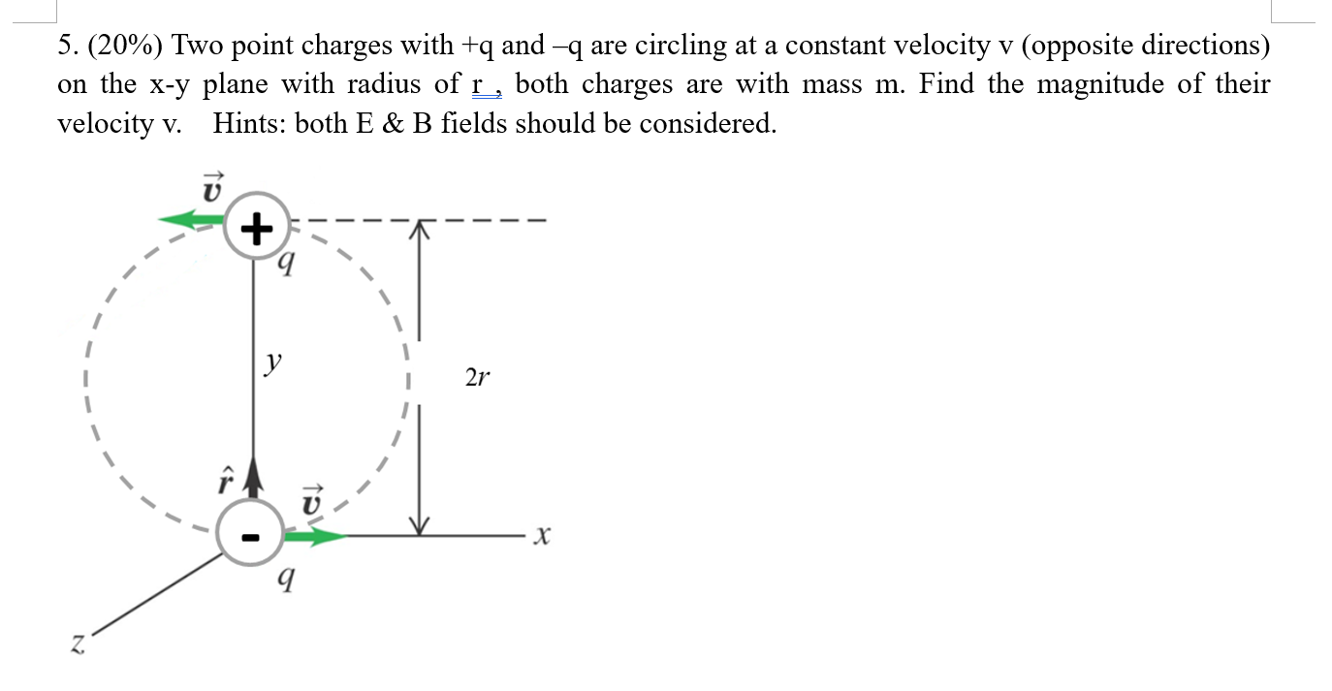

Slide 10
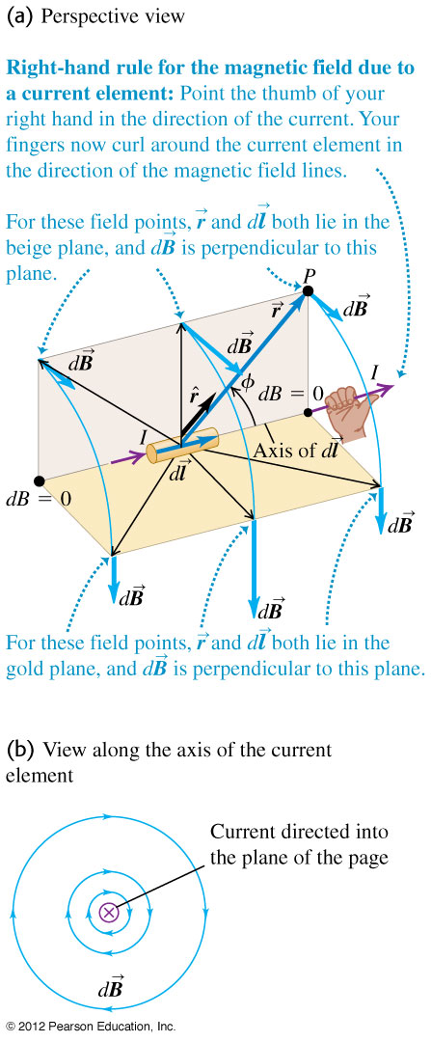






Magnetic field of a current element
law of Biot and Savart.

Slide 11
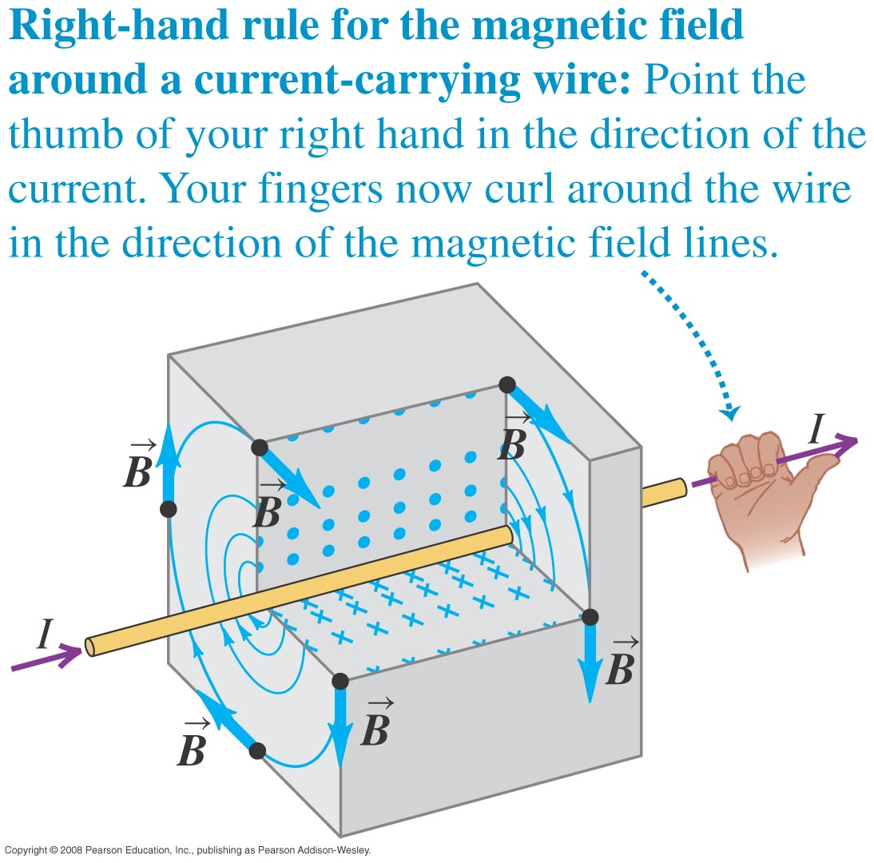
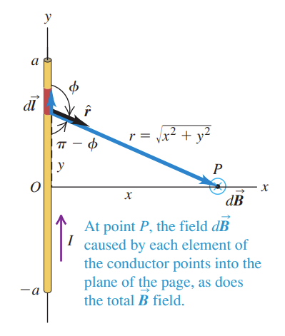
Magnetic field of a straight current-carrying conductor
If we apply the law of Biot and Savart to a long straight conductor, the result is B = μ₀I/2πx. See Figure 28.5 below left. Figure 28.6 below right shows the right-hand rule for the direction of the force.

Slide 12




Magnetic field of a straight current-carrying conductor
If we apply the law of Biot and Savart to a long straight conductor, the result is B = μ₀I/2πx. See Figure 28.5 below left. Figure 28.6 below right shows the right-hand rule for the direction of the force.

Slide 13
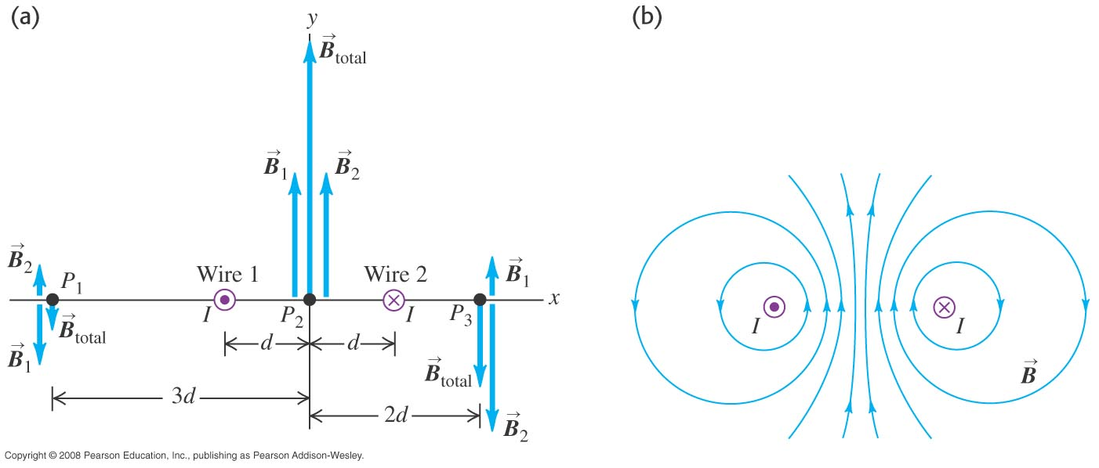
Magnetic fields of long wires
Follow Example 28.3 for one wire.
Follow Example 28.4 for two wires. Use Figure 28.7 below.
http://www.falstad.com/vector3dm/

Slide 14
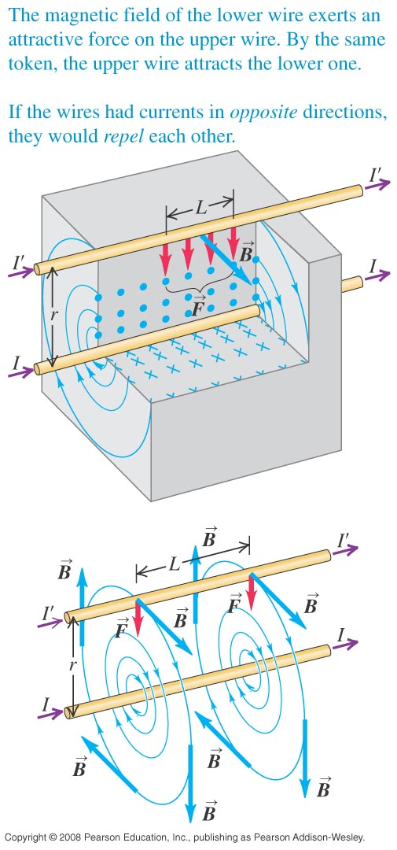



Force between parallel conductors

Slide 15
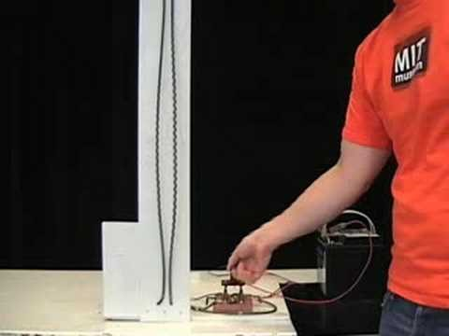
https://www.youtube.com/watch?v=43AeuDvWc0k

Slide 16
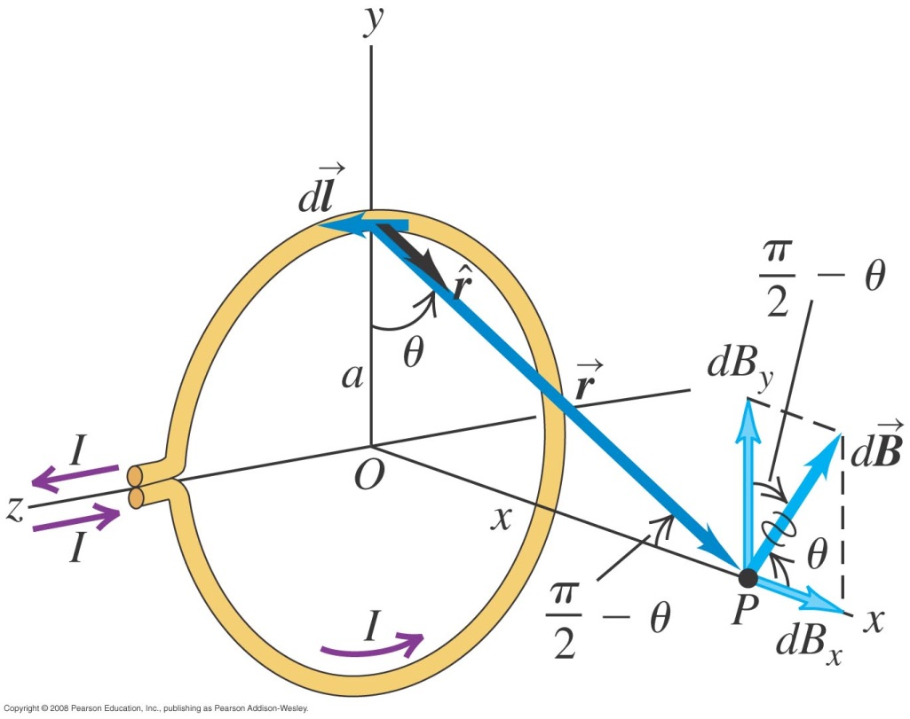
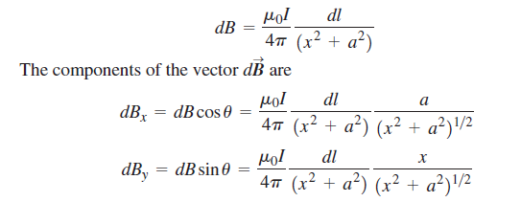


Magnetic field of a circular current loop

Slide 17
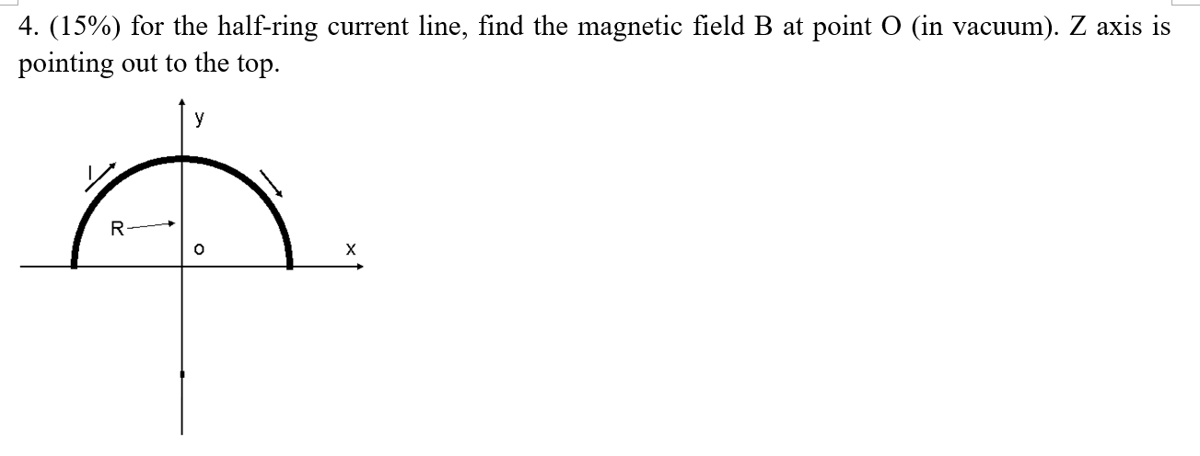

Slide 18
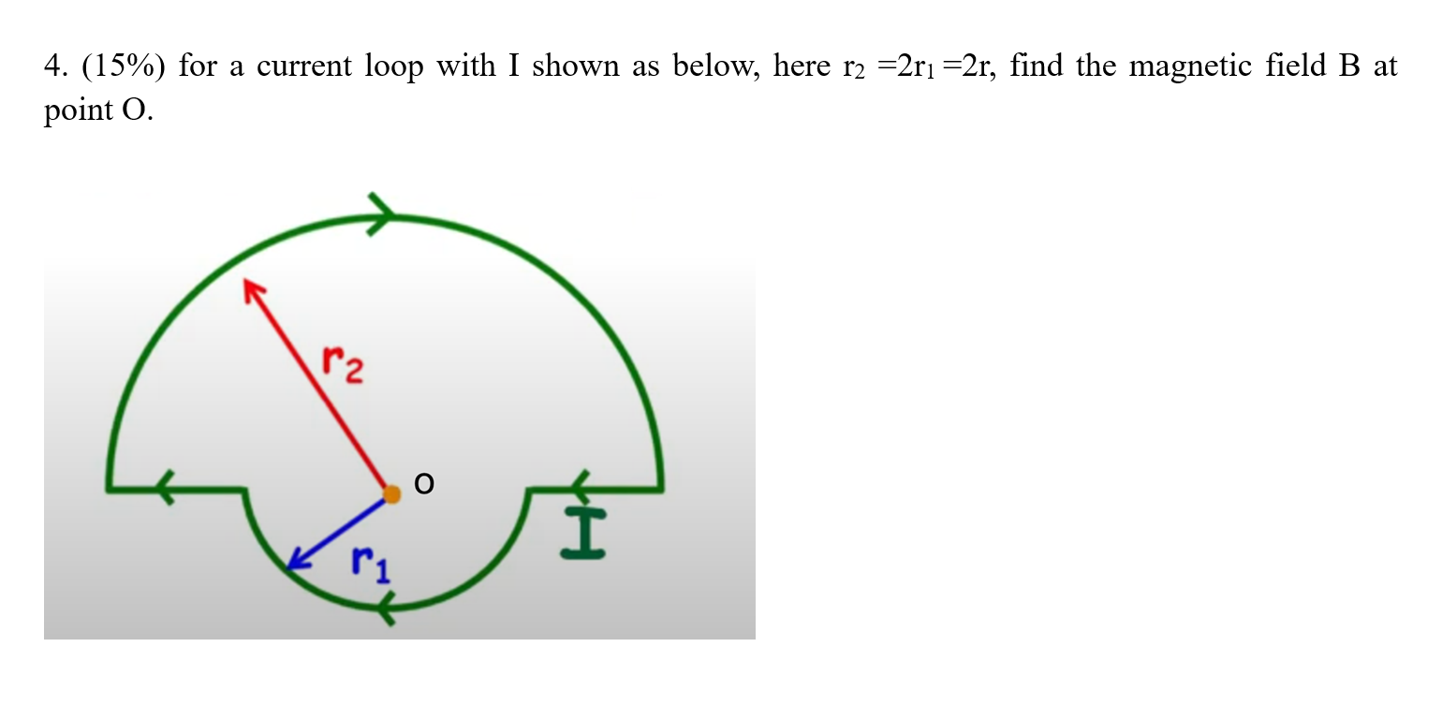

Slide 19
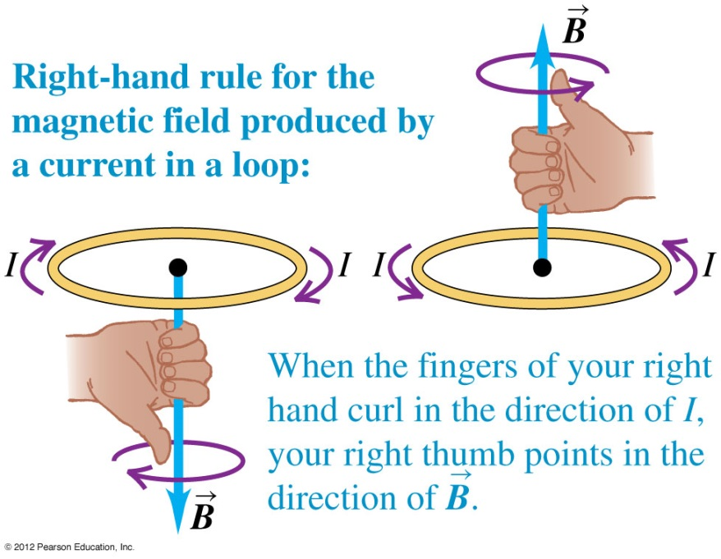
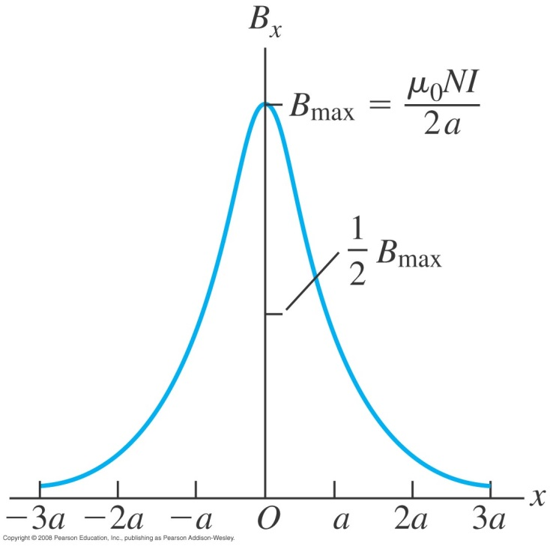
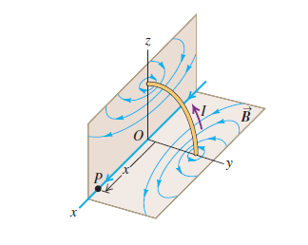
Magnetic field of a coil
Figure 28.13 (top) shows the direction of the field using the right-hand rule.
Figure 28.14 (below) shows a graph of the field along the x-axis.
Follow Example 28.6.

Slide 20

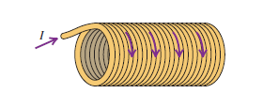

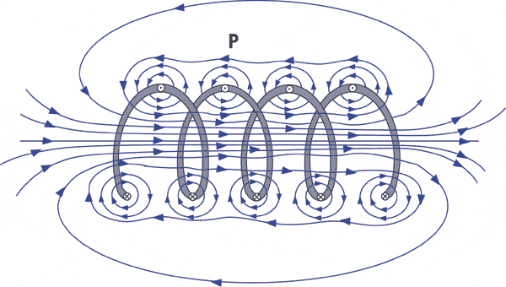
Magnetic field of a coil

Slide 21
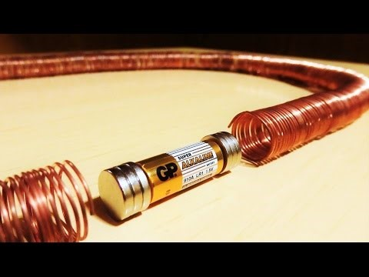
https://www.youtube.com/watch?v=J9b0J29OzAU

Slide 22
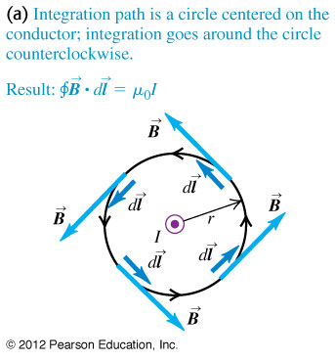
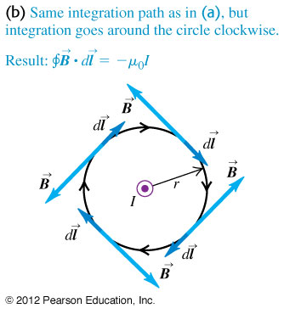
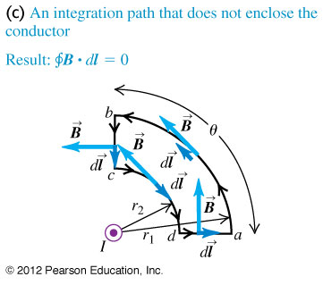


Ampere’s law (special case)
Follow the text discussion of Ampere’s law for a circular path around a long straight conductor, using Figure 28.16 below.

Slide 23
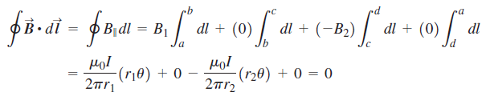
Ampere’s law (special case)
Follow the text discussion of Ampere’s law for a circular path around a long straight conductor, using Figure 28.16 below.

Slide 24
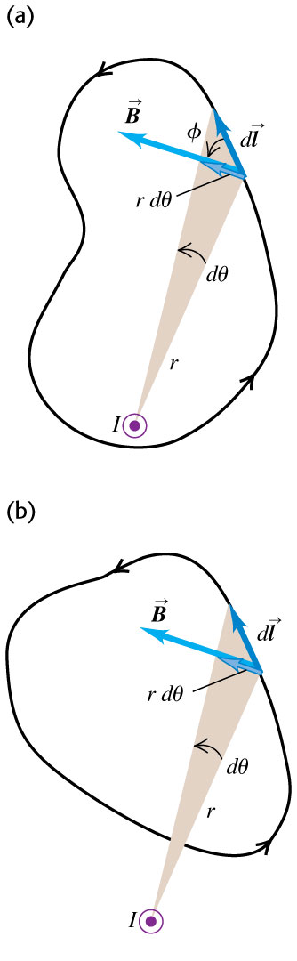
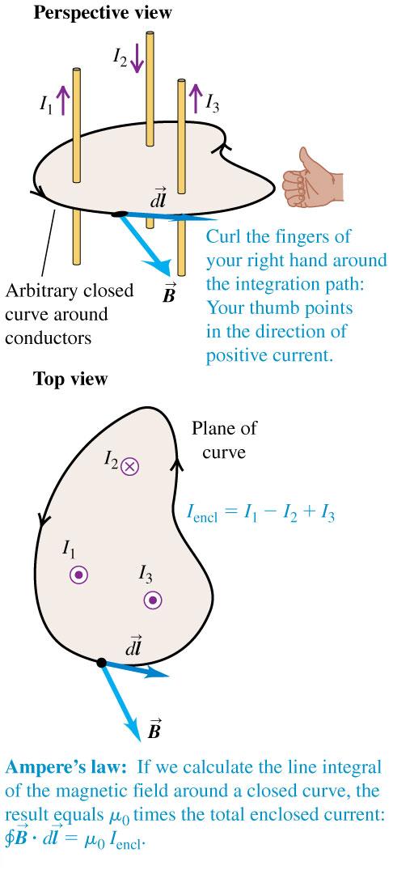




Ampere’s law (general statement)
Follow the text discussion of the general statement of Ampere’s law, using Figures 28.17 and 28.18 below.

Slide 25
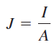
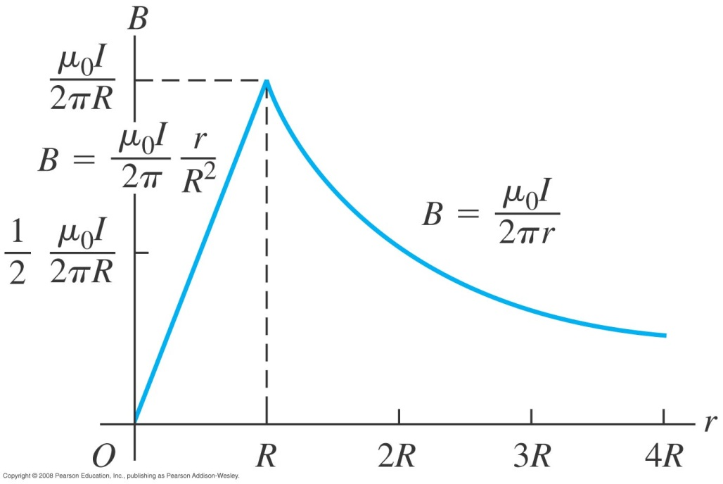
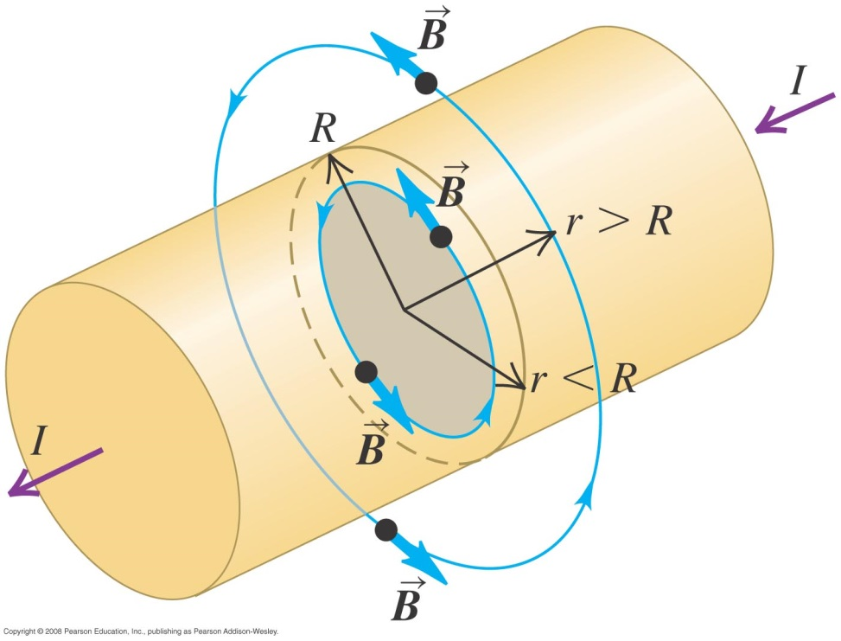
Magnetic fields of long conductors
Read Problem-Solving Strategy 28.2.
Follow Example 28.7 for a long straight conductor.

Slide 26
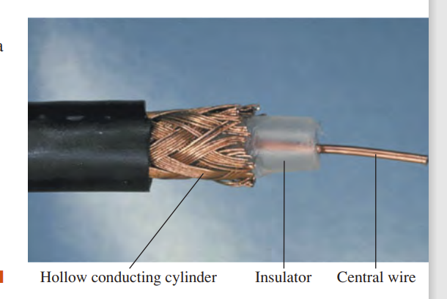
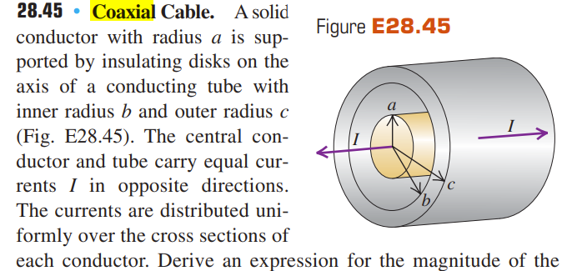
Magnetic fields of long conductors

Slide 27
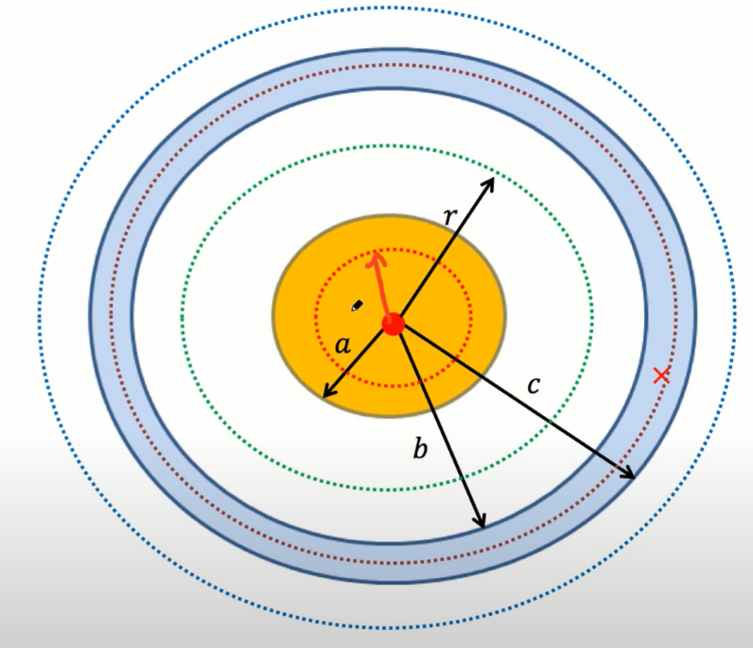
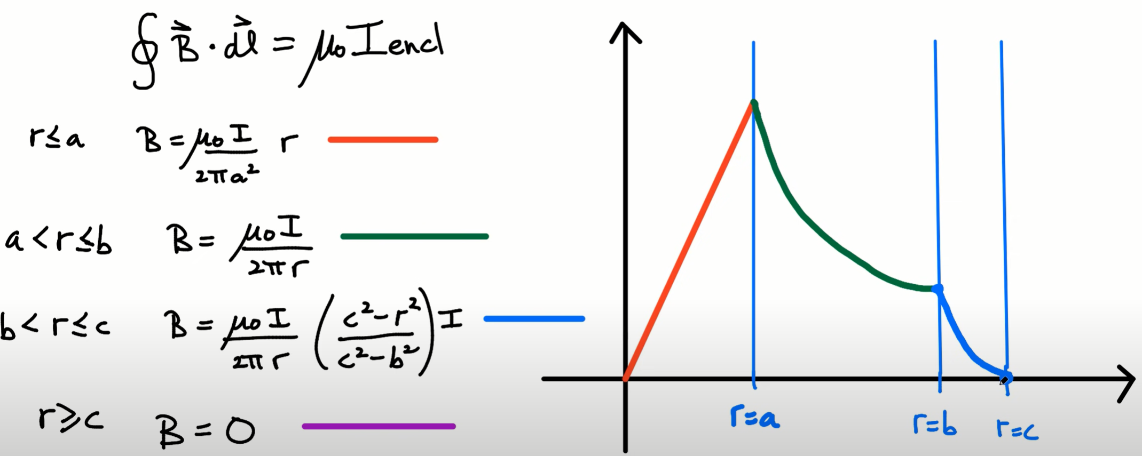

Slide 28
Magnetic field of a coil
Figure 28.13 (top) shows the direction of the field using the right-hand rule.
Figure 28.14 (below) shows a graph of the field along the x-axis.
Follow Example 28.6.

Slide 29
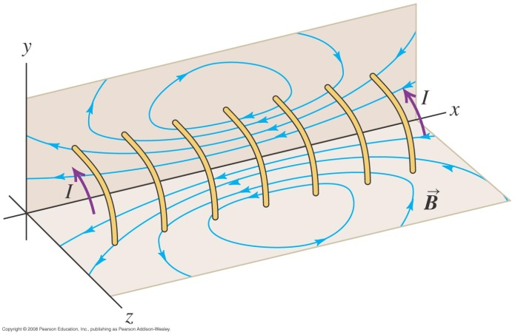
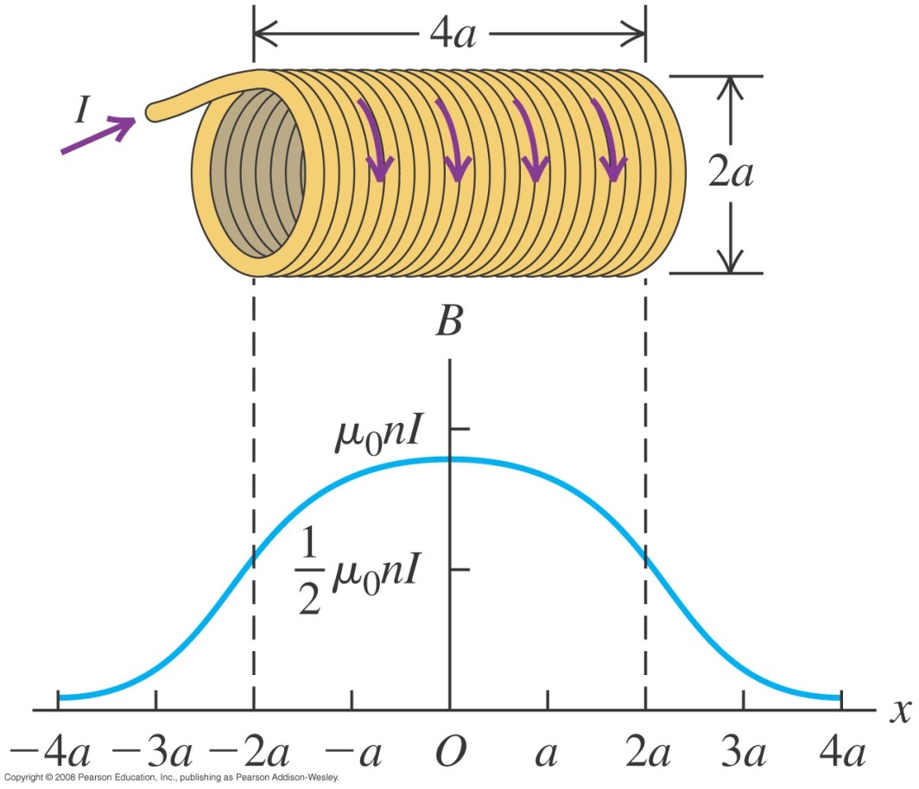
Field of a solenoid
A solenoid consists of a helical winding of wire on a cylinder.
Follow Example 28.9 using Figures 28.22–28.24 below.
http://www.falstad.com/vector3dm/

Slide 30
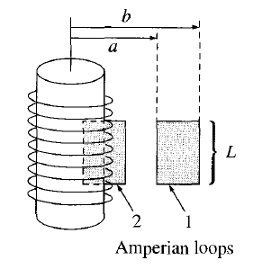
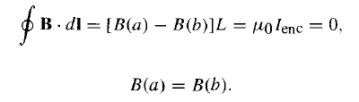
Field of a solenoid
A solenoid consists of a helical winding of wire on a cylinder.
Follow Example 28.9 using Figures 28.22–28.24 below.
B= 0

Slide 31
Field of a solenoid
A solenoid consists of a helical winding of wire on a cylinder.
Follow Example 28.9 using Figures 28.22–28.24 below.

Slide 32
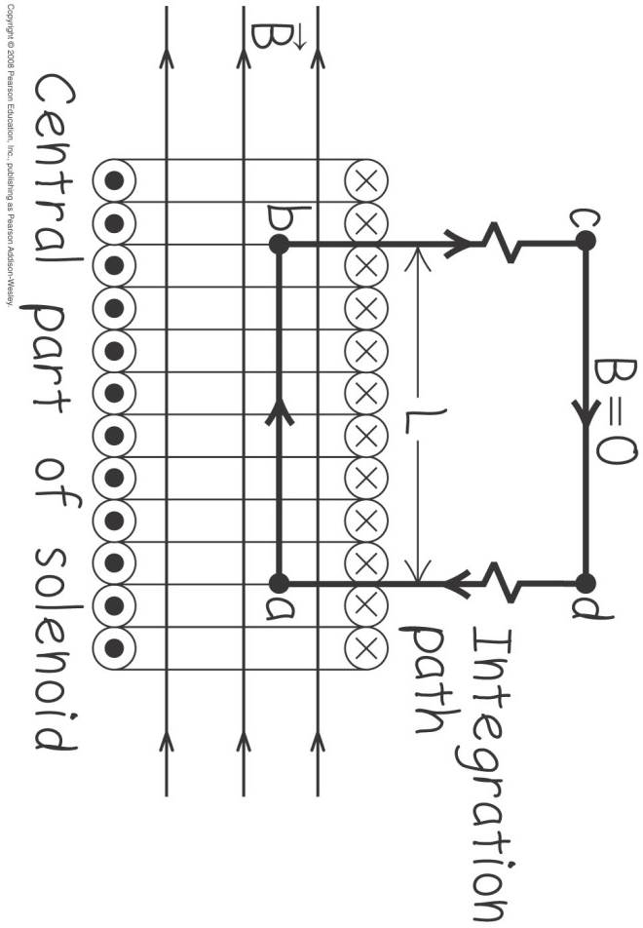


Field of a solenoid
A solenoid consists of a helical winding of wire on a cylinder.
Follow Example 28.9 using Figures 28.22–28.24 below.

Slide 33
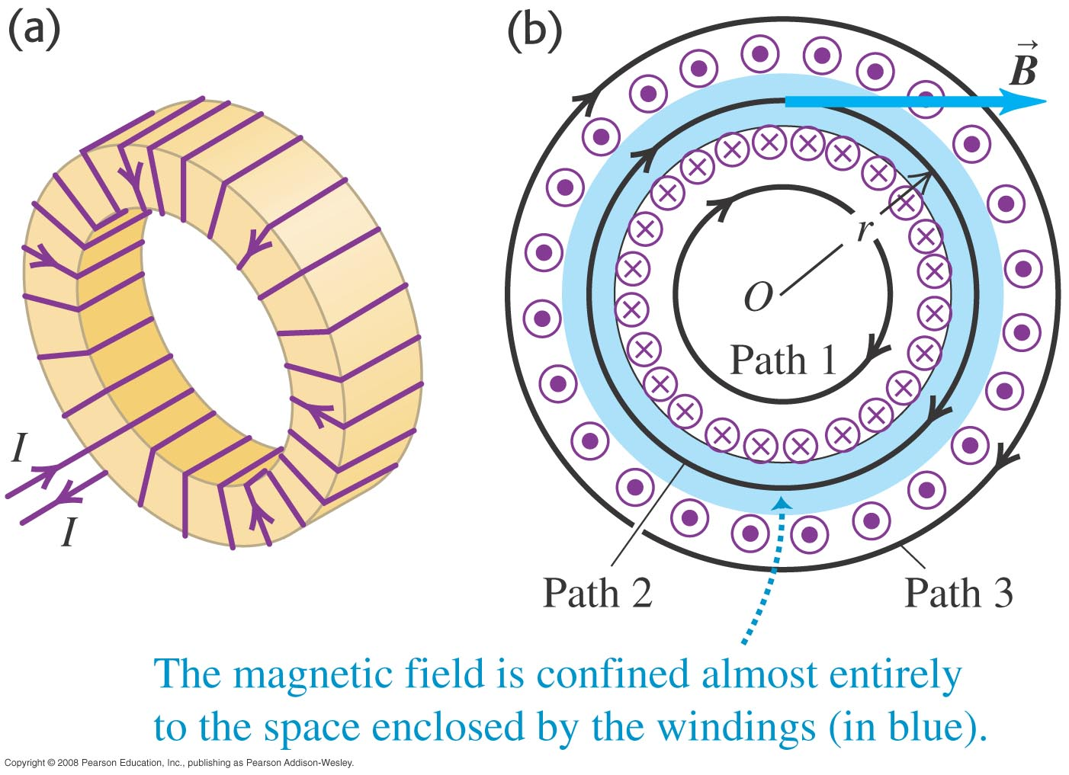

Field of a toroidal solenoid
A toroidal solenoid is a doughnut-shaped solenoid.

Slide 34

The Bohr magneton and paramagnetism
Follow the text discussions of the Bohr magneton

Slide 35
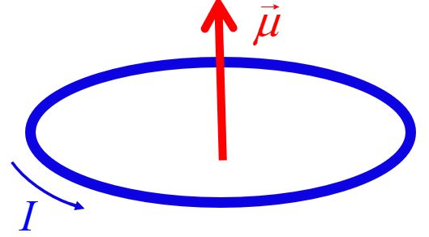
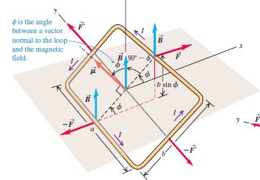
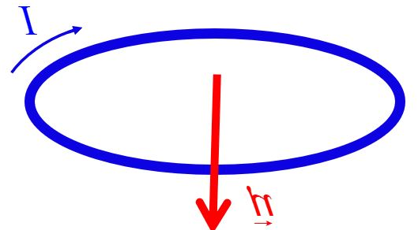
The Bohr magneton and paramagnetism

Slide 36
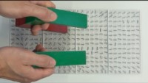
https://www.youtube.com/watch?v=vH5M6vdwqBk

Slide 37





The Bohr magneton and paramagnetism

Slide 38










Molecular model of induced charge - II
  Figure 24.20 below shows polarization of the dielectric and how the induced charges reduce the magnitude of the resultant electric field.

Slide 39

Diamagnetism and Paramagnetism

Slide 40



Perfect diamagnetism
magnetic susceptibility χ_{v} = − 1

Slide 41



ferromagnetism

Slide 42


Diamagnetism and ferromagnetism
Figure 28.27 at the right shows how magnetic domains react to an applied magnetic field.
Figure 28.28 below shows a magnetization curve for a ferromagnetic material.

Slide 43

Hysteresis
Read the text discussion of hysteresis using Figure 28.29 below.
Follow Example 28.12.

Slide 44



Magnetic Lens

