Slide 1
Chapter 29
Electromagnetic Induction

Slide 2
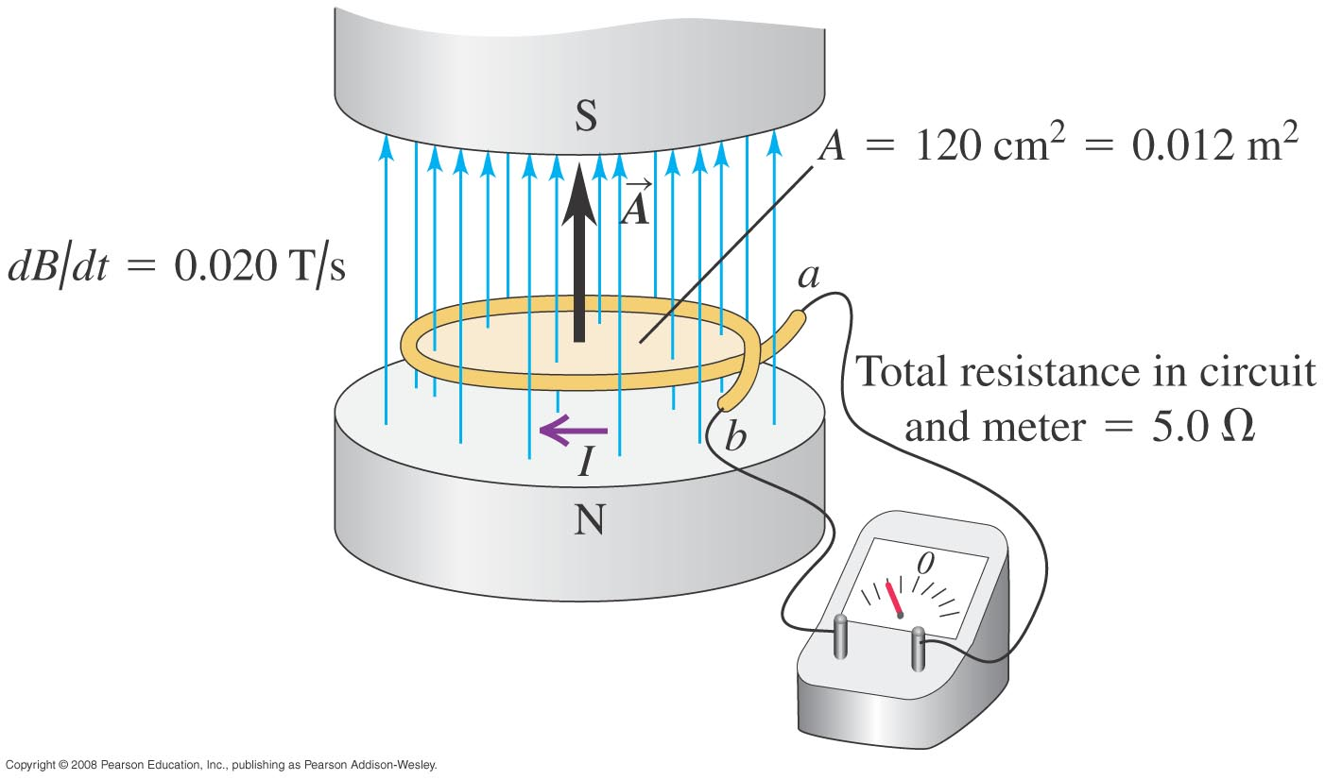


Emf and the current induced in a loop
Follow Example 29.1 using Figure 29.5 below.

Slide 3
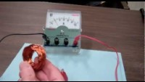
https://www.youtube.com/watch?v=vwIdZjjd8fo&t=26s

Slide 4
Goals for Chapter 29
  To examine experimental evidence that a changing magnetic field induces an emf
  To learn how Faraday’s law relates the induced emf to the change in flux
  To determine the direction of an induced emf
  To calculate the emf induced by a moving conductor
  To learn how a changing magnetic flux generates an electric field
  To study the four fundamental equations that describe electricity and magnetism

Slide 5
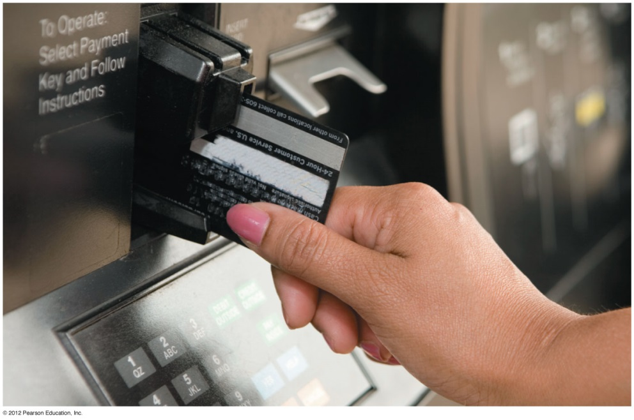
Introduction
  How is a credit card reader related to magnetism?
  Energy conversion makes use of electromagnetic induction.
  Faraday’s law and Lenz’s law tell us about induced currents.
  Maxwell’s equations describe the behavior of electric and magnetic fields in any situation.

Slide 6
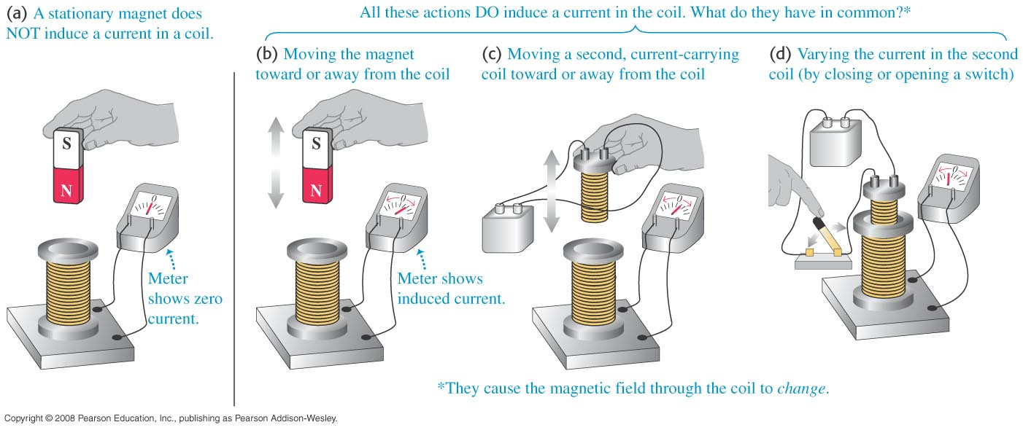
Induced current
  A changing magnetic flux causes an induced current. See Figure 29.1 below.
  The induced emf is the corresponding emf causing the current.

Slide 7
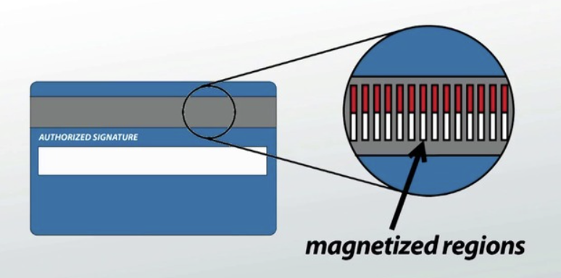

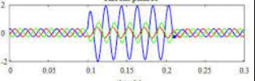

Slide 8

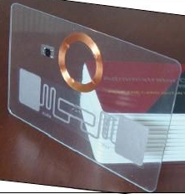
Induced current

Slide 9
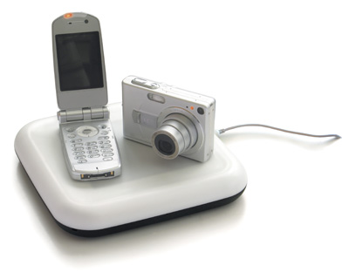
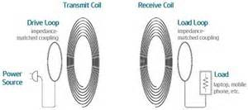


Induced current

Slide 10
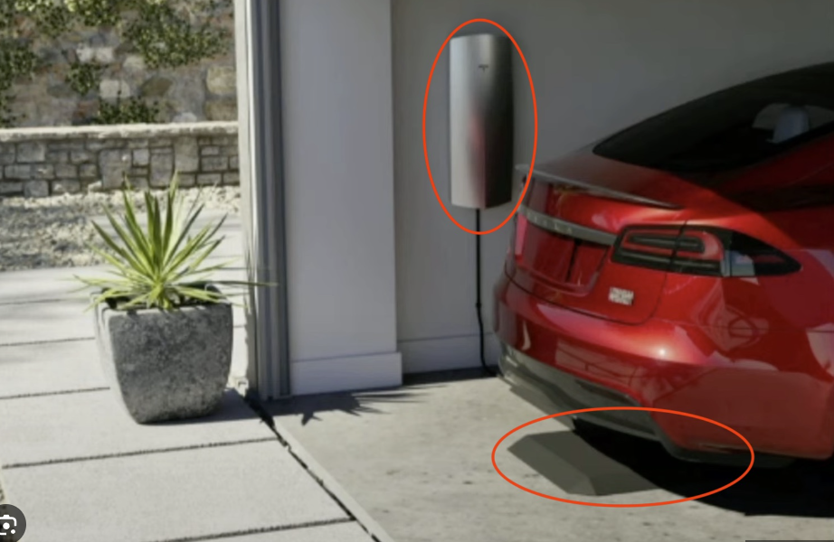

Slide 11

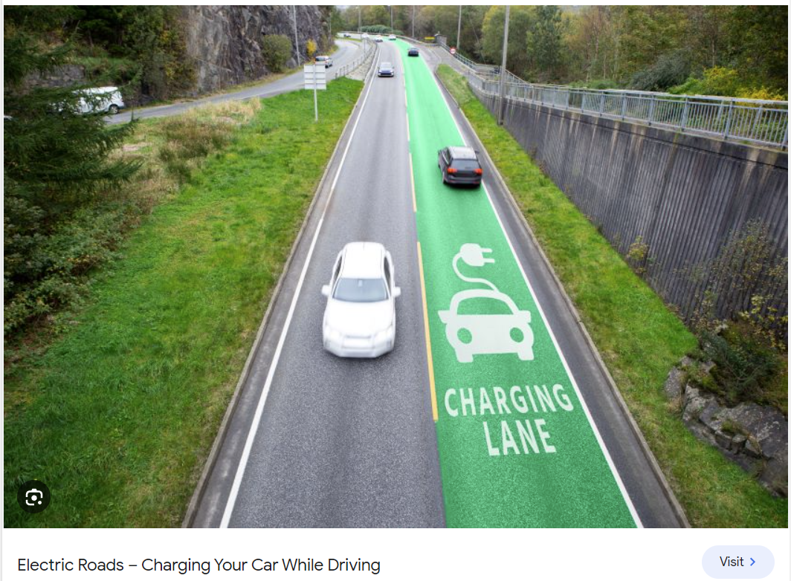

Slide 12
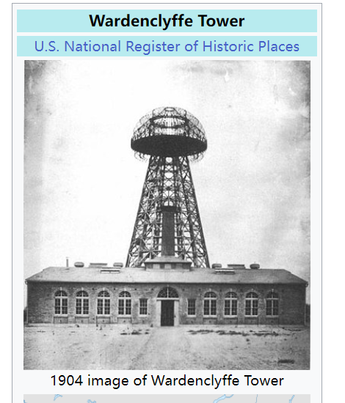
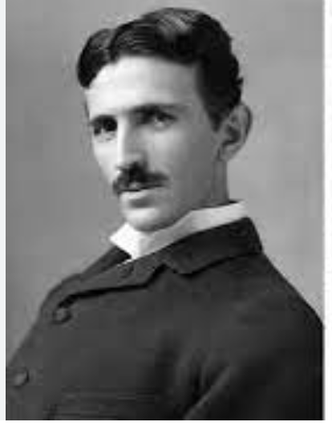
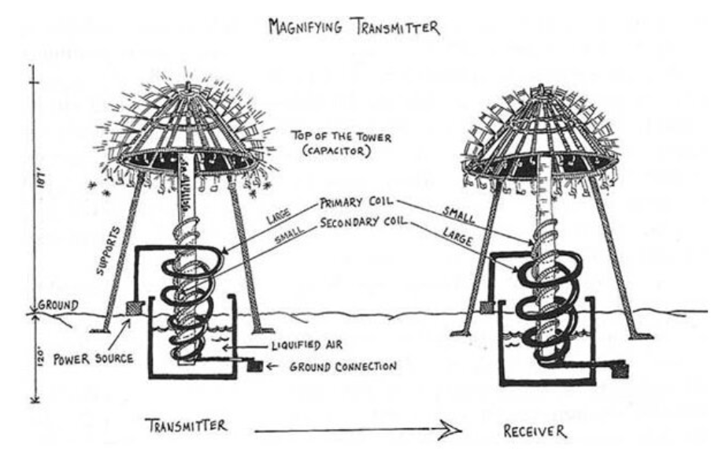

Slide 13
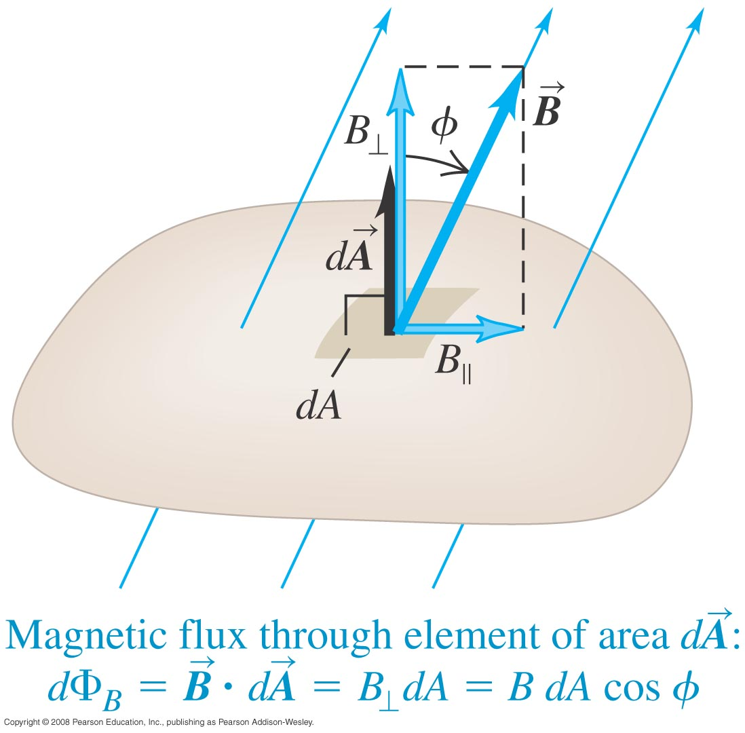
Magnetic flux through an area element
  Figure 29.3 below shows how to calculate the magnetic flux through an element of area.

Slide 14
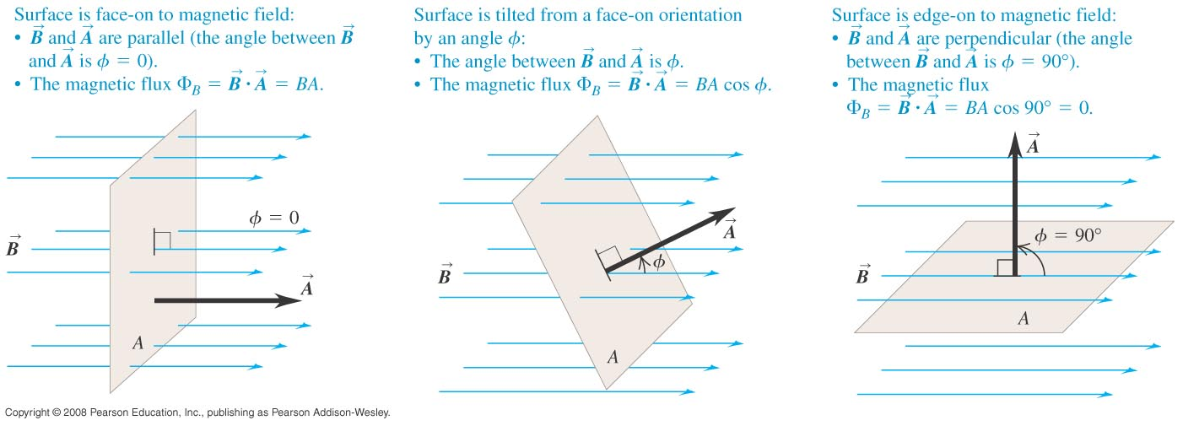
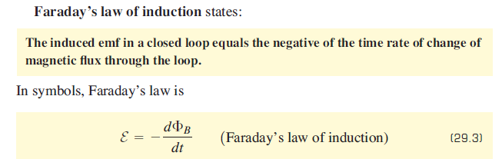
Faraday’s law
  The flux depends on the orientation of the surface with respect to the magnetic field. See Figure 29.4 below.

Slide 15
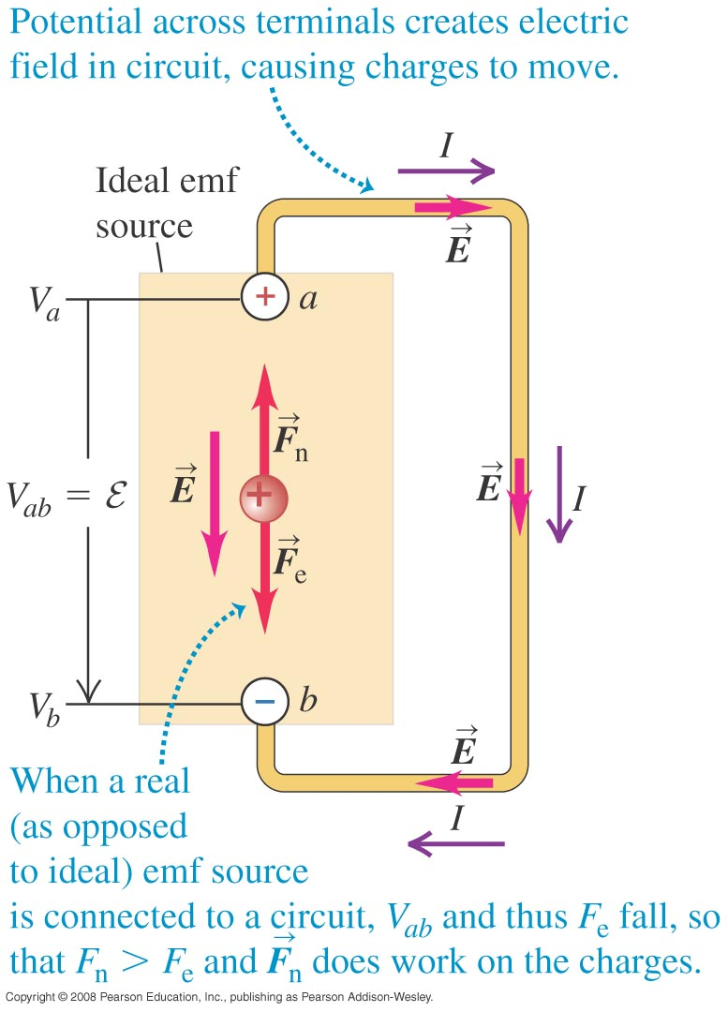
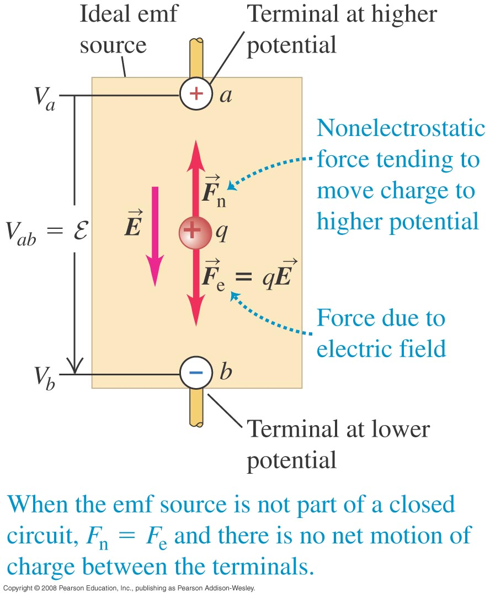
Electromotive force and circuits
  An electromotive force (emf) makes current flow. In spite of the name, an emf is not a force.
  The figures below show a source of emf in an open circuit (left) and in a complete circuit (right).

Slide 16
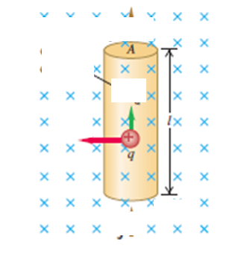

Faraday’s law
  The flux depends on the orientation of the surface with respect to the magnetic field. See Figure 29.4 below.

Slide 17
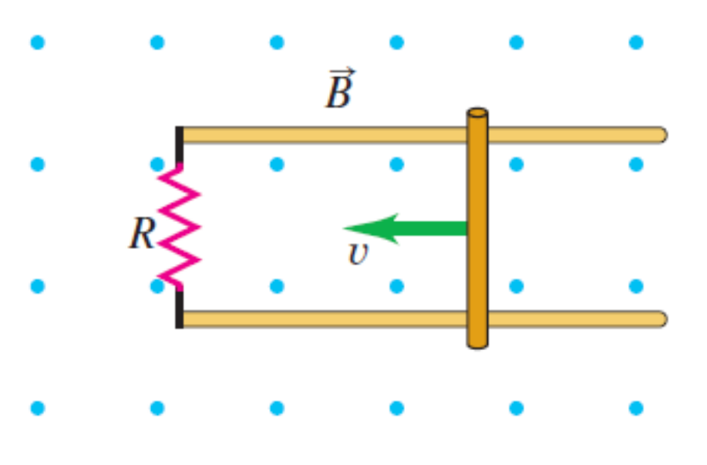
Electromotive force and circuits
  An electromotive force (emf) makes current flow. In spite of the name, an emf is not a force.
  The figures below show a source of emf in an open circuit (left) and in a complete circuit (right).

Slide 18
Emf and the current induced in a loop
Follow Example 29.1 using Figure 29.5 below.

Slide 19
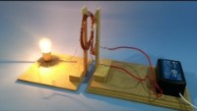
https://www.youtube.com/watch?v=ZKLiuhZjdMo

Slide 20
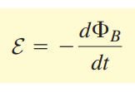
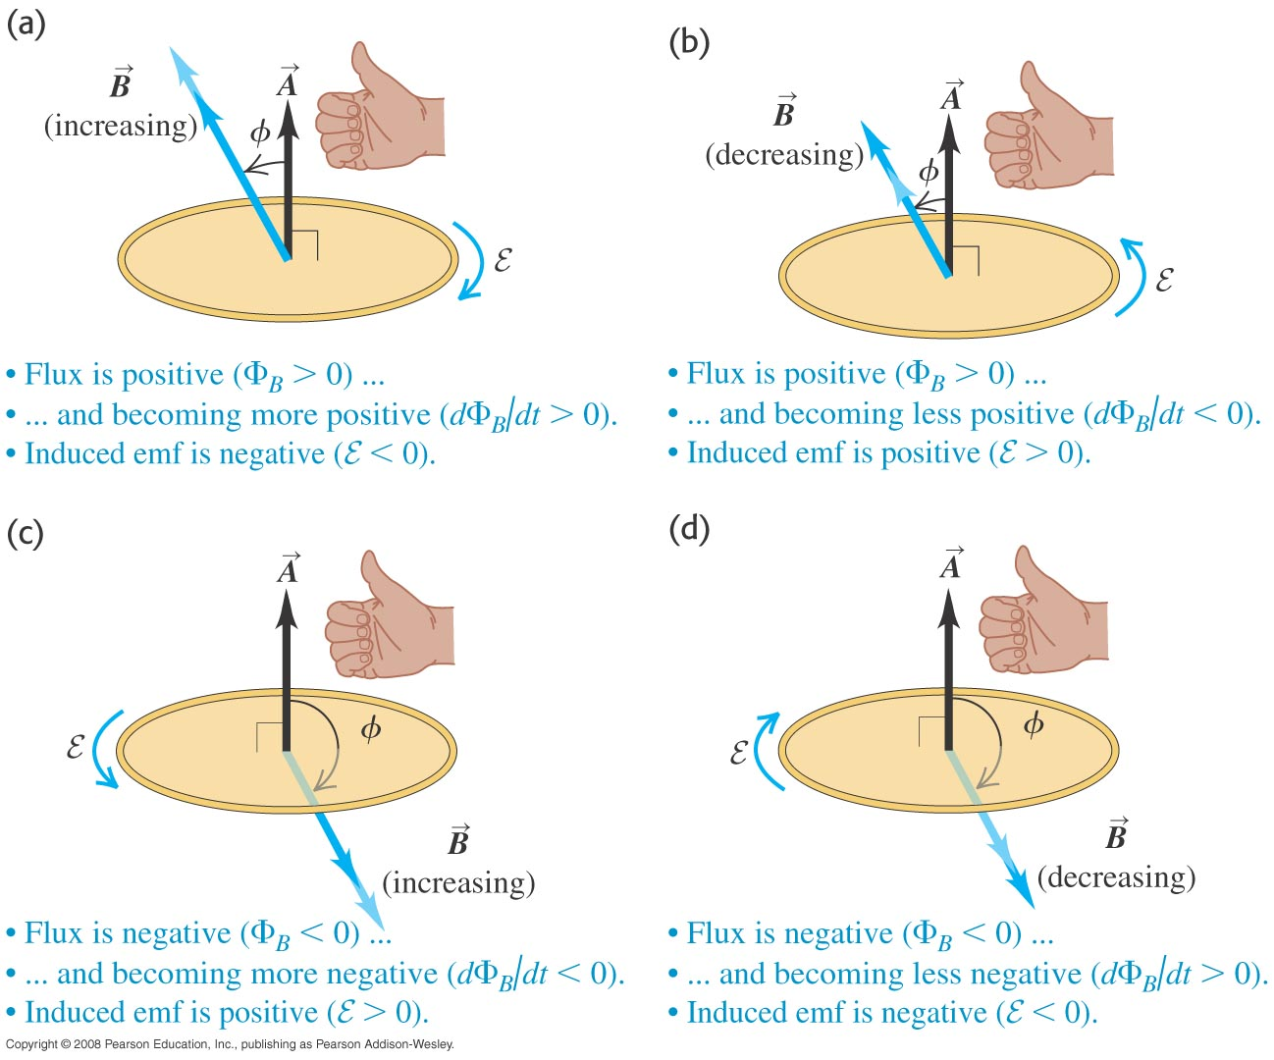
Direction of the induced emf
  Follow the text discussion on the direction of the induced emf, using Figure 29.6 below.

Slide 21
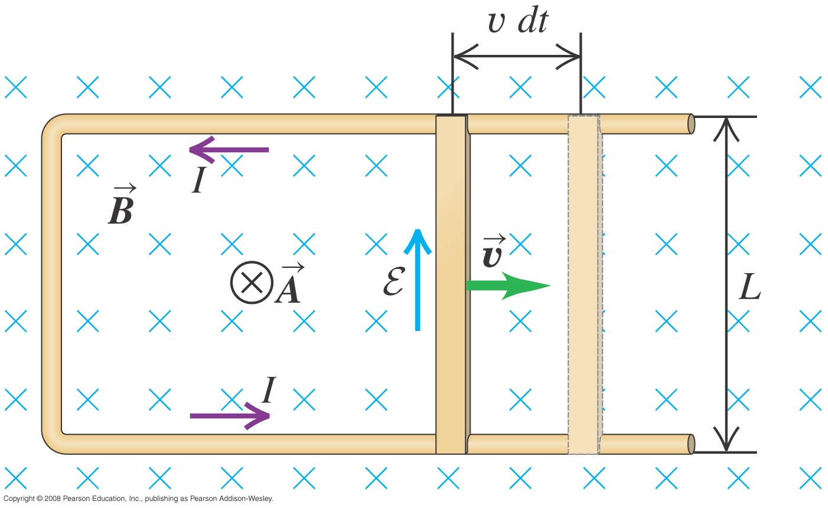


Slidewire generator
  Follow Example 29.5 using Figure 29.11 below.
w=w₀+vt

Slide 22
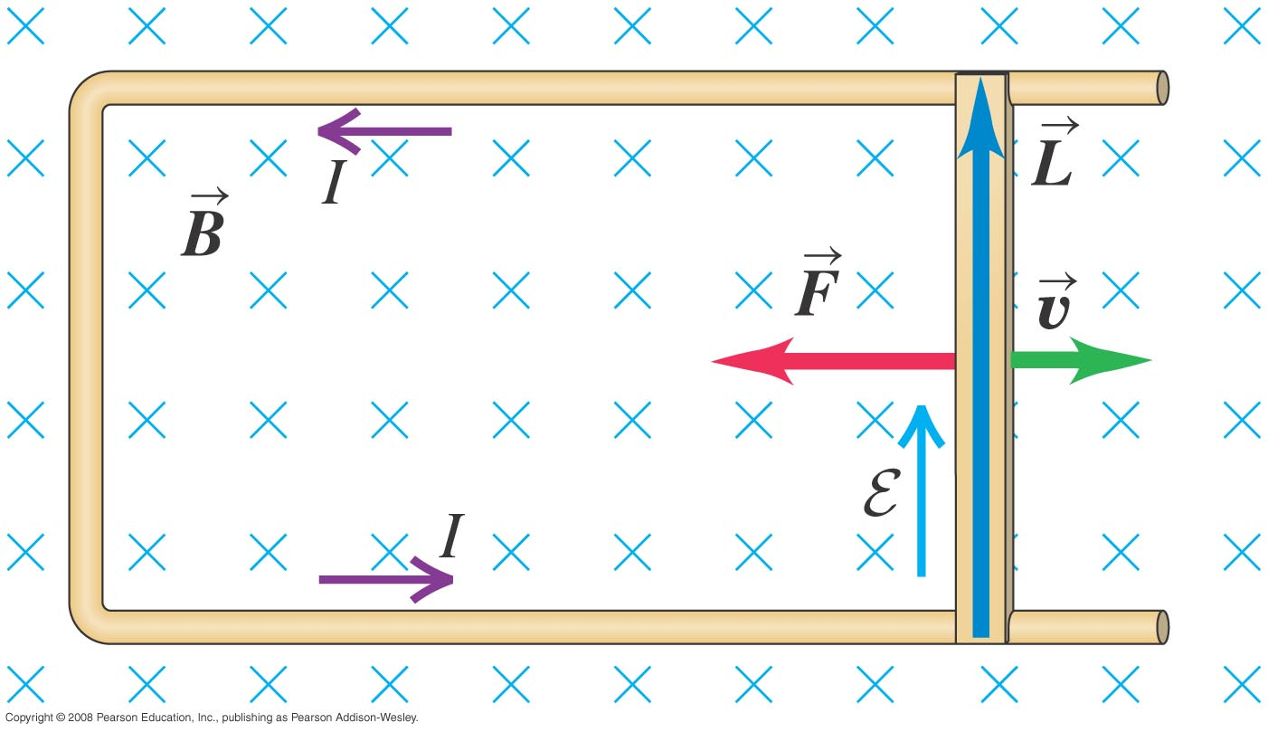

Work and power in the slidewire generator
Follow Example 29.6 using Figure 29.12 below.

Slide 23
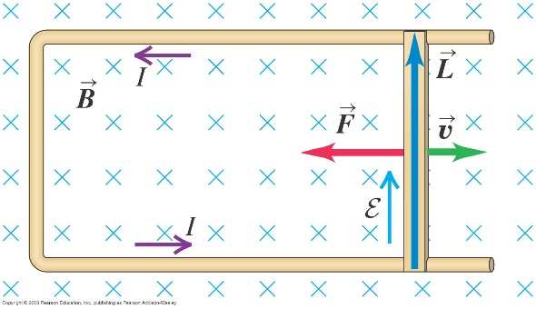
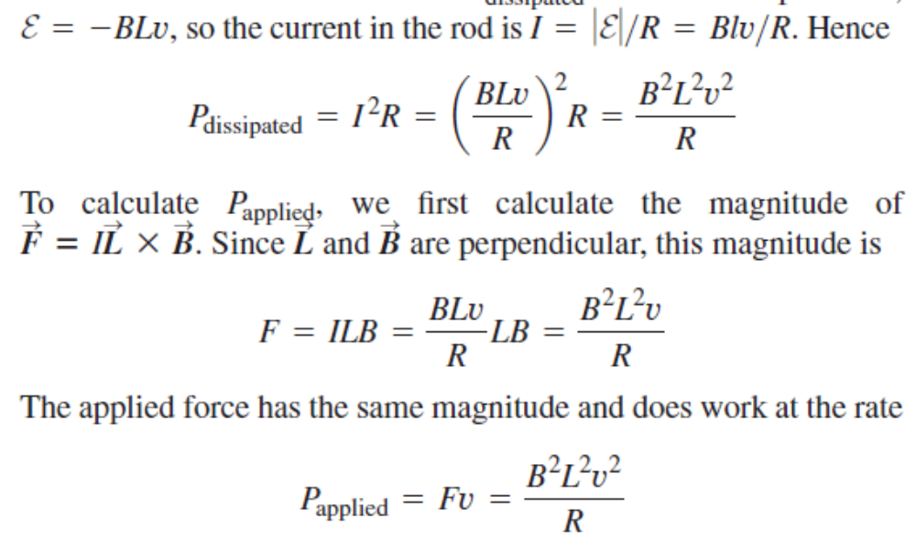
Work and power in the slidewire generator
Follow Example 29.6 using Figure 29.12 below.

Slide 24
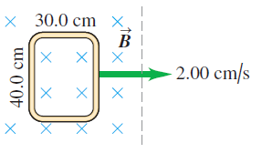

Slide 25
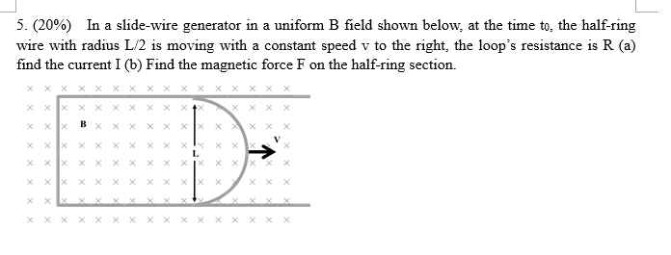
Work and power in the slidewire generator

Slide 26
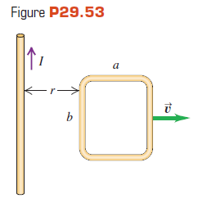

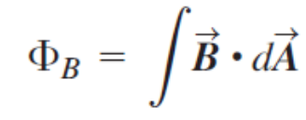
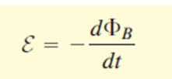
Work and power in the slidewire generator
Follow Example 29.6 using Figure 29.12 below.
r=r₀+vt

Slide 27

Slidewire generator
  Follow Example 29.5 using Figure 29.11 below.
w=w₀+vt

Slide 28
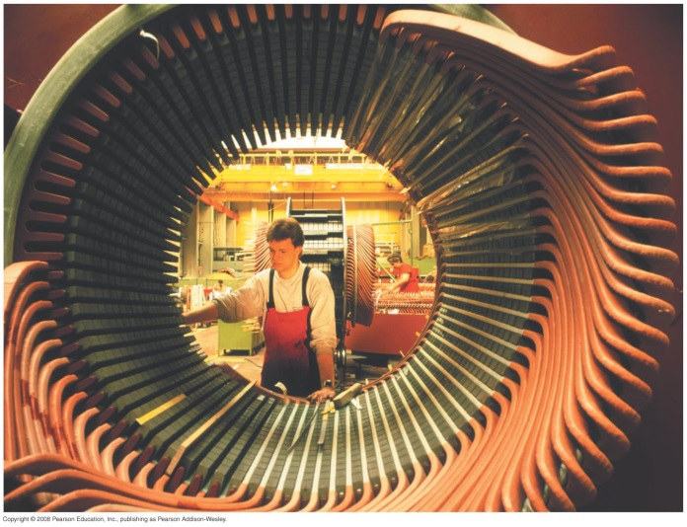

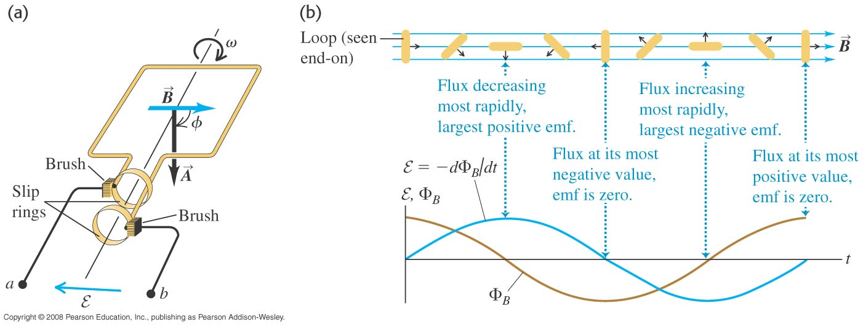
A simple alternator
  Follow Example 29.3 using Figures 29.8 (below) and 29.9 (right).
https://www.falstad.com/generator/

Slide 29
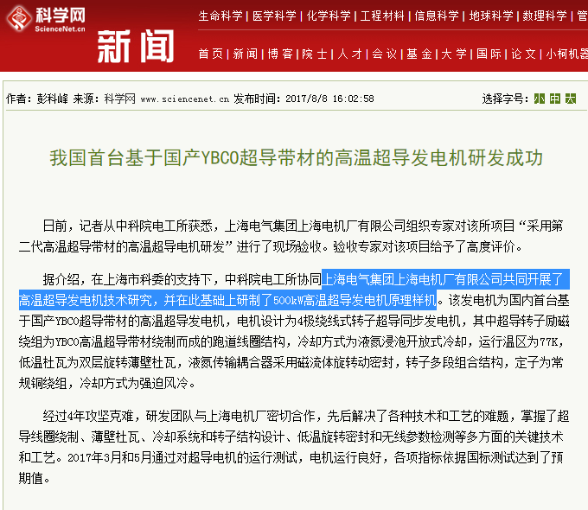
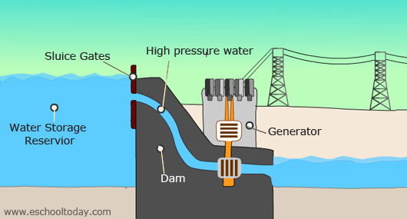
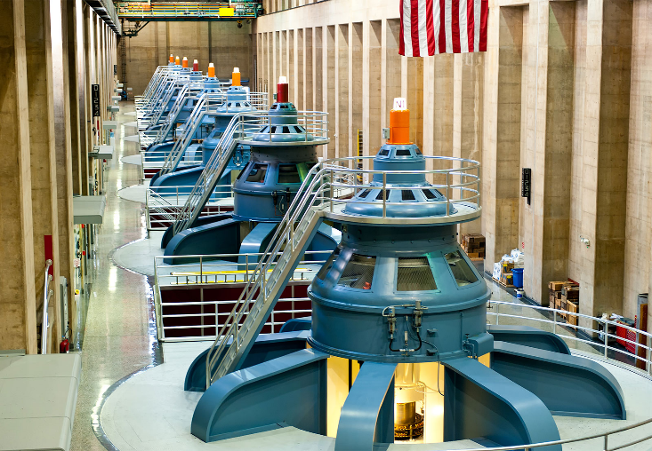

Slide 30
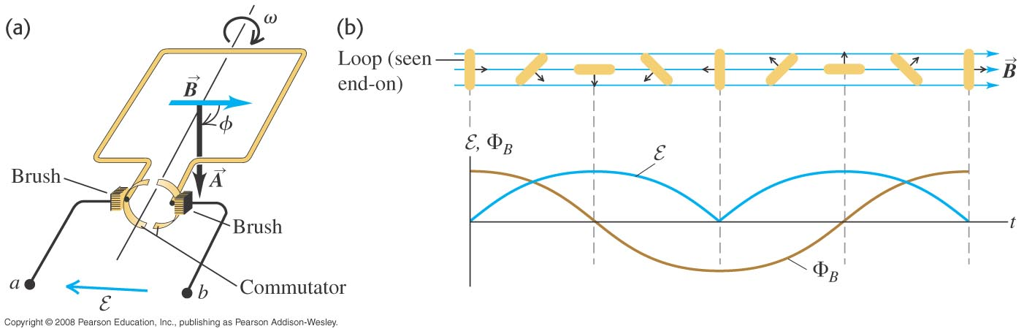
DC generator and back emf in a motor
  Follow Example 29.4 using Figure 29.10 below.

Slide 31
Lenz’s law
  Lenz’s law: The direction of any magnetic induction effect is such as to oppose the cause of the effect.

Slide 32
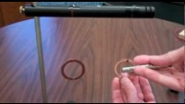
https://www.youtube.com/watch?v=pMfNuP1Wozw&t=70s

Slide 33
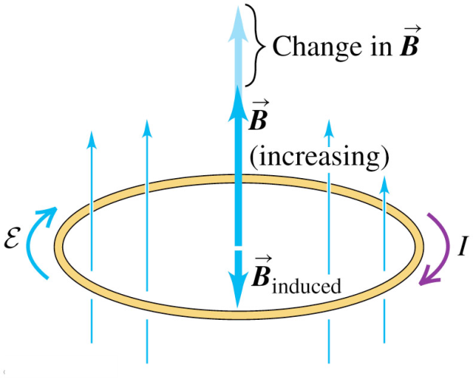
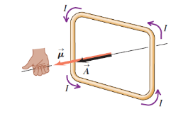
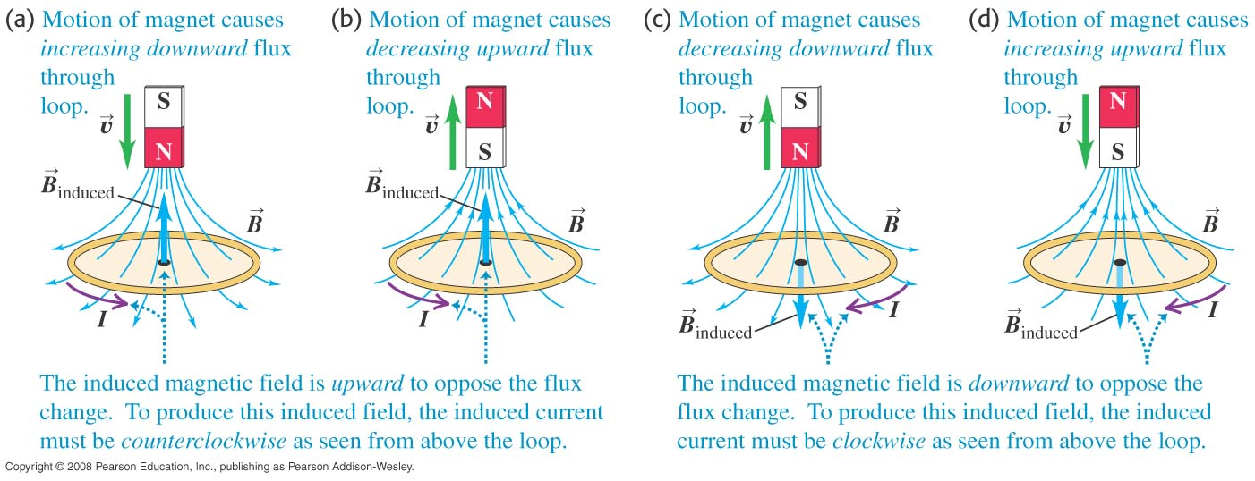
Lenz’s law and the direction of induced current
  Follow Example 29.8 using Figures 29.13 (right) and 29.14 (below).
What about F?

Slide 34
https://www.youtube.com/shorts/3T6Tha13GfI
https://www.youtube.com/watch?v=sPLawCXvKmg&list=PPSV

Slide 35
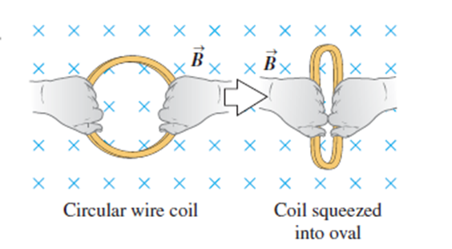
Lenz’s law and the direction of induced current

Slide 36
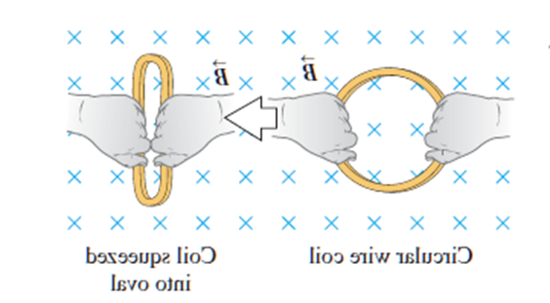
Lenz’s law and the direction of induced current

Slide 37
Induced current
  A changing magnetic flux causes an induced current. See Figure 29.1 below.
  The induced emf is the corresponding emf causing the current.

Slide 38
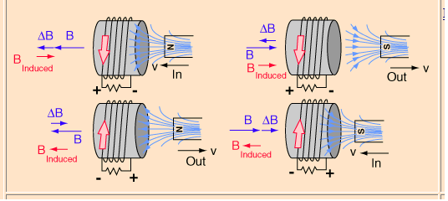

Lenz’s law and the direction of induced current

Slide 39
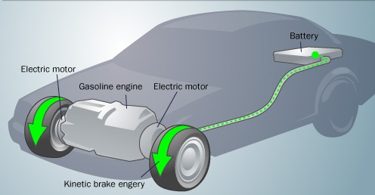
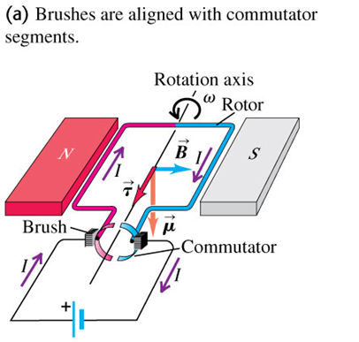
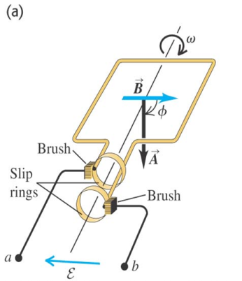
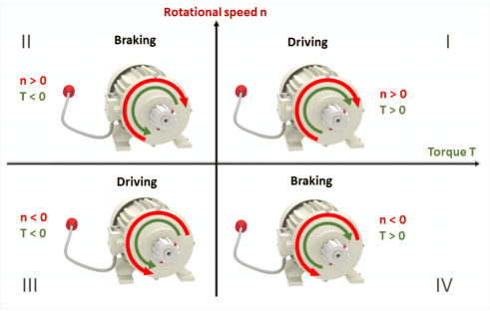
Lenz’s law and the direction of induced current

Slide 40




A slidewire generator and a dynamo
  Follow Example 29.9 for the slidewire generator.
  Follow Example 29.10 for the Faraday disk dynamo, using Figure 29.16 below.

Slide 41

https://www.youtube.com/watch?v=MT4s-pxc9sM

Slide 42





Motional electromotive force
  The motional electromotive force across the ends of a rod moving perpendicular to a magnetic field is ξ = vBL. Figure 29.15 below shows the direction of the induced current.
  Follow the general form of motional emf in the text.

Slide 43


A slidewire generator and a dynamo
  Follow Example 29.9 for the slidewire generator.
  Follow Example 29.10 for the Faraday disk dynamo, using Figure 29.16 below.

Slide 44


Slidewire generator
  Follow Example 29.5 using Figure 29.11 below.

Slide 45
Work and power in the slidewire generator
Follow Example 29.6 using Figure 29.12 below.

Slide 46

Work and power in the slidewire generator

Slide 47

A slidewire generator and a dynamo

Slide 48

Eddy currents
  Follow the text discussion of eddy currents, using Figure 29.19 at the right.

Slide 49

https://www.youtube.com/watch?v=Yu1uRvErM80

Slide 50


Eddy currents
https://www.youtube.com/watch?v=Bkbdm66UQis

Slide 51
https://www.youtube.com/watch?v=YELQNyair7Q&t=71s

Slide 52

Using eddy currents
  Figure 29.20 below illustrates an airport metal detector and a portable metal detector, both of which use eddy currents in their design.

Slide 53


Perfect diamagnetism

Slide 54



Superconductivity
  When a superconductor is cooled below its critical temperature, it loses all electrical resistance.
  Follow the text discussion using Figures 29.23 (below) and 29.24 (right).

Slide 55


Slide 56


Perfect diamagnetism

Slide 57


Induced electric fields
  Changing magnetic flux causes an induced electric field.
  See Figure 29.17 at the right to see the induced electric field for a solenoid.

Slide 58







Induced electric fields

Slide 59




Maxwell’s equations (Ch. 32)
    Gauss’s law for the electric field
    Gauss’s law for the magnetic field
    Ampere’s law
    Faraday’s law.

Slide 60


Ampere’s law (general statement)
Follow the text discussion of the general statement of Ampere’s law, using Figures 28.17 and 28.18 below.

Slide 61

Displacement current
  Follow the text discussion displacement current using Figures 29.21 and 29.22 below.

Slide 62

Displacement current
  Follow the text discussion displacement current using Figures 29.21 and 29.22 below.

Slide 63

https://www.youtube.com/watch?v=IvFVu7Jxa2I

Slide 64

https://www.youtube.com/watch?v=5D2cLj28Pc8&t=5s

Slide 65




Displacement current
  Follow the text discussion displacement current using Figures 29.21 and 29.22 below.

Slide 66



Displacement current
James Clerk Maxwell

Slide 67
Maxwell’s equations (Ch. 32)
    Gauss’s law for the electric field
    Gauss’s law for the magnetic field
    Ampere’s law
    Faraday’s law.

Slide 68


Displacement current
  Follow the text discussion displacement current using Figures 29.21 and 29.22 below.

Slide 69







Displacement current

Slide 70


Magnetic fields of long conductors
Read Problem-Solving Strategy 28.2.
Follow Example 28.7 for a long straight conductor.
Follow Example 28.8 for a long cylinder, using Figures 28.20 and 28.21 below.

Slide 71
Maxwell’s equations (Ch. 32)
    Gauss’s law for the electric field
    Gauss’s law for the magnetic field
    Ampere’s law
    Faraday’s law.

Slide 72

Maxwell’s equations
    Gauss’s law for the electric field
    Gauss’s law for the magnetic field
    Ampere’s law
    Faraday’s law.

