Slide 1
Chapter 27
Magnetic Field and Magnetic Forces

Slide 2
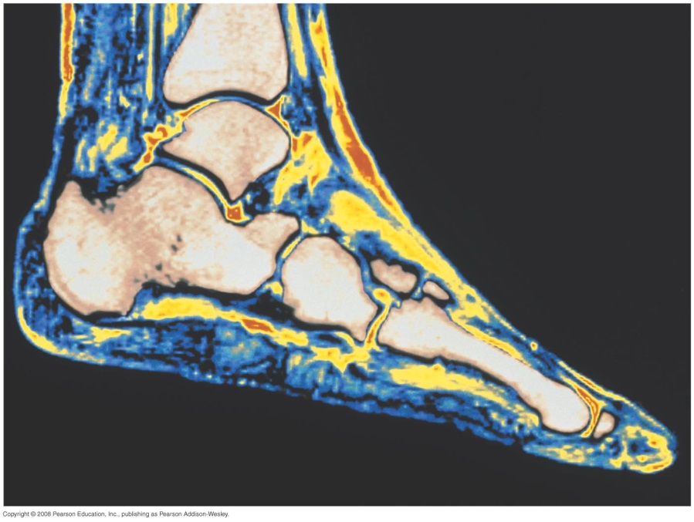
Introduction
  How does magnetic resonance imaging (MRI) allow us to see details in soft nonmagnetic tissue?
  How can magnetic forces, which act only on moving charges, explain the behavior of a compass needle?
  In this chapter, we will look at how magnetic fields affect charges.

Slide 3
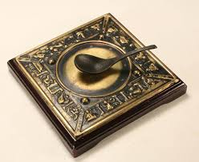
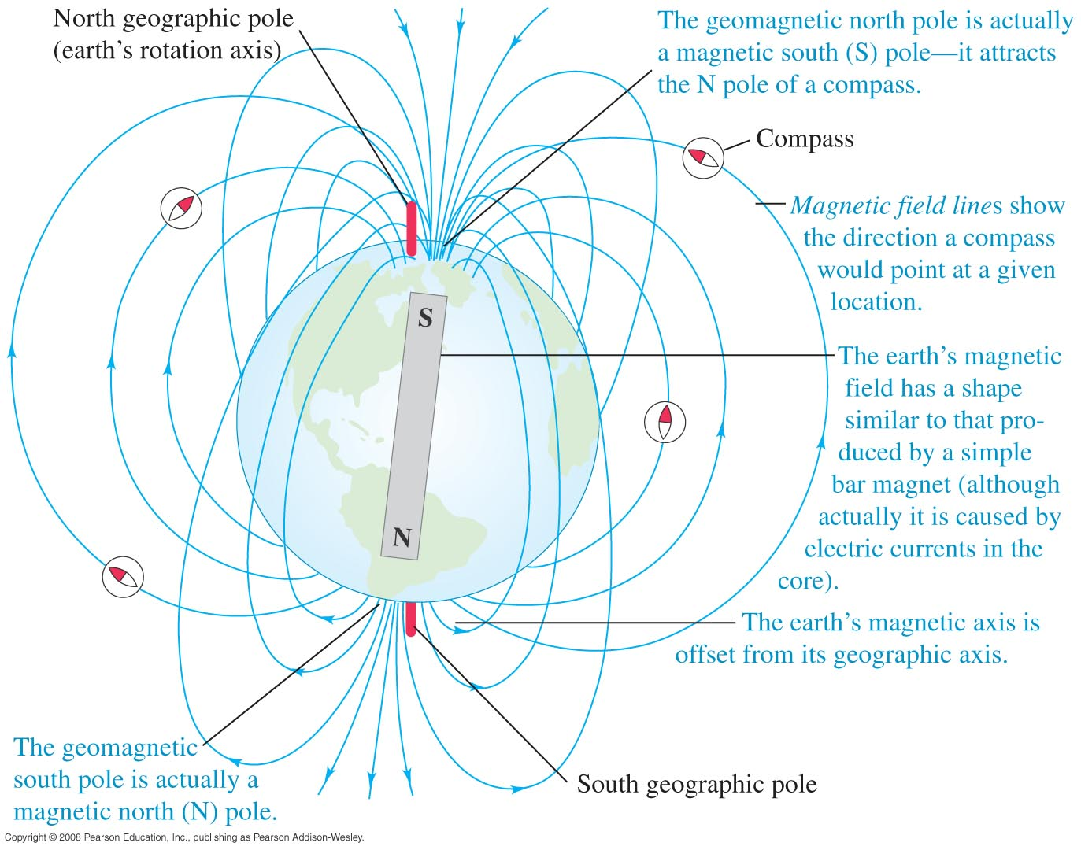
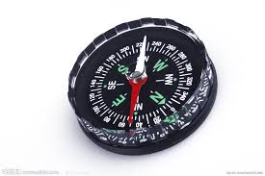
Compass : attractive force
司南

Slide 4
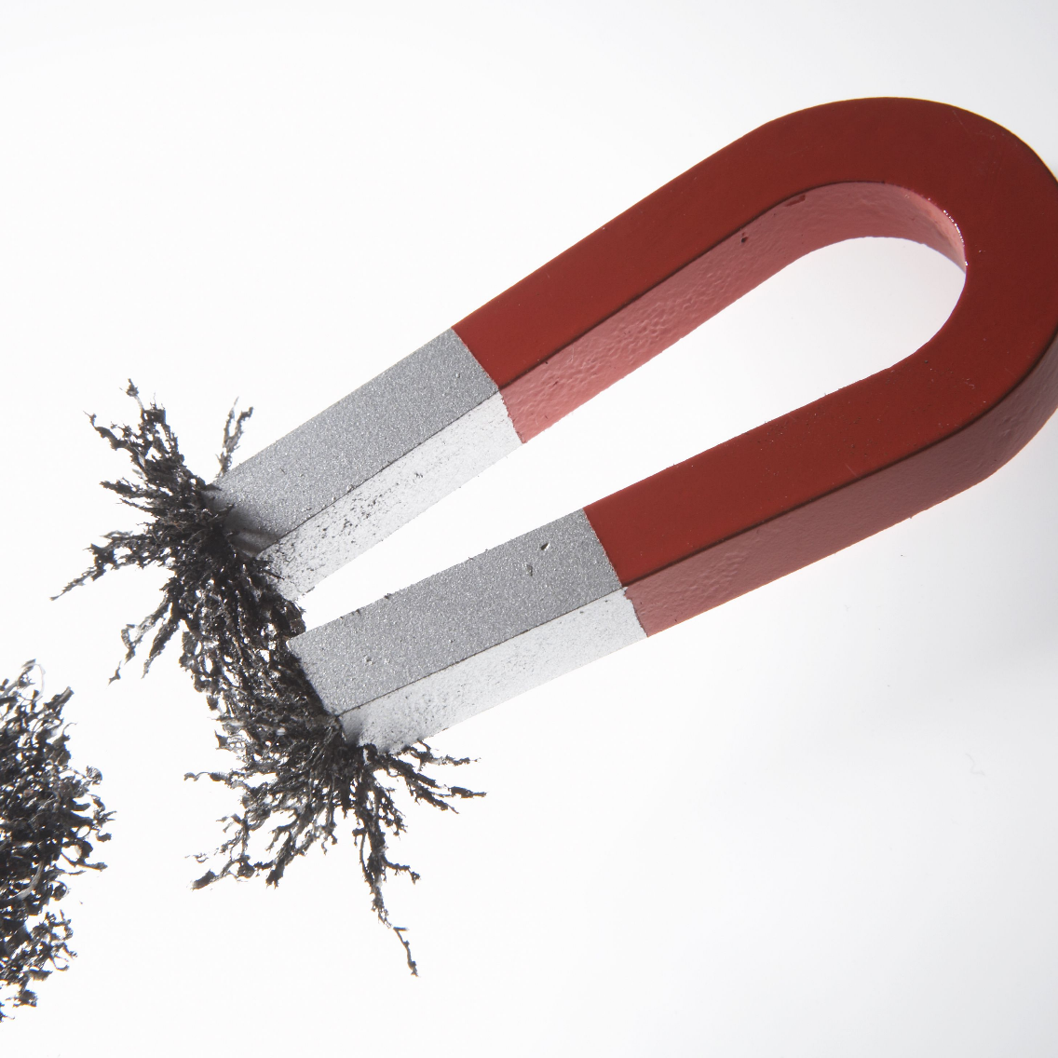

Slide 5
Magnetic field of the earth
  The earth itself is a magnet. Figure 27.3 shows its magnetic field.

Slide 6
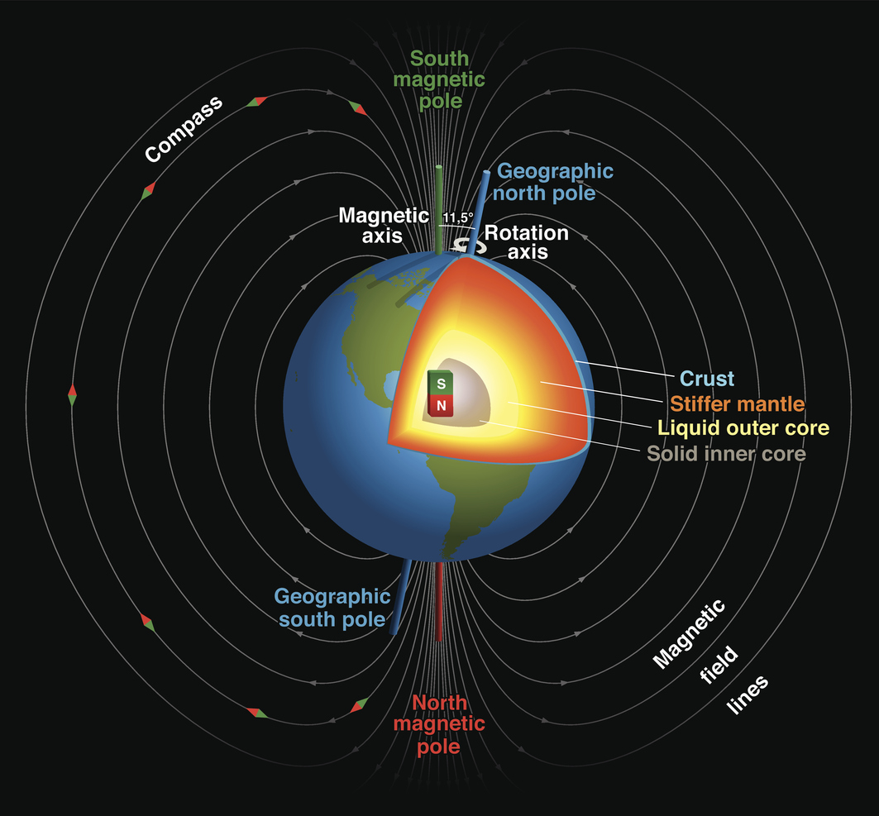

Slide 7

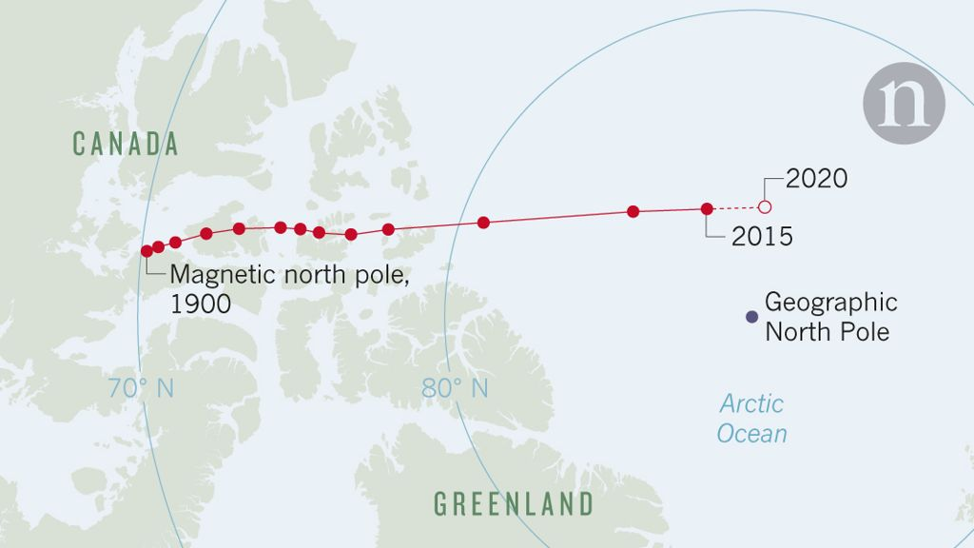

Slide 8
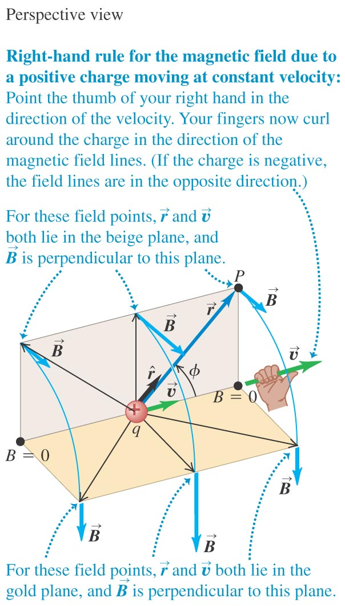
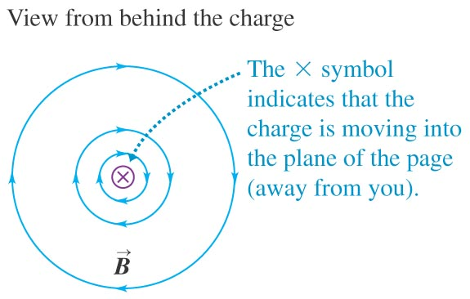
The magnetic field of a moving charge
A moving charge generates a magnetic field that depends on the velocity of the charge.
Figure 28.1 shows the direction of the field.

Slide 9
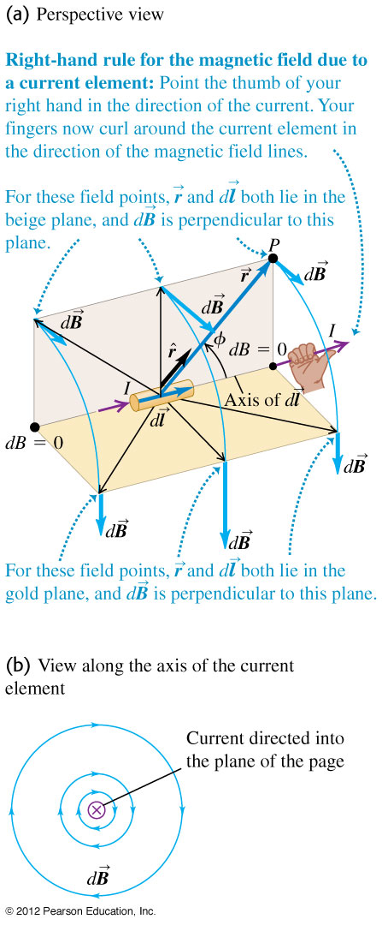






Magnetic field of a current element
law of Biot and Savart.

Slide 10


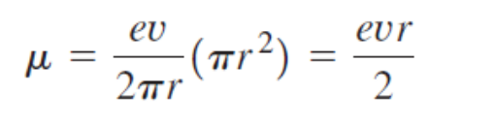

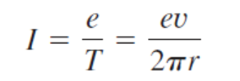


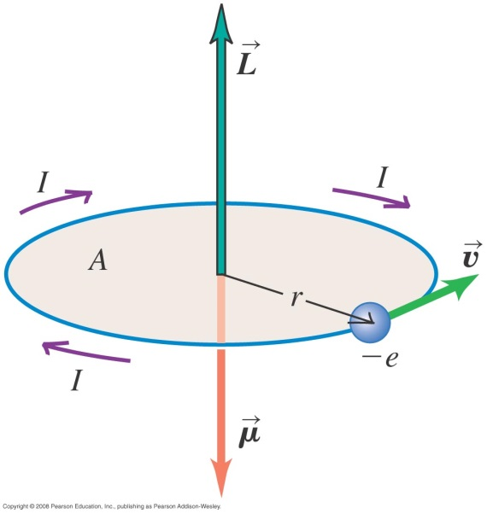

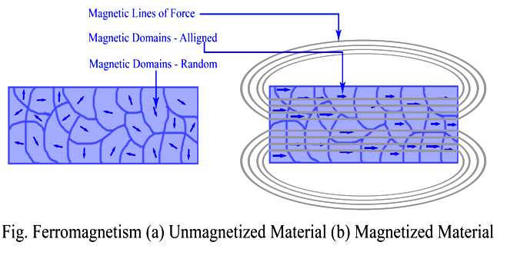
The Bohr magneton and paramagnetism
Follow the text discussions of the Bohr magneton

Slide 11
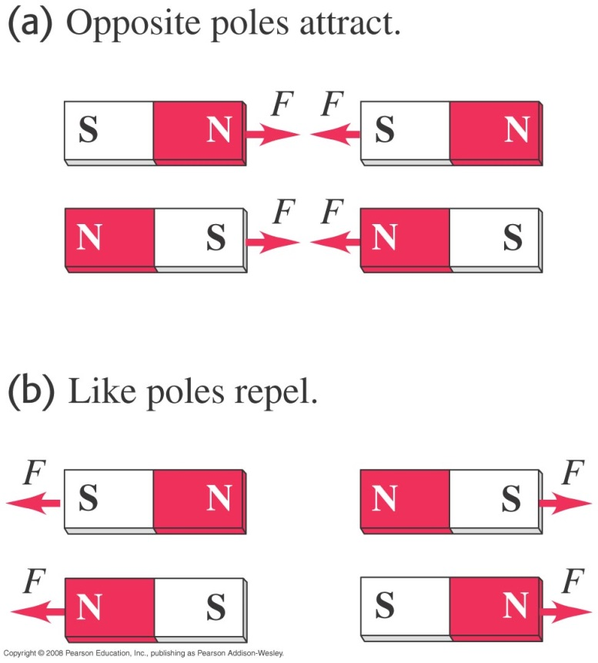
Magnetic poles
  Figure 27.1 at the right shows the forces between magnetic poles.

Slide 12
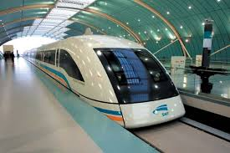
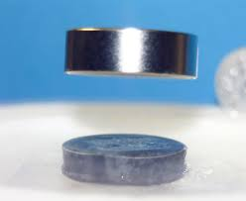
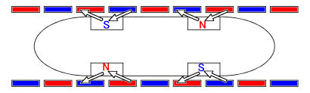
Maglev : repulsive force

Slide 13
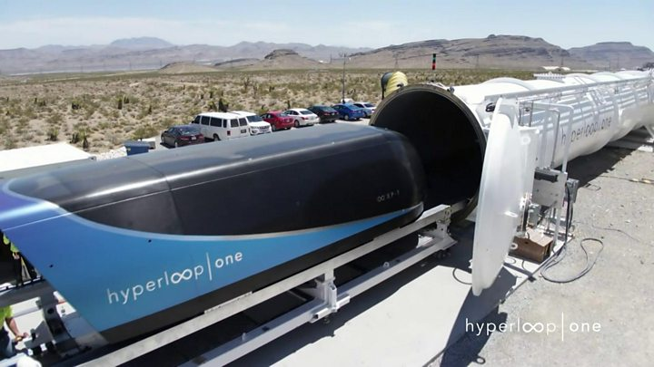
Maglev : repulsive force

Slide 14
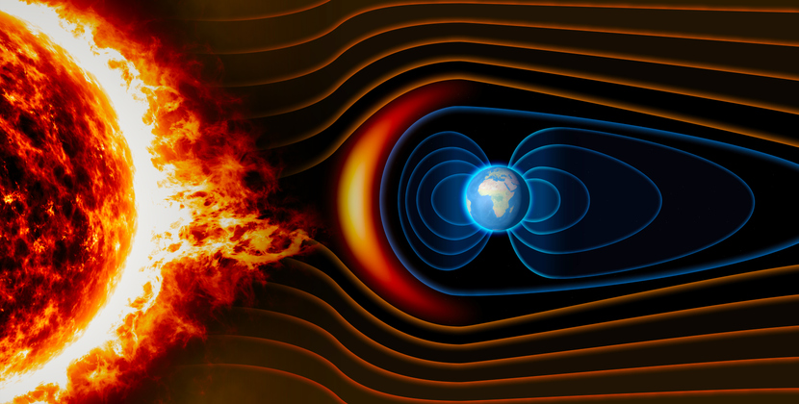

Slide 15
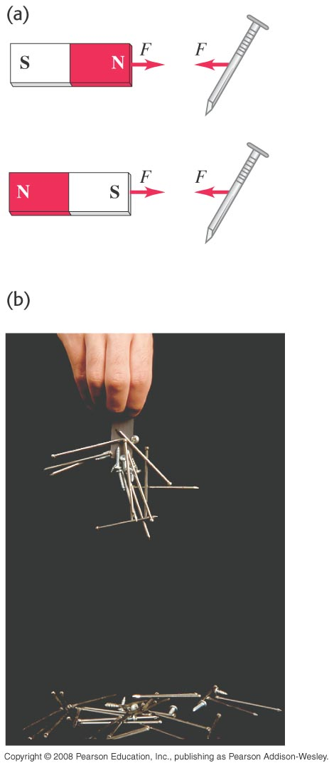
Magnetism and certain metals
  Either pole of a permanent magnet will attract a metal like iron, as shown in Figure 27.2 at the right.

Slide 16
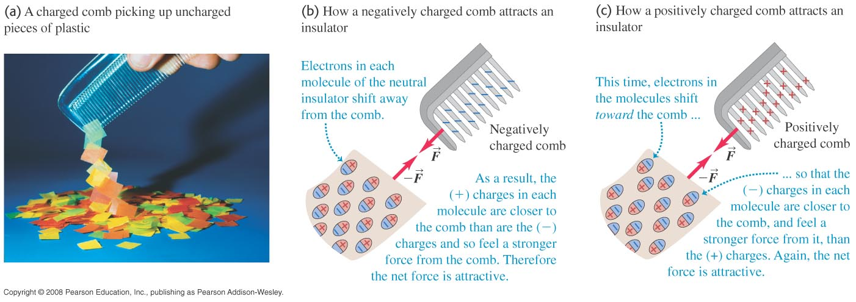
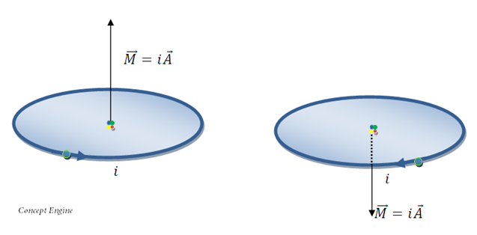
Magnetism and certain metals

Slide 17
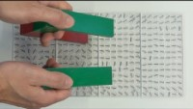
https://www.youtube.com/watch?v=vH5M6vdwqBk

Slide 18
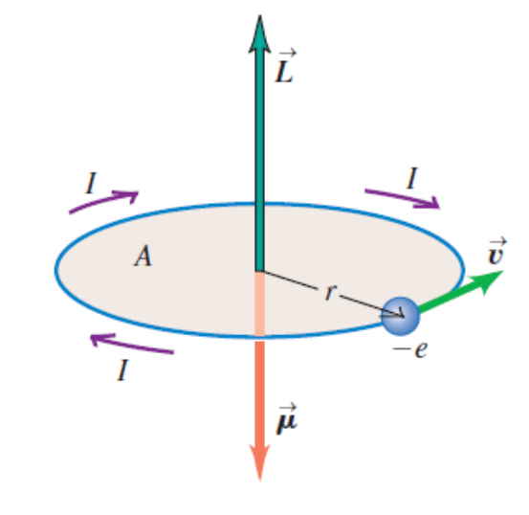

Magnetism and certain metals

Slide 19
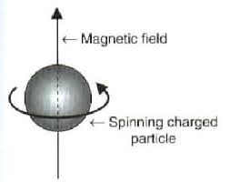
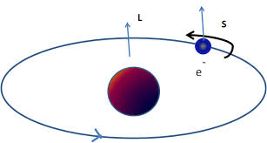
Magnetism and certain metals

Slide 20
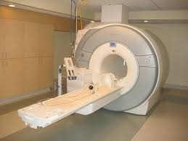
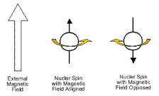
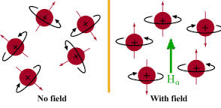
MRI – nuclear magnetic resonance

Slide 21
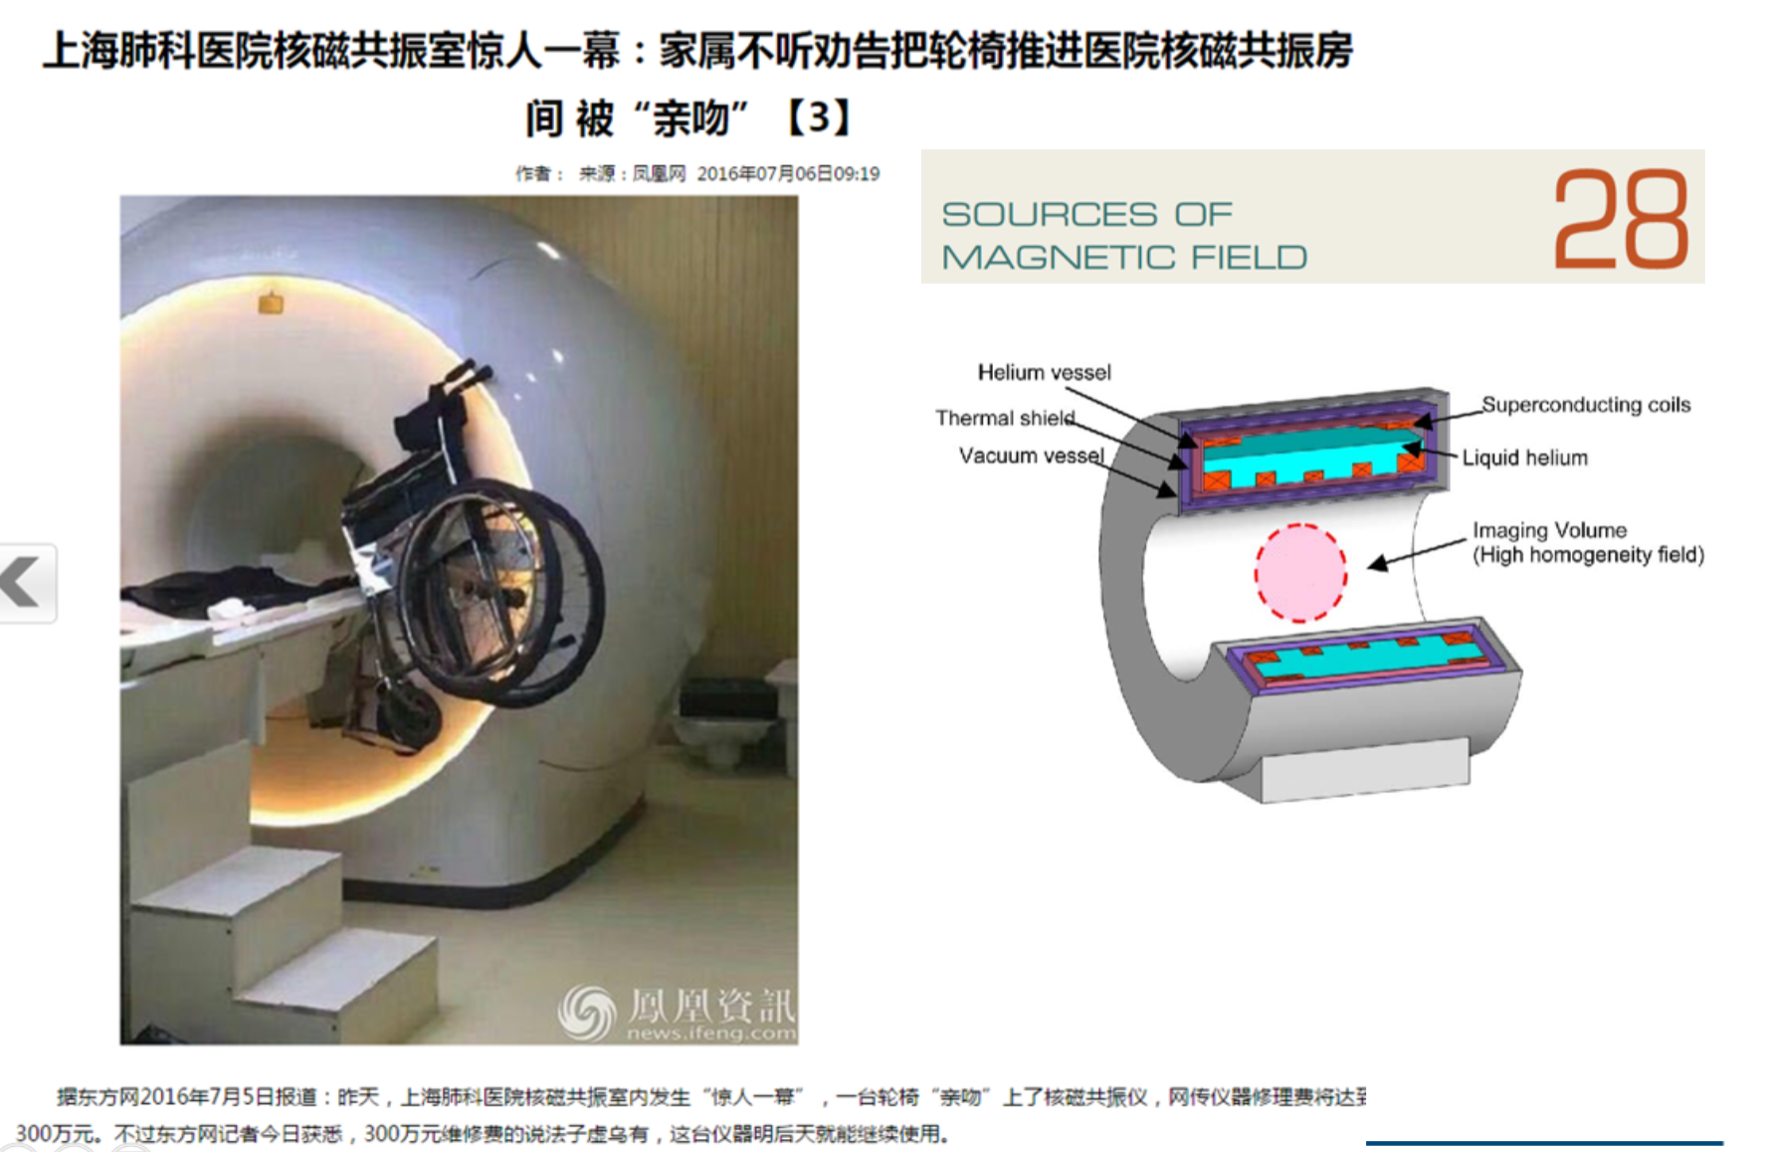

Slide 22

https://www.youtube.com/watch?v=KlJsVqc0ywM

Slide 23
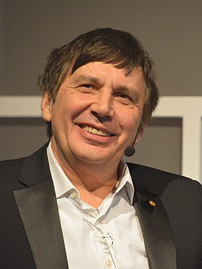
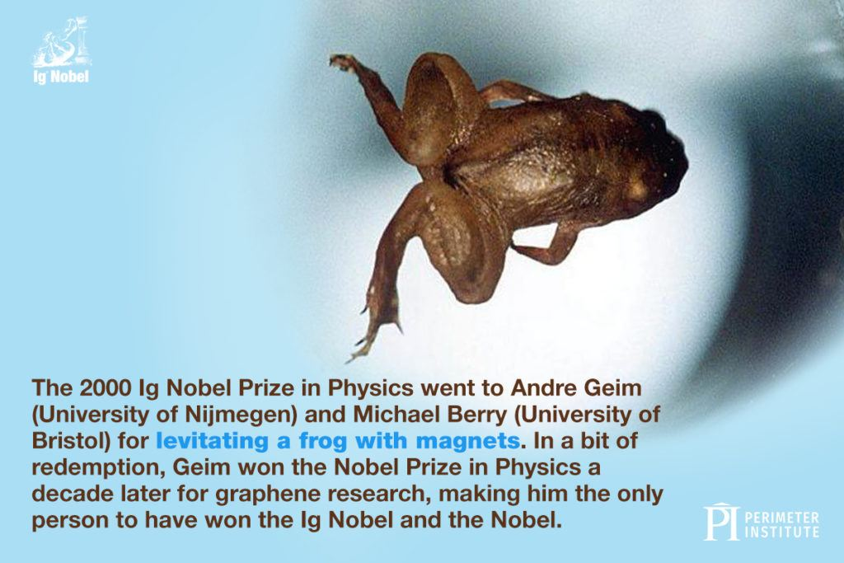
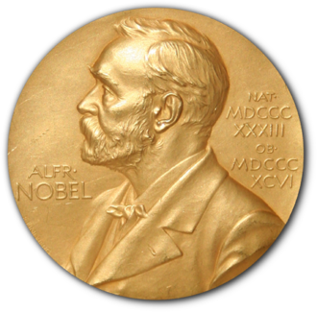
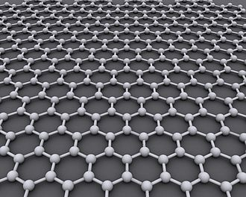
Diamagnetic

Slide 24
The magnetic field
  A moving charge (or current) creates a magnetic field in the surrounding space.
  The magnetic field exerts a force on any other moving charge (or current) that is present in the field.

Slide 25
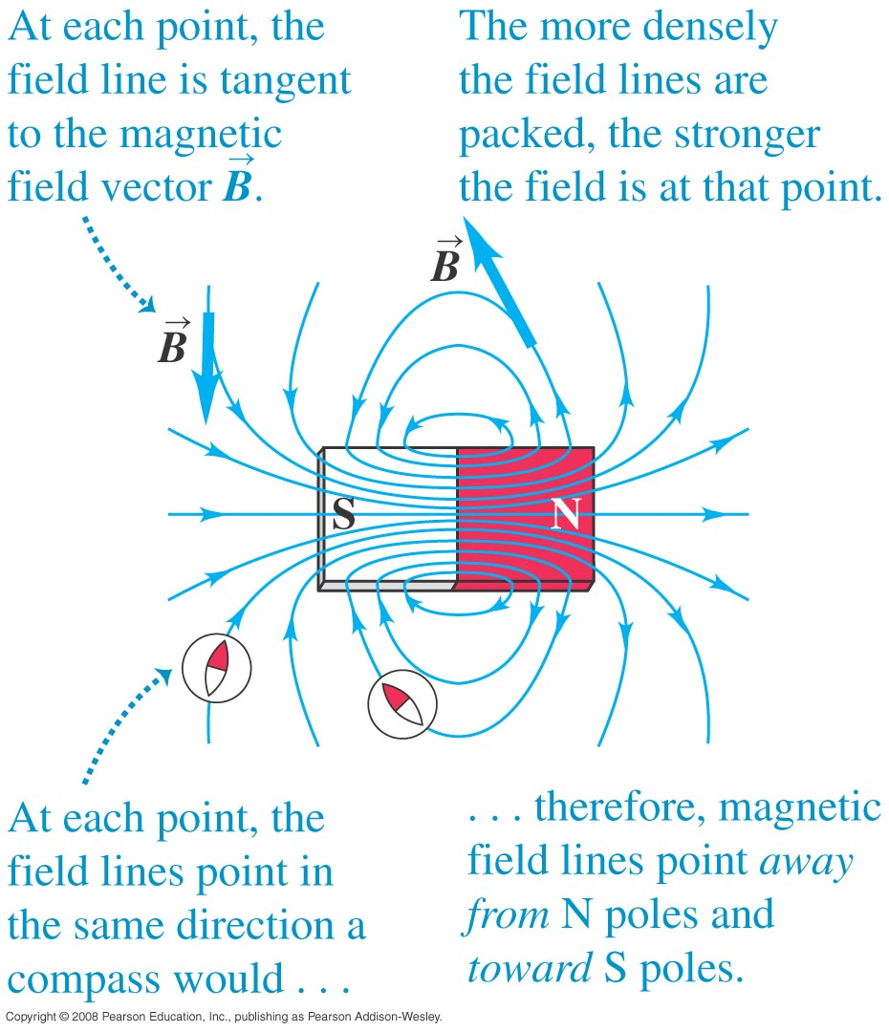
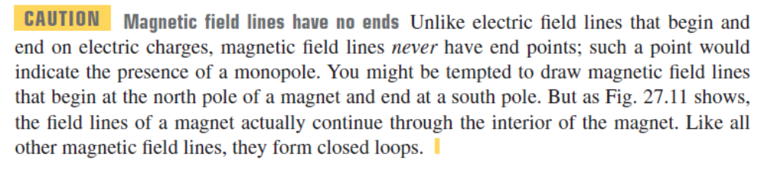
Magnetic field lines
  Figure 27.11 below shows the magnetic field lines of a permanent magnet.

Slide 26
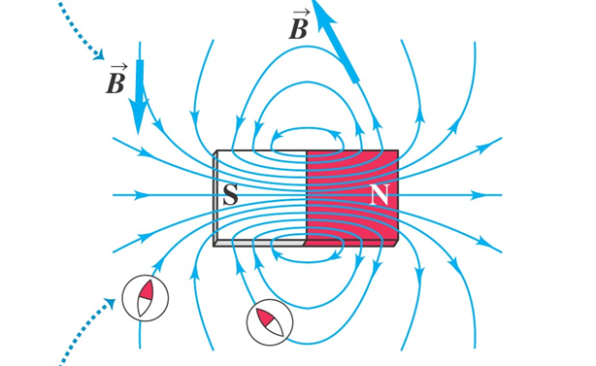
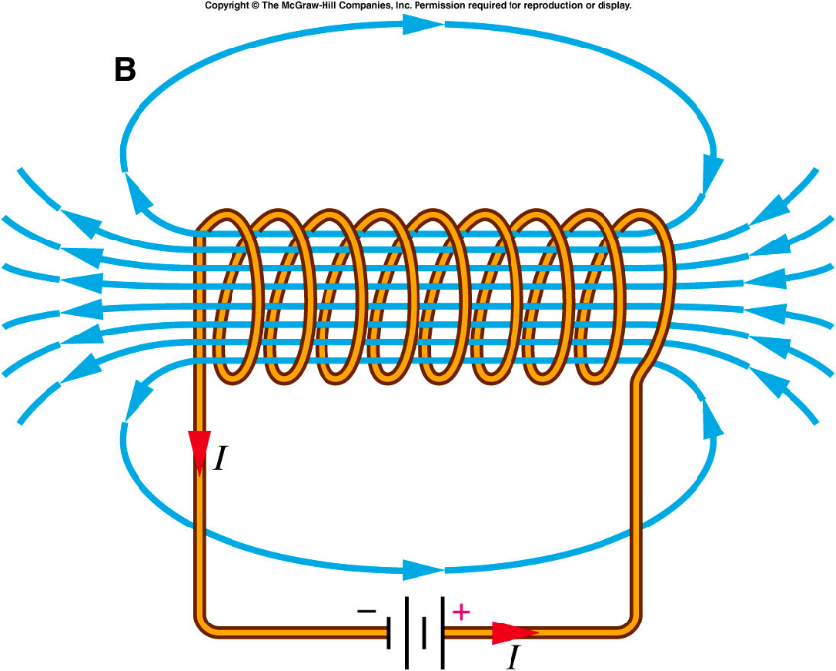

The magnetic field of a moving charge
A moving charge generates a magnetic field that depends on the velocity of the charge.

Slide 27
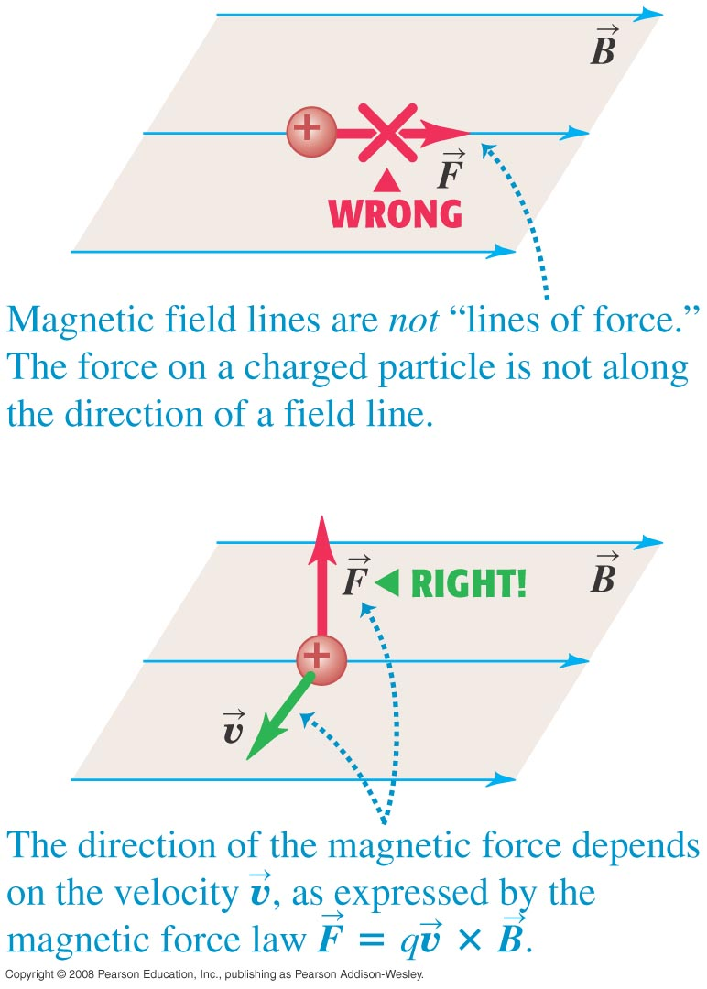
Magnetic field lines are not lines of force
  It is important to remember that magnetic field lines are not lines of magnetic force. (See Figure 27.12 below.)
Not for a charge
But for a small magnet

Slide 28
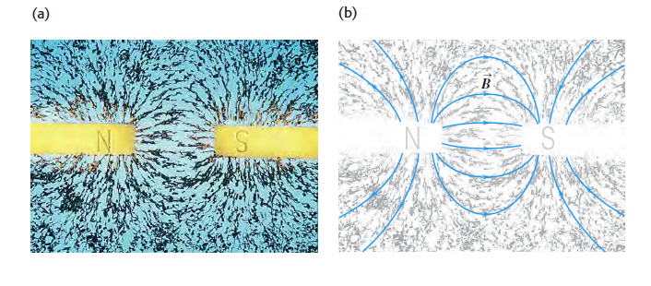
Magnetic field
http://www.falstad.com/vector3dm/

Slide 29
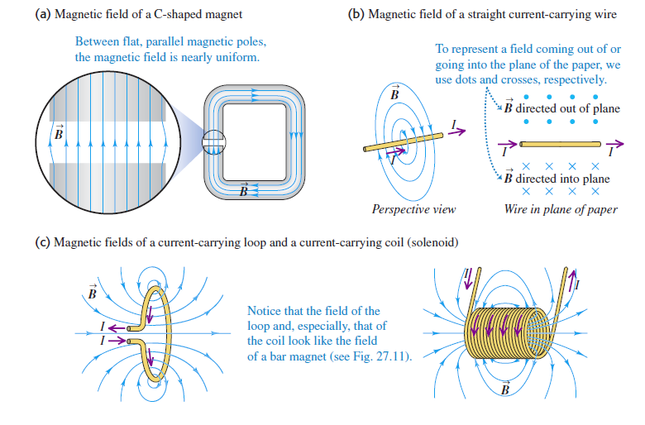
Magnetic field

Slide 30
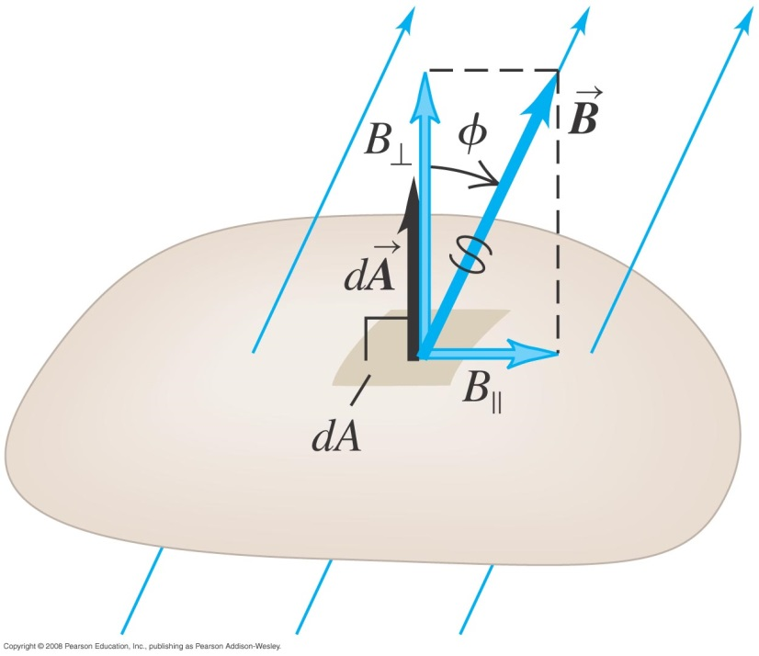
Magnetic flux
We define the magnetic flux through a surface just as we defined electric flux. See Figure 27.15 below.
Follow the discussion in the text of magnetic flux and Gauss’s law for magnetism.
The magnetic flux through any closed surface is zero.

Slide 31


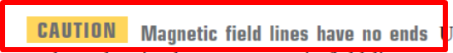
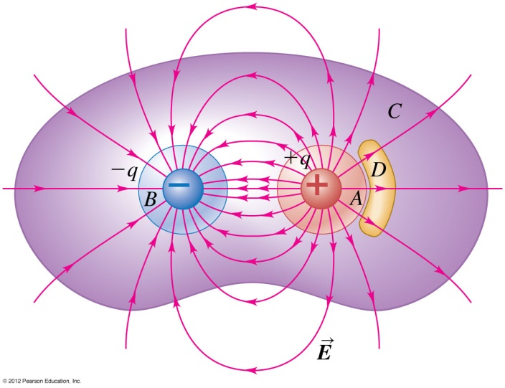
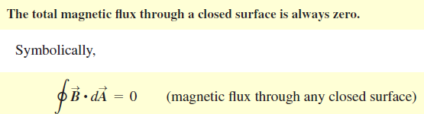
Magnetic flux （Gauss’s law）
No Magnetic monopole

Slide 32
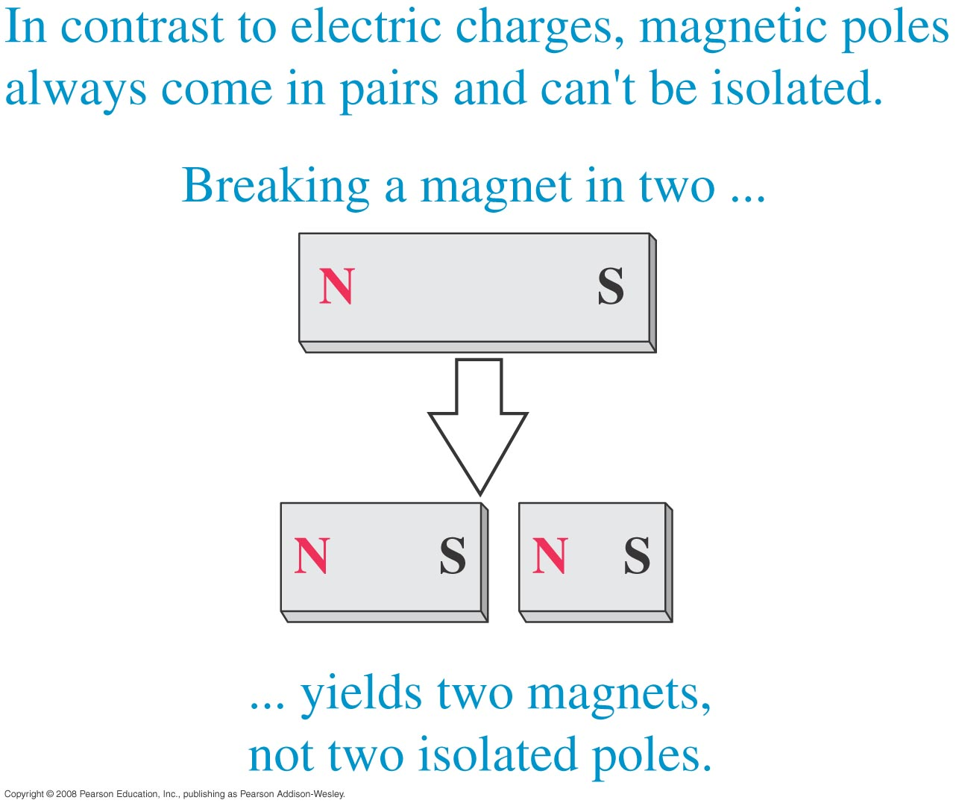

Magnetic monopoles
  Breaking a bar magnet does not separate its poles, as shown in Figure 27.4 at the right.
  There is no experimental evidence for magnetic monopoles.

Slide 33
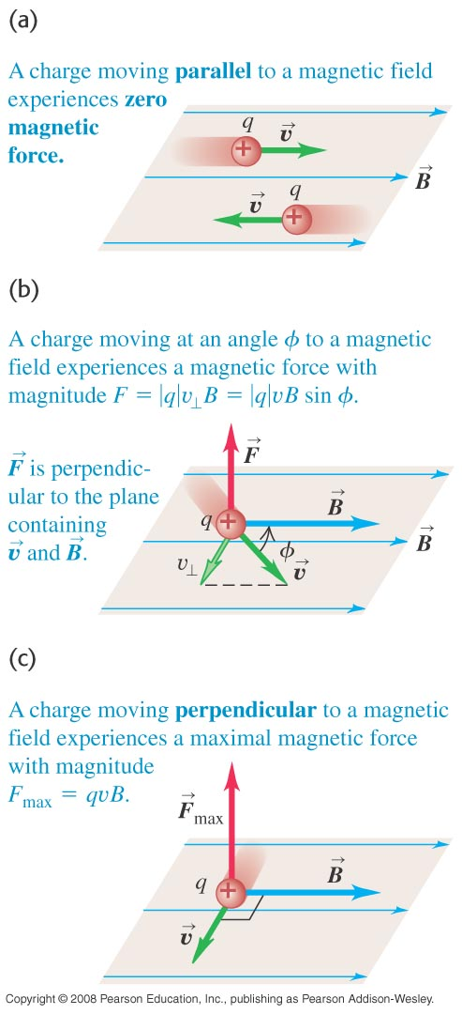
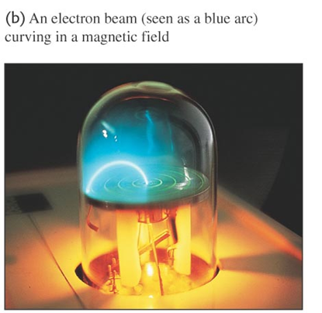
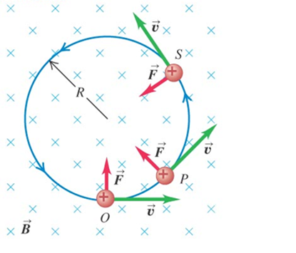
The magnetic force on a moving charge
  The magnetic force on q is perpendicular to both the velocity of q and the magnetic field. (See Figure 27.6 at the right.)
  The magnitude of the magnetic force is F = |q|vB sinφ.

Slide 34


The magnetic force on a moving charge

Slide 35

Magnetic force as a vector product
  We can write the magnetic force as a vector product (see Figure 27.7 below).
  The right-hand rule gives the direction of the force on a positive charge.

Slide 36

Equal velocities but opposite signs
  Two charges of equal magnitude but opposite signs moving in the same direction in the same field will experience magnetic forces in opposite directions. (See Figure 27.8 below.)

Slide 37


Determining the direction of a magnetic field
  A cathode-ray tube can be used to determine the direction of a magnetic field, as shown in Figure 27.9 below.

Slide 38

https://www.youtube.com/watch?v=owI6Ya73ykI

Slide 39



Motion of charged particles in a magnetic field
  A charged particle in a magnetic field always moves with constant speed.
  If the velocity of the particle is perpendicular to the magnetic field, the particle moves in a circle of radius R = mv/|q|B.
  The number of revolutions of the particle per unit time is the cyclotron frequency.

Slide 40


Helical motion
  If the particle has velocity components parallel to and perpendicular to the field, its path is a helix. (See Figure 27.18 at the right.)
  The speed and kinetic energy of the particle remain constant.

Slide 41


Cyclotron radiation
  Figure 27.19 at the right shows charges trapped in a magnetic bottle, which results from a nonuniform magnetic field.
https://www.youtube.com/watch?v=Sf1MGTD9xGY

Slide 42

Cyclotron radiation
  Figure 27.19 at the right shows charges trapped in a magnetic bottle, which results from a nonuniform magnetic field.
  Figure 27.20 below shows the Van Allen radiation belts and the resulting aurora. These belts are due to the earth’s nonuniform field.

Slide 43



A nonuniform magnetic field
Cyclotron radiation

Slide 44

A nonuniform magnetic field
Cyclotron radiation

Slide 45


Nuclear Fusion: Tokamak Scheme

Slide 46


Nuclear Fusion: Tokamak Scheme

Slide 47


Mass spectrometer
  A mass spectrometer measures the masses of ions.
  The Bainbridge mass spectrometer (see Figure 27.24 at the right) first uses a velocity selector. Then the magnetic field separates the particles by mass.

Slide 48




Slide 49


Slide 50


The magnetic force on a current-carrying conductor
  Figure 27.25 (top) shows the magnetic force on a moving positive charge in a conductor.
  Figure 27.26 (bottom) shows that the magnetic force is perpendicular to the wire segment and the magnetic field.
  Follow the discussion of the magnetic force on a conductor in the text.

Slide 51
The magnetic force on a current-carrying conductor
  Figure 27.25 (top) shows the magnetic force on a moving positive charge in a conductor.
  Figure 27.26 (bottom) shows that the magnetic force is perpendicular to the wire segment and the magnetic field.
  Follow the discussion of the magnetic force on a conductor in the text.

Slide 52


Magnetic force on a curved conductor
  Follow Example 27.8 using Figure 27.30 below.

Slide 53



Magnetic force on a curved conductor
  Follow Example 27.8 using Figure 27.30 below.

Slide 54

Work and power in the slidewire generator

Slide 55

Magnetic force on a curved conductor
  Follow Example 27.8 using Figure 27.30 below.

Slide 56



Slide 57



Force and torque on a current loop
  The net force on a current loop in a uniform magnetic field is zero. But the net torque is not, in general, equal to zero.
  Figure 27.31 below shows the forces and how to calculate the torque.

Slide 58






Magnetic moment

Slide 59



Slide 60



Magnetic Torque and coil

Slide 61


The direct-current motor
http://www.falstad.com/motor/

Slide 62

How magnets work
Follow the discussion in the text of magnetic dipoles and how magnets work. Use Figures 27.36 (below) and 27.37 (right).

Slide 63

Loudspeaker
  Figure 27.28 shows a loudspeaker design. If the current in the voice coil oscillates, the speaker cone oscillates at the same frequency.

Slide 64

How magnets work

Slide 65



The Hall Effect
Follow the discussion of the Hall effect in the text using Figure 27.41 below.
Follow Example 27.12.

Slide 66



The Hall Effect
Follow the discussion of the Hall effect in the text using Figure 27.41 below.

Slide 67




Quantum Hall effect

Slide 68



