Slide 1


CALIBRUM
衡准 — The financial standard for machines
The next billion
borrowers may not
be human.
We build the credit infrastructure that makes autonomous machines insurable, financeable and investable.
CALIBRUM 衡准 — MAKING MACHINES BANKABLE Investor deck • September 2026

Slide 2

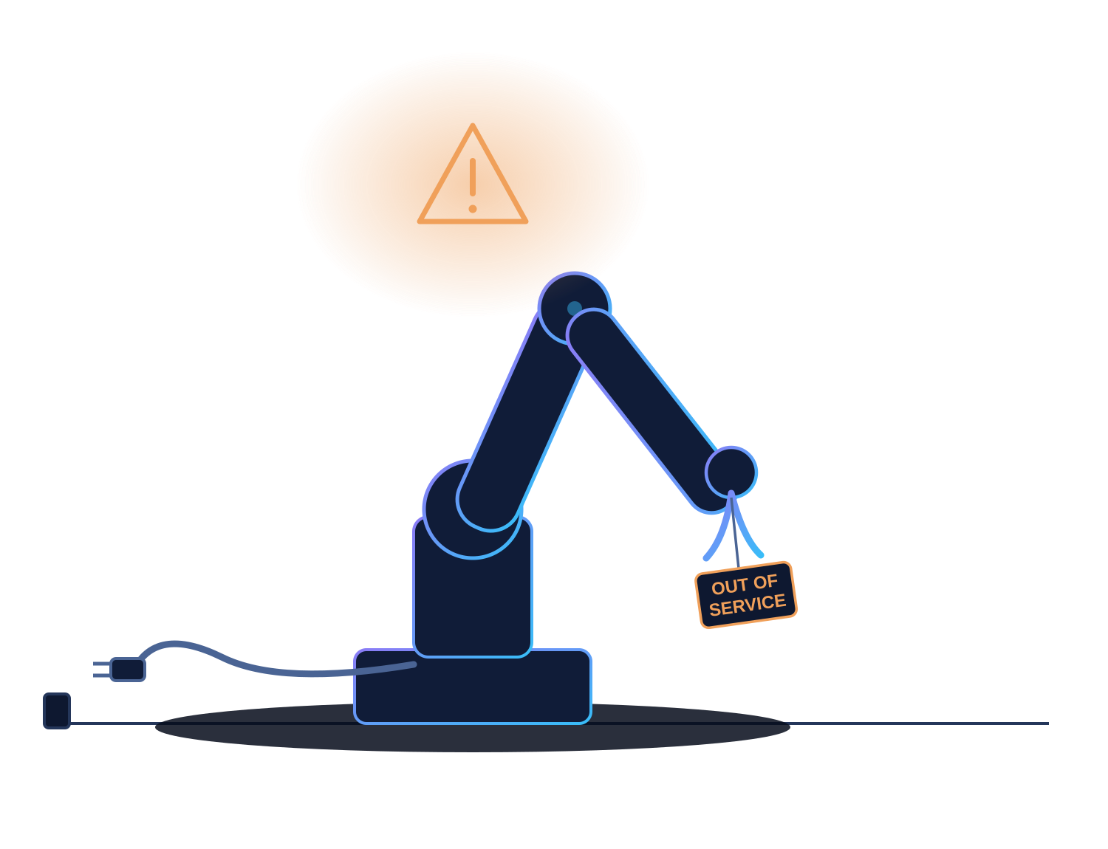




01 — THE FRICTION
Machines can work. Machines still cannot borrow.
Robotics is shifting from hardware sales to fleets and Robots-as-a-Service — and every party in the chain is stuck.
ROBOT OEM
Forced to finance its own deployments — equity capital funds what should be debt.
CUSTOMER
Wants OpEx, not CapEx. Fears downtime and repair bills with no safety net.
INSURER
Cannot price the risk: no loss history, no cross-OEM data, no shared standard.
LENDER
Cannot value the collateral: no residual curve, no verified usage record.
A $200,000 machine, idle. The repair is unfinanced, the replacement unaffordable, the risk unpriced.
When risk cannot be priced, robots consume equity instead of attracting debt — deployment is throttled by balance sheets, not demand.
Calibrum · 衡准 • 2
CONFIDENTIAL • INVESTOR DRAFT

Slide 3
02 — WHY NOW
The machine economy is crossing from CapEx into finance.
Installed base, service robotics and RaaS are scaling at exactly the moment underwriting data starts to exist.
4.66M
542K
+31%
$5T
industrial robots in operational stock (2024)
industrial robots installed in a single year
annual growth of Robots-as-a-Service fleets
humanoid ecosystem estimate by 2050
IFR
IFR
IFR
Morgan Stanley
SELL HARDWARE
→
SELL UPTIME
→
PRICE RISK
→
PRICE CAPITAL
→
TRADE RISK
CapEx
RaaS
Insurance
Credit
Markets
The industry has monetized hardware and uptime. The next three stages all require one missing primitive: a shared way to price machine risk.
Calibrum · 衡准 • 3
CONFIDENTIAL • INVESTOR DRAFT

Slide 4

03 — PROOF
China's insurers moved first — and hit a wall.
Embodied-AI insurance is already being sold at scale in China. The product exists; the pricing infrastructure does not.
SEP 2025
First embodied-AI insurance agreement
PICC signs with the Hangzhou national embodied-AI pilot base.
JAN 2026
First "insurance + leasing" policy
What incumbents say is stopping them:
Ping An folds premium into robot rents with Shanghai Electric Leasing; AI-driven dynamic pricing.
Data barriers — telemetry sits inside OEMs, operators and rental platforms that do not trust each other.
APR 2026
First humanoid insurance claim paid
A robot tips over; PICC settles the claim off the OEM repair quote.
Risk assessment — no cross-OEM loss history; each insurer builds a private, siloed data channel per platform.
2026
Fleets insured, rental market ~$1.4B
PICC covers a 470-unit humanoid rental fleet; platforms now require insurance per robot.
Named publicly by PICC / industry press, 2026.
Insurers are not our competitors. They are our first customers.
Calibrum · 衡准 • 4
CONFIDENTIAL • INVESTOR DRAFT

Slide 5
04 — THESIS
Underwriting Distance
The number of trusted intermediaries between a machine event and a capital decision. Every node can edit the data, has its own interests, and adds cost.
TODAY — DISTANCE ≈ 6
SENSOR
→
OEM CLOUD
→
OPERATOR
→
BROKER
→
INSURER
→
REINSURER
→
LENDER
Each hop: reformatted data, private interests, no independent verification. Unverifiable risk is expensive risk.
WITH MACHINE CREDIT — DISTANCE ≈ 0
MACHINE-SIGNED PROOF
→
RISK ENGINE
→
CAPITAL DECISION
Any counterparty verifies the evidence itself — no one has to be believed.
Lower verification cost → shorter underwriting distance → lower uncertainty → lower cost of machine capital
This is the entire company in one line of economics.

Slide 6
05 — THE GAP
The machine economy is getting wallets before it gets credit.
Identity, reputation and payment rails for machines are being built right now — by others. The credit layer is not.
JAN 2026
ERC-8004 "Trustless Agents"
Identity, reputation and validation registries for agents go live on Ethereum mainnet; 170K+ registrations across chains.
✓
Machine identity
✓
Machine reputation registries
2025–26
x402 machine payments
✓
Machine payments
Coinbase revives HTTP 402: agents settle API calls in stablecoins — no account, no human approval; handed to neutral governance.
✗
Machine credit
2025–26
Card networks move in
✗
Machine insurance standard
Visa Trusted Agent Protocol, Mastercard Agent Pay for machines, Stripe Tempo Machine Payments Protocol — all with stablecoin paths.
✗
Machine capital markets
Software agents need wallets.
Physical agents need balance sheets.
Proof of Operation → Reputation → Credit → Capital
Calibrum · 衡准 • 6
CONFIDENTIAL • INVESTOR DRAFT

Slide 7
06 — ASSET SCOPE
"Machine" is a sequence, not a category.
We enter an asset class only when four tests pass — and the data hook decides the order.
DATA HOOK EXISTS
LOSSES MEASURABLE
FINANCING FRICTION NOW
FRAGMENTED OWNERSHIP
WAVE 1 — NOW
WAVE 2 — 12–24 MO
WAVE 3 — LATER
GPU clusters & neoclouds
Humanoid rental fleets
eVTOL & autonomous vehicles
Collateralized lending exists today; utilization and rental data flow through cloud APIs we can sign.
Concentrated ownership, insured today, loss data accruing fast.
Huge liability pools; enter as certification regimes settle.
Warehouse AMRs & RaaS fleets
Delivery & logistics robots
Consumer-adjacent machines
Fleet software is the hook; China rental platforms already mandate insurance per robot.
Urban incident exposure makes underwriting demand obvious.
Home robots, printer co-ops — as fleets professionalize.
Commercial drones
Industrial 3D-printing farms
New machine classes
Flight logs are regulated artifacts; loss frequency is measurable now.
Per-job logs are a natural Proof of Operation unit.
Same four tests, same rating engine, new asset class.
The hook rule: enter only where telemetry already flows through a platform that can sign — cloud APIs, fleet software, rental platforms. Never beg OEMs machine-by-machine.
Calibrum · 衡准 • 7
CONFIDENTIAL • INVESTOR DRAFT

Slide 8




07 — PRODUCT
The Calibrum Passport.
One persistent, portable record of identity, verified work, incidents and financial behavior — across owners, insurers and borders.
CALIBRUM PASSPORT
VIN
ROBOT #A7-2049
Permanent identity, bound to hardware at manufacture
Warehouse AMR • Ohio, US • VERIFIED
Carfax
Machine Risk Score
782 / 1000
Full life history: usage, maintenance, incidents, claims
Verified operating hours
7,431
FICO
Expected annual loss
186 bps
A dynamic score that every counterparty prices against
Recommended LTV
68%
Residual value (5,000 hrs)
61%
Wallet
A settlement endpoint for premiums, rents and repayments
The passport follows the machine — not the OEM, not the insurer, not the country.
Calibrum · 衡准 • 8
CONFIDENTIAL • INVESTOR DRAFT

Slide 9




08 — WHY A CHAIN
No single party should own the machine's history.
Raw telemetry stays encrypted off-chain. The chain holds identity, proofs and state transitions that six parties must all trust.
OEM
OPERATOR
INSURER
LENDER
SERVICER
BUYER
All six read and write the same machine history. Today each keeps a private, incompatible copy — and any of them can quietly rewrite theirs.
PORTABLE
TAMPER-EVIDENT
COMPOSABLE
PROGRAMMABLE
History survives changes of owner, insurer, lender and jurisdiction. Credit is an asset attached to the machine.
Accident and claims records cannot be quietly edited after the fact — by the OEM, the operator or the insurer.
Insurance, credit and leasing all price off one shared state instead of six siloed data channels.
Verified downtime or loss events trigger stablecoin payouts, covenants and repayments — T+0, cross-border.
The falsification test: remove the chain and you rebuild today's broken state — bilateral "data stays in our domain" silos per insurer, per platform, per country.
Calibrum · 衡准 • 9
CONFIDENTIAL • INVESTOR DRAFT

Slide 10

09 — TECHNICAL MOAT
From verified telemetry to a live capital price.
Not a static classifier — a continuously updated survival, loss and residual-value model over cross-OEM data.
INPUT SIGNALS
FINANCIAL OUTPUTS
Verified operating hours
Task difficulty + environment
Failure + incident history
Maintenance compliance
Firmware / model version
Claims frequency + severity
Utilization + battery wear
Failure probability
1.7%
MACHINE RISK
FOUNDATION MODEL
Expected loss
186 bps
→
Survival analysis — when does it fail?
→
Premium
2.4%
Hazard model — what conditions drive risk?
LTV
68%
Severity + residual value — how costly? what recovery?
Credit spread
+410 bps
Bayesian online learning — updates every operating hour
Residual value
61%
The moat compounds: telemetry linked to claims, repayments and resale outcomes — supervised labels no OEM or insurer holds alone.
Calibrum · 衡准 • 10
CONFIDENTIAL • INVESTOR DRAFT

Slide 11
10 — OWN THE STANDARD
Markets are built on standard units. Machines have none.
We define the unit and the score the whole chain prices against.
EVERY CAPITAL MARKET STARTED WITH A UNIT
THE SCORE
Barrel of oil
commodity markets
MRS
MWh
power markets
Calibrum Machine Risk Score • 0–1000
FICO point
consumer credit
One number that answers what every counterparty is asking: how risky is this machine, and what should its capital cost?
GPU-hour
compute futures (CME, Oct 2026)
If MRS becomes the shared risk language, every insurer, lender and fleet operator becomes a distribution channel.
VMOH — Verified Machine Operating Hour
One hardware-attested hour of machine work: task, environment, utilization, energy, interventions, failures.
Deliberately one score, not a family of trademarked indices. Reference curves (loss, residual value, credit spread) ship as the dataset matures.
Calibrum · 衡准 • 11
CONFIDENTIAL • INVESTOR DRAFT

Slide 12




11 — WHY EVERYONE PLAYS
Every party gets a priced reason to join.
Not a data-charity network: each party contributes data because data lowers its own cost of capital.
GIVES Signed telemetry, BOM, firmware lineage
GETS Fleets sell with financing attached — win deals its balance sheet could never fund
ROBOT OEM
GIVES Usage, maintenance, incident records
GETS Lower premiums and lease rates for verified good behavior — priced, not promised
OPERATOR / RaaS
GIVES Claims outcomes and loss data
GETS A new premium pool it can finally price; underwriting data feed via one API
INSURER / MGA
GIVES Repayment and default outcomes
GETS LTV, haircuts and covenants on a new asset class — with live collateral monitoring
LENDER / LESSOR
The flywheel in one line: more machines → more verified outcomes → better pricing → cheaper insurance and capital → more machines deployed.
Calibrum · 衡准 • 12
CONFIDENTIAL • INVESTOR DRAFT

Slide 13
12 — GO-TO-MARKET
Win one vertical, then become the cross-OEM standard.
Start where telemetry is available, losses are measurable and financing friction is obvious. China rental fleets and US specialty MGAs run in parallel.
0–6 MO
6–18 MO
18–30 MO
30+ MO
PILOT
UNDERWRITE
CREDIT
MARKETS
2–3 robot OEMs / platforms
50K+ machines under score
Lender / lessor APIs
Fleet SPVs and rated pools
1 insurer or MGA design partner
→
Claims-linked telemetry loop
→
Residual-value curves
→
RWA / ABS / risk transfer
10K verified machine-hours
Stablecoin premium settlement
First rated credit facilities
Index licensing revenue
Passport + MRS v0
Insurance data API
LTV + covenant engine
Machine capital markets
Best initial verticals: warehouse AMRs • GPU clusters • commercial drones • RaaS fleets with structured maintenance logs
Calibrum · 衡准 • 13
CONFIDENTIAL • INVESTOR DRAFT

Slide 14
13 — LANDSCAPE
The whitespace is the shared standard, not another silo.
Everyone else owns one silo: identity, insurance workflow, or financing. Nobody owns the cross-party score.
OPEN / PORTABLE STANDARD
* Incumbent insurers are customers, not competitors — they buy the score and the data feed.
IoTeX
CALIBRUM
peaq
IDENTITY / DATA
CAPITAL MARKETS
Autonomy
PolySea
Valgo
Zunya
PICC / Ping An*
CLOSED / PROPRIETARY
Positioning from public materials, accessed Sep 2026.
Calibrum · 衡准 • 14
CONFIDENTIAL • INVESTOR DRAFT

Slide 15



14 — BUSINESS MODEL
One telemetry stream, five monetization layers.
Software-margin revenue first; transaction economics scale with machine asset value under management.
RISK / DATA API
INSURANCE
CREDIT
SETTLEMENT
INDEX LICENSING
$50–200
5–15%
0.5–2%
5–20 bps
License
per machine / year
of premium routed
origination
on flows
+ API subscription
Recurring SaaS to OEMs, insurers, lenders
Broker / MGA economics, no balance-sheet risk
Plus servicing on machine-backed facilities
Stablecoin rails for premiums, rents, repayments
MRS + reference curves; the Moody's layer
North-star economics
Revenue = Machine Asset Value under network × products per machine × retention of verified history
Calibrum · 衡准 • 15
CONFIDENTIAL • INVESTOR DRAFT

Slide 16
15 — DATA MOAT
The network gets cheaper as it gets smarter.
Claims + telemetry create a longitudinal, outcome-linked dataset incumbents do not have and new entrants cannot instantly copy.
MORE
MACHINES
WHAT COMPOUNDS
1.
Cross-OEM failure curves
hard to replicate
MORE
DEPLOYMENT
MORE
TELEMETRY
2.
Claims-linked telemetry
rare proprietary labels
DATA
FLYWHEEL
3.
Task / region benchmarks
network breadth
4.
Loss + residual history
multi-year time moat
LOWER COST
OF CAPITAL
BETTER
MODELS
5.
Pricing feedback
model improves from outcomes
BETTER
PRICING
Moat ≠ blockchain. The moat is the outcome-linked dataset; the chain makes it portable and composable.
Calibrum · 衡准 • 16
CONFIDENTIAL • INVESTOR DRAFT

Slide 17
16 — MARKET
Size the financial take-rate on machine assets.
Do not size "robot insurance" — it is one pool of fees inside the machine balance sheet: credit, leasing, payments, servicing, markets.
MACHINE ECONOMY
ILLUSTRATIVE 2030 COMPANY SCENARIO
MACHINE CAPITAL MARKETS
Connected commercial machines
8.0M
CREDIT + LEASING
Average financeable asset value
$40K
INSURANCE (WEDGE)
Machine Asset Value
$320B
Insurance GWP @ 2.5%
$8B
Financeable pool @ 40%
$128B
Long-term category ceiling
$5T humanoid ecosystem
External anchors: IFR installed-base data; Morgan Stanley 2050 humanoid-ecosystem estimate. 2030 scenario is illustrative company modeling, not a third-party forecast.
Calibrum · 衡准 • 17
CONFIDENTIAL • INVESTOR DRAFT

Slide 18
17 — VENTURE CASE
Scale the asset base first; monetization density follows.
Each connected machine adds products over time: data → insurance → credit → markets. Illustrative five-year venture case.
Illustrative revenue ($M)
$300M
ILLUSTRATIVE OPERATING SCALE
Y1
Y2
Y3
Y4
Y5
Connected robots
10K
75K
300K
1M
3M
$100M
Asset value
$0.3B
$2.5B
$10B
$35B
$100B
$30M
Premium routed
$8M
$60M
$250M
$0.9B
$2.5B
$7M
$1M
Credit originated
$25M
$0.2B
$1B
$4B
$12B
Y1
Y2
Y3
Y4
Y5
Illustrative venture-case scenario — not guidance or forecast.
Bar heights √-scaled for visibility.
RURM
Robots Under Risk Management
MAV
Machine Asset Value
V-MH
Verified Machine Hours
CCM
Cost of Machine Capital
Calibrum · 衡准 • 18
CONFIDENTIAL • INVESTOR DRAFT

Slide 19



18 — FOUNDER-MARKET FIT
From pricing financial assets to pricing machines.
The company sits at the exact intersection of quantitative risk, RWA infrastructure and machine data.
WALL STREET QUANT
HARVARD CSE
RWA CATEGORY CEO
CALIBRUM
→
→
→
Years at Point72 — pricing systems, market data pipelines, risk models under real capital.
Computational science & engineering — the modeling stack behind survival and loss models.
Founded and led BlockStreet — liquidity, collateral and compliance for on-chain assets.
The synthesis: apply capital-markets discipline to the newest asset class — machines.
BlockStreet moved existing financial assets on-chain. Calibrum creates the financial standard for assets that never had one.
Calibrum · 衡准 • 19
CONFIDENTIAL • INVESTOR DRAFT

Slide 20


THE ENDGAME
Lower the cost of
machine capital.
When machines have verifiable identity, reputation and credit, they stop being expensive equipment — and become financeable economic actors.
IDENTITY
RISK
INSURANCE
CREDIT
MARKETS
Calibrum 衡准 • The financial standard for machines • Insurance is the wedge. Machine capital markets are the destination.

Slide 21


APPENDIX — THE ORACLE PROBLEM
Why Proof of Operation can't be cheaply gamed.
The honest objection first: a signed sensor reading only proves the sensor said X — not that X happened. Signed garbage is still garbage.
The cautionary tale: agent registries launched in 2026 filled with shells — only 3–15% of registrations had working endpoints, and 60–90% of reputation reviewers showed sybil behavior. Registration is cheap; performance is expensive. Any trust network is flooded by the cheap side first.
1. PHYSICS CROSS-CHECKS
2. ECONOMIC ADVERSARIES
3. STAKE AND SLASH
Energy draw vs claimed workload, vibration spectra vs claimed task, fleet-level statistical anomaly detection. Faking one record is cheap; faking a physically consistent multi-sensor history is expensive.
Claims and loan defaults are built-in adversarial audits. A machine with an inflated history eventually surfaces at the claim or the default — and both outcome streams live in our graph, feeding back into the score.
OEMs, servicers and validators stake to attest. Fraudulent attestations are slashed. Cheap claims must become expensive to fake — the only role the token plays, and the only one it needs.
No single layer is sufficient. Together they make an honest history the cheapest history to have.
Calibrum · 衡准 • Appendix
CONFIDENTIAL • INVESTOR DRAFT

