Slide 1
FBC Analysis for Radiated Data After Relaxation
Chip 3 – 20 Krad – Block 223

Slide 2
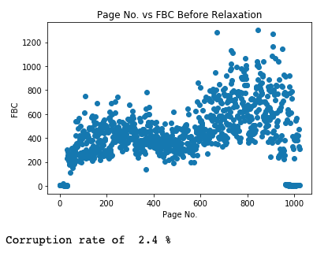
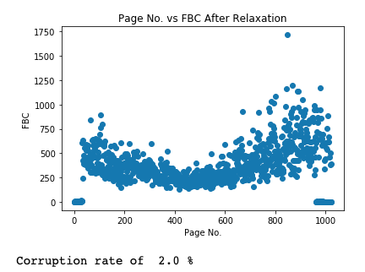
FBC vs Page No. Before and After Relaxation

Slide 3
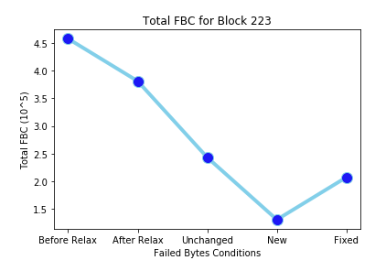
Chip 3 – 20 Krad – Block 223
FBC analysis of corrupted bytes that remained the same, new bytes that got corrupted, and corrupted bytes that got fixed
Total sum of FBCs for the entire block

Slide 4
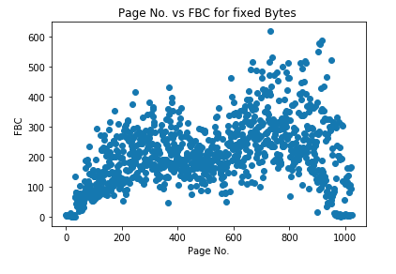
Page No. vs FBC for Fixed Bytes
Fixed bytes (i.e. bytes that got repaired after relaxation)

Slide 5
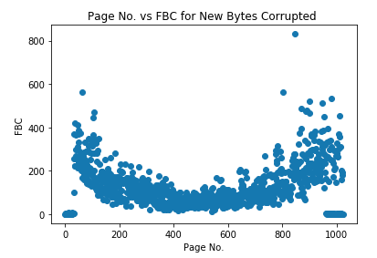
Page No. vs FBC for New Failed Bytes

Slide 6
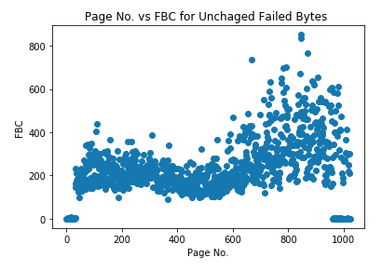
Page No. vs FBC for Unchanged Failed Bytes

Slide 7
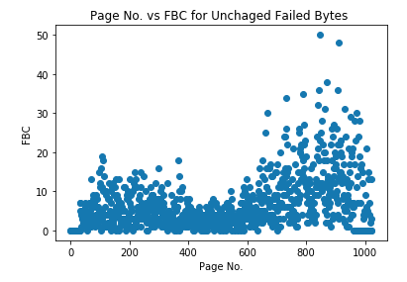
Corrupted Bytes whose values got changed
These bytes remain corrupted, but their values got changed

Slide 9
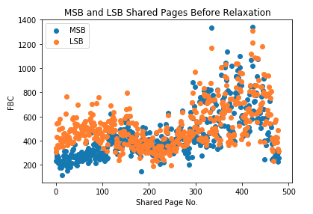
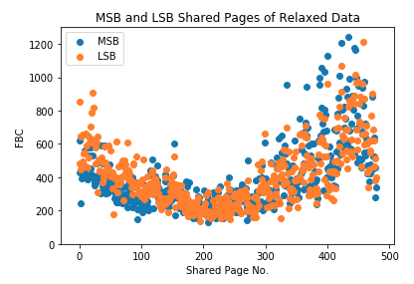
Shared Pages Before and After Relaxation

Slide 10
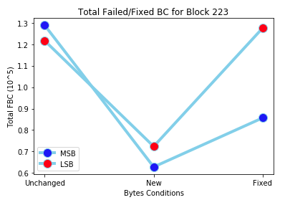
Shared Pages after Relaxation

Slide 11
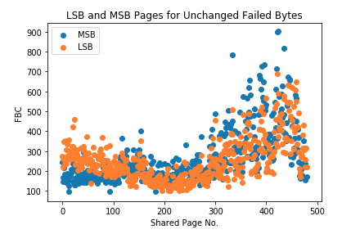
Shared Pages for Unchanged Failed Bytes

Slide 12
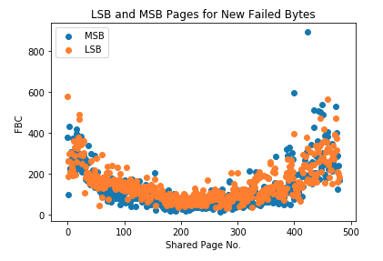
Shared Pages for New Failed Bytes

Slide 13
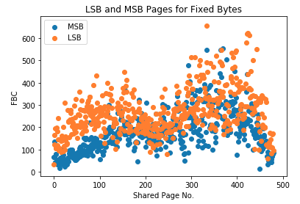
Shared Pages for Fixed Bytes

Slide 15
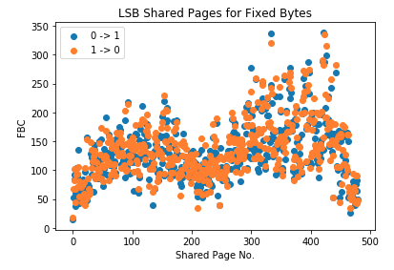
LSB shared pages bits

Slide 16
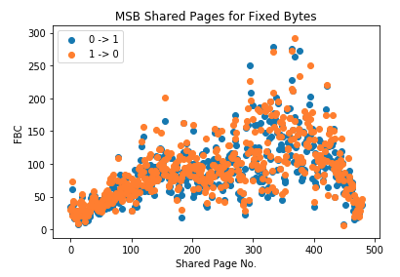
MSB shared pages 0 to 1 and 1 to 0

Slide 17
Zoom WD
Are lsb pages more relaxed than MSB?

Slide 18
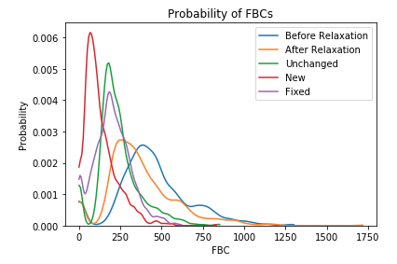
FBC Probabilities

Slide 19
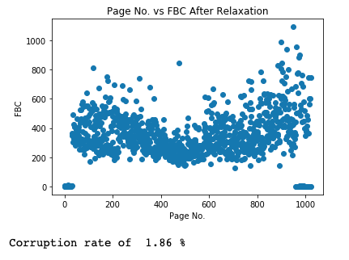
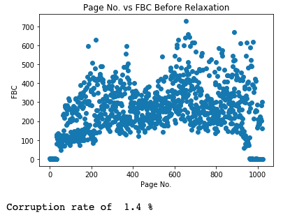
Chip 3 – Block 10

Slide 20
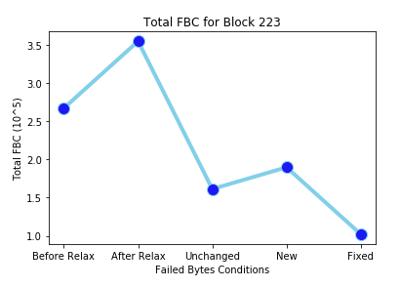
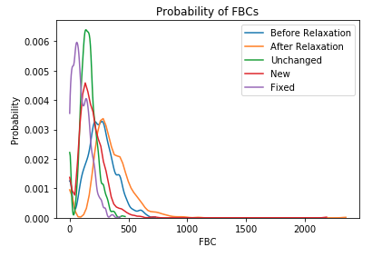

Slide 21
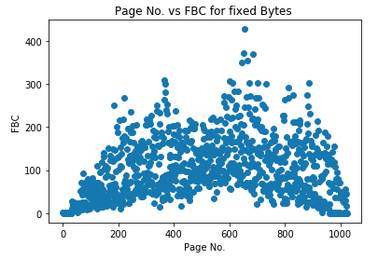
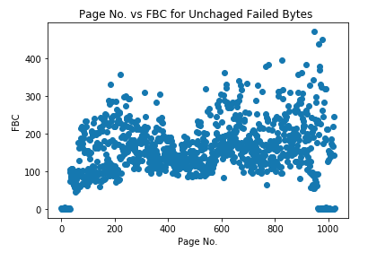

Slide 22
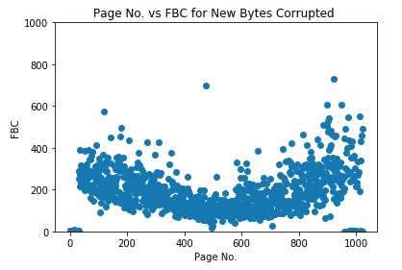
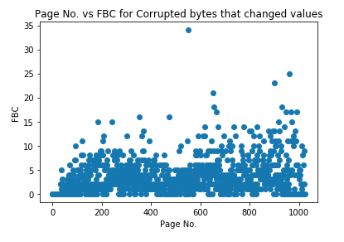

Slide 23
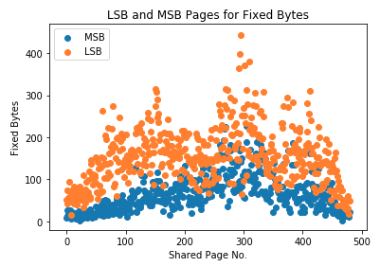
Shared Pages for Fixed Bytes

Slide 24
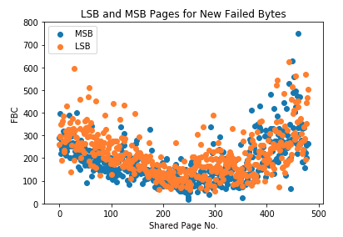
Shared Pages for New Failed Bytes

Slide 25
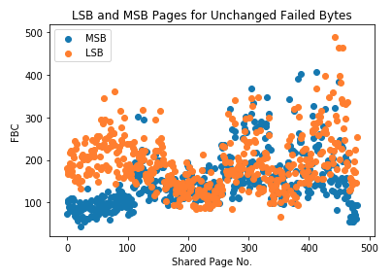
Shared Pages for Unchanged Failed Bytes

Slide 26
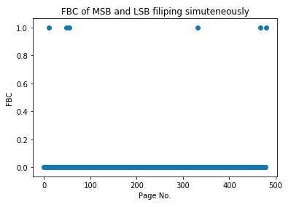
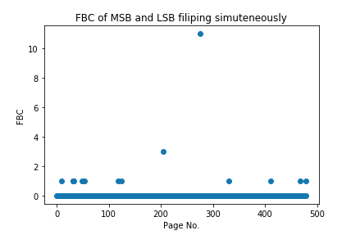

Slide 27
Seeing the number of new fails in the data after relaxation, I believe that the attempt to repair corrupted memory cells using partial programs would greatly reduce the BER after relaxation.

Slide 28
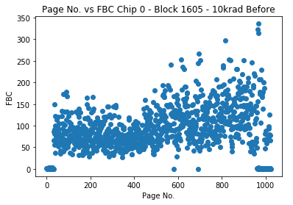
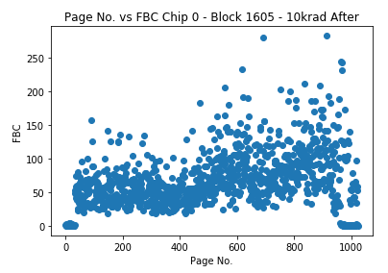
Corruption rate of 0.65 % - Before Relaxation
Corruption rate of 0.36 % - After Relaxation

Slide 29
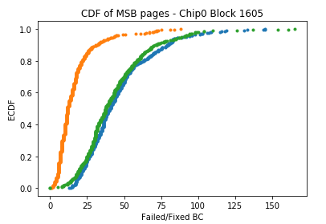
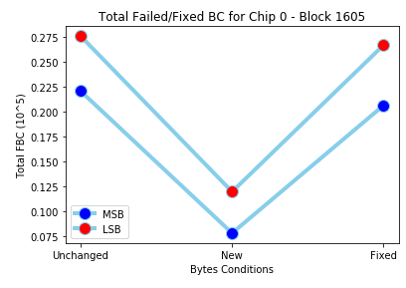

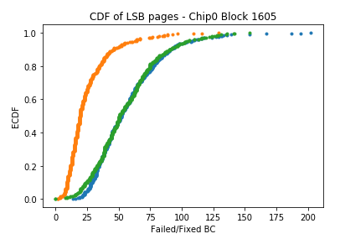
1 Month of Relaxation - LSB and MSB Pages

Slide 30
