Slide 1
Owamp mmWave Test
PC1
Path 1
PC 2
Path 2

Slide 2
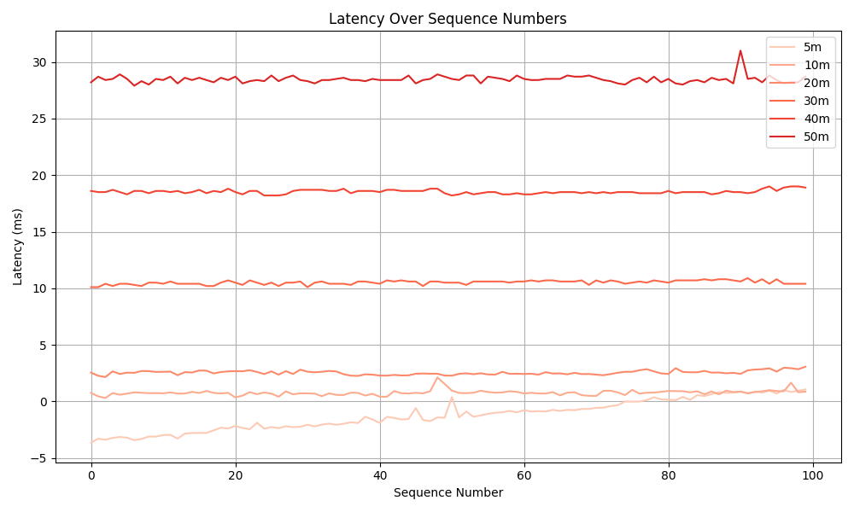
Owamp mmWave Test – Path 1

Slide 3
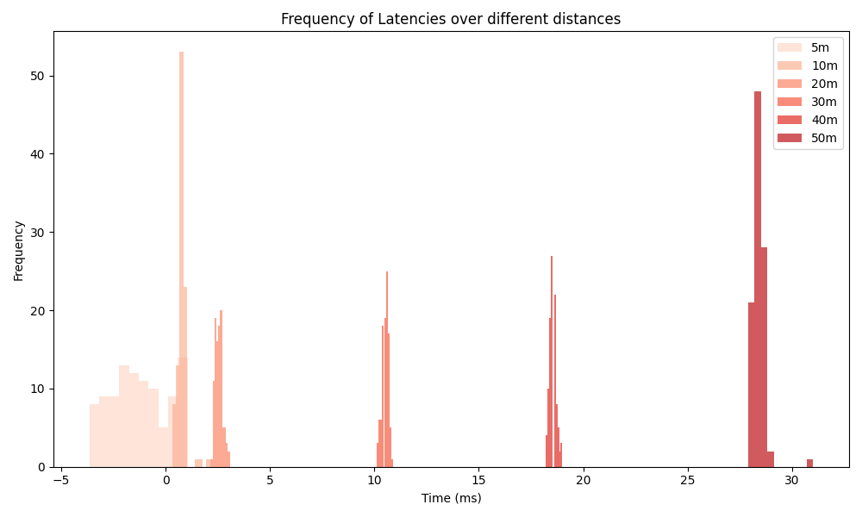
Owamp mmWave Test – Path 1

Slide 4
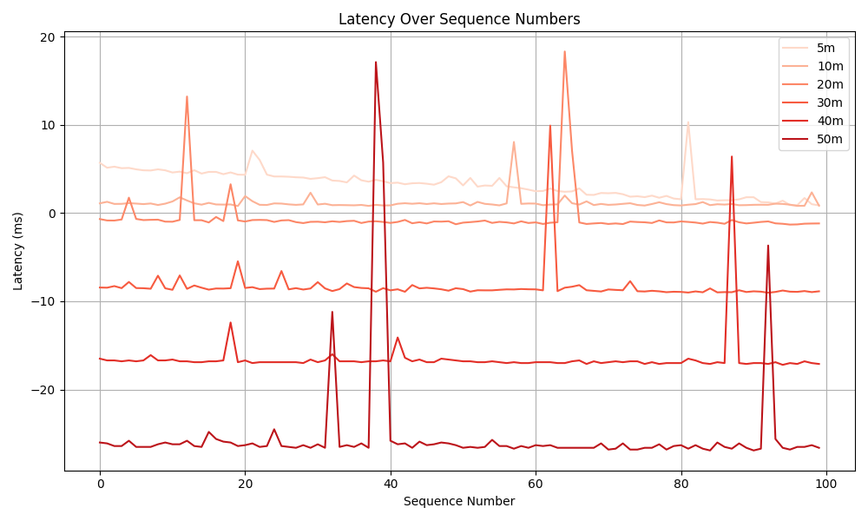
Owamp mmWave Test – Path 2

Slide 5
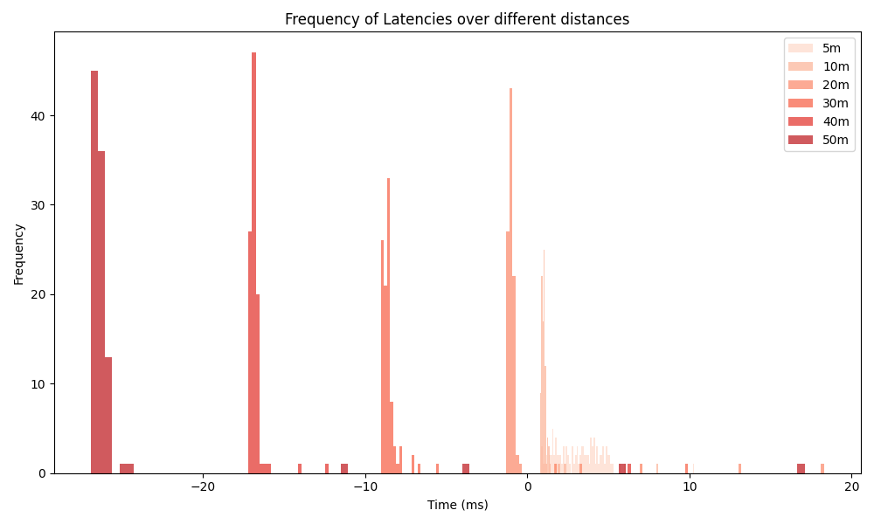
Owamp mmWave Test – Path 2

