Slide 1
Approach for analysis of Datamart objects
18-June-2014
Notes:
To remove the placeholders reserved for customer and product logos, click on them and press [Delete].

Slide 2
Agenda
1 | INTRODUCTION
2 | PARAMETERS AND INFERENCE OF ANALYSIS DATAMART TABLES SOURCES OF DATAMART TABLES DATAMART OBJECTS BASED ON DM TABLES EXECUTION DETAILS
3 | METHOD FOR ANALYSIS OF DM OBJECTS
4 | LIST OF DETAILS CAPTURED FOR ANALYSIS
5 | MAJOR DATAMODELS OF DM OBJECTS
6 | PURPOSE OF DM OBJECTS ANALYSIS
7 | CASE STUDY FROM ISECPD PROJECT / SBI PROD
Notes:
To delete a row, right click inside | Delete Rows.
To insert a row, right click | Insert | Insert Rows Above or Insert Rows Below.
You can copy/paste a line already formatted or use the "Format Painter" icon.

Slide 3
Agenda
1 | INTRODUCTION
2 | PARAMETERS AND INFERENCE OF ANALYSIS DATAMART TABLES SOURCES OF DATAMART TABLES DATAMART OBJECTS BASED ON DM TABLES EXECUTION DETAILS
3 | METHOD FOR ANALYSIS OF DM OBJECTS
4 | LIST OF DETAILS CAPTURED FOR ANALYSIS
5 | MAJOR DATAMODELS OF DM OBJECTS
6 | PURPOSE OF DM OBJECTS ANALYSIS
7 | CASE STUDY FROM ISECPD PROJECT/SBI PROD
Notes:
To delete a row, right click inside | Delete Rows.
To insert a row, right click | Insert | Insert Rows Above or Insert Rows Below.
You can copy/paste a line already formatted or use the "Format Painter" icon.

Slide 4
Introduction
Objective of Reporting stream is to have an efficient DM design
To generate only relevant data according to the scope of the reports
To minimize any duplicity of the data generated across different reports and the efficient reuse of the data
Why efficient DM design ?
Overall optimal performance for the execution of the reports
Efficient maintenance – BAU support
To accommodate any future extension in scope – future projects (?)

Slide 5
Challenges to have an efficient DM design
Most projects are in support mode and the build is owned by clients
Lack of Datamart/Murex knowledge (Best Practices) for the clients
Difficult to get entire scope of all the reports in the project during the design phase
Difficult to monitor and control the Datamart design during the entire span of the project
An efficient and easy tool/method to perform regular health checks are required !

Slide 6
Overview of Datamart Objects
Sources of Datamart Tables
Processing Scripts
Batches of Feeders
Dynamic Tables
Table Feeders
Datamart Tables
Batches of Extractions
Single Extractions
SQL
Batches of Procedures
Stored Procedures
Execution Details

Slide 7
Agenda
1 | INTRODUCTION
2 | PARAMETERS AND INFERENCE OF ANALYSIS DATAMART TABLES SOURCES OF DATAMART TABLES DATAMART OBJECTS BASED ON DM TABLES EXECUTION DETAILS
3 | METHOD FOR ANALYSIS OF DM OBJECTS
4 | LIST OF DETAILS CAPTURED FOR ANALYSIS
5 | MAJOR DATAMODELS OF DM OBJECTS
6 | PURPOSE OF DM OBJECTS ANALYSIS
7 | CASE STUDY FROM ISECPD PROJECT/SBI PROD
Notes:
To delete a row, right click inside | Delete Rows.
To insert a row, right click | Insert | Insert Rows Above or Insert Rows Below.
You can copy/paste a line already formatted or use the "Format Painter" icon.

Slide 8
Datamart Tables
# | Parameters | Inference of the analysis
1 | Type of Datamart Table | Starting Point for DM tables analysis
2 | Number of columns | To identify the size of the table, typically we recommend clients to have only about 150 columns per table
3 | Number of Datamart objects based on same DM Table | Starting point to identify the duplication of the DM objects
4 | Number of DM tables based on same dynamic table | Starting point to identify the duplication of datamart tables
5 | Details of the Indexes | To identify any redundant indexes or requirement of new indexes to be created

Slide 9
Agenda
1 | INTRODUCTION
2 | PARAMETERS AND INFERENCE OF ANALYSIS DATAMART TABLES SOURCES OF DATAMART TABLES DM OBJECTS BASED ON DM TABLES EXECUTION DETAILS
3 | METHOD FOR ANALYSIS OF DM OBJECTS
4 | LIST OF DETAILS CAPTURED FOR ANALYSIS
5 | MAJOR DATAMODELS OF DM OBJECTS
6 | PURPOSE OF DM OBJECTS ANALYSIS
7 | CASE STUDY FROM ISECPD PROJECT/SBI PROD
Notes:
To delete a row, right click inside | Delete Rows.
To insert a row, right click | Insert | Insert Rows Above or Insert Rows Below.
You can copy/paste a line already formatted or use the "Format Painter" icon.

Slide 10
Sources of Datamart Tables
Dynamic table configurations
SQL Queries
Validation of the SQL queries

Slide 11
Dynamic Tables
# | Parameters | Inference of the analysis
1 | Type of the Dynamic table | Starting point for dynamic table analysis
2 | Total number of fields selected | To identify the load on the dynamic and the feasibility of reducing the number of fields per dynamic table
3 | Number of Horizontal Fields
4 | Validation of the DB fetch parser functions used in horizontal fields (*TBLFIELD, *TABLE) | To check the feasibility of replacing these fields with SQL based Datamart tables
5 | Disable compute flag

Slide 12
Dynamic Tables
# | Parameters | Inference of the analysis
6 | Built on (Detailed or Consolidated or Stored Results)
7 | Filter conditions | To identify duplicate dynamic tables with same filter conditions and type of dynamic table
8 | Post-Filter conditions | To check feasibility to move the conditions to pre-filter/ global filter / handle in extraction query
9 | Dynamic Table fields | To understand whether the dynamic tables are been reused efficiently such as maintaining TP fields from a common table to be used for several reports

Slide 13
Agenda
1 | INTRODUCTION
2 | PARAMETERS AND INFERENCE OF ANALYSIS DATAMART TABLES SOURCES OF DATAMART TABLES DM OBJECTS BASED ON DM TABLES EXECUTION DETAILS
3 | METHOD FOR ANALYSIS OF DM OBJECTS
4 | LIST OF DETAILS CAPTURED FOR ANALYSIS
5 | MAJOR DATAMODELS OF DM OBJECTS
6 | PURPOSE OF DM OBJECTS ANALYSIS
7 | CASE STUDY FROM ISECPD PROJECT/SBI PROD
Notes:
To delete a row, right click inside | Delete Rows.
To insert a row, right click | Insert | Insert Rows Above or Insert Rows Below.
You can copy/paste a line already formatted or use the "Format Painter" icon.

Slide 14
Datamart Objects based on DM Tables
Batches of Feeders / Stored procedures / Extractions
# | Parameters | Inference
1 | Number of same table feeders used in different batches of feeders | To identify duplication of data generated to the same Datamart Table
2 | Scanner details | To validate/verify whether the scanner templates are been used only for appropriate batches
3 | Data (Published/ Private) | To understand whether the data handling is done correctly: Private data may be required for intra day reports Published data may be required for EOD reports

Slide 15
Datamart Objects based on DM Tables
Batches of Feeders / Stored procedures / Extractions
# | Parameters | Inference
4 | Data computed by several batches | To identify if batches having same Label and Data computed by several batches have same Historization Historization if set to ‘One data set per day’ to check for periodical purging of data (house keeping)
5 | Label of data
6 | Historization
Having different historizations for the set of batch of feeders with same label will result in inconsistent M_REF_DATA being created hence we recommend to have same historizations in such cases

Slide 16
Datamart Objects based on DM Tables
Batches of Feeders / Stored procedures / Extractions
# | Parameters | Inference
1 | Global filter computing dates | To identify duplicate batches with same filter conditions To optimize the filter conditions
2 | Global filter expressions
3 | Global filter conditions

Slide 17
Agenda
1 | INTRODUCTION
2 | PARAMETERS AND INFERENCE OF ANALYSIS DATAMART TABLES SOURCES OF DATAMART TABLES DM OBJECTS BASED ON DM TABLES EXECUTION DETAILS
3 | METHOD FOR ANALYSIS OF DM OBJECTS
4 | LIST OF DETAILS CAPTURED FOR ANALYSIS
5 | MAJOR DATAMODELS OF DM OBJECTS
6 | PURPOSE OF DM OBJECTS ANALYSIS
7 | CASE STUDY FROM ISECPD PROJECT/SBI PROD
Notes:
To delete a row, right click inside | Delete Rows.
To insert a row, right click | Insert | Insert Rows Above or Insert Rows Below.
You can copy/paste a line already formatted or use the "Format Painter" icon.

Slide 18
Execution Details
# | Parameters | Inference
1 | Last execution time of Batch/Single objects | To identify the recent execution time to highlight the bottleneck objects
2 | Last execution date of Batch/single objects | To identify the configurations that are not been used in production
3 | Number of rows generated by the job to the Datamart table (available from v3.1.28) | To understand and validate the current performance of the batches/ single objects
4 | The Execution User | Same batches may be executed by different users for different entities. Depending on the design, we could replicate the Batches when required to run using different users.

Slide 19
Agenda
1 | INTRODUCTION
2 | PARAMETERS AND INFERENCE OF ANALYSIS DATAMART TABLES SOURCES OF DATAMART TABLES DATAMART OBJECTS BASED ON DM TABLES EXECUTION DETAILS
3 | METHOD FOR ANALYSIS OF DM OBJECTS
4 | LIST OF DETAILS CAPTURED FOR ANALYSIS
5 | MAJOR DATAMODELS OF DM OBJECTS
6 | PURPOSE OF DM OBJECTS ANALYSIS
7 | CASE STUDY FROM ISECPD PROJECT/SBI PROD
Notes:
To delete a row, right click inside | Delete Rows.
To insert a row, right click | Insert | Insert Rows Above or Insert Rows Below.
You can copy/paste a line already formatted or use the "Format Painter" icon.

Slide 20
Method for Analysis
Quick data extraction using SQL
Understanding and Analysis of the configurations
Template for the config parameters

Slide 21
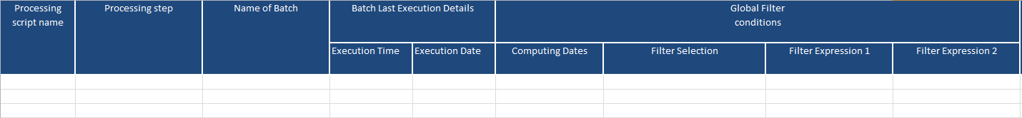
Method for Analysis
Identification of Configurations to analyze:
A pre defined template with the list of all configuration parameters required for analysis as below is created :
Quick Data extraction of the Configuration parameters:
A SQL query to be executed directly on the financial DB to get all the details to fill in the above template
Analysis:
Run the SQL in the Financial DB
Copy the output to the excel sheet and
Perform the analysis

Slide 22
Query Details
The Query was framed using the DSD tool relationships from the Playground env
The query runs successfully in several version of MX DBs such as
ICICI/ ISecPD – 3.1.24.28
SBI - 3.1.28
Siamcom – 3.1.26
Playground env – 3.1.32
The query uses functions such as LISTARG, extract (hour .. ) that works only in Oracle 11g

Slide 23
Agenda
1 | INTRODUCTION
2 | PARAMETERS AND INFERENCE OF ANALYSIS DATAMART TABLES SOURCES OF DATAMART TABLES DATAMART OBJECTS EXECUTION DETAILS
3 | METHOD FOR ANALYSIS OF DM OBJECTS
4 | LIST OF DETAILS CAPTURED FOR ANALYSIS
5 | MAJOR DATAMODELS OF DM OBJECTS
6 | PURPOSE OF DM OBJECTS ANALYSIS
7 | CASE STUDY FROM ISECPD PROJECT/SBI PROD
Notes:
To delete a row, right click inside | Delete Rows.
To insert a row, right click | Insert | Insert Rows Above or Insert Rows Below.
You can copy/paste a line already formatted or use the "Format Painter" icon.

Slide 24
Details captured in SQL Query
DM Table Source Config | DM Table Config | Configs of DM Objects based on DM Tables
Dynamic Table Name Dynamic Table type Dynamic table Default Filter Configurations Computing Dates Pre-filter selections Pre-filter Expression1 Pre-filter Expression 2 Pre-filter Typology conditions Post filter Conditions Number of Horizontal Fields Number of occurrences of DB parser functions (*TBLFIELD and *TABLE()) Datamart SQL | Datamart table Name Columns count Indexes | Processing script name Processing step Name of Batch Batch Last Execution Details Last Execution Time Last Execution Date Global Filter conditions Computing Dates Filter selections Filter Expression Historisation Data Computed by Several Batches Number of Scanner Engines Data (Published /Private) Label of Data Name of single Object (Table Feeder, Single Extraction or Stored Procedure) Single object Last Execution Details Last Execution Time Last Execution Date Object Type (Feeders/Extractions/Procedures)

Slide 25
Agenda
1 | INTRODUCTION
2 | PARAMETERS AND INFERENCE OF ANALYSIS DATAMART TABLES SOURCES OF DATAMART TABLES DATAMART OBJECTS BASED ON DM TABLES EXECUTION DETAILS
3 | METHOD FOR ANALYSIS OF DM OBJECTS
4 | LIST OF DETAILS CAPTURED FOR ANALYSIS
5 | MAJOR DATAMODELS OF DM OBJECTS
6 | PURPOSE OF DM OBJECTS ANALYSIS
7 | CASE STUDY FROM ISECPD PROJECT/SBI PROD
Notes:
To delete a row, right click inside | Delete Rows.
To insert a row, right click | Insert | Insert Rows Above or Insert Rows Below.
You can copy/paste a line already formatted or use the "Format Painter" icon.

Slide 26
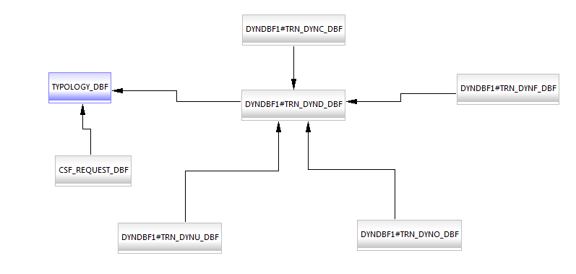
Dynamic table
Filter conditions
Filter on Typology
Selected Fields
Dynamic table definition
Filter expressions
Horizontal Fields

Slide 27
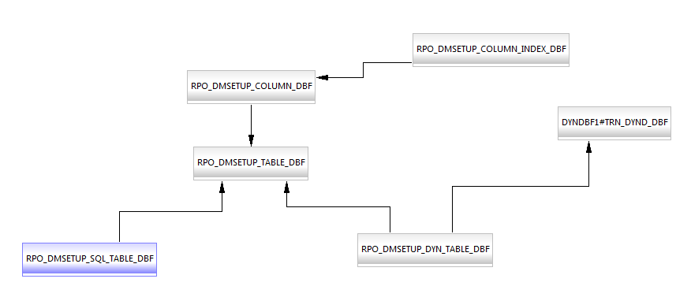
Datamart table
Indexes on Columns
Columns of DM Tables
Dynamic Table definition
Datamart table definition
SQL query for SQL based DM Tables
DM tables based on Dynamic tables

Slide 28
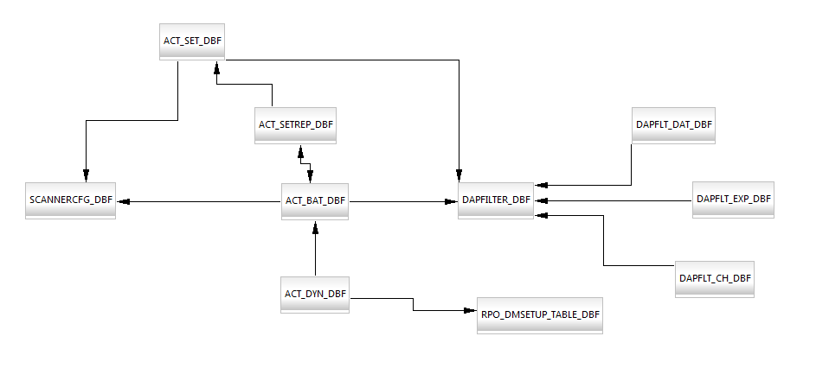
Batches and single DM objects
DM Object Definition for batch
GF Computing Dates
DM Objects underlying a batch
Global Filter Details
GF Expressions
Scanner Template details
DM Object Definition except batch
Global filter condition choices
DM Tables used by DM objects
DM tables definition

Slide 29
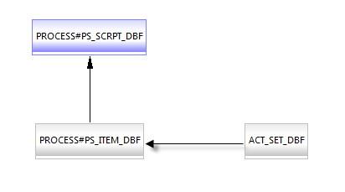
Processing scripts
Processing Script Definition
Processing units Definition
DM Objects definition for batch

Slide 30
Agenda
1 | INTRODUCTION
2 | PARAMETERS AND INFERENCE OF ANALYSIS DATAMART TABLES SOURCES OF DATAMART TABLES DATAMART OBJECTS EXECUTION DETAILS
3 | METHOD FOR ANALYSIS OF DM OBJECTS
4 | LIST OF DETAILS CAPTURED FOR ANALYSIS
5 | MAJOR DATAMODELS OF DM OBJECTS
6 | PURPOSE OF DM OBJECTS ANALYSIS
7 | CASE STUDY FROM ISECPD PROJECT/SBI PROD
Notes:
To delete a row, right click inside | Delete Rows.
To insert a row, right click | Insert | Insert Rows Above or Insert Rows Below.
You can copy/paste a line already formatted or use the "Format Painter" icon.

Slide 31



Purpose of DM Analysis
Analysis of Datamart Objects configuration shall be required in the
Implementation Projects
Migration Projects
Production BAU Support
EOD Performance Analysis : DM Configs + Execution details (time , date, user)

Slide 32
Agenda
1 | INTRODUCTION
2 | PARAMETERS AND INFERENCE OF ANALYSIS DATAMART TABLES SOURCES OF DATAMART TABLES DATAMART OBJECTS EXECUTION DETAILS
3 | METHOD FOR ANALYSIS OF DM OBJECTS
4 | LIST OF DETAILS CAPTURED FOR ANALYSIS
5 | MAJOR DATAMODELS OF DM OBJECTS
6 | PURPOSE OF DM OBJECTS ANALYSIS
7 | CASE STUDY FROM ISECPD PROJECT /SBI PROD
Notes:
To delete a row, right click inside | Delete Rows.
To insert a row, right click | Insert | Insert Rows Above or Insert Rows Below.
You can copy/paste a line already formatted or use the "Format Painter" icon.

Slide 33
Case Study on ISecPD Project
Datamart Table Field counts
Dynamic Table Horizontal Fields counts
Datamart Table | Column count
 | Before | After Clean up
IPD_BD_BRK_PL.REP | 200 | 25
IPD_BD_DEALLIST.REP | 163 | 106
IPD_FUTUREVALDT.REP | 143 | 38
IPD_REPO_MKT_OP.REP | 128 | 61
IPD_REPO_PL.REP | 199 | 12
IPD_DEALLIST.REP | 157 | 157
IPD_BD_PFT_ALLOC.REP | 125 | 125
IPD_BD_PFT_MODIF.REP | 126 | 126
IPD_BD_PL.REP | 128 | 128
Dynamic Tables | Horizontal Fields count |  | HF using DB parser fns
 | Before | After | Before | After
DYN_IPD_BD_AI | 20 | 11 | 5 | 5
DYN_IPD_DEALLIST | 21 | 17 | 6 | 4
DYN_IPD_REPO_MKT_OP | 40 | 12 | 29 | 8
DYN_IPD_BD_PL | 42 | 42 | 19 | 19
DYN_IPD_BF_PFT_ALLOC | 41 | 41 | 31 | 31
DYN_IPD_LB_PL | 25 | 25 | 21 | 21

Slide 34
Case Study on ISecPD Project
Post filter expression that can be moved to pre-filter expression
Dynamic Tables | Post Filter Expression | Equivalent Pre filter expression
DYN_IPD_BD_MTM, DYN_IPD_BD_MTM_INTRA, DYN_IPD_PNL, DYN_IPD_SCF_DEALLIST | TP_DTETRN <=DENV('CRT_BND12') | TRN_DATE<=DENV('CRT_BND12')
DYN_IPD_BD_PMT | DF_ENT='ISECPD_CE' | RQWHERE("DLV_CASH_DBF. M_ENT_REF IN (SELECT M_REF FROM TRN_ENTD_DBF WHERE TRIM(M_LABEL) = 'ISECPD_CE')","")

Slide 35

Case Study on ISecPD Project
Potential Duplicate Dynamic table with same type and similar filter expression
Try to have a single dynamic table and have multiple/single REP tables fed with different filters at the Batch of feeders
Dynamic Table Type | Dynamic Table Name | Pre-filter expression
DYN_TRNRP_CS | DYN_IPD_LB_CS | TRN_FMLY='IRD'.AND.TRN_GRP='LN_BR' .AND. (BENTITY=='ISECPD_CE'.OR.SENTITY== 'ISECPD_CE')
 | DYN_IPD_LB_CS_AI | TRN_FMLY='IRD'.AND.TRN_GRP='LN_BR' .AND. (BENTITY=='ISECPD_CE'.OR.SENTITY== 'ISECPD_CE')
 | DYN_IPD_LB_IPDUE | TRN_FMLY='IRD'.AND.TRN_GRP='LN_BR' .AND. (BENTITY=='ISECPD_CE'.OR.SENTITY== 'ISECPD_CE') .AND. TRN_DATE<=DENV('CRT_BND12')
DYN_TRNRP_MK | DYN_IPD_BD_MK | (BENTITY='ISECPD_CE'.AND.SENTITY='ISECPD_CE')
 | DYN_IPD_REPO_MKT_OP | (BENTITY='ISECPD_CE'.AND.SENTITY='ISECPD_CE') .AND. (TRN_FMLY='IRD'.AND.TRN_GRP='REPO')

Slide 36
Case Study on ISecPD Project
Dynamic Table Type | Dynamic Table Name | Pre-filter expression
DYN_TRNRP_PL | DYN_IPD_BD_PL | (BENTITY='ISECPD_CE'.AND.SENTITY='ISECPD_CE') .AND. ((TRN_FMLY='IRD' .AND. (TRN_GRP='BOND'.OR.TRN_GRP='REPO')).OR.(TRN_FMLY='EQD'.AND.TRN_GRP='EQUIT')).AND.TRN_DATE<=DENV('CRT_BND12')
 | DYN_IPD_BD_DEALLIST | (BENTITY='ISECPD_CE'.AND.SENTITY='ISECPD_CE') .AND. ((TRN_FMLY='IRD'.AND.(TRN_GRP='BOND'.OR.TRN_GRP='REPO')) .OR. (TRN_FMLY='EQD'.AND.TRN_GRP='EQUIT')) .AND. TRN_DATE<=DENV('CRT_BND12')
 | DYN_IPD_BD_DEALS | (BENTITY='ISECPD_CE'.AND.SENTITY='ISECPD_CE').AND.(TRN_FMLY='IRD'.AND.TRN_GRP='BOND') .AND.TRN_STATUS<>'DEAD'
 | DYN_IPD_BD_MTM | (BENTITY='ISECPD_CE'.AND.SENTITY='ISECPD_CE') .AND. ((TRN_FMLY='IRD'.AND.(TRN_GRP='BOND'.OR.TRN_GRP='REPO')) .OR. (TRN_FMLY='EQD'.AND.TRN_GRP='EQUIT'))
 | DYN_IPD_BD_MTM_INTRA | (BENTITY='ISECPD_CE'.AND.SENTITY='ISECPD_CE') .AND. ((TRN_FMLY='IRD'.AND.(TRN_GRP='BOND')) .OR. (TRN_FMLY='EQD'.AND.TRN_GRP='EQUIT'))

Slide 37
Case Study on ISecPD Project
Dynamic Table Type | Dynamic Table Name | Pre-filter expression
DYN_TRNRP_PL | DYN_IPD_LB_AI | TRN_FMLY='IRD'.AND.TRN_GRP='LN_BR' .AND. (BENTITY=='ISECPD_CE'.OR.SENTITY=='ISECPD_CE') .AND. TRN_DATE<=DENV('CRT_BND12')
 | DYN_IPD_LB_PL | TRN_FMLY='IRD'.AND.TRN_GRP='LN_BR' .AND. (BENTITY=='ISECPD_CE'.OR.SENTITY=='ISECPD_CE') .AND. TRN_DATE<=DENV('CRT_BND12')
 | DYN_IPD_PDR2 | (BENTITY='ISECPD_CE'.AND.SENTITY='ISECPD_CE') .AND. ((TRN_FMLY='IRD'.AND.(TRN_GRP='BOND'.OR.TRN_GRP='REPO'.OR.TRN_GRP='LN_BR')) .OR. (TRN_FMLY='EQD'.AND.TRN_GRP='EQUIT'))
 | DYN_IPD_PNL | (BENTITY='ISECPD_CE'.AND.SENTITY='ISECPD_CE') .AND. ((TRN_FMLY='IRD' .AND. (TRN_GRP='BOND'.OR.TRN_GRP='REPO')).OR.(TRN_FMLY='EQD'.AND.TRN_GRP='EQUIT'))
 | DYN_IPD_REPO_DEALIST | (BENTITY='ISECPD_CE'.AND.SENTITY='ISECPD_CE') .AND. ((TRN_FMLY='IRD'.AND.(TRN_GRP='BOND'.OR.TRN_GRP='REPO')) .OR. (TRN_FMLY='EQD'.AND.TRN_GRP='EQUIT')) .AND. TRN_DATE<=DENV('CRT_BND12')

Slide 38
Case Study on SBI Prod
Statistics on unused datamart objects
There are no post filter expressions that can be pushed to Pre filter or global filter
There were no similar dynamic tables with same type and filter criteria
Category | Batches of Feeder | Single Feeders
Number of objects never executed till date | 43 | 9
Number of objects not executed since 1 year | 40 | 5
Number of objects not executed more than 2 years | 90 | 11

Slide 39
Case Study on SBI Prod
Datamart Table Field counts
Dynamic Table Horizontal Fields counts
Datamart Table | Columns count
SAN_DM_MTM_PL.REP | 193
SAN_DM_CS.REP | 102
FX_PL_SIM.REP | 129
CS_ALL_EVALFUT.REP | 116
CCIL_OPTIONS.REP | 185
CCIL_DERV.REP | 185
Dynamic Tables | Fields count | HFields count | HFields using DB parser fns
SAN_DYN_MTM_PL | 121 | 15 | 1
SAN_DYN_CS | 71 | 7 | 1
FX_PL_SIM2 | 129 | 7 | 0
DYN_CS_ALL_EVALFUT | 83 | 12 | 1
CCIL_OPTION1 | 109 | 0 | 0
CCIL_DERV | 109 | 0 | 0
DYN_FX_TP | 102 | 27 | 13
MMAVGRATE | 12 | 20 | 0
MM_TP | 56 | 12 | 0
DYN_PL_DETAIL | 83 | 22 | 0
CBS | 46 | 12 | 4

Slide 40
Case Study on SBI Prod
Analysis on the batches which takes more than 1 hr of execution time
Name of the Batches | Execution Time | Scanner Template | Global Filter | Fields count | HFs count in Dynamic Table | HFs with DB Parser functions | Pre-Filter Expr | Post filter Expr
OutMMPOS_BF | 2 Hrs:28mins | N | N | 12 | 4 | 1 | Y | N
GMUK_IRSM_BAT | 1Hr | N | Y | 31 | 8 | 2 | N | N
GMP_R4_AFS_MTM | 1Hr:10min | N | N | 30 | 0 | 0 | N | N

Slide 41
DM configurations
Output from ISec PD DB
Output from SBI

Slide 42
Docs
You can get the templates, queries and the copy of the session slide in T:\Dept\Integration\Reporting\Docs\EOD Performance Analysis

Slide 43
Thank you

