Slide 1
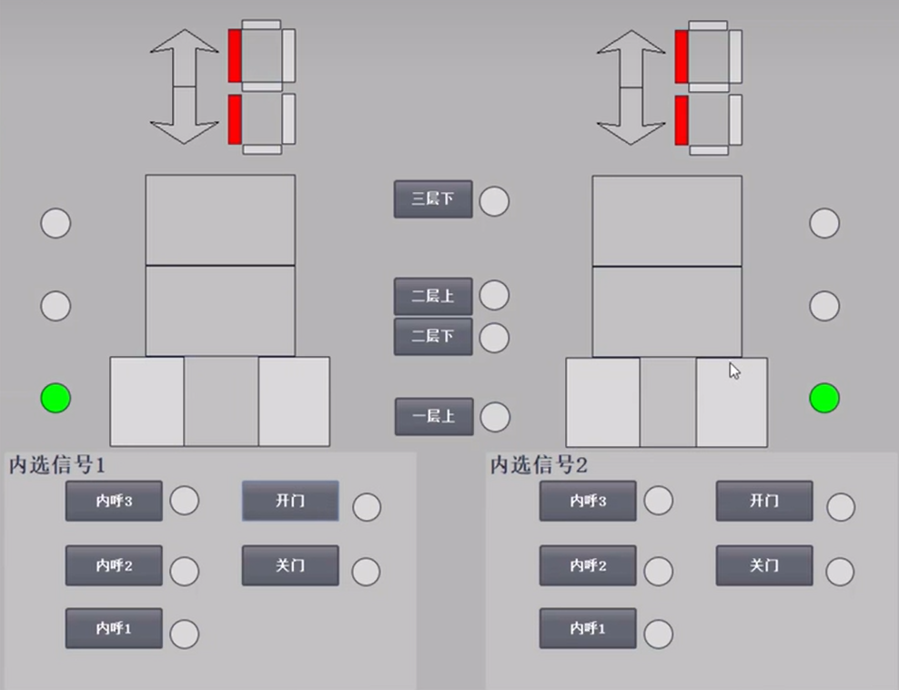
Proximity principle
User 1 call elevator on third floor to second floor
关
Notes:
判断，离的近的接收指令；一样近任意一个即可

Slide 2
关

Slide 3
User 2 call elevator on third floor to first floor
关

Slide 4
关

Slide 5
Current instruction priority principle
User 1 on first floor will go to third floor
关
Notes:
1. 当前正在走的指令优先完成，除非有人顺路（指令终点以及方向相同）
2. 优先调度现有资源给当前接收命令

Slide 6
At the same time, user 2 call elevator from third floor to first floor.
The elevator on the right is on the second floor and has not reached the third floor.
关
Notes:
左边电梯会收到指令运行，而不是等右边到达

Slide 7
At the same time, user 3 on the second floor will go to first floor too.
关
Notes:
右边将不会动，指令将给到左边电梯

Slide 8
关
Notes:
左边电梯将停在二楼然后一起下楼

Slide 9
Safety principle
User 2 call elevator
关
Notes:
右侧电梯将屏蔽其他楼层所有信息

Slide 10
关
Notes:
右侧电梯将屏蔽其他楼层所有信息

