Slide 1

The ElGamal Public-key System
Online Cryptography Course Dan Boneh
Public key encryption from Diffie-Hellman

Slide 2
Recap: public key encryption: (Gen, E, D)
Gen
pk
sk
E
D
m
c
c
m
Notes:
Note: asymmetric keys

Slide 3


Recap: public-key encryption applications
Key exchange (e.g. in HTTPS)
Encryption in non-interactive settings:
Secure Email: Bob has Alice’s pub-key and sends her an email
Encrypted File Systems
sk_{A}
write
read
Alice
E(pk_{A}, K_{F})
Bob
File
E(k_{F}, File)
E(pk_{B}, K_{F})

Slide 4
Recap: public-key encryption applications
Key exchange (e.g. in HTTPS)
Encryption in non-interactive settings:
Secure Email: Bob has Alice’s pub-key and sends her an email
Encrypted File Systems
Key escrow: data recovery without Bob’s key
Escrow
Service
write
sk_{escrow}
E(pk_{escrow}, K_{F})
Bob
E(k_{F}, File)
E(pk_{B}, K_{F})
Notes:
Describe this in corporate settings. Bob’s key is no longer available, but need access to his files.
Escrow service is offline until needed.

Slide 5
Constructions
This week: two families of public-key encryption schemes
Previous lecture: based on trapdoor functions (such as RSA)
Schemes: ISO standard, OAEP+, …
This lecture: based on the Diffie-Hellman protocol
Schemes: ElGamal encryption and variants (e.g. used in GPG)
Security goals: chosen ciphertext security
Notes:
GPG = Gnu Privacy Guard

Slide 6
Review: the Diffie-Hellman protocol (1977)
Fix a finite cyclic group G (e.g G = (Z_{p})* ) of order n
Fix a generator g in G (i.e. G = {1, g, g², g³, … , g^{n-1} } )
Alice
Bob
choose random a in {1,…,n}
choose random b in {1,…,n}
A = gª
B = g^{b}
Bª = (g^{b})ª =
k_{AB} = g^{ab}
= (gª)^{b} = A^{b}
Notes:
Attacker sees g^a, g^b, and supposedly can’t compute g^ab.

Slide 7

ElGamal: converting to pub-key enc. (1984)
Fix a finite cyclic group G (e.g G = (Z_{p})* ) of order n
Fix a generator g in G (i.e. G = {1, g, g², g³, … , g^{n-1}} )
Alice
Bob
Treat as a public key
choose random a in {1,…,n}
choose random b in {1,…,n}
A = gª
compute g^{ab} = A^{b} ,
derive symmetric key k ,
encrypt message m with k
ct = [ , ]
B = g^{b}
Notes:
ElGamal: Hellman student.
First flow happens at one point. Second flow may happen much later.
Secret key = a

Slide 8

ElGamal: converting to pub-key enc. (1984)
Fix a finite cyclic group G (e.g G = (Z_{p})* ) of order n
Fix a generator g in G (i.e. G = {1, g, g², g³, … , g^{n-1}} )
Alice
Bob
Treat as a public key
choose random a in {1,…,n}
choose random b in {1,…,n}
A = gª
compute g^{ab} = A^{b} ,
derive symmetric key k ,
encrypt message m with k
ct = [ , ]
To decrypt:
compute g^{ab} = Bª ,
derive k, and decrypt
B = g^{b}
Notes:
ElGamal: Hellman student.
First flow happens at one point. Second flow may happen much later.

Slide 9

The ElGamal system (a modern view)
G: finite cyclic group of order n
(E_{s}, D_{s}) : symmetric auth. encryption defined over (K,M,C)
H: G² ⟶ K a hash function
We construct a pub-key enc. system (Gen, E, D):
Key generation Gen:
choose random generator g in G and random a in Z_{n}
output sk = a , pk = (g, h=gª )
Notes:
Call pub-key “h” instead of “A”

Slide 10
The ElGamal system (a modern view)
G: finite cyclic group of order n
(E_{s}, D_{s}) : symmetric auth. encryption defined over (K,M,C)
H: G² ⟶ K a hash function
E( pk=(g,h), m) :
b ⟵ Z_{n} , u ⟵ g^{b} , v ⟵ h^{b}
k ⟵ H(u,v) , c ⟵ E_{s}(k, m)
output (u, c)
D( sk=a, (u,c) ) :
v ⟵ uª
k ⟵ H(u,v) , m ⟵ D_{s}(k, c)
output m
R

Slide 11

ElGamal performance
E( pk=(g,h), m) :
b ⟵ Z_{n} , u ⟵ g^{b} , v ⟵ h^{b}
D( sk=a, (u,c) ) :
v ⟵ uª
Encryption: 2 exp. (fixed basis)
Can pre-compute [ g^{(2^i)} , h^{(2^i)} for i=1,…,log₂ n ]
3x speed-up (or more)
Decryption: 1 exp. (variable basis)

Slide 12
End of Segment
Next step: why is this system chosen ciphertext secure?
under what assumptions?

Slide 13
ElGamal Security
Online Cryptography Course Dan Boneh
Public key encryption from Diffie-Hellman

Slide 14
Computational Diffie-Hellman Assumption
G: finite cyclic group of order n
Comp. DH (CDH) assumption holds in G if: g, gª , g^{b} ⇏ g^{ab}
for all efficient algs. A:
Pr[ A(g, gª, g^{b} ) = g^{ab} ] < negligible
where g ⟵ {generators of G} , a, b ⟵ Z_{n}

Slide 15
Hash Diffie-Hellman Assumption
G: finite cyclic group of order n , H: G² ⟶ K a hash function
Def: Hash-DH (HDH) assumption holds for (G, H) if:
(g, gª, g^{b} , H(g^{b},g^{ab}) ) ≈_{p} (g, gª, g^{b} , R )
where g ⟵ {generators of G} , a, b ⟵ Z_{n} , R ⟵ K
H acts as an extractor: strange distribution on G² ⇒ uniform on K

Slide 16
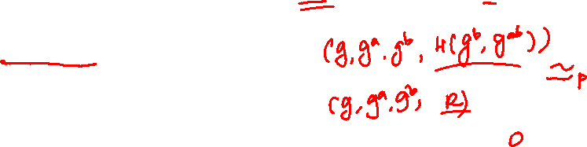
Suppose K = {0,1}¹²⁸ and
H: G² ⟶ K only outputs strings in K that begin with 0
( i.e. for all x,y: msb(H(x,y))=0 )
Can Hash-DH hold for (G, H) ?
Yes, for some groups G
No, Hash-DH is easy to break in this case
Yes, Hash-DH is always true for such H

Slide 17

ElGamal is sem. secure under Hash-DH
KeyGen: g ⟵ {generators of G} , a ⟵ Z_{n}
output pk = (g, h=gª) , sk = a
E( pk=(g,h), m) : b ⟵ Z_{n}
k ⟵ H(g^{b},h^{b}) , c ⟵ E_{s}(k, m)
output (g^{b}, c)
D( sk=a, (u,c) ) :
k ⟵ H(u,uª) , m ⟵ D_{s}(k, c)
output m

Slide 18
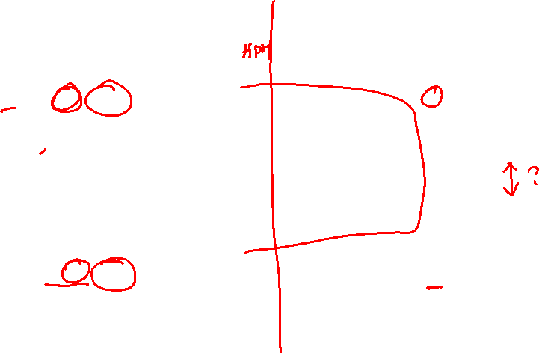
ElGamal is sem. secure under Hash-DH
pk = (g,gª)
pk = (g,gª)
chal.
adv. A
chal.
adv. A
m₀ , m₁
m₀ , m₁
pk,sk
≈_{p}
pk,sk
g^{b}, E_{s}(H(), m₀)
g^{b}, E_{s}(k, m₀)
k←K
b’≟1
b’≟1
(g^{b} , g^{ab})
≈_{p}
≈_{p}
pk = (g,gª)
pk = (g,gª)
chal.
adv. A
chal.
adv. A
m₀ , m₁
≈_{p}
m₀ , m₁
pk,sk
pk,sk
g^{b}, E_{s}(H(), m₁)
g^{b}, E_{s}(k, m₁)
k←K
b’≟1
b’≟1
(g^{b} , g^{ab})
Notes:
Input to hash: g^a, g^ab

Slide 19

ElGamal chosen ciphertext security?
To prove chosen ciphertext security need stronger assumption
Interactive Diffie-Hellman (IDH) in group G:
IDH holds in G if: ∀efficient A: Pr[ A outputs g^{ab}] < negligible
g, h=gª, u=g^{b}
Chal.
Adv. A
(u₁,v₁)
g⟵{gen}
a,b⟵Z_{n}
v
if (u₁)ª = v₁
0 otherwise
wins if v=g^{ab}

Slide 20
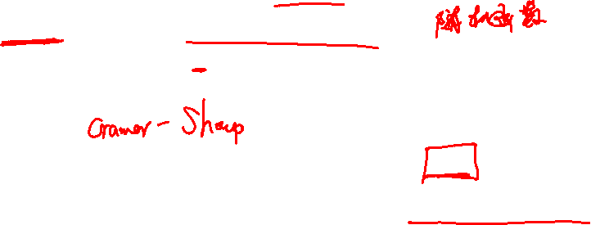
ElGamal chosen ciphertext security?
Security Theorem:
If IDH holds in the group G, (E_{s}, D_{s}) provides auth. enc. and H: G² ⟶ K is a “random oracle” then ElGamal is CCA^{ro} secure.
Questions: (1) can we prove CCA security based on CDH?
(2) can we prove CCA security without random oracles?

Slide 21
Review
Public key encryption from Diffie-Hellman

Slide 22

Public key encryption
Def: a public-key encryption system is a triple of algs. (G, E, D)
G(): randomized alg. outputs a key pair (pk, sk)
E(pk, m): randomized alg. that takes m∈M and outputs c ∈C
D(sk,c): det. alg. that takes c∈C and outputs m∈M or ⊥
Consistency: ∀(pk, sk) output by G :
∀m∈M: D(sk, E(pk, m) ) = m

Slide 23

Security: eavesdropping
For b=0,1 define experiments EXP(0) and EXP(1) as:
Def: E =(G,E,D) is sem. secure (a.k.a IND-CPA) if for all efficient A: Adv_{SS} [A,E] = |Pr[EXP(0)=1] – Pr[EXP(1)=1] | < negligible
pk
b
Chal.
Adv. A
m₀ , m₁ ∈ M : |m₀| = |m₁|
(pk,sk)←G()
c ← E(pk, m_{b})
b’ ∈ {0,1}
EXP(b)
Notes:
Note: no need to give attacker encryption oracle, he can encrypt himself.

Slide 24
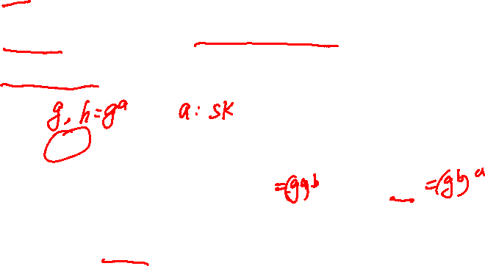
The ElGamal system (a modern view)
G: finite cyclic group of order n
(E_{s}, D_{s}) : symmetric auth. encryption defined over (K,M,C)
H: G² ⟶ K a hash function
E( pk=(g,h), m) :
b ⟵ Z_{n} , u ⟵ g^{b} , v ⟵ h^{b}
k ⟵ H(u,v) , c ⟵ E_{s}(k, m)
output (u, c)
D( sk=a, (u,c) ) :
v ⟵ uª
k ⟵ H(u,v) , m ⟵ D_{s}(k, c)
output m
R

Slide 25
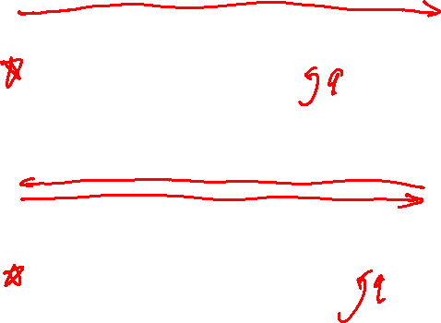
(pub-key) Chosen Ciphertext Security: definition
E = (G,E,D) public-key enc. over (M,C). For b=0,1 define EXP(b):
pk
Chal.
Adv. A
b
(pk,sk)←G()
CCA phase 1: c_{i} ∈ C
m_{i} ← D(k, c_{i})
challenge: m₀ , m₁ ∈ M : |m₀| = |m₁|
c ← E(pk, m_{b})
CCA phase 2: c_{i} ∈ C : c_{i} ≠ c
b’ ∈ {0,1}
m_{i} ← D(k, c_{i})

Slide 26

ElGamal chosen ciphertext security?
To prove chosen ciphertext security need stronger assumption
Interactive Diffie-Hellman (IDH) in group G:
IDH holds in G if: ∀efficient A: Pr[ A outputs g^{ab}] < negligible
g, h=gª, u=g^{b}
Chal.
Adv. A
(u₁,v₁)
g⟵{gen}
a,b⟵Z_{n}
v
if (u₁)ª = v₁
0 otherwise
wins if v=g^{ab}

Slide 27

ElGamal chosen ciphertext security?
Security Theorem:
If IDH holds in the group G, (E_{s}, D_{s}) provides auth. enc. and H: G² ⟶ K is a “random oracle” then ElGamal is CCA^{ro} secure.
Questions: (1) can we prove CCA security based on CDH?
(2) can we prove CCA security without random oracles?

Slide 28
ElGamal Variants With Better Security
Online Cryptography Course Dan Boneh
Public key encryption from Diffie-Hellman

Slide 29
Review: ElGamal encryption
KeyGen: g ⟵ {generators of G} , a ⟵ Z_{n}
output pk = (g, h=gª) , sk = a
E( pk=(g,h), m) : b ⟵ Z_{n}
k ⟵ H(g^{b},h^{b}) , c ⟵ E_{s}(k, m)
output (g^{b}, c)
D( sk=a, (u,c) ) :
k ⟵ H(u,uª) , m ⟵ D_{s}(k, c)
output m

Slide 30

ElGamal chosen ciphertext security
Security Theorem:
If IDH holds in the group G, (E_{s}, D_{s}) provides auth. enc. and H: G² ⟶ K is a “random oracle” then ElGamal is CCA^{ro} secure.
Can we prove CCA security based on CDH (g, gª , g^{b} ↛ g^{ab} ) ?
Option 1: use group G where CDH = IDH (a.k.a bilinear group)
Option 2: change the ElGamal system
Notes:
Say, “without hurting efficiency too much”

Slide 31

Variants: twin ElGamal [CKS’08]
KeyGen: g ⟵ {generators of G} , a1, a2 ⟵ Z_{n}
output pk = (g, h₁=g^{a1}, h₂=g^{a2}) , sk = (a1, a2)
E( pk=(g,h₁,h₂), m) : b ⟵ Z_{n}
k ⟵ H(g^{b}, h₁^{b}, h₂^{b})
c ⟵ E_{s}(k, m)
output (g^{b}, c)
D( sk=(a1,a2), (u,c) ) :
k ⟵ H(u, u^{a1}, u^{a2})
m ⟵ D_{s}(k, c)
output m

Slide 32
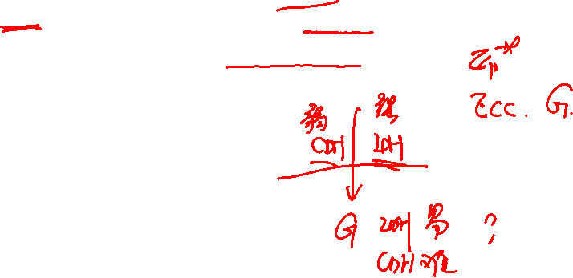
Chosen ciphertext security
Security Theorem:
If CDH holds in the group G, (E_{s}, D_{s}) provides auth. enc. and H: G³ ⟶ K is a “random oracle” then twin ElGamal is CCA^{ro} secure.
Cost: one more exponentiation during enc/dec
Is it worth it? No one knows …
Notes:
50% slower. Is IDH = CDH in all groups? (either both easy or both hard?)

Slide 33
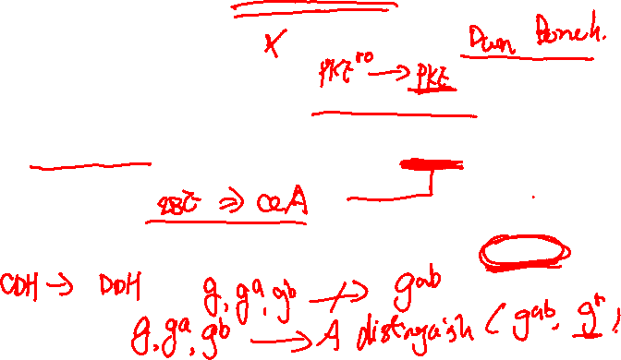
ElGamal security w/o random oracles?
Can we prove CCA security without random oracles?
Option 1: use Hash-DH assumption in “bilinear groups”
Special elliptic curve with more structure [CHK’04 + BB’04]
Option 2: use Decision-DH assumption in any group [CS’98]

Slide 34

Further Reading
The Decision Diffie-Hellman problem. D. Boneh, ANTS 3, 1998
Universal hash proofs and a paradigm for chosen ciphertext secure public key encryption. R. Cramer and V. Shoup, Eurocrypt 2002
Chosen-ciphertext security from Identity-Based Encryption. D. Boneh, R. Canetti, S. Halevi, and J. Katz, SICOMP 2007
The Twin Diffie-Hellman problem and applications. D. Cash, E. Kiltz, V. Shoup, Eurocrypt 2008
Efficient chosen-ciphertext security via extractable hash proofs. H. Wee, Crypto 2010

Slide 35

A Unifying Theme
Online Cryptography Course Dan Boneh
Public key encryption from Diffie-Hellman

Slide 36
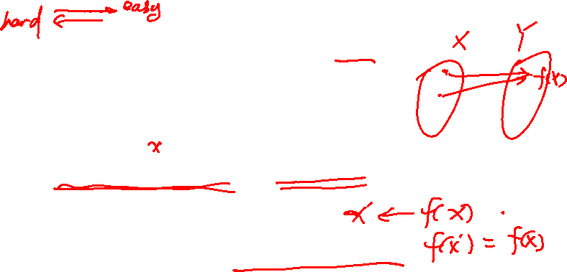
One-way functions (informal)
A function f: X ⟶ Y is one-way if
There is an efficient algorithm to evaluate f(⋅), but
Inverting f is hard:
for all efficient A and x ⟵ X :
Pr[ A(f(x)) ] < negligible
Functions that are not one-way: f(x) = x, f(x) = 0
Notes:
f( A( f(x) ) ) = f(x).

Slide 37

Ex. 1: generic one-way functions
Let f: X ⟶ Y be a secure PRG (where |Y| ≫ |X| )
(e.g. f built using det. counter mode)
Lemma: f a secure PRG ⇒ f is one-way
Proof sketch:
A inverts f ⇒ B(y) = is a distinguisher
Generic: no special properties. Difficult to use for key exchange.
Notes:
1 if f(A(y))=y and 0 otherwise. In fact, we can construct PRGs from generic one-way functions [HILL].

Slide 38
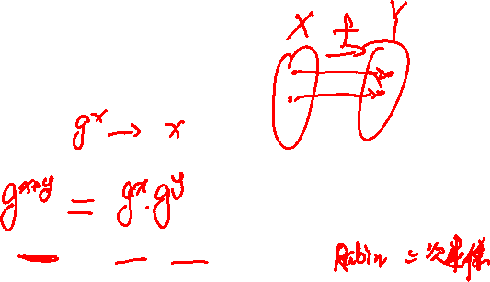
Ex 2: The DLOG one-way function
Fix a finite cyclic group G (e.g G = (Z_{p})* ) of order n
g: a random generator in G (i.e. G = {1, g, g², g³, … , g^{n-1}} )
Define: f: Z_{n} ⟶ G as f(x) = g^{x} ∈ G
Lemma: Dlog hard in G ⇒ f is one-way
Properties: f(x), f(y) ⇒ f(x+y) = f(x) ⋅ f(y)
⇒ key-exchange and public-key encryption

Slide 39


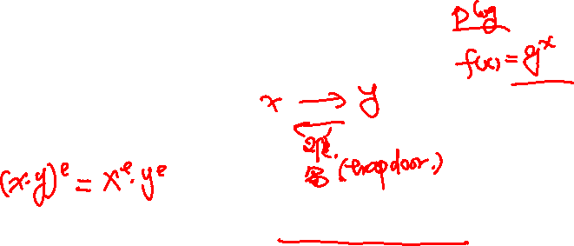
Ex. 3: The RSA one-way function
choose random primes p,q ≈1024 bits. Set N=pq.
choose integers e , d s.t. e⋅d = 1 (mod ϕ(N) )
Define: f: as f(x) = x^{e} in
Lemma: f is one-way under the RSA assumption
Properties: f(x⋅y) = f(x) ⋅ f(y) and f has a trapdoor

Slide 40
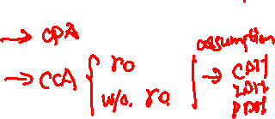
Summary
Public key encryption:
made possible by one-way functions with special properties
homomorphic properties and trapdoors

Slide 41
Quick Review
Online Cryptography Course Dan Boneh

Slide 42
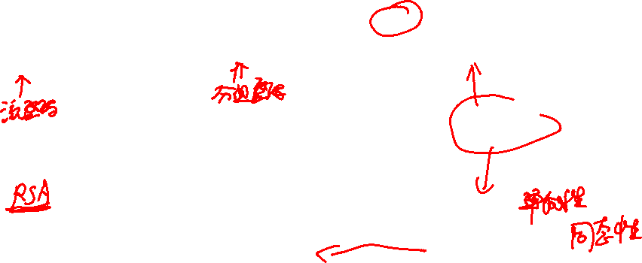
Quick Review: primitives
CTR
PRG
PRF, PRP
CMAC, HMAC PMAC
MAC
GGM
Collision resistance
key exchange
Trapdoor Functions
public key encryption
Diffie-Hellman groups
Notes:
Draw a line separating the two

Slide 43
Quick Review: primitives
To protect non-secret data: (data integrity)
using small read-only storage: use collision resistant hash
no read-only space: use MAC … requires secret key
To protect sensitive data: only use authenticated encryption
(eavesdropping security by itself is insufficient)
Session setup:
Interactive settings: use authenticated key-exchange protocol
When no-interaction allowed: use public-key encryption

