Slide 1

What is a digital signature?
Online Cryptography Course Dan Boneh
Digital Signatures

Slide 2
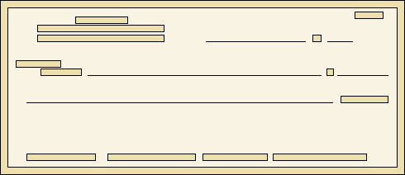

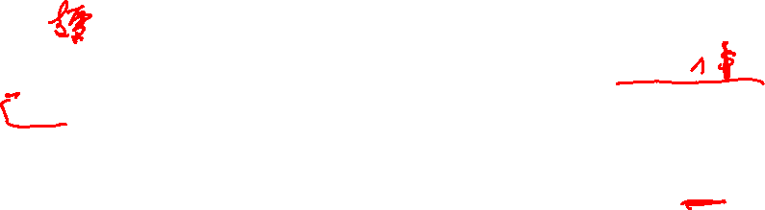
Physical signatures
Goal: bind document to author
Bob agrees to pay Alice 1$
Bob agrees to pay Alice 100$
Problem in the digital world:
anyone can copy Bob’s signature from one doc to another
Notes:
Bad example: will see why on the last slide of this segment.

Slide 3
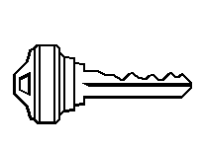

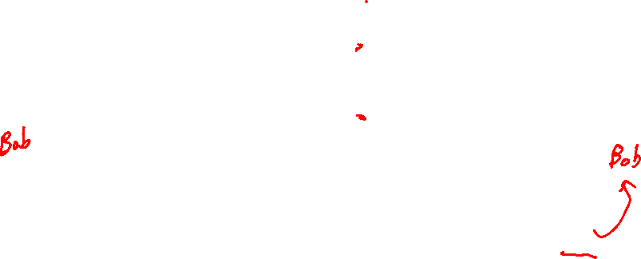
Digital signatures
Solution: make signature depend on document
Signer
Verifier
‘accept’
or
‘reject’
Bob agrees to pay Alice 1$
verifier
signature
signing
algorithm
secret signing key (sk)
public verification key (pk)

Slide 4


A more realistic example
Software vendor
clients
pk
software update
sig
untrusted hosting site
pk
secret signing key (sk)
signing
algorithm
verify sig,
install if valid
Notes:
Could be millions of clients. All can verify signature. Same software update sent to everyone.
Much harder to do with MACs. Generally, signatures are needed when many verifiers need to verify signature.

Slide 5
Digital signatures: syntax
Def: a signature scheme (Gen,S,V) is a triple of algorithms:
Gen(): randomized alg. outputs a key pair (pk, sk)
S(sk, m∈M) outputs sig. σ
V(pk, m, σ) outputs ‘accept’ or ‘reject’
Consistency: for all (pk, sk) output by Gen :
∀m∈M: V(pk, m, S(sk, m) ) = ‘accept’

Slide 6

Digital signatures: security
Attacker’s power: chosen message attack
for m₁,m₂,…,m_{q} attacker is given σ_{i} ← S(sk, m_{i})
Attacker’s goal: existential forgery
produce some new valid message/sig pair (m, σ).
m ∉ { m₁ , … , m_{q} }
⇒ attacker cannot produce a valid sig. for a new message

Slide 7

Secure signatures
For a sig. scheme (Gen,S,V) and adv. A define a game as:
Def: SS=(Gen,S,V) is secure if for all “efficient” A: Adv_{SIG}[A,SS] = Pr[ A wins] is “negligible”
pk
Chal.
Adv.
m₁ ∈ M
m₂
, …, m_{q}
(pk,sk)←Gen
σ₁ ← S(sk,m₁)
σ₂
, …, σ_{q}
(m,σ)
Adv. wins if V(pk,m,σ) = `accept’ and m ∉ {m₁, … , m_{q}}

Slide 8

Alice generates a (pk,sk) and gives pk to her bank.
Later Bob shows the bank a message m=“pay Bob 100$” properly signed by Alice, i.e. V(pk,m,sig) = ‘yes’
Alice says she never signed m. Is Alice lying?
Alice is lying: existential unforgeability means Alice signed m and therefore the Bank should give Bob 100$ from Alice’s account
Bob could have stolen Alice’s signing key and therefore the bank should not honor the statement
What a mess: the bank will need to refer the issue to the courts

Slide 9
Applications
Online Cryptography Course Dan Boneh
Digital Signatures

Slide 10

Applications
Code signing:
Software vendor signs code
Clients have vendor’s pk. Install software if signature verifies.
software vendor
many clients
initial software install (pk)
pk
sk
[ software udate #1 , sig ]
[ software udate #2 , sig ]

Slide 11


More generally:
One-time authenticated channel (non-private, one-directional) ⟹ many-time authenticated channel
Initial software install is authenticated, but not private
Sender
Recipients
one-time authenticated channel
pk
(pk, sk) ← Gen
pk
eavesdrop, but not modify
sig₁← S(sk, m₁)
m₁
sig₁
sig₂← S(sk, m₂)
m₂
sig₂
⋮
Notes:
If sender can only send one authenticated message to receiver, then send pk. This lets sender send many more authenticated messages.
Stateless: messages are sent and received independently of one another. Otherwise, TESLA can be used (good exercise).

Slide 12

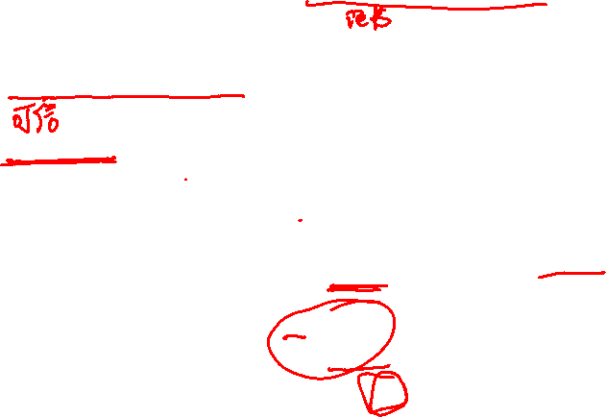
Important application: Certificates
Problem: browser needs server’s public-key to setup a session key
Solution: server asks trusted 3rd party (CA) to sign its public-key pk
Certificate Authority (CA)
browser
Gmail.com
choose
(pk, sk)
pk and
proof “I am Gmail”
verification key
check
proof
pk_{CA}
pk_{CA}
Sign Cert using sk_{CA} :
sk_{CA}
verify
cert
pk is key for Gmail
pk is key for Gmail
CA sig
signing key
CA sig
Server uses Cert for an extended period (e.g. one year)
Notes:
One signer (CA), many verifiers (browsers).
Everyone is assumed to have pk_CA.

Slide 13
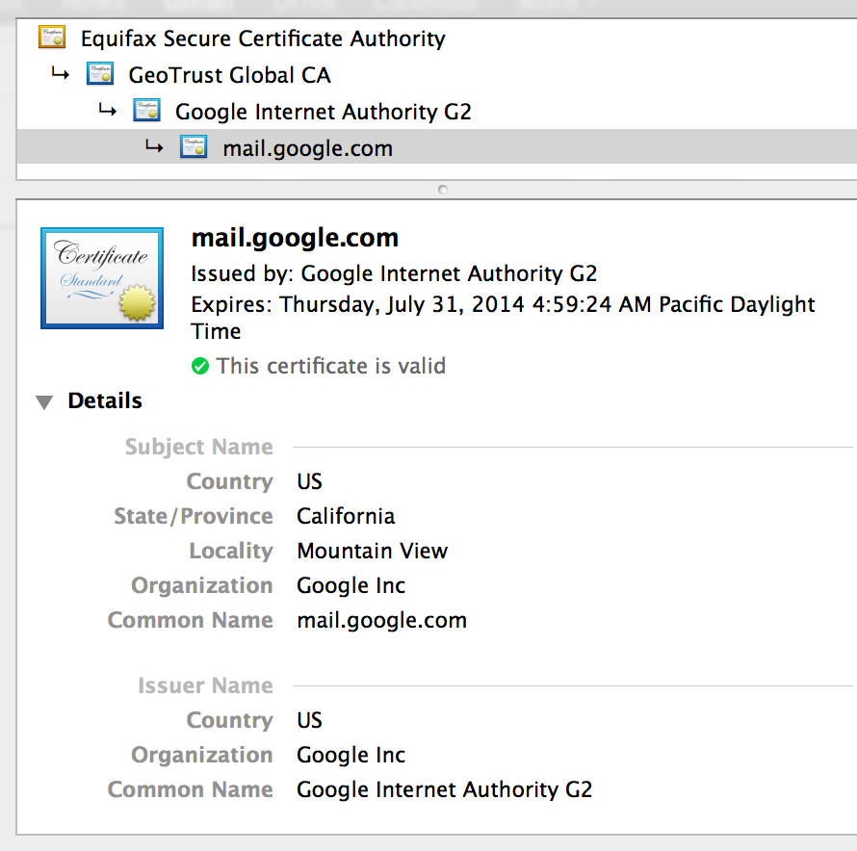
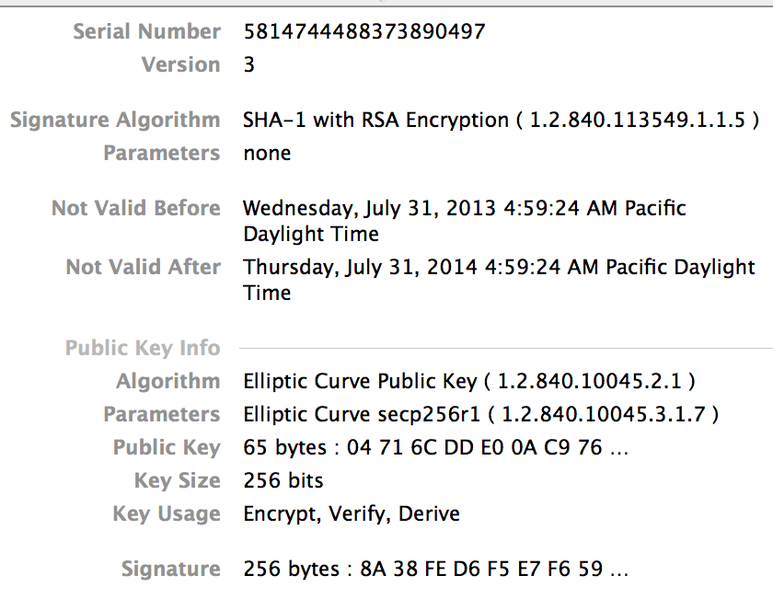

Certificates: example
Important fields:

Slide 14
What entity generates the CA’s secret key sk_{CA} ?
the browser
Gmail
the CA
the NSA

Slide 15
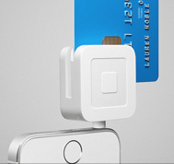
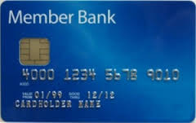

Applications with few verifiers
EMV payments:
(greatly simplified)
Signed email: sender signs email it sends to recipients
Every recipient has sender’s public-key (and cert). A recipient accepts incoming email if signature verifies.
transaction details
(nonce, PIN)
sk
signature (card cert)
transaction details and signature
Point of Sale terminal
Notes:
For DDA (dynamic data authentication) and CDA (combined data authentication) cards.
Explain why can’t use a MAC: for EMV, don’t want POS terminal to modify transaction. For email, can’t generate a shared key: non-interactive.
EMV europay, mastercard, visa

Slide 16

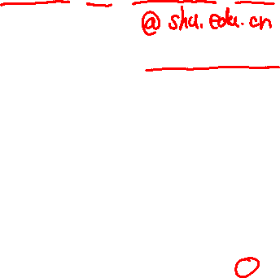
Signing email: DKIM (domain key identified mail)
Problem: bad email claiming to be from someuser@gmail.com
but in reality, mail is coming from domain badguy.com
⇒ Incorrectly makes gmail.com look like a bad source of email
Solution: gmail.com (and other sites) sign every outgoing mail
From: bob@gmail.com
DNS
email
query
body
body
Recipients
Gmail pk
signing key
sig
verify sig
Gmail
user
Gmail.com
badguy.com ??
Notes:
Problem: source domain of email is unauthenticated. Interferes with blacklisting services that block sources of bad emails.
DKIM assumes the channel Gmail -> DNS -> recipient is authenticated (but not private): attacker cannot feed its own key as Gmail’s key.

Slide 17
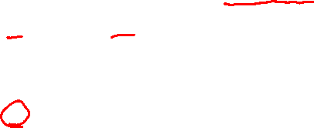
example DKIM header from gmail.com
X-Google-DKIM-Signature: v=1; a=rsa-sha256; c=relaxed/relaxed;
d=1e100.net; s=20130820;
h=x-gm-message-state:mime-version:in-reply-to:references:from:date: message-id:subject:to:content-type;
bh=MDr/xwte+/JQSgCG+T2R2Uy+SuTK4/gxqdxMc273hPQ=;
b=dOTpUVOaCrWS6AzmcPMreo09G9viS+sn1z6g+GpC/ArkfMEmcffOJ1s9u5Xa5KC+6K
XRzwZhAWYqFr2a0ywCjbGECBPIE5ccOi9DwMjnvJRYEwNk7/sMzFfx+0L3nTqgTyd0ED
EGWdN3upzSXwBrXo82wVcRRCnQ1yUlTddnHgEoEFg5WV37DRP/eq/hOB6zFNTRBwkvfS
0tC/DNdRwftspO+UboRU2eiWaqJWPjxL/abS7xA/q1VGz0ZoI0y3/SCkxdg4H80c61DU
jdVYhCUd+dSV5fISouLQT/q5DYEjlNQbi+EcbL00liu4o623SDEeyx2isUgcvi2VxTWQ
m80Q==
(lookup 20130820. _domainkey.1e100.net in DNS for public key)
(hash of message body)
Gmail’s signature on headers, including DKIM header (2048 bits)
Notes:
b=(signature on headers); bh=(hash of message body using SHA-256); d=(signing domain); s=(selector); h=(list of signed header fields); c=(canonicalization algorithm)
1e100 = 10^100 = googol : 1e100.net is a Google domain
Domain field (d=1e100.net) is verified by signing practice (from previous gmail.com emails or by querying DNS for ADSP (RFC 5617)). Also see DMARC.

Slide 18
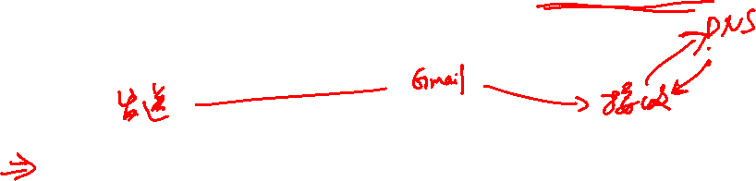
Suppose recipients could retrieve new data from DNS for every email received, could Gmail implement DKIM without signatures?
(ignoring, for now, the increased load on the DNS system)
Yes, Gmail would write to DNS a collision-resistant hash of every outgoing email. The recipient retrieves the hash from DNS and compares to the hash of the incoming message.
No, the proposal above is insecure.
⇒ Signatures reduce the frequency that recipients need to query DNS

Slide 19
Applications: summary
Code signing
Certificates
Signed email (e.g. DKIM)
Credit-card payments: EMV
and many more.

Slide 20
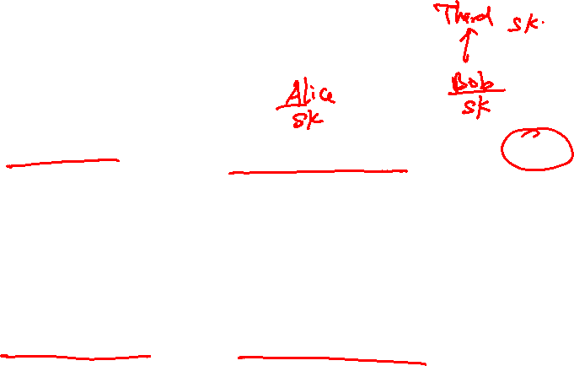
When to use signatures
Generally speaking:
If one party signs and one party verifies: use a MAC
Often requires interaction to generate a shared key
Recipient can modify the data and re-sign it before passing the data to a 3rd party
If one party signs and many parties verify: use a signature
Recipients cannot modify received data before passing data to a 3rd party (non-repudiation)

Slide 21

Review: three approaches to data integrity
1. Collision resistant hashing: need a read-only public space
Software Vendor
Small read-only public space
Alice
2. Digital signatures: vendor must manage a long-term secret key
Vendor’s signature on software is shipped with software
Software can be downloaded from an untrusted distribution site
Bob
3. MACs: vendor must compute a new MAC of software for every client
and must manage a long-term secret key (to generate a per-client MAC key)
Notes:
Draw untrusted distribution site and the interaction with clients as they download software.

Slide 22
Constructions overview
Online Cryptography Course Dan Boneh
Digital Signatures

Slide 23
Review: digital signatures
Def: a signature scheme (Gen,S,V) is a triple of algorithms:
Gen(): randomized alg. outputs a key pair (pk, sk)
S(sk, m∈M) outputs sig. σ
V(pk, m, σ) outputs ‘yes’ or ‘no’
Security:
Attacker’s power: chosen message attack
Attacker’s goal: existential forgery

Slide 24
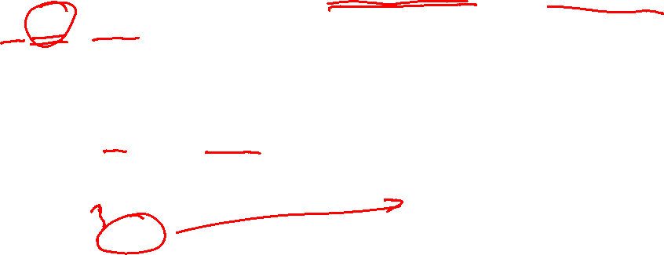
Extending the domain with CRHF
Let Sig=(Gen, S, V) be a sig scheme for short messages, say M = {0,1}²⁵⁶
Let H: M^{big} → M be a hash function (s.g. SHA-256)
Def: Sig^{big} = (Gen, S^{big} , V^{big} ) for messages in M^{big} as:
S^{big}(sk, m) = S(sk,H(m)) ; V^{big}(pk, m, σ) = V(pk,H(m),σ)
Thm: If Sig is a secure sig scheme for M and H is collision resistant then Sig^{big} is a secure sig scheme for M^{big}
⟹ suffices to construct signatures for short 256-bit messages

Slide 25
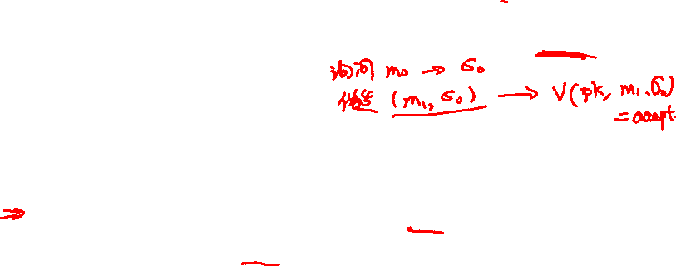
Suppose an attacker finds two distinct messages m₀, m₁
such that H(m₀) = H(m₁) . Can she use this to break Sig^{big} ?
No, Sig^{big} is secure because the underlying scheme Sig is
It depends on what underlying scheme Sig is used
Yes, she would ask for a signature on m₀ and obtain an existential forgery for m₁

Slide 26
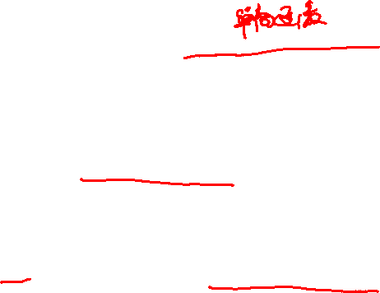
Primitives that imply signatures: OWF
Recall: f: X ⟶Y is a one-way function (OWF) if:
easy: for all x∈X compute f(x)
inverting f is hard:
Example: f(x) = AES(x, 0)
Signatures from OWF: Lamport-Merkle (see next module), Rompel
Signatures are long: stateless ⇒ > 40KB
stateful ⇒ > 4KB
key
Notes:
Will define OWF precisely in the next module (also in lecture 12.4). Lamport-Merkle signatures actually need CRHF.

Slide 27
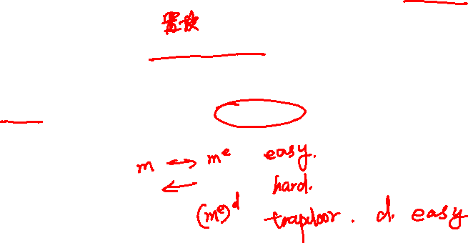
Primitives that imply signatures: TDP
Recall: f: X ⟶X is a trapdoor permutation (TDP) if:
easy: for all x∈X compute f(x)
inverting f is hard, unless one has a trapdoor
Example: RSA
Signatures from TDP: very simple and practical (next segment)
Commonly used for signing certificates
Notes:
Will define OWF precisely in the next module

Slide 28

Primitives that imply signatures: DLOG
G = {1,g,g²,…,g^{q-1}}: finite cyclic group with generator g , |G| = q
discrete-log in G is hard if f(x) = g^{x} is a one-way function
note: f(x+y) = f(x) ⋅ f(y)
Examples: = (multiplication mod p) for a large prime p
= (group of points on an elliptic curve mod p)
Signatures from DLOG: ElGamal, Schnorr, DSA, EC-DSA, …

Slide 29
Signatures From Trapdoor Permutations
Online Cryptography Course Dan Boneh
Digital Signatures

Slide 30
Review: Trapdoor permutation (G, F, F⁻¹)
Key Gen
G
pk
sk
F
F⁻¹
x
y
y
x
f(x) = F(pk, x) is one-to-one (X ⟶ X) and is a one-way function.
Notes:
Standard example: RSA

Slide 31
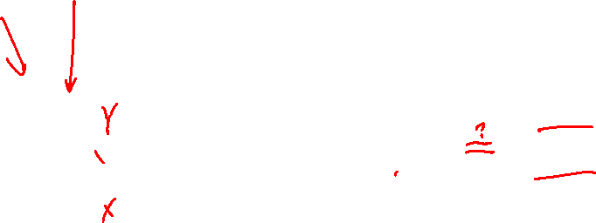
Full Domain Hash Signatures: pictures
S(sk, msg):
V(pk, msg, sig):
msg
msg
H
H
≟ ⇒
accept
or
reject
F⁻¹(sk,⋅)
sig
F(pk,⋅)
sig

Slide 32
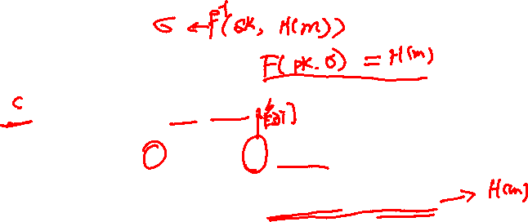
Full Domain Hash (FDH) Signatures
(G_{TDP}, F, F⁻¹ ): Trapdoor permutation on domain X
H: M ⟶ X hash function (FDH)
(Gen, S, V) signature scheme:
Gen: run G_{TDP} and output pk, sk
S(sk, m∈M): output σ ⟵ F⁻¹(sk, H(m))
V(pk, m, σ): output ‘accept’ if F(pk, σ) = H(m)
‘reject’ otherwise

Slide 33
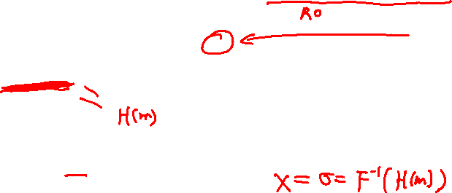
Security
Thm [BR]: (G_{TDP}, F, F⁻¹) secure TDP ⇒ (Gen, S, V) secure signature when H: M ⟶ X is modeled as an “ideal” hash function
Difficulty in proving security:
us
adversary
pk, F(pk, x)
pk
Signature Forger
m_{i}
⟲
How can use use forger?
σ_{i}
x
(m,σ)
Solution: “we” will know sig. on all-but-one of m where adv. queries H(). Hope adversary gives forgery for that single message.
Notes:
Recall: security means EUF security.

Slide 34
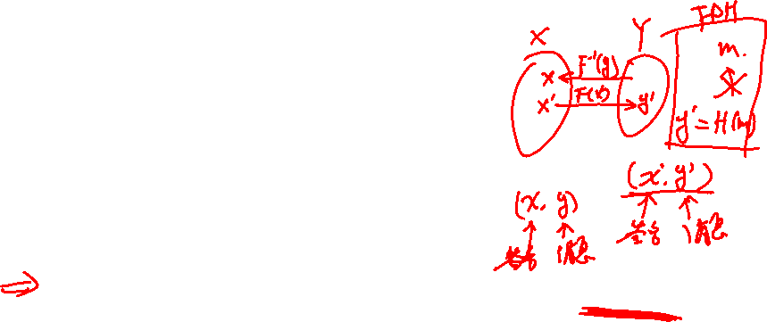
Why hash the message?
Suppose we define NoHash-FDH as:
S’(sk, m∈X): output σ ⟵ F⁻¹(sk, m)
V’(pk, m, σ): output ‘accept’ if F(pk, σ) = m
Is this scheme secure?
Yes, it is not much different than FDH
No, for any σ∈X, σ is a signature forgery for the msg m=F(pk, σ)
Yes, the security proof for FDH applies here too
It depends on the underlying TDP being used
Notes:
The hash prevents this attack because given H(m):=F(pk, σ) the attacker can’t find m

Slide 35

RSA-FDH
Gen: generate an RSA modulus N = p⋅q and e⋅d = 1 mod φ(N)
construct CRHF H: M ⟶ Z_{N}
output pk = (N,e,H) , sk = (N,d,H)
S(sk, m∈M): output σ ⟵ H(m)^{d} mod N
V(pk, m, σ): output ‘accept’ if H(m) = σ^{e} mod N
Problem: having H depend on N is slightly inconvenient

Slide 36
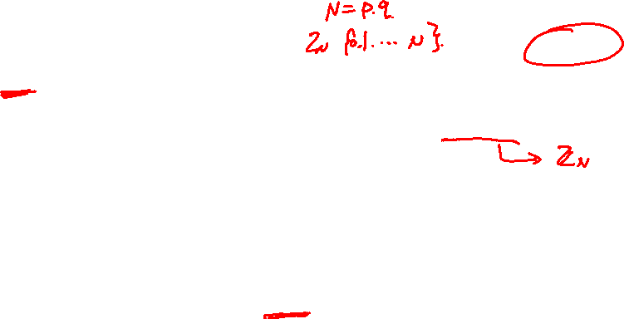
PKCS1 v1.5 signatures
RSA trapdoor permutation: pk = (N,e) , sk = (N,d)
S(sk, m∈M):
output: σ ⟵ (EM)^{d} mod N
V(pk, m∈M, σ ): verify that σ^{e} mod N has the correct format
Security:
256 bits
16 bits
EM =
01
0xFF 0xFF 0xFF … 0xFF 0xFF
00
H(m)
RSA modulus size (e.g. 2048 bits)
Jager, Tibor, Saqib A. Kakvi, and Alexander May. "On the security of the PKCS# 1 v1. 5 signature scheme." CCS 2018.
Notes:
The goal of the pad is to make sure we only compute roots of large values. Computing cube roots of small values (e.g. 256 bits) is vulnerable to Desmedt-Odlyzko attacks.

Slide 37
Security Proofs (optional)
Online Cryptography Course Dan Boneh
Digital Signatures

Slide 38
Proving security of RSA-FDH
(G, F, F⁻¹): secure TDP with domain X
Recall FDH sigs: S(sk, m) = F⁻¹(sk, H(m)) where H: M ⟶ X
We will show: TDP is secure ⇒ FDH is secure, when H is a random function
us
adversary
pk, y=F(pk, x)
pk
Signature Forger
m_{i}
⟲
σ_{i}
m_{i}
⟲
H(m_{i})
x
(m,σ)
Notes:
To prove security based on the security of the TDP we have to cheat: we have to assume that H is a random oracle.
q_H: denotes upper bound on number of hash queries from forger.

Slide 39
Proving security
Thm [BR]: (G_{TDP}, F, F⁻¹) secure TDP ⇒ (G_{TDP}, S, V) secure signature when H: M ⟶ X is modeled as a random oracle.
∀A ∃B: Adv_{SIG}[A,FDH] ≤ q_{H} ⋅ Adv_{TDP}[B,F]
Proof:
^{(RO)}
B
A
pk, y=F(pk, x)
pk
Signature Forger
choose i* ⟵ {1,…,q_{H}}
m_{i}
⟲
H(m_{i})
if i ≠ i*: x_{i} ⟵ X, H(m_{i}) = F(pk, x_{i})
else: H(m_{i}) = y
m_{i}
⟲
σ_{i}
m = m_{i*} ⇒ σ = F⁻¹(sk, y) = x
(m,σ)
Pr[m=m_{i*}] = 1/q_{H}
Notes:
Adv^{(RO)} denotes advantage in the random oracle model.
If q_H < 2^64 and Adv_TDP is always < 2^{-192} then Adv_SIG < 2^{-128}. Reduction is not tight: we need TDP to be extra secure which implies larger parameters.
In the proof setting H(m_{i}) = F(pk, x_{i}) is valid because H maps m_{i} to a random element in X. This is where we use the fact that H is a full domain hash.

Slide 40
Proving security
Thm [BR]: (G_{TDP}, F, F⁻¹) secure TDP ⇒ (G_{TDP}, S, V) secure signature when H: M ⟶ X is modeled as a random oracle.
∀A ∃B: Adv_{SIG}[A,FDH] ≤ q_{H} ⋅ Adv_{TDP}[B,F]
Proof:
^{(RO)}
So: Adv_{TDP}[B,F] ≥ (1/q_{H}) ⋅ Adv_{SIG}[A,FDH]
Prob. B outputs x
Pr[m=m_{i*}]
Prob. forger A outputs valid forgery

Slide 41
Alg. B has table:
m₁, x₁ : H(m₁) = F(pk, x₁)
m₂, x₂ : H(m₂) = F(pk, x₂)
⋮
How B answers a signature query m_{i} :
m_{i*}, H(m_{i*}) = y
⋮
m_{q}, x_{q} : H(m_{q}) = F(pk, x_{q})
Notes:
If forgery m equals mi* then mi \neq mi* , so easy to answer sig query. Also, assume H(mi) is already defined.

Slide 42
Partial domain hash: Suppose (G_{TDP}, F, F⁻¹) is defined over domain X = {0,…,B-1}
but H: M ⟶ {0,…,B/2} .
Can we prove FDH secure with such an H?
No, FDH is only secure with a full domain hash
Yes, but we would need to adjust how B defines H(m_{i}) in the proof
It depends on what TDP is used
Notes:
If the hash domain gets too small then we can’t prove security. This is the problem with PKCS1 v1.5: hash range is size 2^256, but TDP domain size is about 2^2048, so we can’t find an x s.t. F(pk,x) is in the small domain.

Slide 43
PSS: Tighter security proof
Some variants of FDH:
tight reduction from forger to inverting the TDP (no q_{H} factor). Still assuming hash function H is “ideal.”
Examples:
PSS [BR’96]: part of the PKCS1 v2.1 standard
KW’03: S( (sk,k), m) = [ b⟵PRF(k,m)∈{0,1} , F⁻¹(sk, H(bllm)) ]
many others
Notes:
KW’03: specific to RSA. Needs random self reduction. PSS is tight for all TDPs.

Slide 44
End of Segment

Slide 45

Secure Signatures Without Random Oracles
Online Cryptography Course Dan Boneh
Digital Signatures

Slide 46
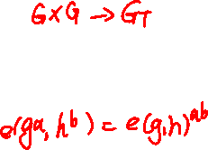
A new tool: pairings
Secure signature without “ideal” hash function (a.k.a. random oracles):
can be built from RSA, but
most efficient constructions use pairings
G , G_{T} : finite cyclic groups G={1,g,…,g^{p-1}}
Def: A pairing e: G×G → G_{T} is a map:
bilinear: e(gª, h^{b}) = e(g,h)^{ab} ∀a,b∈Z, g,h∈G
efficiently computable and non-degenerate: g generates G ⇒ e(g,g) generates G_{T}
G
G_{T}
gª
e(g,h)^{ab}
h^{b}
Notes:
Useful for lots of things in crypto.

Slide 47
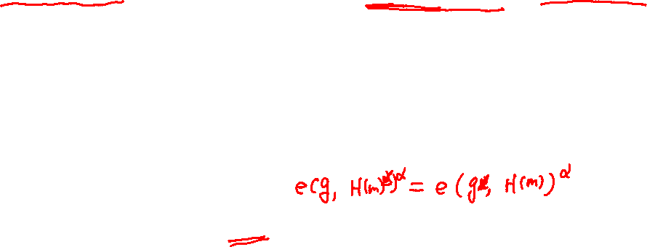
BLS: a simple signature from pairings
e: G×G → G_{T} a pairing where |G|=p , g∈G generator, H: M ⟶ G
Gen: sk = (random α in Z_{p}) , pk = g^{α} ∈ G
S(sk, m): output σ = H(m)^{α} ∈ G
V(pk, m, σ): accept if e( g, σ ) ≟ e( pk, H(m))
Thm: secure assuming CDH in G is hard, when H is a random oracle
Notes:
Write: CDH: g, gx, gy cannot compute gxy.
Explain EUF secure.

Slide 48

Security without random oracles [BB’04]
Gen: sk = (rand. α, β ⟵ Z_{p}) , pk = ( g , y=g^{α} ∈G , z=g^{β} ∈G )
S(sk, m∈Z_{p}): r⟵Z_{p}, σ = g^{1/(α+rβ+m)} ∈ G , output (r,σ)
V(pk, m, (r,σ)): accept if e( σ, y⋅z^{r}⋅g^{m} ) ≟ e(g,g)
Thm: secure assuming q_{S}-BDH in G is hard
∀A ∃B : Adv_{SIG}[A,BBsig] ≤ Adv_{qS-BDH}[B,G] + (q_{S}/p)
Notes:
Recall: security means existential unforgeability under a chosen message attack
Write out q-BDH: (g,g₁,…,g_{q}, h, h_{q+2}) can’t compute e(g_{q+1} , h)

Slide 49
Proof strategy
us
adversary
q-BDH challenge
pk
Signature Forger
m_{i}
⟲
σ_{i}
solution
(m,σ)
σ
We choose pk so that:
⋯
⋯
m₀
m₁
m₂
m
m₂256

Slide 50

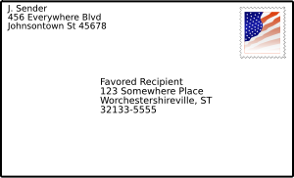

Reducing signature size
Online Cryptography Course Dan Boneh
Digital Signatures

Slide 51
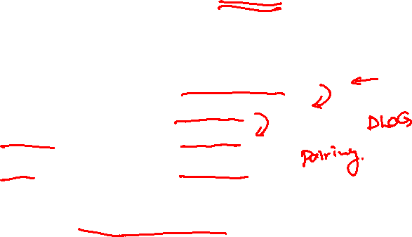
Signature lengths
Goal: best existential forgery attack time ≥ 2¹²⁸
signature
algorithm size _
RSA 2048-3072 bits
EC-DSA 512 bits
Schnorr 384 bits
BLS 256 bits
Open problem: practical 128-bit signatures

Slide 52

Signatures with Message Recovery
Suppose Alice needs to sign a short message, say m ∈ {0,1}⁵¹²
Can we do better? Yes: signatures with message recovery
Security: existential unforgeability under a chosen message attack
sk
verifier
m
m
sig σ
accept
reject
V(pk, m, σ) =
512 bits
2048 bits
sk
accept, m
reject
m
sig σ
V(pk, σ) =
2048 bits
Notes:
Short message example: transaction ID or product serial #.
Security: given signatures of adversary’s choice, attacker cannot come up with a new valid signature.

Slide 53

Sigs with Message Recovery: Example
X₀
X₁
(G_{TDP}, F, F⁻¹ ): TDP on domain (X₀ × X₁)
Hash functions:
H: X₁ ⟶ X₀
G: X₀⟶ X₁
{0,1}²⁵⁶
{0,1}²⁰⁴⁸⁻²⁵⁶⁼¹⁷⁹²
msg space
⟶
⟶
Signing: S(sk, m∈X₁): h ⟵ H(m) ∈ X₀
256 bits
EM =
h
m ⊕ G(h)
∈ X₀ × X₁
output: σ ⟵ F⁻¹(sk, EM)

Slide 54
Sigs with Message Recovery: Example
S(sk, m∈X₁): choose random h ⟵ H(m) ∈ X₀
256 bits
EM =
h
m ⊕ G(h)
∈ X₀ × X₁
output: σ ⟵ F⁻¹(sk, EM)
V(pk, σ): (x₀, x₁) ⟵ F(pk, σ) , m ⟵ x₁⊕ G(x₀) if x₀=H(m) output “accept, m” else “reject”
Thm: (G_{TDP}, F, F⁻¹) secure TDP ⇒ (G_{TDP}, S, V) secure MR signature when H, G are modeled as random oracles
Notes:
Say a good exercise: adapt proof for FDH to prove this theorem. Same security loss.

Slide 55
Standard for sigs with message-recovery: RSA-PSS-R (PKCS1)
Consider the following MR signature: S(sk, m) = F⁻¹(sk, [m ll H(m)] ) V(pk, σ): (m,h) ⟵ F(pk, σ) if h=H(m) outputs “accept, m”
Unfortunately, we can’t prove security.
Should we use this scheme with RSA and with H as SHA-256?
(ISO/IEC 9796-2 sigs. and EMV sigs.)
Yes, unless someone discovers an attack
No, only use schemes that have a clear security analysis
It depends on the size of the RSA modulus
[Practical cryptanalysis of ISO/IEC 9796-2 and EMV signatures, in Proc. of Crypto 2009]
Notes:
Domain of F is 2048-bits and H(m) outputs 256-bits. Note: normally would pad m to 1792 bits using something like PKCS1 v1.5.
This is insecure: Coron-Naccach-Tibouchi-Weinmann Crypto 2009. But does not break EMV for operational reasons: can’t mount a chosen message attack.

Slide 56
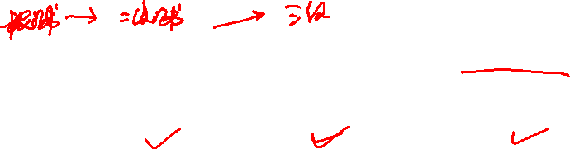
Aggregate Signatures [BGLS’03]
Certificate chain:
subj-id: Equifax CA
pub-key: ….
subj-id: GeoTrust CA
pub-key: ….
subj-id: Internal CA
pub-key: ….
subj-id: www.xyz.com
pub-key: ….
self-signed
signature
signature
signature
Aggregate sigs: lets anyone compress n signatures into one
pk₁ , m₁ ⟶ σ₁
V_{agg}( pk , m , σ* ) = “accept”
means for i=1,…,n: user i signed msg m_{i}
⋮
aggregate
⟶ σ*
pk_{n} , m_{n} ⟶ σ_{n}

Slide 57
Aggregate Signatures [BGLS’03]
Certificate chain with aggregates sigs:
subj-id: Equifax CA
pub-key: ….
subj-id: GeoTrust CA
pub-key: ….
subj-id: Internal CA
pub-key: ….
subj-id: www.xyz.com
pub-key: ….
aggregate-sig
Aggregate sigs: let us compress n signatures into one
pk₁ , m₁ ⟶ σ₁
V_{agg}( pk , m , σ* ) = “accept”
means for i=1,…,n: user i signed msg m_{i}
⋮
aggregate
⟶ σ*
pk_{n} , m_{n} ⟶ σ_{n}
Notes:
Certificate chain becomes shorter because the n signatures are replaced by one.

Slide 58
Privacy: Group Signatures
msg
User 1
sig
Key Issuer
Is sig from user 1 or 2?
User 2
Simple solution: give all users same private key
… but also need to revoke signers when they misbehave

Slide 59
Example: Vehicle Safety Comm. (VSC)
1.
Car 1
Car 2
Car 3
Car 4
brake
out of my way !!
2.
Car
Ambulance
Require authenticated (signed) messages from cars.
Prevent impersonation and DoS on traffic system.
Privacy problem: cars broadcasting signed (x,y, v).
Clean solution: group sigs. Group = set of all cars.
J. Li, Y. Li, C. Cao and K. -Y. Lam, "Conditional Anonymous Authentication With Abuse-Resistant Tracing and Distributed Trust for Internet of Vehicles," in IEEE Internet of Things Journal, vol. 9, no. 11, pp. 8749-8762, 1 June1, 2022.

Slide 60

Further Reading
PSS. The exact security of digital signatures: how to sign with RSA and Rabin, M. Bellare, P. Rogaway, 1996.
On the exact security of full domain hash, J-S Coron, 2000.
Short signatures without random oracles, D. Boneh and X. Boyen, 2004.
Secure hash-and-sign signatures without the random oracle, R. Gennaro, S. Halevi, T. Rabin, 1999.
A survey of two signature aggregation techniques, D. Boneh, C. Gentry, B. Lynn, and H. Shacham, 2003.

Slide 61
End of Segment

