Slide 1
Dependency Management with Poetry - Simple and Effortless, Yet Better
Open Source Hong Kong x Python User Group Meetup, Oct 2024

Slide 2





Who am I
Data Scientist
4 years of experience in Python
Data Science
Software
Development
Just a random small potato :D
MLOps
Astrophysics

Slide 3



QR Codes
Slides for Today
Code for Today
PyConHK 2024 Ticket

Slide 4
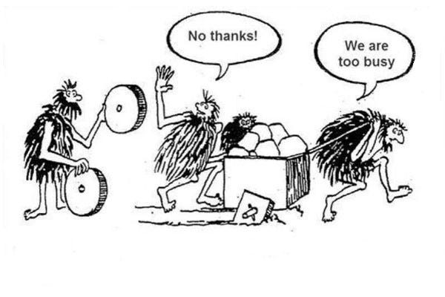
Why Dependency
More efficient development
Scalability and maintainability
Leverage developer community
From Medium

Slide 5
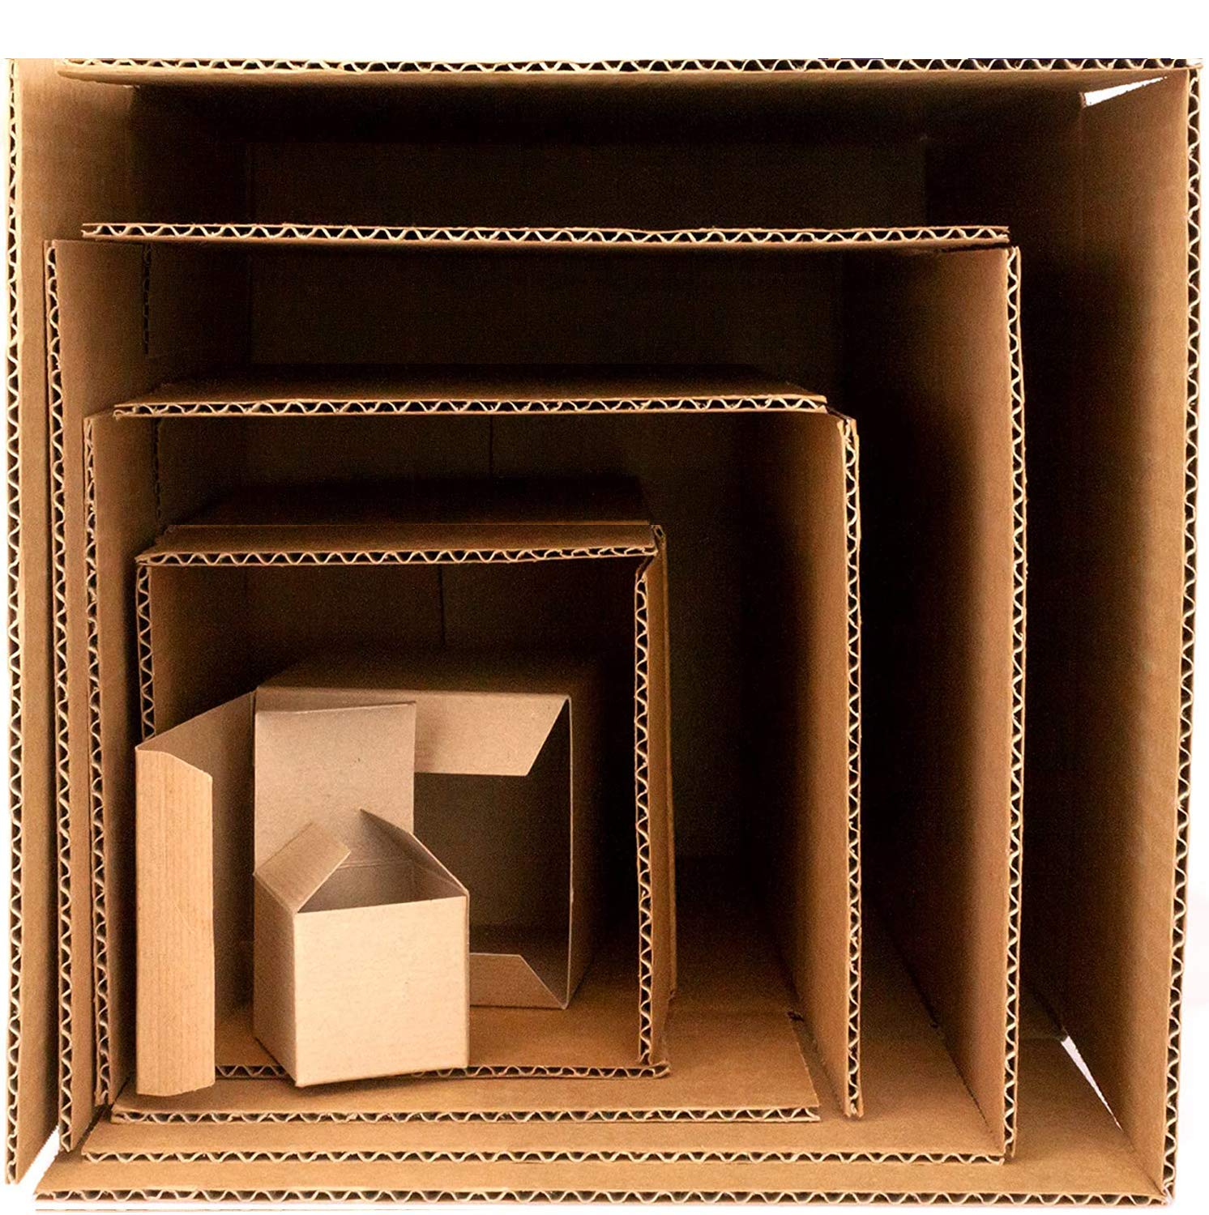
Why Dependency Management
Maintain consistent development environment
Handle nested dependencies
Facilitate reproducibility across machines
Package A
Package B used by Package A
Package C used by Package B
Package D used by Package C
Package E used by Package D
From Amazon

Slide 6
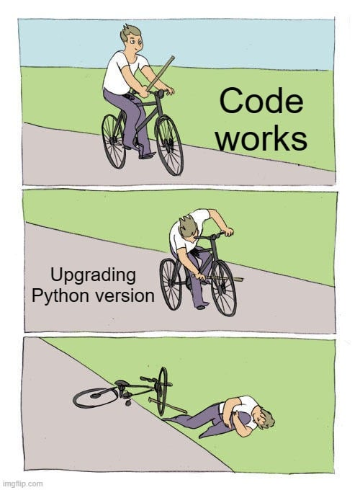
Why Good Dependency Management
Avoid breakage during upgrades
Enhance project stability
Reduce debugging time
Simplify collaboration
From Reddit

Slide 7
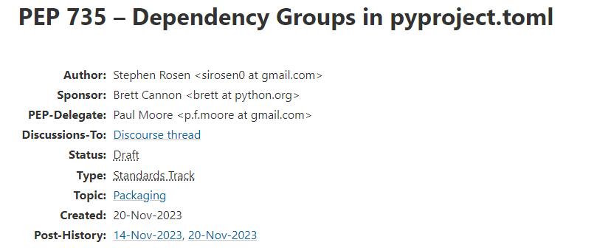
Python Enhancement Proposals
Design document
Proposal of changes or features
From PEP

Slide 8
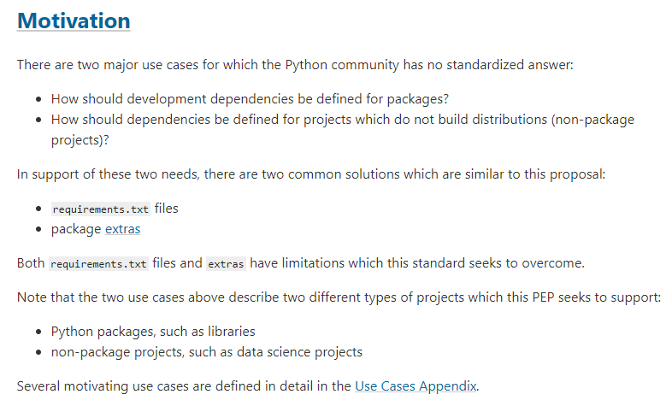
Dependency Management? How Proper?
From PEP

Slide 9
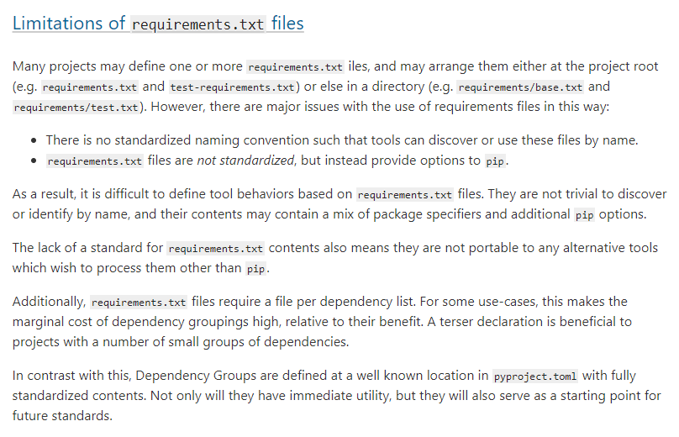
Limitations of requirements.txt
TLDR:
No clear standard for dependency management
From PEP

Slide 10
Traditional Dependency Management
pip and requirements.txt
Challenge | Consequence
No built-in version locking | Inconsistent environment across machines
No native dev dependencies | Inseparable development and production dependencies
Inability to handle transitive dependencies | Potential hard-to-debug issues due to package version conflicts
No built-in support for multi-project setup | Incompatible dependency version across projects

Slide 11
Solution: poetry
Challenge | Poetry
No built-in version locking | poetry.lock
No native dev dependencies | Separate dependencies by group
Inability to handle transitive dependencies | Automatic resolve
No built-in support for multi-project setup | Integration with virtual environment

Slide 12
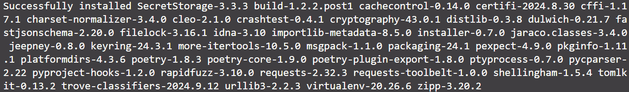
Installation
Caution:
Poetry should always be installed in a dedicated virtual environment to isolate it from the rest of your system.
Initialize your virtual environment
pip install poetry
…

Slide 13
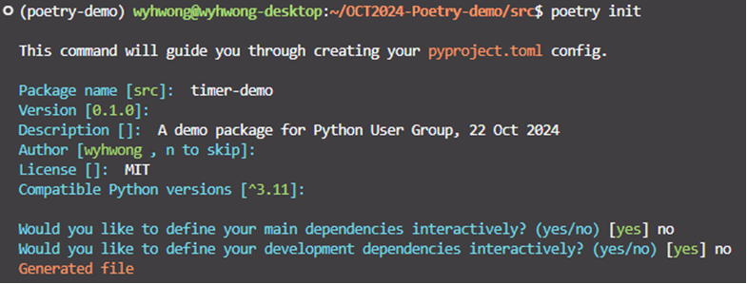
Project Initialization
poetry init

Slide 14
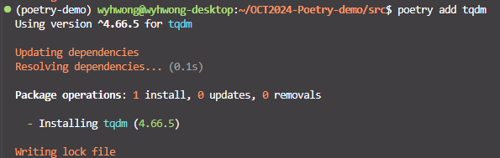
Add dependency
poetry add <package>

Slide 15
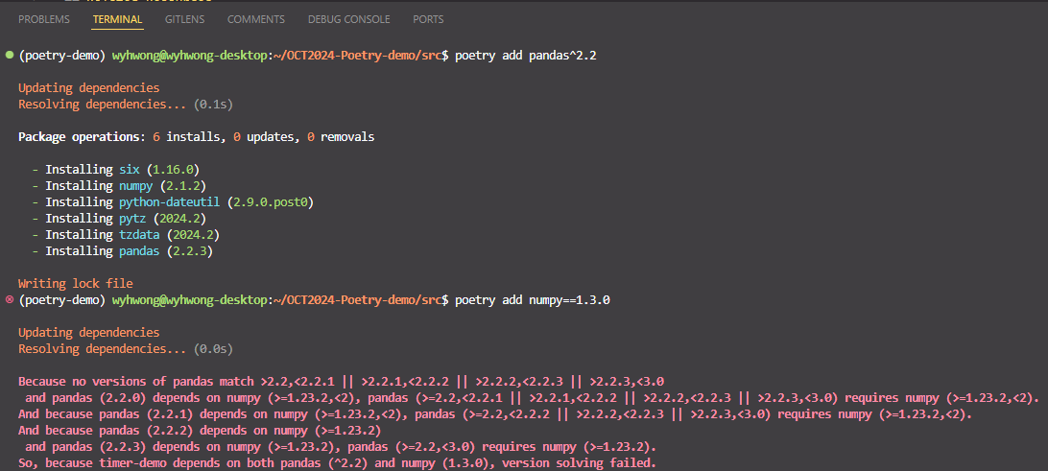
Conflict of Dependencies

Slide 16
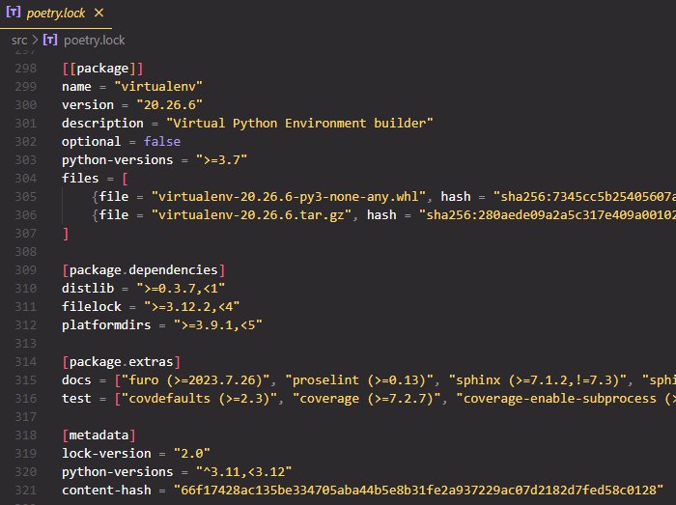
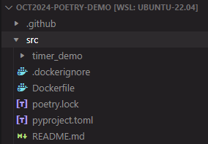
Lock File
Created by poetry after poetry add
Manage transitive dependencies
Check integrity of pyproject.toml

Slide 17
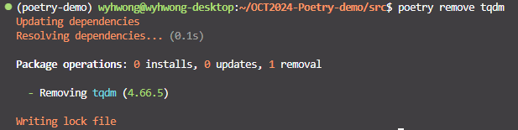
Remove Dependency
poetry remove <package>

Slide 18
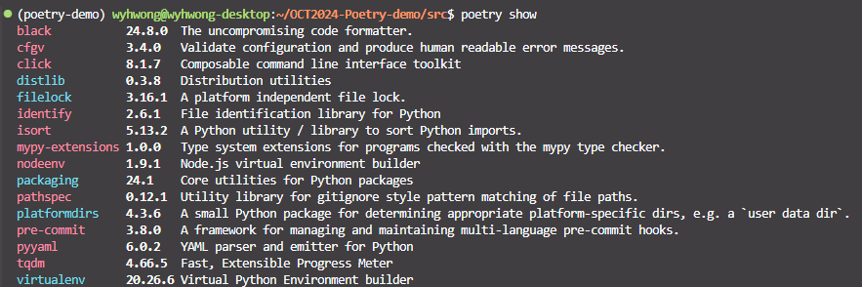
Show Project-specific Dependencies
poetry show
Red: Not installed yet
Blue: Installed

Slide 19
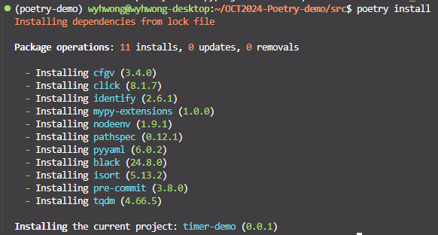
Project Installation
poetry install

Slide 20
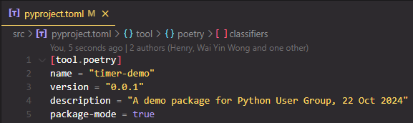
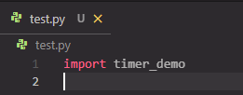
Install as a package
Configurable in pyproject.toml
Possible to import in other directories

Slide 21
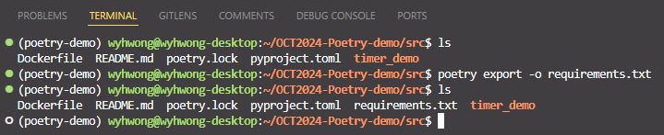
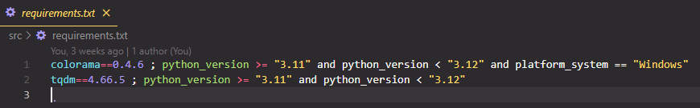
From poetry to requirements.txt
poetry export
Users do not need to install poetry to run your project

Slide 22
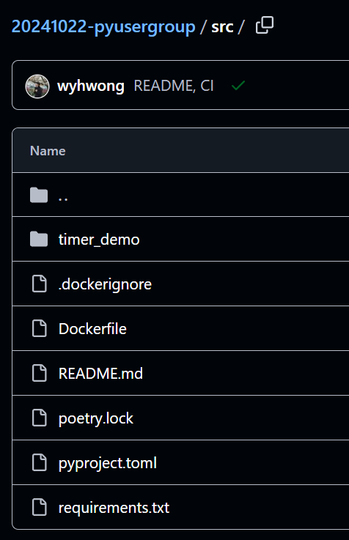
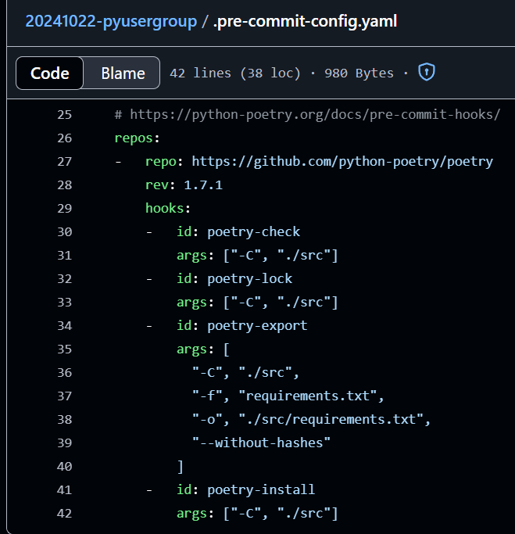
Pre-commit hooks
Automatic export of requirements.txt
Compatibility for non-poetry users

Slide 23
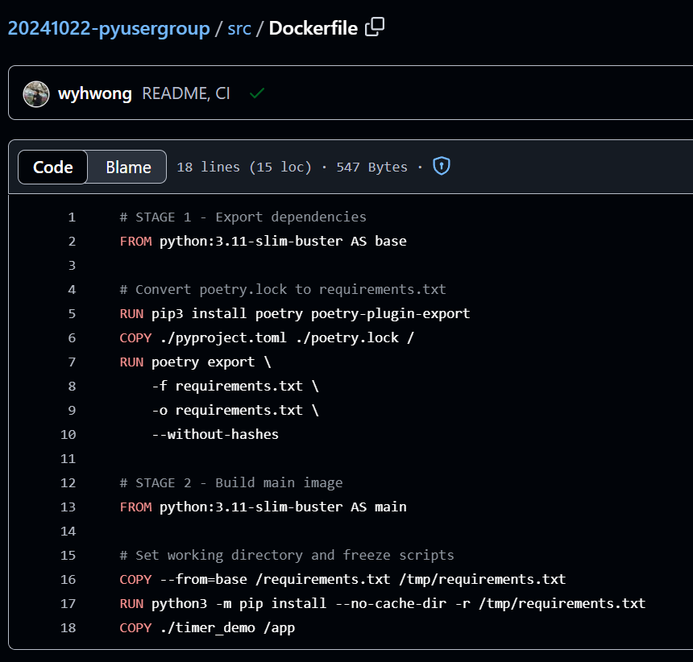
Ship to Production
Stage 1: Dependency export
Stage 2: Build image

Slide 24
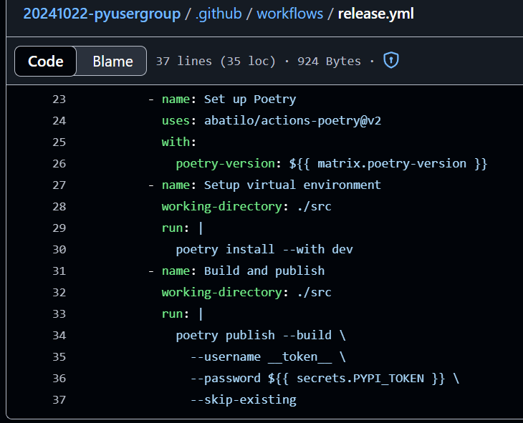
Release with GitHub Actions
Simple setup, install, and publish

Slide 25
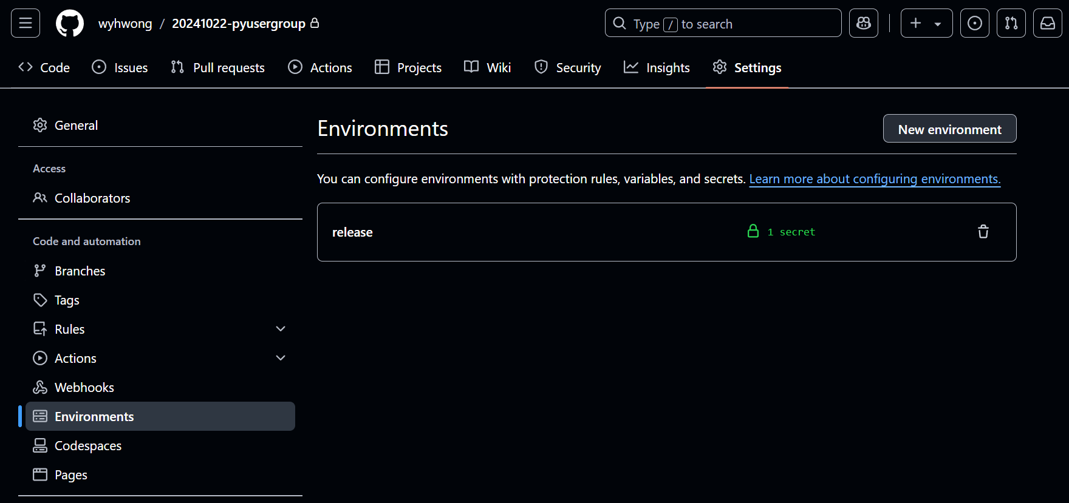
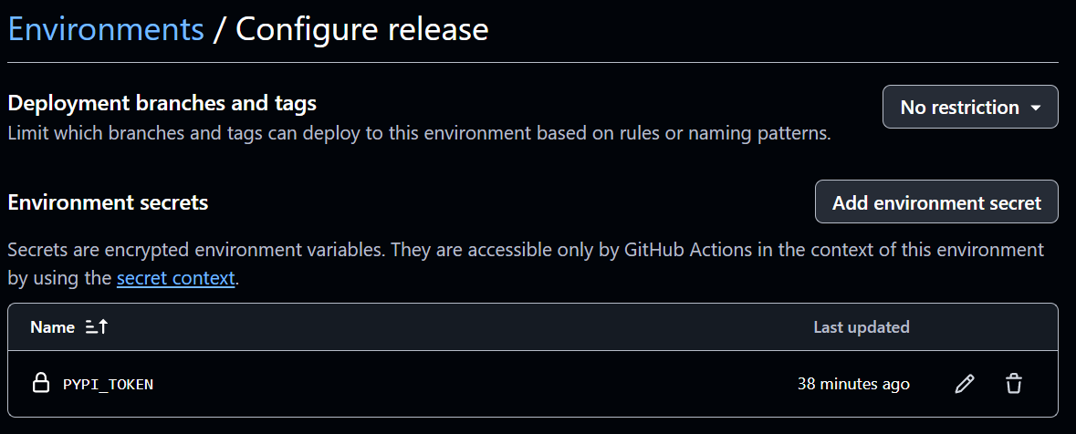
Simple Setup of Environment

Slide 26
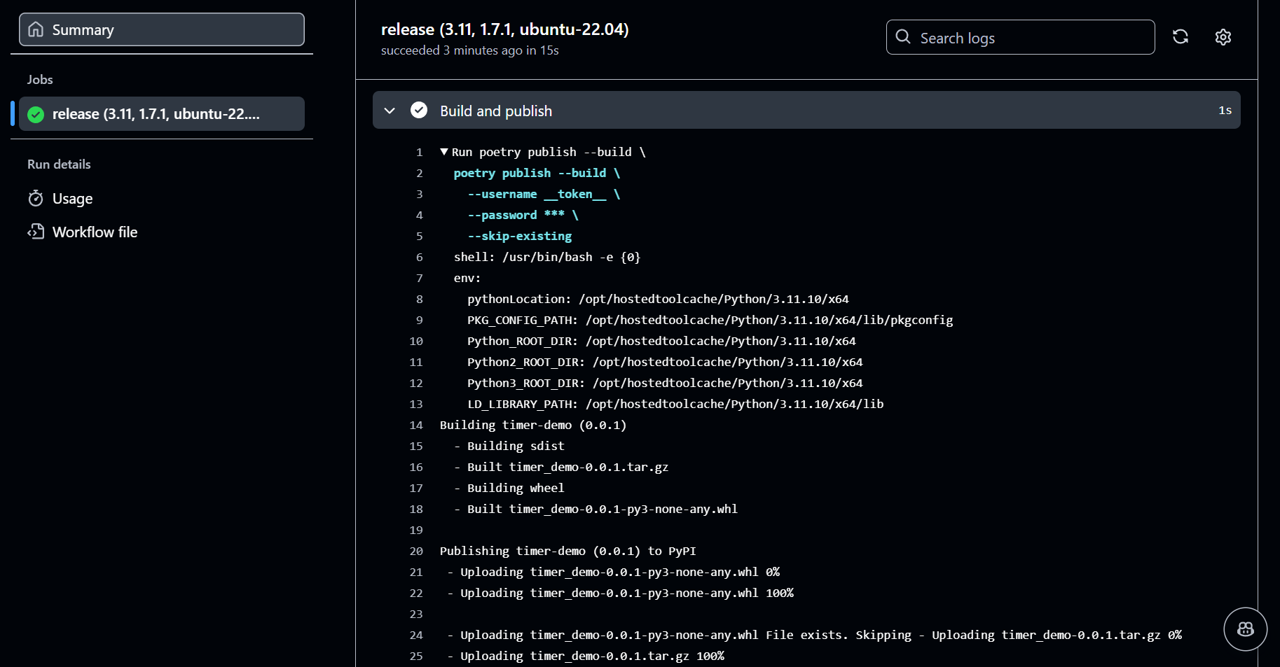
Logs on GitHub Actions

Slide 27
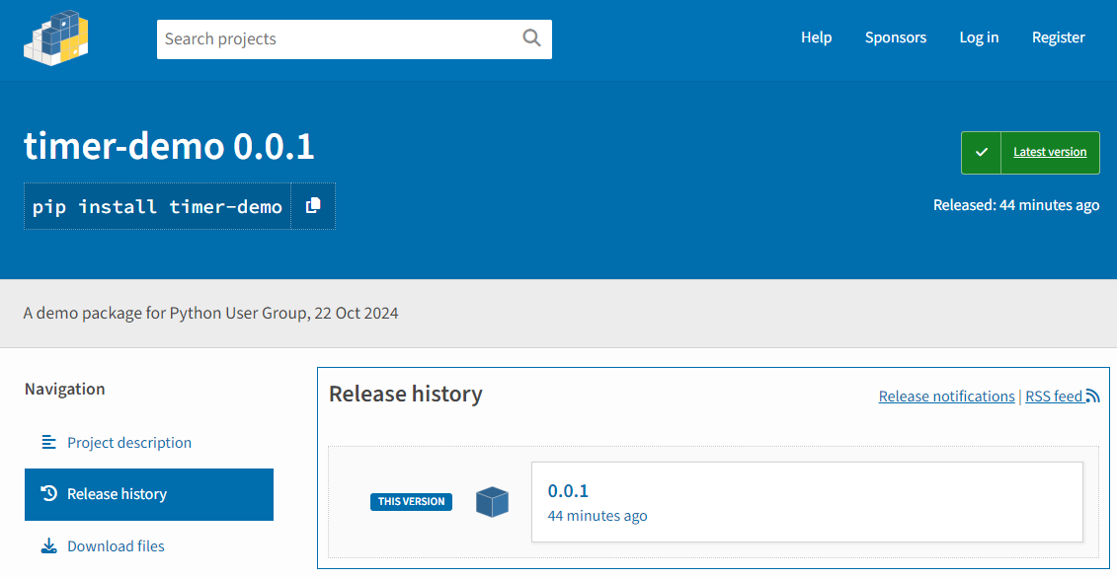
View on PyPI

Slide 28
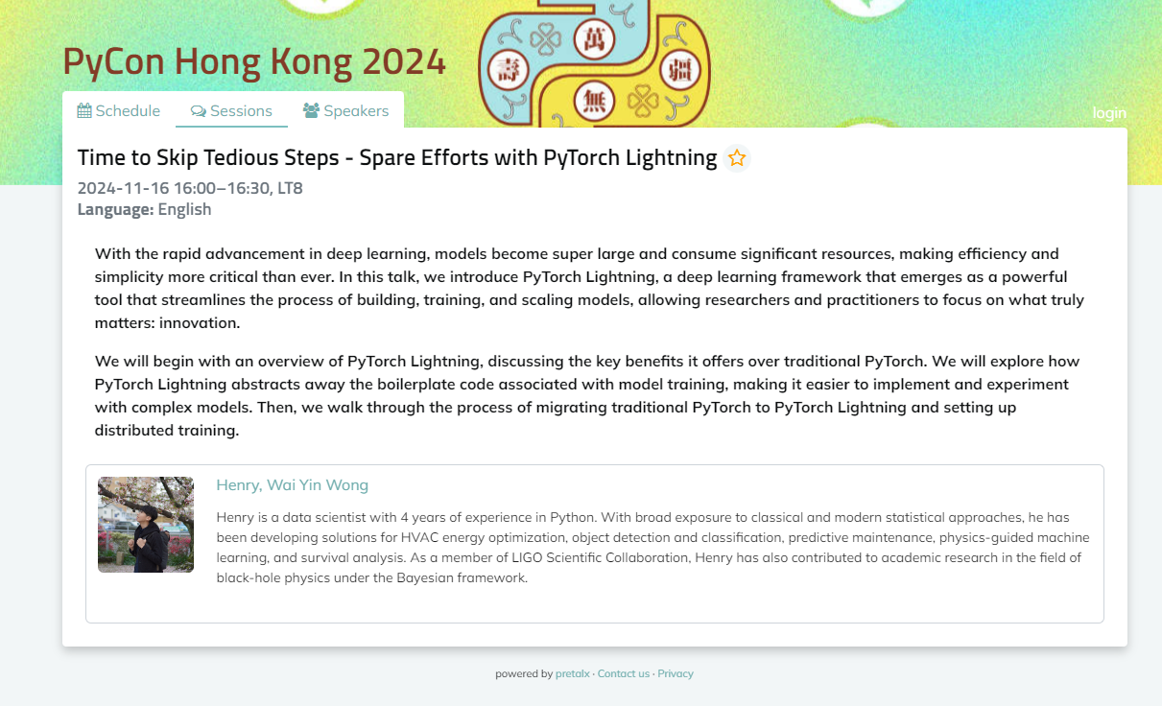

Slide 29

Secure Your Ticket

Slide 30
QnA

