Slide 1
SRTM Extraction
Yijie Wang

Slide 2
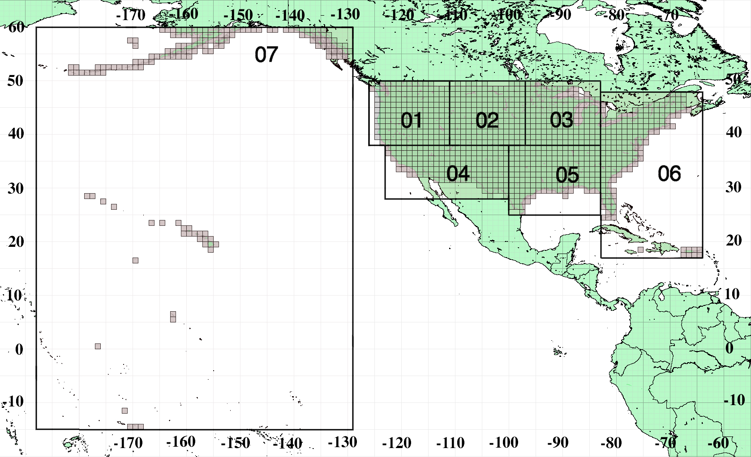
SRTM1

Slide 3
N39W112
N39W111
Store in file:
N38W112.hgt
N38W112
N38W111

Slide 4
Resolution Problems
Our grid may not be exact the same as the SRTM Grid due to different resolutions.
Therefore, when extract SRTM data, we may encounter the following situations.

Slide 5
A
B
C
D

Slide 6
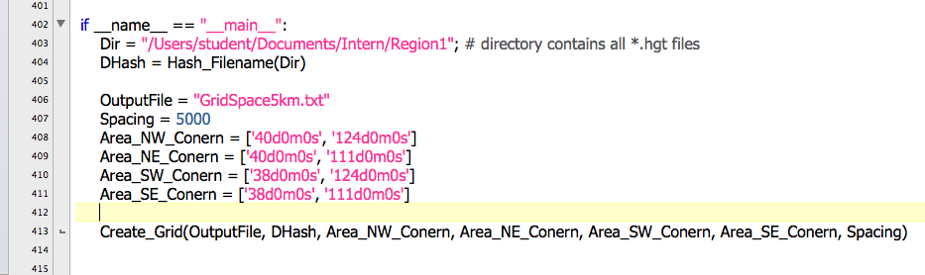
Inputs
Directory conations all *.hgt files we may use
Our grid spacing (i.e. 10km, 5km, 1km)
Four corners latitudes and longtitudes

Slide 7
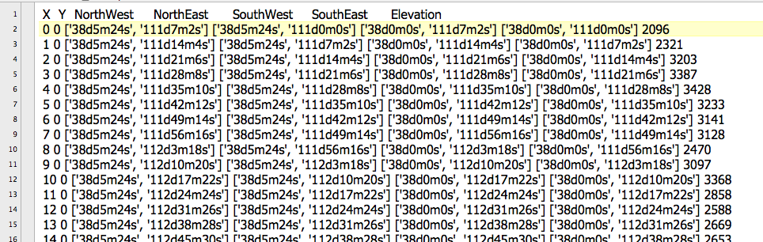
Output
Store in .txt file with the following format:

Slide 8
N40W124
N40W111
N38W124
N38W111
Spacing 10KM
Spacing 5KM
Spacing 1KM

