Slide 1
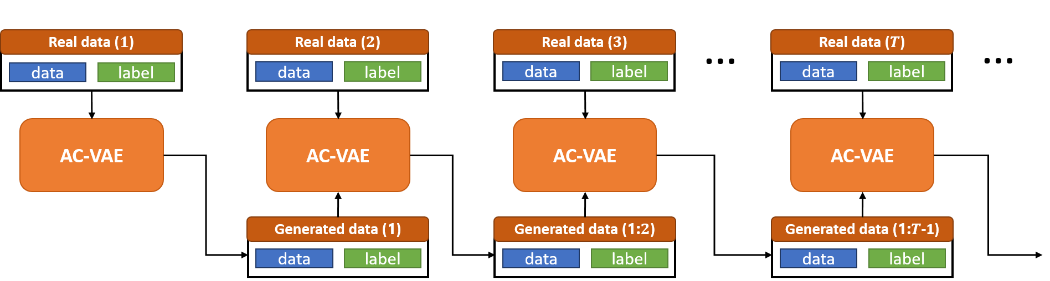
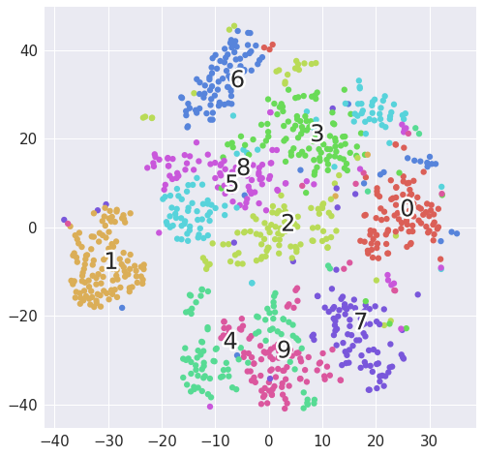
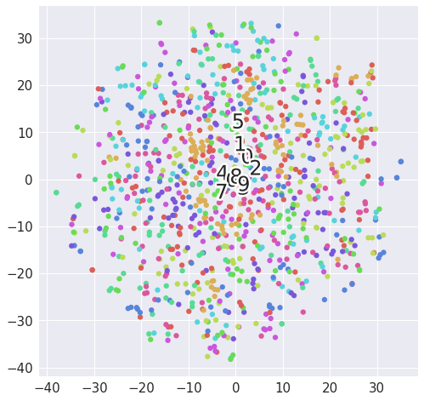
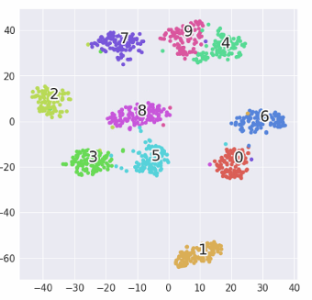
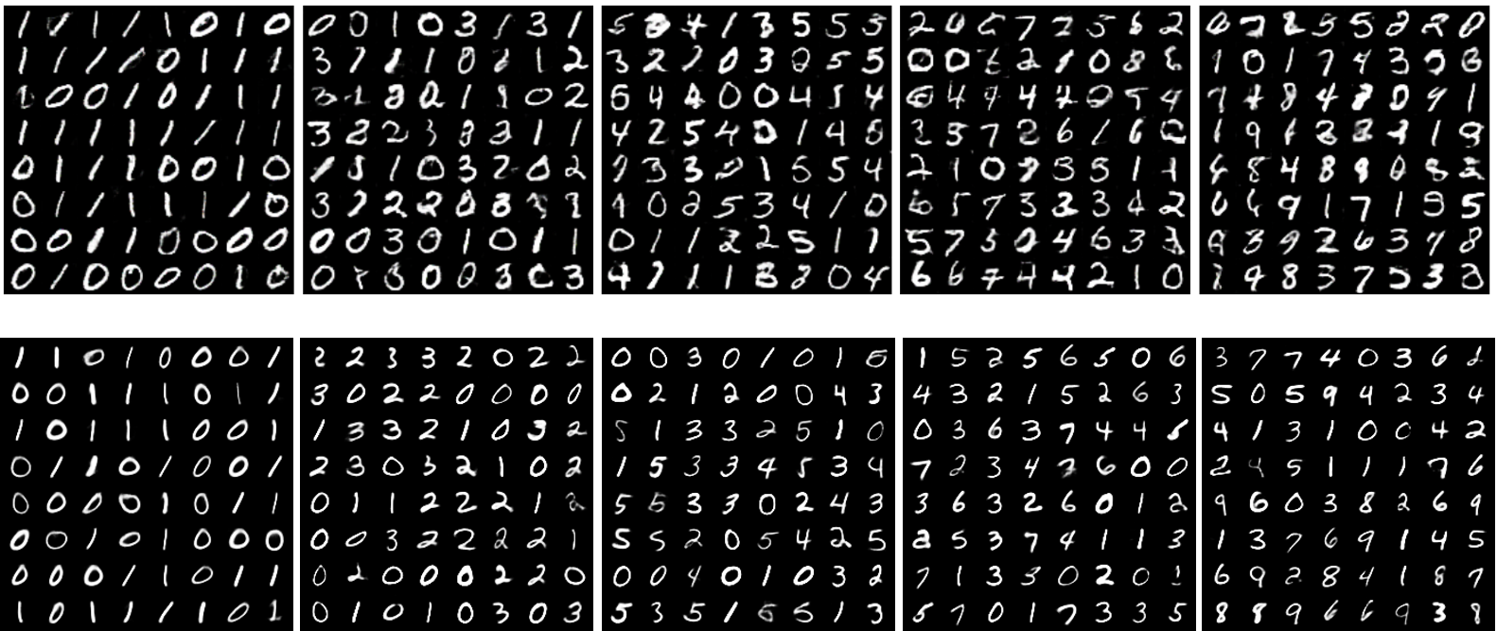
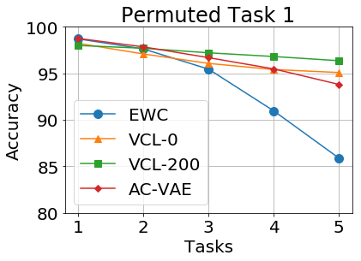
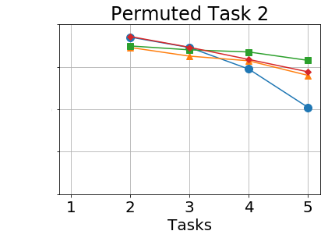
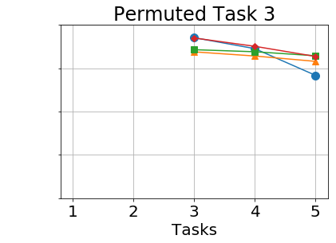
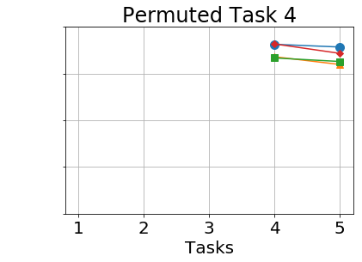
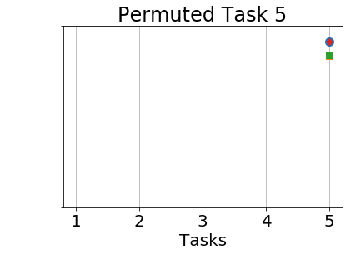
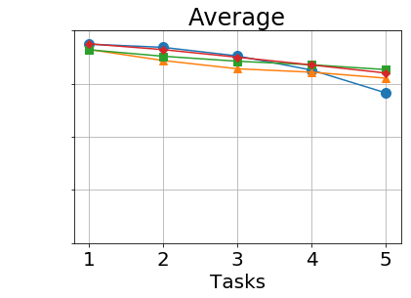
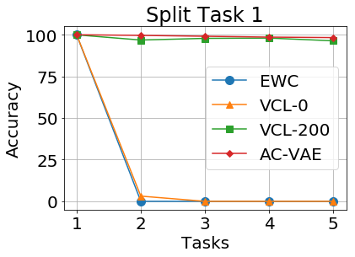
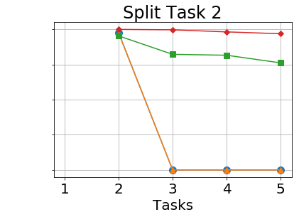
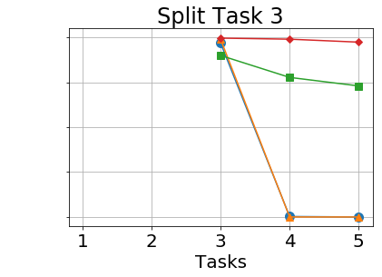
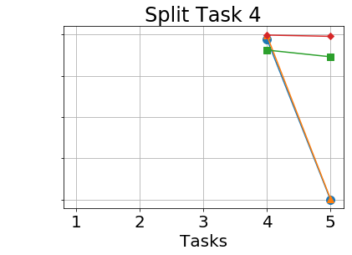
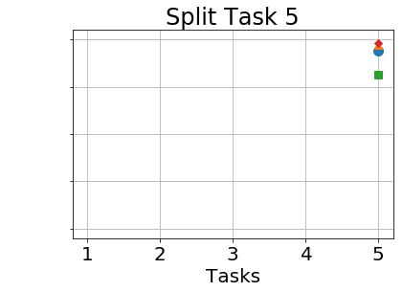
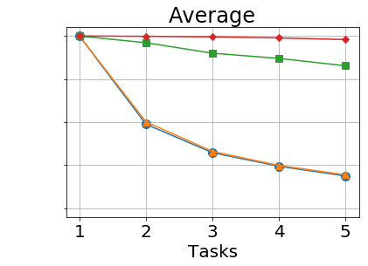
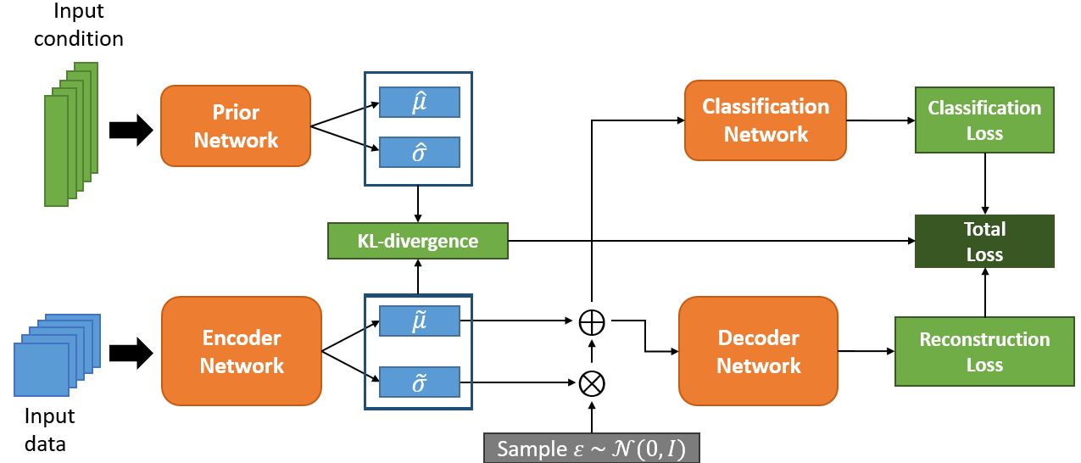
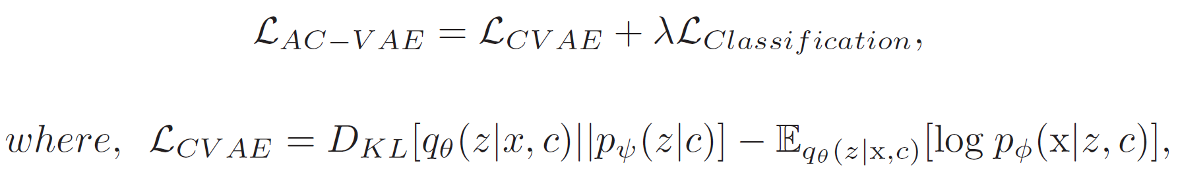
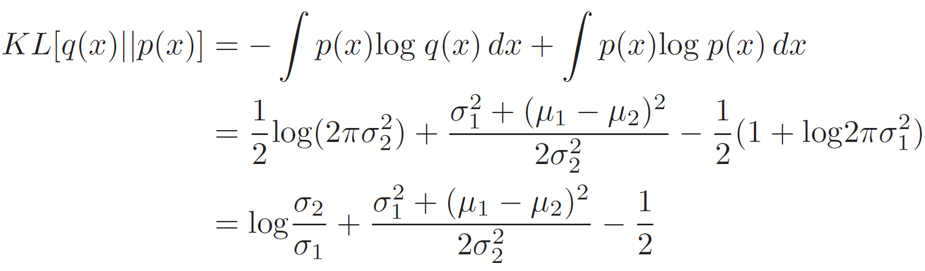


Continual Learning with Generative Replay via
Discriminative Variational Autoencoder
Authors: Woo-Young Kang¹ and Byoung-Tak Zhang^{1,2}
Surromind Robotics¹
School of Computer Science and Engineering, Seoul National University²
wykang@surromind.ai, btzhang@snu.ac.kr
Backgrounds
Experimental Results
Continual learning is one of the most challenging tasks in gradient-based machine learning approaches due to the catastrophic forgetting problem.
Various studies are using generative models which approximate previous data to mitigate the catastrophic forgetting problem.
Key Ideas
Fig3. The process for incremental learning with our AC-VAE
Classifier-Integrated Variational Autoencoder
We consolidated the two-staged training processes which are specific to the generative replay-based approaches.
Parameterized Conditional Prior Distributions
By introducing a prior network, we can parameterize the prior distributions and lean explicit class-wise prior distributions.
(a) VAE
(b) CVAE
(c) Our AC-VAE
Fig4. Visualization of the latent space with t-SNE
Methodology
We observed that explicit class-conditional distributions learned by our model
Learn proper data manifold instead of randomly fixed distributions
We also conducted experiments with Permuted MNIST and Split MNIST data.
Prior-focused approaches perform well in Permuted MNIST task, but they are not enough to solve Split MNIST task
Likelihood-focused approaches can effectively mitigate the catastrophic problem on both Permuted and Split MNIST tasks
If a generative model generates poor quality samples, the accuracy for the previous task may decrease significantly
We need to generate clear samples with a conditional generative model
Fig1. Comparison between unconditional and conditional generation
Fig5. Learning curve for both Permuted and Split MNIST tasks
Table 1. Average accuracy of 5 task settings for each dataset
Approach | Model | Permuted MNIST | Split MNIST
Prior- focused | EWC | 94.14 | 18.77
 | VCL-0 | 95.33 | 19.47
 | VCL-200 | 96.33 | 82.71
Likelihood- focused | DGR | ~92.3 | ~94.8
 | VGER | ~96 | ~95
 | AC-VAE(ours) | 96.01 | 97.95
Fig2. Overview of the AC-VAE
We can use the encoder net as a feature learner net for a classifier
Simple additional layers for classification task
Class-wise specific distributions
Discussion
There are two critical issues that generative likelihood-based approaches have to consider
It is hard to extend to complex data such as ImageNet
The approximation error for previous tasks will gradually accumulate
It will be a good option to carefully integrate the prior- and likelihood-focused approaches
I will apply for U.S. graduate schools for Ph.D. course in this December.
If you are interested in my works, all suggestions are welcome!
Please visit my homepage for more about my works: https://wykang.github.io/
Surromind Robotics | http://Surromind.ai

