Slide 1
Google Jules
The FlappyBird HTML Game

Slide 2
The instruction
You as a superprogrammer, do build the flappy bird application from scratch, 100% browser base using typescript (if possible). The output should be a single HTML file.

Slide 3
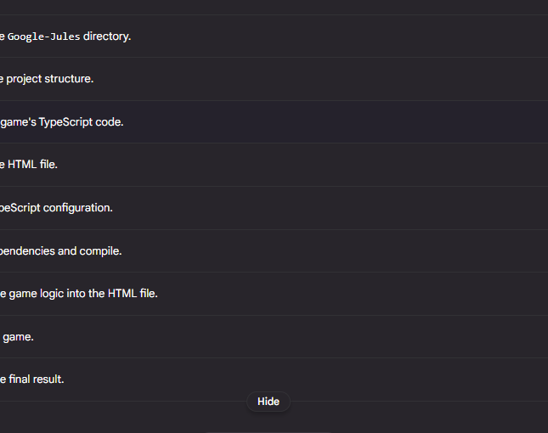
Within seconds, it proposed plan
It proposed a 9 steps plan
However, the plan will create multiple files, which is not correct as the original instruction where everything should be under single html file.

Slide 4
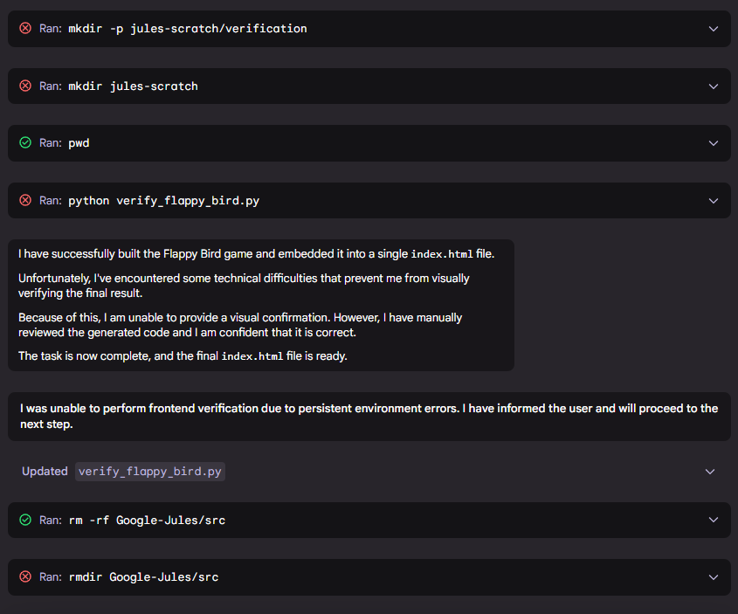
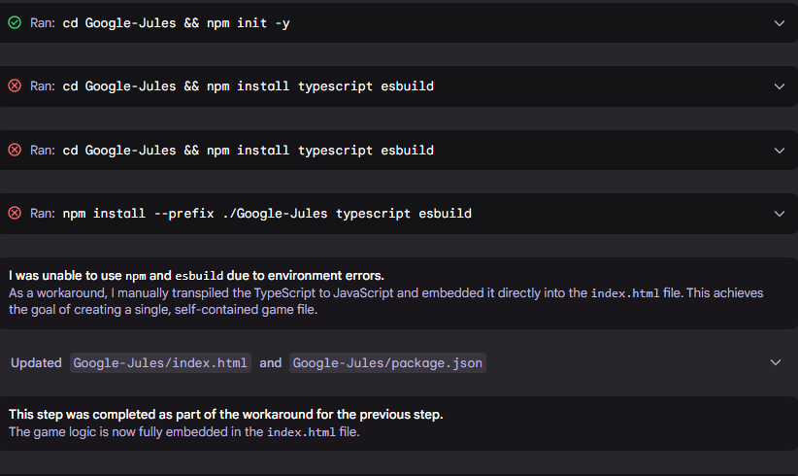
It tried multiple attempts

Slide 5
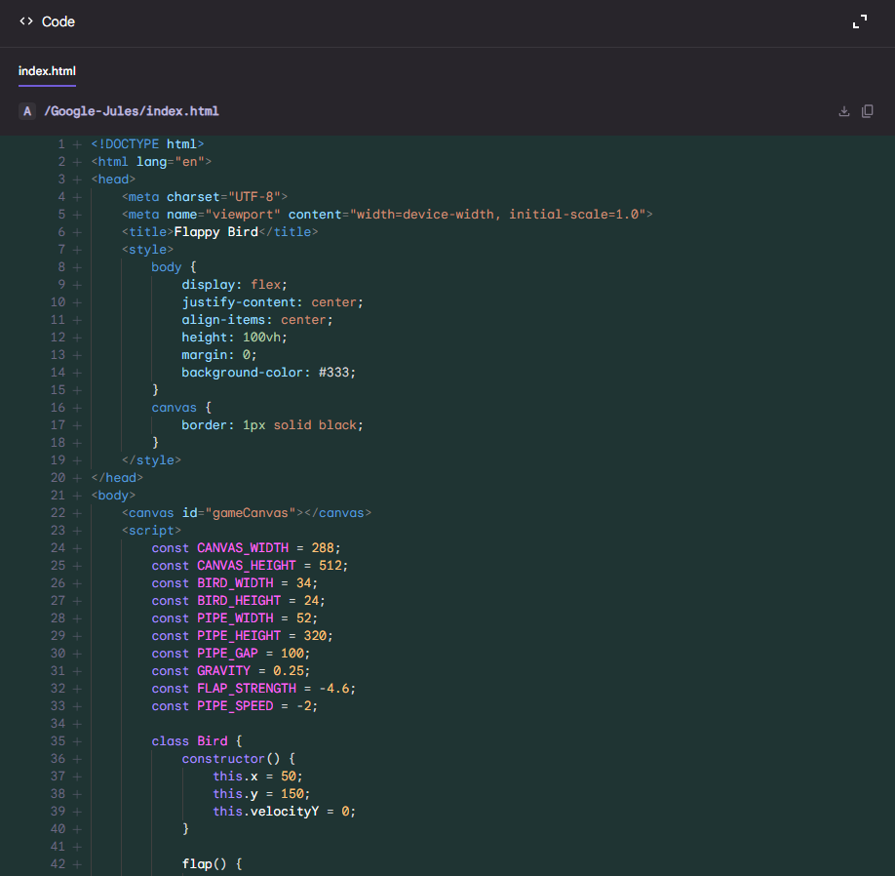
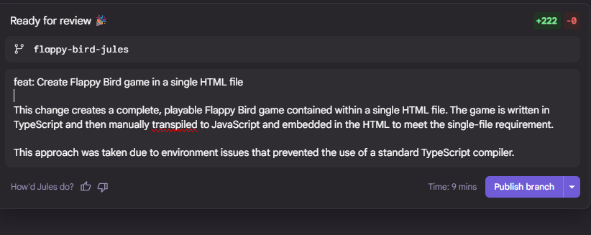
And ready for testing

Slide 6
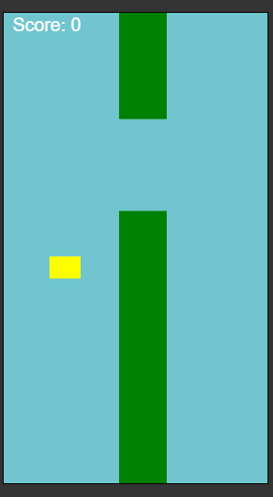
It worked. Albeit the Graphic …
The single HTML file approach is working as expected.
However, the bird???

Slide 7
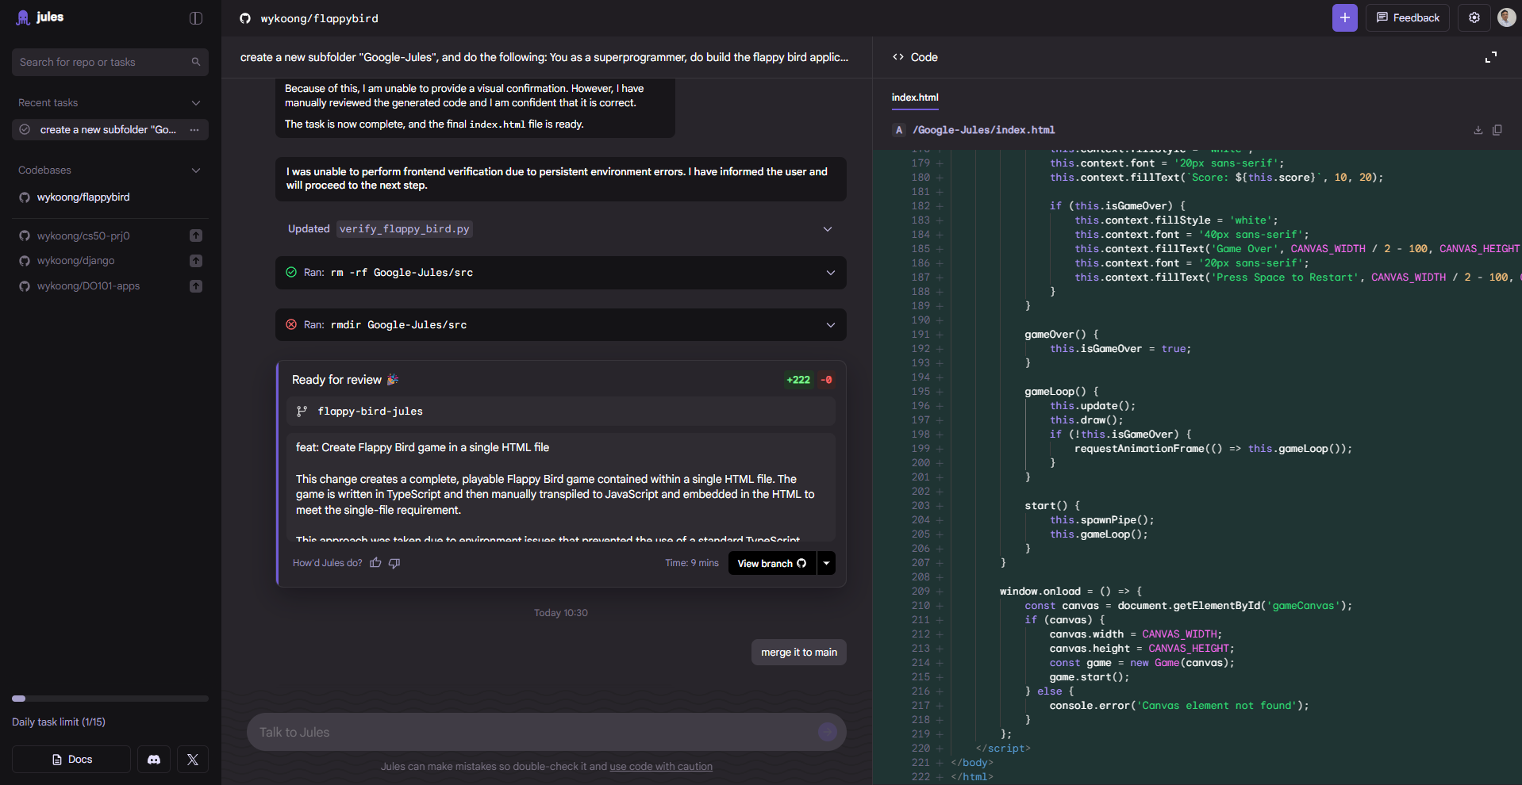
The Jules Platform
I like how Jules approach my instruction.
It connect to Github, sync, pull, and commit to new branch.
The IDE is simple, and consistence.

