Slide 1
第5章 视觉图像特征信息提取
5.2 兴趣点检测

Slide 2
内容
Features（点特征）
Harris corner detector
SIFT
Extensions
Applications

Slide 3
Features

Slide 4
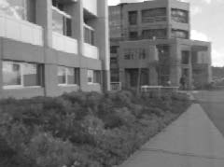
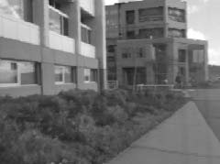
Features
Also known as interesting points, salient points or keypoints. Points that you can easily point out their correspondences in multiple images using only local information.
?

Slide 5
Desired properties for features
Distinctive: a single feature can be correctly matched with high probability.
Invariant: invariant to scale, rotation, affine, illumination and noise for robust matching across a substantial range of affine distortion, viewpoint change and so on. That is, it is repeatable.

Slide 6
Applications
Object or scene recognition
Structure from motion
Stereo
Motion tracking
…

Slide 7
Components
Feature detection locates where they are
Feature description describes what they are
Feature matching decides whether two are the same one

Slide 8
内容
Features（点特征）
Harris corner detector
SIFT
Extensions
Applications

Slide 9
Harris corner detector

Slide 10
Moravec corner detector (1980)
We should easily recognize the point by looking through a small window
Shifting a window in any direction should give a large change in intensity

Slide 11
Moravec corner detector
flat

Slide 12
Moravec corner detector
flat

Slide 13
Moravec corner detector
flat
edge

Slide 14
Moravec corner detector
corner
isolated point
flat
edge

Slide 15
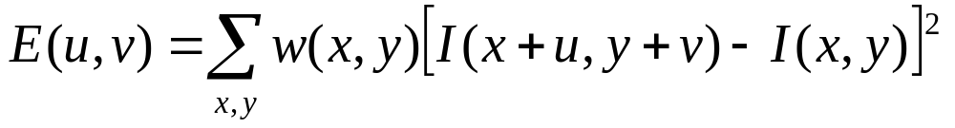
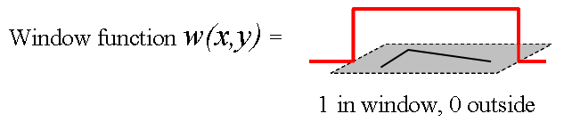
Moravec corner detector
Change of intensity for the shift [u,v]:
window function
shifted intensity
intensity
Four shifts: (u,v) = (1,0), (1,1), (0,1), (-1, 1)
Look for local maxima in min{E}

Slide 16
Problems of Moravec detector
Noisy response due to a binary window function
Only a set of shifts at every 45 degree is considered
Only minimum of E is taken into account
Harris corner detector (1988) solves these problems.

Slide 17
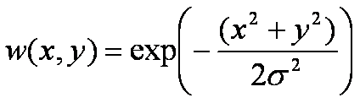
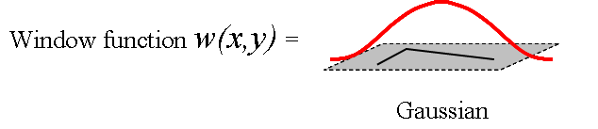
Harris corner detector
Noisy response due to a binary window function
Use a Gaussian function

Slide 18
Harris corner detector
Only a set of shifts at every 45 degree is considered
Consider all small shifts by Taylor’s expansion

Slide 19
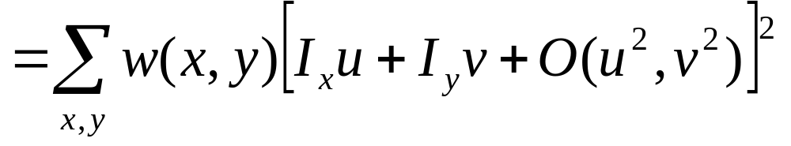
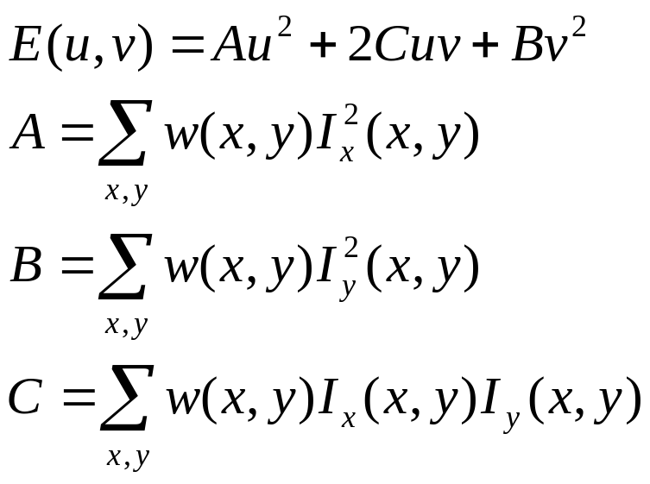
Harris corner detector
Only a set of shifts at every 45 degree is considered
Consider all small shifts by Taylor’s expansion

Slide 20
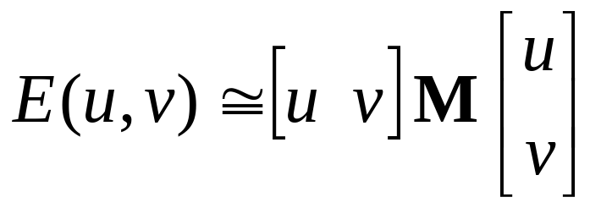
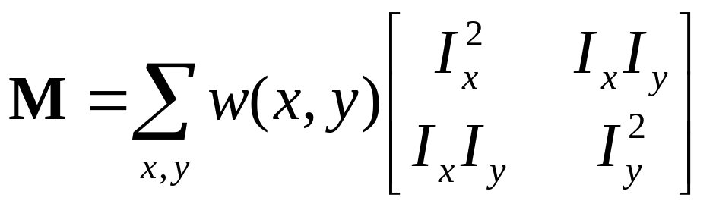
Harris corner detector
Equivalently, for small shifts [u,v] we have a bilinear approximation:
, where M is a 2×2 matrix computed from image derivatives:

Slide 21
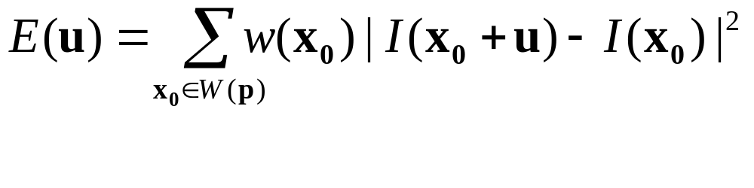
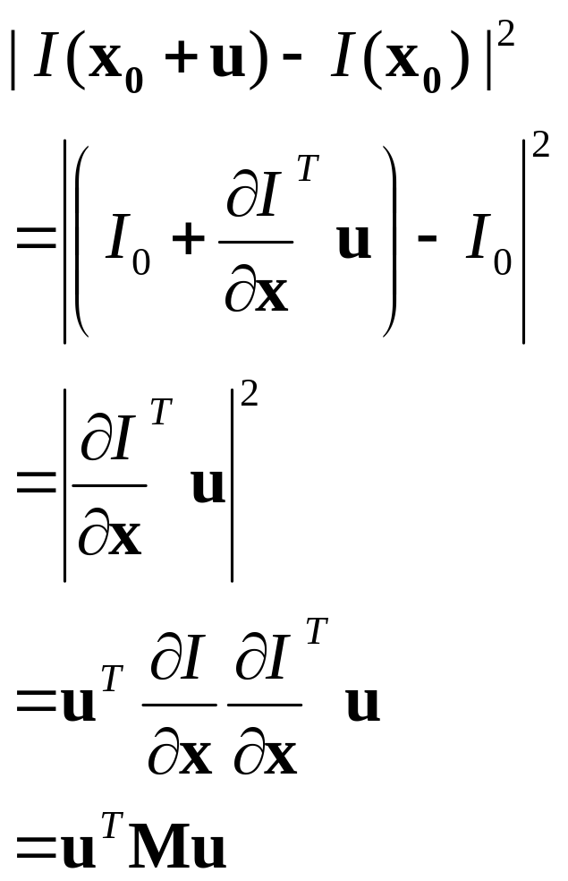
Harris corner detector (matrix form)

Slide 22
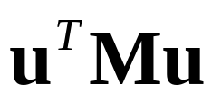
Harris corner detector
Only minimum of E is taken into account
A new corner measurement by investigating the shape of the error function
represents a quadratic function; Thus, we can analyze E’s shape by looking at the property of M

Slide 23
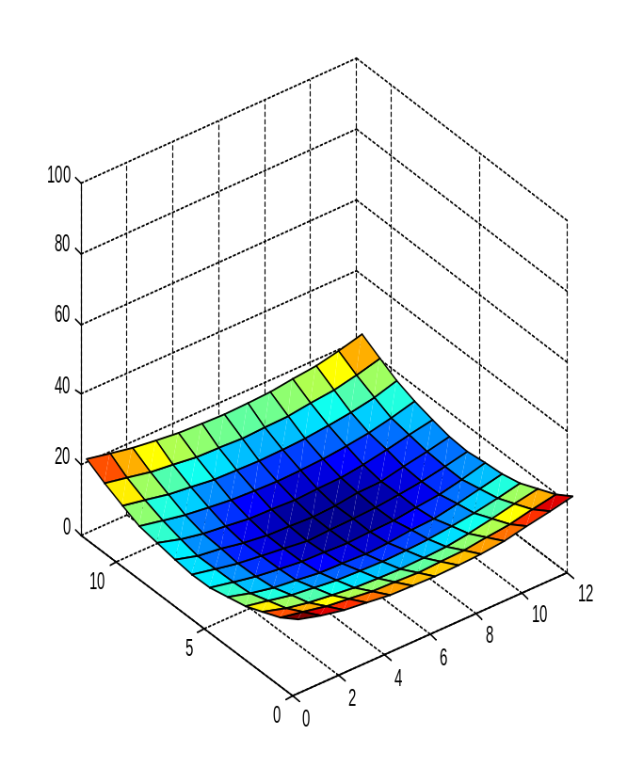
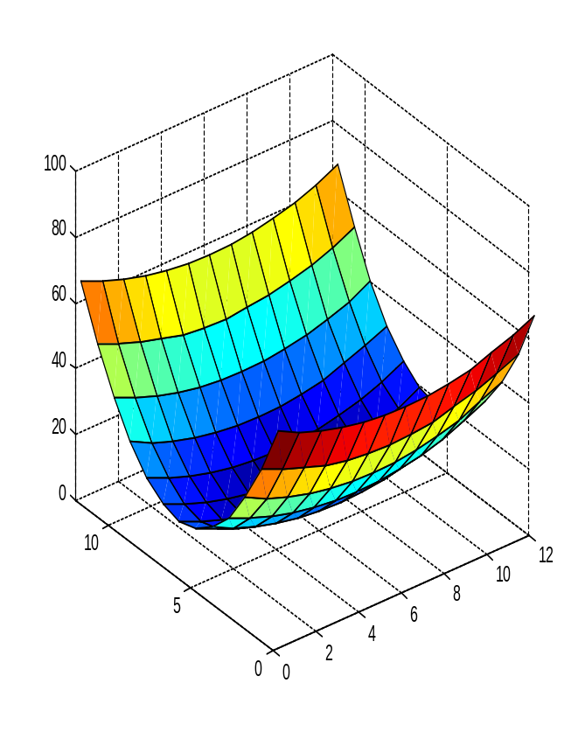
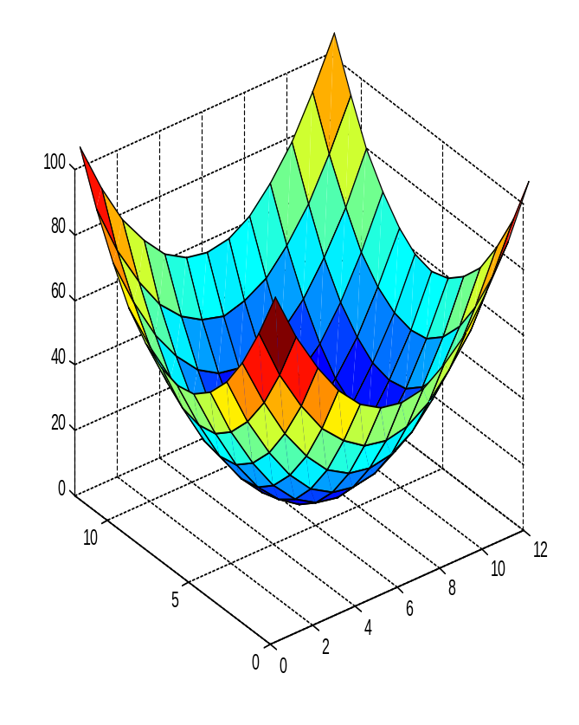
Harris corner detector
High-level idea: what shape of the error function will we prefer for features?
flat
edge
corner

Slide 24
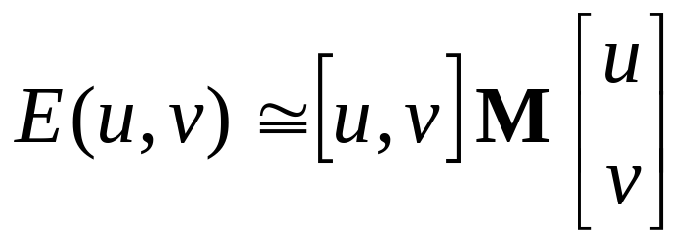
Harris corner detector
Intensity change in shifting window: eigenvalue analysis
λ₁, λ₂ – eigenvalues of M
Ellipse E(u,v) = const
direction of the fastest change
使方程等于常数，用于绘制一条等高线。
direction of the slowest change
(λ_{max})^{-1/2}
(λ_{min})^{-1/2}
椭圆的长、短半轴为什么取这样的值？

Slide 25
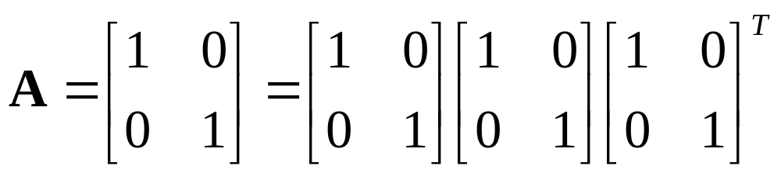
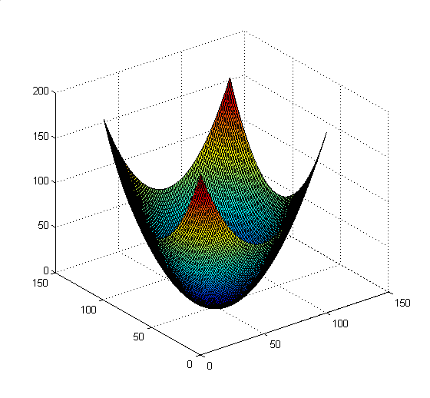
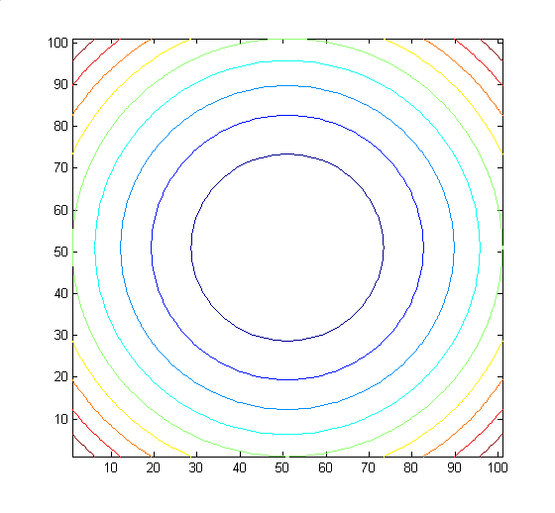
Visualize quadratic functions
朝各个方向函数的递增速度均相同

Slide 26
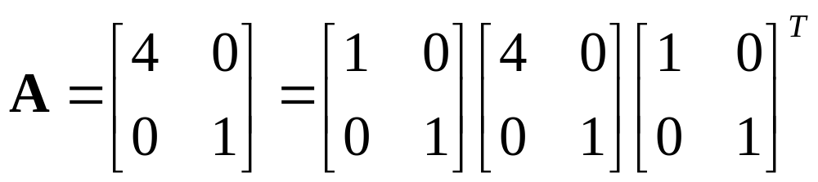
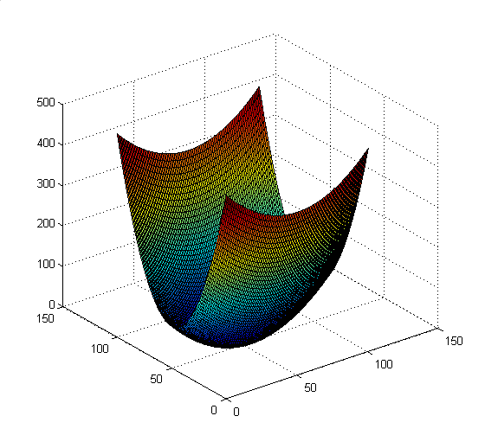
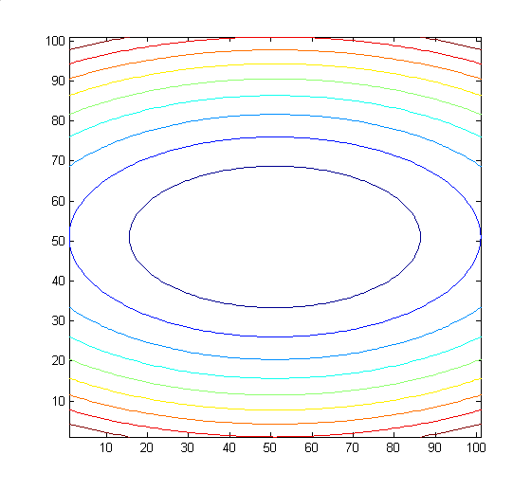
Visualize quadratic functions
在垂直方向上函数的递增速度大

Slide 27
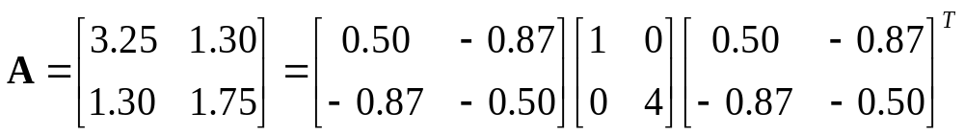
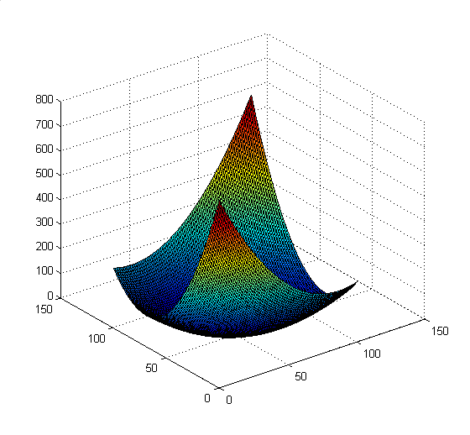
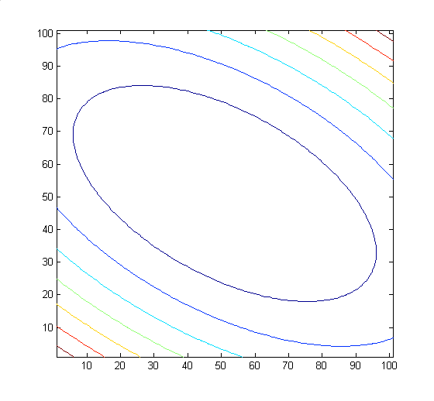
Visualize quadratic functions

Slide 28
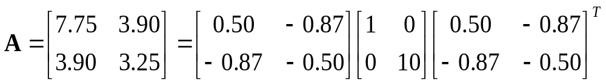
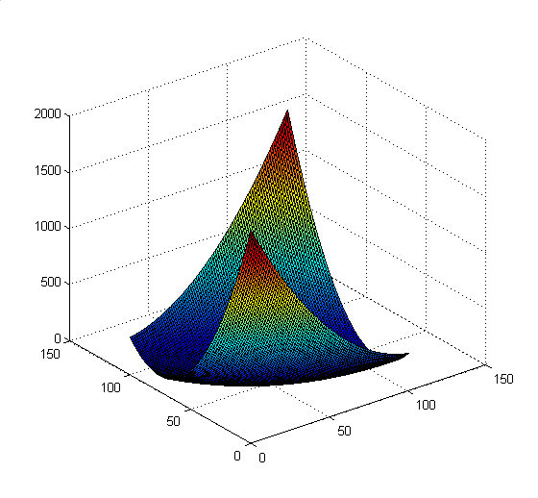
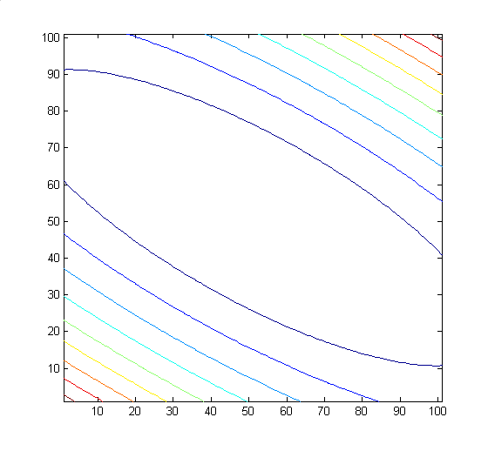
Visualize quadratic functions

Slide 29
Harris corner detector
Classification of image points using eigenvalues of M:
λ₂
edge
λ₂ >> λ₁
Corner
λ₁ and λ₂ are large,
λ₁ ~ λ₂;
E increases in all directions
λ₁ and λ₂ are small;
E is almost constant in all directions
edge
λ₁ >> λ₂
flat
λ₁

Slide 30
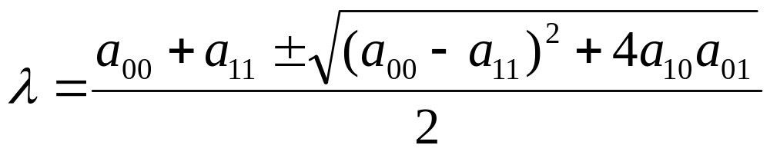
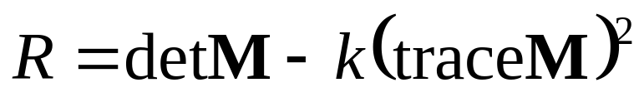
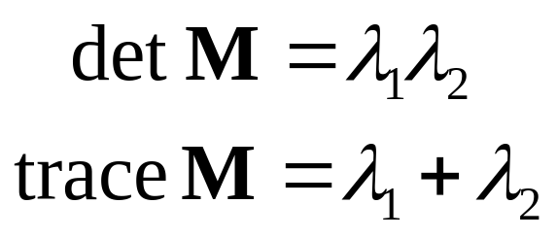
Harris corner detector
Only for reference,
you do not need
them to compute R
Measure of corner response:
哪来的公式？
来自于作者的灵感（论文中描述）.
(k – empirical constant, k = 0.04-0.06)
Notes:
http://mathworld.wolfram.com/Eigenvalue.html

Slide 31
Harris corner detector
λ₂
“Edge”
“Corner”
R < 0
R > 0
R只与M的特征值有关
角点：R为大数值正数
边缘：R为大数值负数
平坦区：R为小数值
“Flat”
“Edge”
|R| small
R < 0
λ₁

Slide 32
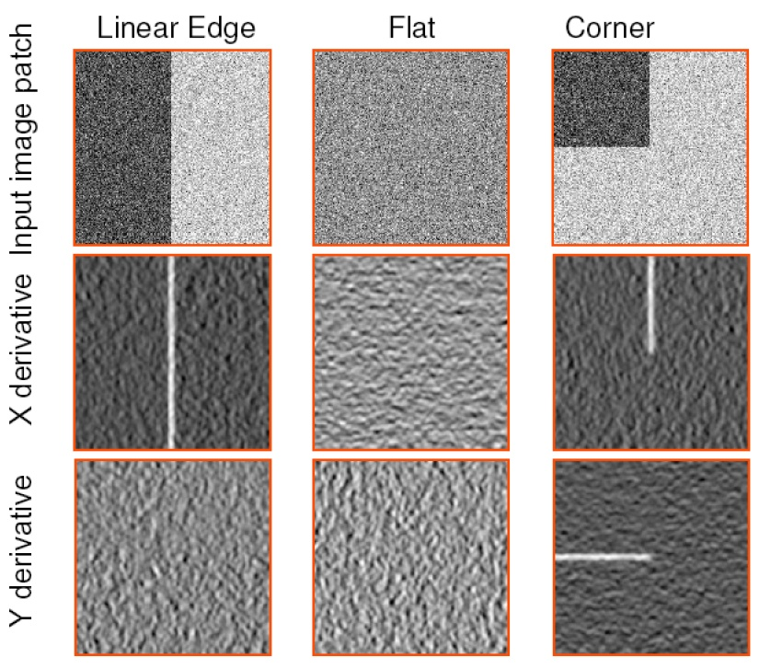
Another view

Slide 33
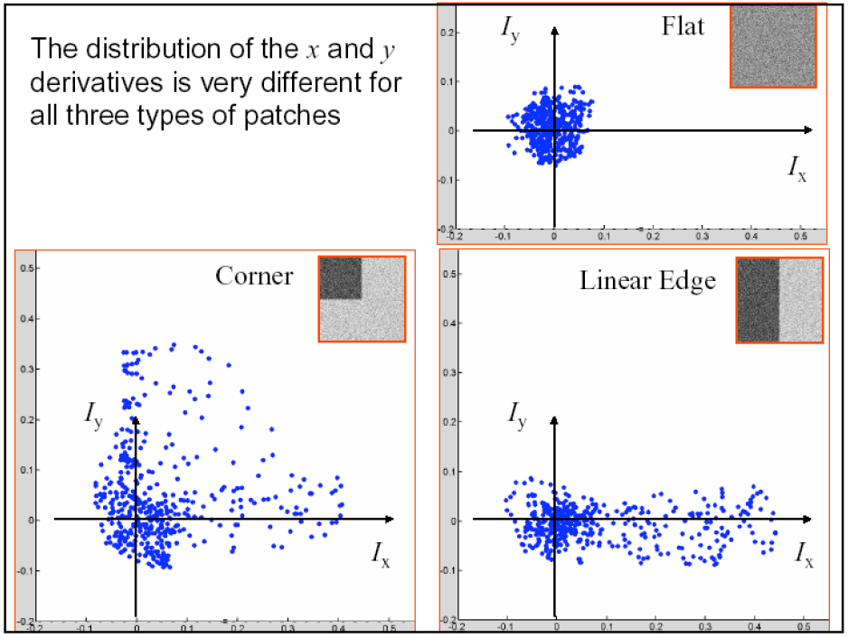
Another view

Slide 34
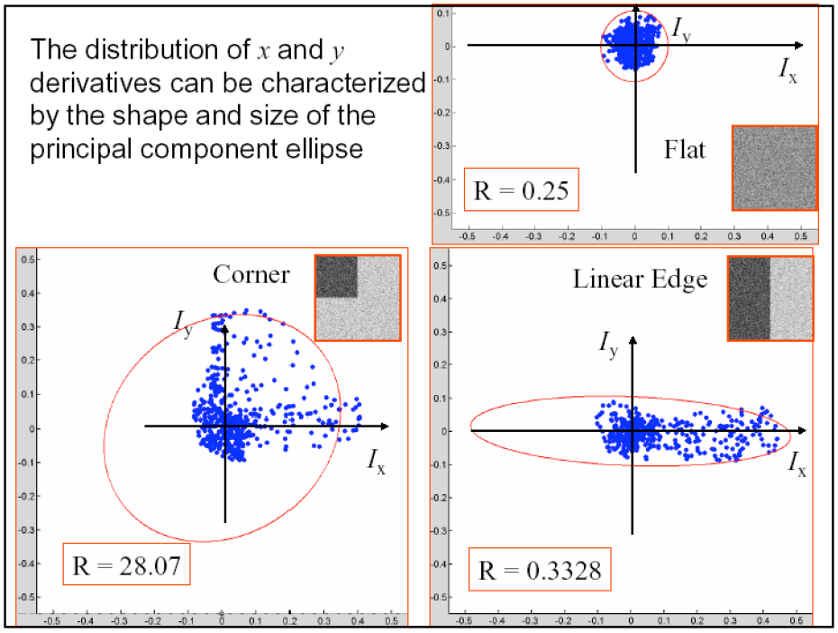
Another view

Slide 35
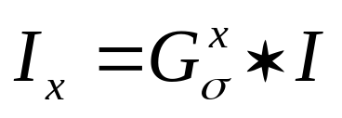
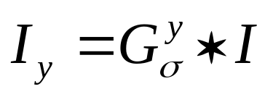
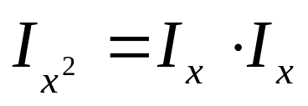
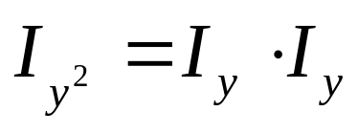
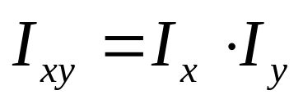
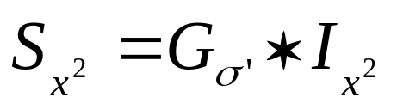
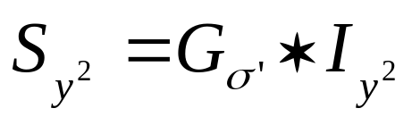
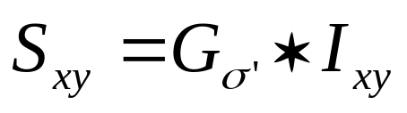
Summary of Harris detector
Compute x and y derivatives of image
Compute products of derivatives at every pixel
Compute the sums of the products of derivatives at each pixel

Slide 36
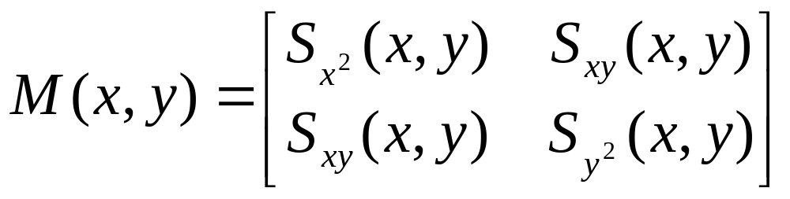
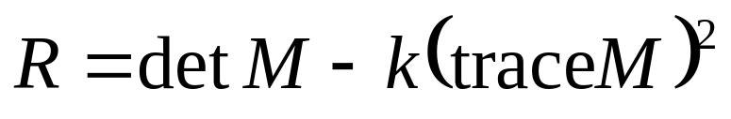
Summary of Harris detector
Define the matrix at each pixel
Compute the response of the detector at each pixel
Threshold on value of R; compute non-max suppression.

Slide 37
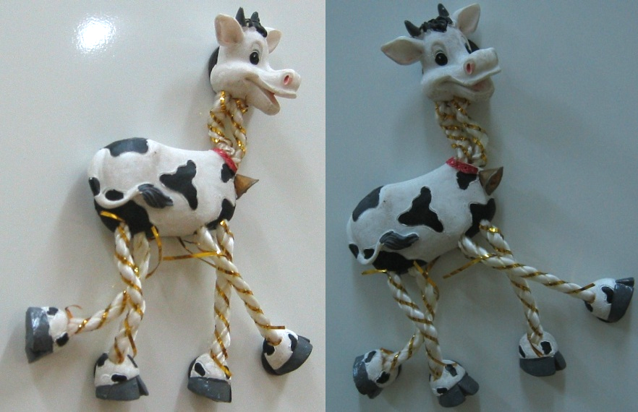
Harris corner detector (input)

Slide 38
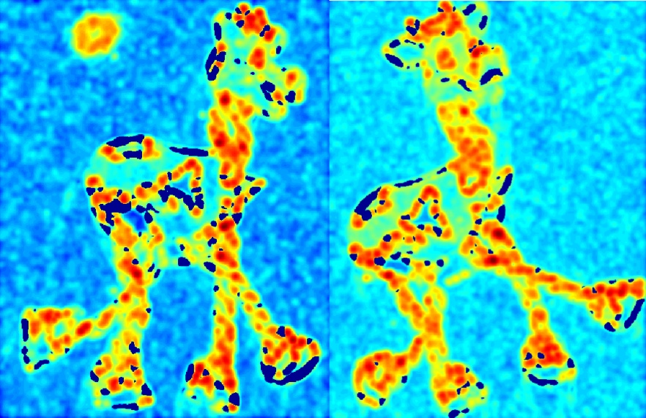
Corner response R

Slide 39
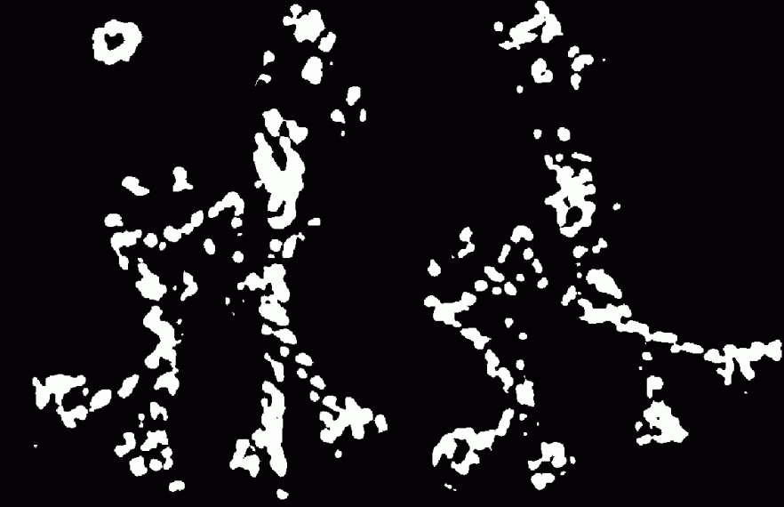
Threshold on R

Slide 40
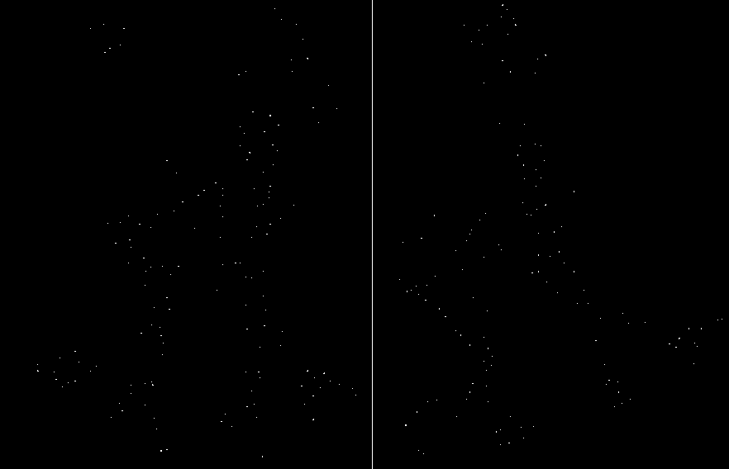
Local maximum of R

Slide 41
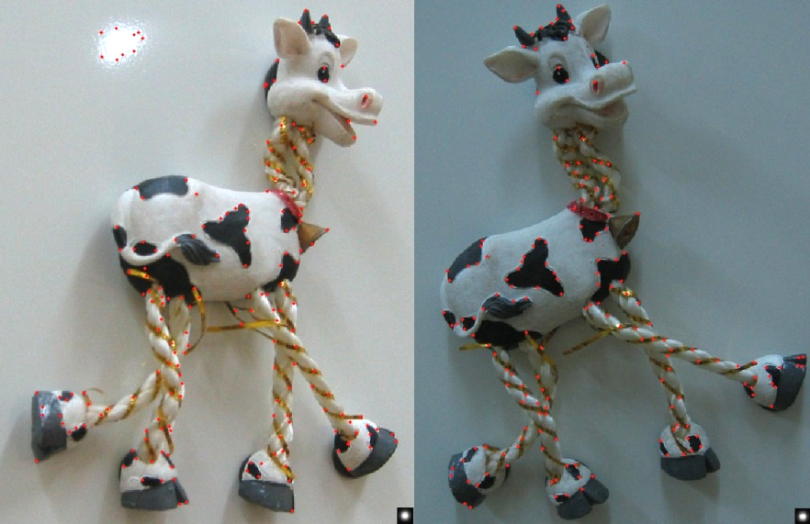
Harris corner detector

Slide 42

Harris detector: summary
Average intensity change in direction [u,v] can be expressed as a bilinear form:
Describe a point in terms of eigenvalues of M:
measure of corner response
A good (corner) point should have a large intensity change in all directions, i.e. R should be large positive

Slide 43
Now we know where features are
But, how to match them?
What is the descriptor for a feature? The simplest solution is the intensities of its spatial neighbors. This might not be robust to brightness change or small shift/rotation.
1
2
3
4
5
6
7
8
9
(
)
1
2
3
4
5
6
7
8
9

Slide 44
Harris detector: some properties
Partial invariance to affine intensity change
Only derivatives are used => invariance to intensity shift I → I + b
Intensity scale: I → a I
R
R
threshold
x (image coordinate)
x (image coordinate)

Slide 45
Harris Detector: Some Properties
Rotation invariance
Ellipse rotates but its shape (i.e. eigenvalues) remains the same
Corner response R is invariant to image rotation

Slide 46



Harris Detector is rotation invariant
Repeatability rate:
# correspondences
# possible correspondences

Slide 47
Harris Detector: Some Properties
But: not invariant to image scale!
All points will be classified as edges
Corner !

Slide 48


Harris detector: some properties
Quality of Harris detector for different scale changes
Repeatability rate:
# correspondences
# possible correspondences

