Slide 1

SignalR
William Austin
Consultant, sdg
@wyldebill00
www.solutiondesign.com
August I 2014

Slide 2
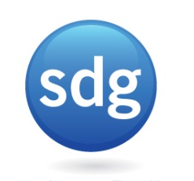
Agenda
History
SignalR
Demo: Long Polling MVC
Demo: SignalR ProgressBar
Gotchas
SignalR I 2014

Slide 3
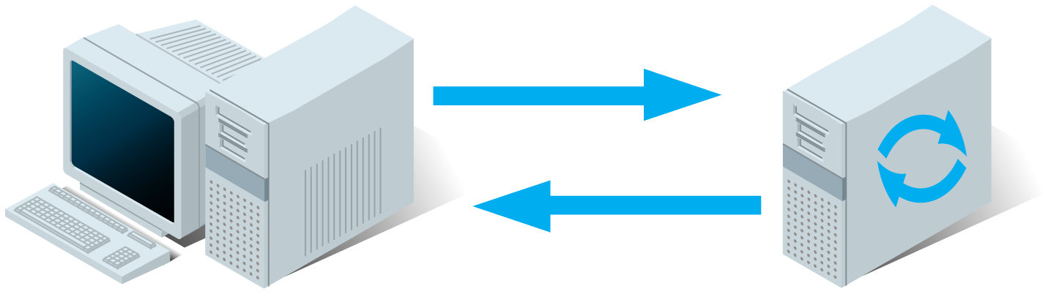
History
HTTP
Request Response
Client initiated
Synchronous interaction (blocking)
SignalR I 2014

Slide 4
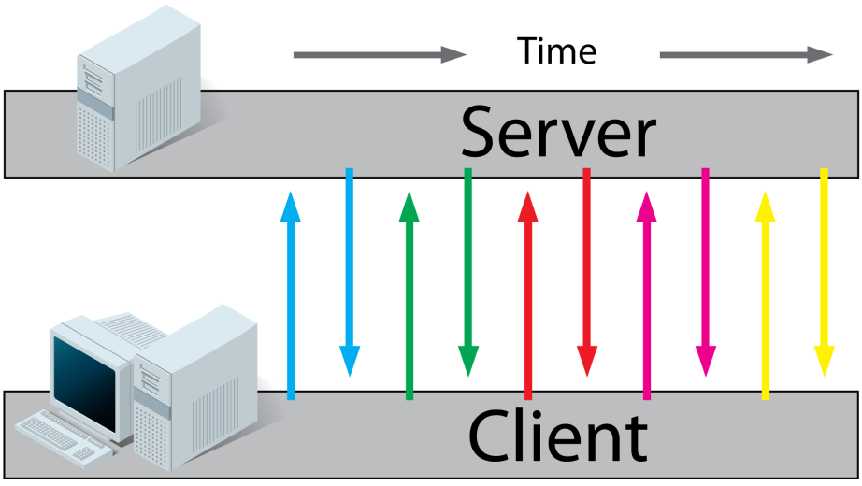
Realtime Today
Polling
Universally supported
Connections tied up while polling
Pull Model
SignalR I 2014
Notes:
Time between polls, no notification
Work around, poll period algorithms.
Catching a ride on existing req’s

Slide 5
Wouldn’t it be nice…
“Push” updates from servers
Asynchronous operations
Non-blocking client operations
Messaging
SignalR I 2014
Notes:
2 minutes to this slide

Slide 6
Enter SignalR
Incredibly simple Real-Time Web for ASP.NET
Logical abstraction of 2-way connection
RPC-like proxy-based API
Messages, queuing, scale out/backplane
SignalR I 2014

Slide 7
SignalR Transports
WebSockets
Server Sent Events (all but IE)
Forever Frame (IE only)
Long Polling
SignalR I 2014
Notes:
5 minutes

Slide 8
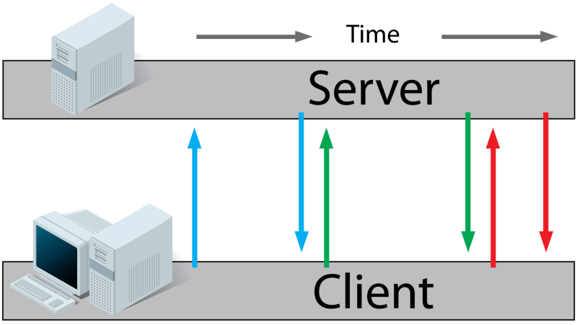
Long Polling
Connection stays open
Instant updates on client
Asynchronous
2nd connection required to send
http://stackoverflow.com/questions/11077857/what-are-long-polling-websockets-server-sent-events-sse-and-comet
SignalR I 2014
Notes:
Time between polls
Time outs, and proxies killing connection when no da

Slide 9
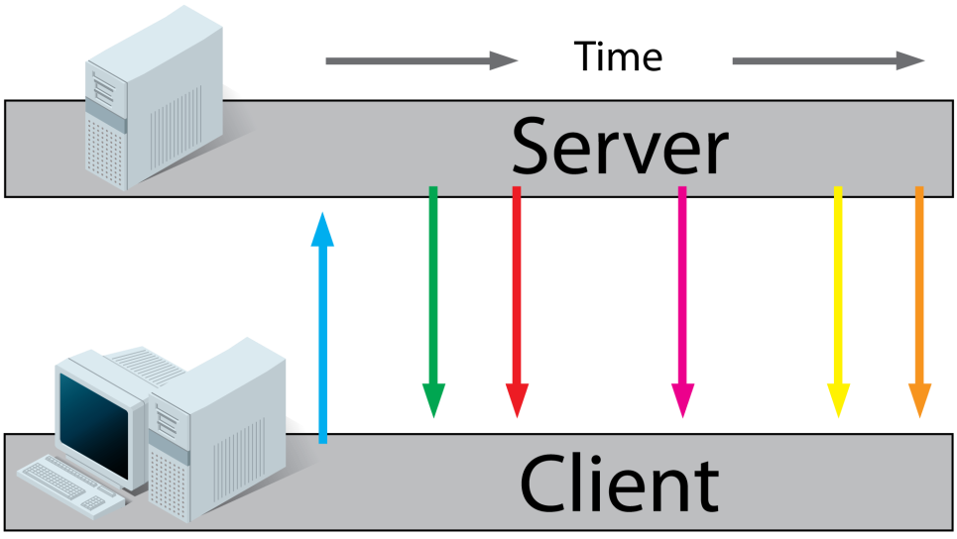
Forever Frame
Use embedded <iframe>
Streams script functions forever
Timeout, buffering, flushing
2nd connection required
SignalR I 2014

Slide 10
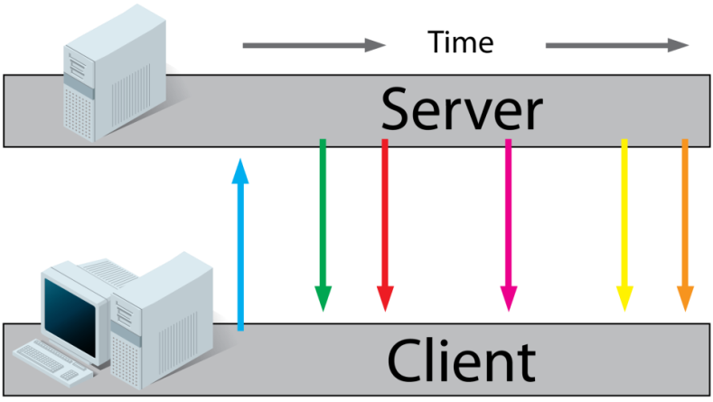
Server Sent Events
HTML5
One-way Server to Client, client subscribes
All browsers, except IE
Separate connection to send
SignalR I 2014
Notes:
Timeout, buffering, may interfere

Slide 11
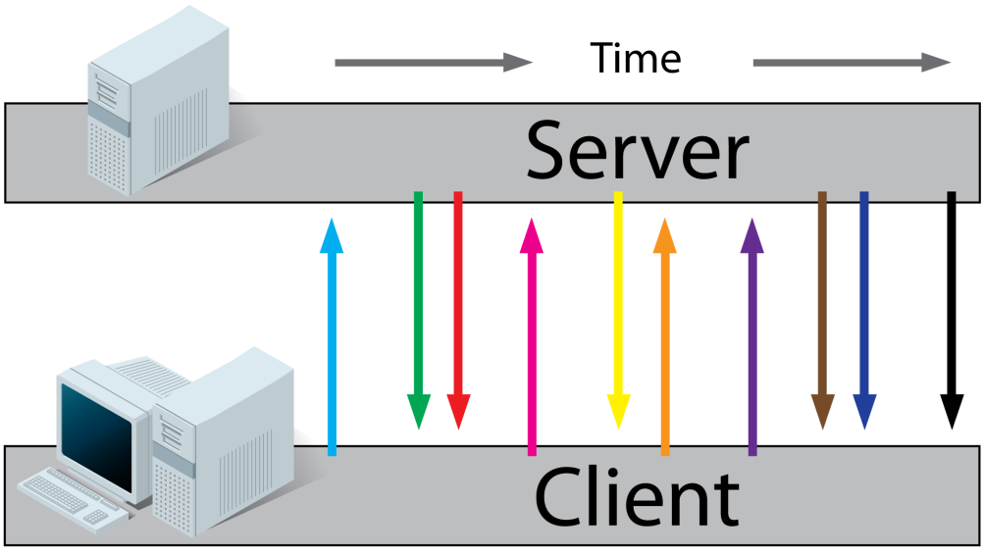
WebSockets
HTML5
Raw API
Persistent 2-way communication
Newer protocol, hardware
SignalR I 2014
Notes:
10 minutes

Slide 12
Demo
Roll-our-own Long Poll
Server will not reply right away
When *something* happens, server replies
TaskCompletionSource.SetResult is the *something*
SignalR I 2014

Slide 13
SignalR API’s
Hubs – Fine unless games, Wall St.
Persistent Connection – Raw data, strings only
SignalR I 2014

Slide 14
Demo
SignalR Progress Bar
Hosted on AppHarbor
SignalR I 2014

Slide 15
Connection Negotiation
HTTP 101, Switching Protocols
Server uses WebSockets if supported
Connectionid
JSON payload
SignalR I 2014

Slide 16
Gotchas
Javascript camelcase / [HubName]
Calls from Server fail silently
Camel casing / [attributes]
Verify proxy at /signalr/hubs
Startup.cs for OWIN
MVC Folders named SignalR
JSON Parser required, IE7
SignalR I 2014

Slide 17
Go try it!
NuGet Sample “signalr.stockticker”
www.asp.net/signal
Jabbr.net
SignalR I 2014

Slide 18
Blank Slide
SignalR I 2014

Slide 19
Client Side (too much)
$.connection.hub.start()
Var p = $.connection.<hubname> get a proxy object
P.server.<hubmethod>(params) calls the server
Hub method calls return promises
SignalR I 2014

Slide 20
Client Side hub/proxy setup too much?
In document.ready…
Get proxy reference, $.connection.yourhub
Define your methods server can call on you
Proxy.client.SomeMethod = function() {..}
Then, call $.connection.start() and inside the .done() kick off the initialization, click handlers, etc.
SignalR I 2014

Slide 21
Hub Order of Events
Client calls $.connection.hub.start() (it’s always hub, not <yourhubderivedc#classname>
This kicks off the connection negotiation
Cross domain connections ok if server configured with enablecrossdomain
Start returns a js promise, with a .done or .fail possible callback
Camel case in the client vs .net class is important, or use [hubname] attribute
SignalR I 2014

Slide 22
Client Side (Remove)
Has a .server property that exposes all methods on hub derived class
May have more than one object for client side hub(s)
camelCasing applies to calling hub methods too
SignalR I 2014

Slide 23
Hubs (too much?)
When the signalr/hubs request is made, the assemblies are scanned that inherit from Hub. A js proxy object is returned to the client and cached for the remainder of the session
The signalr/hubs URL (mvc route) is registered in the mapSignalR() call.
Static js proxy for build machines
Calls to Client return Task
SignalR I 2014

Slide 24
This Slide not Needed
Good news is, signalr uses all of these transport emethods (except polling)
More good news, the api looks like rpc (though it’s messaging, queues, async)
Officially part of asp.net family
Tracks clients, supports groups, events connect/disconnect/reconnect
Queues messages, message bus, backplane
Signalr isn’t just for web, but http. Wpf, Windows phone, android, iPhone clients (proxies) available.
Nuget package
SignalR I 2014

Slide 25
Prerequisites
Dynamic types
Json
Promises in js
jQuery/js
HTTP / Headers / Codes 101
Tasks/Async Await to a lesser extent
SignalR I 2014

Slide 26
From Client Side
Methodname call to client ignores case
Calls to method names are dynamic, won’t fail at compile time
Calls to non-existent methods silently fail
Returns from server calls are possible 2 way
SignalR I 2014
Notes:
10 minutes

Slide 27
contact I William Austin
title I Consultant
email I william.austin@solutiondesign.com
office I 952.278.2500
7500 Olson Memorial Hwy, Suite 250 I Golden Valley, MN 55427 I www.solutiondesign.com

