Slide 1
Undergraduate Presentation
Presented by CSUA, IEEE, HKN, & UPE

Slide 2
Thank you for…
Coming to student group events
New classes
Considering the 5-year Master’s program
Providing group advising for L&S CS students
“EECS profs rock! Yay EECS profs!”

Slide 3
The Survey
236 registered students responded
~60% EECS students
~25% L&S CS students
This is approximately 20% of all EECS and declared L&S CS students
More detailed information in our packet

Slide 4
Today’s Plan
Resources
Classes
Faculty Advising
Research
Community
Faculty-Student Panel

Slide 5
Resources
Classes
Faculty Advising
Research
Community
Faculty-Student Panel

Slide 6
Resources
Be aware of what your students are lacking, and advocate for them
Examples
  Southside labs (and open access to HFA labs)
  Allocation of resources (lab space, availability of programs)
  AirBears coverage

Slide 7
Resources
Classes
Faculty Advising
Research
Community
Faculty-Student Panel

Slide 8
Classes
Projects
  More accountability for group projects
  “I like group projects because [they allow] me to interact with my peers, most of whom are not very social.”
When courses are taught by members of the industry, students prefer a Berkeley professor to co-teach

Slide 9
Classes
Honors classes and discussion sections
  Student reaction was mixed
    Challenges students with new and current material, rather than repeating lecture and homework
    Creates rift among students

Slide 10
Resources
Classes
Faculty Advising
Research
Community
Faculty-Student Panel

Slide 11
Faculty Advising
2 out of 3 polled students feel that advising should be required
Faculty advisors should do more than just “sign the paper”
Advising should start well before Telebears, and office hours should be extended during this time

Slide 12
Faculty Advising
L&S CS Students want individual advising in addition to group advising
  Such advising would be most helpful to new admits
Anonymous feedback for advising

Slide 13
Resources
Classes
Faculty Advising
Research
Community
Faculty-Student Panel

Slide 14
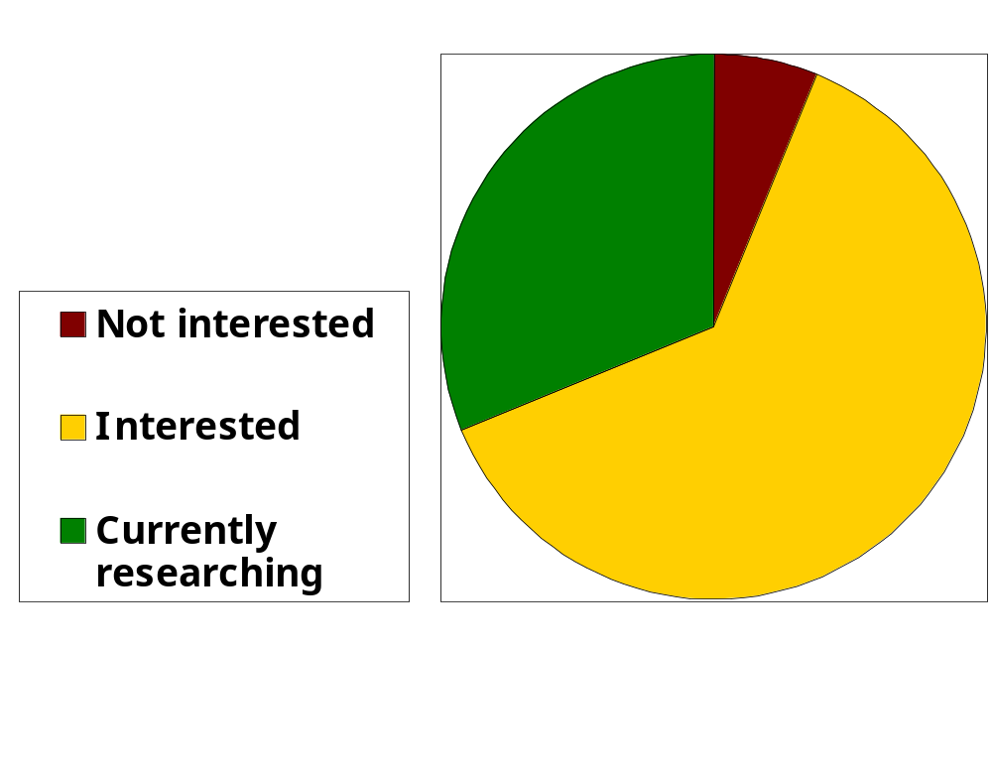
Research
Students are interested in research!

Slide 15
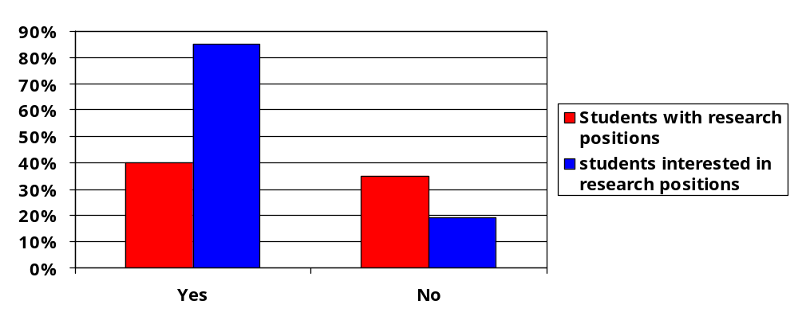
Research
Do you find it difficult to find research?

Slide 16
Research
Students feel it is difficult to find research positions
  Half of students with research positions feel that research is difficult to find
    They don’t know where to look
    The places they’re looking are not up-to-date
    Skill requirements are unclear
    They feel intimidated to approach faculty

Slide 17
Research
Supporting undergraduate research
  Advertise means to find research
  Update web pages to reflect current research activity
  Encourage individual students to find research
  Announce technical talks in lectures
  Educate students about what is involved in research

Slide 18
Resources
Classes
Faculty Advising
Research
Community
Faculty-Student Panel

Slide 19
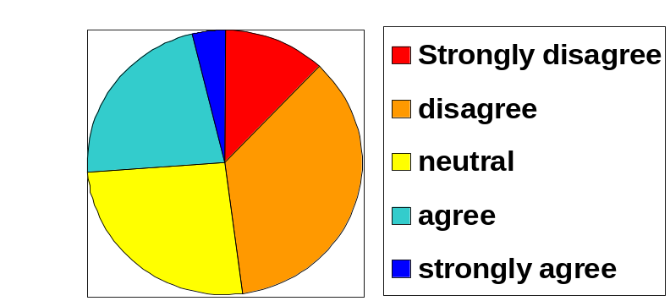
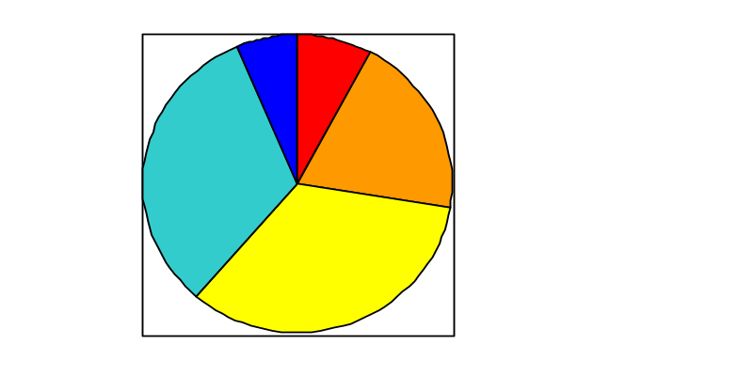
Community
Do you feel there is a sense of community among students, staff, and faculty in EE and CS?
L&S CS
EECS
Students feel strongly that there is a severe lack of community interaction between students and faculty

Slide 20
Why is community important?
Alleviates industry concerns regarding student communication skills
Enables students to more effectively utilize existing resources
Improves communication between students and faculty
Encourages the sharing of ideas
End result: better graduates

Slide 21
Community
Suggestions
  Regularly scheduled student-faculty mixer
  Invite students in lecture to technical talks

Slide 22
Resources
Classes
Faculty Advising
Research
Community
Faculty-Student Panel

Slide 23
Faculty-Student Panel
Why?
  Students do not understand the reasoning behind department decisions. (e.g. changes in Cory lab space, curriculum requirements)
  The information flow is limited
Regular meetings and email correspondence

Slide 24
Conclusion
Community
  Faculty-Student panel
  Mixers
  Invitations to talks and other events

Slide 25
Questions?
CSUA: Erik Klavon, Eric Miles, Jeff Varga, David Schultz, Daniel Ong
IEEE: Thomas Kuo, Shawn Cheng
HKN: Isaac Seetho, Ellen Zeng, Amy Wung, Mimi Yang
UPE: Diana Michalek, Chris Loer, David Sontag
retreat@csua.berkeley.edu

