Slide 1
2006 Undergraduate Student Presentation

Slide 2
Ideals of Students in EECS
Engage in Berkeley’s Strong Academic Community
Learn and Explore Today’s Technology
Contribute to Tomorrow’s Technology

Slide 3
2005 Student Presentation Requests
5th Year Masters program
Computer Security class
THANK YOU!

Slide 4
Course Surveys

Slide 5
Concerns
Students do not see course surveys effecting change in EECS courses
Low ratings do not lead to changes in course structure or staffing
High ratings do not lead to visible recognition

Slide 6
Proposed Solutions
Have professors examine and adjust to specific (teaching style-related) course survey responses

Slide 7
Proposed Solutions
Rotate professors with low ratings to classes that may more closely fit their interests
Professor peer review and teaching seminars

Slide 8
High Ratings – 6.2+ in Fall 2005
EE:
Michael Gastpar Chenming Hu
CS:
Dan Garcia Randy Katz
John Kubiatowicz David Wagner
THANK YOU!

Slide 9
Redundant Course Material

Slide 10
Concern
Students feel that too much prerequisite material is repeated in later classes, especially at the semester’s beginning
  Basic FT in Math 54, EE 20N, 120, 121, 123
  RSA is taught in Math 55, CS 70, 170, 162, 194
Takes time away from advanced material

Slide 11
Proposed Solutions
Introduce honors classes with advanced topics in place of redundant review material
Restrict review material to first homework
Move review material into extra, optional, discussion sections or review sessions

Slide 12
Undergraduate Research

Slide 13
Concerns
Undergraduates still find it hard to participate in research

Slide 14
Proposed Solutions
Create a seminar class for professors to present their research to interested undergraduates
  Motivate students to do research
  Inform students of the latest work in EECS
  Help students find specific areas of interest

Slide 15
Proposed Solutions
Create more 98/198 courses
  Students like opportunities like UCBUGG, Gamescrafters, etc.
  98/198s are bridges between normal classes and 99/199 research

Slide 16
Proposed Solutions
Graduate student-led research
  Graduate students can lead 198/199 groups for undergraduate research
  Could count towards graduate TA requirement

Slide 17
Faculty-Student Interaction

Slide 18
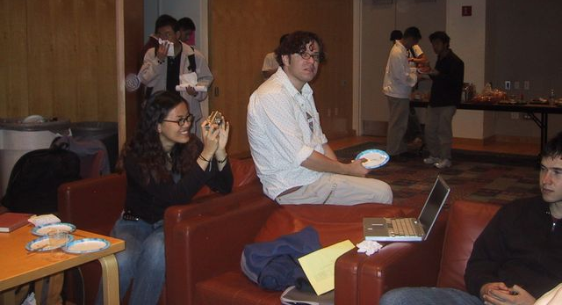
Interaction — Fa05 Faces of Research
Students: 10 Professors: 0

Slide 19
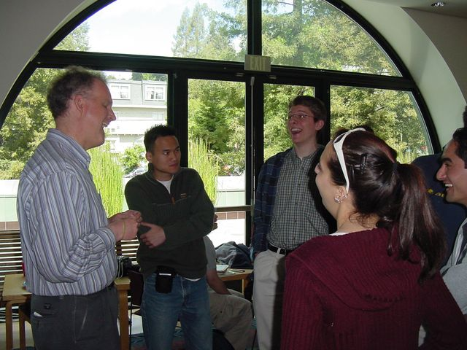
Proposed Solutions

Slide 20
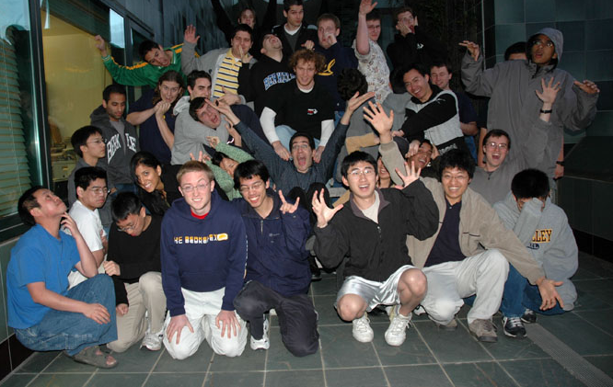
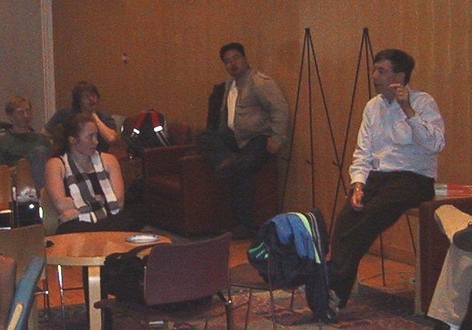
Proposed Solutions

Slide 21
Conclusions

Slide 22
Recommendations
Department should act in response to course survey results
Restructure curricula to minimize redundant material
Introduce research overview seminar for undergrads
Increase accessibility of 98/198 research

