Slide 1

Student/Faculty Lunch 2007
University of California, Berkeley
EECS Undergraduate Student Groups
Monday, May 7th, 2007
Presented by the EECS Undergraduate Student Groups

Slide 2
The Survey
210 responses from EECS Undergraduates
  20.2% Freshmen
  23.2% Sophomores
  26.3% Juniors
  30.3% Seniors
Approximately 20% of EECS Undergraduates responded to the survey

Slide 3
Overview
Freshmen in EECS
Undergraduate TAs
Course Scheduling
Professor Interaction
EECS Research

Slide 4
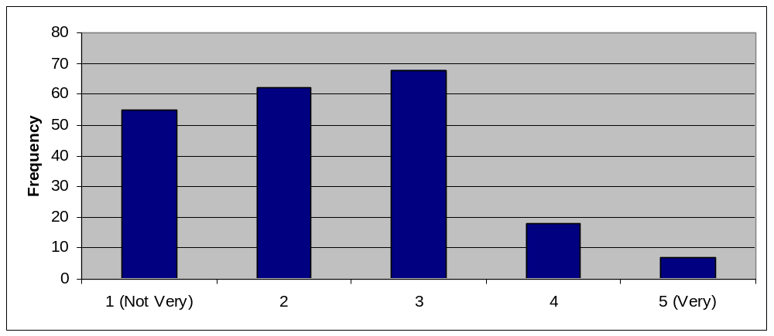
Freshmen in EECS
How involved and integral do students in the EECS department feel as freshmen?

Slide 5
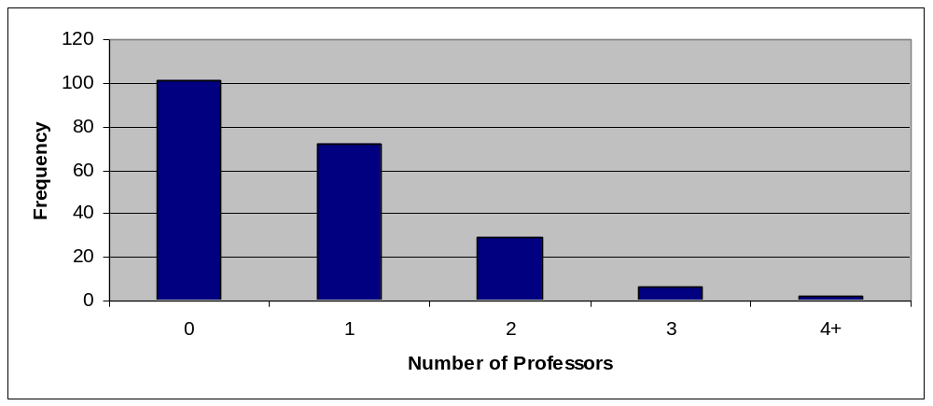
Freshmen in EECS
How many EECS professors do students know well enough to feel comfortable talking to as freshmen?

Slide 6
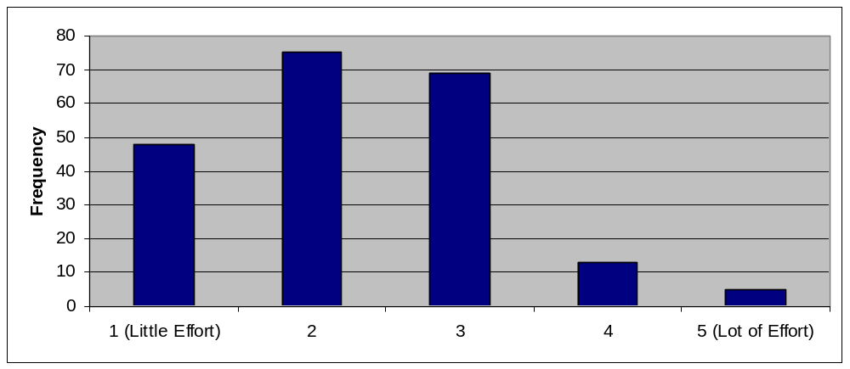
Freshmen in EECS
How much effort do students feel the EECS department takes in making freshmen feel valued and important in the EECS community?

Slide 7
Freshmen in EECS
Suggestions include:
  More EECS welcome week events
  Require peer and faculty advising
  More freshmen seminars, including one to teach basic skills such as UNIX and Matlab
  More social events for freshmen to meet other EECS students and their professors
  Advertise events and services more in lower division classes

Slide 8
Undergraduate TAs
Issue as to whether students mind relatively high number of undergraduate TAs
Most EECS students (87%) have had an undergraduate TA for an EECS class

Slide 9
Undergraduate TAs
Most students (71%) happy with undergraduate teaching effectiveness—rated them 4 or 5 out of 5.
Majority of students (55%) found undergraduate TA teaching abilities on par with graduate ones TA's
  Rest divided between better and worse

Slide 10
Undergraduate TAs
Again, most students (76%) find undergraduate TA's very approachable—rated them 4 or 5 out of 5
Interestingly, a third of the respondents found them more approachable than a GSI; another half of the respondents found them just as approachable as a GSI

Slide 11
Undergraduate TAs
Large number of undergraduate TA's
Students generally perceive them as at least as good as their graduate counterparts

Slide 12
Course Scheduling
How do students feel about the way their courses are scheduled?

Slide 13
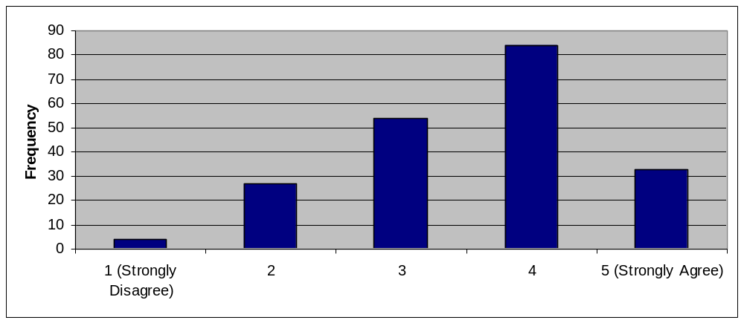
Course Scheduling
Number of Courses
Are students happy with the number of EECS classes offered each semester?

Slide 14
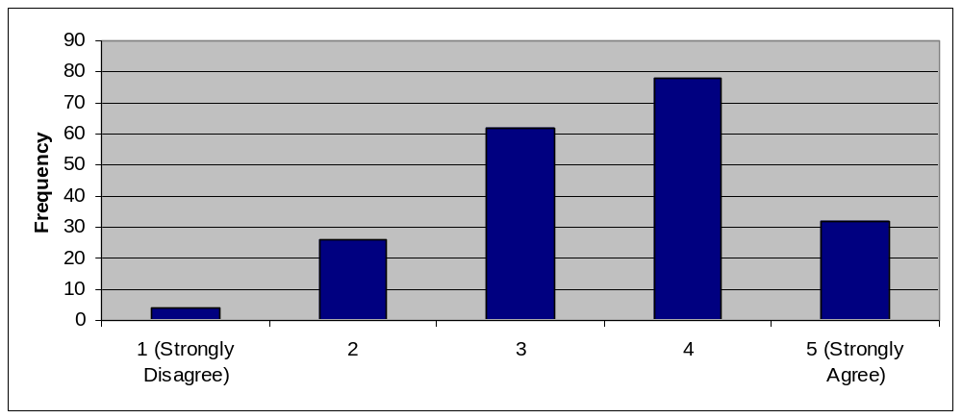
Course Scheduling
Variety of Courses
Are students happy with the variety of EECS classes offered each semester?

Slide 15
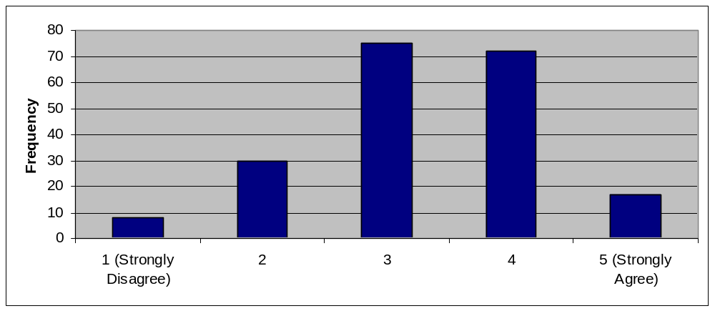
Course Scheduling
Timings of Courses
Are students happy with the timings for EECS classes offered each semester?

Slide 16
Course Scheduling
In general students are content with the number and variety of EECS courses offered each semester
There were some suggestions for changing the timings of classes
  Less evening lectures
  Fewer Tuesday & Thursday classes
  Fewer conflicts, especially in core courses (i.e. EE40 and CS61BL next semester)

Slide 17
Course Scheduling
Courses Not Offered Every Semester
Students also wanted to see these classes offered more often:
  EE 123: Digital Signal Processing
  EE 145 Series
  CS 152: Computer Architecture
  CS 172: Computability and Complexity
  CS 194: Security

Slide 18
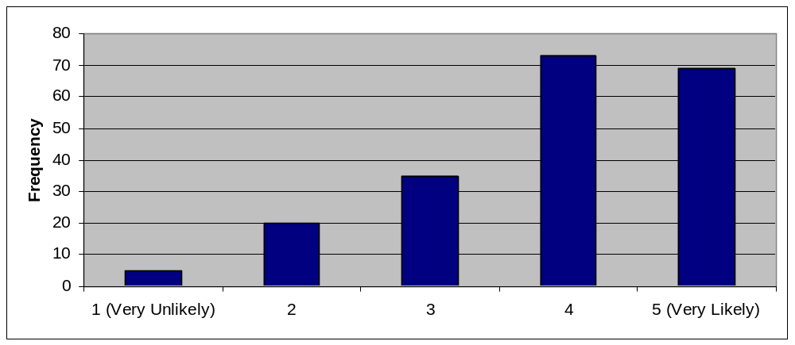
Course Scheduling
Draft Schedule
How likely is it that students would give feedback on the draft schedules if the department were to listen to their input?

Slide 19
Course Scheduling
General Comments and Suggestions
“It isn't perfect, but it can never be perfect. Right now is as good as it gets.”
“Thank the Lord you guys don't schedule our required EECS classes before 11. Thank you. Thank you.”

Slide 20
Course Scheduling
General Comments and Suggestions
Some suggestions include:
  Scheduling classes that aren’t offered every semester in the proper order (i.e. CS 172 & CS 174)
  Listening to feedback from students on the initial schedule
  Solving the problem of conflicting EECS courses

Slide 21
Professor Interaction
Students think that professors and GSI’s explain things clearly and at a good pace.
Most students know when their professors’ office hours are
They feel comfortable going to office hours
Most students feel comfortable talking to their professors about academic subjects

Slide 22
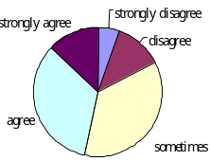
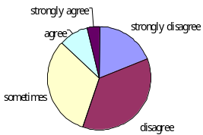
Professor Interaction
Academic
Non-Academic
Many students feel that it can be hard to talk to professors about topics outside of class. Professors can take the initiative to start a conversation first.

Slide 23
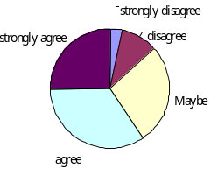
Professor Interaction
Mentor Program
Many People Feel that a mentoring program is beneficial.
This can strength the relationship between students and professors.
At the same time, students may feel more comfortable talking to the professor as their mentor about non-academic subjects.

Slide 24
EECS Research
89% are interested in doing research
About two-thirds of respondents are aware of URO and URAP, but 64% of them feel there are not enough positions available
45.5% feel that the research topics listed there are not relevant to their future plans

Slide 25
EECS Research
93% of students would like to have more research opportunities made available
86% of students would like to have industry related research during their time at Cal

Slide 26
Questions?
Representatives
  Ming-Hay Luk, Wei Hua Peng, Suhaas Prasad, John Torous, Katrina Yim
  deprel@hkn.eecs.berkeley.edu

