Slide 1

Faculty Retreat Presentation
University of California, Berkeley
EECS Undergraduate Student Groups
Thursday, May 1st, 2008
Presented by the EECS Undergraduate Student Groups

Slide 2
The Survey
222 responses from EECS Undergraduates
  21.3% Freshmen
  31.7% Sophomores
  27.1% Juniors
  19.9% Seniors
Approximately 20% of EECS Undergraduates responded to the survey

Slide 3
Overview
Lower Division Overhaul
Course Scheduling
EECS Research
Miscellaneous

Slide 4
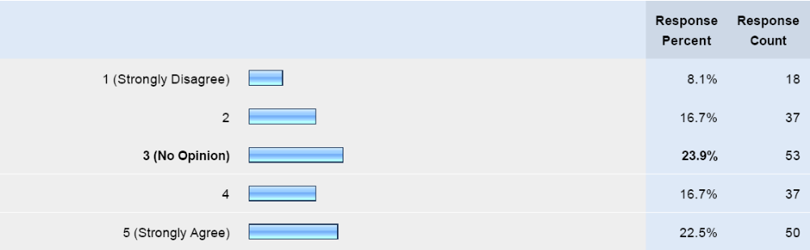
Lower Division EECS
Do you agree that CS61B should no longer be a prerequisite for CS61C?

Slide 5
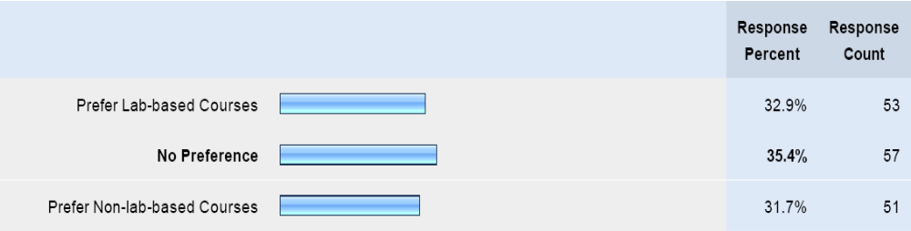
Lower Division EECS
If you have taken a lab-based lower division EECS course, how would you compare it with a normal course?

Slide 6
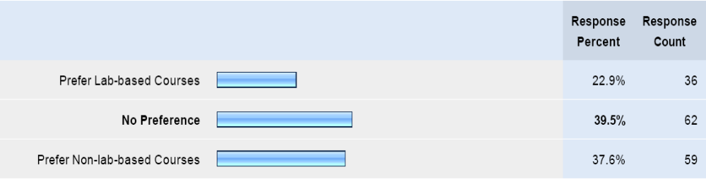
Lower Division EECS
If you have not taken a lab-based course, what is your opinion on lab-based courses?

Slide 7
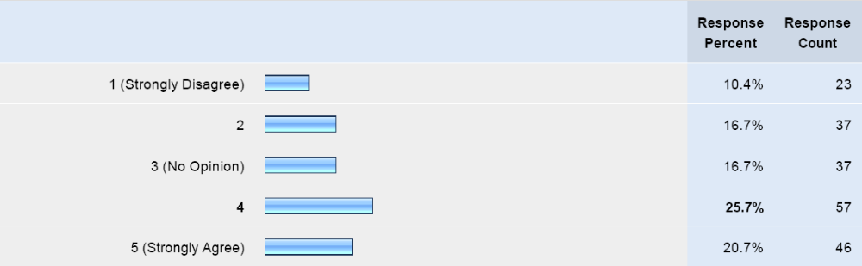
Lower Division EECS
Do you think EE20N should be more application driven with more hands-on work?

Slide 8
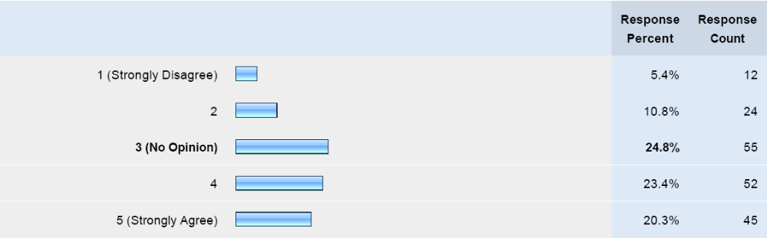
Lower Division EECS
Do you think that EE40 should be more application driven with more hands-on work?

Slide 9
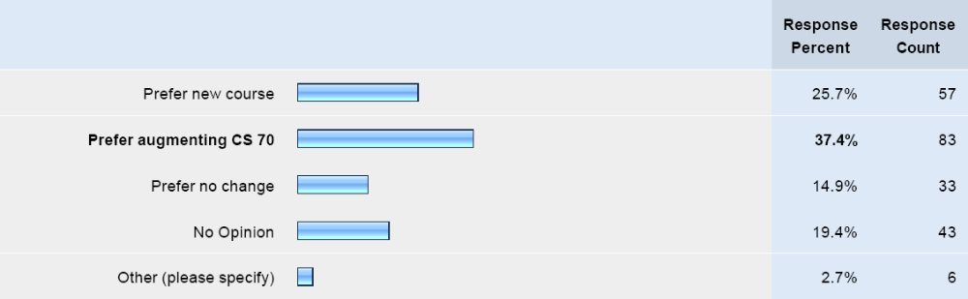
Lower Division EECS
The department is considering providing exposure to probability in either a new lower division random systems course or by augmenting CS 70. What do you prefer?

Slide 10
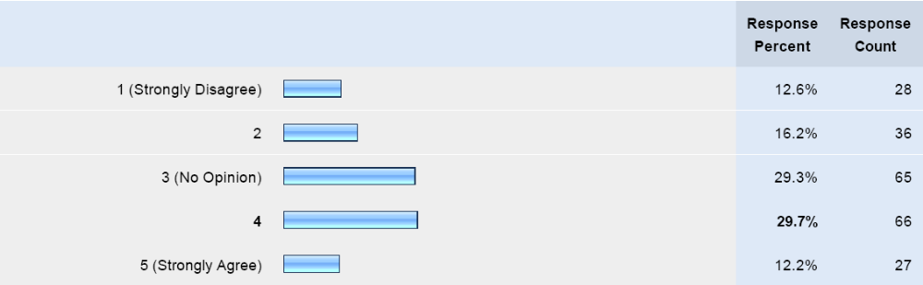
Lower Division EECS
Do you think that a new lower division course on physical electronics, which would cover device physics, should be offered?

Slide 11
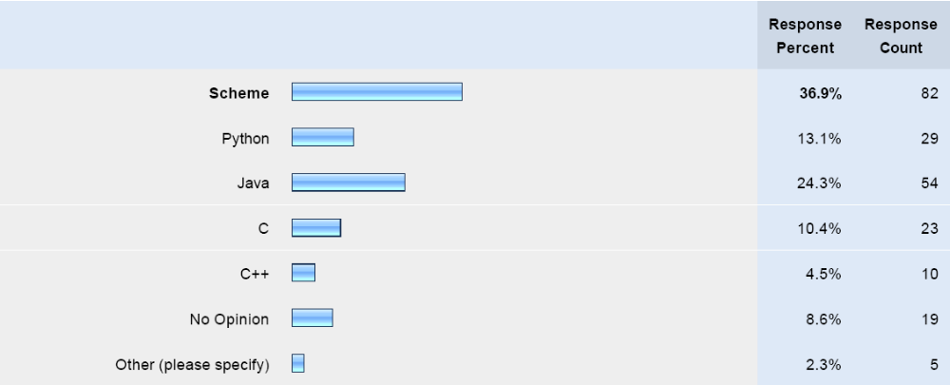
Lower Division EECS
In terms of educational value, what programming language do you think students should learn first?

Slide 12
Lower Division EECS
Suggestions include:
  Removing redundant material that appears in multiple courses
    EE40 & Physics 7B
    EE20 & EE120
  Offering a seminar to introduce freshmen to EECS courses, industry, and useful information (e.g. how to use UNIX and bash)

Slide 13
Lower Division EECS
Suggestions include:
  Improving EE20 and EE40:
    “The CS courses are structured very nicely to give a good idea of what the upper divs are in CS. It is not the same case with EE lower divs.”
    “EE20 and EE40 seem to turn many people away from EE. I think it would be beneficial to improve these courses.”
    “More hands on work in EE20 that teaches applications of what is learned”
    “Better lab materials in EE40 is needed”
  “Some lower division courses work well as lab based courses (e.g. CS61B) while some would work very poorly as lab based (e.g. CS61C)”

Slide 14
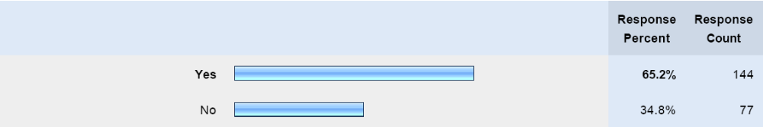
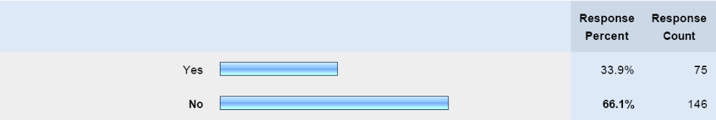
Course Scheduling
Are you aware that the department posts draft EE and CS schedules for the next year early on in spring semester?
Have you had any problems with course scheduling for EECS courses this semester?

Slide 15
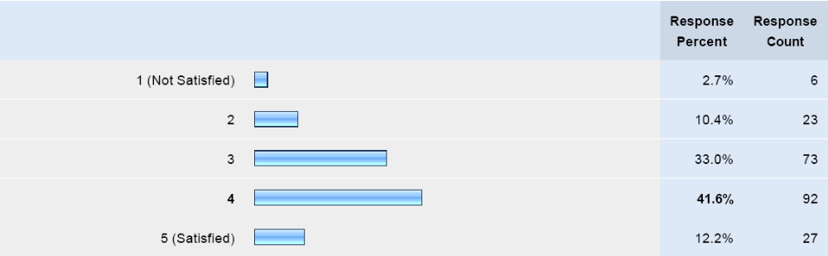
Course Scheduling
Are you satisfied with the times (e.g. TuTh 11-12:30) when EECS courses are held?

Slide 16
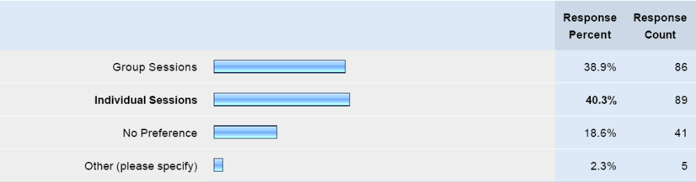
Course Scheduling
Do you prefer to have group or individual advising sessions when meeting with your advisor to choose your next semester’s courses?

Slide 17
Course Scheduling
General Comments and Suggestions
“I think that courses in the EECS department are much better schelduled than courses in other departments.”
“Too many classes on Tuesday and Thursday.”
“Schedule changes occur too frequently, causing frustrating conflicts.”

Slide 18
Course Scheduling
General Comments and Suggestions
Some suggestions include:
  Having more courses on MW or MWF with hour long lectures to avoid conflicts and morning classes
  Getting to feedback from students on the initial schedule
  Avoiding early and late timings (e.g. 5:30-7)

Slide 19
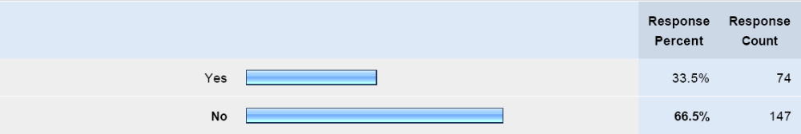
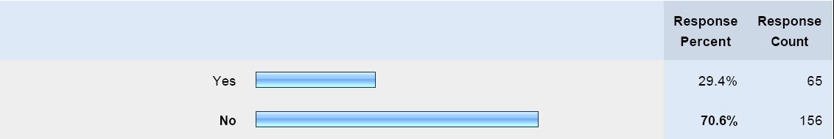
EECS Research
Are you doing or have you done research in UC Berkeley?
Are you doing or have you done research in the EECS department?

Slide 20
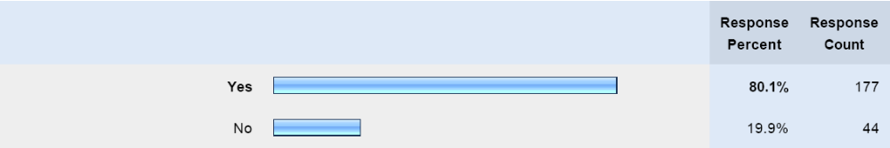
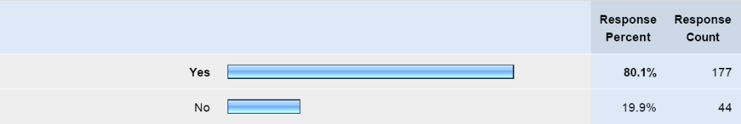
EECS Research
If you have not done EECS research, do you want to?
Are you aware of the URO and URAP programs for research opportunities?

Slide 21
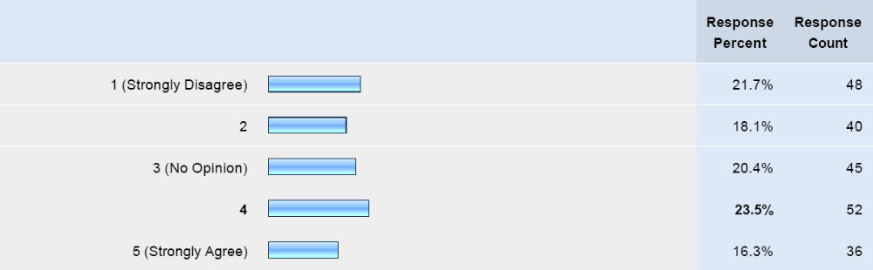
EECS Research
Do you think there should be a research requirement (e.g. 2 units) included in the required 45 engineering units for undergraduate EECS students?

Slide 22
EECS Research
If you would like to do EECS research but aren’t, why not?
“Hard to find a professor to talk to; not many resources available to find research”
“Many professors have the attitude that undergraduates aren't capable of research and their research group is entirely comprised of graduate students.”
“Not sure where/how to look for research for undergraduates.”

Slide 23
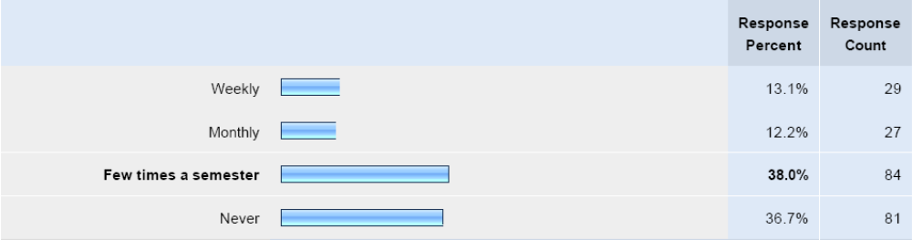
Miscellaneous
How often do you go to your professors’ office hours?

Slide 24
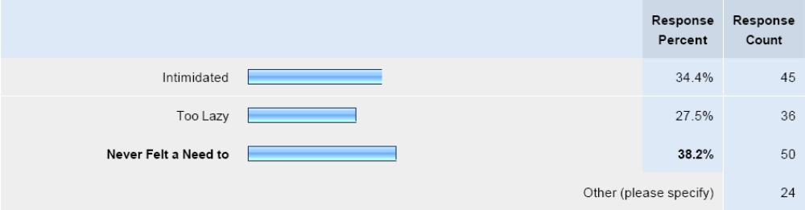
Miscellaneous
If you’ve never gone to an EECS professors’ office hours, why not?
Other reasons:
  Time conflicts
  Prefer GSI’s office hours

Slide 25
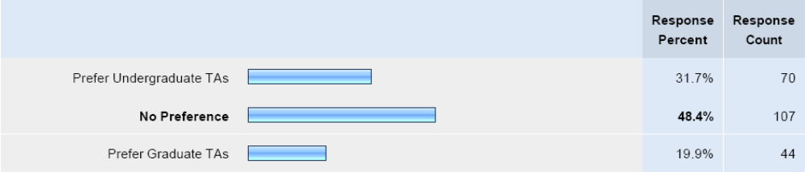
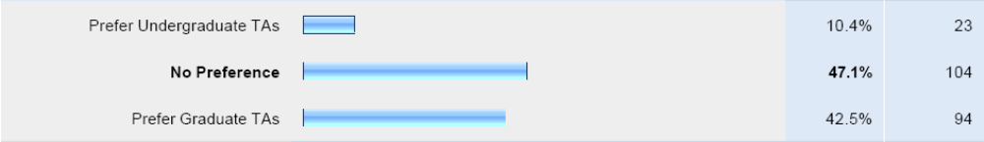
Miscellaneous
For lower division courses, do you prefer undergraduate TAs or graduate TAs?
For upper division courses, do you prefer undergraduate TAs or graduate TAs?

Slide 26
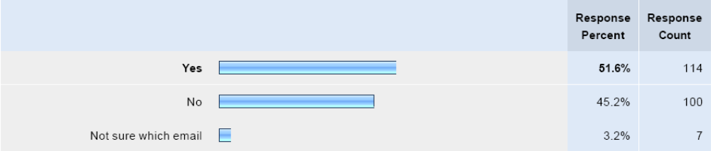
Miscellaneous
Do you generally read the EECS undergraduate announcements email?

Slide 27
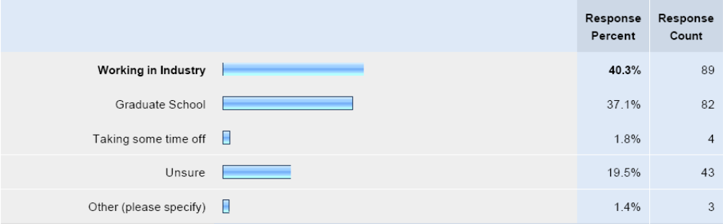
Miscellaneous
What are your plans for what you’ll be doing after you graduate?

Slide 28
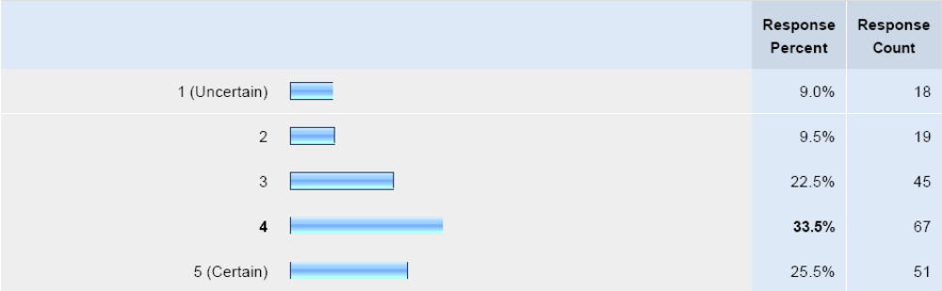
Miscellaneous
How certain are you about your plans for after you graduate?

Slide 29
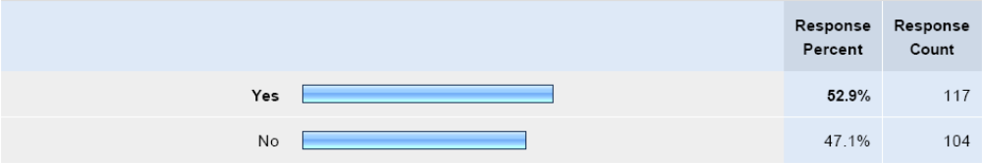
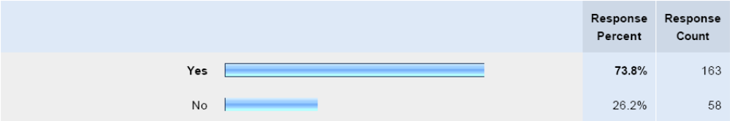
Miscellaneous
Are you aware of Peer Advising Sessions?
Are you aware of the EECS Honors Degree Program?

Slide 30
General Suggestions & Comments
Make accommodations for transfer students (e.g. extra semester or more lenient credit transfers)
TAs should be interviewed because GPA doesn’t equate to good teaching skills
Undergraduate TAs are better for project classes since the project experience is useful, while graduate TAs are more helpful for theory classes where deeper understanding of material is useful

Slide 31
Questions?
Contact
  Suhaas Prasad: deprel@hkn.eecs.berkeley.edu
  CSUA: politburo@csua.berkeley.edu

