Slide 1
Lesson 4
液壓機械臂
Hydraulic Robotic Arm
S2 Little Makers Class - Unit 2: Advanced Hands-on STEAM

Slide 2
物資表 Materials List
針筒（10 毫升，不連針頭） Syringes (10 mL, without needles) × 4 支
透明膠喉（約 50 厘米） Plastic tubing (approx. 50 cm) × 2 條
紙皮／卡紙 Cardboard × 2 塊
熱熔膠槍及膠條（全班共用） Glue guns and glue sticks (shared) × 每班 4–5 把
膠紙 Adhesive tape × 1 卷
波子及目標杯 Marbles and target cup × 5 粒＋1 隻杯
水、杯、紙巾 Water, cups, paper towels × 1 套
工作紙 Worksheet × 每人 1 張

Slide 3
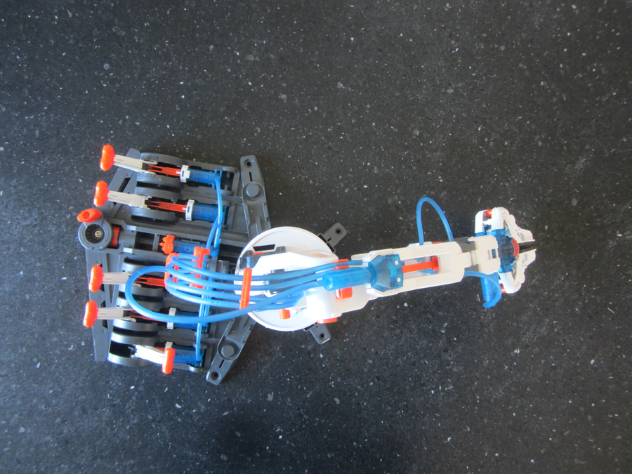

Slide 4
課堂目標
Lesson Objectives
• 說出帕斯卡原理，並解釋液壓傳動的運作方式 State Pascal's principle and explain hydraulic transmission
• 製作液壓機械臂，限時夾起最少三粒波子 Build a hydraulic arm; pick up at least 3 marbles in the time limit
• 舉出兩個液壓技術的現實應用 Give two real-life applications of hydraulics

Slide 5
帕斯卡原理
Pascal's Principle
• 施加於密閉容器內靜止液體的壓力，會以相同大小傳遞到液體每一部分 Pressure applied to an enclosed fluid is transmitted undiminished to every part
• 液體近乎不可壓縮 —— 這是液壓傳動的關鍵 Liquids are virtually incompressible — the key to hydraulic transmission
• 推動一端 → 壓力經液體即時傳到另一端 → 推動活塞 Push one end → pressure travels through the liquid → pushes the far piston

Slide 6
力的放大
Force Multiplication
• 壓力 P ＝ 力 F ÷ 面積 A；兩邊壓力相等：F₁/A₁ ＝ F₂/A₂ P = F/A; equal pressure both sides: F₁/A₁ = F₂/A₂
• 數字例子：小針筒 1 cm² 推 6 N → 大針筒 4 cm² 得 24 N（4 倍） Example: 1 cm² pushed with 6 N → 4 cm² gives 24 N (4×)
• 代價：體積守恆（A₁d₁ ＝ A₂d₂），大針筒行程只有 1/4 Trade-off: volume conserved, so the large syringe travels only 1/4 of the distance

Slide 7
液壓系統三要素
Three Elements of a Hydraulic System
• 密閉液體（用水）：不可壓縮，傳遞壓力 Enclosed liquid (water): incompressible, transmits pressure
• 壓力傳遞：推一端，即時到另一端 Pressure transmission: instant from one end to the other
• 活塞面積：面積差決定力量放大或縮小 Piston area: area difference sets force multiplication

Slide 8
現實應用
Real-life Applications
• 液壓挖土機：控制桿小動作 → 液壓油放大 → 推動沉重挖臂 Excavator: small lever movements amplified to drive the heavy arm
• 汽車制動：腳踏力經煞車油傳到四個車輪 Car brakes: pedal force transmitted by brake fluid to all four wheels
• 液壓千斤頂：小力抬起汽車 Hydraulic jack: a small force lifts a car

Slide 9
製作步驟
Construction Steps
• 按設計圖組裝：底座、臂身、液壓夾 Assemble: base, arm, hydraulic gripper
• 接駁水管必須穩固；注水時針筒垂直向上，慢慢推走氣泡 Secure tubing joints; hold syringes vertically and expel air slowly
• 測試開合：緩慢、穩定地推拉 —— 不是愈大力愈好 Test: push and pull slowly and steadily

Slide 10
夾波子比賽規則
Marble-pickup Competition Rules
• 每組限時 2 分鐘 2 minutes per group
• 夾起波子放進目標容器，按準確數目計分 Pick up marbles into the target cup; score by number
• 成功關鍵：穩定緩慢的操作 Key: slow, steady operation

Slide 11
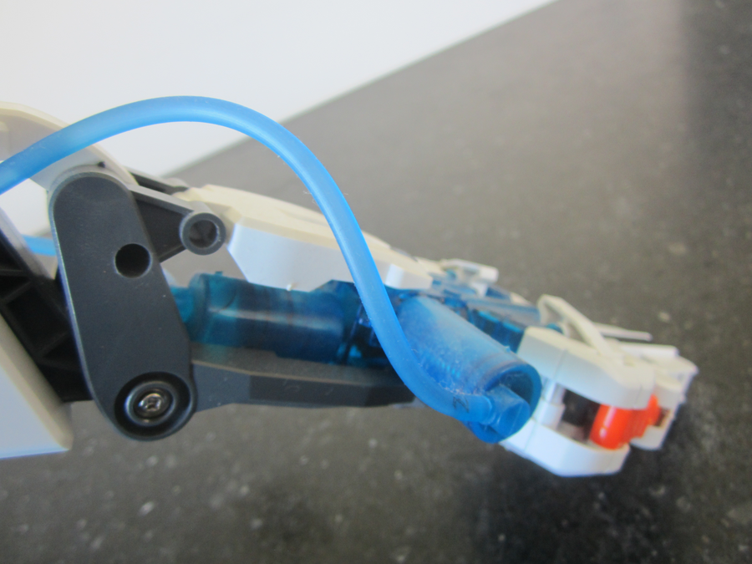

Slide 12
安全須知
Safety Notes
• 針筒不連針頭；不可嬉戲或指向他人 Syringes without needles; no playing around
• 漏水即時抹乾，保持地面及電源範圍乾爽 Wipe up leaks immediately
• 熱熔膠槍只准在教師指導下使用 Glue gun only under teacher supervision

Slide 13
總結與反思
Summary and Reflection
• 帕斯卡原理：密閉液體壓力均勻傳遞 Pascal's principle: undiminished pressure transmission
• 面積差放大力量，行程相應縮短 Force multiplied by area difference; travel shortened
• 關愛反思：液壓省力裝置如何幫助手部乏力的長者？ Caring reflection: how can hydraulic aids help elderly people with weak hands?

