Slide 1
創科班 S1 Unit 1｜第 1 堂
歡迎來到創科班：工程師思維
Welcome to the Little Makers Class: Thinking Like an Engineer
全年主題：正能量——用創科關愛弱勢社群
Year theme: Positive Energy — Using Innovation and Technology to Care for Disadvantaged Groups

Slide 2
物資表 Materials List
A4 白紙 A4 paper × 10 張 10 sheets
皺紋膠紙 Masking tape × 1 卷 1 roll
一元硬幣（測試用） $1 coins (for load test) × 20 枚 20 coins
直尺（30 厘米） Ruler (30 cm) × 1 把 1 each
剪刀 Scissors × 1 把 1 each
計時器 Timer × 全班 1 個 1 per class
工作紙 Worksheet × 每人 1 張 1 per student

Slide 3
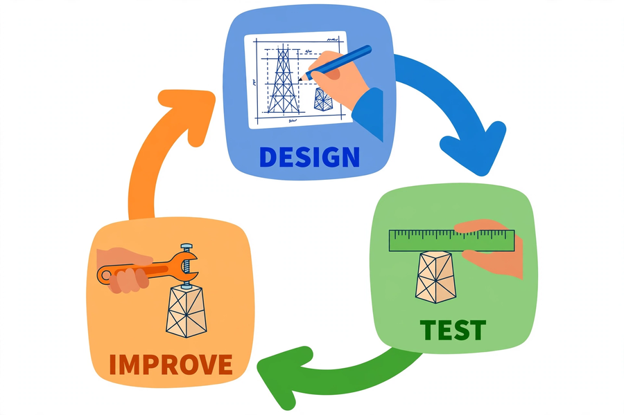
工程循環 The Engineering Cycle

Slide 4
工程師做甚麼？
What do engineers do?
● 把意念變成有用的東西：橋樑、大廈、手機、輪椅
Turn ideas into useful things: bridges, buildings, phones, wheelchairs
● 遇到難題不靠空想，用可靠的方法解決問題
Solve problems with a reliable method, not daydreaming
● 工程師的方法：先設計 → 再測試 → 最後改良
The engineer's method: design → test → improve

Slide 5
工程循環
The engineering cycle
● ① 設計 Design：想出辦法，繪畫草圖，先想後做
Think of solutions, draw a sketch — think before you build
● ② 測試 Test：動手試做，用統一方法量度並記錄
Build it, measure with a consistent method, record the data
● ③ 改良 Improve：找出弱點，針對修正，再測試一次
Find weaknesses, fix them, and test again
▶ 失敗不是終點，而是改良的起點 / Failure is not the end — it is the starting point of improvement

Slide 6
紙塔挑戰：規則
Paper Tower Challenge: rules
● 四至五人一組；物料：A4 紙 10 張、皺紋膠紙 1 卷、剪刀、直尺
Groups of 4–5; materials: 10 sheets of A4 paper, 1 roll of masking tape, scissors, ruler
● 先繪畫設計草圖，才可動手；限時建造
Draw a design sketch first; build within the time limit
● 紙塔必須能獨立站立
The tower must stand on its own
● 評分：高度（厘米）＋ 承重（硬幣數目）
Scoring: height (cm) + load (number of coins)

Slide 7
結構小知識：怎樣才站得穩？
A little about structures
● 底座愈闊，站得愈穩（重心不易超出底座）
The wider the base, the more stable (centre of gravity stays within the base)
● 三角形是最穩固的形狀：三邊固定，形狀不變
The triangle is the most rigid shape: fixed sides mean a fixed shape
● 把紙捲成紙筒／摺成三角形，可增加強度
Roll paper into tubes or fold into triangles for extra strength
▶ 提示：結構設計比物料多寡更重要 / Hint: structural design matters more than the amount of material

Slide 8
量度與記錄
Measuring and recording
● 高度：直尺垂直放桌上，由桌面量至塔頂（厘米）
Height: ruler vertical on the desk, desk surface to tower top (cm)
● 承重：硬幣逐枚輕放塔頂，直至倒塌，記錄數目
Load: place coins one by one on top until collapse; record the number
● 每輪測試後立即記錄，兩輪數據都要齊全
Record immediately after each round; both rounds must be complete

Slide 9
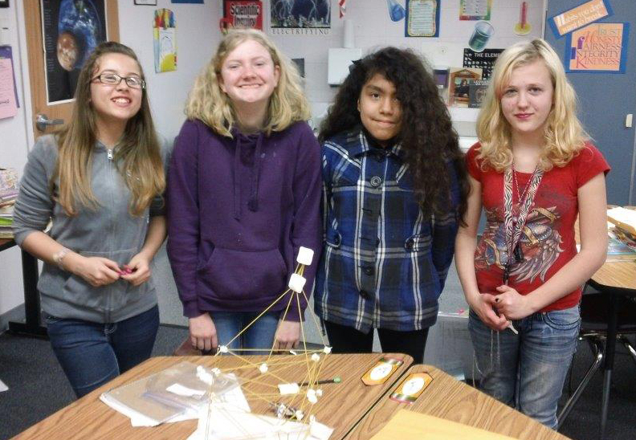
團隊合作三要素
Three keys to teamwork
● 分工：每人負責一項工作
Division of labour: each person takes one job
● 溝通：有想法、有困難都要說出來
Communication: speak up with ideas and difficulties
● 互相聆聽：聽完別人才發表意見
Listen: hear others out before giving your view

Slide 10
第一輪建造（20 分鐘）
Round 1 building (20 minutes)
● 按照草圖分工建造
Build according to your sketch, with assigned roles
● 建造時思考：底座夠不夠闊？結構夠不夠穩？
While building, ask: is the base wide enough? Is the structure stable?
● 時間由老師嚴格控制
Time is kept strictly by the teacher
▶ 先畫草圖，後動手 / Sketch first, build afterwards

Slide 11
改良：針對弱點，不是重做
Improve: fix weaknesses, not redo
● 分析第一輪的問題出在哪裡
Analyse where Round 1 went wrong
● 提出針對弱點的改良方案
Propose improvements targeting the weaknesses
● 在原有紙塔上修正，再測試一次
Fix the existing tower, then test again

Slide 12
總結＋課業
Summary and assignment
● 工程循環：設計 → 測試 → 改良；失敗是改良的起點
Engineering cycle: design → test → improve; failure is the starting point of improvement
● 穩固＝闊底座＋三角形支撐；測試要記錄數據
Stable = wide base + triangular bracing; record test data
● 課業：完成「紙塔挑戰反思工作紙」
Assignment: complete the "Paper Tower Challenge Reflection Worksheet"
● (1) 描述三個步驟 (2) 填寫兩輪數據 (3) 改良前後對比（不少於五十字）
(1) Describe the three steps (2) Fill in both rounds of data (3) Before-and-after comparison (≥50 Chinese characters)

