Slide 1
創科班 S1 Unit 1｜第 2 堂
設計思維五步：為同學設計理想筆袋
The Five Steps of Design Thinking: Designing an Ideal Pencil Case for a Classmate
好的設計，由了解用家的需要開始
Good design starts from understanding the user's needs

Slide 2
物資表 Materials List
訪問記錄工作紙 Interview record worksheet × 每人 1 張 1 per student
A4 卡紙（不同顏色） A4 card stock (assorted colours) × 每人 2–3 張 2–3 per student
皺紋膠紙 Masking tape × 每組 1 卷 1 roll per group
剪刀 Scissors × 每組 2 把 2 per group
顏色筆 Colour pens × 每組 1 盒 1 box per group
雙面膠紙 Double-sided tape × 每組 1 卷 1 roll per group

Slide 3
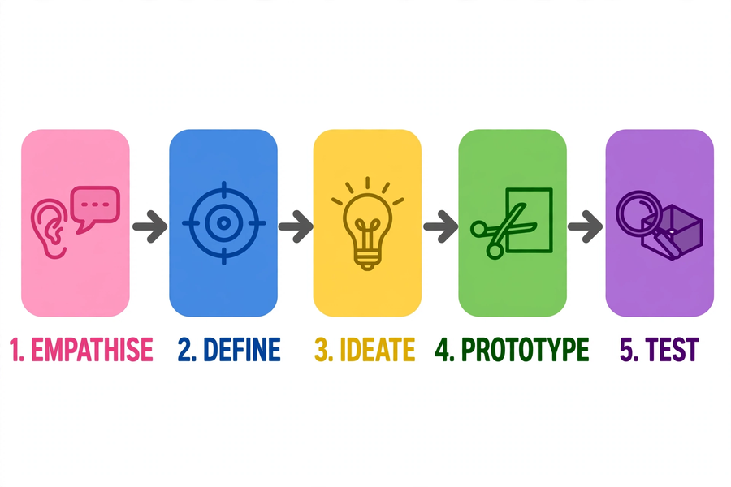
設計思維五步 Five Steps of Design Thinking

Slide 4
想一想：不好用的設計
Think: poorly designed objects
● 日常生活中，你遇過哪些「不好用」的設計？
What poorly designed everyday objects have you come across?
● 例如：常常卡住的拉鏈、拿不穩的水樽
E.g. a zip that always gets stuck, a bottle that is hard to grip
● 它忽略了用家的甚麼需要？
Which user need did it overlook?
● 舉手分享你的例子
Raise your hand and share your example

Slide 5
甚麼是設計思維？
What is design thinking?
● 一套以「用家」為中心的設計方法
A user-centred method for designing
● 五個步驟：同理心 → 定義問題 → 構思 → 原型 → 測試
Five steps: empathise → define → ideate → prototype → test
● 不是一次做對，而是不斷循環改良
Not getting it right at once, but looping and improving

Slide 6
步驟 1＋2：同理心、定義問題
Steps 1–2: empathise, define
● 同理心：觀察＋聆聽，了解用家的真正需要，不憑空假設
Empathise: observe and listen to learn the user's real needs — no assumptions
● 定義問題：歸納成一句「需要陳述」
Define: summarise into one "need statement"
● 公式：需要，因為
Formula: [user] needs [what], because [reason]
▶ 例子：「小文需要一個能同時放十支筆和計算機的筆袋，因為他的筆袋常常爆開。」 / E.g. "Man needs a pencil case that holds ten pens and a calculator, because his pencil case often bursts open."

Slide 7
訪問小貼士
Interview tips
● 多用開放式問題，少用是非題
Use open-ended questions more, yes/no questions less
● ✗ 不好：「你喜歡大筆袋嗎？」
✗ Poor: "Do you like big pencil cases?"
● ✓ 好：「你平時帶多少支筆回校？為甚麼？」
✓ Good: "How many pens do you usually bring to school? Why?"
● 多追問「為甚麼」；記下對方的原話
Keep asking "why"; note the interviewee's own words

Slide 8
步驟 3：構思
Step 3: ideate
● 想出愈多主意愈好，先求數量
Come up with as many ideas as possible — quantity first
● 不作批評：先畫出來，再選最好的
No criticism yet: draw everything out, then choose the best
● 畫二至三個設計草圖
Draw two to three design sketches

Slide 9
步驟 4：原型
Step 4: prototype
● 用卡紙等便宜物料，快速做出可測試的模型
Build a testable model quickly with cheap materials like card stock
● 求快不求美：重點是測試意念，不用裝飾外觀
Speed over beauty: the point is testing ideas, not decorating
● 原型不是成品，粗糙一點沒有關係
A prototype is not a finished product — rough is fine

Slide 10
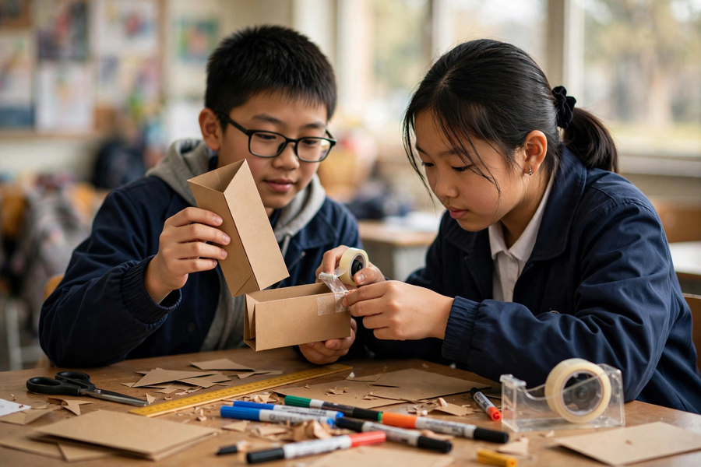
步驟 5：測試與回饋
Step 5: test and feedback
● 把原型交給用家試用，收集意見
Let the user try the prototype and collect comments
● 給回饋：先說喜歡之處，再提改善建議
Giving feedback: first say what you like, then suggest improvements
● 回饋要具體；回饋是改良的養分
Be specific; feedback nourishes improvement

Slide 11
本課任務
Today's task
● 兩人一組，輪流訪問對方（各 5 分鐘）
Work in pairs; interview each other (5 minutes each)
● 寫出需要陳述，畫二至三個草圖
Write the need statement; draw 2–3 sketches
● 用卡紙製作「理想筆袋」紙樣原型
Build the "ideal pencil case" paper prototype from card stock
● 向同伴展示原型，收集並記錄回饋
Present the prototype to your partner; collect and record feedback
▶ 嚴格計時：訪問環節最容易超時 / Keep strict time: the interview stage tends to overrun

Slide 12
總結＋課業
Summary and assignment
● 五步：同理心 → 定義問題 → 構思 → 原型 → 測試
Five steps: empathise → define → ideate → prototype → test
● 好設計由用家需要出發；原型用來測試意念
Good design starts from user needs; prototypes test ideas
● 課業：完成「理想筆袋設計記錄表」
Assignment: complete the "Ideal Pencil Case Design Record Sheet"
● 整理訪問記錄＋需要陳述＋用家回饋＋下次改良（不少於五十字）
Organise interview records + need statement + user feedback + next improvement (≥50 Chinese characters)

