Slide 1
創科班 S1 Unit 1｜第 3 堂
認識關愛：弱勢社群的生活體驗
Understanding Care: Experiencing the Lives of Disadvantaged Groups
全年主題：正能量——用創科關愛弱勢社群
Year theme: Positive Energy — Using Innovation and Technology to Care for Disadvantaged Groups

Slide 2
物資表 Materials List
眼罩 Blindfolds × 每組 2–3 個 2–3 per group
輪椅 Wheelchair × 全班 1–2 部（向學校借用） 1–2 per class (borrowed from the school)
觀察記錄工作紙 Observation record worksheet × 每人 1 張 1 per student
急救箱 First-aid kit × 全班 1 個（由教師攜帶） 1 per class (carried by the teacher)

Slide 3

視障人士 Visually Impaired Persons

Slide 4
甚麼是弱勢社群？
What are disadvantaged groups?
● 在生活中遇到較多困難、需要社會關懷的人士
People who face more difficulties in life and need care from society
● 他們的困難不是他們的錯，而是環境和設計沒有照顧他們
Their difficulties are not their fault — the environment and its designs have not catered for them
● 創科可以幫忙：這正是我們全年要做的事
Innovation and technology can help: that is what we will do this year

Slide 5
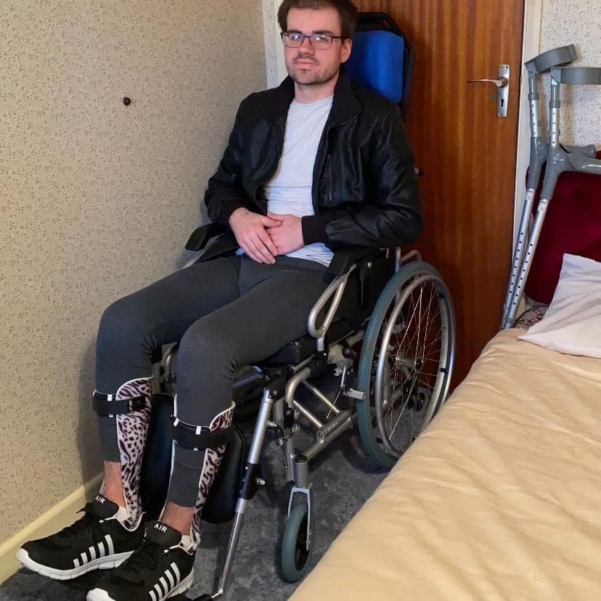
三類弱勢社群的生活挑戰
Life challenges of three groups
● 視障人士：過馬路難判斷車輛位置、上落樓梯易踏空
Visually impaired: hard to judge vehicles when crossing roads; may miss steps on stairs
● 輪椅使用者：門檻阻擋、斜道不足或太斜、通道狹窄難轉彎
Wheelchair users: blocked by thresholds; missing or steep ramps; narrow passages
● 長者：看不清細字、聽不清廣播、提重物吃力
Elderly: cannot read small print, hear announcements, or carry heavy things easily

Slide 6
體驗活動：蒙眼／輪椅
Experiential activity: blindfold / wheelchair
● 蒙眼行走：在同伴陪伴下，於指定路段行走
Blindfold walk: walk the designated route accompanied by a partner
● 輪椅體驗：乘坐輪椅，由他人從旁協助推動
Wheelchair experience: ride in a wheelchair pushed with assistance alongside
● 每人約五至八分鐘；另一位同學陪伴並觀察
About 5–8 minutes each; a partner accompanies and observes
● 目的：親身感受不便，培養同理心
Purpose: feel the inconvenience first-hand and build empathy

Slide 7
⚠ 安全守則（必須遵守）
Safety rules (must be followed)
● 全程跟隨教師指示，只在指定平坦路段活動
Follow the teacher's instructions; stay on the designated flat route
● 蒙眼須有同伴陪伴；頭暈不適立即除下眼罩舉手
A partner must accompany you when blindfolded; remove it and raise your hand if dizzy
● 輪椅必須有人從旁協助推動，不可自行高速推動
The wheelchair must be assisted alongside — never propel it fast alone
● 這是嚴肅的學習活動，不是遊戲
This is a serious learning activity, not a game

Slide 8
同理心：體驗只是起點
Empathy: the experience is only a starting point
● 親身體驗比單憑想像更真實
First-hand experience is more real than imagination alone
● 但短暫體驗 ≠ 完全明白
But a brief experience ≠ full understanding
● 真正的了解，需要長期接觸和聆聽
Real understanding needs long-term contact and listening
● 體驗的價值：開始留意平時忽略的細節
The value: starting to notice details we usually overlook

Slide 9
觀察與記錄的方法
How to observe and record
● 用具體文字，不用空泛形容詞
Use concrete words, not vague adjectives
● ✗ 空泛：「好驚」「好辛苦」
✗ Vague: "so scary", "so hard"
● ✓ 具體：「蒙眼聽到腳步聲會緊張得停下來」
✓ Concrete: "Hearing footsteps while blindfolded made me stop nervously"
● 可分三方面：身體感覺、聽到／摸到的細節、情緒變化
Cover three aspects: physical sensations, details heard/touched, feelings

Slide 10
小組討論
Group discussion
● 分享你的三項觀察或感受
Share your three observations or feelings
● 專心聆聽組員的分享
Listen attentively to your group members
● 引導問題：最困難的是甚麼？你留意到甚麼平時忽略的細節？
Guiding questions: What was the most difficult part? What details did you notice that you usually overlook?
● 填寫「關愛體驗觀察記錄表」
Complete the "Caring Experience Observation Record"

Slide 11
全年主題＋個人承諾
Year theme and personal pledge
● 正能量——用創科關愛弱勢社群
Positive Energy — Using Innovation and Technology to Care for Disadvantaged Groups
● 意思：用創意和科技，為有需要的人帶來正能量，改善生活
Meaning: use creativity and technology to bring positive energy to people in need and improve lives
● 寫下你的一句承諾，例如：「我想為長者設計＿＿。」
Write your personal pledge, e.g. "I would like to design __ for elderly people."

Slide 12
總結＋課業
Summary and assignment
● 認識三類弱勢社群及其生活挑戰
Know three disadvantaged groups and their life challenges
● 安全第一；體驗只是同理心的起點
Safety first; the experience is only the start of empathy
● 課業：完成「關愛體驗觀察記錄表」
Assignment: complete the "Caring Experience Observation Record"
● 三項觀察＋組員分享＋全年主題意思（不少於八十字）
Three observations + group sharing + meaning of the theme (≥80 Chinese characters)

