Slide 1
第 5 堂
能量轉換——橡筋動力車
Energy Conversion — Rubber-band Powered Car
聖公會呂明才中學 創科班
單元二：動手做 STEAM Unit 2: Hands-on STEAM

Slide 2
物資表 Materials List
小紙盒 Small cardboard box × 每組 1 個 1 per group
橡筋 Rubber bands × 每組 5 條 5 per group
竹籤／飲管 Bamboo skewers / straws × 每組 4 支 4 per group
瓶蓋（車輪） Bottle caps (wheels) × 每組 4 個 4 per group
膠紙、剪刀 Tape, scissors × 課室現有 Available in classroom
捲尺 Measuring tape × 每組 1 個 1 per group
粉筆／膠紙（起跑線） Chalk / tape (start line) × 全班共用 Shared by class

Slide 3
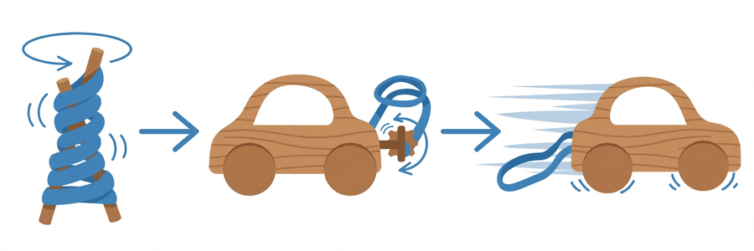
能量轉換：由扭緊到前進｜Energy Conversion: Twisting to Moving

Slide 4
學習目標
Learning Objectives
▸ 製作一部能靠橡筋動力前進的車輛
Build a car that moves on rubber-band power
▸ 以「橡筋扭轉圈數」為變量，記錄行走距離
Record travel distance using twists as the variable
▸ 解釋彈性勢能轉化為動能的過程
Explain how elastic potential energy becomes kinetic energy
▸ 說出公平測試須控制的變量
Name the variables to control in a fair test

Slide 5
引入：能量去了哪裡？
Where Does the Energy Go?
▸ 老師拉動橡筋再鬆手 —— 「啪！」
The teacher stretches a rubber band and lets go — "snap!"
▸ 你的手做了功，能量去了哪裡？
Your hand did work — where did the energy go?
▸ 今天我們把這份能量裝上車輪！
Today we put that energy onto wheels!

Slide 6
彈性勢能 → 動能
Elastic Potential Energy → Kinetic Energy
▸ 扭緊橡筋：手做功 → 儲存彈性勢能
Twist the band: hand does work → elastic potential energy stored
▸ 鬆手釋放：彈性勢能 → 車輪轉動的動能 → 車前進
Release: elastic potential energy → kinetic energy of wheels → car moves
▸ 車停下：部分能量因摩擦變成熱散失
Car stops: some energy lost as heat through friction
▸ 能量不會消失，只會轉換形式
Energy never disappears, only changes form

Slide 7
摩擦力：朋友還是敵人？
Friction: Friend or Foe?
▸ 適當摩擦 → 車輪抓地前進
Proper friction → wheels grip and drive forward
▸ 摩擦太大 → 車走不遠
Too much friction → short run
▸ 橡筋扭太多 → 車軸打滑 → 浪費能量
Over-twisted band → axle slips → energy wasted
▸ 車輪要對齊，否則偏離跑道
Wheels must be aligned or the car veers off

Slide 8
公平測試
Fair Test
▸ 改變：橡筋扭轉圈數
Change: number of twists
▸ 不變：同一跑道、同一條起跑線、同一條橡筋
Keep same: track, starting line, rubber band
▸ 量度：行走距離（米）
Measure: travel distance (m)
▸ 比賽時每組圈數相同，先公平，後比較！
Same twists for every group in the race — fair first, then compare!

Slide 9
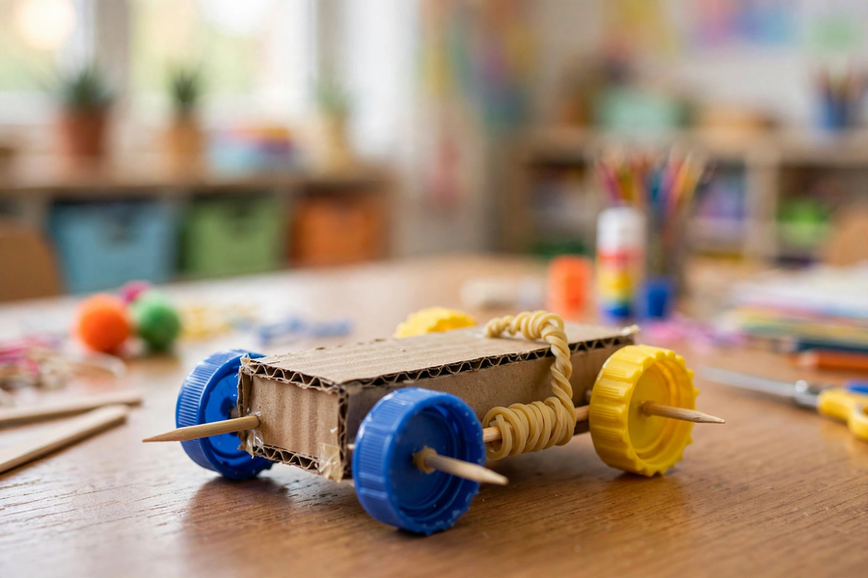
製作要點
Making Tips
▸ 車身：小紙盒；車軸：竹籤／飲管（要轉得動）
Body: small box; axles: skewers/straws (must spin freely)
▸ 車輪：四個瓶蓋，左右對齊
Wheels: four bottle caps, aligned left–right
▸ 橡筋一端固定車頭，另一端繞在後軸上
Fix band to the front, wind the other end round the rear axle
▸ 扭緊後軸儲能 → 鬆手 → 出發！
Twist the rear axle to store energy → release → go!
⚠ 橡筋不可對人彈射；竹籤尖銳，小心使用

Slide 10
數據記錄表示例
Sample Data Table
▸ 10 圈 → 1.5 米（車身有點歪）
10 twists → 1.5 m (body slightly crooked)
▸ 20 圈 → 3.2 米
20 twists → 3.2 m
▸ 30 圈 → 4.6 米（後輪輕微打滑）
30 twists → 4.6 m (rear wheels slipped slightly)
▸ 發現：圈數愈多，走得愈遠（但打滑會浪費能量）
Finding: more twists → further run (but slipping wastes energy)

Slide 11
測試與競速
Testing and Racing
▸ 每組最少記錄三組「圈數 — 距離」數據
Each group records at least three "twists–distance" data sets
▸ 競速：圈數相同，鬥行得遠、鬥走直線
Race: same twists — compete for distance and straight running
▸ 成功標準：靠橡筋動力前進最少 2 米
Success criteria: travel at least 2 m on rubber-band power

Slide 12
總結
Summary
▸ 彈性勢能 → 動能 → 前進；摩擦把部分能量變成熱
Elastic potential energy → kinetic energy → motion; friction turns some into heat
▸ 公平測試：改變圈數，不變跑道／橡筋／起跑線
Fair test: change twists; keep track/band/starting line unchanged
▸ 下堂預告：電磁鐵拾物比賽 ＋ 磁浮貓！
Next lesson: electromagnet pick-up contest + levitating cat!

