Slide 1
第 6 堂
電與磁——電磁鐵拾物比賽＋磁浮貓
Electromagnet Pick-up Contest and Levitating Cat
聖公會呂明才中學 創科班
單元二：動手做 STEAM Unit 2: Hands-on STEAM

Slide 2
物資表 Materials List
漆包線 Enamelled copper wire × 每組約 2 米 approx. 2 m per group
大鐵釘 Large iron nail × 每組 1 枚 1 per group
AA 電池 AA batteries × 每組 2 粒 2 per group
電池盒 Battery holder × 每組 1 個 1 per group
回形針 Paper clips × 每組 20 枚 20 per group
圓形磁石 Disc magnets × 每組 4 粒 4 per group
紙杯、卡紙（磁浮貓底座及貓形） Paper cup and card (base and cat shape) × 每組 1 套 1 set per group
砂紙（小塊） Sandpaper (small piece) × 每組 1 小塊 1 small piece per group

Slide 3
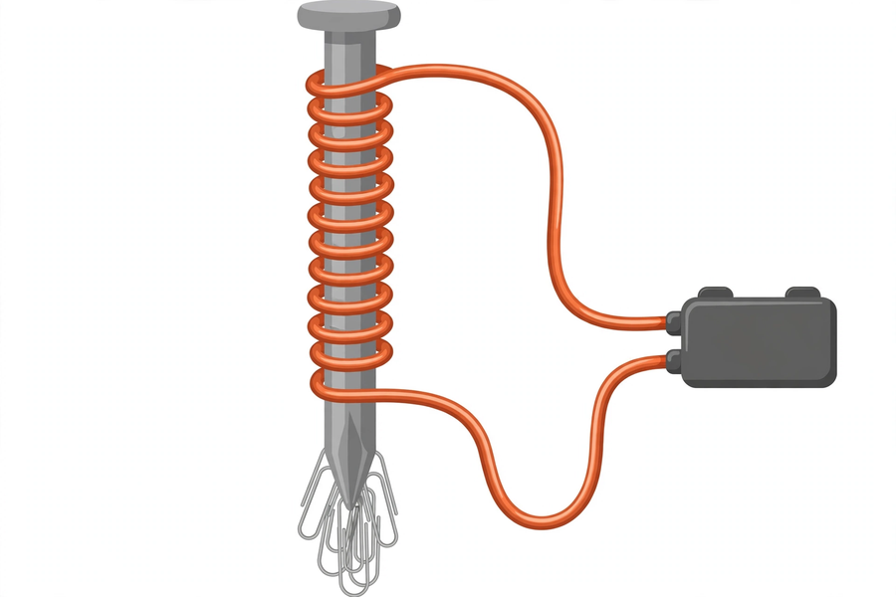
電磁鐵的構造｜Structure of an Electromagnet

Slide 4
學習目標
Learning Objectives
▸ 製作一個可吸起回形針的電磁鐵
Make an electromagnet that attracts paper clips
▸ 記錄線圈匝數與吸起數目的關係
Record how coil turns relate to clips attracted
▸ 說出「同極相斥、異極相吸」
State "like poles repel, unlike poles attract"
▸ 正確說出電池安全規則
State battery safety rules correctly

Slide 5
引入：磁石 → 電磁鐵
From Magnet to Electromagnet
▸ 磁石吸起回形針 —— N 極、S 極
A magnet picks up paper clips — N pole, S pole
▸ 問題：磁力可以「開關」嗎？
Question: can magnetism be "switched" on and off?
▸ 答案：可以！電流產生磁場 —— 電生磁
Answer: yes! Current creates a magnetic field — electricity produces magnetism

Slide 6
同極相斥、異極相吸
Like Poles Repel, Unlike Poles Attract
▸ N＋N → 排斥 S＋S → 排斥
N+N → repel; S+S → repel
▸ N＋S → 吸引
N+S → attract
▸ 磁力在兩極最強
Magnetism is strongest at the poles

Slide 7
電磁鐵的構造
Structure of an Electromagnet
▸ 線圈：漆包線緊密纏繞（兩端刮除漆皮，否則不導電！）
Coil: enamelled wire wound tightly (scrape both ends or no conduction!)
▸ 鐵芯：大鐵釘，集中磁場
Iron core: large nail, concentrates the field
▸ 電源：2 粒 AA 電池，只在測試時接上
Power: 2 AA batteries, connected only during testing

Slide 8
匝數與磁力
Coil Turns and Magnetic Strength
▸ 電池相同，匝數愈多 → 磁力一般愈強
Same batteries: more turns → generally stronger magnetism
▸ 斷電 → 電流停止 → 磁力消失（可開關！）
Disconnected → current stops → magnetism vanishes (switchable!)
▸ 這是電磁鐵與永久磁石最大的分別
The biggest difference from a permanent magnet

Slide 9
電池安全三規則
Three Battery Safety Rules
▸ ⛔ 不可短路：勿用導線直連電池正負極
No short circuits: never wire the terminals directly
▸ ⏱ 不可長時間接駁：只在測試時接上
No prolonged connection: only during testing
▸ 🔌 用完即拆：教師統一回收
Disconnect after use: teacher collects all batteries

Slide 10
拾物比賽
Pick-up Contest
▸ 計時一分鐘：看誰吸起最多回形針！
One minute on the clock: who attracts the most clips!
▸ 記錄：線圈匝數 → 吸起數目
Record: coil turns → clips attracted
▸ 成功標準：吸起最少 5 枚回形針
Success criteria: attract at least 5 paper clips

Slide 11
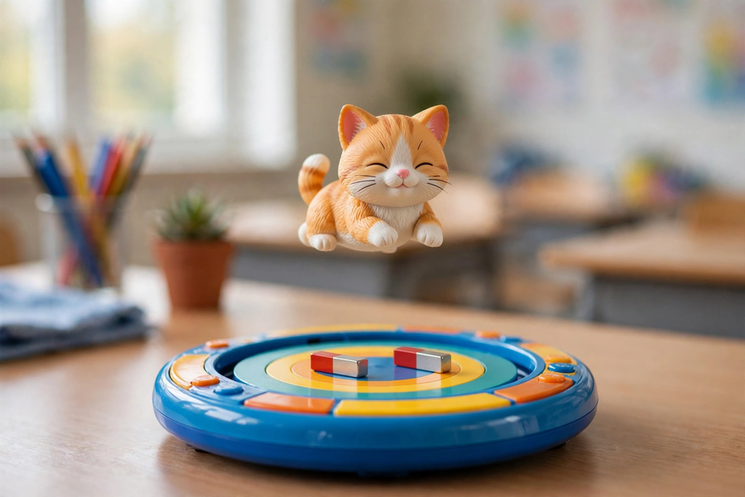
磁浮貓
Levitating Cat
▸ 原理：同極相斥，把小貓托在半空
Principle: like poles repel, holding the cat in mid-air
▸ 底座磁石與貓底磁石：同極相對
Base magnet and cat magnet: like poles facing
▸ 慢慢調校位置，直至懸浮
Adjust slowly until it levitates
▸ 磁石易碎，輕拿輕放；遠離電子產品
Magnets are fragile — handle gently; keep away from electronics

Slide 12
總結
Summary
▸ 同極相斥、異極相吸；電生磁
Like poles repel, unlike poles attract; electricity produces magnetism
▸ 匝數愈多磁力愈強；斷電磁力消失
More turns, stronger magnetism; it vanishes when disconnected
▸ 電池安全：不短路、不久駁、用完即拆
Battery safety: no shorts, no long connections, disconnect after use
▸ 下堂預告：自製萬花筒／潛望鏡 —— 光與影！
Next lesson: DIY kaleidoscope / periscope — light and shadow!

