Slide 1
第 7 堂
光與影——萬花筒／潛望鏡
Light and Shadow — Kaleidoscope / Periscope
聖公會呂明才中學 創科班
單元二：動手做 STEAM Unit 2: Hands-on STEAM

Slide 2
物資表 Materials List
鏡面紙／小鏡片 Mirror paper / small mirrors × 每組 3 片（萬花筒）或 2 片（潛望鏡） 3 per group (kaleidoscope) or 2 per group (periscope)
硬卡紙筒 Cardboard tube × 每組 1 個 1 per group
長紙盒（潛望鏡用） Long box (for periscope) × 每組 1 個 1 per group
彩色碎紙／珠仔 Coloured paper scraps / beads × 每組 1 小包 1 small pack per group
透明膠片 Transparent film × 每組 1 片 1 per group
膠紙、剪刀、間尺 Tape, scissors, ruler × 課室現有 Available in classroom
手機／平板 Mobile phone / tablet × 學生自備或小組共用 Students' own or group-shared

Slide 3
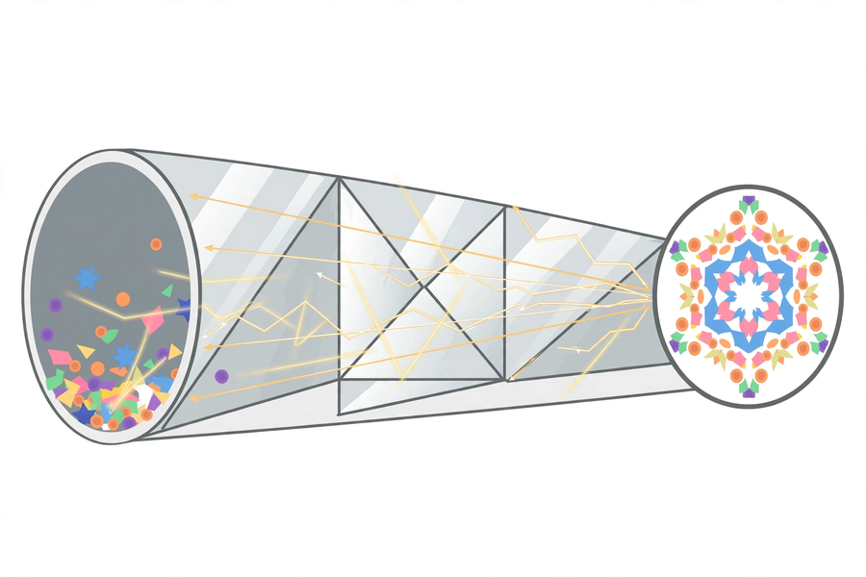
萬花筒的原理｜How a Kaleidoscope Works

Slide 4
學習目標
Learning Objectives
▸ 製作一個成像清晰的萬花筒或潛望鏡
Make a kaleidoscope or periscope with a clear image
▸ 解釋萬花筒圖案與鏡面反射的關係
Explain how kaleidoscope patterns relate to mirror reflection
▸ 解釋潛望鏡兩次反射改變光路的原理
Explain how a periscope changes the light path with two reflections
▸ 拍攝最少三張光影相片並作說明
Take at least three light-shadow photos with captions

Slide 5
引入：鏡子如何改變光的方向？
How Does a Mirror Change Light's Direction?
▸ 看看萬花筒的圖案相片 —— 美麗的對稱圖案從何而來？
Look at kaleidoscope photos — where do the beautiful symmetrical patterns come from?
▸ 看看潛望鏡實物 —— 躲在書堆後，也能看到另一邊！
Look at a real periscope — hide behind book piles and still see the other side!
▸ 答案：光的反射
The answer: reflection of light

Slide 6
反射定律
Law of Reflection
▸ 光以直線前進，遇到鏡面改變方向
Light travels straight; it changes direction at a mirror
▸ 入射角 ＝ 反射角（方向對稱）
Angle of incidence = angle of reflection (symmetrical)
▸ 我們在鏡中看到自己，正是反射的結果
Seeing ourselves in a mirror is exactly reflection at work

Slide 7
萬花筒的原理
How a Kaleidoscope Works
▸ 三片鏡組成三角形筒，反光面朝內
Three mirrors form a triangular tube, reflective sides inwards
▸ 彩色碎紙經三片鏡互相多重反射 → 對稱圖案
Coloured scraps reflect repeatedly among three mirrors → symmetrical patterns
▸ 轉動筒身 → 碎紙位置改變 → 圖案不斷變化
Rotate the tube → scraps move → patterns keep changing
▸ 圖案不是畫上去的！
The patterns are NOT painted on!

Slide 8
潛望鏡的原理
How a Periscope Works
▸ 兩片鏡互相平行，各與鏡筒成 45 度
Two parallel mirrors, each at 45° to the tube
▸ 光 → 頂部鏡（第 1 次反射）→ 轉向下方
Light → top mirror (1st reflection) → turns downwards
▸ → 底部鏡（第 2 次反射）→ 進入眼睛
→ bottom mirror (2nd reflection) → into the eye
▸ 光線平行移位，看到障礙物後的景象；不會放大影像
Rays shift in parallel to reveal hidden views; no magnification

Slide 9
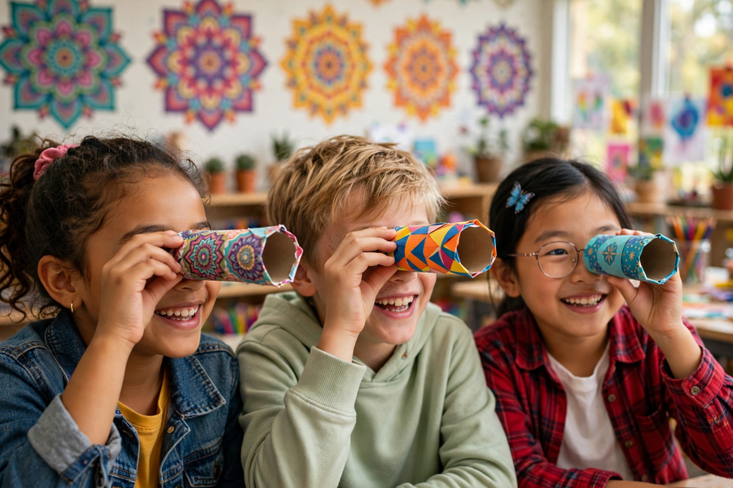
製作要點
Making Tips
▸ 萬花筒：反光面朝內；一端裝碎紙＋透明膠片
Kaleidoscope: reflective sides inwards; load scraps + film at one end
▸ 潛望鏡：兩片鏡必須平行，否則看不見影像
Periscope: the two mirrors must be parallel or no image appears
▸ 鏡面保持清潔；鏡片邊緣或割手，小心
Keep mirrors clean; edges may cut — be careful

Slide 10
光影攝影
Light-shadow Photography
▸ 尋找光影對比強烈的地方：窗邊、欄杆、樹蔭
Find strong contrast: windows, railings, tree shade
▸ 用自製教具觀察，再用手機／小組平板拍攝
Observe with your DIY instrument, then shoot with a phone / group tablet
▸ 最少三張，每張寫一句說明
At least three photos, one caption each
▸ 拍攝時注意安全，勿只顧螢幕不看路面
Stay safe; don't stare at the screen and ignore your steps
⚠ 鏡片邊緣或割手；拍攝時注意路面安全

Slide 11
分享與總結
Sharing and Summary
▸ 展示：最滿意的光影相片＋一句說明
Show your best light-shadow photo and its caption
▸ 成功標準：萬花筒呈現對稱圖案，或潛望鏡清晰成像
Success criteria: symmetrical kaleidoscope patterns, or a clear periscope image
▸ 核心概念：光經鏡面反射 —— 入射角＝反射角
Core idea: light reflects off mirrors — incidence = reflection
▸ 下堂預告：關愛夜燈 —— 為長者做紙電路 LED 門牌！
Next lesson: caring night light — a paper-circuit LED doorplate for the elderly!

