Slide 1
第 8 堂
簡單電路——關愛夜燈
Simple Circuits — Caring Night Light
聖公會呂明才中學 創科班
單元二：動手做 STEAM Unit 2: Hands-on STEAM

Slide 2
物資表 Materials List
銅箔膠帶 Copper foil tape × 每組約 50 厘米 approx. 50 cm per group
LED（3mm 或 5mm） LED (3 mm or 5 mm) × 每組 2 粒 2 per group
CR2032 鈕扣電池 CR2032 button cell × 每組 1 粒 1 per group
厚卡紙 Thick card × 每組 1 張 1 per group
顏色筆 Colour pens × 課室現有 Available in classroom
膠紙、剪刀 Tape, scissors × 課室現有 Available in classroom

Slide 3
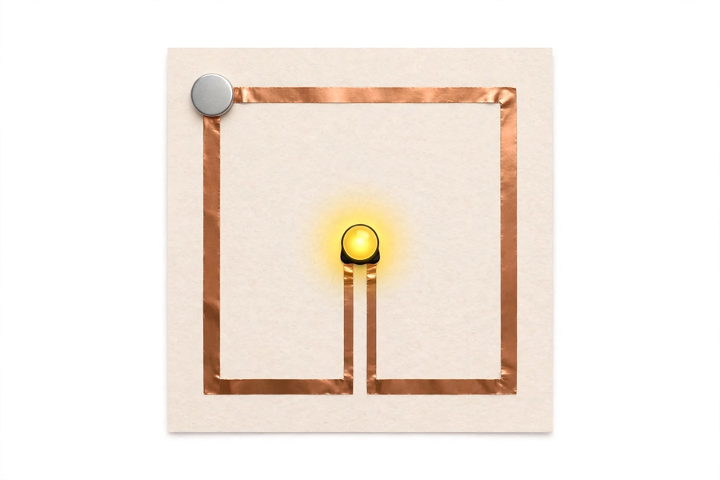
紙電路：銅箔＋電池＋LED｜Paper Circuit: Copper Foil + Battery + LED

Slide 4
學習目標
Learning Objectives
▸ 鋪設一條能令 LED 發光的紙電路
Lay a paper circuit that lights an LED
▸ 說出電路三要素及 LED 正負極
Name the three circuit elements and LED terminals
▸ 說出設計如何幫助長者解決夜間摸黑問題
Explain how the design helps the elderly at night
▸ 為門牌設計一句關懷標語
Design a caring slogan for the doorplate

Slide 5
引入：長者夜晚的處境
Elderly People at Night
▸ 想像：半夜起身，四周漆黑，要摸索去洗手間……
Imagine: getting up at midnight, pitch dark, groping your way to the bathroom…
▸ 長者視力較差，摸黑容易跌倒
Elderly people with poor vision can easily fall in the dark
▸ 問題：我們可以用電路幫助他們嗎？
Question: can we help them with circuits?

Slide 6
電路三要素
Three Elements of a Circuit
▸ 🔋 電源：提供電能（鈕扣電池 CR2032）
Power source: supplies energy (CR2032 button cell)
▸ 🟧 導線：傳送電流（銅箔膠帶）
Conductor: carries current (copper foil tape)
▸ 💡 負載：使用電能（LED 燈）
Load: uses the energy (LED lamp)
▸ 電流：正極 → 導線 → 負載 → 負極（完整一圈）
Current: positive → conductor → load → negative (a complete loop)

Slide 7
通路與斷路
Closed and Open Circuits
▸ 通路：電路完整接通 → LED 發光 ✔
Closed: circuit complete → LED lights ✔
▸ 斷路：中間斷開 → LED 不亮 ✘
Open: circuit broken → LED dark ✘
▸ 常見斷路原因：銅箔沒壓實、LED 接反
Common causes: loose foil, reversed LED

Slide 8
LED 的秘密
Secrets of the LED
▸ LED 是發光二極管：電流只容許單向通過
An LED is a light-emitting diode: current flows one way only
▸ 長腳＝正極，接電池正極；短腳＝負極
Long leg = positive, to battery positive; short leg = negative
▸ 接反了不會亮，也不會燒毀 —— 調轉再接即可
Reversed it won't light, but won't burn out — just flip it
▸ 省電、壽命長，一粒電池就夠
Power-saving and long-lasting; one cell is enough

Slide 9
鋪設紙電路
Laying the Paper Circuit
▸ 在卡紙上用銅箔膠帶由電池鋪到 LED，再回到電池
Lay foil tape on card from battery to LED and back to battery
▸ 轉彎處：摺疊壓實，否則接觸不良
At corners: fold and press firmly, or contact fails
▸ 先測試 LED 發光，才黏貼裝飾
Test the LED first, decorate afterwards
⚠ 鈕扣電池不可放入口；用完由教師回收

Slide 10
以用家為本的設計
User-centred Design
▸ 用家：夜晚起身的長者；需要：在黑暗中看清門口和通道
User: elderly people up at night; need: to see the doorway in the dark
▸ 設計：夜間發光的門牌，照亮門口
Design: a doorplate that glows at night, lighting the doorway
▸ 加上你的關懷標語，例如：「夜裡起身不用怕，門燈為您照亮路」
Add your caring slogan, e.g. "No need to fear getting up at night; the door light brightens your way"

Slide 11
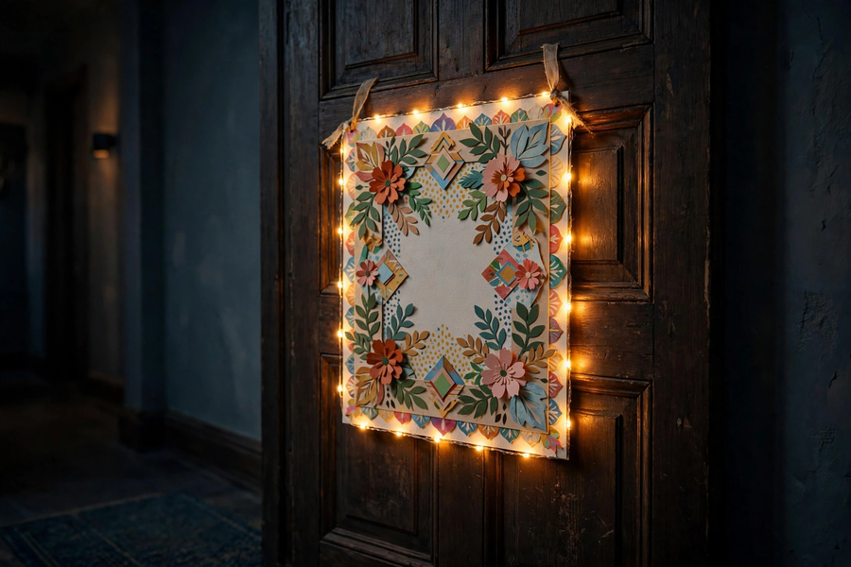
關燈測試
Lights-off Test
▸ 完成後關燈：看看各組的門牌有多亮！
When finished, lights off: see how bright each doorplate glows!
▸ 展示門牌，讀出你的關懷標語
Show your doorplate and read out your caring slogan
▸ 成功標準：LED 正常發光；能說出三要素及正負極
Success criteria: LED lights normally; can name the three elements and terminals

Slide 12
總結
Summary
▸ 電源＋導線＋負載＝完整電路；斷開即斷路
Source + conductor + load = complete circuit; a break means open
▸ LED 單向導電，長腳正極
LEDs conduct one way; long leg is positive
▸ 好設計從用家需要出發 —— 用創科關愛社群
Good design starts from user needs — care for the community with innovation
▸ 下堂預告：動手大挑戰 —— 水火箭發射（戶外）！
Next lesson: grand challenge — water rocket launch (outdoor)!

