Slide 1
第 9 堂
動手大挑戰——水火箭發射
Grand Challenge — Water Rocket Launch
聖公會呂明才中學 創科班
單元二：動手做 STEAM Unit 2: Hands-on STEAM

Slide 2
物資表 Materials List
1.25L／2L 汽水樽 1.25 L / 2 L soft-drink bottle × 每組 2 個 2 per group
軟木塞／發射塞 Cork / launch stopper × 每組 1 個 1 per group
單車打氣筒 Bicycle pump × 全班共用 2 個 2 shared by class
硬卡紙（尾翼） Card (fins) × 每組 1 張 1 per group
膠紙、剪刀 Tape, scissors × 課室現有 Available in classroom
捲尺（量度距離） Measuring tape (for distance) × 每組 1 個 1 per group
水 Water × 適量 As needed

Slide 3
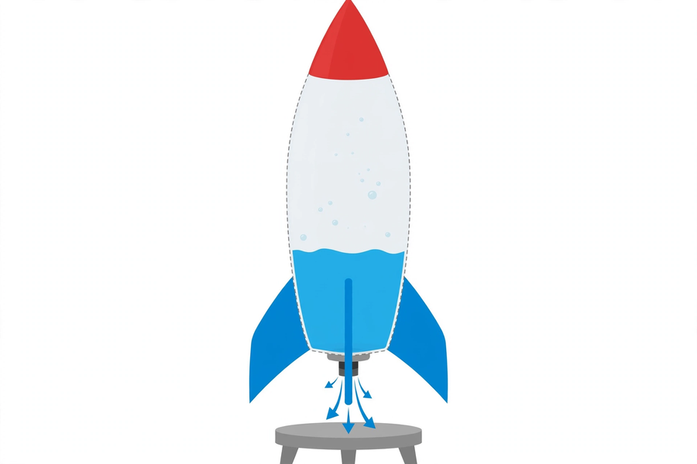
水火箭的結構｜Water Rocket Structure

Slide 4
學習目標
Learning Objectives
▸ 製作一個可發射的水火箭
Build a launchable water rocket
▸ 準確量度並記錄每次發射的飛行距離
Measure and record each flight distance accurately
▸ 指出最少兩個影響飛行距離的因素
Identify at least two factors affecting flight distance
▸ 根據數據提出一項改良並實踐
Propose one data-based improvement and carry it out

Slide 5
引入：水火箭靠甚麼升空？
What Lifts a Water Rocket?
▸ 汽水樽 ＋ 水 ＋ 打氣 ＝ 沖天而起！
Bottle + water + pumping = blast-off!
▸ 想想：吹脹的氣球一鬆手，為甚麼會亂飛？
Think: why does a released balloon dart around?
▸ 答案：作用力與反作用力
The answer: action and reaction

Slide 6
氣壓原理
Air Pressure
▸ 打氣 → 樽內空氣被壓縮 → 氣壓升高
Pump → air inside compressed → pressure rises
▸ 壓縮空氣把水從樽口向下猛力推出
Compressed air forces water violently downwards out of the mouth
▸ 水量約樽身三分之一效果較佳
About one-third of a bottle of water works best
▸ ⚠ 氣壓有安全上限，只准老師操作打氣
Pressure has a safety limit — only the teacher operates the pump

Slide 7
作用力與反作用力
Action and Reaction
▸ 水被向下推出（作用力）↓
Water pushed downwards (action) ↓
▸ 水對火箭產生反向推力（反作用力）↑
Water pushes back on the rocket (reaction) ↑
▸ 火箭升空！真實火箭原理相同（噴出燃氣）
Lift-off! Real rockets work the same way (ejecting exhaust gas)

Slide 8
飛得遠的秘訣
Secrets of Flying Further
▸ 水量：約三分之一；太多 → 壓縮空氣不足；太少 → 推力維持短
Water: ~1/3; too much → little compressed air; too little → brief thrust
▸ 角度：約 45 度最遠（太直飛不高遠，太平很快落地）
Angle: ~45° flies furthest
▸ 尾翼：對稱黏貼，保持方向；不對稱會偏航打轉
Fins: symmetric for stability; asymmetric fins veer and spin

Slide 9
安全規則
Safety Rules
▸ ⛔ 發射區清空，無關人員不可進入
Clear the launch area; keep others out
▸ ⛔ 只准老師操作打氣
Only the teacher operates the pump
▸ ⛔ 發射時所有人退到安全線後
Everyone stays behind the safety line during launches
▸ ✔ 使用前檢查樽身無裂痕
Check the bottle for cracks before use

Slide 10
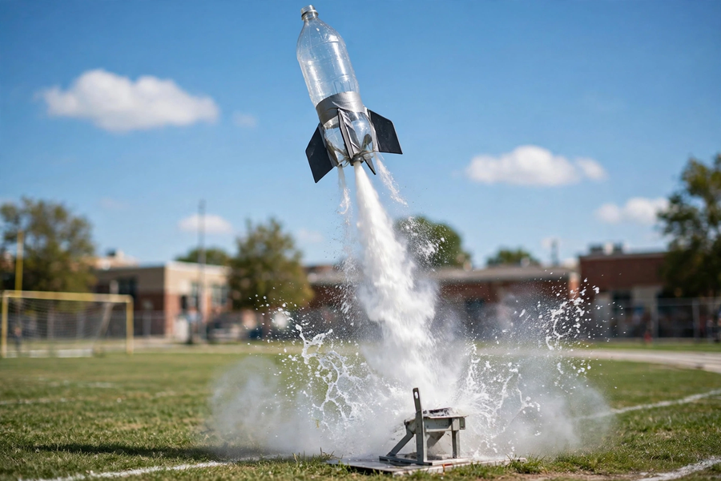
製作與發射流程
Build and Launch
▸ 課室：組裝火箭（樽身、尾翼、錐頭）
Classroom: assemble the rocket (body, fins, nose cone)
▸ 操場：劃定發射區與安全線
Playground: mark the launch area and safety line
▸ 老師打氣 → 逐組發射 → 量度距離 → 記錄
Teacher pumps → launch group by group → measure → record
▸ 分析數據 → 改良 → 第二輪發射
Analyse data → improve → second round of launches

Slide 11
數據記錄表示例
Sample Data Table
▸ 第 1 次：水量 1/2 → 8 米（尾翼有點歪）
1st: half water → 8 m (fins slightly crooked)
▸ 第 2 次：水量 1/3 → 14 米
2nd: one-third water → 14 m
▸ 改良：調直尾翼，把水量減至 1/3
Improvement: straightened fins, reduced water to one-third
▸ 第 3 次：水量 1/3 → 17 米 ✔
3rd: one-third water → 17 m ✔

Slide 12
總結
Summary
▸ 氣壓推水向下 → 反作用力推火箭向上
Air pressure pushes water down → reaction pushes rocket up
▸ 三分之一水量、45 度、對稱尾翼
One-third water, 45°, symmetric fins
▸ 工程思維：量度 → 分析 → 改良 → 再測試
Engineering: measure → analyse → improve → retest
▸ 下堂預告：發明家日記 —— 整理作品、反思與單元小結！
Next lesson: inventor's diary — organise work, reflect, and conclude the unit!

