Slide 1
第 10 堂
發明家日記
Inventor's Diary
聖公會呂明才中學 創科班
單元二：動手做 STEAM Unit 2: Hands-on STEAM

Slide 2
物資表 Materials List
「發明家日記」工作紙 “Inventor's Diary” worksheet × 每人 1 份 1 per student
膠水 Glue × 每組 1 支 1 per group
顏色筆 Colour pens × 課室現有 Available in classroom
學生作品相片 Photos of students' work × — —
釘書機 Stapler × 全班共用 Shared by class

Slide 3
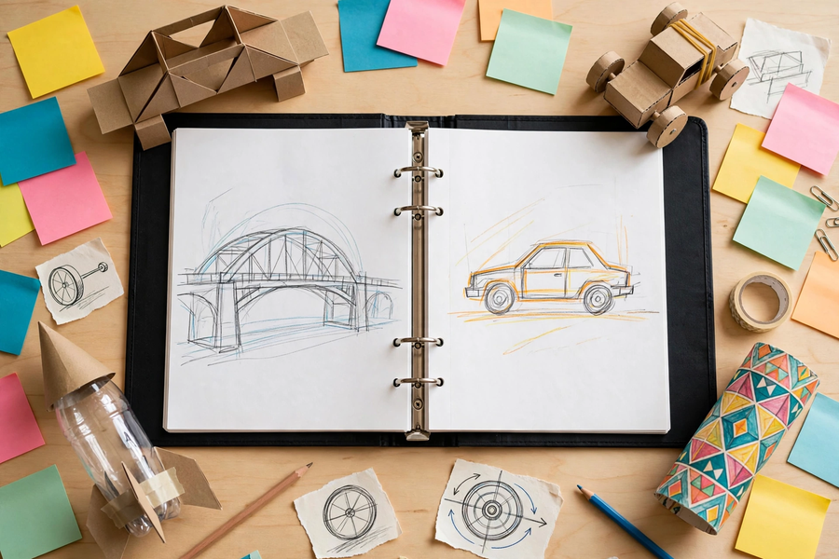
整理個人作品集｜Organise Your Portfolio

Slide 4
單元回顧：七堂動手做
Unit Review: Seven Hands-on Lessons
▸ 第 4 堂：紙橋承重挑戰 —— 結構力學
L4: Paper bridge challenge — structural mechanics
▸ 第 5 堂：橡筋動力車 —— 能量轉換
L5: Rubber-band car — energy conversion
▸ 第 6 堂：電磁鐵＋磁浮貓 —— 電磁
L6: Electromagnet + levitating cat — electromagnetism
▸ 第 7 堂：萬花筒／潛望鏡 —— 光的反射
L7: Kaleidoscope / periscope — reflection of light
▸ 第 8 堂：關愛夜燈 —— 簡單電路
L8: Caring night light — simple circuits
▸ 第 9 堂：水火箭發射 —— 氣壓
L9: Water rocket launch — air pressure

Slide 5
六個科學概念
Six Science Concepts
▸ 形狀影響承重：三角形最穩固
Shape affects load-bearing: triangles are most stable
▸ 彈性勢能 → 動能；摩擦把部分能量變成熱
Elastic potential energy → kinetic energy; friction turns some into heat
▸ 電生磁；同極相斥、異極相吸
Electricity produces magnetism; like poles repel, unlike poles attract
▸ 入射角＝反射角；影子是光被擋住
Incidence = reflection; shadows are blocked light
▸ 電源＋導線＋負載；LED 單向導電
Source + conductor + load; LEDs conduct one way
▸ 氣壓推水向下 → 反作用力推火箭向上
Air pressure pushes water down → reaction pushes rocket up

Slide 6
甚麼是好的反思？
What Is Good Reflection?
▸ ✘ 不是讚美自己，也不是「我學到很多」
NOT praising yourself, NOT "I learned a lot"
▸ ✔ 具體事例：真實發生的事＋數字
Concrete examples: real events + numbers
▸ ✔ 概念連結：事例扣連科學概念
Concept links: examples tied to science concepts
▸ ✔ 進步與改進：誠實寫不足＋下次做法
Progress and improvements: honest shortcomings + next steps

Slide 7
例子：空泛 vs 具體
Example: Vague vs Concrete
▸ 空泛：「這次活動很有趣，我學到很多。」
Vague: "This activity was fun. I learned a lot."
▸ 具體：「我們的橡筋車只走了 1.5 米，因為車輪不對齊。這令我明白公平測試為甚麼要求車輪對齊。下次我會先檢查車輪再測試。」
Concrete: "Our car travelled only 1.5 m because the wheels were misaligned. This taught me why a fair test requires aligned wheels. Next time I will check the wheels first."

Slide 8
整理個人作品集
Organise Your Portfolio
▸ 收集六堂的作品相片和工作紙，按堂次排列
Collect photos and worksheets from six lessons, in lesson order
▸ 每件作品加一句說明：是甚麼、用甚麼原理、結果如何
One caption per piece: what it is, which principle, what resulted
▸ 最少包含四堂的作品記錄
Include work records from at least four lessons
▸ 用膠水／釘書機整理成冊
Bind with glue / staples

Slide 9
撰寫發明家日記
Write the Inventor's Diary
▸ 一、作品相片黏貼欄
1. Photo collage box
▸ 二、本單元學到的三個科學概念
2. Three science concepts learned
▸ 三、我的進步與不足
3. My progress and shortcomings
▸ 四、最滿意的作品介紹（圖文並茂）
4. My most satisfying work (pictures + words)
▸ 五、給下一單元的自己一句話
5. One sentence to myself for the next unit

Slide 10
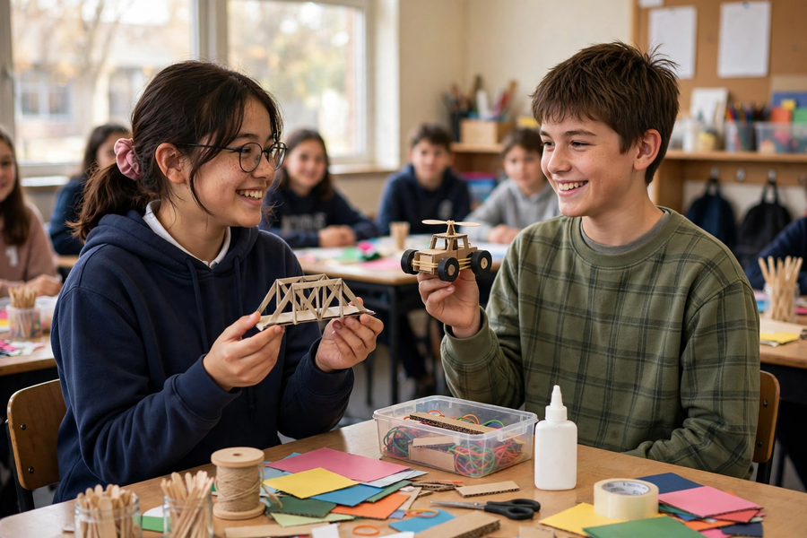
小組分享
Group Sharing
▸ 每人約兩分鐘，介紹最滿意的作品
About two minutes each: present your most satisfying work
▸ 說出設計意念、科學概念、測試結果
Describe the design idea, science concept and test result
▸ 聆聽組員，說出一件你欣賞的作品及原因
Listen and name one piece you admire, with a reason

Slide 11
單元小結
Unit Conclusion
▸ 七堂動手做，六個科學概念，一個關愛主題
Seven hands-on lessons, six science concepts, one caring theme
▸ 正能量 —— 用創科關愛弱勢社群（關愛夜燈）
Positive energy — caring for the underprivileged with innovation (night light)
▸ 完成發明家日記，提交個人作品集
Finish the inventor's diary and submit your portfolio
▸ 下一單元預告：繼續動手，挑戰更多！
Next unit preview: keep making, more challenges ahead!

