Slide 1
第 14 堂：演算法效率
Lesson 14: Algorithmic Efficiency
中二創科班｜Unit 3 進階編程思維｜不插電課堂
S2 Little Makers Class | Unit 3 Advanced Programming Thinking | Unplugged

Slide 2
物資表 Materials List
撲克牌（每組取 A 至 8 共 8 張） Playing cards (8 cards, A–8, per group) × 每組 1 副（課室常用，可重用；如需購買約 HK$10／副） 1 pack per group (reusable classroom stock; approx. HK$10 per pack if purchased)
大示範紙牌（教師自製） Large demonstration cards (teacher-made) × 教師 1 套 1 set for the teacher
數據紀錄表（列印） Data record sheets (printed) × 每組 1 份 1 per group
計時器 Timer × 每組 1 個（可用課室時鐘或教師手機） 1 per group (classroom clock or teacher's phone may be used)

Slide 3
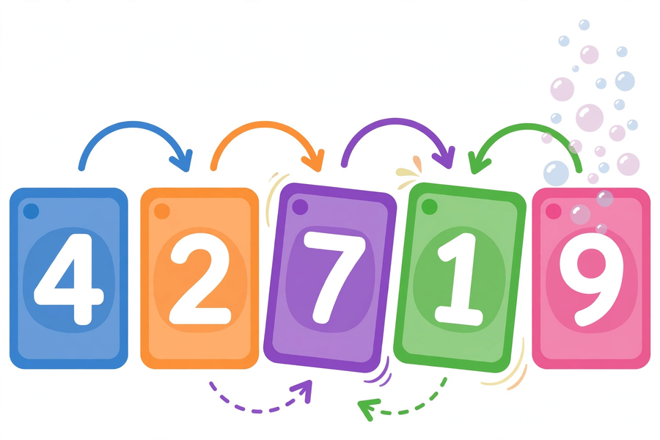
圖：氣泡排序 ｜ Illustration: bubble sort

Slide 4
本堂目標 Lesson objectives
• 能用撲克牌正確執行氣泡排序及選擇排序。
Perform bubble sort and selection sort correctly with playing cards.
• 能透過計時及計算比較次數，以數據比較兩種排序法的效率。
Compare the two methods' efficiency with data: timing and comparison counts.
• 能解釋「同一問題可有多種解法，而效率各異」。
Explain that one problem can have multiple solutions of different efficiency.

Slide 5
複習：排序有快慢之分？ Revision: are some sorts faster?
• 中一玩過「排序網絡」—— 今日問：不同的排序方法，有沒有快慢之分？
In S1 you tried the "sorting network" — today: are some sorting methods faster?
• 先猜想：哪種方法可能較快？為什麼？
Hypothesise first: which method might be faster, and why?
• 親手驗證：用數據說話，不憑感覺！
Verify by hand: let data speak, not feeling!

Slide 6
氣泡排序 Bubble sort
• 相鄰兩張兩張比較：若左邊大於右邊，就交換。
Compare adjacent pairs: swap if the left card is larger.
• 每完成一輪，最大的牌便「浮」到最右。
Each round "bubbles" the largest card to the right end.
• n 張牌共做 n−1 輪。
For n cards, run n−1 rounds.
• 例子 [3, 1, 4, 2]：第 1 輪後 → [1, 3, 2, 4]；第 2 輪後 → [1, 2, 3, 4]。
Example [3, 1, 4, 2]: after round 1 → [1, 3, 2, 4]; after round 2 → [1, 2, 3, 4].

Slide 7
選擇排序 Selection sort
• 每一輪：從未排序的牌中選出最小的一張，放到最前面。
Each round: pick the smallest from the unsorted cards; put it at the front.
• n 張牌共做 n−1 輪。
For n cards, run n−1 rounds.
• 例子 [3, 1, 4, 2]：第 1 輪選 1 → [1, 3, 4, 2]；第 2 輪選 2 → [1, 2, 4, 3]；第 3 輪選 3 → [1, 2, 3, 4]。
Example [3, 1, 4, 2]: round 1 picks 1 → [1, 3, 4, 2]; round 2 picks 2 → [1, 2, 4, 3]; round 3 picks 3 → [1, 2, 3, 4].

Slide 8
數算比較次數 Counting comparisons
• 兩張牌比一次，數一數共比了多少次。
Each pair compared counts once — count them all.
• n 張牌：(n−1)＋(n−2)＋…＋1 ＝ n(n−1)／2
For n cards: (n−1)+(n−2)+…+1 = n(n−1)/2
• 8 張牌 → 28 次比較（兩種方法都是！）
8 cards → 28 comparisons (for both methods!)
• 選擇排序交換較少：8 張牌最多交換 7 次。
Selection sort swaps less: at most 7 swaps for 8 cards.

Slide 9

實測規則 Trial rules
• 每組 8 張牌（A 至 8）；每種方法各排 3 次。
8 cards per group (A–8); 3 trials per method.
• 每次記錄：時間（秒）＋ 比較次數。
Record each trial: time (seconds) + comparison count.
• 分工：一人排序、一人計時、一人記錄；輪流交換崗位。
Roles: sorter, timer, recorder — rotate each round.
• 如實記錄，不可編造數據！
Record faithfully — never make up data!

Slide 10
數據紀錄表示例 Data sheet example
方法 Method | 第幾次 Trial | 時間 Time (s) | 比較次數 Comparisons
氣泡排序 | 1 | 25 | 28
氣泡排序 | 2 | 22 | 28
選擇排序 | 1 | 30 | 28
留意：氣泡排序 8 張牌的比較次數固定是 28 次 —— 可作核對！

Slide 11
匯報與討論 Report and discuss
• 各組匯報：兩種方法的平均時間、平均比較次數。
Each group reports: average time and average comparisons for both methods.
• 討論一：根據數據，哪種方法較有效率？為什麼？
Discussion 1: from the data, which method is more efficient? Why?
• 討論二：若牌增至 16 張，比較次數變 120 次，差異會如何？
Discussion 2: with 16 cards (120 comparisons), how would the gap change?

Slide 12
為何比較次數更客觀？ Why are comparison counts more objective?
• 時間受手法快慢、反應影響 —— 快手 ≠ 好方法。
Time is affected by hand speed — fast hands ≠ a better method.
• 比較次數只取決於方法本身，人人一樣。
Comparison counts depend only on the method itself.
• 實證精神：重複實驗取平均，減少誤差；用證據下結論。
Empirical spirit: repeat trials, average, reduce error; conclude from evidence.

Slide 13
單元總結 Unit review
• 第 11 堂 流程圖：把事務拆解為有序步驟。
L11 Flowcharts: decompose tasks into ordered steps.
• 第 12 堂 條件與迴圈：作決定、重複做，迴圈必須有終止。
L12 Conditions & loops: decide, repeat — loops must terminate.
• 第 13 堂 密碼學：編碼、密鑰、頻率分析；加密保護個人資料。
L13 Cryptography: encoding, keys, frequency analysis; encryption protects data.
• 第 14 堂 演算法效率：同一問題多種解法，用數據比較效率。
L14 Efficiency: many solutions to one problem — compare with data.
• 運算思維四要素：分解、模式識別、抽象化、演算法設計。
Four elements of computational thinking: decomposition, pattern recognition, abstraction, algorithm design.

Slide 14
家課＋延伸探索 Homework + extension
• 甲部：選擇題 4 題。
Section A: 4 multiple-choice questions.
• 乙部：用氣泡排序排 [5, 2, 8, 1, 4]，寫出每輪過程；單元反思 150–200 字。
Section B: bubble-sort [5, 2, 8, 1, 4] showing each round; unit reflection (150–200 words).
• 延伸探索（自選）：Google Teachable Machine
Extension (optional): Google Teachable Machine
• https://teachablemachine.withgoogle.com/
https://teachablemachine.withgoogle.com/
• 下堂課前交回。
Submit before the next lesson.

