Slide 1
第 18 堂｜教電腦認東西
Lesson 18 | Teaching Computers to Recognise Things
• Teachable Machine 影像辨識：剪刀石頭布
Image recognition with Teachable Machine: rock-paper-scissors
• 創科班 Little Makers Class
S.K.H. Lui Ming Choi Secondary School
1

Slide 2
物資表 Materials List
共用手提電腦／平板（具鏡頭） Shared laptops / tablets (with camera) × 2–3 部（全班輪用） 2–3 for the class
工作紙 Worksheets × 每組 1 張 1 per group
Teachable Machine 網站 Teachable Machine website × 老師預先在示範電腦開啟 Pre-opened by teacher

Slide 3
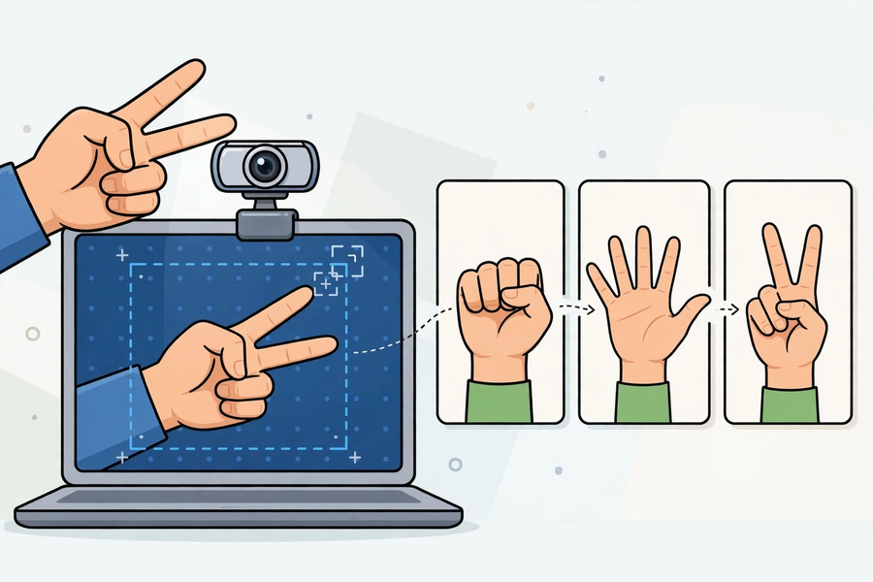

Slide 4
學習目標
Learning Objectives
• 按序說出機器學習流程：收集數據 → 訓練 → 測試
State the ML workflow: collect data → train → test
• 親手完成一次影像分類模型訓練
Personally complete one image-classifier training
• 用數據解釋模型認錯的原因
Explain errors in terms of data
• 舉出一個數據偏見的例子
Give one example of data bias
2

Slide 5
引入：電腦認得剪刀石頭布！
Hook: The Computer Recognises Rock-Paper-Scissors!
• 老師開啟 Teachable Machine，用預先訓練好的模型即時辨識
Teacher opens Teachable Machine and recognises live with a pre-trained model
• 全班見證「電腦認得」
The class witnesses "the computer can tell"
• 問題：它為什麼認得？
Question: how does it know?
3

Slide 6
Teachable Machine 是什麼？
What is Teachable Machine?
• Google 的免費網上工具，不用寫程式也能訓練 AI
Google's free web tool — train AI without coding
• 可以訓練影像、聲音、姿勢分類模型
Trains image, sound and pose classification models
• 可在裝置本機運作，鏡頭影像不會離開你的電腦
Runs on-device; webcam images never leave your computer
• 網址：https://teachablemachine.withgoogle.com/
URL: https://teachablemachine.withgoogle.com/
4

Slide 7
訓練四步
Four Training Steps
• ① 開設三個類別：剪刀／石頭／布
1. Create three classes: scissors / rock / paper
• ② 每類按住按鈕拍約三十張（轉換角度、轉換手，背景簡潔）
2. Hold the button: ~30 samples per class (vary angles and hands; simple backgrounds)
• ③ 按「訓練」（約十秒）
3. Click "Train" (about ten seconds)
• ④ 用新姿勢測試
4. Test with new poses
5

Slide 8
拍攝要點
Capturing Tips
• 背景盡量簡潔
Keep backgrounds simple
• 每類約三十張是經驗值，太少會不穩定
~30 per class is a rule of thumb; too few is unstable
• 轉換角度、轉換手——多元比多更重要
Vary angles and hands — diversity matters more than amount
• 預測：如果只拍五張，會怎樣？
Predict: what if only five samples per class?
6

Slide 9
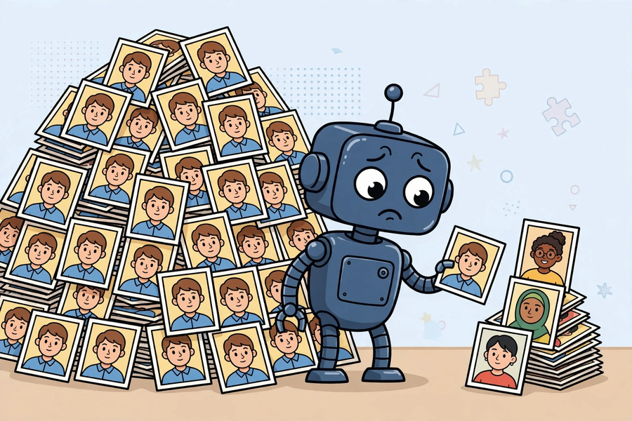
小組輪流操作
Group Rotation
• 2–3 部具鏡頭裝置，每組約六至八分鐘
2–3 camera devices, 6–8 minutes per group
• 每組重建一次模型並測試
Each group rebuilds and tests a model
• 輪候組：記錄預測與觀察，填寫實驗記錄表
Waiting groups: log predictions and observations
• 鏡頭勿直射強光；課後蓋上鏡頭
Avoid pointing cameras at strong light; cover cameras afterwards
7

Slide 10
偏見實驗：作弊版
Bias Experiment: The "Cheat" Version
• 只用右手訓練 → 用左手測試
Train with the right hand only → test with the left
• 全班看著模型認錯！
The class watches the model fail!
• 討論：為什麼會錯？
Discuss: why did it fail?
• 答案：數據太單一
Answer: the data was too uniform
8

Slide 11
數據偏見
Data Bias
• 定義：訓練數據有偏差，AI 就學到偏差
Definition: biased training data teaches the AI the bias
• 真實例子：國際研究曾發現，某些人臉辨識系統對部分膚色的準確度較低，原因是訓練數據不夠多元
Real case: research found some face-recognition systems less accurate for certain skin tones — training data lacked diversity
• 科技並非中立：人選擇用什麼數據，會影響 AI 的判斷
Technology is not neutral: human data choices shape AI's judgements
9

Slide 12
總結
Summary
• 完整流程：收集數據 → 訓練 → 測試
Full cycle: collect data → train → test
• 數據的質和量決定 AI 的表現
Data quality and quantity decide AI performance
• 有偏見的數據 → 有偏見的 AI
Biased data → biased AI
• 電腦只是在比對圖案特徵，不是真正思考
The computer only matches visual features; it does not truly think
10

Slide 13
小測驗＋預告
Mini Quiz + Next Lesson
• 抽問：什麼是數據偏見？舉一個例子
Quick quiz: what is data bias? Give an example
• 下堂：AI 倫理（一）真假難分——Deepfake 查證
Next: AI Ethics (1) — deepfakes and verification
11

