Slide 1
第 19 堂｜AI 倫理（一）：真假難分
Lesson 19 | AI Ethics (1): Hard to Tell True from False
• Deepfake 與假資訊＋查證練習、AI 幻覺
Deepfakes, misinformation, verification practice, AI hallucination
• 創科班 Little Makers Class
S.K.H. Lui Ming Choi Secondary School
1

Slide 2
物資表 Materials List
可疑訊息卡 Suspicious message cards × 每組 1 套（3 張） 1 set (3 cards) per group
查證清單卡 Verification checklist cards × 每人 1 張 1 per student
投影機 Projector × 1 套 1 set

Slide 3
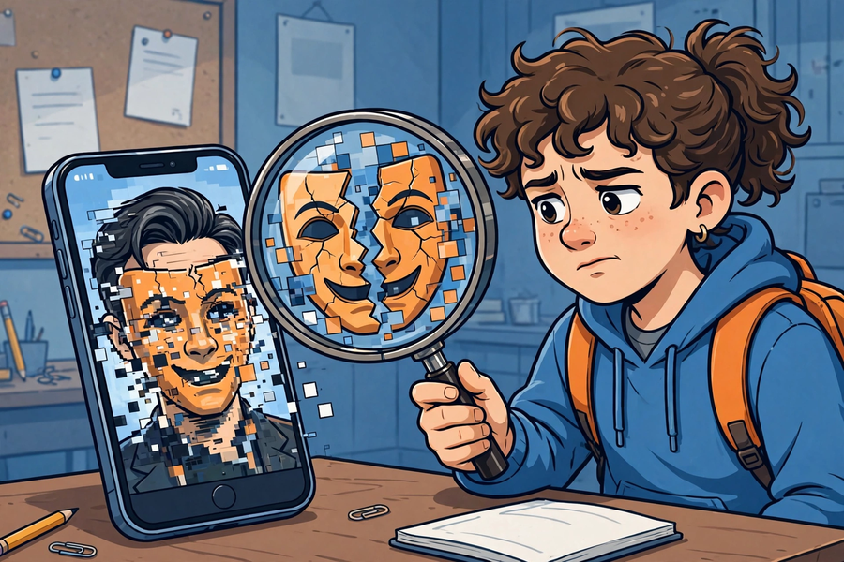

Slide 4
學習目標
Learning Objectives
• 說出 deepfake 的定義
Define deepfake
• 列出至少三個查證方法
List at least three verification methods
• 小組判斷可疑訊息並說出理由
Judge suspicious messages in groups with reasons
• 解釋「AI 幻覺」
Explain "AI hallucination"
2

Slide 5
引入投票：哪張是真？
Hook: Which One Is Real?
• 投影兩張圖：一張真實新聞相片、一張 AI 生成圖
Project two images: one real news photo, one AI-generated
• 舉手投票，並說出判斷依據
Vote and explain your reasoning
• 公佈答案：眼見不一定為實！
Reveal the answer: seeing is not always believing!
3

Slide 6
什麼是 Deepfake？
What is Deepfake?
• 用 AI 偽造的逼真影像或聲音
Realistic images or audio faked with AI
• 例如：換臉影片、模仿某人聲音的錄音
E.g. face-swap videos, voice-cloning recordings
• 國際上曾有騙徒用 AI 模仿聲音詐騙
International cases of AI voice-cloning scams exist
• 所有課堂例子經老師預先篩選，適合中一程度
All class examples are pre-screened as age-appropriate
4

Slide 7
AI 假資訊三手法
Three AI-Misinformation Tactics
• ① 以假亂真的圖片：AI 生成圖冒充新聞相片
1. Deceptively real images: AI pictures passed off as news photos
• ② 斷章取義的標題：標題與內容不符
2. Clickbait headlines taken out of context
• ③ 假冒名人發言：名人根本沒說過的話
3. Fake celebrity quotes: words never said
5

Slide 8
查證三步
Three Verification Steps
• ① 停一停：太驚人／太令人憤怒的，先別轉發
1. Pause: shocking or enraging? Don't forward yet
• ② 查來源：誰發的？是官方嗎？
2. Check the source: who sent it? Is it official?
• ③ 找多個來源：有無其他可靠媒體報導？
3. Find multiple sources: have other reliable outlets reported it?
• 熟習後只需約一分鐘
Takes about a minute once familiar
6

Slide 9

小組練習：可疑訊息卡
Group Practice: Suspicious Message Cards
• 每組三則訊息卡，判斷「可信／可疑／假」
Three cards per group; judge "credible / suspicious / false"
• 寫下理由和所用查證方法
Write reasons and verification methods used
• 重點：講理由，不只猜對錯
Focus: give reasons, not just guesses
7

Slide 10
AI 幻覺
AI Hallucination
• 即場示範：問 AI 一條它不可能知道的問題
Live demo: ask AI an unknowable question
• AI 會一本正經地編出答案！
AI fabricates a confident answer!
• 原因：AI 按機率推測下一個字，不會查證事實
Why: AI predicts likely next words; it never checks facts
• 啟示：問 AI 功課答案，也要再查證
Lesson: verify AI answers about homework too
8

Slide 11
總結
Summary
• Deepfake ＝ AI 偽造的影像／聲音
Deepfake = AI-faked images/audio
• 查證三步：停一停、查來源、找多個來源
Three steps: pause, check the source, find multiple sources
• AI 幻覺：AI 會自信地編造答案
AI hallucination: AI confidently fabricates answers
• 金句：先查證，後轉發
Motto: verify before forwarding
9

Slide 12
查證清單卡＋預告
Checklist Card + Next Lesson
• 每人領取查證清單卡，貼在書桌當眼處
Each student gets a verification checklist card for the desk
• 下堂：AI 倫理（二）偏見與私隱——AI 會歧視嗎？
Next: AI Ethics (2) — can AI discriminate? Privacy protection
10

