Slide 1
第 20 堂｜AI 倫理（二）：偏見與私隱
Lesson 20 | AI Ethics (2): Bias and Privacy
• 為何 AI 會歧視、我的資料很值錢、網絡安全
Why AI can discriminate; my data is valuable; cyber security
• 創科班 Little Makers Class
S.K.H. Lui Ming Choi Secondary School
1

Slide 2
物資表 Materials List
情境卡 Scenario cards × 每組 1 套（6 張） 1 set (6 cards) per group
承諾卡 Pledge cards × 每人 1 張 1 per student
投影機 Projector × 1 套 1 set

Slide 3
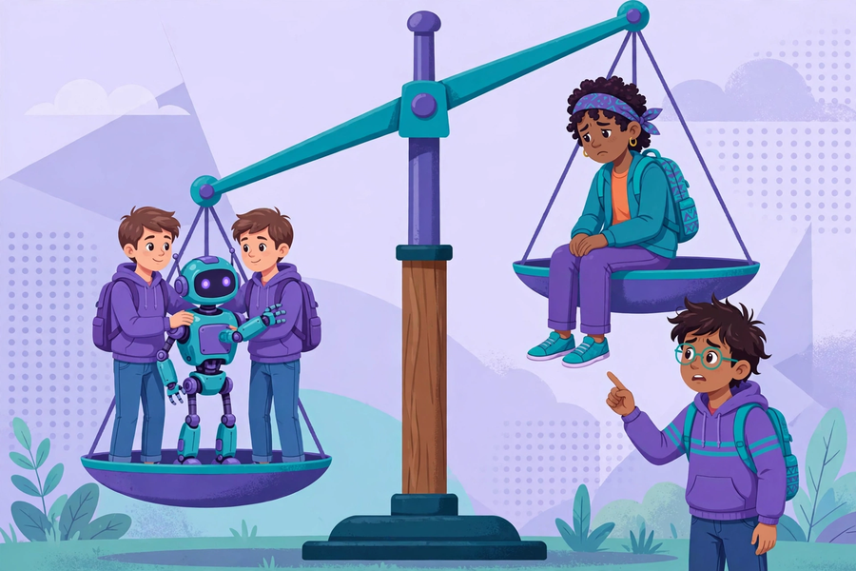

Slide 4
學習目標
Learning Objectives
• 用一句話解釋演算法偏見
Explain algorithmic bias in one sentence
• 舉出至少一個 AI 偏見的例子
Give at least one example of AI bias
• 列出至少四個保護個人私隱的方法
List at least four privacy-protection methods
• 說出網絡安全問題的基本應對
State basic responses to cyber security issues
2

Slide 5
回顧：上堂學了什麼？
Recap: What Did We Learn Last Lesson?
• 快問快答：deepfake 是什麼？
Rapid-fire: what is deepfake?
• 查證三步是什麼？
What are the three verification steps?
• 什麼是 AI 幻覺？
What is AI hallucination?
• 今日問題：「AI 會歧視人嗎？」
Today's question: "Can AI discriminate?"
3

Slide 6
真實個案：招聘 AI
Real Case: Recruitment AI
• 某大型科技公司曾用 AI 篩選求職履歷
A large tech company once used AI to screen job applications
• 訓練數據大多來自男性員工的履歷
Training data came mostly from male employees' CVs
• 結果：AI 較少推薦女性求職者
Result: the AI recommended fewer female candidates
• 小組討論：公平嗎？問題出在哪裡？
Group discussion: is it fair? Where is the problem?
4

Slide 7
演算法偏見
Algorithmic Bias
• 定義：AI 學了有偏見的數據，就會做出有偏見的判斷
Definition: AI trained on biased data makes biased judgements
• 問題不在電腦，在數據
The problem is not the computer; it is the data
• 科技並非中立：數據的選擇影響公平
Technology is not neutral: data choices affect fairness
• 例子：只用右手訓練的剪刀石頭布模型（上堂）
Example: the right-hand-only rock-paper-scissors model (last hands-on lesson)
5

Slide 8
我的資料很值錢
My Data is Valuable
• 數據是 AI 的糧食
Data is the food of AI
• 你的相片、位置、喜好都是有價值的數據
Your photos, location and preferences are all valuable data
• 私隱自保四招：
Four privacy self-protection tips:
• ① 不隨便上傳個人相片 ② 關閉不必要的定位 ③ 強密碼並保密 ④ 不亂點不明連結
1. No casual photo uploads 2. Turn off unneeded location 3. Strong secret passwords 4. No random clicks
6

Slide 9

小組活動：情境判斷
Group Activity: Scenario Judgement
• 每組六張情境卡，判斷「安全／不安全」並寫理由
Six scenario cards per group; judge "safe / unsafe" with reasons
• 例如：上傳學生證相換禮物／遊戲要求開定位／「學校」短訊叫點連結交費／生日做密碼／陌生人私訊索相
E.g. uploading student-card photo for gifts / game wants location / "school" SMS payment link / birthday password / stranger asking for photos
• 派代表分享
Share with the class
7

Slide 10
網絡安全＋免費自學資源
Cyber Security + Free Self-Study
• 遇到網絡安全問題：不亂點、不回覆，立即告訴信任的成人（老師／家長）
Cyber issues: don't click, don't reply; tell a trusted adult (teacher/parent) at once
• HKIRC「網絡安全學生培訓」免費網上課程
HKIRC free online "Student Cyber Security Training"
• 內容：保護私隱、保護設備、識別釣魚攻擊
Covers: protecting privacy, protecting devices, spotting phishing
• 網址：https://cyberhub.hk/tc/student-training
URL: https://cyberhub.hk/tc/student-training
8

Slide 11
總結
Summary
• 有偏見的數據 → 有偏見的 AI
Biased data → biased AI
• 我的資料很值錢；記牢私隱自保四招
My data is valuable; remember the four privacy tips
• 網絡安全：不亂點，告訴信任的成人
Cyber security: don't click randomly; tell a trusted adult
9

Slide 12
單元總結＋承諾卡
Unit Round-up + Pledge Card
• 六堂回顧：AI 是什麼 → 提示工程 → 生成作品 → 教電腦 → 真假難分 → 偏見私隱
Six-lesson recap: what is AI → prompting → generative works → teaching computers → true/false → bias & privacy
• 每人寫一句「我會……」（例如：我會先查證後轉發）
Each student writes one "I will…" pledge (e.g. "I will verify before forwarding")
• 貼在課室「正能量牆」
Post it on the classroom positivity wall
10

